Slide 1




Combined Neutron, X-ray and SEM imaging of complex fluid movement through porous rock
Helen Lewis ¹ *, Gary Couples ¹, Jim Buckman ¹, Erika Tudisco ², Alessandro Tengattini ³
1: Heriot-Watt University, Scotland 2: University of Lund, Sweden
3: Universite Grenoble Alpes and ILL, France
ISRD-4 In Situ Studies of Rock Deformation
https://link.springer.com/article/10.1007/s11242-022-01873-6
1
Notes:
This about using both XRT and NT together ( non-destructive) to assess deformed rocks and their contained fluids and to subsequently use SEM to rationally (but not quantitatively) . It’s . conceptual drivers are geological, primarily addressing the sequential development of rock damage sensu largo, and the fluid movement consequences, Application is just about anything is the subsurface. It does involve equipment of course, in this case the D50 neutron and x-ray beam at ILL. But interest is in void system in the rock and the movement of fluid, here water, through it. This particular experiment was one of the earliest on this instrument, and – for good or bad- the most interesting. Done quite a few since and all do add to the story. That said, some samples done just last month with better everything show promise of better quantification.

Slide 2
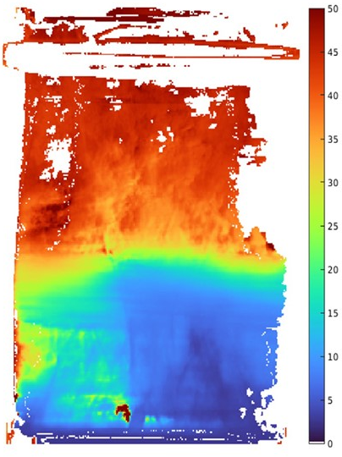
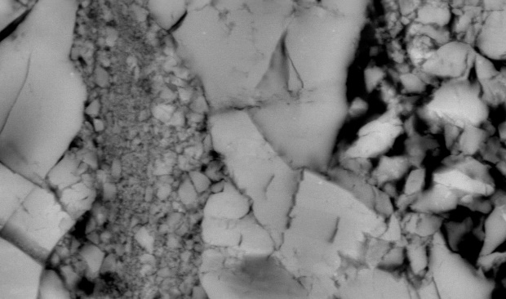
Overview
Use 3 techniques to identify both the detailed void system in a lab-deformed limestone and water movement through void system
Technique 1. X-ray tomography – dry sample
Technique 2. Neutron tomography – water movement
Technique 3. SEM – rock texture to sub-micron scale
L20 X-ray tomography
L20 Water flight time, base to top
ESEM
~10 microns
2
Notes:
Emphasises that all 3 methods contribute. Example images will be addressed later

Slide 3
Components – The Recipe
Take 1 microporous limestone cylinder
Deform cylinder triaxially to just past peak
Prepare 1 X-ray tomograph (void-solid distribution)
Perform flow experiment in neutron beam , 1st D₂O into air, then H₂O into D₂O
Cut into slices for SEM scans
Add SEM images
Assemble and serve to the scientific community
L20 X-ray tomography
L20 Water flight time, base to top
SEM
~10 microns
3
https://doi.org/10.1007/s11242-022-01873-6
Notes:
What was done. This is a complicated recipe in spite of looking simple. I will have to confine myself to highlights of the various stages

Slide 4
Questions I want to ask
What do fracture and deformation (shear) bands look like at the ~ micron scale?
  How / where did damage occur? What size voids and connectivities (3D)?
What % water moves through pores and what % induced voids?
How does the water (D₂O) replace air?
  Simple front progression base-to-top or strongly partitioned?
What happens within the water phase?
What drives the fluid movement?
  Imbibition?
  Pressure-driven (viscous) flow
What has the geologist learned?
4
Notes:
This is a election of questions that a researcher could ask depending on their interests. Generally fits under Structural Geology, Geomechanics and GeoEnergy Engineering.

Slide 5
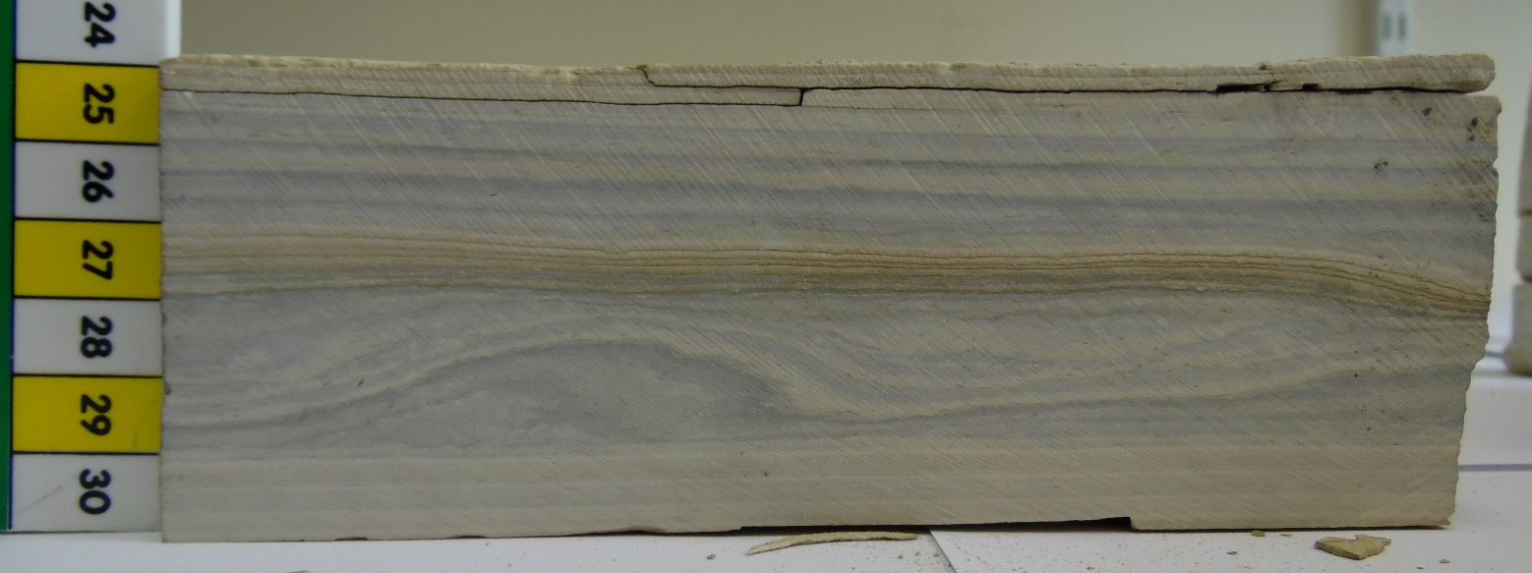
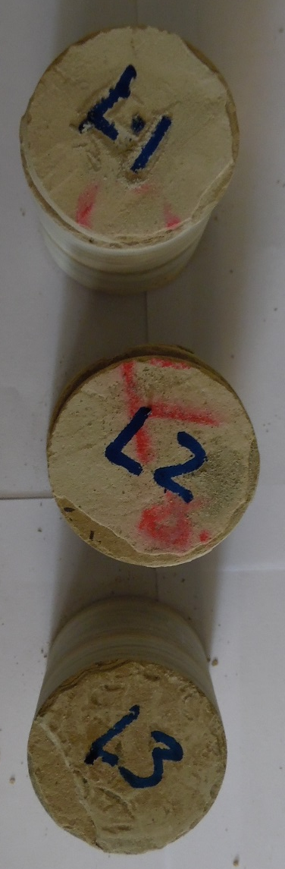
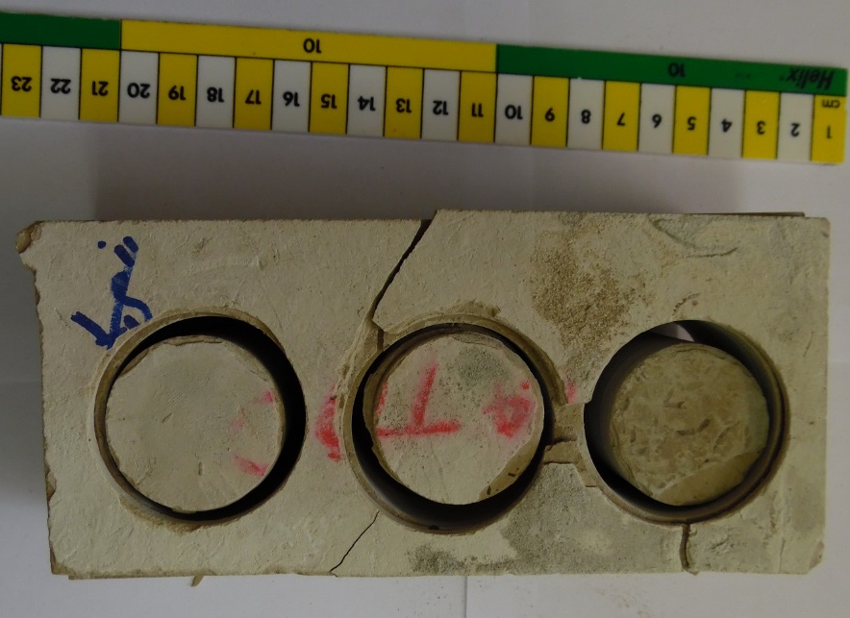
Microporous Limestone - Laminite
Courtesy Stephanie Zihms
Ø 38mm
5
Notes:
Top middle image: view of laminite block from which samples were cored.
Right side and lowest image: samples cored. Note that most this work was done on cut sample L3. Note that when this sample was deformed in the Rock Mechanics lab it was renamed L20 to designate that it was deformed at a confining pressure of 20MPa.
Stephanie Zihms was the postdoc doing the sample prep and the rock mechanics labwork.

Slide 6
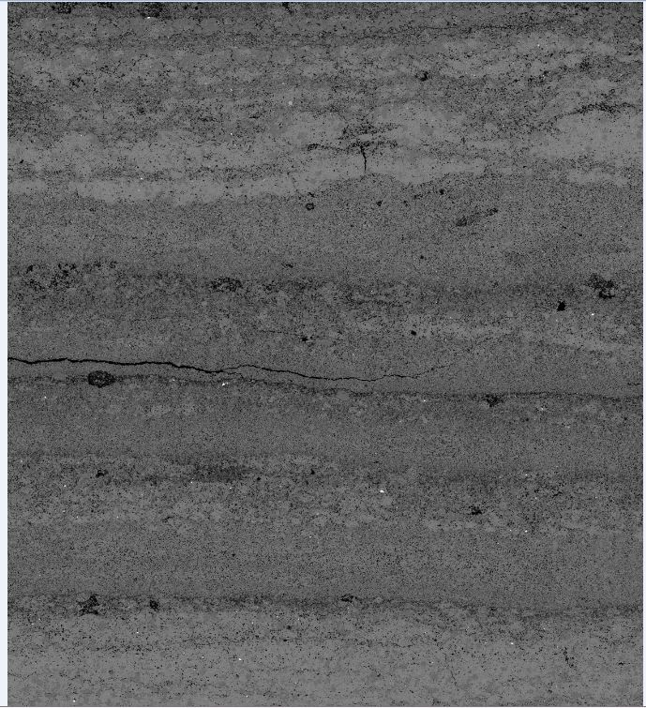
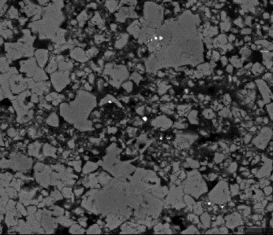
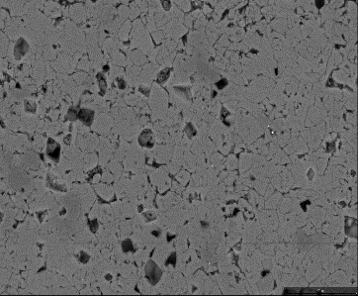
Laminite (undeformed)
Laminites are layered lacustrine deposits – calcite crystal size ~5 μ, original bulk porosity ~15%, permeability mD-μD
Laminae somewhat wavy and variable thickness with tendency to alternating more- and less- porous
Chosen for its complexity – layered and micro-particles encourage complex and realistic fracture patterns
SEM various scales
6
Notes:
SEM photomontages of part of finely layered limestone (a Laminite) block shown in previous slide. It was cut adjacent to cored sample L20.
Larger rectangular image shows whole sample (approx. 70mm high and 35mm wide) using thousands of individual SEM images.
Two square images show examples of the 2 most common lamina (thin layer) types. For scale, are approx. 5 microns diameter. One is clearly more porous than the other. Permeability difference is less easy to estimate.
Note this is all before rock was deformed in the Rock Mechanics Lab.

Slide 7
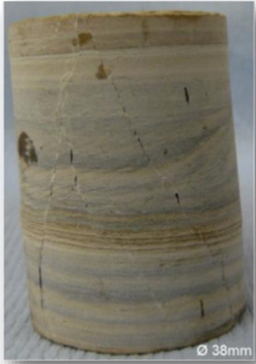
Rock Mechanics Experiments
38 * 76mm laminite samples shortened axi-symmetrically (triaxially) at Pc values 10 – 40MPa.
This sample Pc=20MPa
High stiffness, high strength response, reaching yield at 0.5-1.5% axial strain and strain harden, some with multiple yield points. None lose their load-bearing capability completely.
Post- experiment porosity almost unchanged; perm (base to top) from unchanged to 10³ increase
7
Notes:
Cored sample L3 was deformed axi-symmetrically (triaxially) at 20MPa confining pressure to what the Force-displacement curve suggested was just part peak the axial and circumferential loads were removed.. The deformed sample is renamed L20 to designate its deformation history.
The Laminite proved to be strong and stiff which is likely with a well cemented micro-crystalline limestone.
Note that sample L1 was deformed at 40MPa and L2 at 20MPa confining pressure but neither as taken to the neutron beam and they are not the focus of this talk.
Note also that L1 failed on a lamina boundary ( i.e. a bedding plane) at an axial load well below that achieved for the other 2 samples. It’s known that the laminite does tend to split along the laminae boundaries, at least after collection, storage and handling.

Slide 8
Induced Void system
Post- experiment porosity almost unchanged; perm (base to top) from unchanged to 10³ increase
Sample remains intact but develops ~ vertical semi-open semi-radial fractures and closed (?) steeply dipping shears visible on circumference
8
Notes:
Photo of sample perimeter – interesting but not that informative. Some open (at atmospheric pressure) and some apparently closed / compacted / damage-filled new features are seen, most steep to vertical.

Slide 9
Rock Mechanics Experiments
20MPa
30MPa
40MPa
Differential stress Q
Mean stress P
P*
Courtesy Stephanie Zihms
9
Notes:
Data for 3 laminite samples.

Slide 10
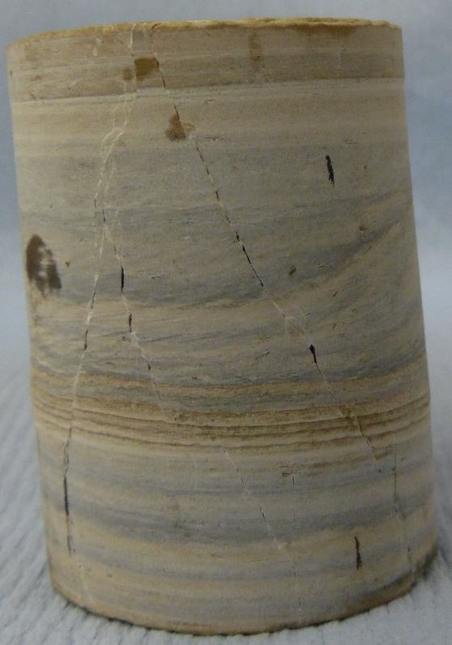
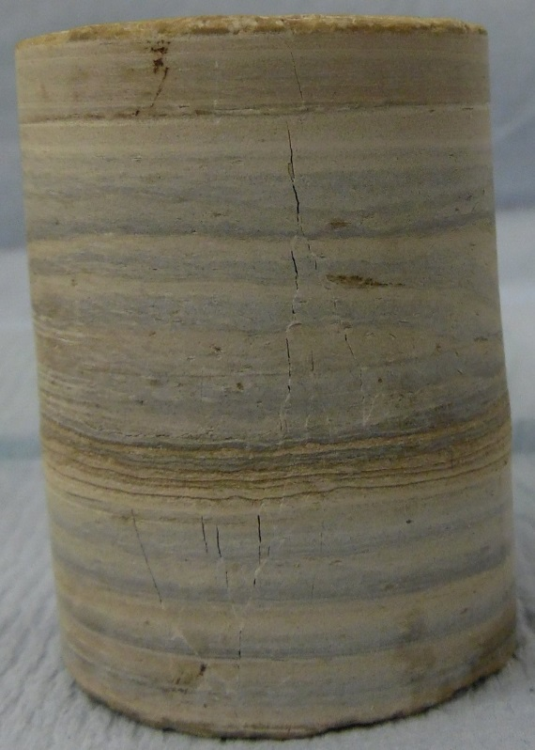
Deformed Laminites – image analysis
Analysis of fractures seen on cylinder surface
What can be done without XRT
L20 - 20MPa
L30 - 30MPa
Ø 38mm
Ø 38mm
Courtesy Stephanie Zihms
10

Slide 11
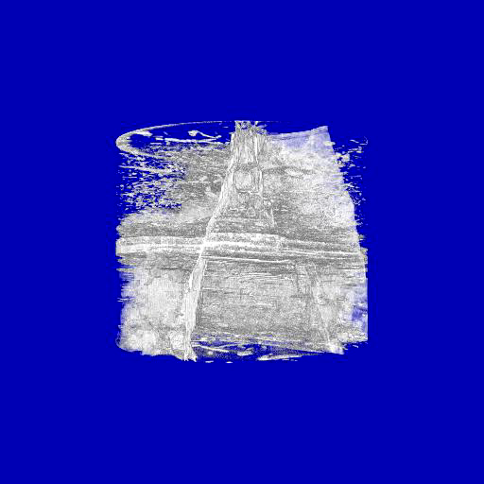
L20 X-ray tomograph
XRT pre-dates neutron beam flow test
white = less dense
40 μ resolution
Courtesy Stephen A Hall
11
Notes:
Movie of XRT performed by Dr S.A. Hall , Lund university who was a collaborator on the project.

Slide 12
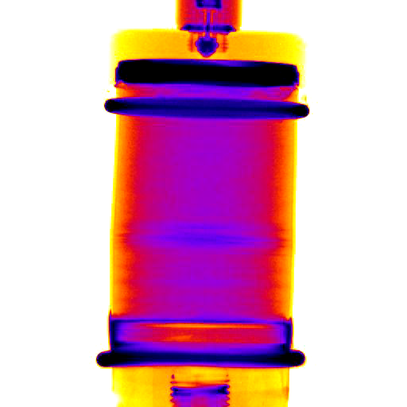
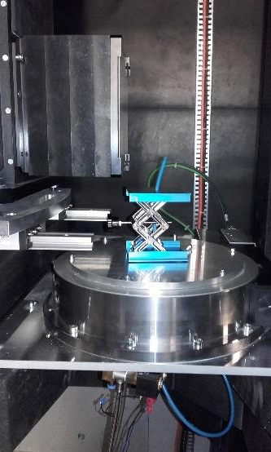
Neutron Beam Flow Experiments - ILL
Early-stage Radiography - D₂O into air
Neutrons interact with hydrogen – so detect water (difference between H₂O and D₂O forms), but neutrons almost unaffected by the rock or test cell
Produce sequential rotated radiographies – 2D projections of 3D object – these inverted to create a tomogram at single timestep
Also take sequential radiographs with static sample to record fluid movement
D₂O
12
Notes:
Background information. This early water-flow experiment used a mixture of radiographies and several tomographic acquisitions for which the sample was rotated 180 degrees. The radiographies were orientated to best show the dominant potentially open fractures and/or deformation bands. For the structural geologists the fracture / bands strike was into the screen.

Slide 13
Neutron Beam Flow Experiments - ILL
Early-stage Radiography - D₂O into air
Sample heat shrink jacketed with reservoir at base.
D₂O injected into base at controlled rate while watching radios. (Max water pressure 100kPa.)
When D₂O seen at top, change to H₂O.
Continue until H₂O reaches top.
No confining pressure (no cell) and fluid to 100kPa
D₂O followed by H₂O
13
Notes:
Sample prep: jacketed using heat shrink tubing (and a heat gun) with a suitable aluminium endcup incorporating a water reservoir at the base. O-rings were used in this assembly but have since been abandoned because sealing can be achieved more simply in other ways and they obscure part of the image.

Slide 14
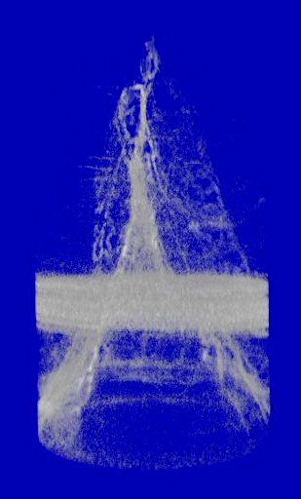
Neutron Tomograph D₂O into air
Mid-time tomograph
Void space is white
This is a 3D snapshot of void occupation by D₂O when D₂O has almost reached sample top.
Image processing allows selected features to be displayed for visualisation
14
D₂O replacing air

Slide 15
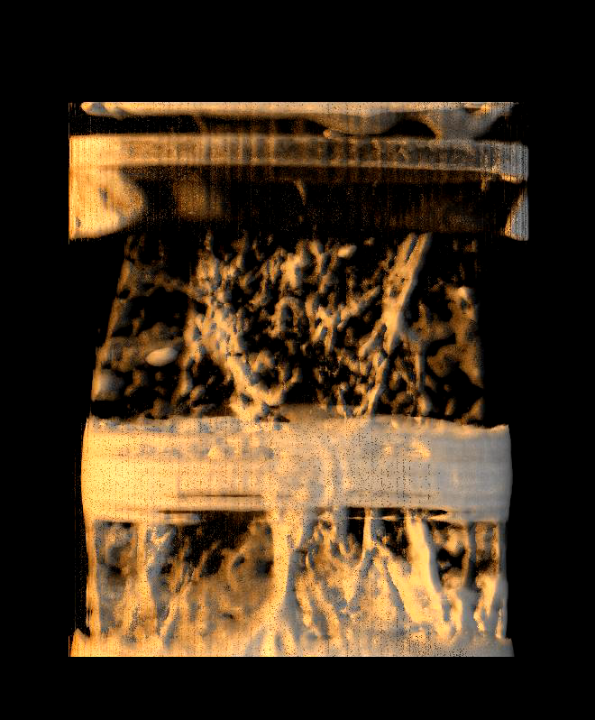
Tomograph H₂O into D₂O
Multi-fluid phase expts. completed
Late-time Tomograph
H₂O has reached sample top
D₂O (and residual air) replaced by H₂O provides marker in water phase
H₂O replacing D₂O (+ residual air)
15
Notes:
Remember that H2O and D2O have very similar physical properties but very different scattering / signal saturation. As such it main use is as a marker within the water phase.

Slide 16
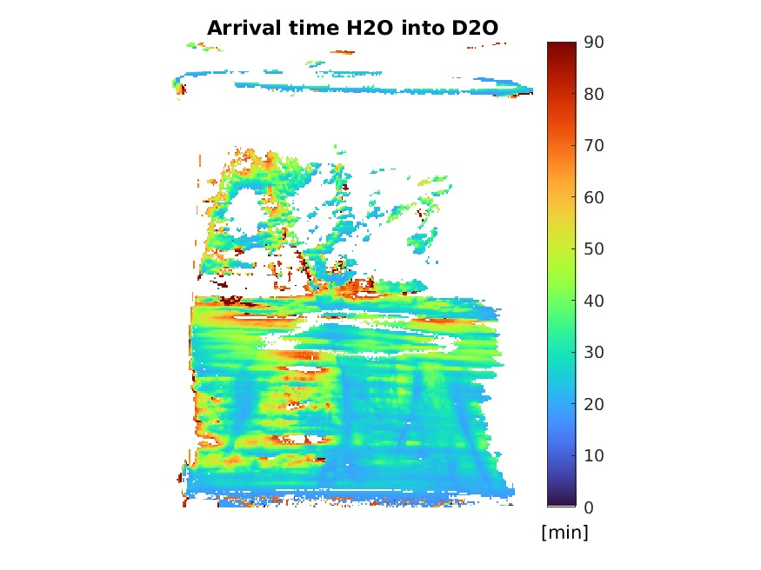
Calculated water(s) time of flight
D₂O
H₂O
Matrix + fracture
Fracture dominant
16
Notes:
Calculation of time it took for D2O (left) and H2O (right) to first appear at each position. Start time is when the relevant fluid reached the bottom of the sample. White signifies one or both of insufficient quality data or insufficient liquid present at the end of the experiment.
There is no information on the path the waters used to get to their destination, just the time it took.
D2O shows mixture of matrix and “fracture” transport. H2O shoes a much stronger

Slide 17
Water Pathways Matrix and Fractures
17
Notes:
Principal fluid movements in matrix (white arrows) and fractures (black arrows) in the Base and LM Zones superposed on composite SEM image of the deformed rock (see next slide).
Numbers are equal intervals in the radiograph sequence. Each arrow shows the (inferred) main progress of fluid movement over that interval.

Slide 18
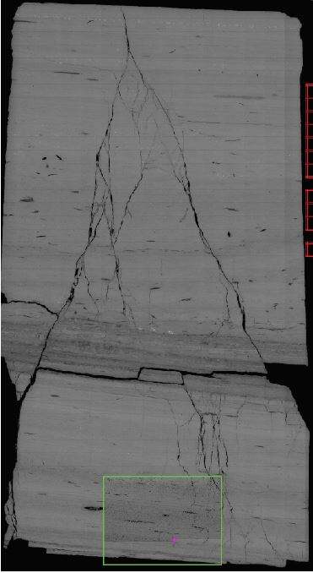
SEM – Scanning Electron Microscopy
Electron images of surface features – normally a thin section with very smooth surface
Resolution to sub-micron – which really matters to get details of 5μ scale crystal damage
A composite image of many scans
But to get these images you have to cut up your precious sample
So it always come at the end even when you would love to have it early
Composite SEM
18
Notes:
Note sample loss (black areas towards base ) of the SEM whole-sample image and the layer-parallel split in the Lower Middle layer were not present in L20 after the Rock Mechanics test. They are typical of the very challenging thin section preparation methods.

Slide 19
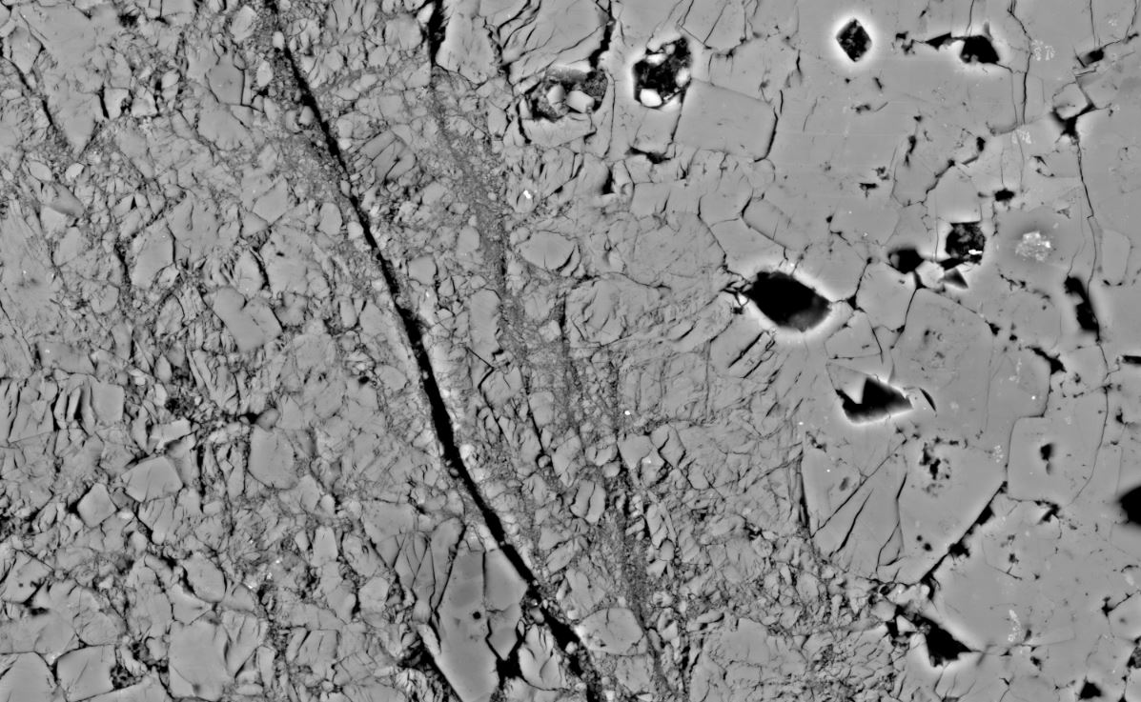
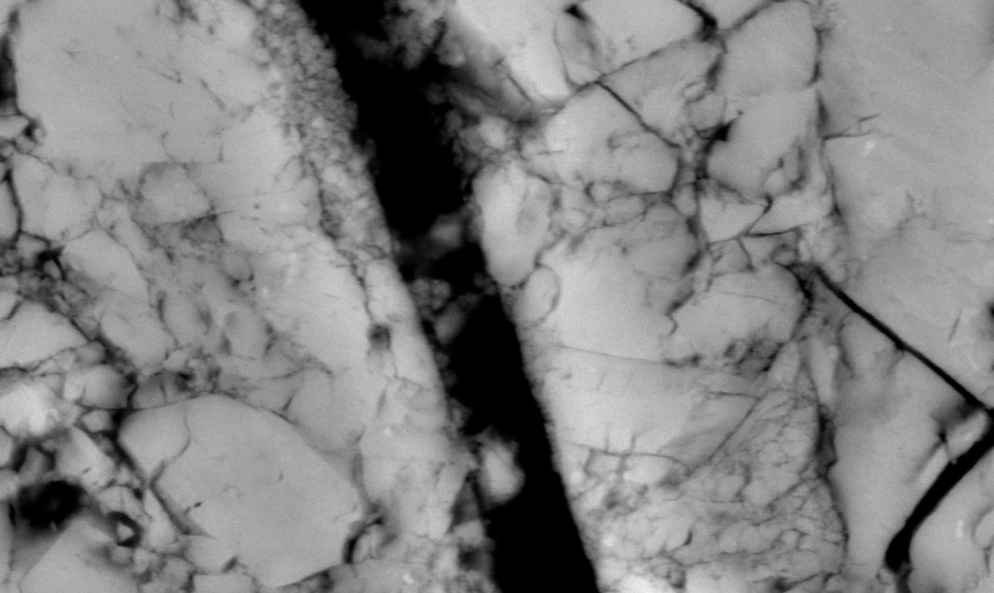

Example Textures: Open Fracture in a Zone of Damage
~250microns
~50microns
19
Notes:
Left – composite SEM image of sample region shown in red in small insert.

Slide 20
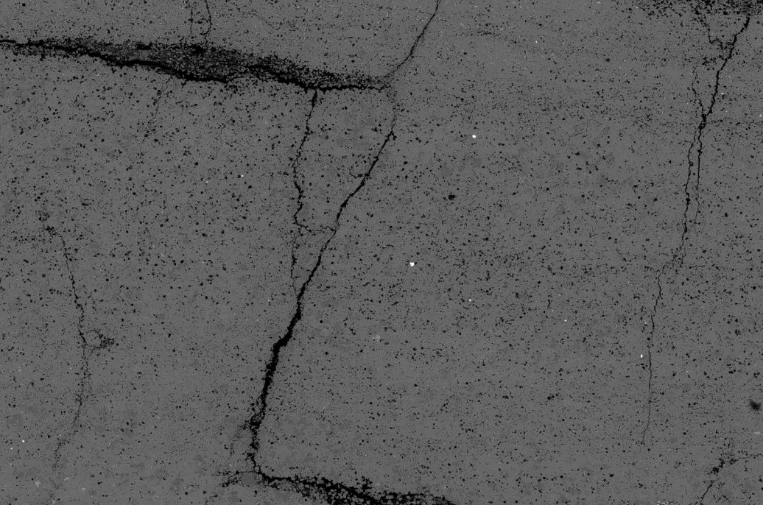
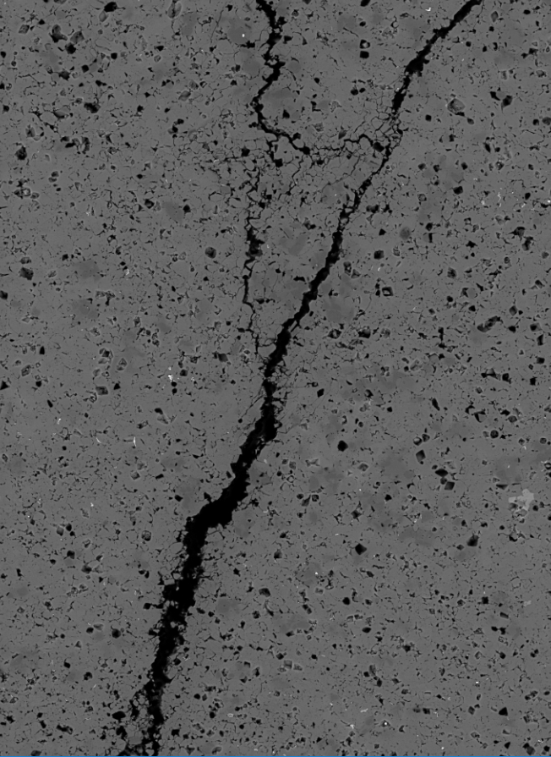
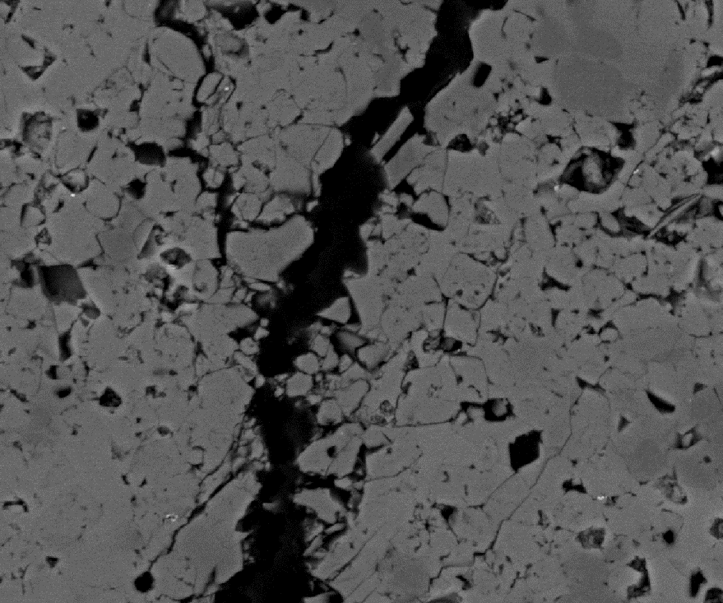
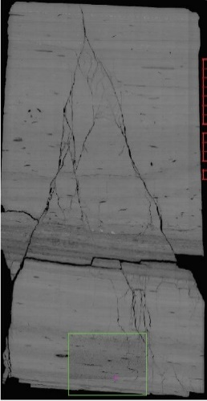
Some (almost) ideal open fractures
~5mm
~250microns
~50microns
20
Notes:
Examples from blue box shown in small insert. Sequence of SEM images left to right is progressively more detail of the same area.

Slide 21
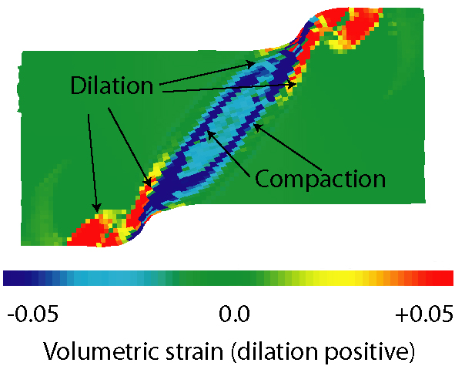
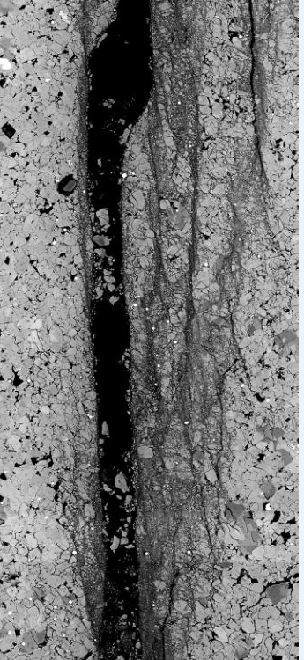
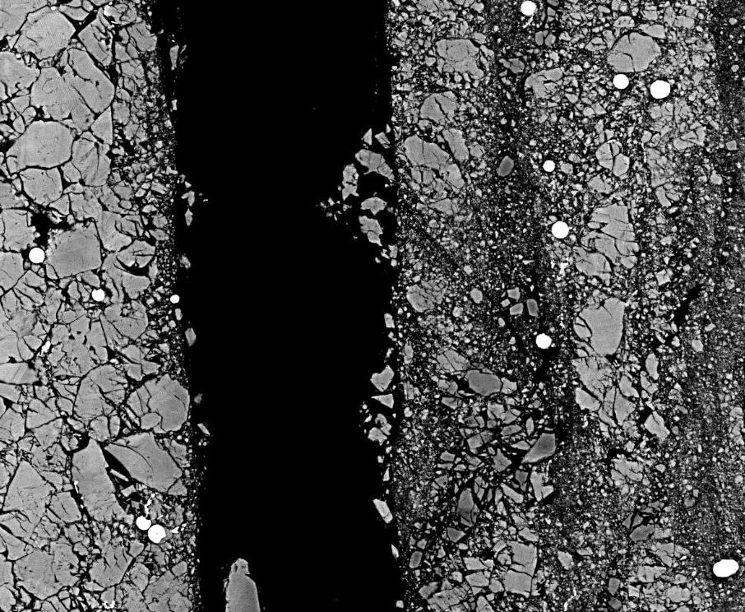
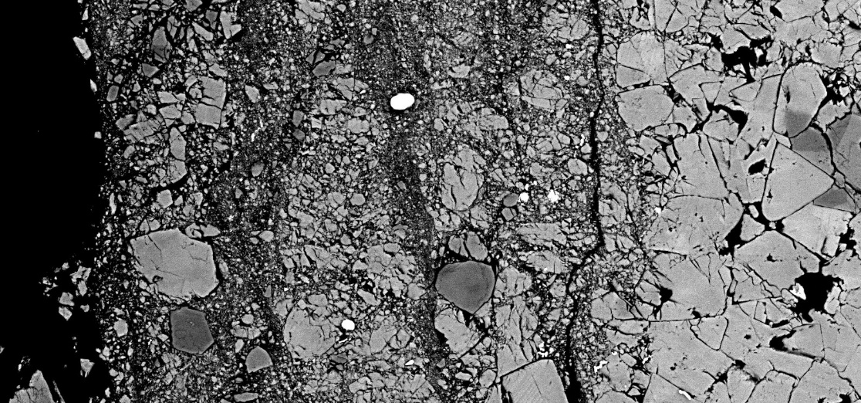
But some are very different.
Vol strains in a shear-zone simulation
Lewis et al. 2009
Combination
of open fracture and
deformation band
Mean-stress in shear-zone simulation illustrating emergent patterns (unpub.)
21
~100microns
Notes:
What looks like a deformation band with cataclasis and shear offset textures and probably void loss plus an apparent open fracture at 100 microns shows to be progressively more grain-breakage dominated at higher magnifications. Broken grain fragments are typically synonymous with reduced void space but this has not been calculated here. (For the structural geologists the sample was cut as close as possible to normal to strike so fracture apparent width is almost true width.)
Coloured image top right is a geomechanical simulation of a shear zone (or depending on scale assumed fault zone) showing volumetric strain distribution. It develops both dilational and compactional volumetric strain along with shear strain. It is consistent with the structural features seen in L20 SEM images.

Slide 22
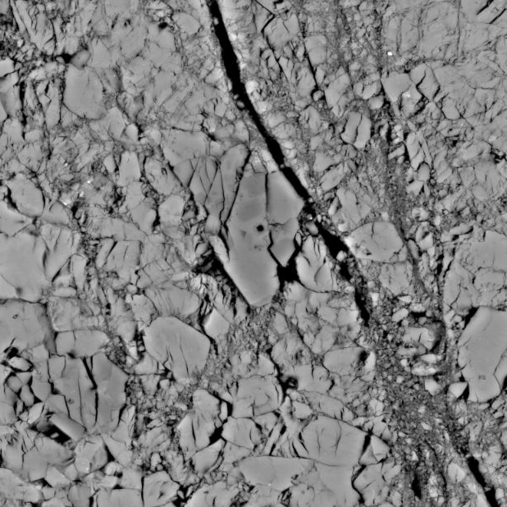
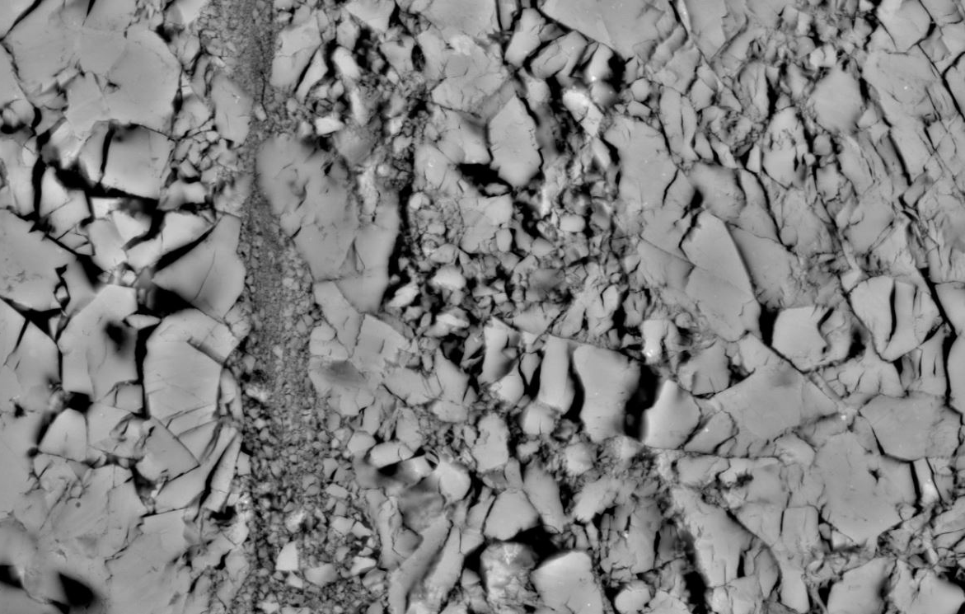

And some fractures are filled with “debris”
The particle sizes of the fill do not seem to agree with models of fragmentation… we do not know the process
~100microns
This is neither a fracture nor a deformation band as normally used
22
Notes:
What are these? The fracture geometry looks classic for opening-modes fractures but part of the “open” fracture is filled with finely comminuted material. The “open” fracture walls are also heavily damaged – probably preferentially along calcite cleavage planes.

Slide 23
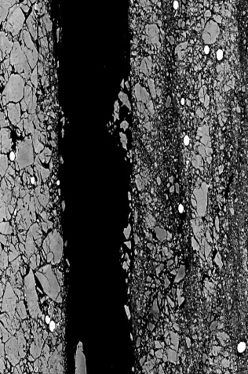

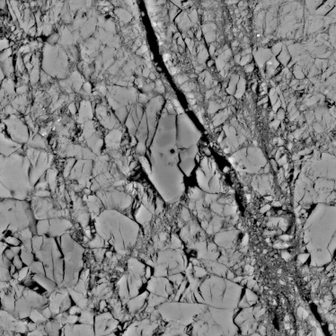


Questions I can answer (partly)
Combination
of open fracture and
deformation band.
Fracturebands??
What are fracture and deformation (shear) bands like at the ~ micron scale?
  Mix of opening and shear along sharp interfaces + finite width shear bands+ cataclastic damages –all mixed up.
  Close in space. Did they form together or sequentially?
  Voids highly variable – sub micron to 100μ +
  Matrix pores and fracturebands here achieve base to top flow but not all laminite samples do this
23

Slide 24
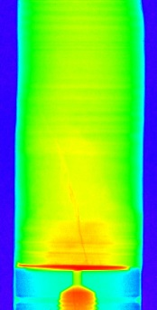
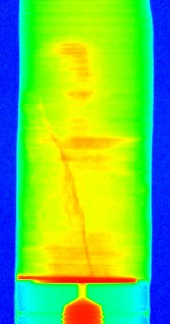
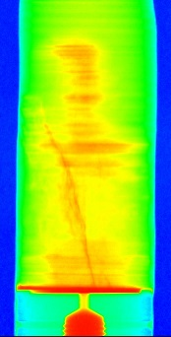
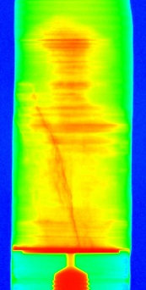
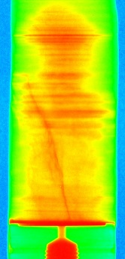
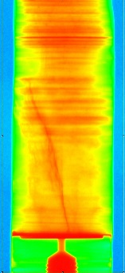
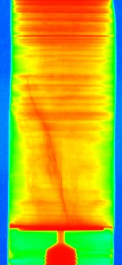
Questions I can answer - partly
What % water moves through pores and what % induced voids?
Variable but both contribute
Typically fractureband is participating in flow from start
Chosen samples have fracture at base
Fracturebands seem to provide key connections to ‘good’ layers in the laminated matrix material
No fractureband = no water ingress
Early
Late
24
Notes:
This is the sequence of radiographies from a different laminite sample treated in the same way as L20 with water (D2O) injected at a constant rate into the sample reservoir. The sample is jacketed to prevent water simply escaping through the sides. It shows clear water entry (here D2O) from the immediately below the rock sample base into the lower laminae and what appears to be an open (or semi-open) fracture intersecting the sample base (and near the reservoir). Both “fracture” and laminae progressively taking up water - which is why I show this image.

Slide 25
Questions I can answer - partly
D₂O
How does the water (D₂O) replace air? Simple front progression base-to-top or strongly partitioned?
Moderately partitioned into fractures
No such thing as a front
No idea if fingering buried in there
25
Notes:
Water replaces air using both laminae (layers) and fractures (or dilatant deformation bands) - as shown in the last slide.
There is no such thing as a front. Water first arrivals are far to complex in time-space to allow the term front to have any meaning. This complexity is highly likely to be a direct consequence of the damage (here induced voids but can be natural fractures) complicating what would otherwise probably be a simpler progression of the water replacement of air from base to top.
Given this highly complex time- and space progression I’ve not been able to address fingering.

Slide 26
Questions I can answer (partly)
H₂O
What happens within the water phase?
Strongly partitioned into fractures
No such thing as a front
Far too complex to see fingering - wrong conditions?
Fracture dominant
26
Notes:
Within the water phase fractures very definitely speed up water movement – fracture dominant.
It’ interesting to consider how the replacement of air by water makes good use of both laminae (layers) while the water movement away from the air-water interface is fracture dominant. Are the water molecule pathways within the water more tortuous and the water replacement of air less tortuous?

Slide 27
Questions I can (partly) answer
Time of flight D₂O into air
What is the fluid movement driver?
  Imbibition?
  Pressure-driven (viscous) flow
Time of flight H₂O into D₂O
Liquid movement sequence
27
Notes:
See next slide

Slide 28
Capillarity vs. pressure-driven
Time of flight D₂O into air
Capillarity – fluid fills smallest-width voids 1st. It is a physical process
Pressure-driven - widest voids first and less clearly a physical process
Capillary action and it’s parameters can be measured, but only in geometrically simple cases (so far)
Time of flight H₂O into D₂O
Liquid movement sequence
28
Notes:
See next slide

Slide 29
Learnings
Time of flight D₂O into air
Both drivers operate in close proximity in both time and space
Pressure-driven - widest voids first and less clearly a physical process
Capillary action and it’s parameters can be measured, but only in geometrically simple cases (so far)
So I can infer capillarity and pressure –driven flow both act but I can’t prove it (yet)
Time of flight H₂O into D₂O
Liquid movement sequence
29

Slide 30
Conclusions
1. Alternating layers provide primary material heterogeneity, while experimentally created deformations lead to quasi-planar zones of highly comminuted matrix and fractureband-like voids, each with characteristic scales sub-mm to cm.
2. Together, the induced deformation features delineate a partially connected array That is semi—connected to the natural voids (pores).
3. The interplay between fluid movement through deformation features, and flow into (and out of) the laminae, implies near-equivalence of local driving pressure and capillary related energies, with subtle shifts in this balance as water saturation increases.
4. The insights gained invite a re-examination of common rules-of-thumb for multi-phase fluid flow often adopted in fractured, low-permeability microporous rocks.
30

Slide 31
References
Lewis, H., Couples, G., Tengattini, A. et al. Interactions Between Imbibition and Pressure-Driven Flow in a Microporous Deformed Limestone. Transp Porous Med 146, 559–585 (2023). https://doi.org/10.1007/s11242-022-01873-6
Tudisco, E., Etxegarai, M., Hall, S.A., Charalampidou, E.-M., Couples, G.D., Lewis, H.: Fast 4-D imaging of fluid flow in rock by high-speed neutron tomography. J. Geophys. Res. Solid Earth 124, 3557–3569 (2019). https://doi.org/10.1029/2018JB016522
Lewis, H., Couples, G.D., Buckman, J., Jiang, J.: Fracture or band? - A transitional type of deformation feature with surprising flow effects. Search and Discovery article #51590 (2019)

Slide 32
Questions Welcome

Slide 33
Spares for Questions

Slide 34


Fracturebands Characteristics
Components of open fractures, of deformation bands (shear-dilation and shear-compaction) and debris-filled fractures
Regions of dilation and regions of compaction (often adjacent)
Not really a spectrum
  Open fractures are an end-member, but a deformation band is not an end-member
  What are fragment-filled zones? – not really cataclastic bands, but not fractures either
They have same issues of relationships to faults as deformation bands do
NOT suggesting new terminology!! Maybe we need one, maybe we don’t
But am identifying that such transitional forms exist, at least in the lab
13

Slide 35
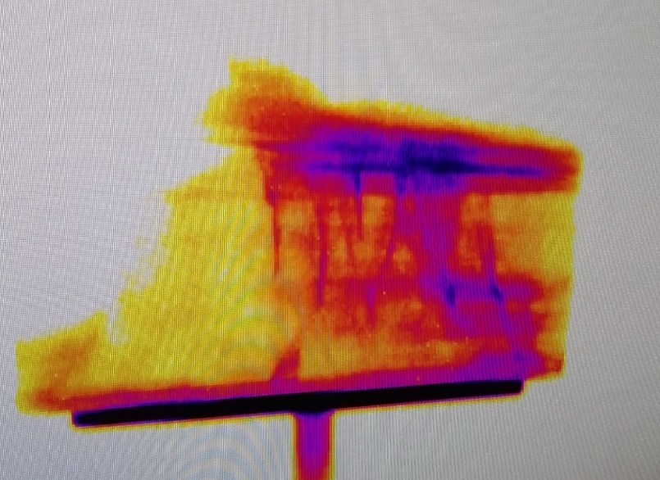
Petrophysics to Flow Simulations: But Flow Mechanisms More Complex
Imbibition into matrix pore system and very thin fractures, while viscous (pressure driven) flow operates in wider pores and fractures
They are not mutually exclusive - both are taking advantage of local conditions
“All those little water blobs are having an interesting ride!”
So “just” a poroperm distribution isn’t good enough
We need a suitable simulation tool…
15

Slide 36
Application Now and Future
Build them into a geomodel of a reservoir? – not directly - upscaling
Need to estimate (or better calculate) the combined matrix / pore, and fracture-band petrophysical response
Then use rules of upscaling to represent it at the required grid scale (which may vary a lot across a given problem) – this needs distribution models of the fracture-bands, along with the usual lithological story
Plenty of work still to do…
16

Slide 37
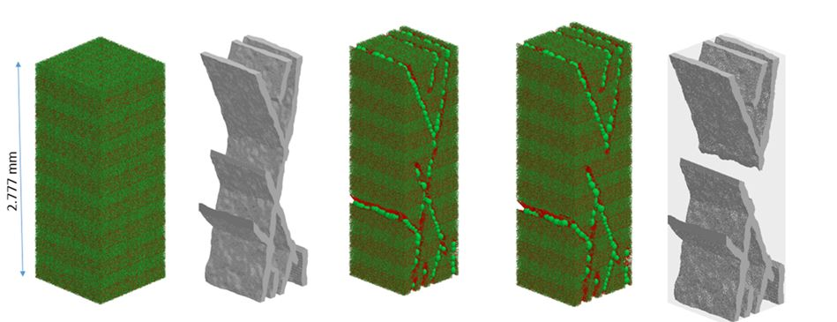
(Local) Flow Simulations
Pore System Model represents the integrated pore network composed of:
  Laminated matrix
  Open fractures
  Fracture fill
  Deformation band
Then simulate 2-phase flow through the network, and derive ‘effective’ flow properties
Fractureband
These models represent a significant extension of our digital-rock capabilities
They demonstrate composite models, containing elements with limited pore-system characteristics, and discrete fractures (as pore networks; Li et al 2019)
17

Slide 38
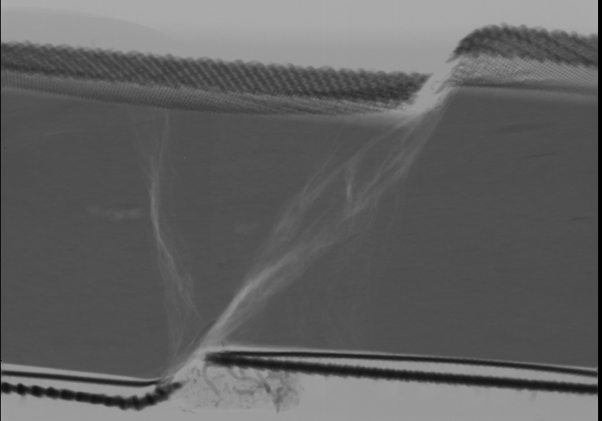
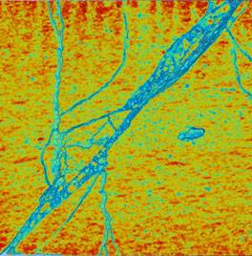
Some Implications/ Conclusions
Shale - radiograph of experimentally-created shear zone
These newly-recognised transitional-form features seen so far in crystal-dominated rock with small-scale layered/laminated textures
They emerge at very low bulk plastic strains, and show a clear association with small-scale primary textural variations, here layering
They allow both capillary-driven and pressure driven fluid flow at same time and (almost) same place
Potentially occur in other rocks e.g. shales
Their unexpected flow effects could become important aspects in understanding fluid performance in challenging reservoirs
Shin010
~1cm
Notice the cataclastic texture of the shear zones
Does this suggest perm increase?
~0.3mm
This sample is from a rich source rock, with laminations of organic-rich matter and diagenetic carbonate-replacement texture
18

Slide 39
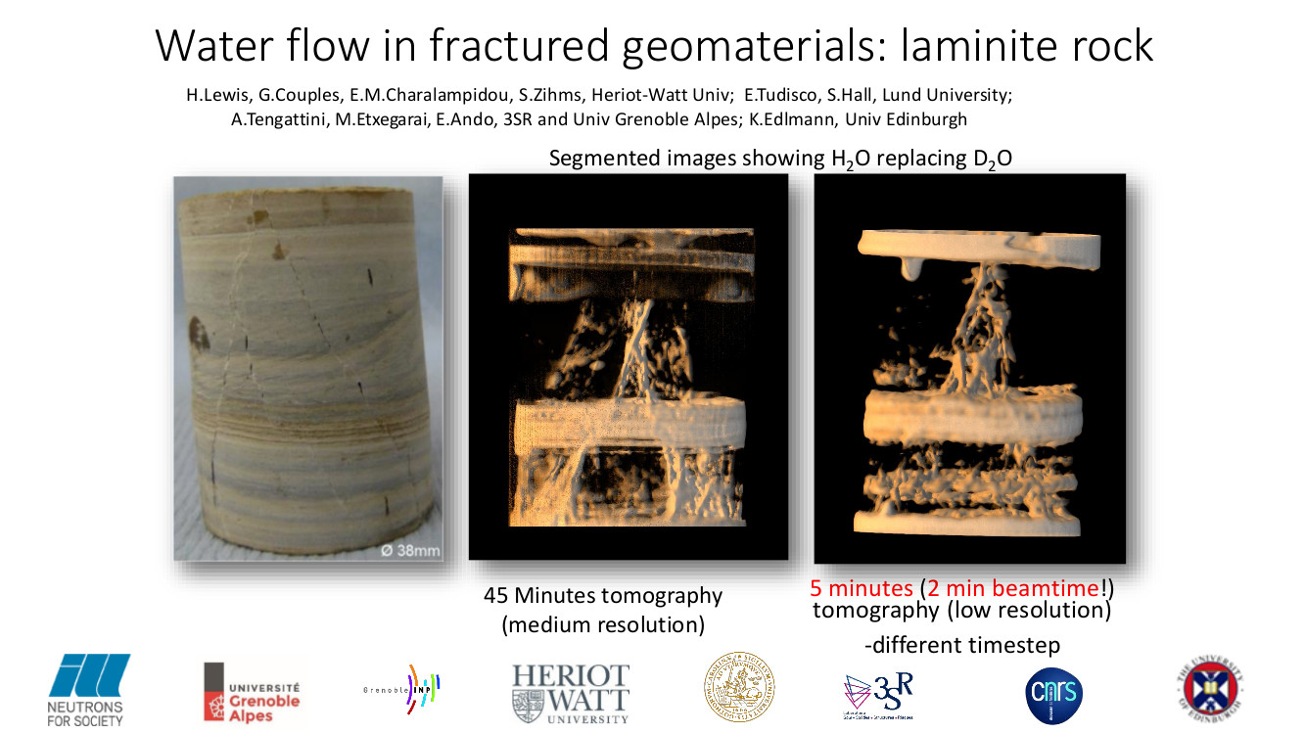
Laminite fracture permeability
Official promotion material for Grenoble neutron facility
16
Notes:
Grenoble was impressed with our laminite experiment it's officially part of the advertisement for the facility

Slide 40
This Work Matters Because…
Void systems are ubiquitous in subsurface rock – both non-porous and porous
Liquids and gases move through void systems - CO₂, hydrogen, petroleum, water - huge economic and societal impact (even UN and WHO list them)
Many voids are rock damage – almost all rocks and some sediments are damaged – fractures, joints, deformation bands, fracturebands, faults. Some open, some sealing, many do both in same volume
Structural geologists care about the whole process. the damage so this is an evolving process to me. I don’t just care about the end product but about all the stages. For rock damage and for fluid movement.

Slide 41
Why Lab Experiments?
Lab deformation is NOT the same as natural. Loads are typically much simpler and tend towards end-points of the natural damage spectrum
But still get complex arrays superposed on pore system
Know conditions of damage
This is good… informative simplifications

Slide 42

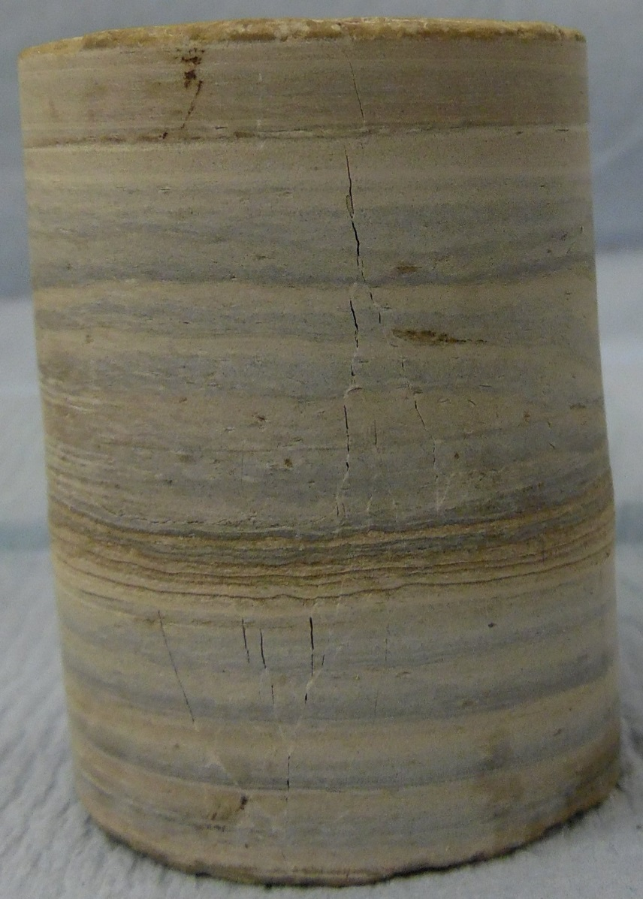
Post-deformation: x-ray tomography
34
Slice | “Dip” Shear fractures (°) | “Dip” Now-open fractures (°)
34 – 265 | 74 | 104
 | 83
265 – 448 | 75 | 109
 | 95
448 – 500 | 65 | 104 111
 | 77
 | 71
500 – 702 | 71 | 104
 | 89 | 107
 | 82 | 51
265
448
500
702
Ø 38mm
30MPa

Slide 43
Laminite – image analysis
ImageJ analysis of fractures on the plug surface – Laminite
40MPa
Differential stress Q
Ø 38mm
Mean stress P
P*
Compaction bands are hard to identify

Slide 44
Evidence of Flow Drivers
Time of Flight D2O into air
Neutron images document significant, evolving, water speed and flow direction variability at the deci-micron scale and spatially-complex patterns of both increasing and decreasing water saturation.
Infer capillarity-driven and pressure-driven water movement occur concurrently, in close proximity, and in competition
As local and global water saturations evolve these two drivers can change their dominance in both matrix and deformed elements.
Time of Flight H2O D2O
Fluid movement sequence
12

Slide 45
Objectives of Fluid Flow Experiments
Identify fluid movement paths for individual samples
Quantify - but limited because resolution > feature width
  Can achieve e.g. water arrival times, sequence of movements but fluid path inferred not detected
Identify generalities – particularly drivers of fluid movement
  Pore vs. damage voids – preferences where and why
  Imbibition vs. pressure-driven (viscous) flow – where and why

