Slide 1



Multiscale observations of deformation in porous rocks based on full field measurements
Pierre Bésuelle
Université Grenoble Alpes, CNRS, Laboratoire 3SR
Grenoble, France
4th ISRD-RCN workshop – 21-23 May 2024 – Grenoble, France

Slide 2
1
Introduction
Constitutive behaviour of rocks, mechanisms of deformation, strain localisation
Strain localisation is a major failure process in porous rocks, well-known to be mean-stress dependant.
  However, experimental characterisation is mainly limited to axisymmetric conditions (axisymmetric compression tests, axisymmetric extension tests)
  Not representative of real in situ stress states, quite particular in term of localisation conditions
  Only a few experimental devices for elementary tests in rock mechanics are not axisymmetric: plane strain compression, true-triaxial cell, …
in operando full field measurements allow to detect and characterise strain localisation
Extended experimental characterisations with
  a true-triaxial cell using in operando 2D full field kinematic measurement
  axisymmetric cell using in operando 3D full field kinematic measurement
Mesoscale deformation mechanisms characterisation is needed to understand deformation: constitutive modelling, multiscale modelling.
  post mortem analysis
  in operando hight resolution full field measurements

Slide 3
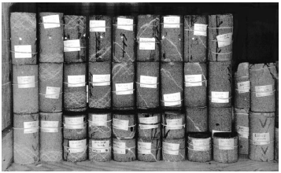
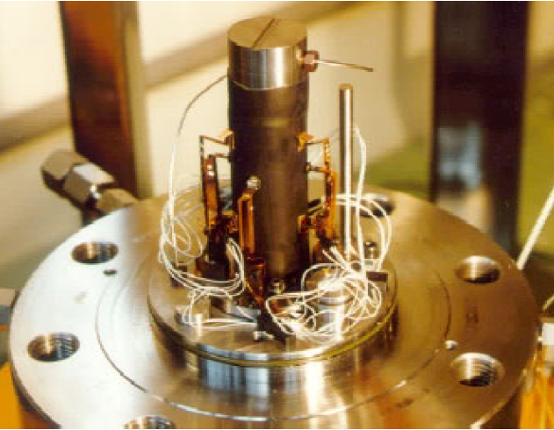
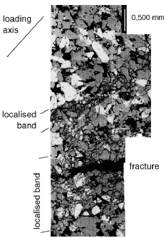
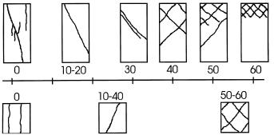
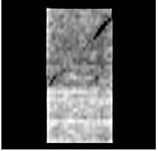
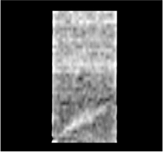
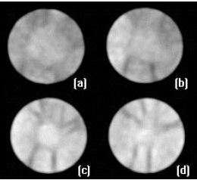
1
Introduction
Constitutive behaviour of rocks, mechanisms of deformation, strain localisation
SEM post mortem
Experimental characterisation on a sandstone
x-ray CT on sandstone specimens after loading
σ₃ = 20 MPa
σ₃ = 50 MPa
How the emergence of digital images analysis contributes to improve experimental characterisation in rock mechanics ?
Bésuelle P., Desrues J. and Raynaud. S., 2000, Experimental characterisation of the localisation phenomenon inside a Vosges sandstone in a triaxial cell. Int. J. Rock Mech. Mining Sci., Vol. 37, n° 8, pp. 1223-1237.
Bésuelle P., Baud P. and Wong T.-f., 2003, Failure mode and spatial distribution of damage in Rothbach sandstone in the brittle-ductile transition. Pure Appl. Geoph., Vol. 160, n° 5-6, pp. 851-868
Notes:
a quick review of what we were doing 20-25 years ago, to consider developments since then.

Slide 4
Outline
Introduction
Materials
  Red Vosges sandstone
  Callovo-Oxfordian clay rock
Experimental loading devices and in situ full field measurements
  True triaxial cell with 2D-imaging
  Triaxial cells for lab and synchrotron x-ray CT
Strain localisation and small scale deformation in sandstone
  Strain localisation macro-scale characterisation (2D-DIC)
  2D post mortem meso-scale analysis (SEM)
  3D in situ meso-scale analysis (lab x-ray CT)
Strain localisation and small scale deformation in a clay rock
  Strain localisation macro-scale characterisation (2D-DIC)
  2D post mortem micro-scale analysis (BIB-SEM)
  3D in situ meso-scale analysis (ESRF ID19 x-ray CT + 3D-ηDIC)
Conclusions

Slide 5
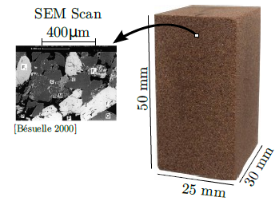
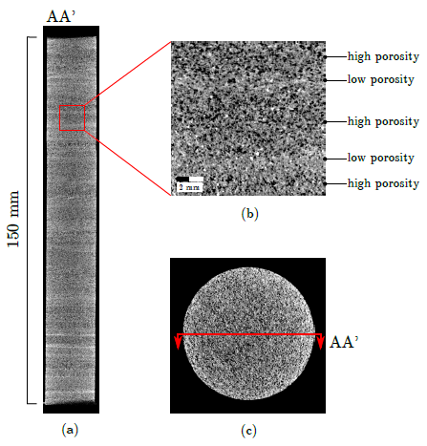
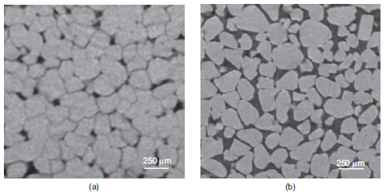
Materials
Red Vosges sandstones (eastern France):
‘Isotropic’ Woustwiller sandstone
  Porosity 21 %
  Mean grain size d₅₀ ~ 300 µm
  95% quartz, 5% microcline, 1% mica, 1% kaolonite
Anisotropic Hangviller sandstone
  Porosity 22.6 %
  Mean grain size d₅₀ ~ 300 µm
  88% quartz, 8% microcline, 3% mica, 1% kaolinite
  Natural bedding with alternating bi-modal porosity
    1-2 mm thick low porosity layer
    2-4 mm thick high porosity layer
Fontainebleau sandstones (Paris basin)
  2 Porosities: ‘stiff’ 6% and ‘soft’ 21 %
  Mean grain size d₅₀ ~ 260 µm
  100% quartz
[Couture 2020]
[Fonseca et al. 2013]
Notes:
The materials studied: sandstones

Slide 6
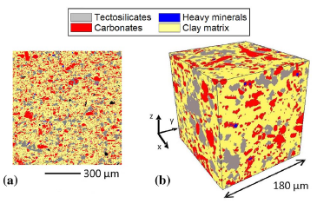
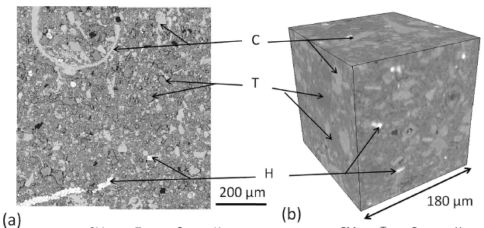
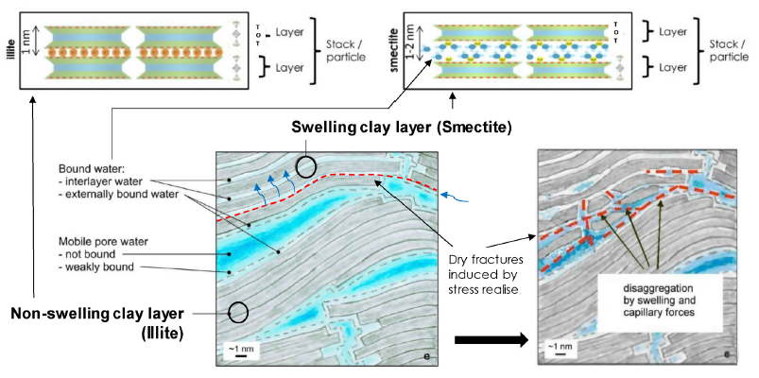
Materials
Callovo-Oxfordian clay rock (eastern France – Meuse/Haute Marne URL):
  Depth: -490 m
  Porosity ~18 %
  15-25 % quartz, 25-35 % carbonates, 40-60 % clay (illite, smectite), ~2 % pyrite
  Pre-consolidation pressure: ~10 MPa
  In situ permeability: ~10⁻²⁰ m²
SEM
X-ray CT
[Robinet et al. 2012]
[Di Donna et al. 2022]
Notes:
And a clay rock

Slide 7
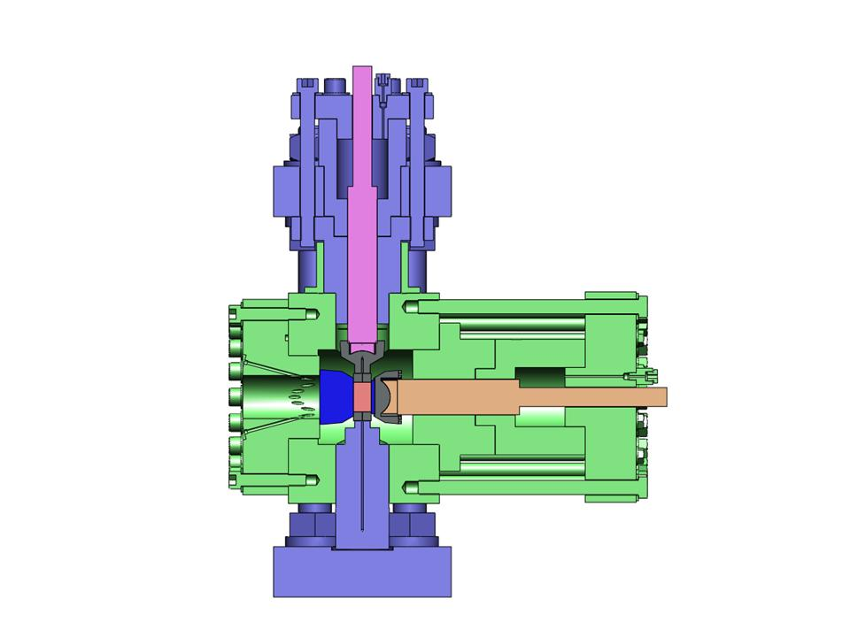
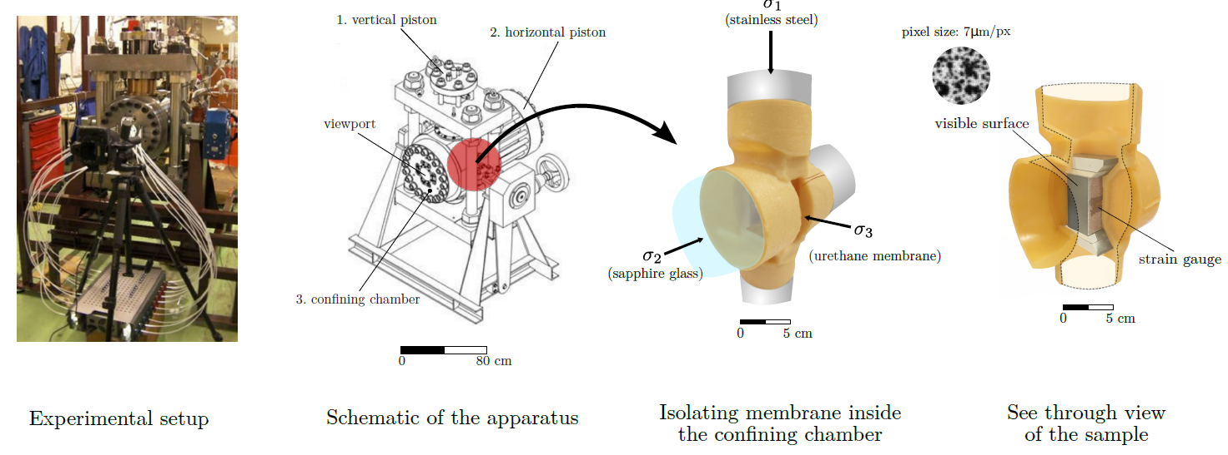
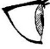
Experimental Devices
True triaxial cell with visualising device:
  Independent principal stresses loading with fixed directions
  Confining pressure 100 MPa, max. major stress 750 MPa
  Prismatic specimen size: H 50 mm, W 25 mm, T 30 mm
  Stress or displacement control in directions 1 and 2
  Window (sapphire) in direct contact with specimen
  surface perpendicular to direction 2
  Synthetic speckle on the visible surface
  Lubrication of the 6 specimen surfaces
  Rotating loading caps in direction 1 and 2
  High-resolution Camera 36 MPx, ~7µm/px
  DIC (Photowarp and then SPAM)
Major Stress σ₁
(max. 750 MPa)
σ₁
Intermediate stress σ₂
(Max. 450 MPa)
Minor stress σ₃
(Max. 100MPa)
σ₂
σ₃
1
2
3
Bésuelle P., Lanatà P., 2016, A new true triaxial cell for field measurements on rock specimens and its use in the characterization of strain localization on a Vosges sandstone during a plane strain compression test, Geotechnical Testing Journal, vol. 39, n°5, pp. 879-890. ISSN 0149-6115, doi.org/ 10.1520/GTJ20150227.
Notes:
The true-triaxial cell with a large viewport the protograph the surface of the specimens during loading.

Slide 8
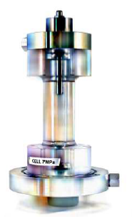
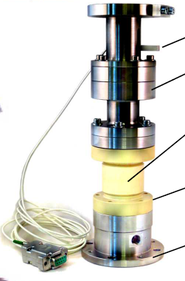
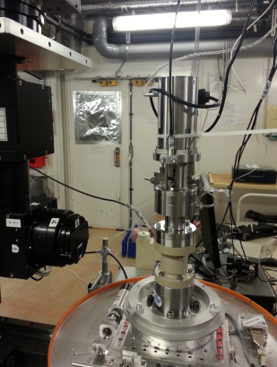
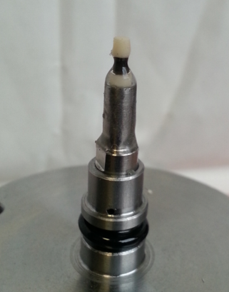
Experimental Devices
Axisymmetric triaxial cell for 3SR x-ray CT apparatus:
  Max. confining pressure 10 MPa
  Specimen size: 11 mm diameter, 22 mm height
  Scans with 8.5 µm voxel size
Axisymmetric micro-triaxial cell for ESRF ID19:
  Max. confining pressure 20 MPa
  Specimen size: 1 mm diameter, 2 mm height
  Scans with 0.7 µm voxel size
Piezo-actuator
Force & displacement transducers
Self-compensated hydraulic piston
Double-wall cell (aluminium & PEEK)
hydraulic connexion
base fixed on the rotating plateau
Specimen with silicon coating (jacket) and alumine heads
Notes:
Two axisymetric cells for x-ray CT

Slide 9
Outline
Introduction
Materials
  Red Vosges sandstone
  Callovo-Oxfordian clay rock
Experimental loading devices and in situ full field measurements
  True triaxial cell with 2D-imaging
  Triaxial cells for lab and synchrotron x-ray CT
Strain localisation and small scale deformation in sandstone
  Strain localisation macro-scale characterisation (2D-DIC)
  2D post mortem meso-scale analysis (SEM)
  3D in situ meso-scale analysis (lab x-ray CT)
Strain localisation and small scale deformation in a clay rock
  Strain localisation macro-scale characterisation (2D-DIC)
  2D post mortem micro-scale analysis (BIB-SEM)
  3D in situ meso-scale analysis (ESRF ID19 x-ray CT + 3D-ηDIC)
Conclusions

Slide 10
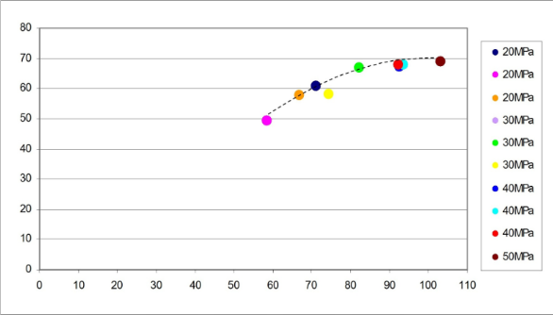
Strain Localisation & small scale Deformation in Sandstone
Experimental campaign #1 on the isotropic Vosges sandstone: (coll. P. Lanatà)
  Plane strain compression tests (ε₂ = 0) with different minor stress σ₃ values [20-50 MPa]
  Prismatic specimen size: H 50 mm, W 25 mm, T 30 mm
peak values in I₂ vs. p
σ₁- σ₃ [MPa]
ε_{v}
ε₁
P. Lanatà, 2015, Full-field experimental characterization of mechanical behaviour and failure in porous rock in plane strain compression: homogeneous deformation and strain localization, PhD thesis Univ. Grenoble.
Notes:
We did a classical mechanical characterisation, however it's not the main focus of the presentation.

Slide 11
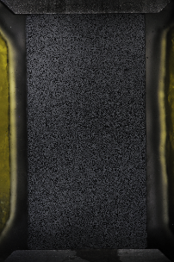
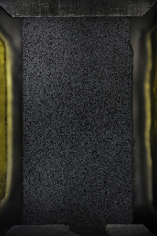
Strain Localisation & small scale Deformation in Sandstone
Experimental campaign #1 on the isotropic Vosges sandstone: (coll. P. Lanatà)
  Plane strain compression tests (ε₂ = 0) with different minor stress σ₃ values [20-50 MPa]
  Prismatic specimen size: H 50 mm, W 25 mm, T 30 mm
Incremental shear strain
σ₁- σ₃ [MPa]
ε₁
P. Lanatà, 2015, Full-field experimental characterization of mechanical behaviour and failure in porous rock in plane strain compression: homogeneous deformation and strain localization, PhD thesis Univ. Grenoble.
Notes:
Example of what we measured thanks to the 2D DIC. Here, incremental shear strain fields, i.e., zone of active deformation during loading. Structured patterns appear well before the peak stress, and evolve up to the peak and then after, with a progressive reduction of the number of active localised bands.

Slide 12

Strain Localisation & small scale Deformation in Sandstone
B
C
B
C
D
A
B
C
A
D
A
σ₁- σ₃ [MPa]
D
σ₁- σ₃ [MPa]
σ₁- σ₃ [MPa]
20 MPa
40 MPa
50 MPa
ε_{v}
ε_{v}
ε_{v}
ε₁
ε₁
ε₁
A
ε_{s}
B
ε_{v}
A
ε_{s}
B
ε_{v}
A
ε_{s}
B
ε_{v}
C
D
C
D
C
D
dilating shear bands
compacting shear bands
compacting shear bands
P. Lanatà, 2015, Full-field experimental characterization of mechanical behaviour and failure in porous rock in plane strain compression: homogeneous deformation and strain localization, PhD thesis Univ. Grenoble.
Notes:
Effect of the mean stress (confining pressure) on the strain localisation patterns (incremental shear and volume strain fields).

Slide 13
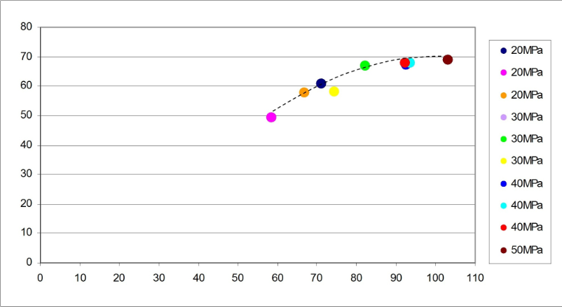
Strain Localisation & small scale Deformation in Sandstone
Experimental campaign #1 on the isotropic Vosges sandstone: (coll. P. Lanatà)
  Plane strain compression tests (ε₂ = 0) with different minor stress σ₃ values [20-50 MPa]
  Mean stress dependence on band orientation and volume strain inside band
  A difference between band orientation before peak and post-peak bands
peak values in I₂ vs. p
Pre-peak
Post-peak
P. Lanatà, 2015, Full-field experimental characterization of mechanical behaviour and failure in porous rock in plane strain compression: homogeneous deformation and strain localization, PhD thesis Univ. Grenoble.
Notes:
Evolution of the pre-peak and post-peak band orientation with respect of the confining pressure.

Slide 14
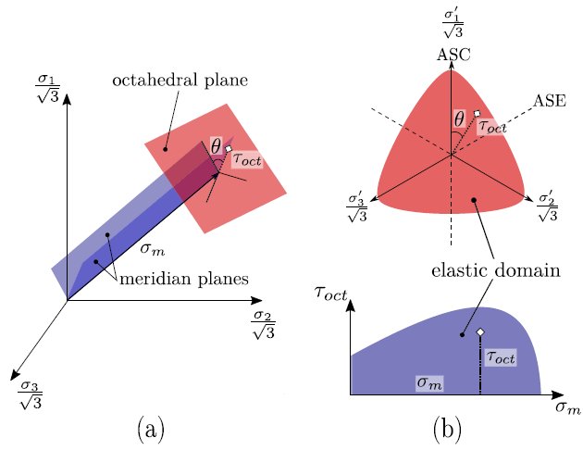
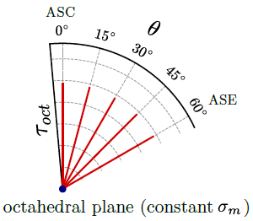
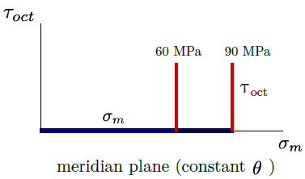
Strain Localisation & small scale Deformation in Sandstone
Experimental campaign #2 on the isotropic Vosges sandstone: (coll. C. Couture)
  True triaxial tests at 2 constants mean stress [60 & 90 MPa] and 5 constant Lode angles [0-60°]
  Isotropic loading then deviatoric loading
  Prismatic specimen size: H 50 mm, W 25 mm, T 30 mm
  The Lode angle is defined here to be 0° for ASC (σ₁ > σ₂ = σ₃) and 60° for ASE (σ₁ = σ₂ > σ₃)
σ_{m} \ θ | 0° | 15° | 30° | 45° | 60°
60 MPa | x | x | x | x | x
90 MPa | x | x | x | x | x
C. Couture, 2021, Mechanical characterization of porous sandstones in true triaxial conditions : diffuse and localized deformation, effect of anisotropy, PhD thesis Univ. Grenoble.
Couture C., Bésuelle P., 2022, A true triaxial experimental study on porous Vosges sandstone: from strain localization precursors to failure using full-field measurements, Int. J. Rock Mech. Mining Sci., vol. 153, pp. 105031, doi: 10.1016/j.ijrmms.2021.105031
Notes:
True-triaxial loading, a short recall of what is the Lode angle in the stress frame.

Slide 15
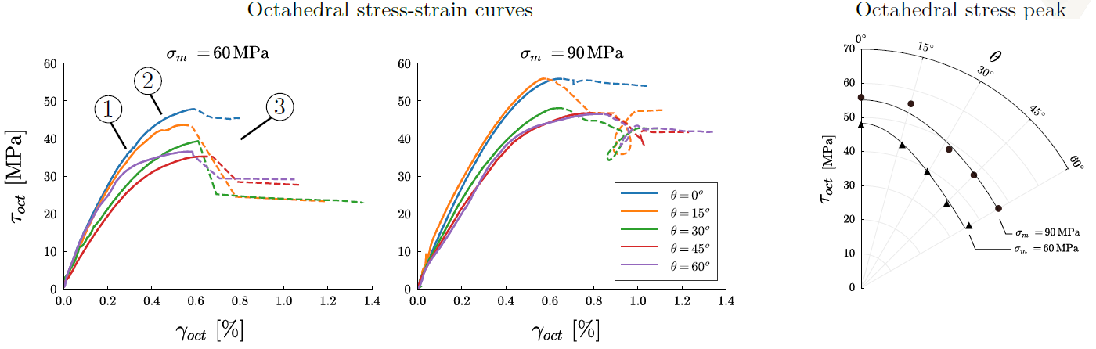
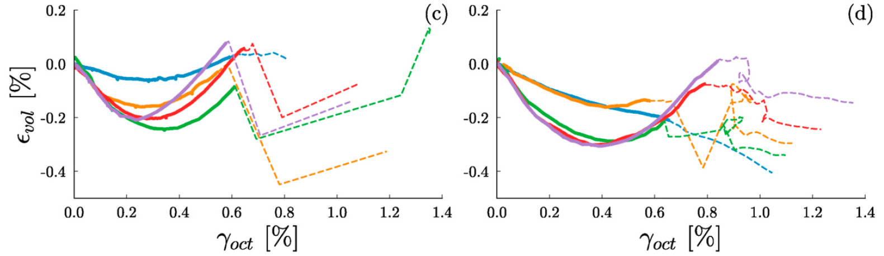
Strain Localisation & small scale Deformation in Sandstone
Experimental campaign #2 on the isotropic Vosges sandstone: (coll. C. Couture)
  True triaxial tests at 2 constants mean stress [60 & 90 MPa] and 5 constant Lode angles [0-60°]
C. Couture, 2021, Mechanical characterization of porous sandstones in true triaxial conditions : diffuse and localized deformation, effect of anisotropy, PhD thesis Univ. Grenoble.
Notes:
Mechanical characterisation. On the right, peak stress in the deviatoric plane.

Slide 16
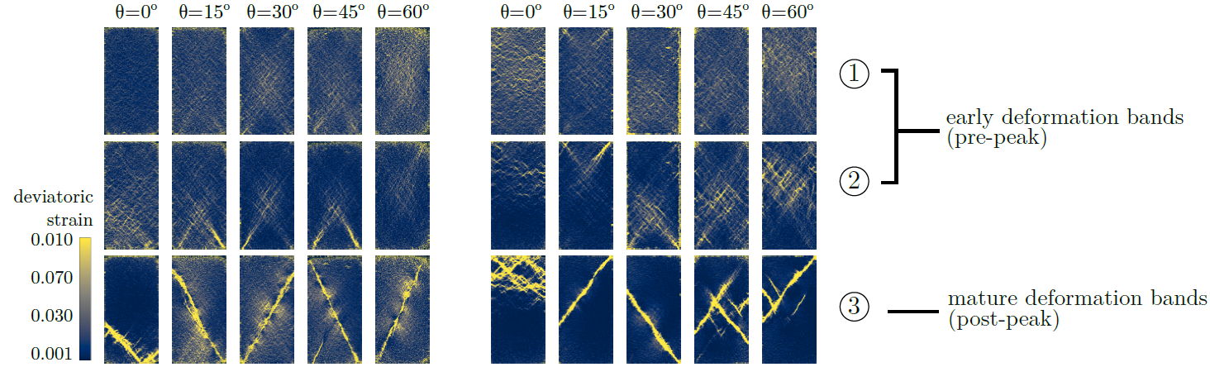
Strain Localisation & small scale Deformation in Sandstone
Experimental campaign #2 on the isotropic Vosges sandstone: (coll. C. Couture)
  True triaxial tests at 2 constants mean stress [60 & 90 MPa] and 5 constant Lode angle [0-60°]
(increment)
Notes:
Observed strain localisation patterns (steps 1-3) for the two mean stresses and the five Lode angles

Slide 17

Strain Localisation & small scale Deformation in Sandstone
Experimental campaign #2 on the isotropic Vosges sandstone: (coll. C. Couture)
  True triaxial tests at 2 constants mean stress [60 & 90 MPa] and 5 constant Lode angle [0-60°]
(increment)
Notes:
zoom

Slide 18
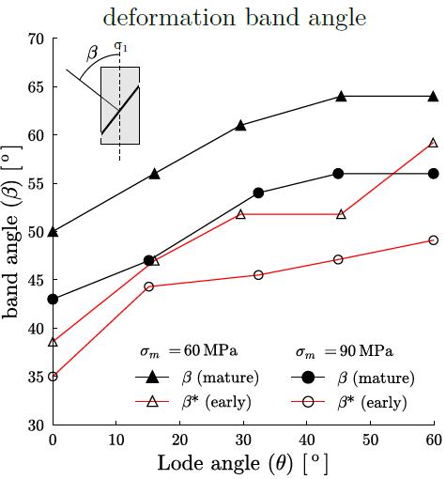
Strain Localisation & small scale Deformation in Sandstone
Experimental campaign #2 on the isotropic Vosges sandstone: (coll. C. Couture)
  True triaxial tests at 2 constants mean stress [60 & 90 MPa] and 5 constant Lode angle [0-60°]
Notes:
Effect of the Lode angle on the shear band orientation (on the rigth)

Slide 19
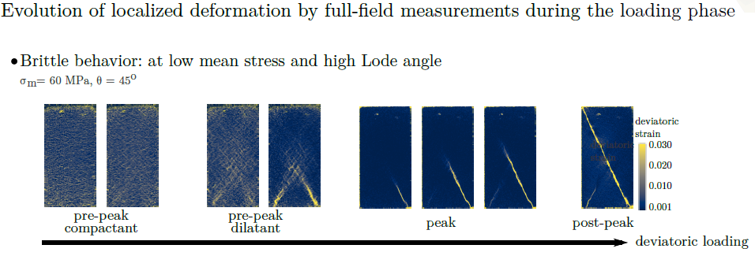
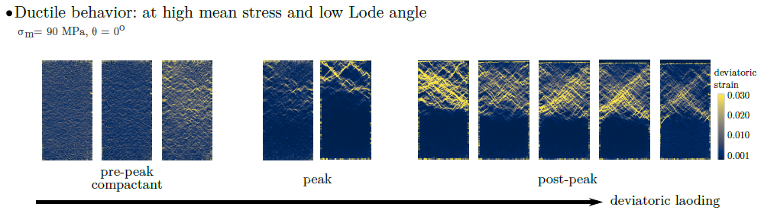
Strain Localisation & small scale Deformation in Sandstone
Experimental campaign #2 on the isotropic Vosges sandstone: (coll. C. Couture)
  True triaxial tests at 2 constants mean stress [60 & 90 MPa] and 5 constant Lode angles
C. Couture, 2021, Mechanical characterization of porous sandstones in true triaxial conditions : diffuse and localized deformation, effect of anisotropy, PhD thesis Univ. Grenoble.
Notes:
The brittle-ductile transition, a combined effect of the mean stress AND the Lode angle.

Slide 20
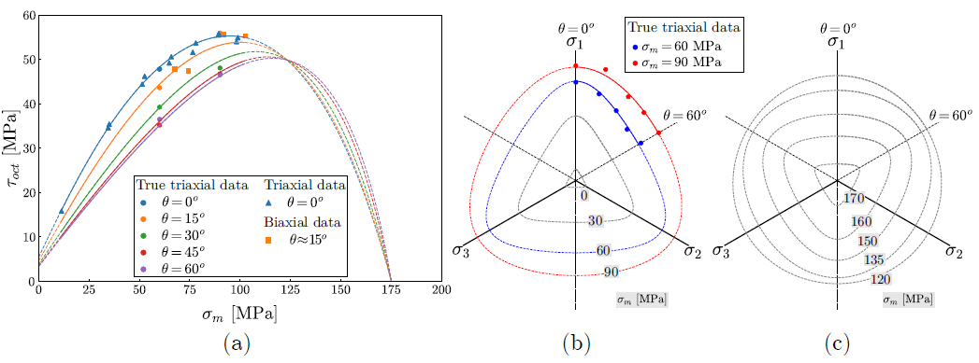
Strain Localisation & small scale Deformation in Sandstone
Experimental campaign #2 on the isotropic Vosges sandstone: (coll. C. Couture)
  True triaxial tests at 2 constants mean stress [60 & 90 MPa] and 5 constant Lode angles
C. Couture, 2021, Mechanical characterization of porous sandstones in true triaxial conditions : diffuse and localized deformation, effect of anisotropy, PhD thesis Univ. Grenoble.
Couture C., Bésuelle P., 2023, Three-invariants model and bifurcation analysis of deformation bands for a sandstone subjected to true triaxial loading paths, Acta Geotechnica, doi.org/10.1007/s11440-023-01811-w
Notes:
Enveloppe of the stress peaks for various mean stresses and Lode angle.

Slide 21
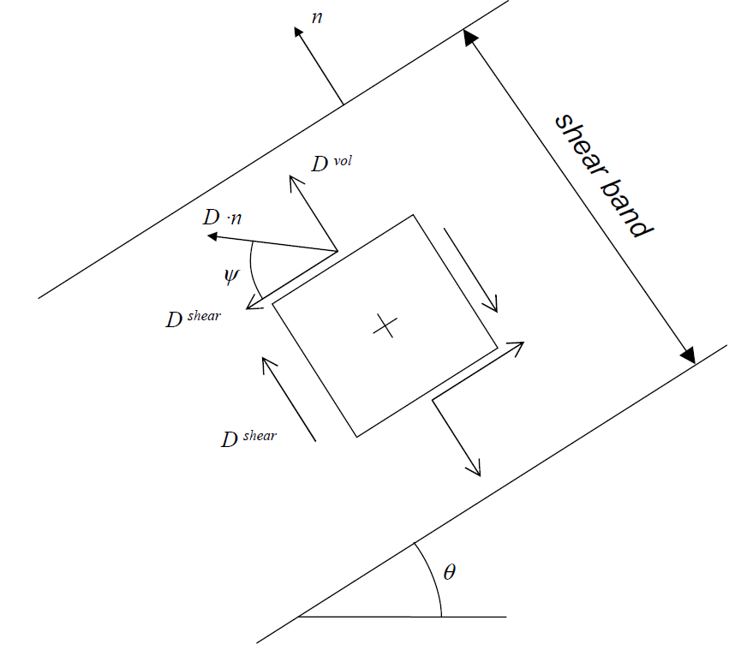

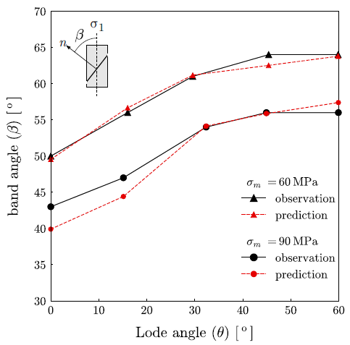
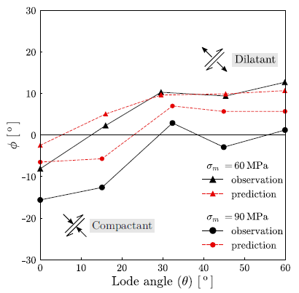
Strain Localisation & small scale Deformation in Sandstone
Experimental campaign #2 on the isotropic Vosges sandstone: (coll. C. Couture)
  True triaxial tests at 2 constants mean stress [60 & 90 MPa]
  Shear band dilatancy angle [Bésuelle, 2001]:
    Shearing with compaction: φ < 0°
    Shearing with dilation: φ > 0° and 5 constant Lode angles
Comparison of the shear band orientation (th vs. exp)
Comparison of the shear band dilatancy angle (th vs. exp)
C. Couture, 2021, Mechanical characterization of porous sandstones in true triaxial conditions : diffuse and localized deformation, effect of anisotropy, PhD thesis Univ. Grenoble.
Notes:
What about volume strain associated to shear strain inside band. Dilating and compacting shear bands.

Slide 22
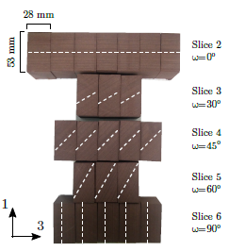
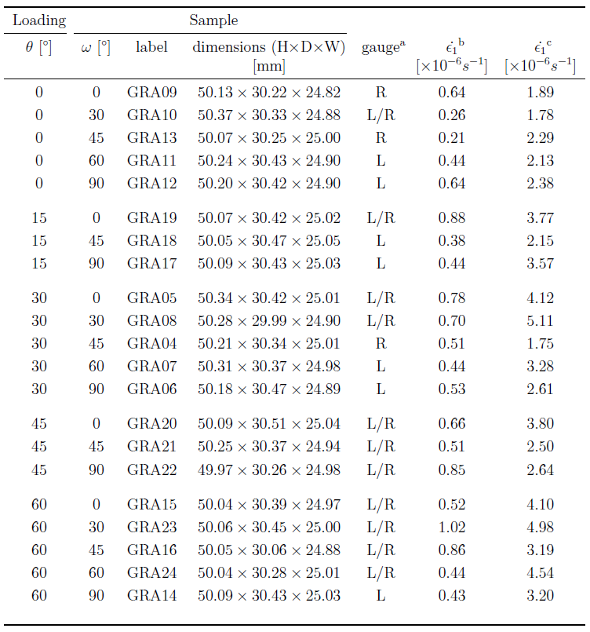
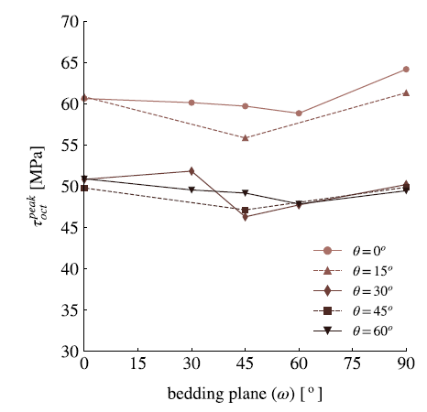
Strain Localisation & small scale Deformation in Sandstone
Experimental campaign #3 on the anisotropic Vosges sandstone: (coll. C. Couture)
  True triaxial tests at constant mean stress [90 MPa]
  Several Lode angles [0 - 60 °]
  Several bedding orientations [0 – 90 °]
C. Couture, 2021, Mechanical characterization of porous sandstones in true triaxial conditions : diffuse and localized deformation, effect of anisotropy, PhD thesis Univ. Grenoble.
Notes:
Introduction of the experimental campaign on the anisotropic sandstone.

Slide 23
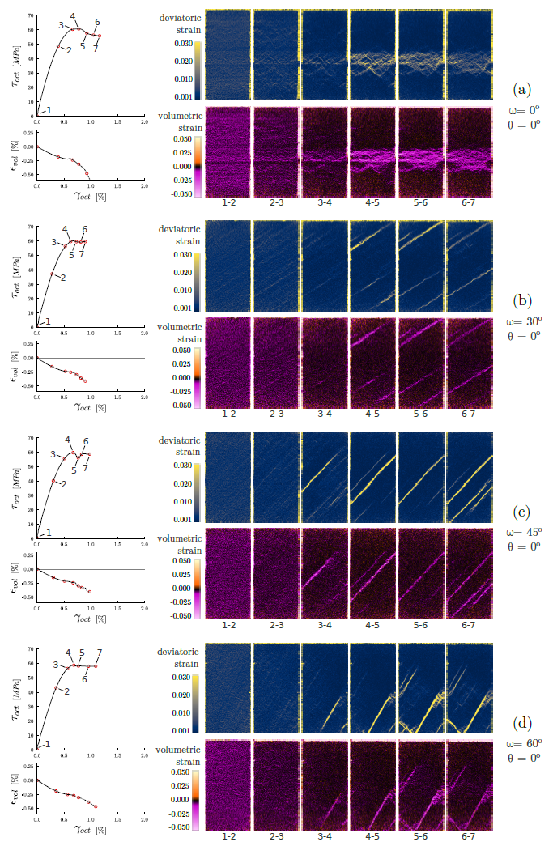
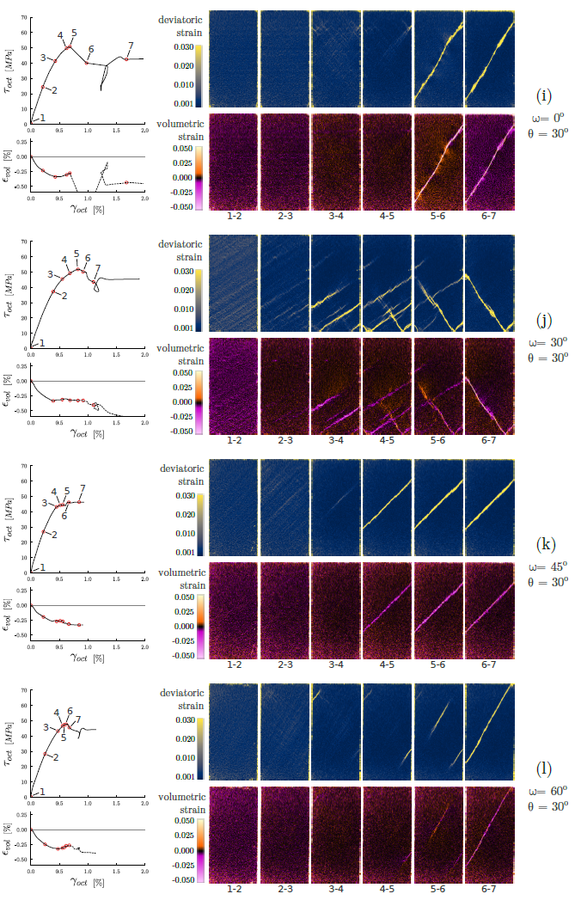
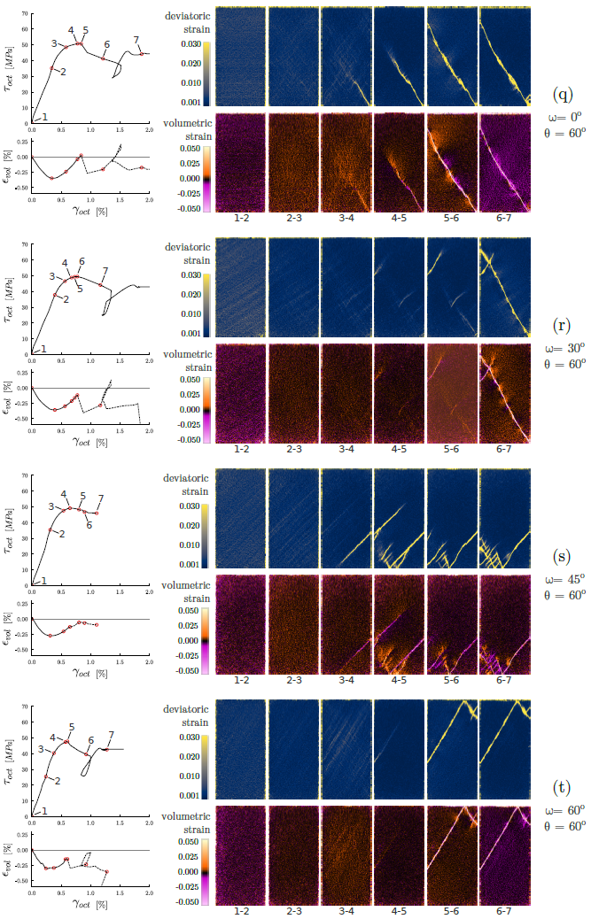
Strain Localisation & small scale Deformation in Sandstone
Experimental campaign #3 on the anisotropic Vosges sandstone: (coll. C. Couture)
  True triaxial tests at constant mean stress [90 MPa]
  Several Lode angles θ [0 - 60 °]
  Several bedding orientations ω [0 – 90 °]
θ = 0 °
θ = 30 °
θ = 60 °
C. Couture, 2021, Mechanical characterization of porous sandstones in true triaxial conditions : diffuse and localized deformation, effect of anisotropy, PhD thesis Univ. Grenoble.
Notes:
For a given mean stress value, time evolution ot the shear strain fields for selected values of Lode angles and bedding orientations. How the strain localisation pattern can be influenced by the bedding.

Slide 24
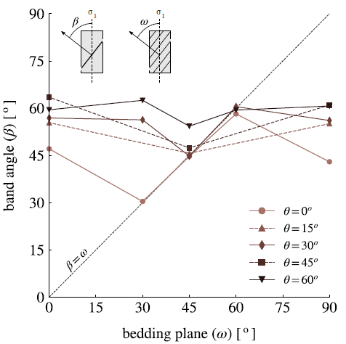
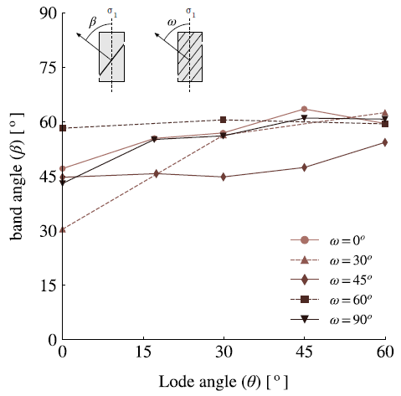
Strain Localisation & small scale Deformation in Sandstone
Experimental campaign #3 on the anisotropic Vosges sandstone: (coll. C. Couture)
  True triaxial tests at constant mean stress [90 MPa]
  Several Lode angles [0 - 60 °]
  Several bedding orientations [0 – 90 °]
Shear band orientation vs. bedding orientation and Lode angle
C. Couture, 2021, Mechanical characterization of porous sandstones in true triaxial conditions : diffuse and localized deformation, effect of anisotropy, PhD thesis Univ. Grenoble.
Notes:
Attractor effect of the bedding on localisation, when bedding orientation is closed to the ‘natural’ shear band orientation.

Slide 25
Strain Localisation & small scale Deformation in Sandstone
Experimental campaign #1 on the isotropic Vosges sandstone: (coll. P. Lanatà)
  Plane strain compression tests (ε₂ = 0) with different minor stress σ₃ values [20-50 MPa]
  Damage characterisation by post mortem observations (SEM) for test at 50 MPa
  Thin slice close to the observed surface, SEM analysis & shear strain field overlapping
Zone in the main shear band (active in post-peak regime)
Zone in an early shear band
(de-activated in post-peak regime)
P. Lanatà, 2015, Full-field experimental characterization of mechanical behaviour and failure in porous rock in plane strain compression: homogeneous deformation and strain localization, PhD thesis Univ. Grenoble.
Notes:
Now, post mortem observation by SEM. Two selected areas in the major shear band and in a de-activated early band.

Slide 26
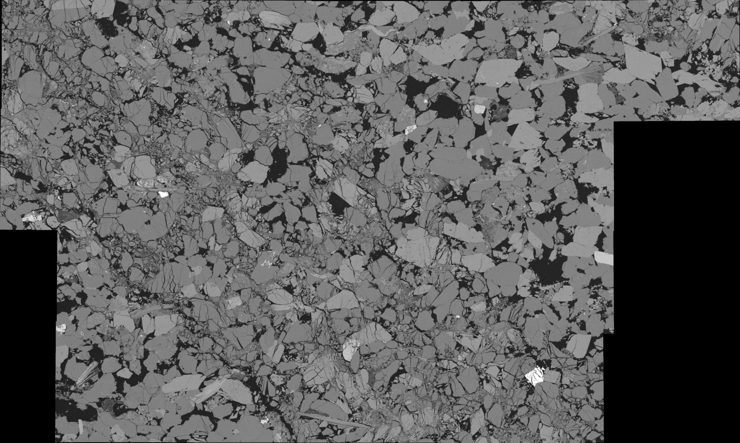
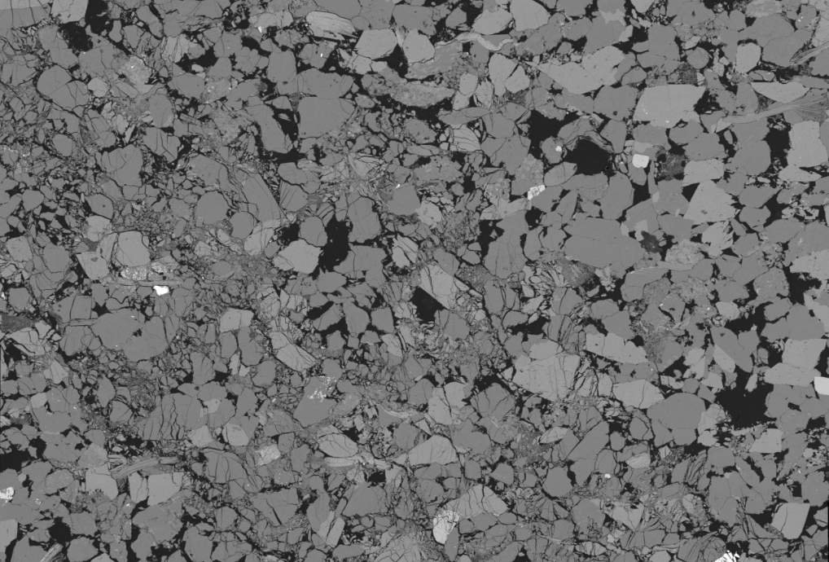
Strain Localisation & small scale Deformation in Sandstone
Experimental campaign #1 on the isotropic Vosges sandstone: (coll. P. Lanatà)
  Plane strain compression tests (ε₂ = 0) with different minor stress σ₃ values [20-50 MPa]
  Damage characterisation by post mortem observations (SEM) for test at 50 MPa
Zone in the main shear band (active in post-peak regime)
µm
px
I2
1,4
A1
A1
B
B
0,7
B1
B1
100 μm
A
100 μm
A
100 μm
B1
0
100 μm
A1+B
100 μm
A
I1
R
P. Lanatà, 2015, Full-field experimental characterization of mechanical behaviour and failure in porous rock in plane strain compression: homogeneous deformation and strain localization, PhD thesis Univ. Grenoble.
Notes:
Cataclastic deformation in the major band.

Slide 27
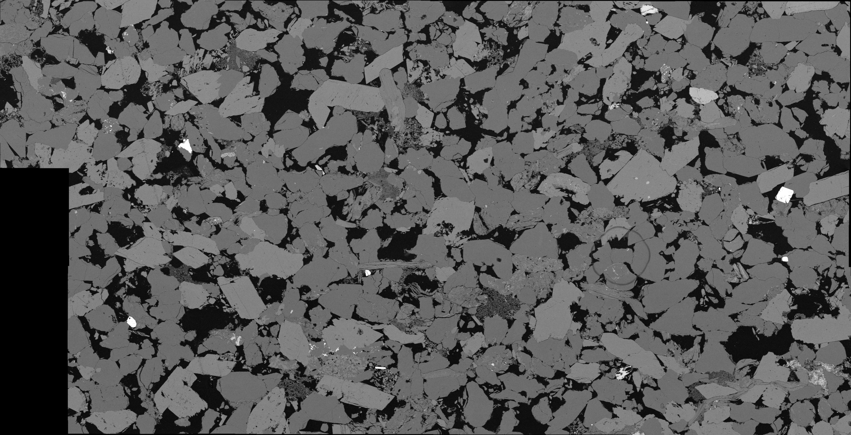


Strain Localisation & small scale Deformation in Sandstone
Experimental campaign #1 on the isotropic Vosges sandstone: (coll. P. Lanatà)
  Plane strain compression tests (ε₂ = 0) with different minor stress σ₃ values [20-50 MPa]
  Damage characterisation by post mortem observations (SEM) for test at 50 MPa
Zone in an early shear band (de-activated in post-peak regime)
px
µm
I2
0,14
B1
B1
0,07
100 μm
B1
100 μm
100 μm
A
A
100 μm
A
0
P. Lanatà, 2015, Full-field experimental characterization of mechanical behaviour and failure in porous rock in plane strain compression: homogeneous deformation and strain localization, PhD thesis Univ. Grenoble.
Notes:
Light damage in the de-activated early band

Slide 28
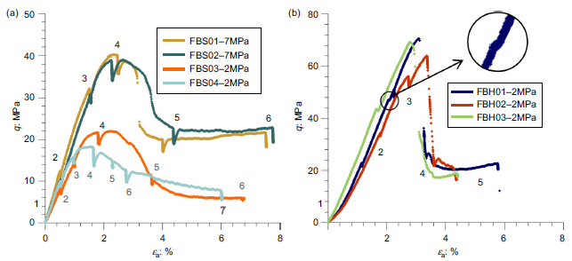
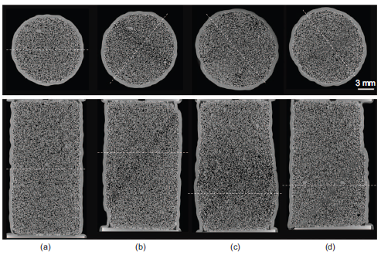

Strain Localisation & small scale Deformation in Sandstone
Experimental campaign #4 on Fontainebleau sandstones: (coll. J. Fonseca & C. Viggiani)
  Axisymetric compression tests at 2 & 7 MPa confining pressures
  Damage characterisation by in operando x-ray CT (3SR)
Soft FBS03-2MPa FBS04-2MPa FBS02-7MPa
Stiff FBH01-2MPa at different loading steps
1
6
7
6
1
2
3
4
J. Fonseca, P. Bésuelle, C. Viggiani, 2013, Micromechanisms of inelastic deformation in sandstones: an insight using x-ray micro-tomography, Géotechnique Letters, vol. 3 n° 2, pp 78-83.
Notes:
Now, 3D observations thanks to in operando x-ray CT. Two Fontainebleau sandstones, one soft (porous), the other stiff (less porous).

Slide 29


Strain Localisation & small scale Deformation in Sandstone
Experimental campaign #4 on Fontainebleau sandstones: (coll. J. Fonseca & C. Viggiani)
  Damage characterisation by in operando x-ray CT --- SOFT Sandstone
  Strain localisation observed visually after peak stress
  No damage observed before peak, given the x-ray CT scan resolution (8.5 µm) – however could possibly start before
  Intra-granular cracking at peak, small fragments, grain rearrangement.
  Cracking initiates at grain contact, depending on the contact surface, with sub-vertical alignement, influenced by the grain coordination
Soft FBS03-2MPa FBS04-2MPa FBS02-7MPa
1
6
7
6
J. Fonseca, P. Bésuelle, C. Viggiani, 2013, Micromechanisms of inelastic deformation in sandstones: an insight using x-ray micro-tomography, Géotechnique Letters, vol. 3 n° 2, pp 78-83.
Notes:
Grains cracking for the soft sandstone. Effect the grain-to-grain contact shape.

Slide 30

Strain Localisation & small scale Deformation in Sandstone
Experimental campaign #4 on Fontainebleau sandstones: (coll. J. Fonseca & C. Viggiani)
  Damage characterisation by in operando x-ray CT --- STIFF Sandstone
  Strain localisation observed before peak stress
  Damaging of the cement between grains, along vertical ridges, formation of vertical columns of horizontaly undounded grains
  Intra-granular cracking inhibited dut to extended grain contacts
  As shearing progresses, vertical columns eventually collapse, unbounded grains increases shear band thickness
Stiff FBH01-2MPa at different loading steps
1
2
3
4
J. Fonseca, P. Bésuelle, C. Viggiani, 2013, Micromechanisms of inelastic deformation in sandstones: an insight using x-ray micro-tomography, Géotechnique Letters, vol. 3 n° 2, pp 78-83.
Notes:
Grain debonding in the stiff sandstone to form sub-axial columns.

Slide 31
Outline
Introduction
Materials
  Red Vosges sandstone
  Callovo-Oxfordian clay rock
Experimental loading devices and in situ full field measurements
  True triaxial cell with 2D-imaging
  Triaxial cells for lab and synchrotron x-ray CT
Strain localisation and small scale deformation in sandstone
  Strain localisation macro-scale characterisation (2D-DIC)
  2D post mortem meso-scale analysis (SEM)
  3D in situ meso-scale analysis (lab x-ray CT)
Strain localisation and small scale deformation in a clay rock
  Strain localisation macro-scale characterisation (2D-DIC)
  2D post mortem micro-scale analysis (BIB-SEM)
  3D in situ meso-scale analysis (ESRF ID19 x-ray CT + 3D-ηDIC)
Conclusions

Slide 32

Strain Localisation & small scale Deformation in a Clay Rock
Experimental campaign #1 on the Callovo-Oxfordian clay rock:
  Plane strain compression tests (ε₂ = 0) with different minor stress σ₃ values [2-20 MPa]
  Horizontal bedding
  Prismatic specimen size: H 50 mm, W 25 mm, T 30 mm
peak values in I₂ vs. p
σ₁- σ₃ [MPa]
ε₁
deviatoric plane
ε_{v}
Notes:
The same with a clay rock

Slide 33


Strain Localisation & small scale Deformation in a Clay Rock
Experimental campaign #1 on the Callovo-Oxfordian clay rock:
  Plane strain compression tests (ε₂ = 0) with different minor stress σ₃ values [2-20 MPa]
σ₃ = 2 MPa
σ₃ = 12 MPa
Notes:
Two examples of the time evolution of the incremental shear strain fields for a low and higher confining pressures.

Slide 34
Strain Localisation & small scale Deformation in a Clay Rock
Experimental campaign #1 on the Callovo-Oxfordian clay rock:
  Plane strain compression tests (ε₂ = 0) with different minor stress σ₃ values [2-20 MPa]
normal gap
tangential gap
σ₃ = 2 MPa
σ₃ = 12 MPa
Notes:
Normal and tangential components the displacement jump.

Slide 35



Strain Localisation & small scale Deformation in a Clay Rock
Experimental campaign #2 on the Callovo-Oxfordian clay rock:
  Plane strain compression tests (ε₂ = 0) with two minor stress σ₃ values [2 & 12 MPa]
  Assessment of anisotropy: effect of bedding orientation
σ₃ = 2 MPa
σ₃ = 12 MPa
peak stress vs. bedding orientation
σ₁- σ₃ [MPa]
ε₁
ε_{v}
Notes:
Anisotropy in the clay rock on mechanical response

Slide 36




Strain Localisation & small scale Deformation in a Clay Rock
Experimental campaign #2 on the Callovo-Oxfordian clay rock:
  Plane strain compression tests (ε₂ = 0) with two minor stress σ₃ values [2 & 12 MPa]
  Assessment of anisotropy: effect of bedding orientation
12°
15°
24°
53°
80°
σ₃ = 2 MPa
Fault orientation [°]
Fault // bedding
Bedding orientation [°]
0°
45°
50°
77°
σ₃ = 12 MPa
Fault orientation [°]
Fault // bedding
Bedding orientation [°]
Notes:
Examples of possible interactions between bedding and shear localisation.

Slide 37


Strain Localisation & small scale Deformation in a Clay Rock
Experimental campaign #1 on the Callovo-Oxfordian clay rock: (coll. G. Dubois, J. Urai et al.)
  Plane strain compression tests (ε₂ = 0) with different minor stress σ₃ values [2-20 MPa]
  Microstructure observation by BIB-SEM
Desbois G., Höhne N., Urai J.L., Bésuelle P., Viggiani G., 2017, Deformation in cemented mudrock (Callovo-Oxfordian Clay) by microcracking, granular flow and phyllosilicate plasticity: insights from triaxial deformation, broad ion beam polishing and scanning electron microscopy, Solid Earth, vol. 8, pp. 291-305. .
Notes:
Hight resolution observations by BIB-SEM of the microstructure after unloading in four selected areas.

Slide 38


Strain Localisation & small scale Deformation in a Clay Rock
Experimental campaign #1 on the Callovo-Oxfordian clay rock: (coll. G. Dubois, J. Urai et al.)
  Plane strain compression tests (ε₂ = 0) with different minor stress σ₃ values [2-20 MPa]
  Microstructure observation by BIB-SEM
ROI-2
Desbois G., Höhne N., Urai J.L., Bésuelle P., Viggiani G., 2017, Deformation in cemented mudrock (Callovo-Oxfordian Clay) by microcracking, granular flow and phyllosilicate plasticity: insights from triaxial deformation, broad ion beam polishing and scanning electron microscopy, Solid Earth, vol. 8, pp. 291-305. .
Notes:
In the cluster of conjugated bands

Slide 39

Strain Localisation & small scale Deformation in a Clay Rock
Experimental campaign #1 on the Callovo-Oxfordian clay rock: (coll. G. Dubois, J. Urai et al.)
  Plane strain compression tests (ε₂ = 0) with different minor stress σ₃ values [2-20 MPa]
  Microstructure observation by BIB-SEM
Desbois G., Höhne N., Urai J.L., Bésuelle P., Viggiani G., 2017, Deformation in cemented mudrock (Callovo-Oxfordian Clay) by microcracking, granular flow and phyllosilicate plasticity: insights from triaxial deformation, broad ion beam polishing and scanning electron microscopy, Solid Earth, vol. 8, pp. 291-305. .
Notes:
With the legend

Slide 40


Strain Localisation & small scale Deformation in a Clay Rock
Experimental campaign #1 on the Callovo-Oxfordian clay rock: (coll. G. Dubois, J. Urai et al.)
  Plane strain compression tests (ε₂ = 0) with different minor stress σ₃ values [2-20 MPa]
  Microstructure observation by BIB-SEM
Desbois G., Höhne N., Urai J.L., Bésuelle P., Viggiani G., 2017, Deformation in cemented mudrock (Callovo-Oxfordian Clay) by microcracking, granular flow and phyllosilicate plasticity: insights from triaxial deformation, broad ion beam polishing and scanning electron microscopy, Solid Earth, vol. 8, pp. 291-305. .
Notes:
In the major fault

Slide 41


Strain Localisation & small scale Deformation in a Clay Rock
Experimental campaign #1 on the Callovo-Oxfordian clay rock: (coll. G. Dubois, J. Urai et al.)
  Plane strain compression tests (ε₂ = 0) with different minor stress σ₃ values [2-20 MPa]
  Microstructure observation by BIB-SEM
Desbois G., Höhne N., Urai J.L., Bésuelle P., Viggiani G., 2017, Deformation in cemented mudrock (Callovo-Oxfordian Clay) by microcracking, granular flow and phyllosilicate plasticity: insights from triaxial deformation, broad ion beam polishing and scanning electron microscopy, Solid Earth, vol. 8, pp. 291-305. .
Notes:
Deduced scenario of mechanisms of deformation during loading

Slide 42


Strain Localisation & small scale Deformation in a Clay Rock
Experimental campaign #3 on the Callovo-Oxfordian clay rock: (coll. E. Ando et al.)
  Axisymetric compression tests with minor stress σ₃ value [5 & 20 MPa]
  Specimen size: 1 mm diameter, 2 mm height
  in operando X-ray CT at ID19 (ESRF): voxel size 0.7 µm
σ₁- σ₃ [MPa]
ε₁
100µm
10µm
Notes:
Now, high resolution 3D in operando images during triaxial loading on a very small sample. A complex microstructure with different mineral inclusions imbedded in a textured clay matrix.

Slide 43

Strain Localisation & small scale Deformation in a Clay Rock
Experimental campaign #3 on the Callovo-Oxfordian clay rock: (coll. E. Ando et al.)
  Axisymetric compression tests with minor stress σ₃ value [5 & 20 MPa]
  Specimen size: 1 mm diameter, 2 mm height
  in operando X-ray CT at ID19 (ESRF): voxel size 0.7 µm
Notes:
Time evolution of the meso-structure: faulting

Slide 44
Strain Localisation & small scale Deformation in a Clay Rock
Experimental campaign #3 on the Callovo-Oxfordian clay rock: (coll. E. Ando et al.)
  Axisymetric compression tests with minor stress σ₃ value [5 & 20 MPa]
  Specimen size: 1 mm diameter, 2 mm height
  in operando X-ray CT at ID19 (ESRF): voxel size 0.7 µm
Notes:
Zoom: grain debonding and faulting

Slide 45

Strain Localisation & small scale Deformation in a Clay Rock
Experimental campaign #3 on the Callovo-Oxfordian clay rock: (coll. E. Ando et al.)
  Axisymetric compression tests with minor stress σ₃ value [5 & 20 MPa]
  Specimen size: 1 mm diameter, 2 mm height
  in operando X-ray CT at ID19 (ESRF): voxel size 0.7 µm
  DIC (Spam) analysis - ongoing work with E. Ando and O. Stamati
    Continuous DIC: many ‘homogenous’ (without texture) mineral inclusions !
    Discrete DIC: ok for mineral inclusions (if powerfull grain segmentation…), not for clay matrix !
    Mixing continuous + discrete: ok for both clay matrix and mineral inclusions
    Ongoing task: improving grain segmentation
      Based on both grey level + variance: ok but…
      Deep learning ?
    Objectives: quantify micro-mechanisms of deformation at mesoscale (grain debonding, grain breakage, etc…)
X-ray CT + discrete V-DIC on a sand [Ando, 2015]
Notes:
V-DIC measurement (in progress work)

Slide 46
Strain Localisation & small scale Deformation in a Clay Rock
Experimental campaign #3 on the Callovo-Oxfordian clay rock: (coll. E. Ando et al.)
  Axisymetric compression tests with minor stress σ₃ value [5 & 20 MPa]
  Specimen size: 1 mm diameter, 2 mm height
  in operando X-ray CT at ID19 (ESRF): voxel size 0.7 µm
Notes:
Time evolution of the incremental shear strain field

Slide 47

Strain Localisation & small scale Deformation in a Clay Rock
Self-sealing experiment on the Callovo-Oxfordian clay rock: (coll. A. Di Donna et al.)
  Self-sealing experiment with synthetic crack
  Specimen size: 12 mm diameter, 20 mm height
  Oedometric conditions
  in operando X-ray CT at 3SR Lab & ID19 (ESRF): voxel size 0.7 µm
Di Donna A., Charrier P., Dijkstra J., Andò E., Bésuelle P., 2022, The contribution of swelling to self-sealing of claystone studied through x-ray tomography, Phys. Chem. Earth, Part A, vol. 127, pp. 103191, doi : 10.1016/j.pce.2022.103191.
Notes:
Not presented – sealf sealing tests in the clay rock.

Slide 48


Strain Localisation & small scale Deformation in a Clay Rock
Self-sealing experiment on the Callovo-Oxfordian clay rock: (coll. A. Di Donna et al.)
  Self-sealing experiment with synthetic crack
  Specimen size: 12 mm diameter, 20 mm height
  Oedometric conditions
  in operando X-ray CT at 3SR Lab & ID19 (ESRF): voxel size 0.7 µm
3SR x-ray CT
voxel size 7.5 µm
10’
ID19 x-ray CT
voxel size 0.7 µm
5’
Di Donna A., Charrier P., Dijkstra J., Andò E., Bésuelle P., 2022, The contribution of swelling to self-sealing of claystone studied through x-ray tomography, Phys. Chem. Earth, Part A, vol. 127, pp. 103191, doi : 10.1016/j.pce.2022.103191.
Notes:
Not presented – sealf sealing tests.
Hight resolution x-ray CT scans to observed a short-term sealing process by micro-faulting to fill the initial (synthetic) fault (before a long term swelling – not shown here)

Slide 49
Conclusions
3D full field measurement well adapted for axisymetric loading condition
True-triaxial loading accessible for 2D DIC
2D DIC fields used to define investigation zones by microscopy
  one can go back to the loading history if we identify zones that have been deactivated during loading
  However, post mortem analysis problematic
3D imaging: need to adapt the spatial resolution to the material microstructure:
  small specimen for fine microstructure, limits are evolving, however, technical difficulties
Notes:
The end.

