Slide 1
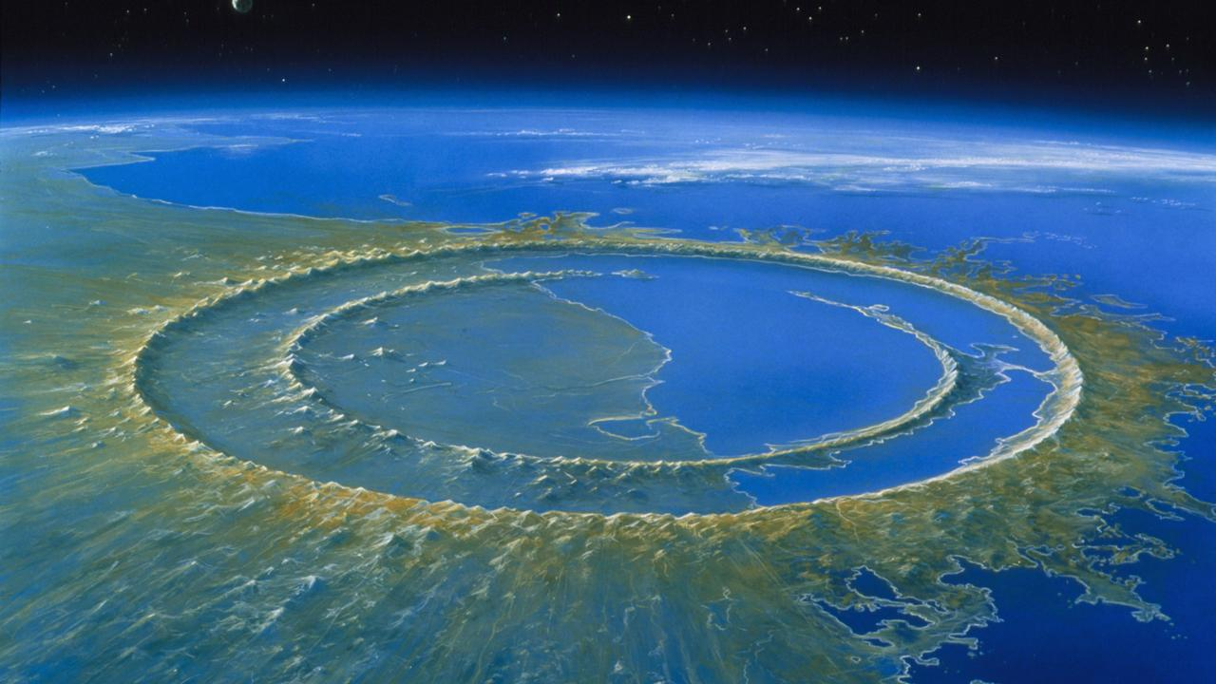


Seismic Explorations of Impact Structures*
Douglas R Schmitt
Purdue University
September 16, 2020
Colorado School of Mines
Bernd Milkereit, Marek Welz, Len Tober
Wei Xie, Todd Bown,
Chris Nixon, Randy Kofman
Brian Robataille + …….
* And some excellent adventures about
Notes:
Image from https://www.sciencemag.org/news/2016/11/updated-drilling-dinosaur-killing-impact-crater-explains-buried-circular-hills

Slide 2
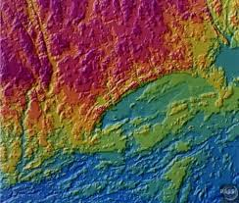
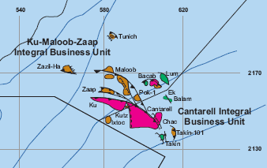
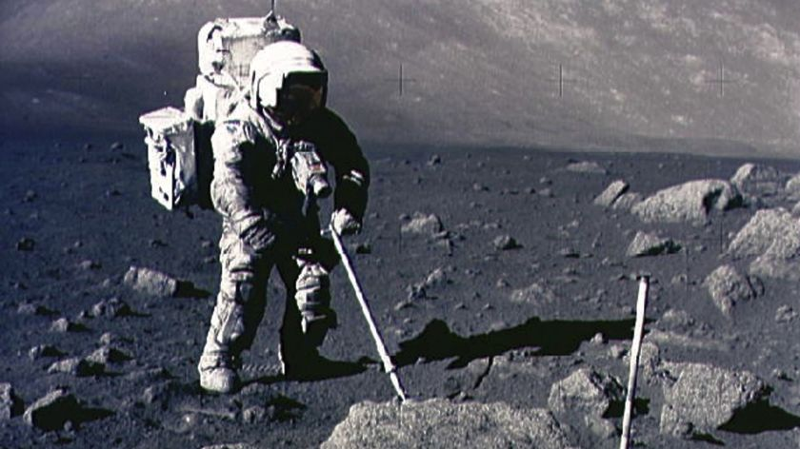
There are a number of reasons that studying impact structures is useful
Basic knowledge
Resources
‘Exploration & Development’ in solar system
Notes:
Seismic image at RedWing from thesis https://scholar.colorado.edu/concern/graduate_thesis_or_dissertations/7d278t31k

Slide 3
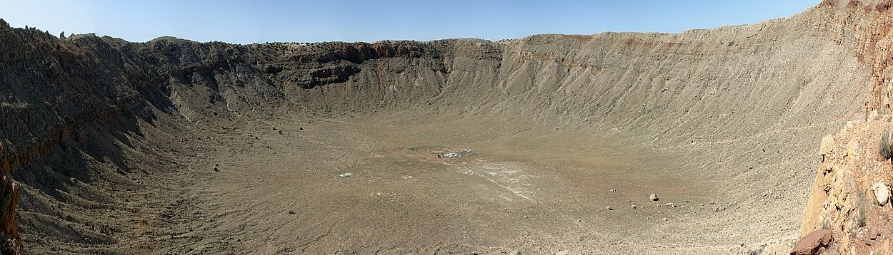
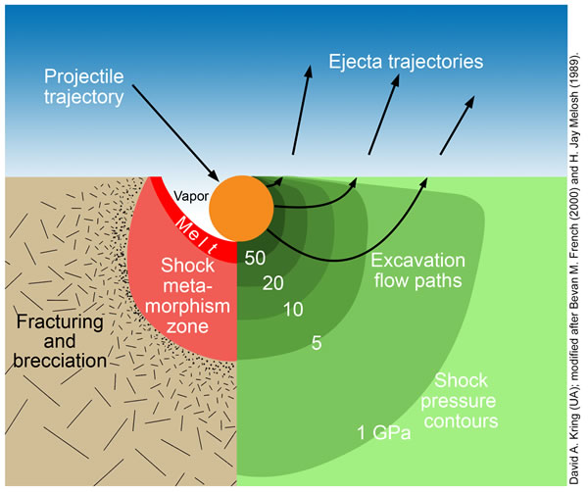
Impacts release large amounts of energy deforming and pressurizing materials
Density
Porosity
Seismic
Propagation
Magnetic
Electrical
By Kring modified after French, Melosh
Notes:
https://www.lpi.usra.edu/exploration/training/illustrations/craterMechanics/

Slide 4

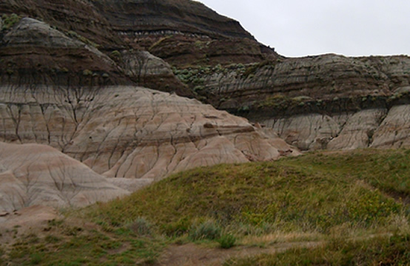
Adventure #3 – Chicxulub Impact Structure
K-Pg Boundary

Slide 5
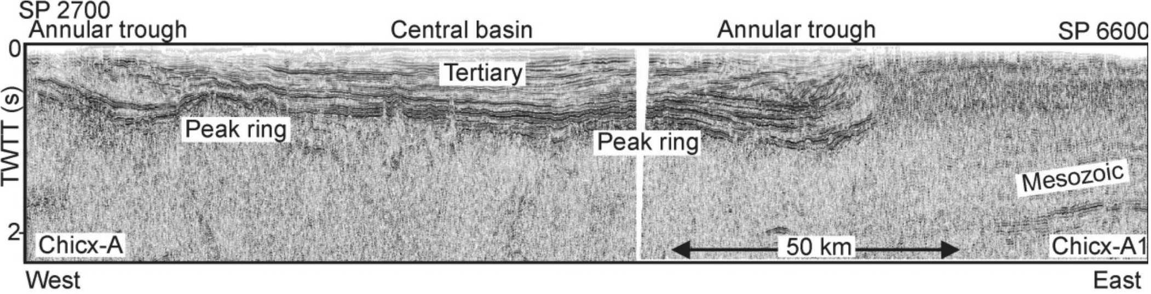
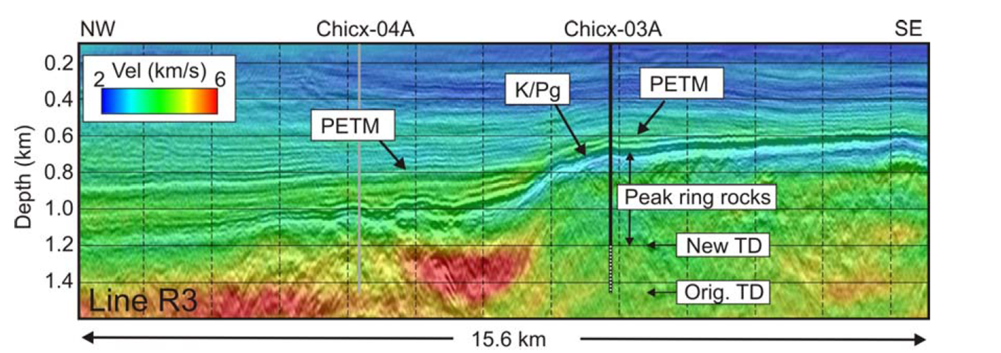
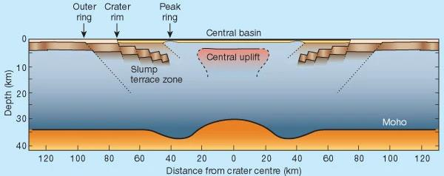
Melosh, 2001
Bell et al, 2003
Notes:
http://craterexplorer.ca/chicxulub-impact-structure/
Seismic section originally at 1. BELL, C., et al., Stratigraphic and sedimentological observations from seismic data across the Chicxulub impact basin. Meteoritics & Planetary Science, 2004. 39(7): p. 1089-1098.
Cartoon from 1. Melosh, J., Geophysics - Deep down at chicxulub. Nature, 2001. 414(6866): p. 861-862.

Slide 6
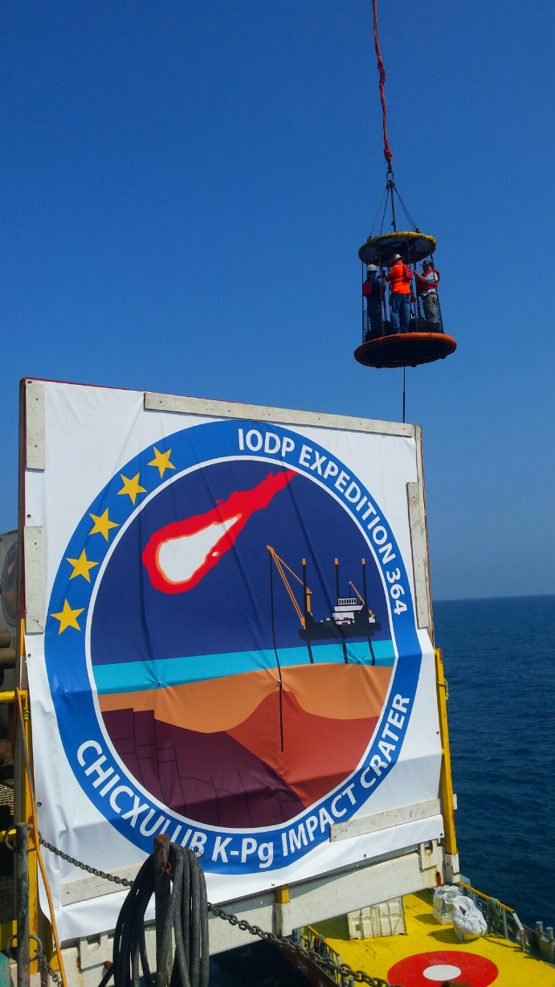

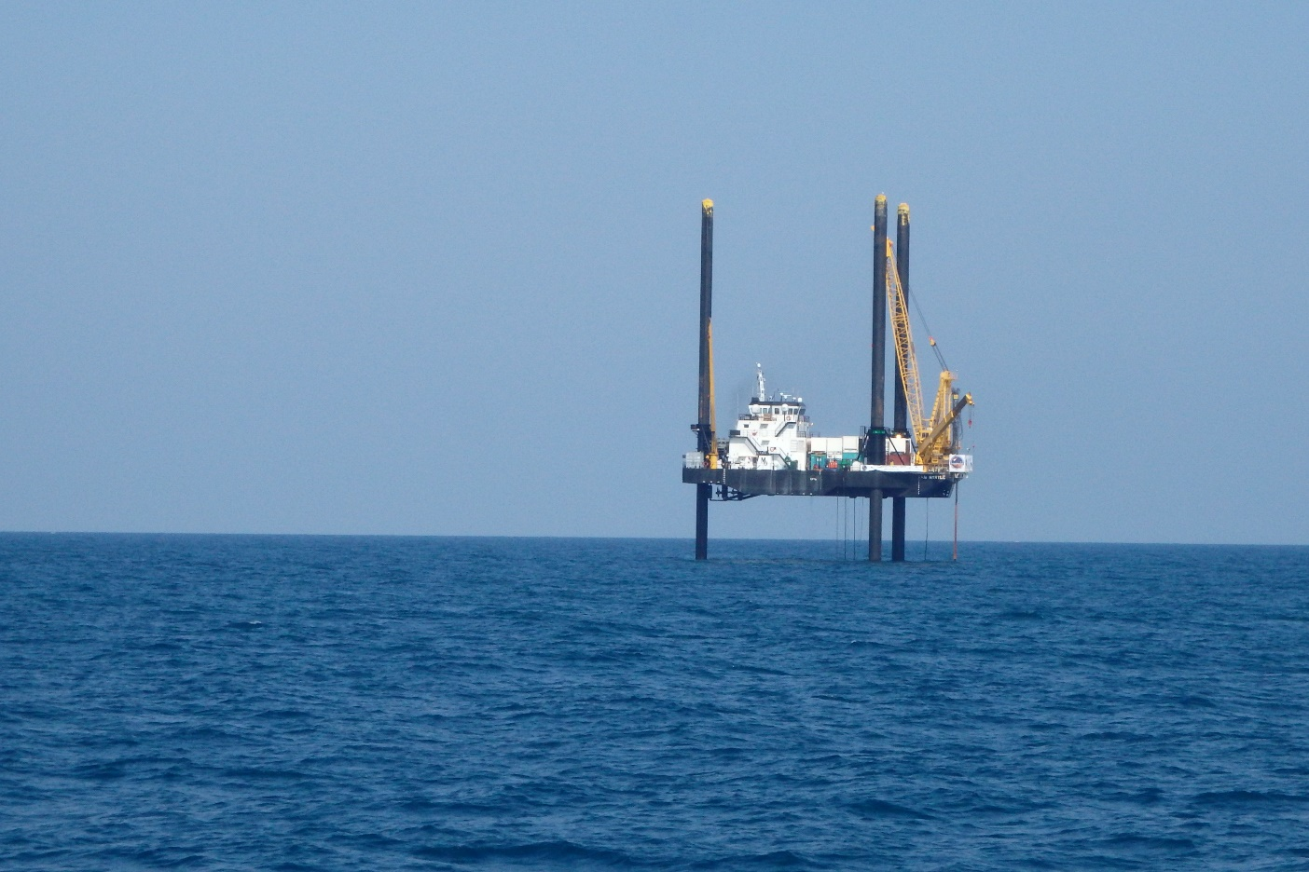
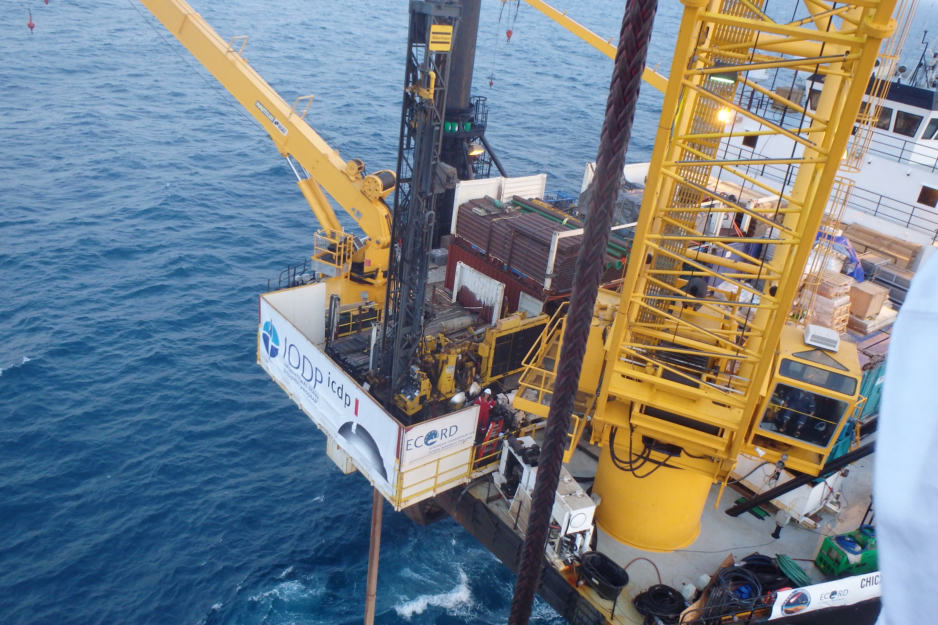
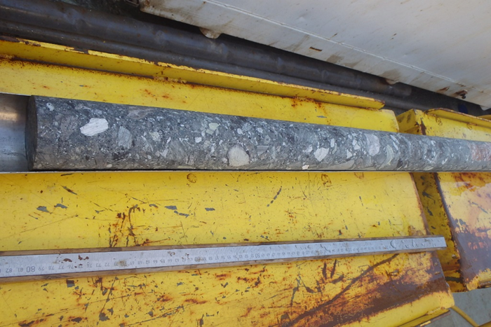
Drilling into Chicxulub to test the ideas of its formation – ICDP/IODP Expedition 364

Slide 7
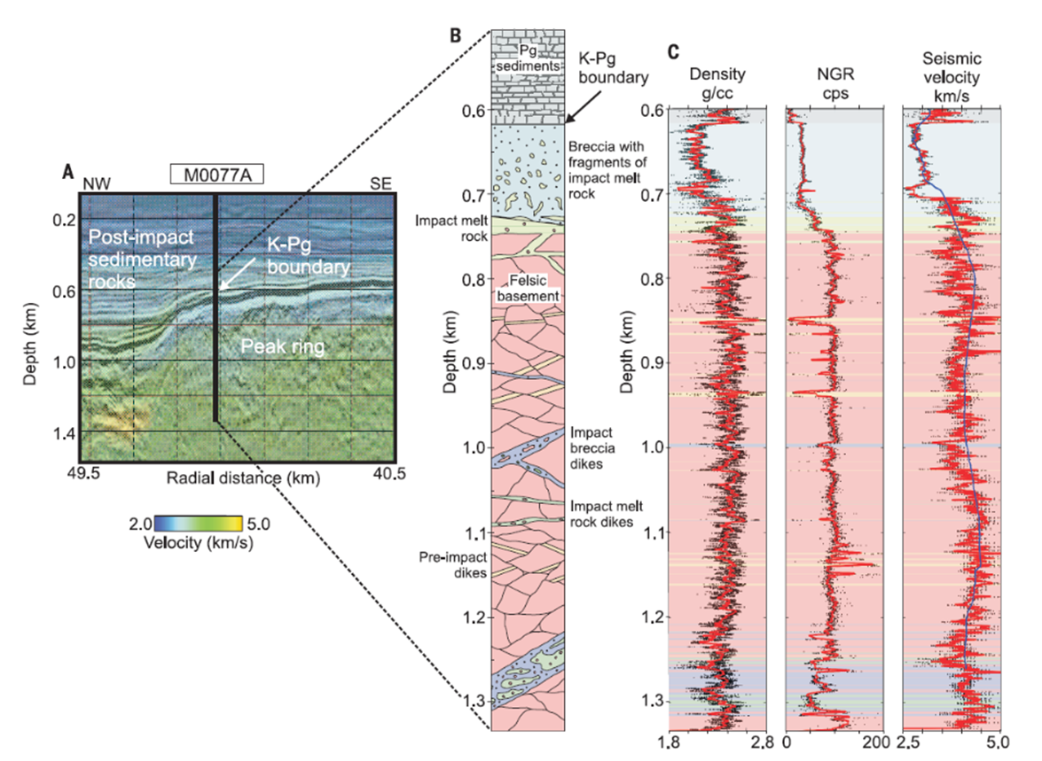
Christesen et al, 2018

Slide 8
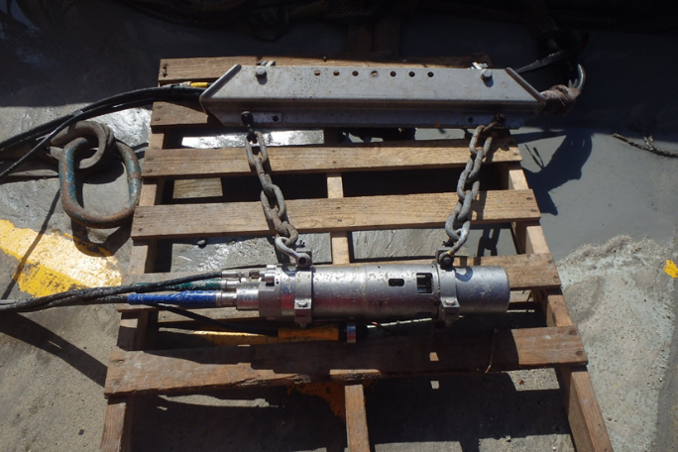
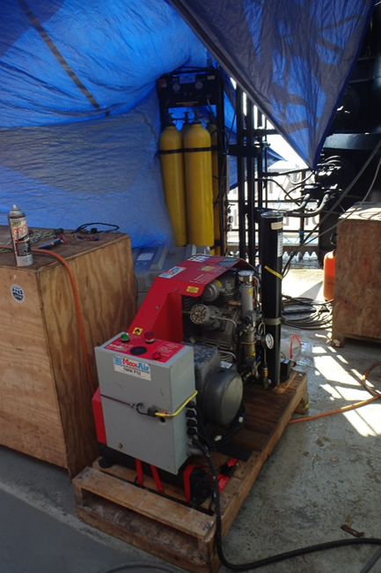
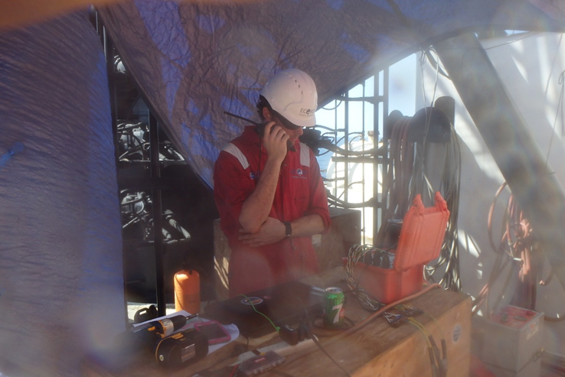
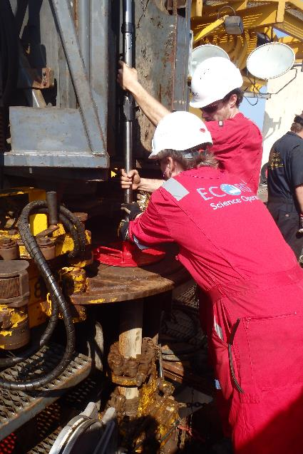

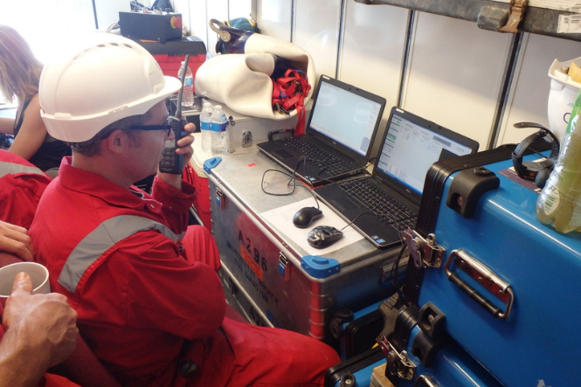
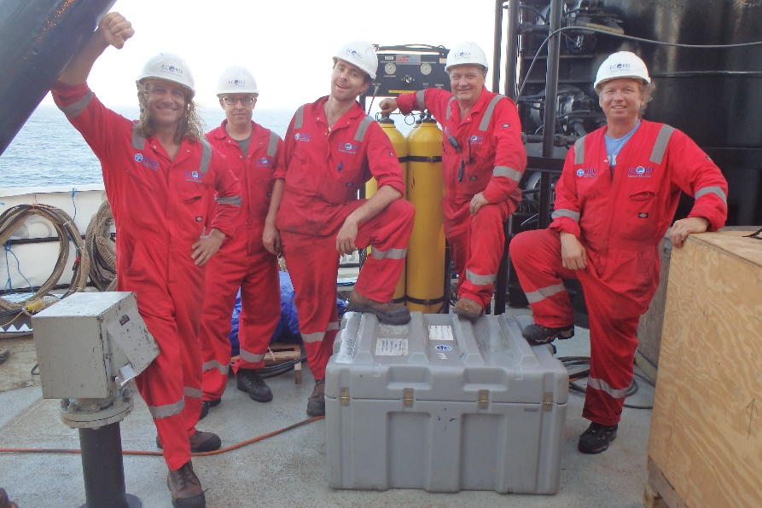
Chicxulub – Vertical Seismic Profiling
Notes:
Vertical seismic profling carried out to]
Calibrate Seismic Data
Examine in situ reflectivity in detail
Determine in situ velocities at seismic frequency
Understand scattering/attenuation within the highly shocked materials.

Slide 9
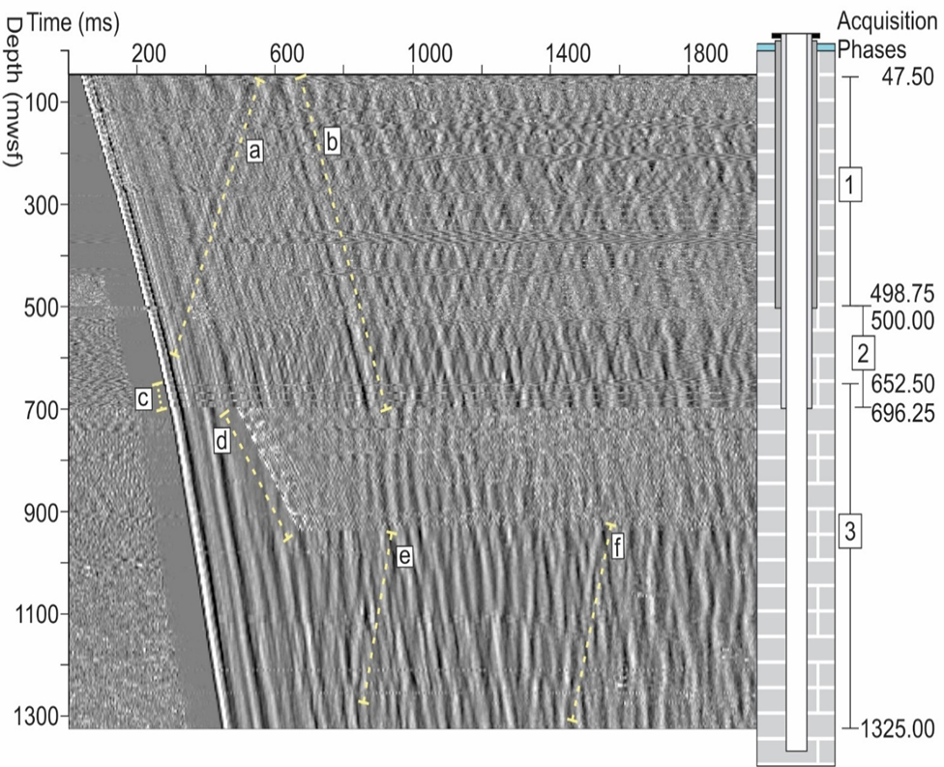
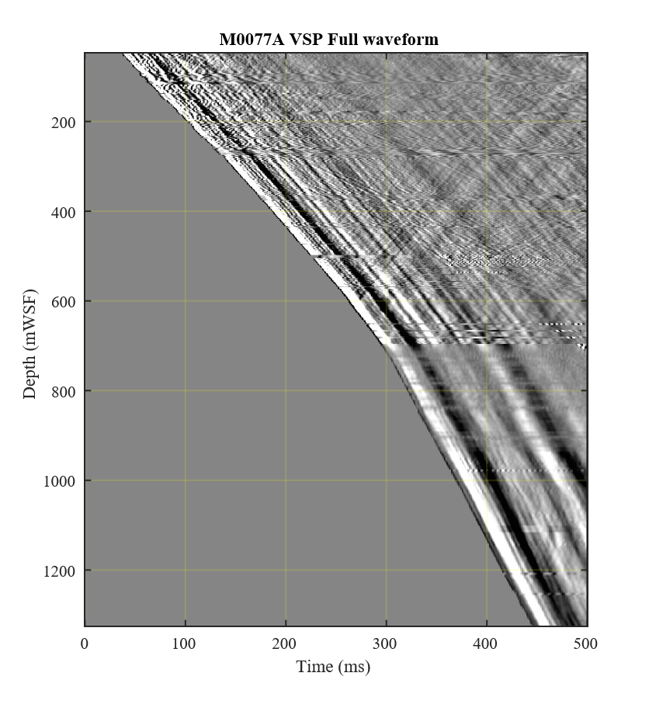
Raw VSP data shows reflections and distinct zones down borehole
2285 m/s
2567 m/s
2970 m/s
4236 m/s

Slide 10
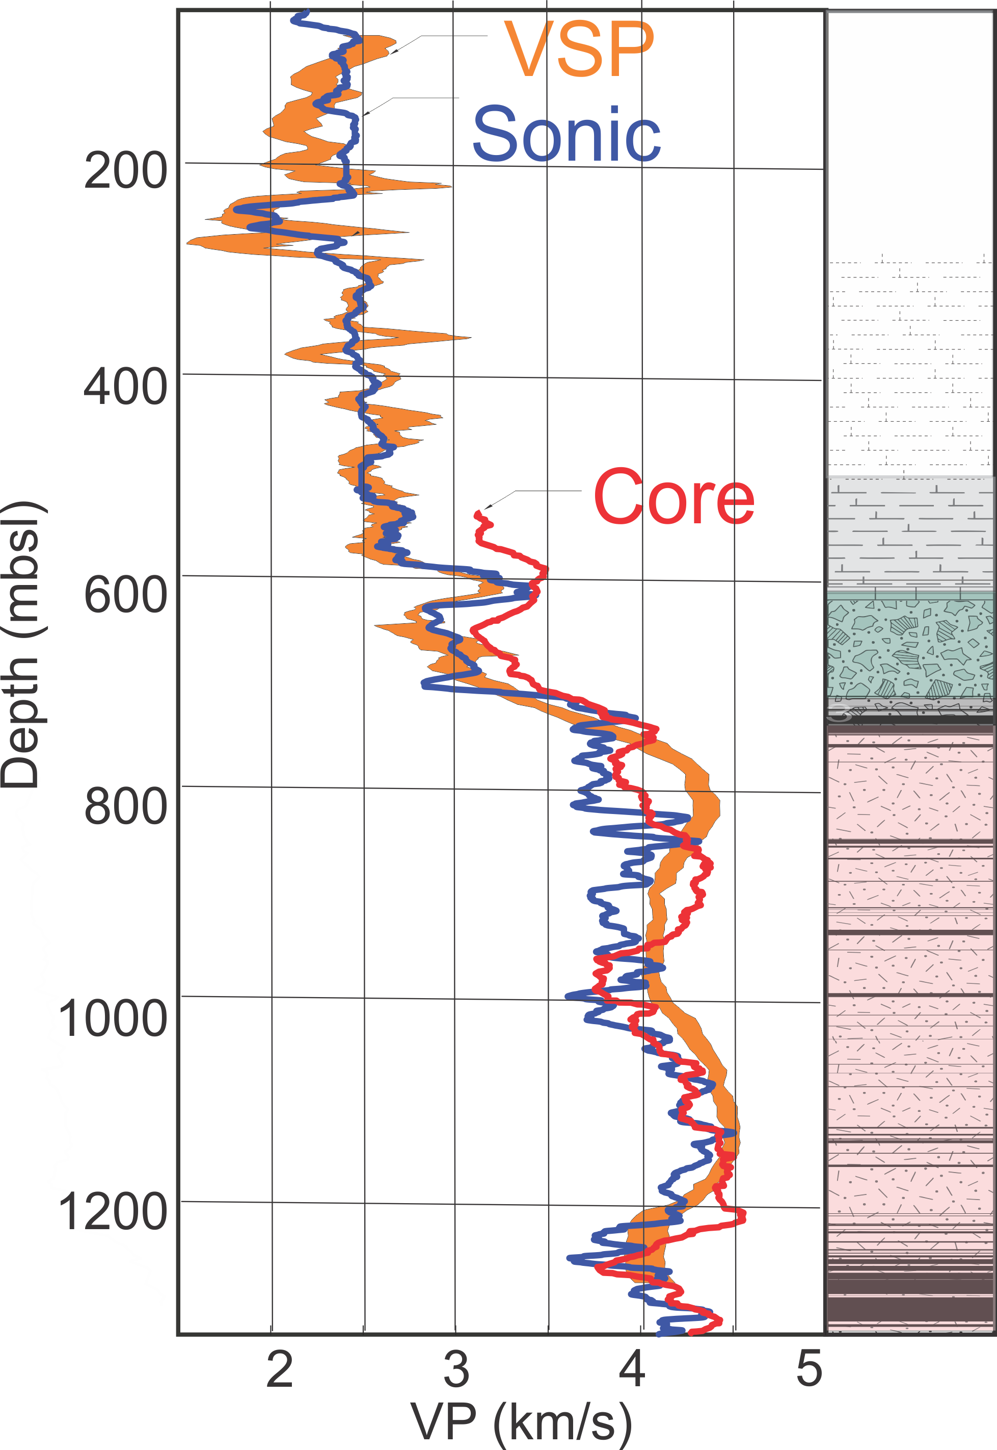
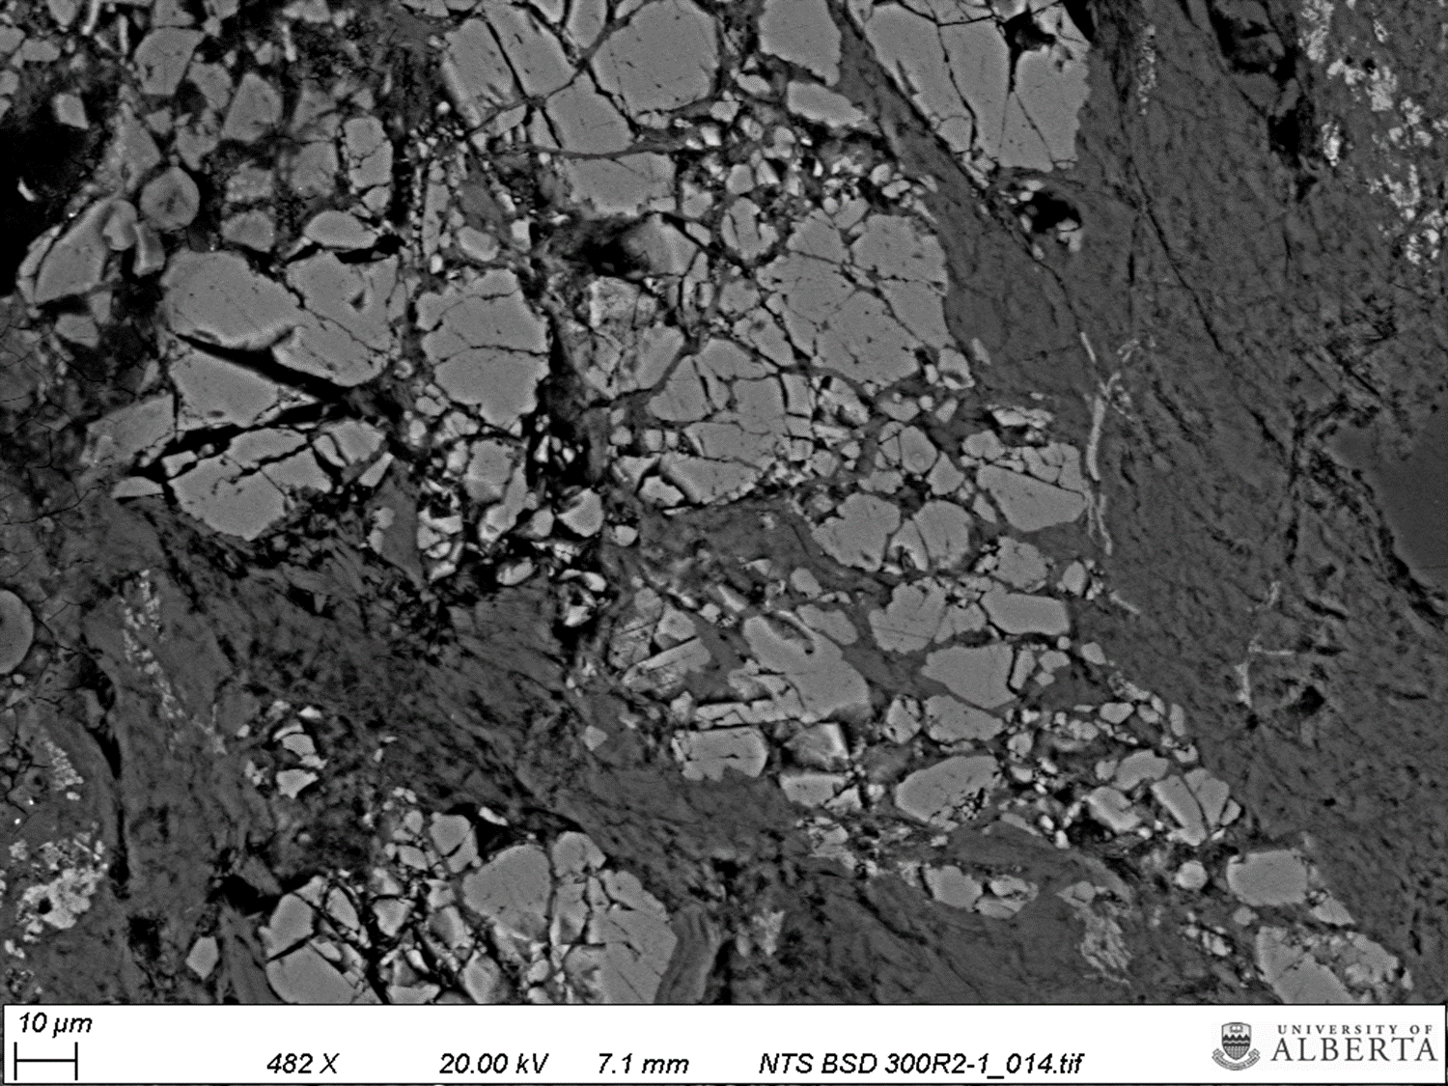
Chicxulub wave speeds
Marl 615 mbsl
Suevite 715 mbsl
Granitoid 753 mbsl

