Slide 1
Tomography Processing Basics
Data collection
  Collect radiographs of the sample from 0 to 180 degrees in small angle steps
  Collect one or more “flat field” images: images with no sample
  Collect one or more “background” images: images with no x-rays
Normalize data for background and flat field
  I/I₀ = (Image - Background)/(Flat field – Background)
Have I/I₀ for each pixel in every projection
  For 1920x1200 detector with 1800 projections (angles), that is 4.15 billion measurements of I/I₀!
Convert each row of detector to a sinogram (X vs theta) by taking logarithm
Filter the sinogram with a high pass filter
Reconstruct (backproject) from X,Y,Theta space to X,Y,Z space
Analyze the resulting reconstructions

Slide 2
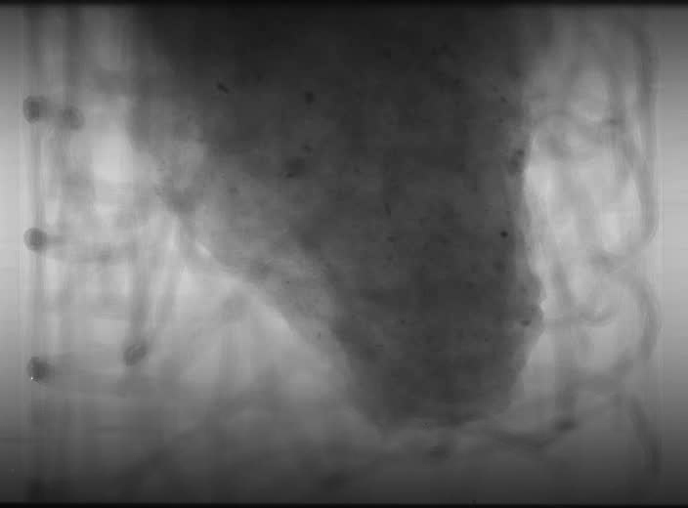
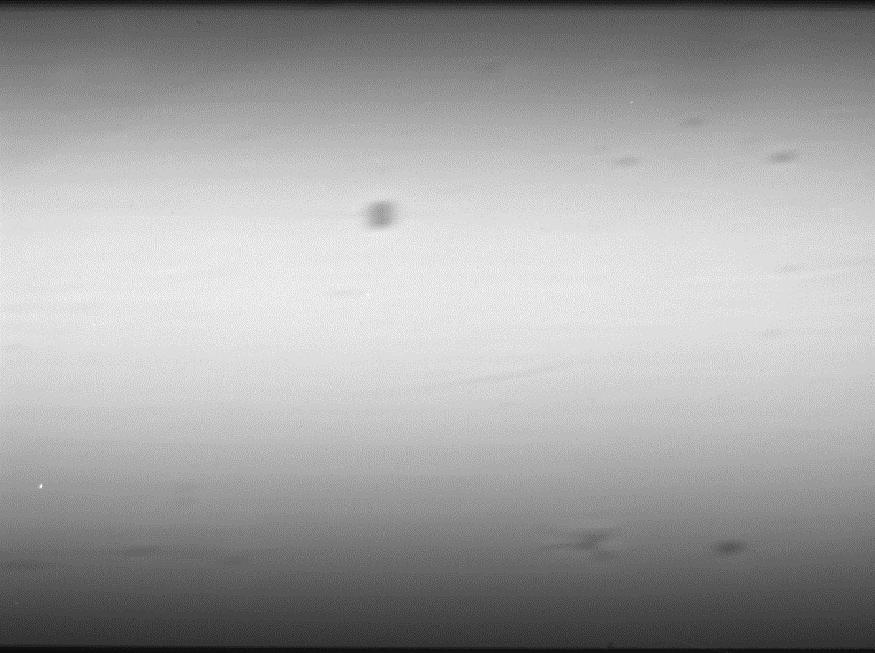
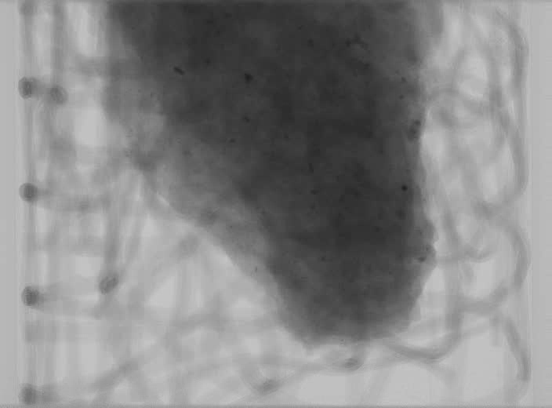
Raw projections
Data Corrections
Flat fields (no sample)
Normalized projections
(Raw-Dark)/(Flat field – Dark)

Slide 3
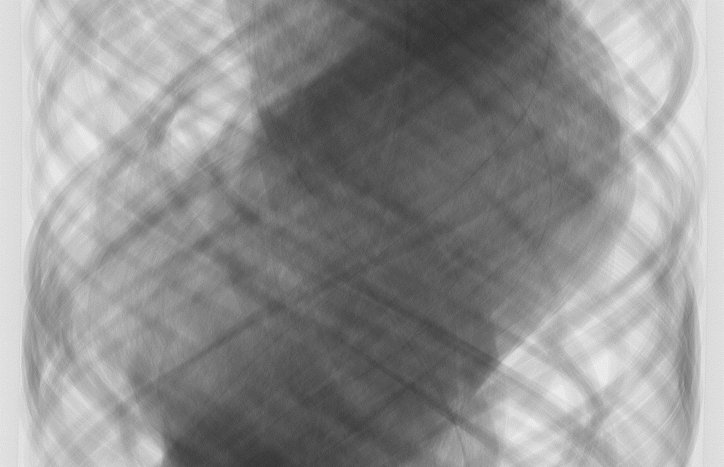
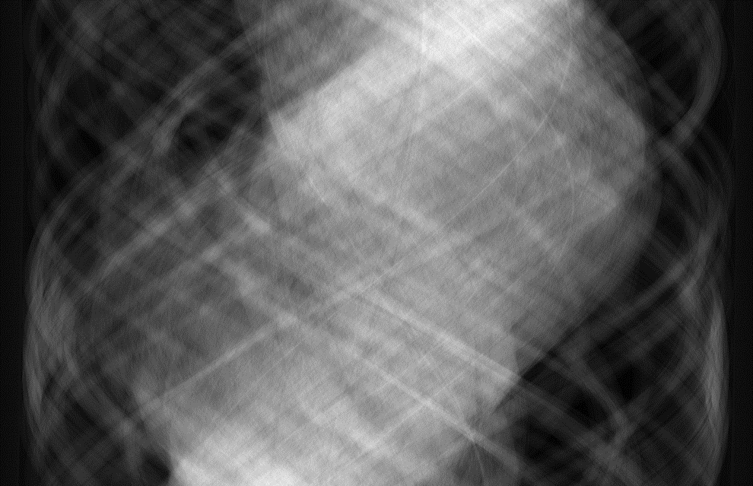
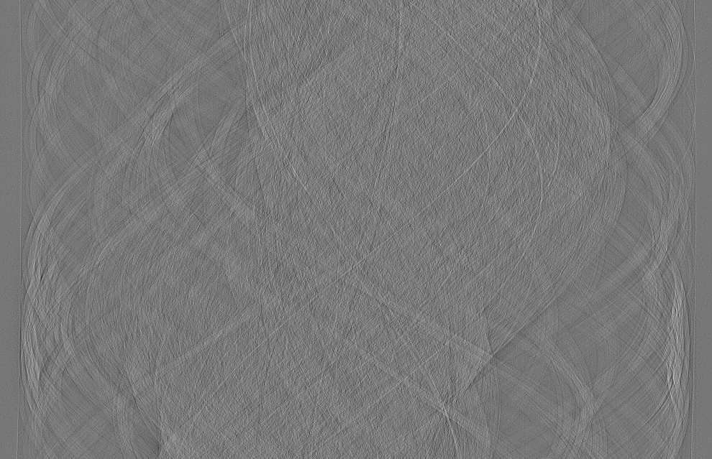
Raw sinogram (I/I₀)
Sinograms
X
Theta
Take logarithm
High-pass Shepp-Logan filter

Slide 4
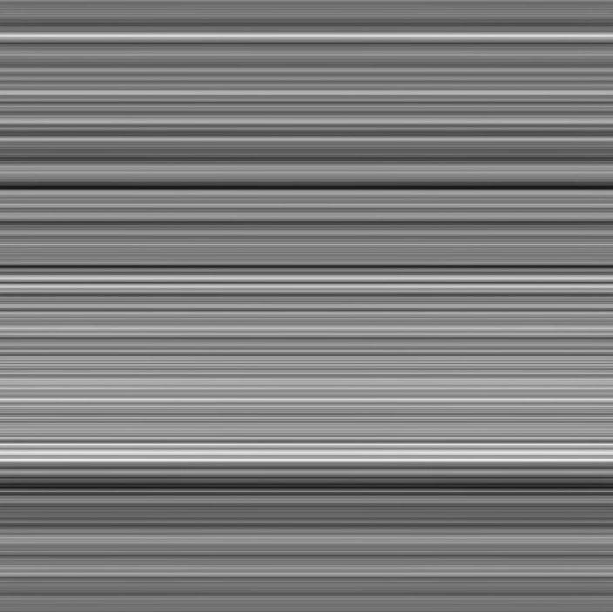
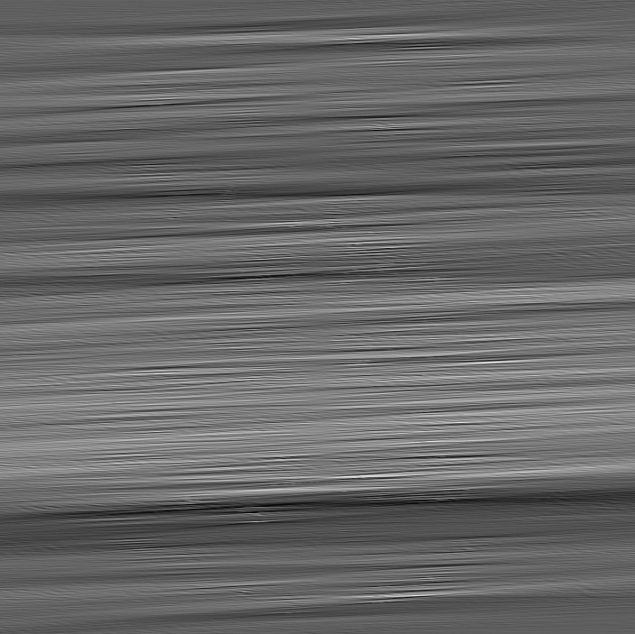
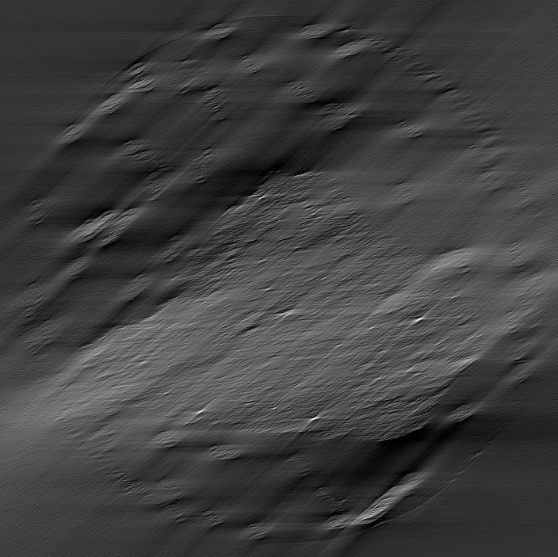
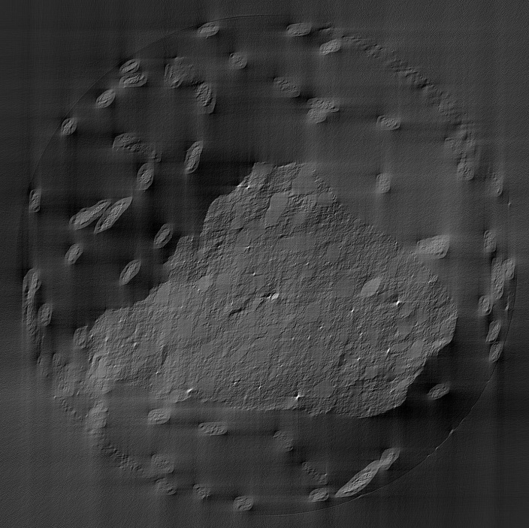
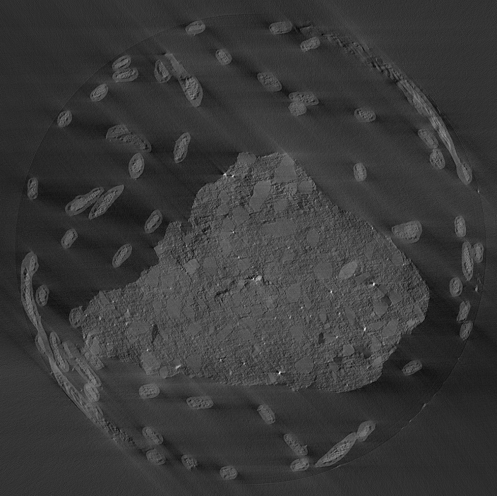
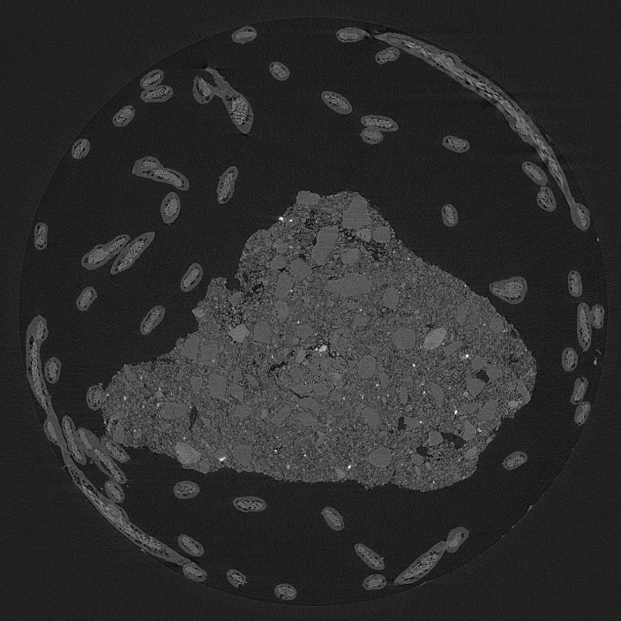
Backprojection
1 projection at 0°
25 projections from 0°-5°
225 projections from 0°-45°
450 projections from 0°-90°
675 projections from 0°-135°
900 projections from 0°-180°

Slide 5
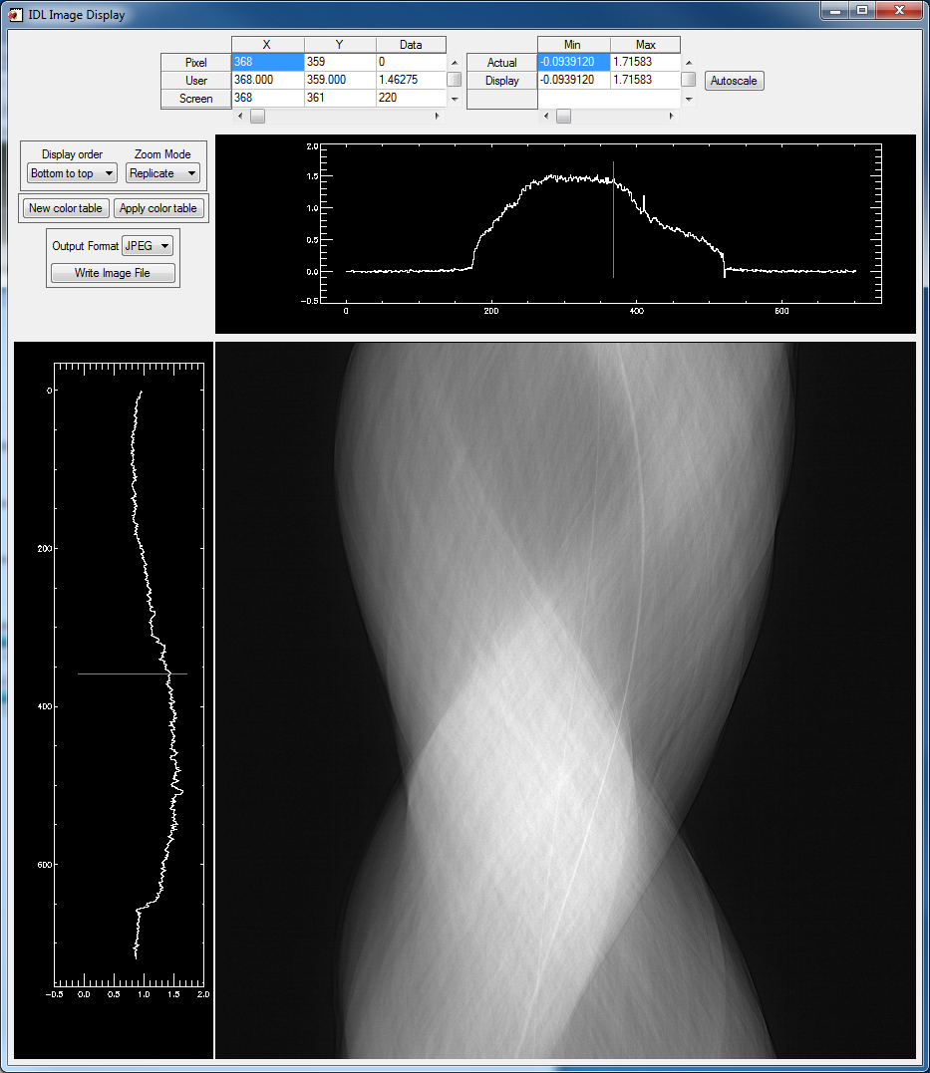
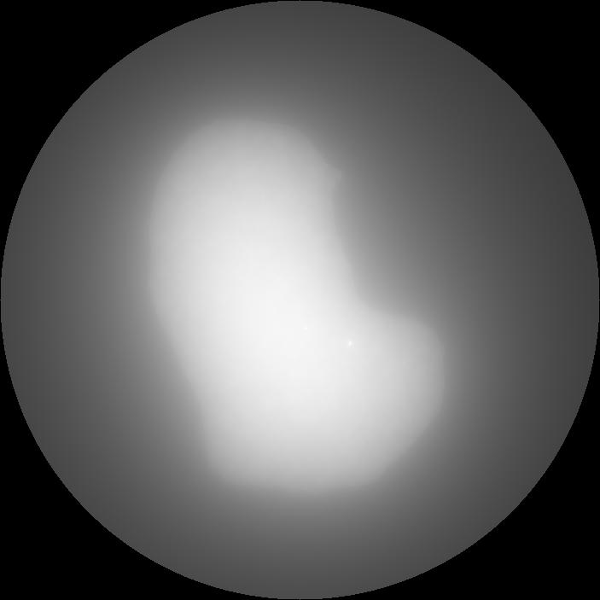
Effect of Filters On Reconstruction
No filter
Sinogram
Reconstruction

Slide 6
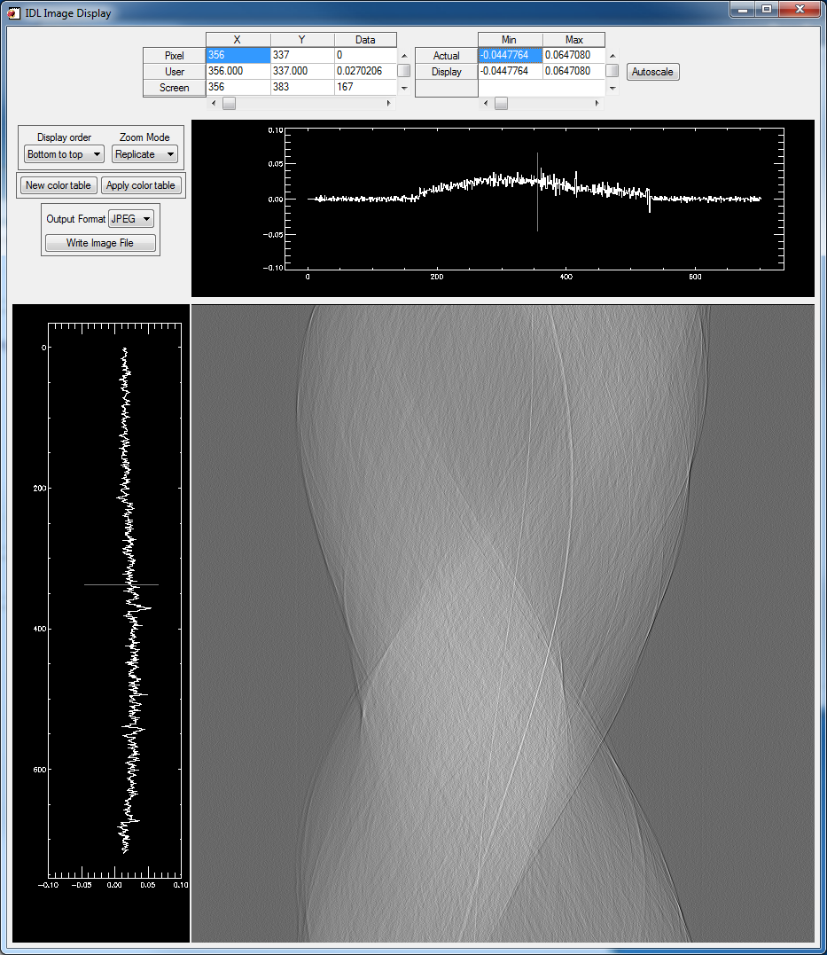
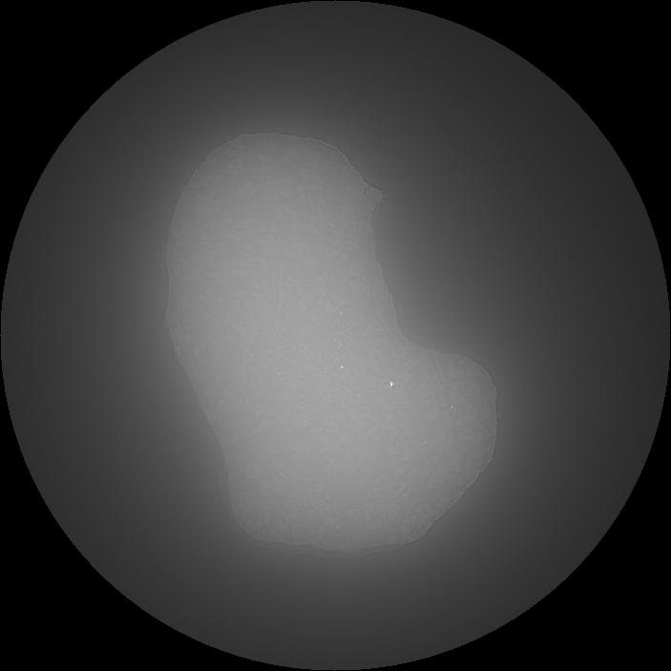
Effect of Filters On Reconstruction
Shepp-Logan Filter, Length=10
Sinogram
Reconstruction

Slide 7
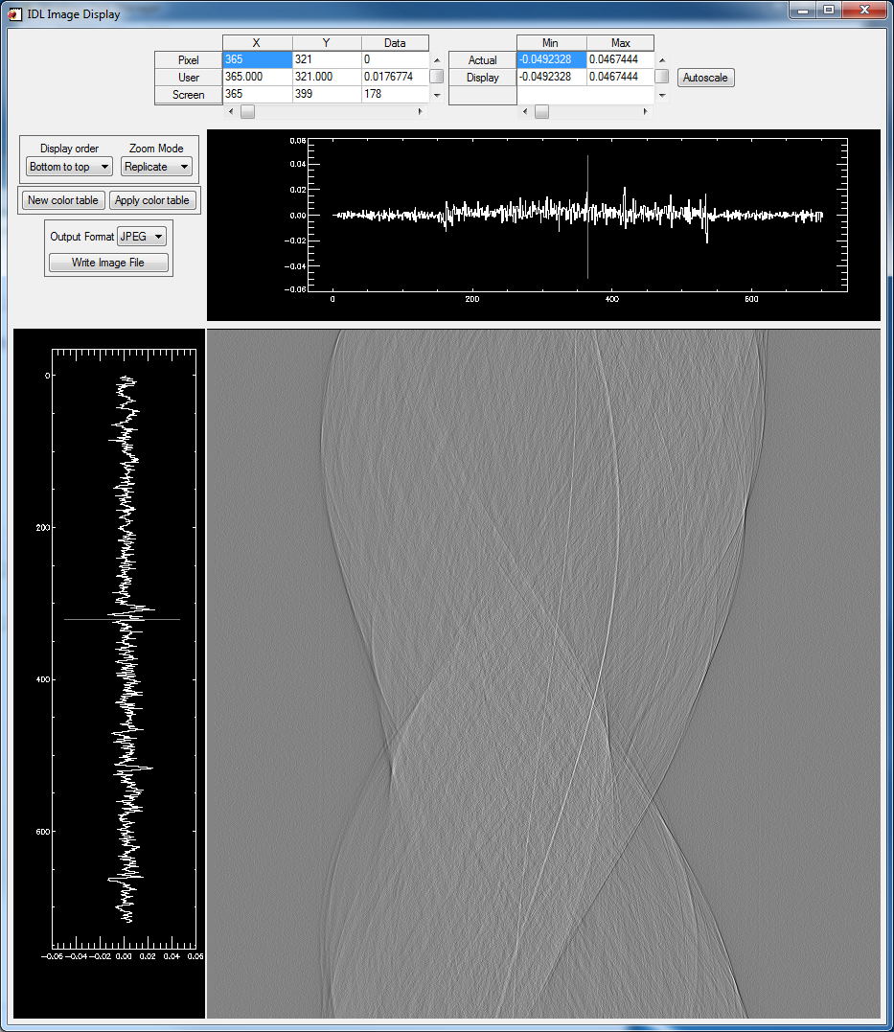
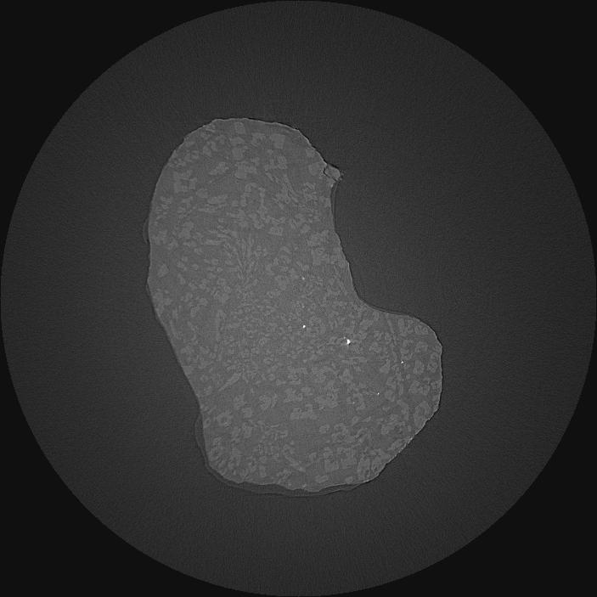
Effect of Filters On Reconstruction
Shepp-Logan Filter, Length=100
Sinogram
Reconstruction

Slide 8
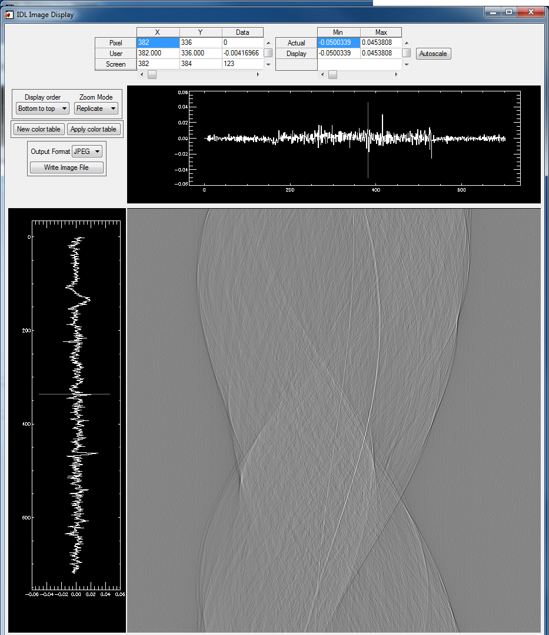
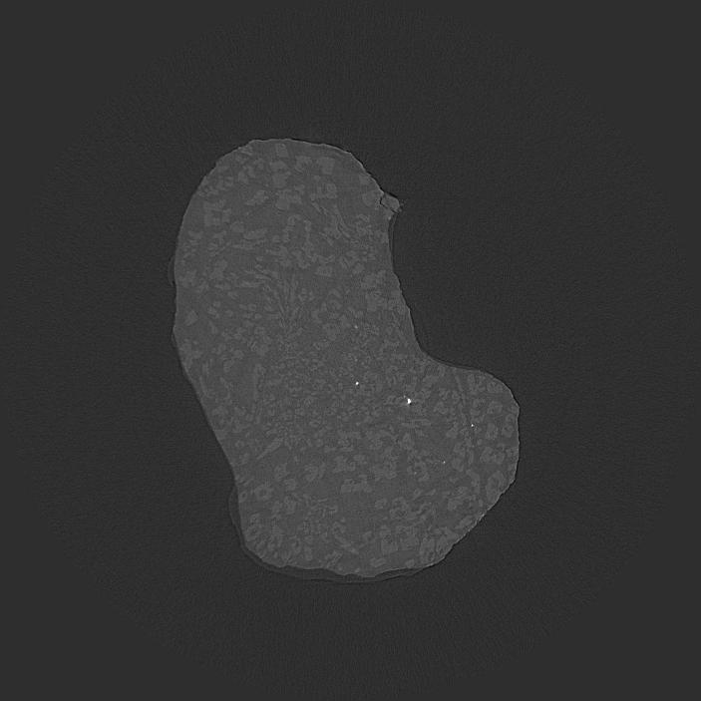
Effect of Filters On Reconstruction
Shepp-Logan Filter, Length=1000
Sinogram
Reconstruction

Slide 9
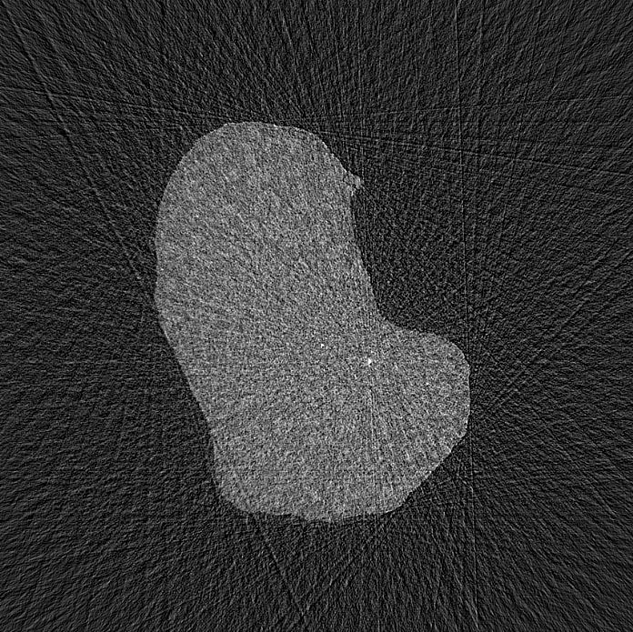

Effect of Number of Projections (Angles) on Reconstruction
45 Projections (4 degree steps)
90 Projections (2 degree steps)

Slide 10


Effect of Number of Projections (Angles) on Reconstruction
180 Projections (1 degree steps)
360 Projections (0.5 degree steps)

Slide 11

Effect of Number of Projections (Angles) on Reconstruction
720 Projections 0.25 degree steps)

Slide 12

Effect of Rotation Center on Reconstruction
Rotation center = 343.5
The rotation axis will “project” onto a specific column in the detector
Determining that position is very important
Sub-pixel accuracy is needed

Slide 13

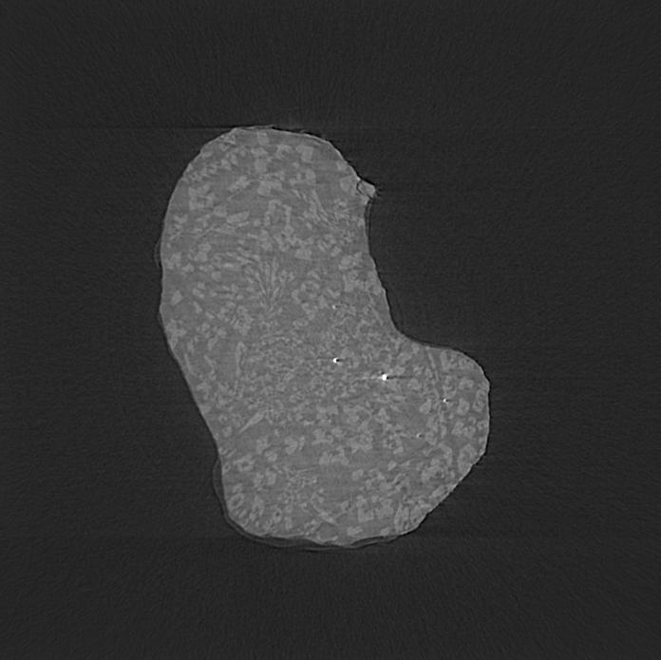
Effect of Rotation Center on Reconstruction
Rotation center = 342 (-1.5 pixels)
Rotation center = 345 (+1.5 pixels)

Slide 14
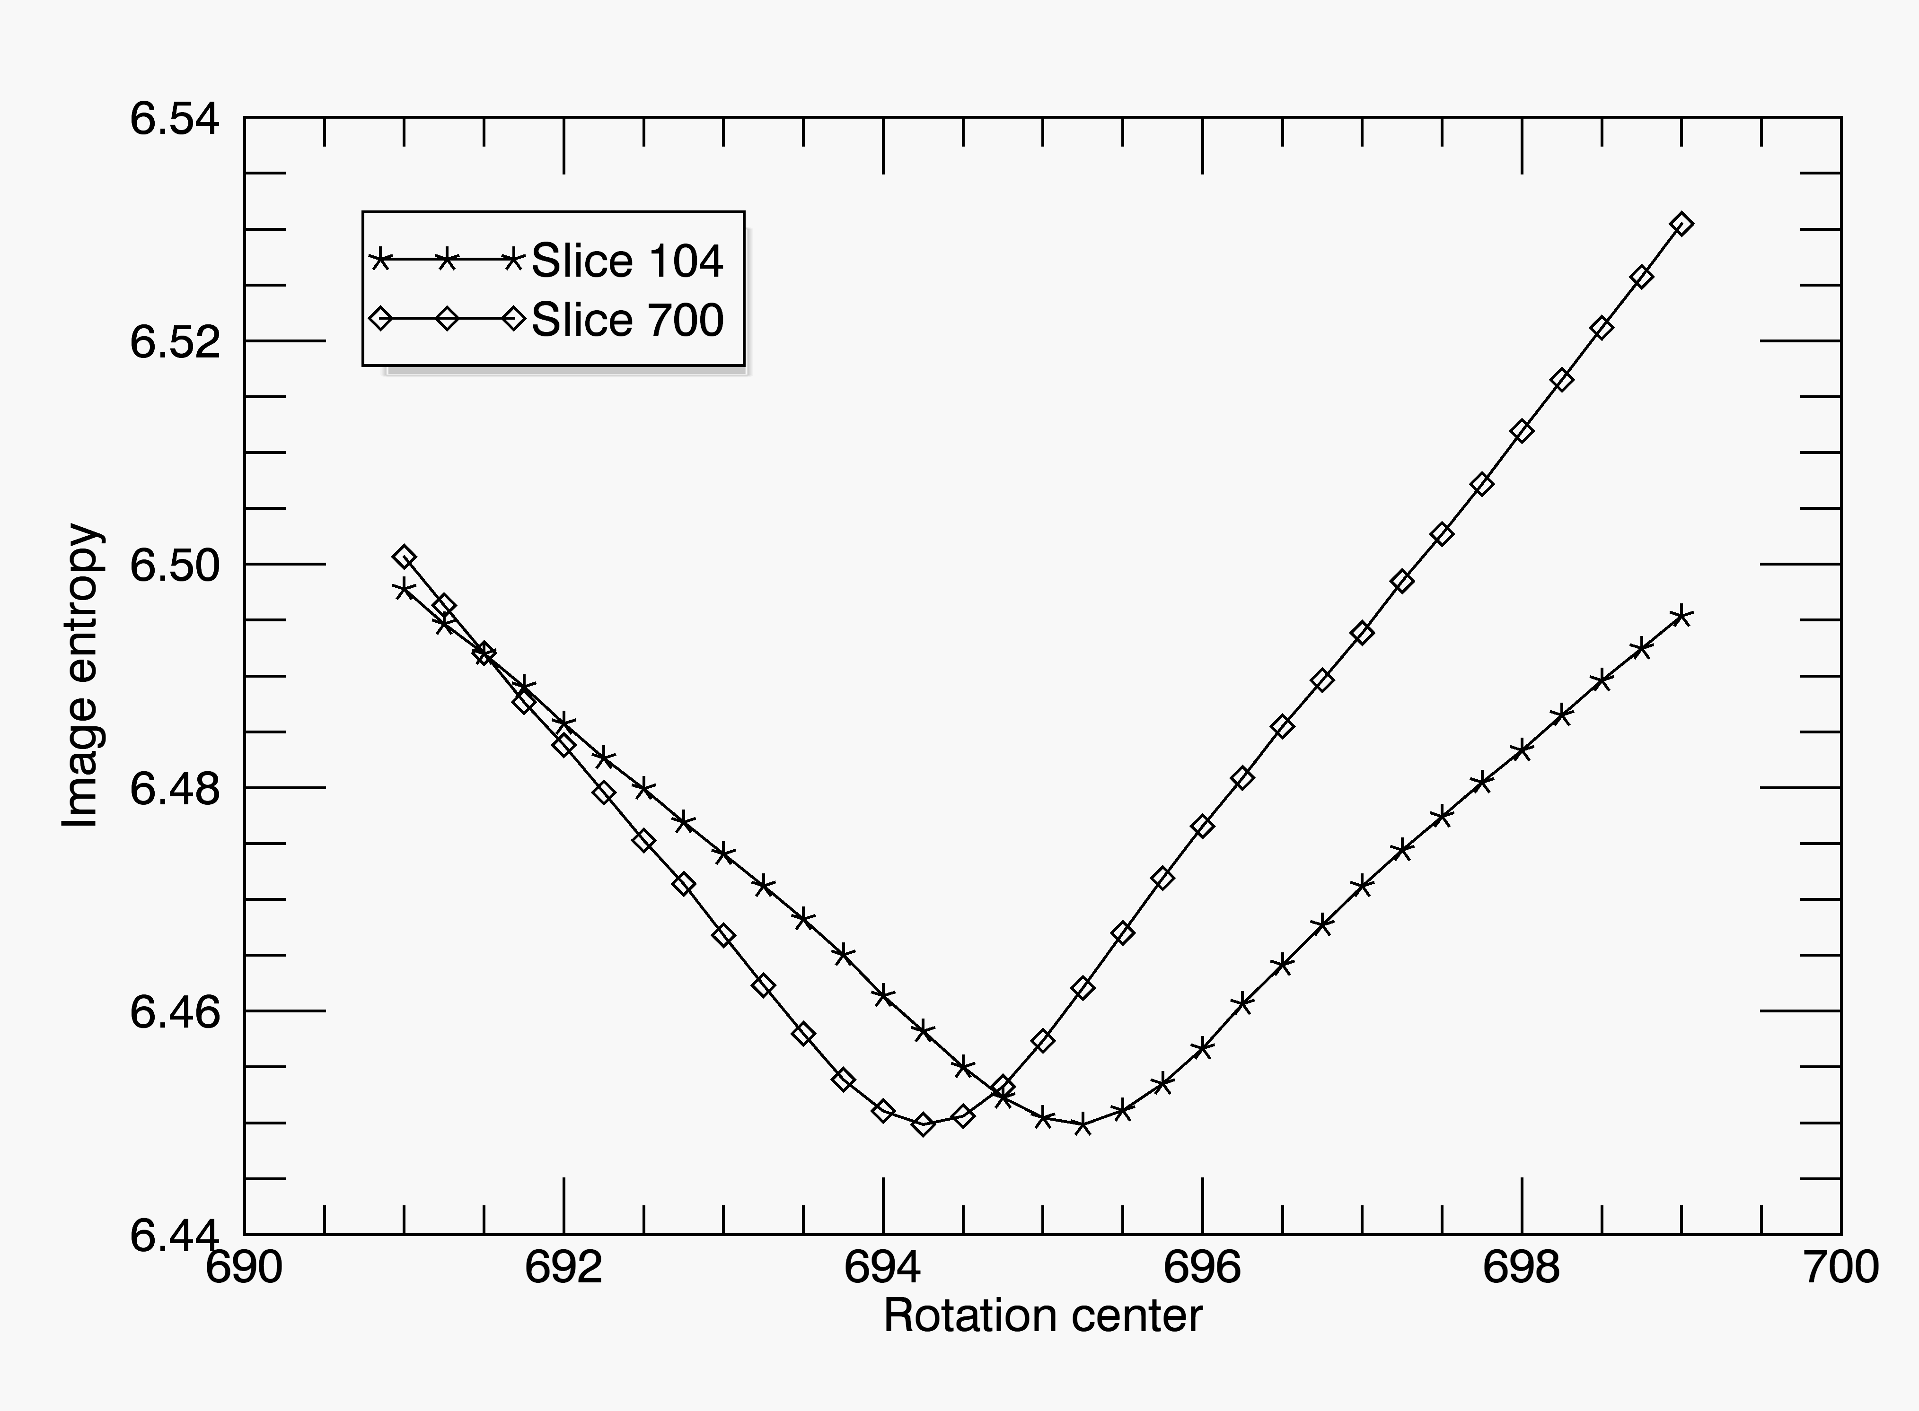
Automated Optimization of Rotation Center
Do reconstructions for 1 slice over a range of rotation centers (i.e. +- 1 pixel in 0.25 pixel steps)
Compute the “entropy” of the image for each rotation center. The entropy is simply a measure of the sharpness of the histogram of the image.
The optimum rotation center is where the entropy is minimized
Do this for 2 slices: one near the vertical top of the sample, one near the bottom: if they are not identical then the mechanical alignment was not perfect.
Typically off by <1 pixel; interpolate best center for each slice when reconstructing the entire volume

Slide 15
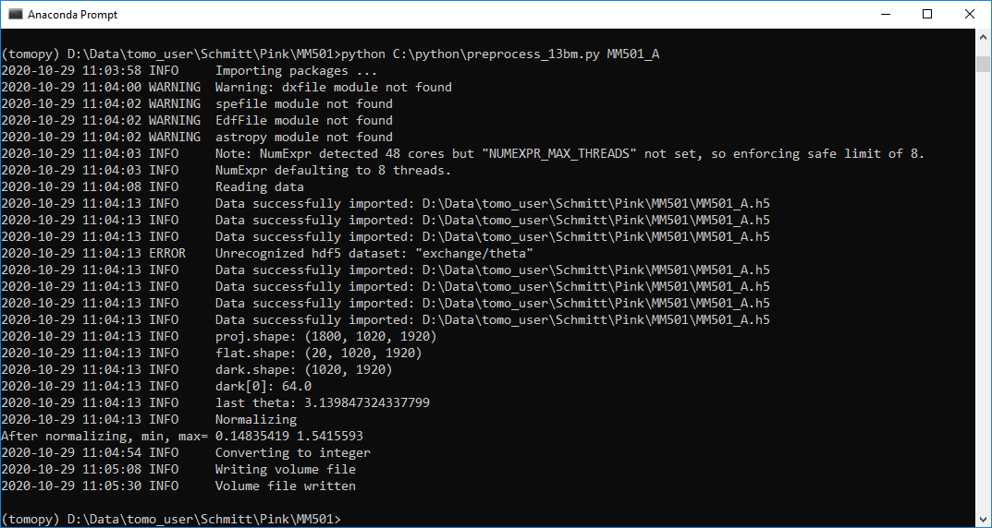
Reconstruction: Pre-processing
Python script based on TomoPy, a Python tomography processing package
  Previously this step was done in the IDL GUI used for reconstruction
Reads HDF5 data file containing dark fields, flat fields, and projections
Subtracts dark field from all flat-field and projection images
Averages flat fields
Divides each projection by average flat field. Range should be 0 to 1.
Scales by 10,000 and converts to 16-bit integer
Writes the data to netCDF .volume

Slide 16
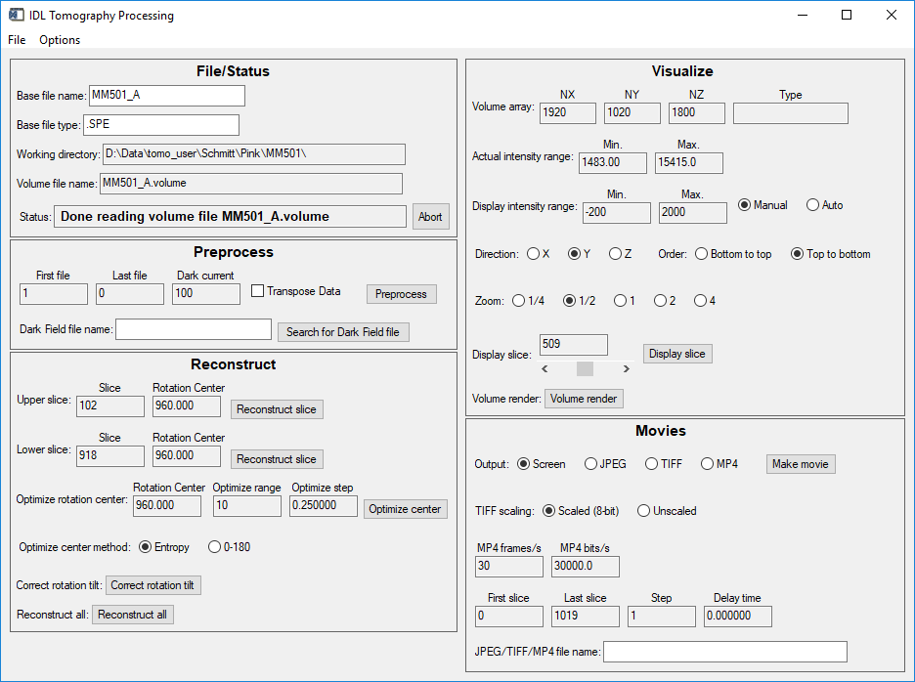
Reconstruction
IDL class library and GUI
Reads the normalized .volume file written in pre-processing step
Calls C++ code that uses the Gridrec FFT algorithm to do the actual reconstruction.
Writes the reconstructed data to a 16-bit integer netCDF recon.volume file.
Provides tools for optimizing several parameters
Provides quick visualization

