Slide 1

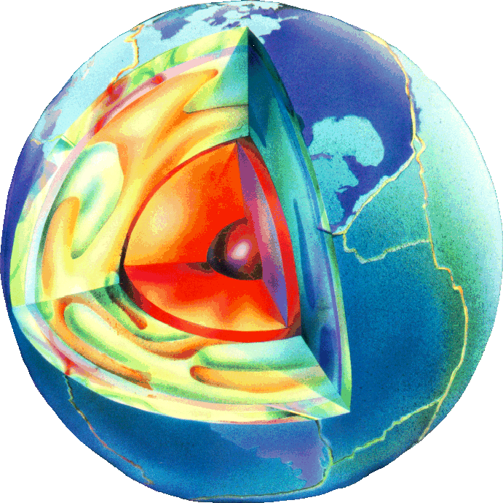
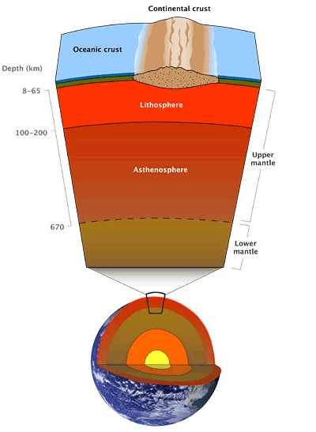
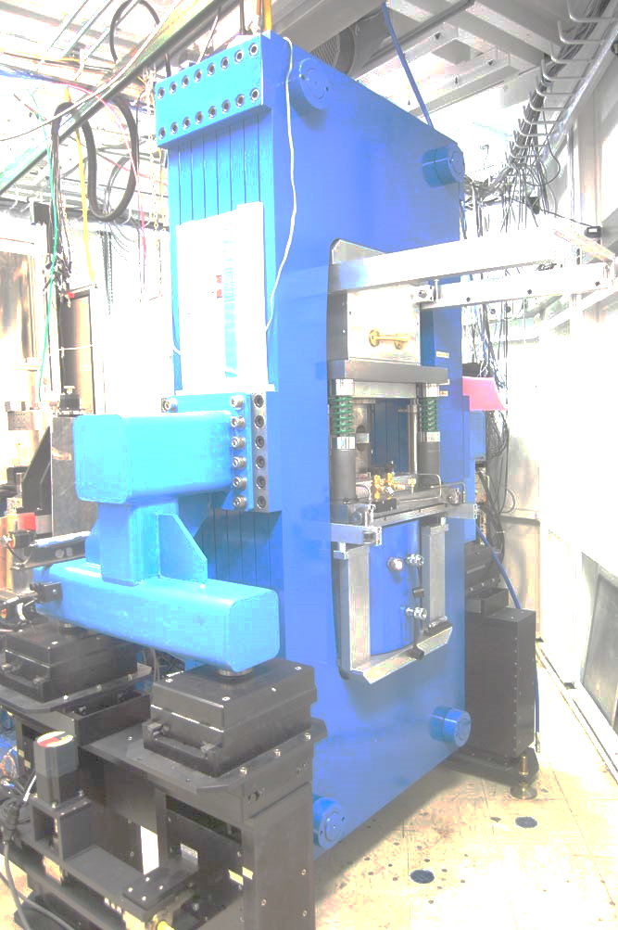
Acoustic Velocity Measurements at High Pressures and Temperatures: State of the Art at Beamline 6-BM-B and Future Perspectives
Matthew L. Whitaker, Kenneth J. Baldwin, and William R. Huebsch
Mineral Physics Institute & Department of Geosciences
Stony Brook University

Slide 2
6-BM-B: White Beam Multi-Anvil Facility
Bending Magnet Beamline at Sector 6 at APS
Energy Dispersive X-Ray Diffraction; ~20-100 keV X-Ray Energy Range
10-Element Array of Solid State Ge Detectors
X-Radiographic Imaging w/ YAG & Prosilica CCD Camera
250-ton Hydraulic Press Installed; D-DIA Module Standard Installation
Differential Hydraulic Pumps for Deformation Studies
Press also accommodates T-10/Tcup (Kawai)
SAM85 can be temporarily removed for Rotational Drickamer Apparatus
Steady State and Dynamic Stress Studies
New Integrated Acoustic Velocity System
User Program Began in 2015-2 Cycle
We Are Open for Business!!!

Slide 3
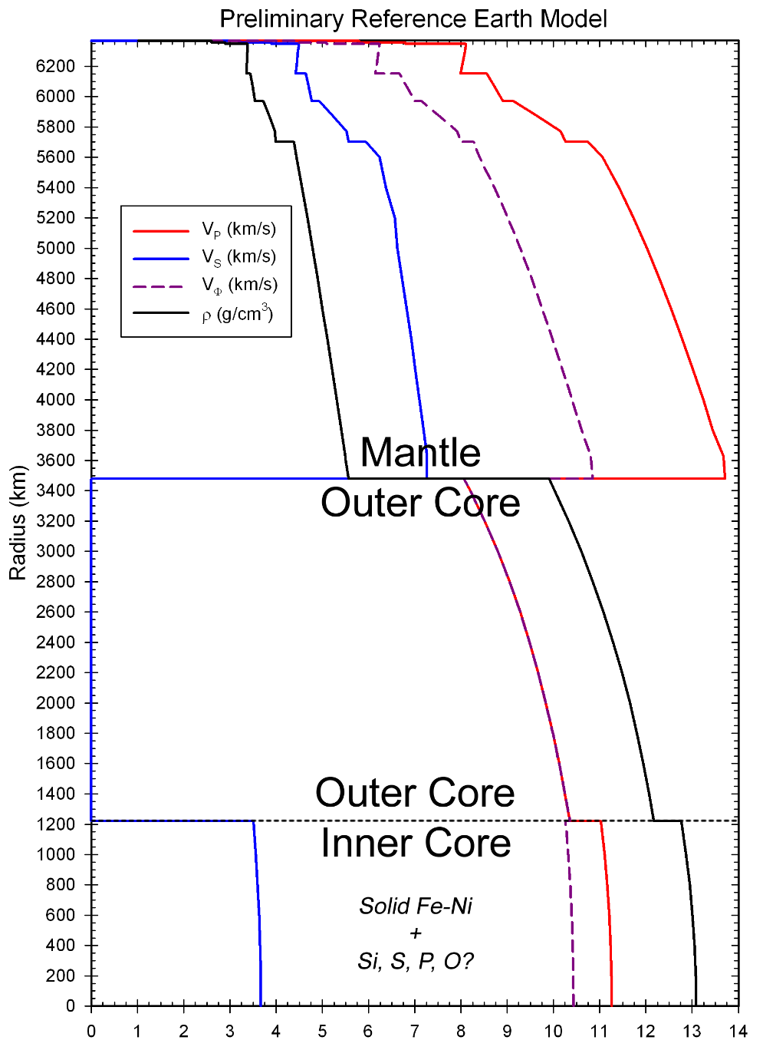
The Problem
Minerals that exist at the surface are not the same as the ones found in the deep Earth
Temperature and Pressure increase w/ depth below surface
Many minerals change structure, chemistry, and behavior with changes in P and T
No direct access to Earth’s deep interior
Seismic data hint at interior structure and composition
To find out what materials might be found deep below the Earth’s surface, we must study minerals at high temperatures and pressures to compare to seismology
Dziewonski & Anderson 1981

Slide 4
The Question
Long-standing question: What is the composition of the deep Earth?
Many mineral phases consistent with geochemical arguments
Need experimental data to constrain possible phases present under the conditions of the deep Earth
Must ascertain physical properties of candidate deep Earth materials and analogs at extreme conditions
Apply the results of these studies to seismic profiles of Earth’s interior
Isotopic, geochemical, and meteoritic evidence suggest several candidate phases and compositions
Synchrotron X-Radiation and Ultrasonic Interferometry in Multi-Anvil Apparatus

Slide 5
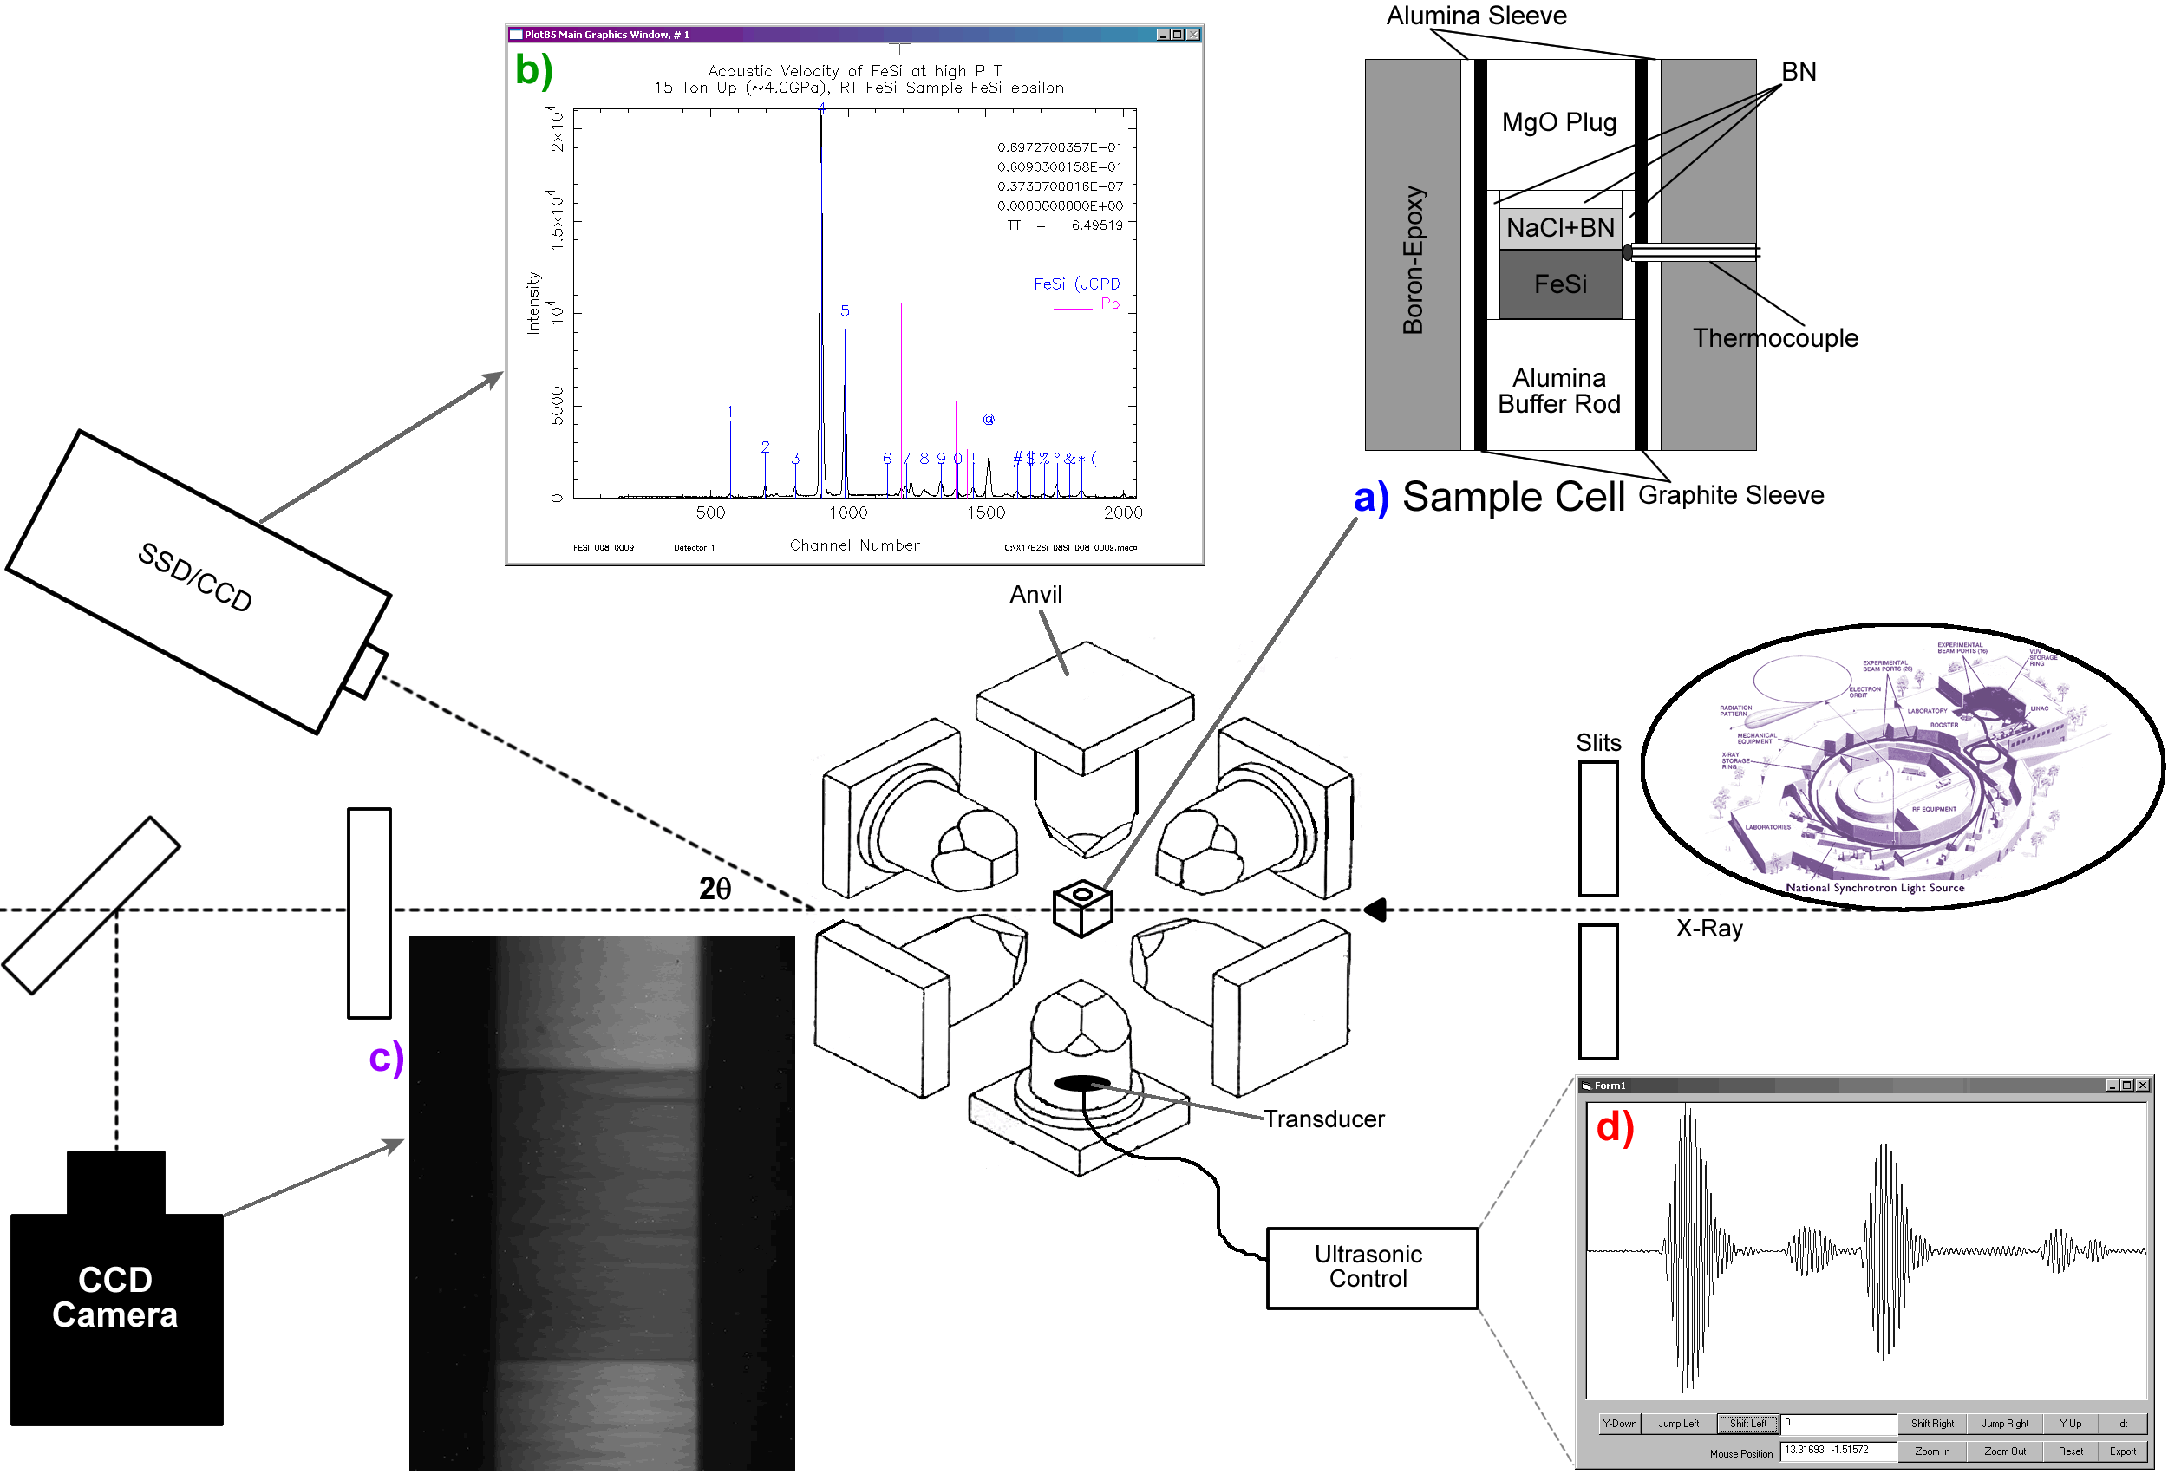
Ultrasonic Experiment
Directly measures several physical properties
Not dependent upon a pressure standard
Provide important ground truth benchmarks against which other techniques can be compared
Measure shear properties; other techniques do not
Diffraction gives density
Image gives sample length
Ultrasonics give P- and S-wave travel times
Density and velocities yield bulk and shear modulus

Slide 6
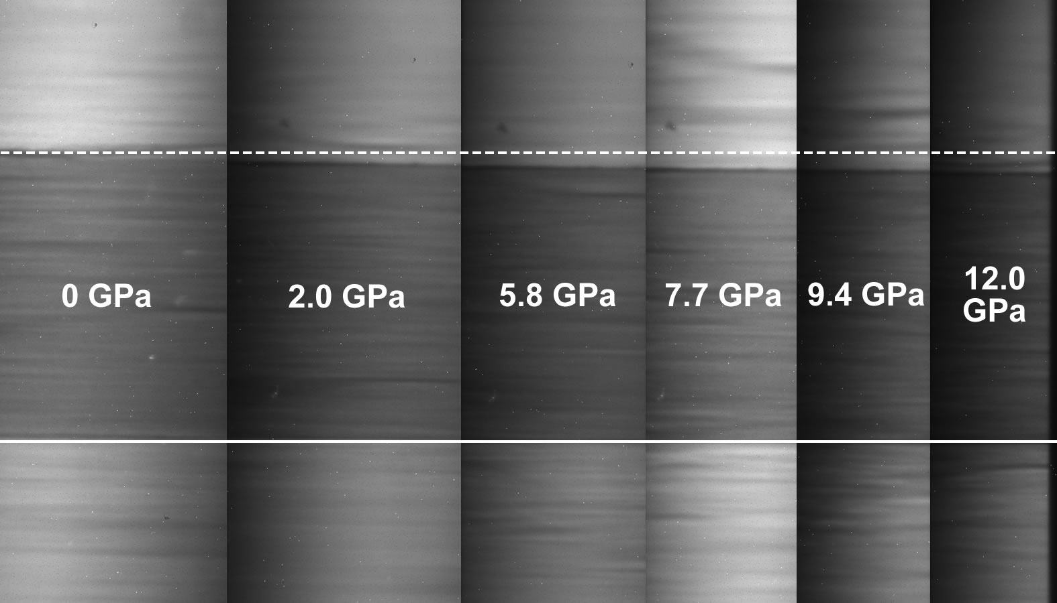
X-Radiographic Imaging

Slide 7
Ultrasonic Signal
Whitaker, Baldwin & Huebsch (2017) RSI

Slide 8
Finite Strain Equations

Slide 9
Technical Developments for Ultrasonics
Separate control system not integrated into experimental controls
No ability to script, automate, or coordinate experimental data collection
Other multi-anvil-based ultrasonic systems in the U.S. take ~150-200 sec to collect and add 1024 waveform acquisitions
SPring-8 in Japan, 45-60 seconds (now down to ~30 sec)
Relatively “slow” collection speed limits experiments and measurements
Rely on one XRD detector; no information on potential differential stress

Slide 10
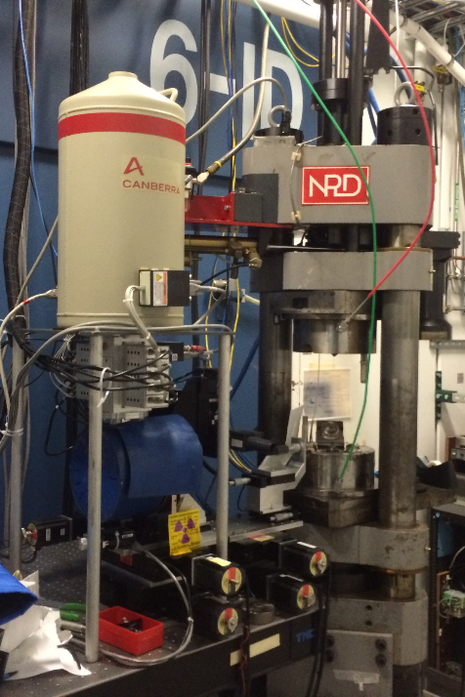
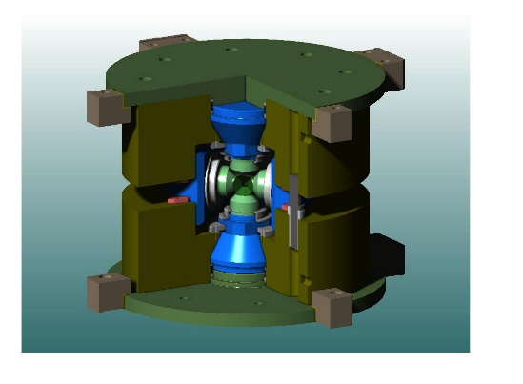
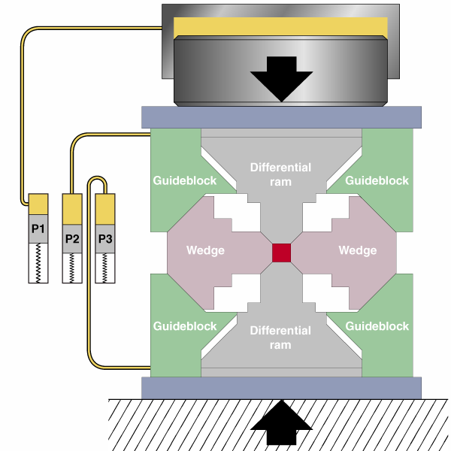
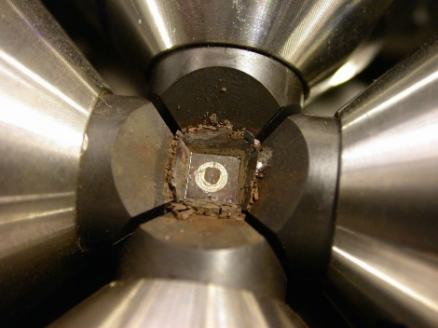
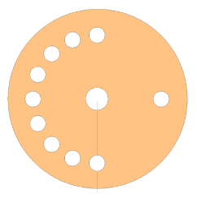
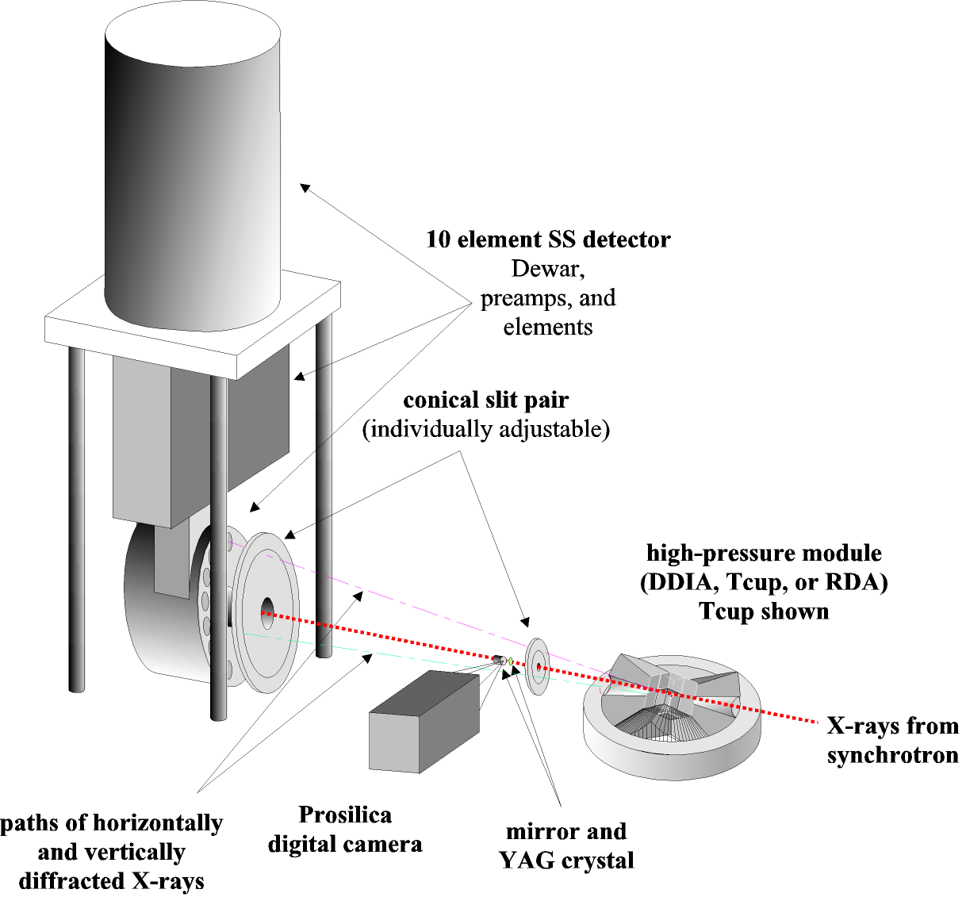
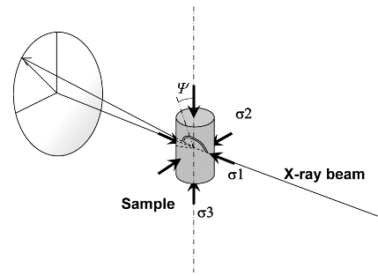
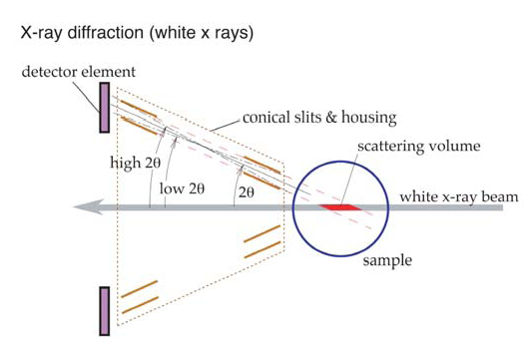
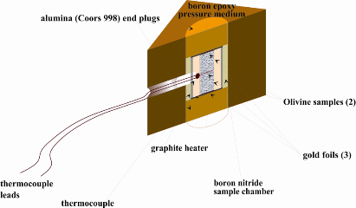
New Opportunities at 6-BM-B

Slide 11
DIASCoPE System
Whitaker, Baldwin & Huebsch (2017)
Reviews of Scientific Instruments

Slide 12
Technical Developments for Ultrasonics
Separate control system not integrated into experimental controls
No ability to script, automate, or coordinate experimental data collection
Other multi-anvil-based ultrasonic systems in the U.S. take ~150-200 sec to collect and add 1024 waveform acquisitions
SPring-8 in Japan, 45-60 seconds (now down to ~30 sec)
Relatively “slow” collection speed limits experiments and measurements
Rely on single detector; no information on potential differential stress
DIASCoPE system collects full set of ultrasonic data in ONE SECOND!!!
Can measure processes like melting and phase changes as they occur
Makes use of full suite of detectors to quantify differential stress
Full integration into experimental EPICS-based controls

Slide 13
DIASCoPE System
Whitaker, Baldwin & Huebsch (2017) RSI

Slide 14
DIASCoPE Applications: Phase Transitions
Whitaker, Baldwin & Huebsch (2017) RSI

Slide 15
DIASCoPE Applications: Phase Transitions
Whitaker, Baldwin & Huebsch (2017) RSI

Slide 16
DIASCoPE: Elasticity of Fe-rich Olivines
Bejina, Terce (Ph.D. Thesis), Whitaker, Bystricky

Slide 17
DIASCoPE: Elasticity of Fe-rich Olivines
Bejina, Terce (Ph.D. Thesis), Whitaker, Bystricky

Slide 18
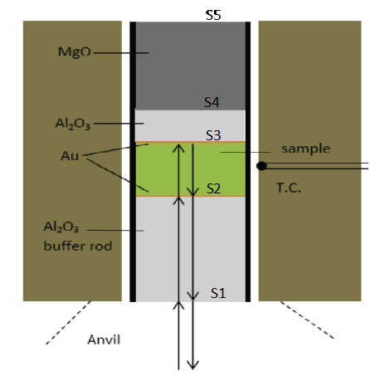
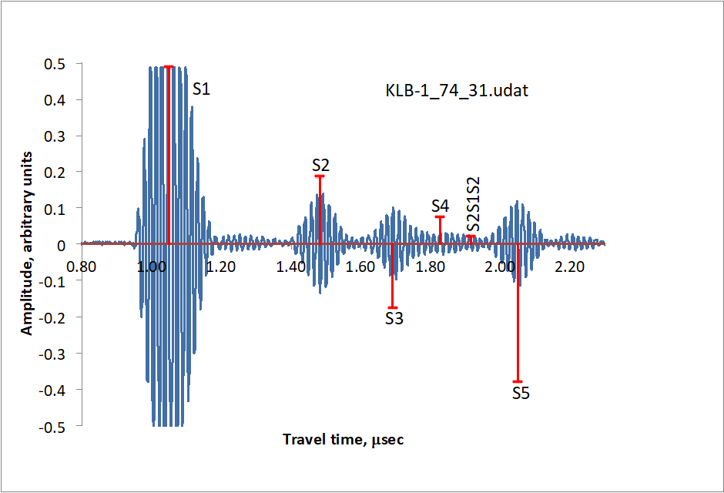
Double Reflectors for Problem Samples
Li, Whitaker, Weidner (2018) RSI (Editor’s Pick!)

Slide 19
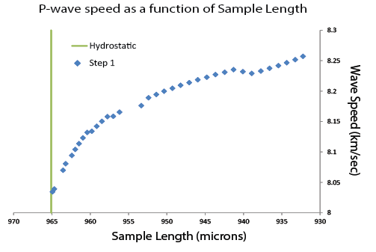
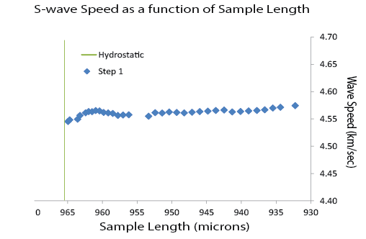
Ultrasonics + Steady-State Deformation
Collaboration with Pamela Burnley’s group – Data Analysis Heavy Lifting by student Taryn Traylor

Slide 20
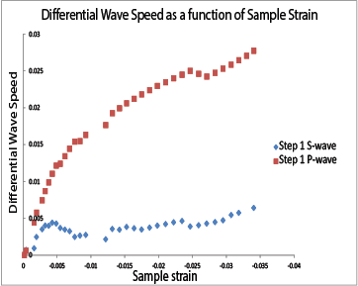
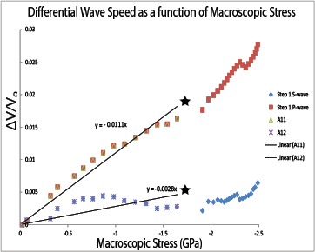
Ultrasonics + Steady-State Deformation
Collaboration with Pamela Burnley’s group – Data Analysis Heavy Lifting by student Taryn Traylor

Slide 21
New Ultrasonic Directions & Collaborations
DIASCoPE Data Collection now another 100x faster; 4-11x better S/N
Ultrasonic Acoustic Velocities During Partial Melting of KLB-1 Weidner et al. (2018) Journal of Geophysical Research; Solid Earth
Ultrasonic Acoustic Wave Velocities of Neighborite (NaMgF₃) Across Orthorhombic to Cubic Phase Boundary at High P-T Li et al. (2018) Physics of the Earth and Planetary Interiors
Acoustic Velocities in Hydrous Wadsleyite as a function of Water Content – w/ Gabriel Gwanmesia, Delaware State U.
First experiment combining steady state deformation with acoustic velocity measurements – w/ Pamela C. Burnley, UNLV
First experiment combining sinusoidally oscillating stress fields with acoustic velocity measurements – w/ Donald J. Weidner, SBU
Potential interest from this broader community?

Slide 22
General User Proposal Deadline for the 2019-1 Cycle @ APS:
October 26, 2018!!!
Have an idea for an experiment? Let’s Talk!

Slide 23
MAXPD: Multi-Anvil X-ray
Powder Diffraction -
COMPRES Multi-Anvil Facility at Beamline XPD-D at NSLS-II
Matthew L. Whitaker, Kenneth J. Baldwin, William R. Huebsch, Michael T. Vaughan, Donald J. Weidner, Richard S. Triplett

Slide 24
MAXPD Beamline Details
Insertion Device Beamline; Sector 28-ID-2-D
1.8 Tesla Damping Wiggler Source
1100-ton Hydraulic Press Installed
DT-25 (Differential Kawai) Standard Module
D-DIA Module Also Available
Differential Hydraulic Pumps for Deformation
Monochromatic Beam; Tunable ~30-70 keV (52 & 67)
Angle Dispersive XRD; Perkin-Elmer Area Detector
X-Radiographic Imaging; YAG & Point Gray Camera

Slide 25
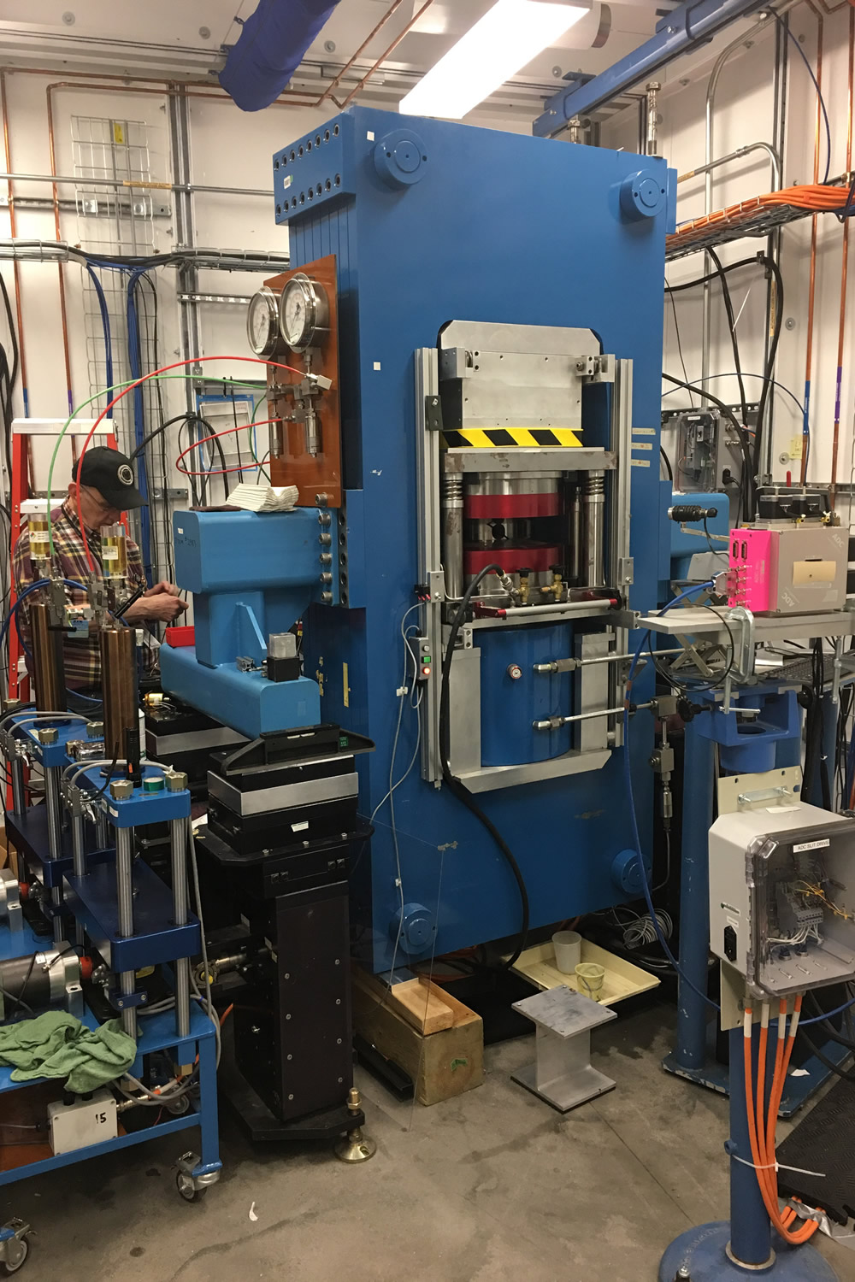
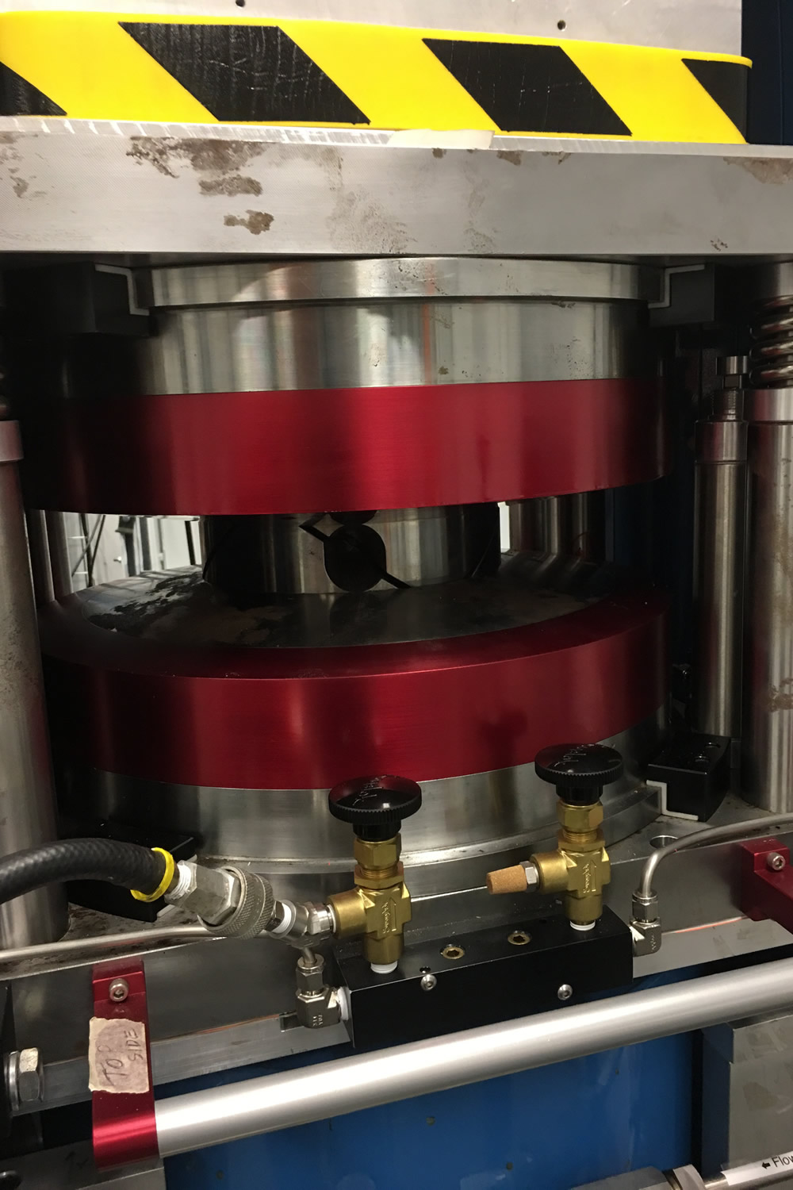
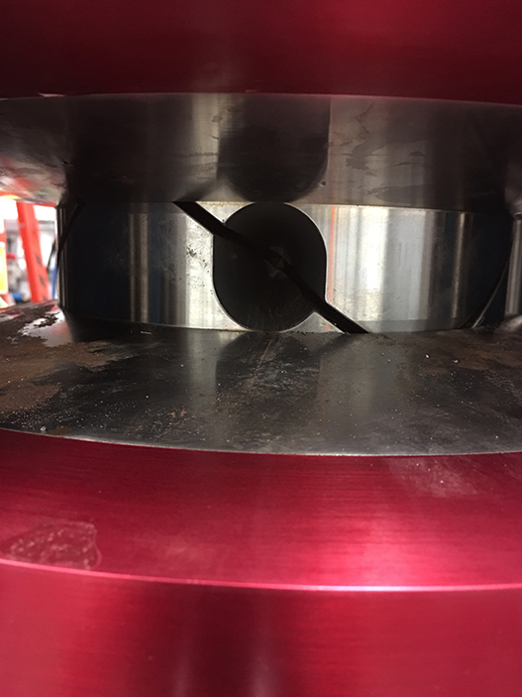
Inside the MAXPD Hutch

Slide 26
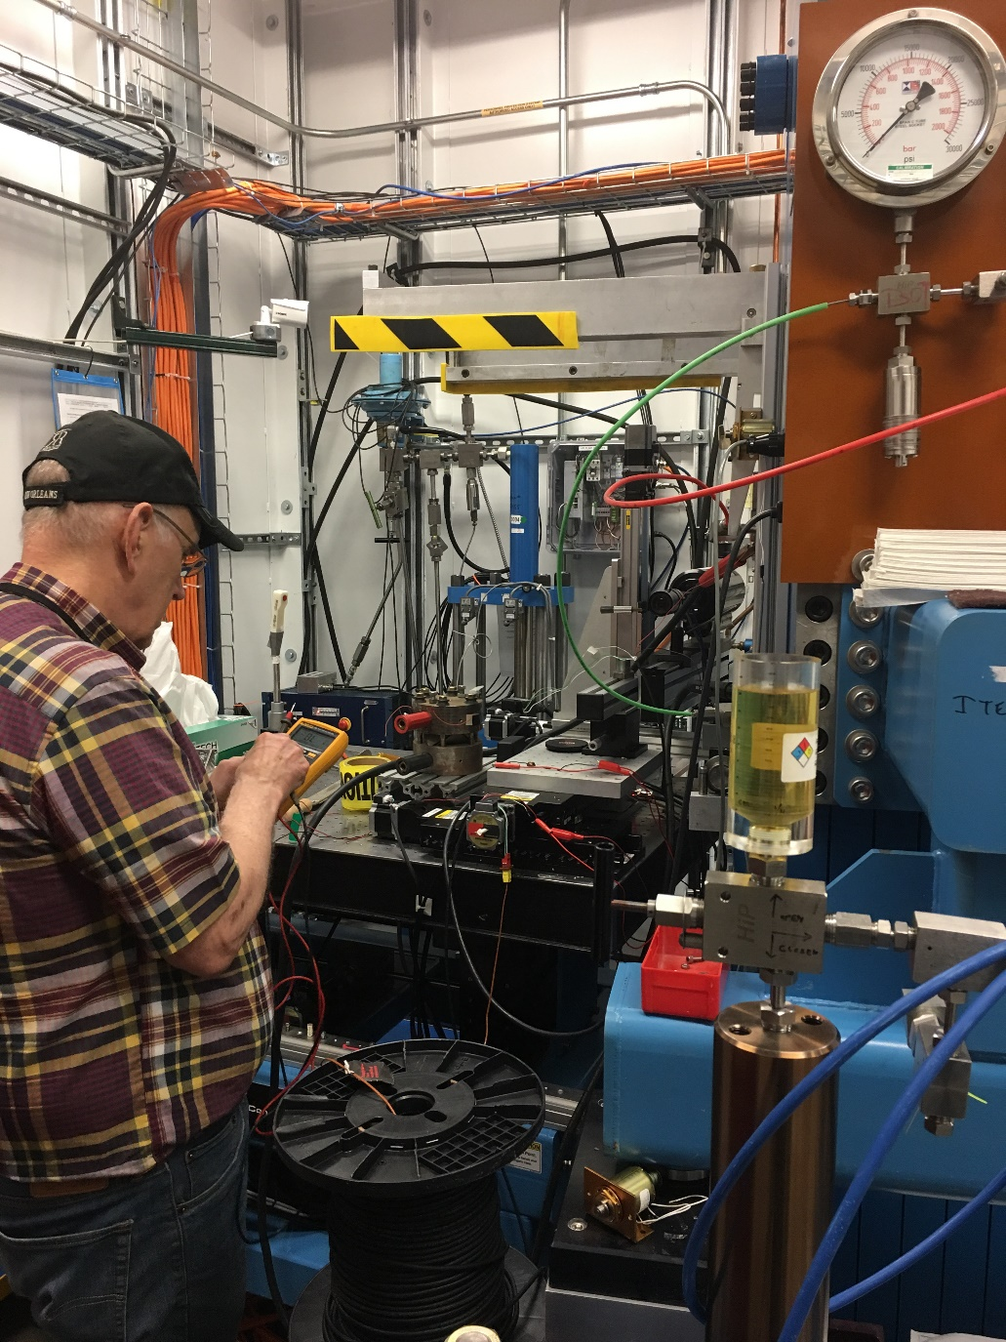
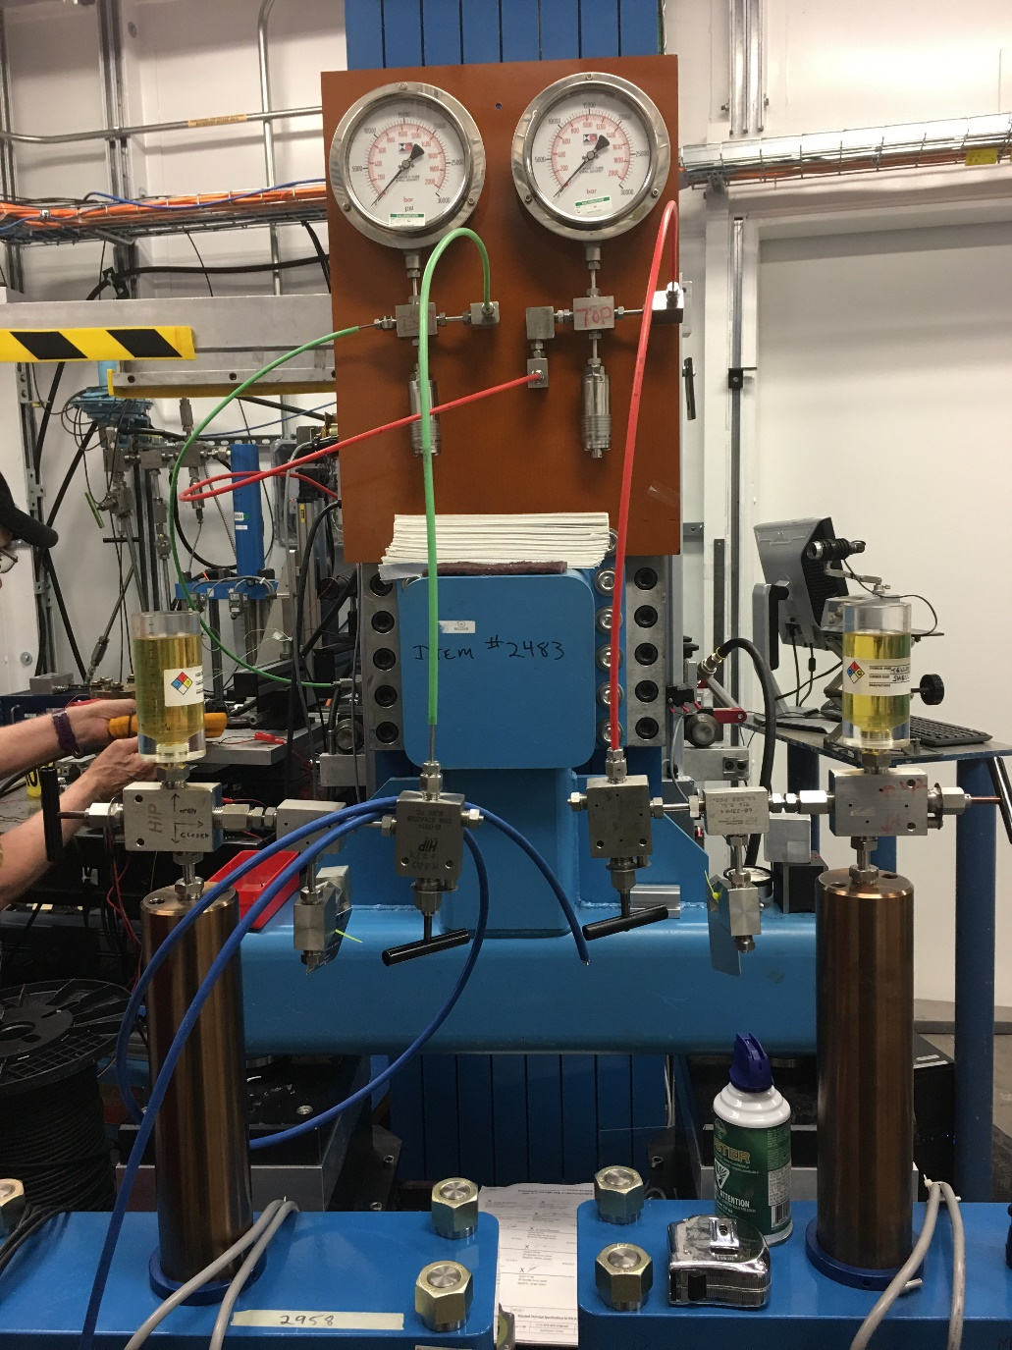
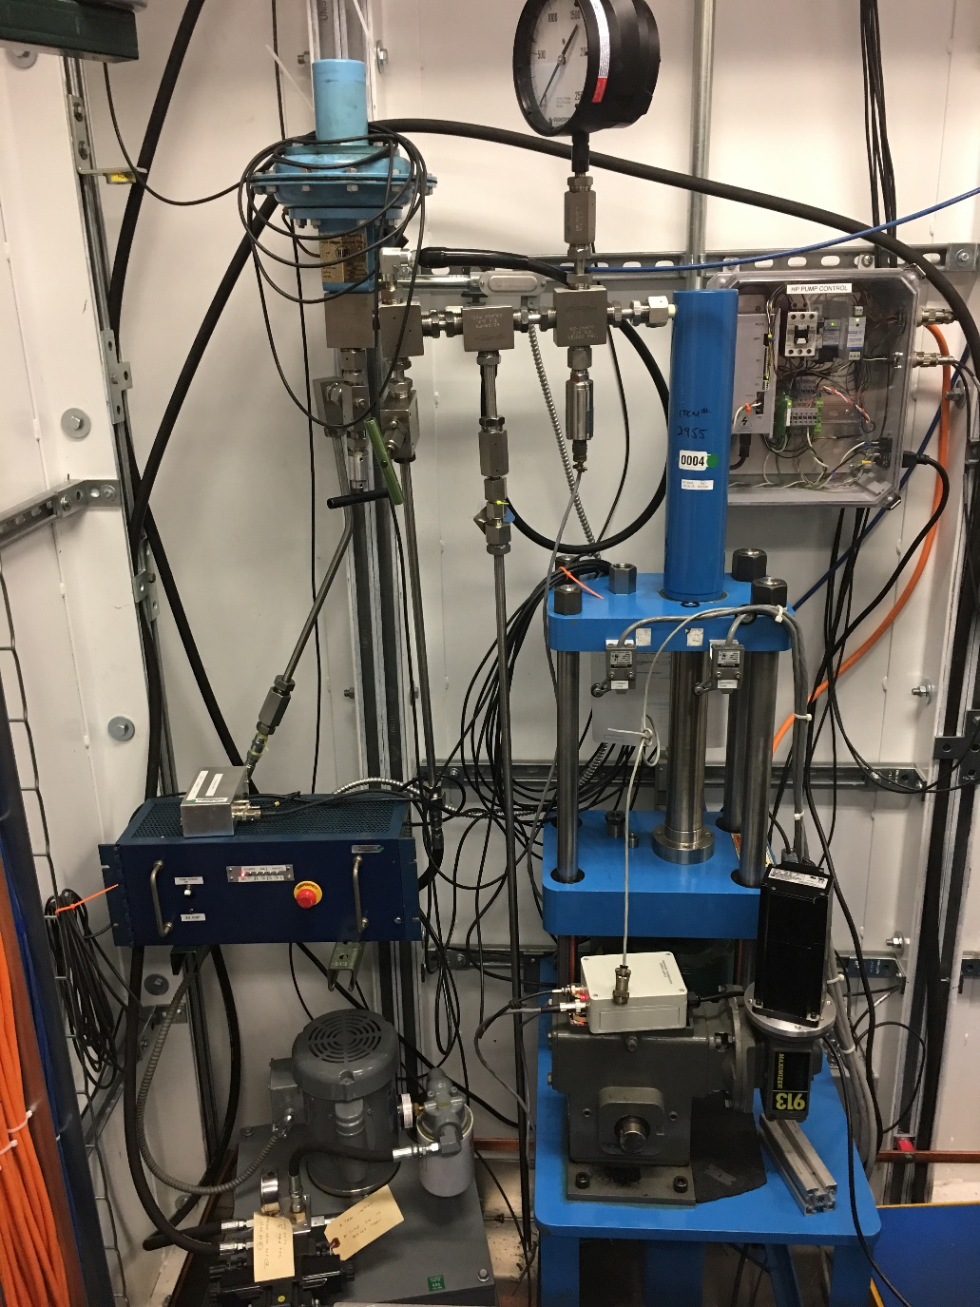
Inside the MAXPD Hutch

Slide 27
The DT-25 Experimental Details

Slide 28
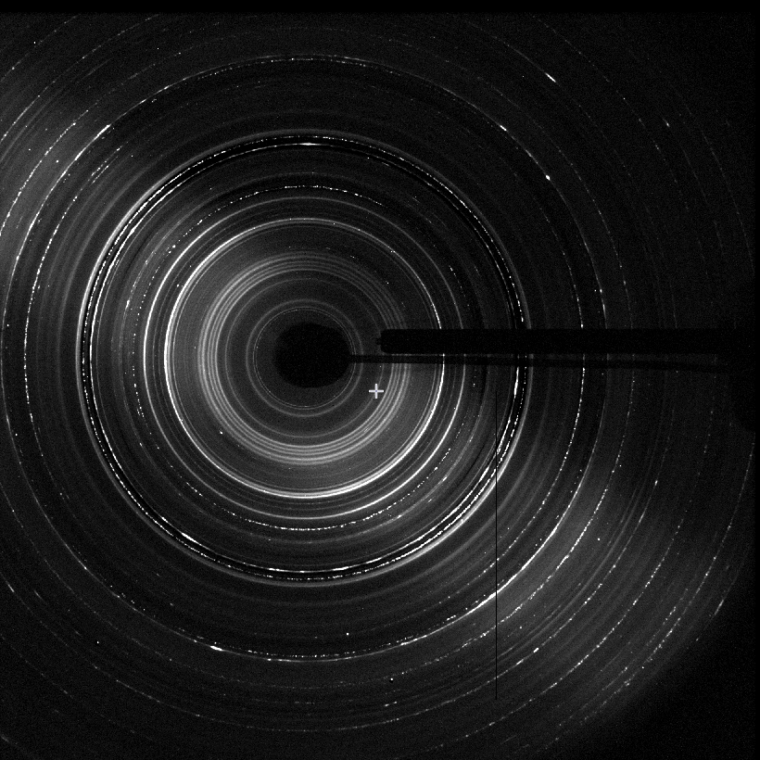
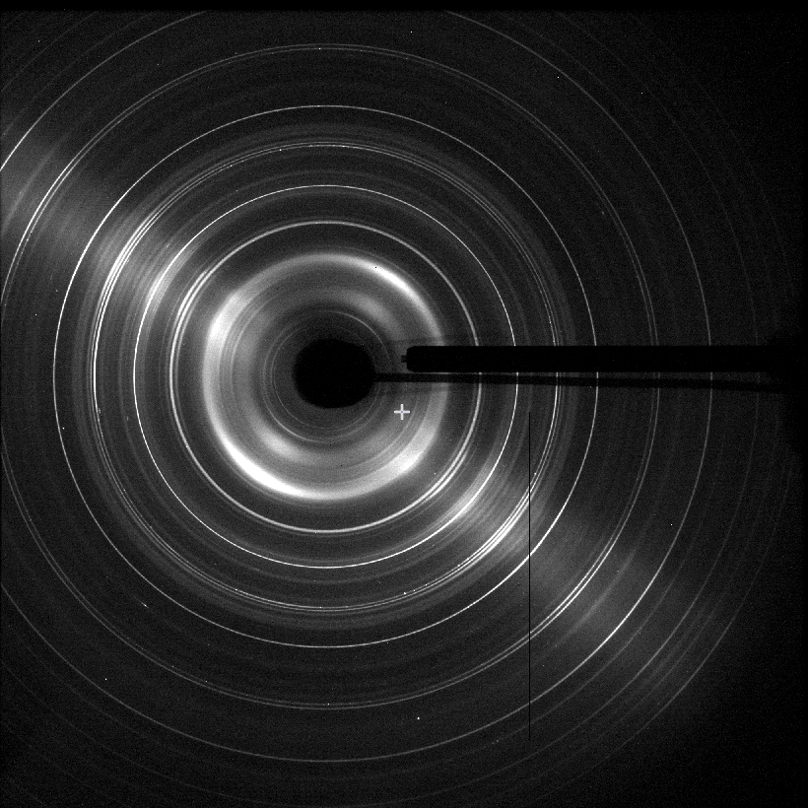
Formation of CaSiO₃ Perovskite
Experimental Conditions:
~18 Gpa
300 tons
(30% Max!)
~1000°C
Pseudowollastonite
to
CaSiO₃ Perovskite

Slide 29
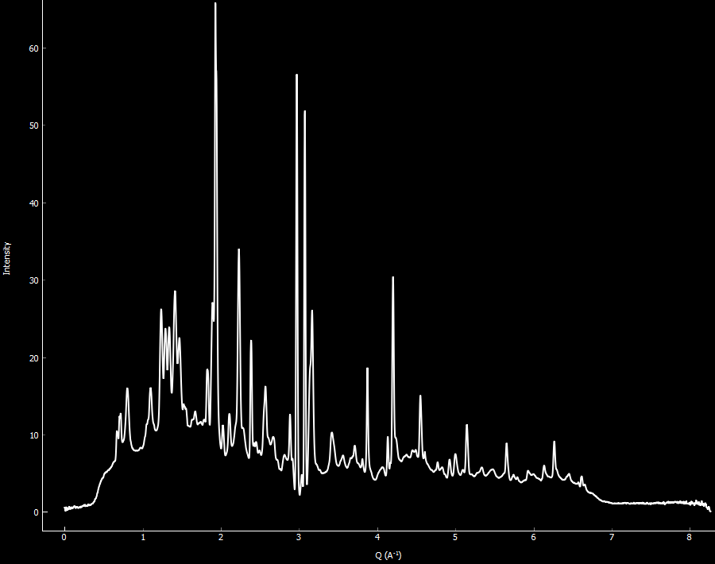
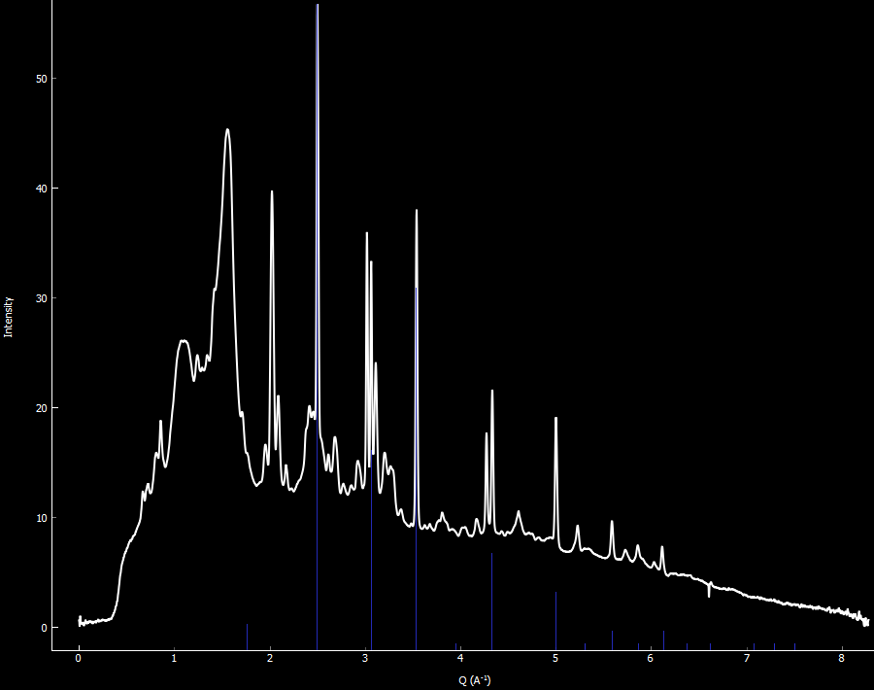
Formation of CaSiO₃ Perovskite
Room P & T
Pseudowollastonite
18 Gpa, 1000°C
CaSiO₃ Perovskite

Slide 30
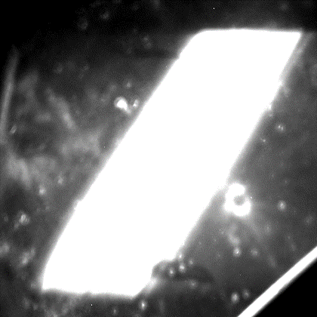
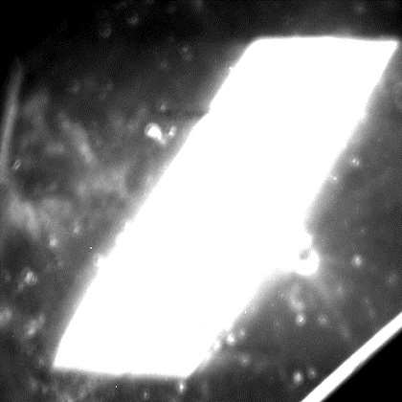
Deformation of CaSiO₃ Perovskite

Slide 31
Deformation of CaSiO₃ Perovskite
~18% Deformation!

Slide 32
Science Enabled by MAXPD
Stress – strain – time relationships for Earth and other materials
Elastic, anelastic, plastic properties from MHz to mHz
Kinetics of phase transitions
Atomic structure
Crystalline phases & liquids and amorphous materials
Thz to mhz elastic, viscous properties
Equation of state
Metallurgical and ceramic phase relations
Physics of fracking
Solidus of the lower mantle
Water/Volatiles in the Earth
Properties of melts
Rock mechanics
Carbon sequestration
Mechanical and chemical interaction of rocks and fluids
Earthquake faulting
Effects of/on Q (attenuation)
Cation coordination, order / disorder relationships
Extreme petrology
Petrology of the whole Earth

Slide 33
Forward Momentum
Full General User Program begins in 2018-3 cycle
Continuing work on integration with Bluesky and xpdAcq
Development of essential CSS experimental controls with dynamic feedback capabilities
Planned commissioning work on “spiderweb slits” for use in conjunction with multi-anvil experiments
Preparation of DT-25 module for integration of acoustic velocity measurements; elasticity vs. plasticity
Continued expansion of potential user base both within and beyond the Earth Science community

Slide 34
General User Proposal Deadline for the 2019-1 Cycle @ NSLS-II:
September 30, 2018!!!
Have an idea for an experiment? Let’s Talk!

Slide 35



Obligatory Kid Closer (Not To Scale)
Nikolas (17 Months)
Emiko (96 Months)
Bronwyn (17 Months)
So Sleep Tight, Little Atlas, ‘Cause When Your Daddy Goes Off, Just You Know
That You’re The Weight Of His Anchor; The Love That Is Guiding Him Home.

Slide 37

Mimicking Meteorites in the Multi-Anvil
Many mineral phases only found in meteorites or impacts
How do we investigate the formation of these phases?
LET’S BEAT UP THE PRESS!!!
Quick compression to peak load (~1-2 hours; 2-5x faster)
Spike heating from room T to ~1500°C in <1 sec! (~1000x)
Quench to room T after 5-60 seconds
Decompress and recover sample (~1-2 hours; 5-12x faster)
Experimental protocol is like a reverse impact event
Temperature wave enters first, followed by pressure wave
Rucks et al. (in press) Making Tissintite: Mimicking Meteorites in the Multi – Anvil. American Mineralogist (September 2018)
This new spike heating technique is now available for other experiments and new collaborations looking at CaSiO₃ perovskite, diamondoids, etc.
Melinda Rucks
Ph.D. Candidate (2019)
w/ T.D. Glotch & M.L. Whitaker
Stony Brook University

Slide 38

Maskelynite Formation via DAC Abuse
My insane suggestion – load the DAC to just below amorphization pressure (~15 GPa)
Then, pick up the DAC and drop it on table
Took a good deal of thought and convincing
First attempt – 2 ft. drop: No effect
Second attempt – 6 ft. drop: Maskelynite remained amorphous for several minutes upon decompression, then recrystallized
Third attempt – SMACADAC: load as a above, then hit it with a hammer
SUCCESS!!! Sample remained amorphous even after decompressing!
Not just the addition of strain, but strain-rate
Melissa Sims
Ph.D. Candidate (2018)
w/ T.D. Glotch & M.L. Whitaker
Stony Brook University

