Slide 1
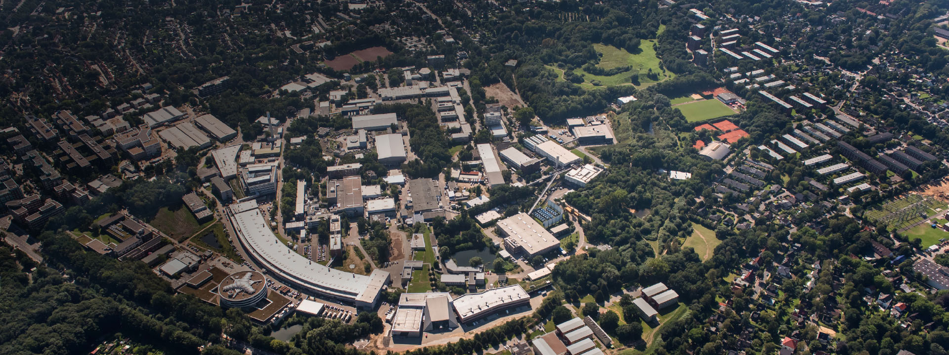
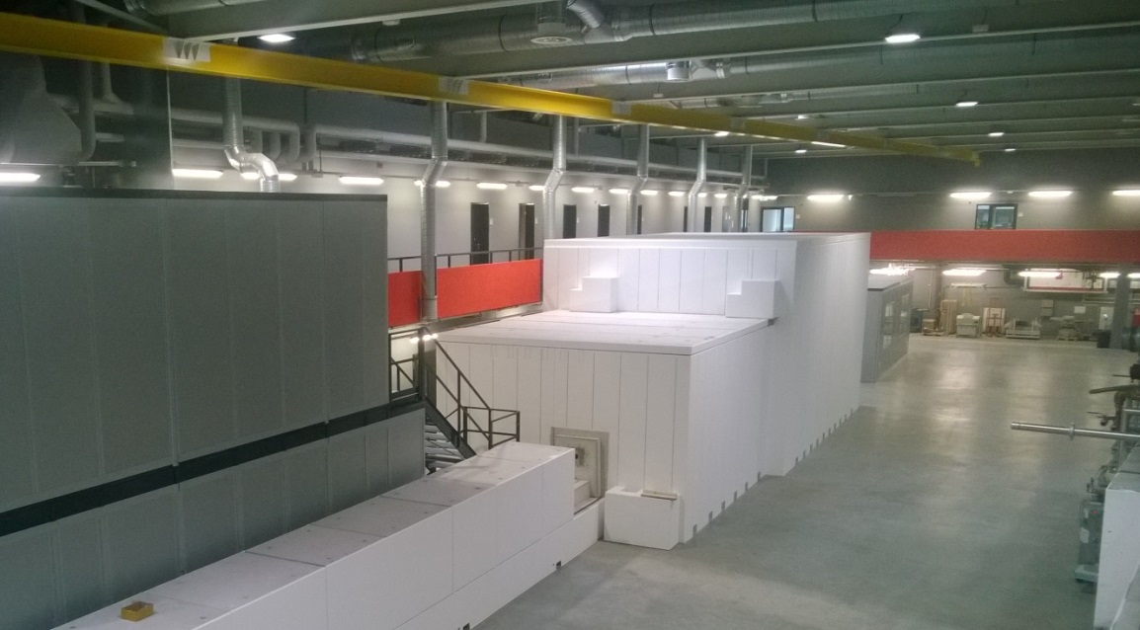
The LVP beamline P61B at PETRA III:
Development and experiments
Robert FARLA
APS, Argonne Nat. Lab, USA
28 September 2018
Ack: Shrikant Bhat, Stefan Sonntag, Nico Gaida, Eleonora Kulik, Norimasa Nishiyama, Wolfgang Drube, Tomo Katsura

Slide 2
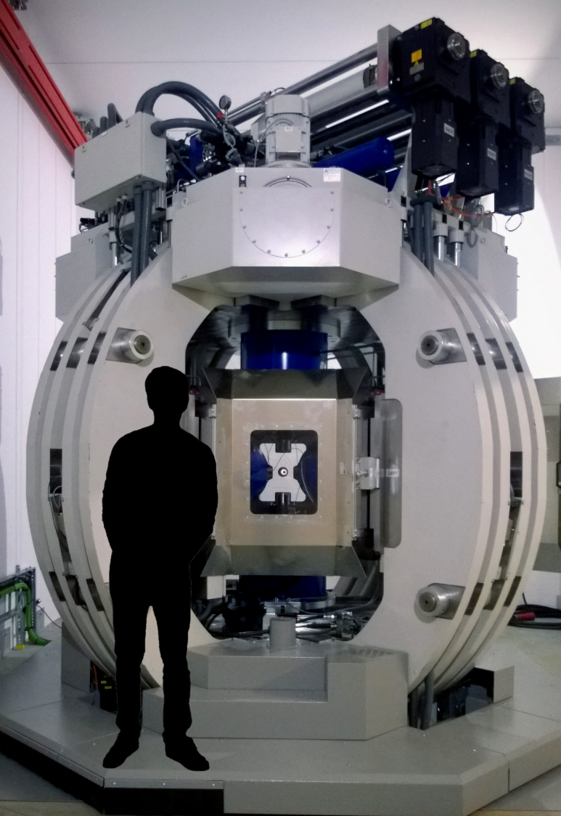
Overview of P61B (PETRA III)
01 Strategy of operation
02 Beamline characteristics
03 High-pressure techniques
04 Science highlights (ex situ studies)
05 Instrumentation (detectors…)
06 User support
07 Future plans (supply/demand)
08 Summary

Slide 3
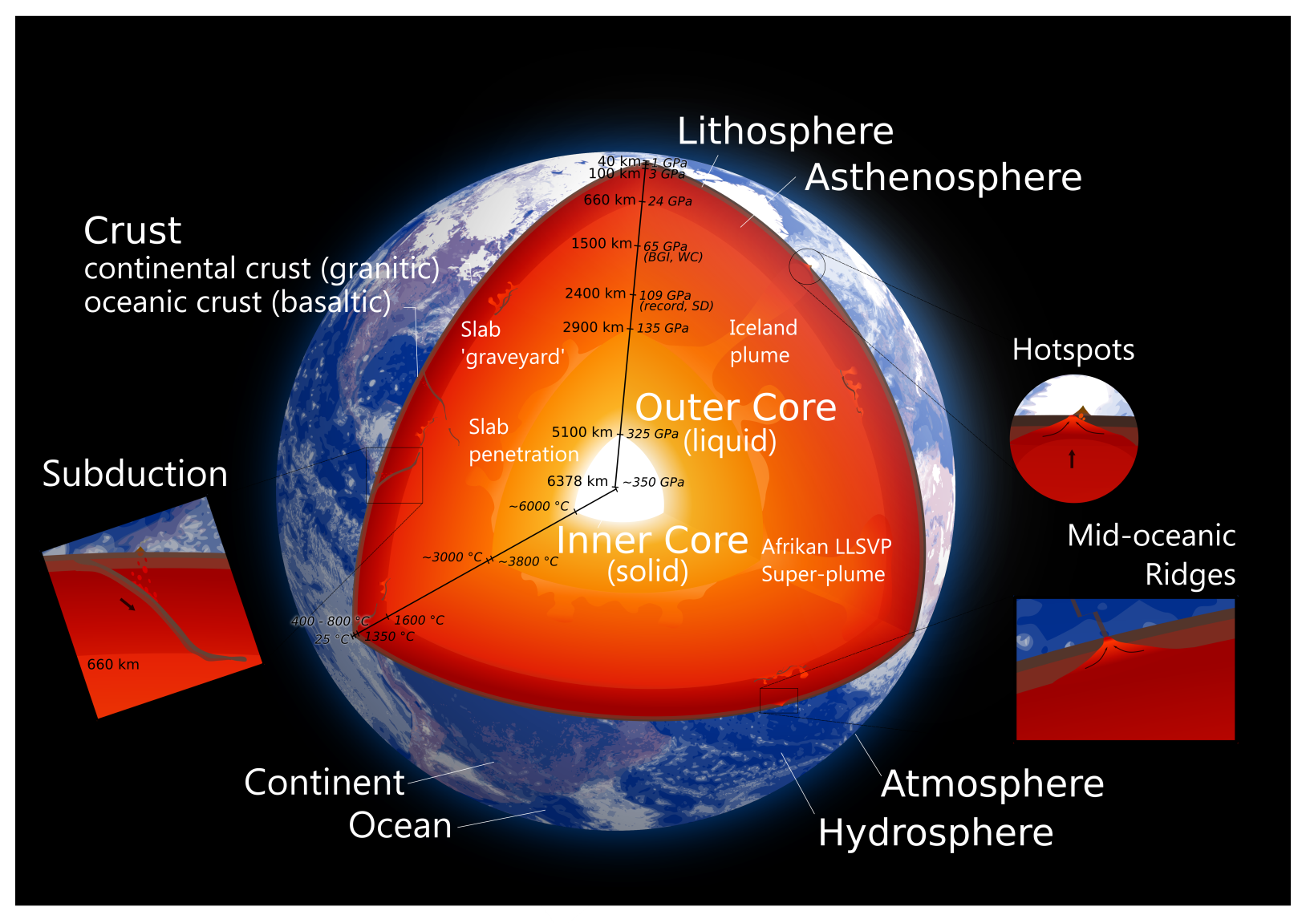
Strategy for beamline operations
Serving the Earth and Materials Science communities
I. Geochemistry, Geophysics, Seismology,…
Phase relations: • Transformation • Nucleation • Melting curves (solidus/liquidus) • Equations of state
Controlled rock deformation
Melt viscosity measurements
Amorphous materials
Acoustic interferometry
Electrical conductivity
The Earth

Slide 4
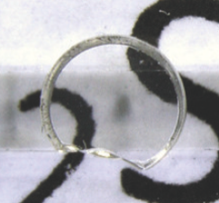
Strategy for beamline operations
Serving the Earth and Materials Science communities
II. Materials Science: functional materials with exotic properties
Band-gap tuning / semiconductors
Super-hard
Phase relations: • Transformation • Nucleation • Melting curves (solidus/liquidus) • Equations of state
Characterization of new unknown structures
Large (~1 cm³) sample synthesis
• Hardness testing, etc.
Si-Ti-C nitrides
Metal borides
Carbides
Sn-Ge-Si, Ta & Ga Nitrides
Tellurides (CrTe₃)
Indium oxides (In₂O₃)
Super-conductive
Optical windows
Metal hydrides
cubic-Si₃N₄
Al₂SiO₅ kyanite / Al₂O₃ / SiO₂ nano-composites
Catalyzers
Quadruple perovskites (AA′₃ B₄O₁₂)
Numerous uses in industry, multi-billion dollar markets

Slide 5
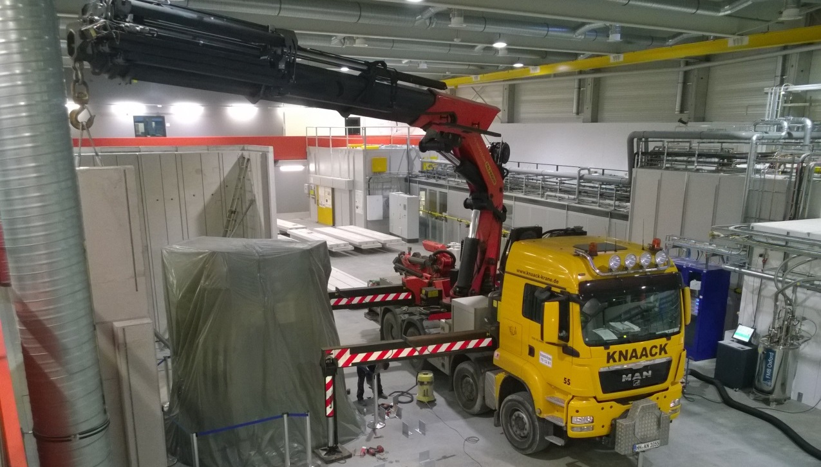
Beamline construction
10 Jan 2018

Slide 6
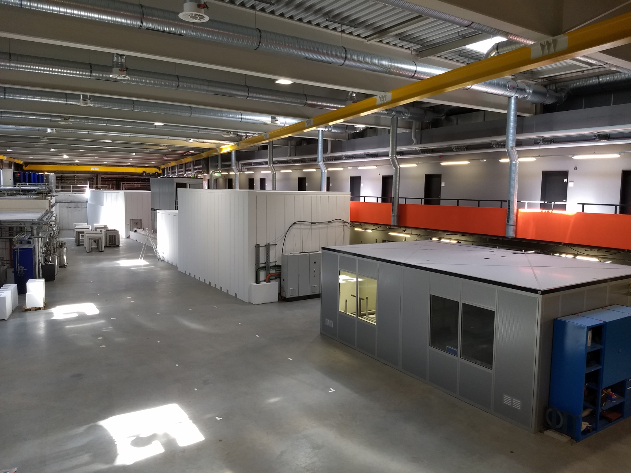
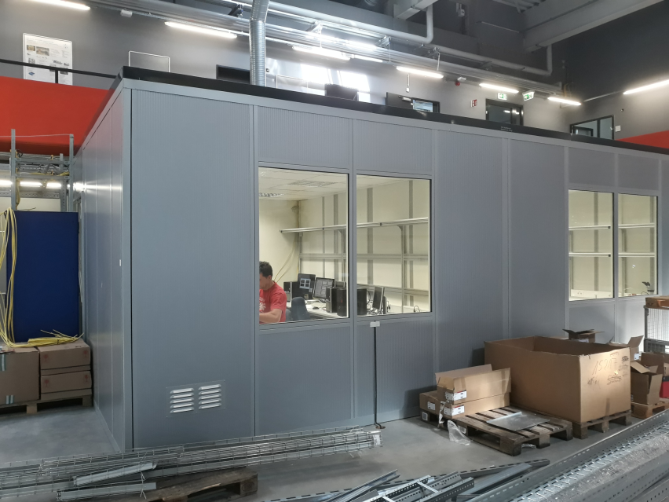
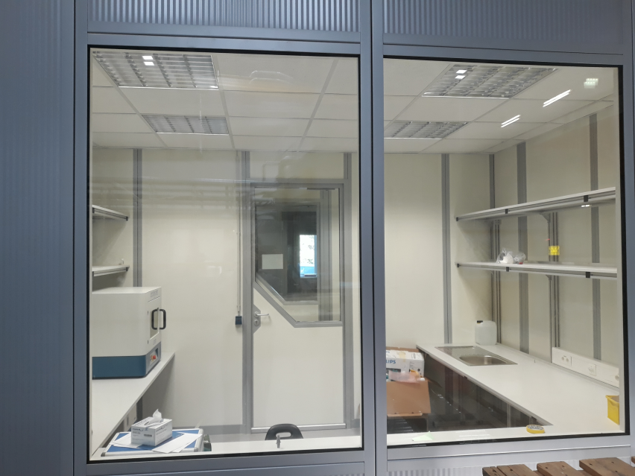
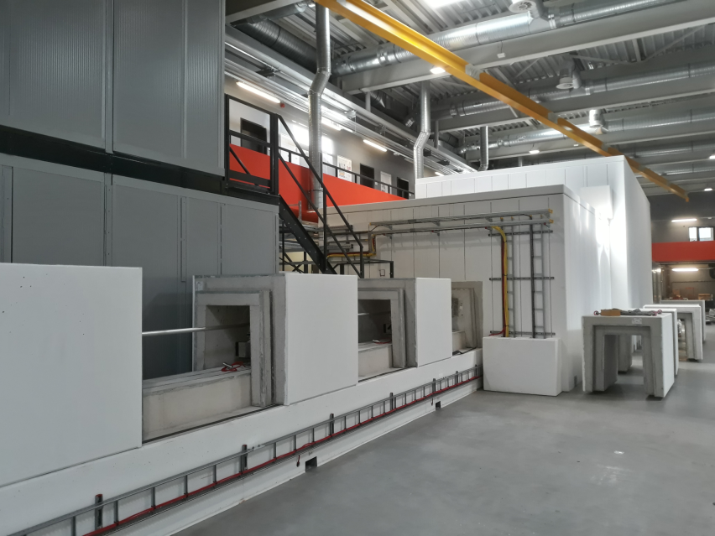
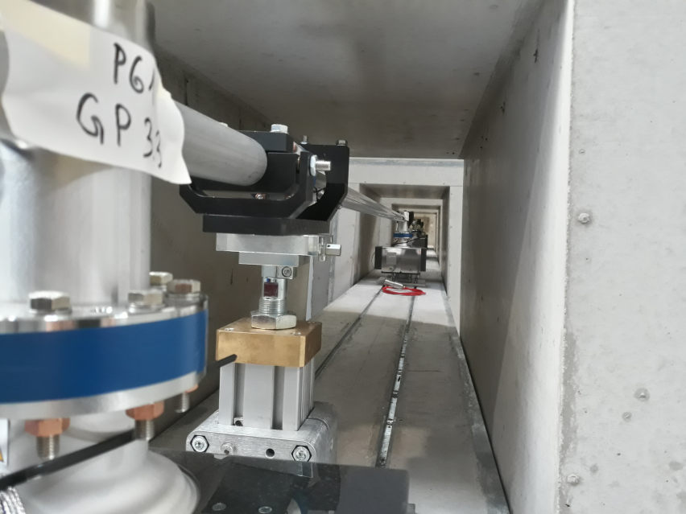
Beamline construction
Today
Control hutch + XRD lab
XRD lab and CNC room (behind)
Beam transport tunnel (to P61B)
View inside tunnel

Slide 7
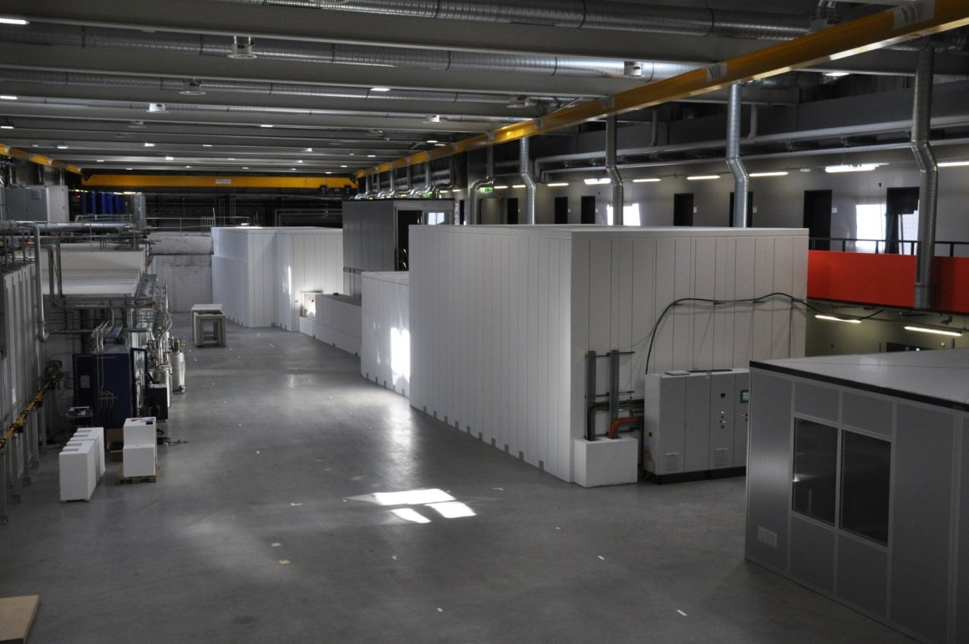
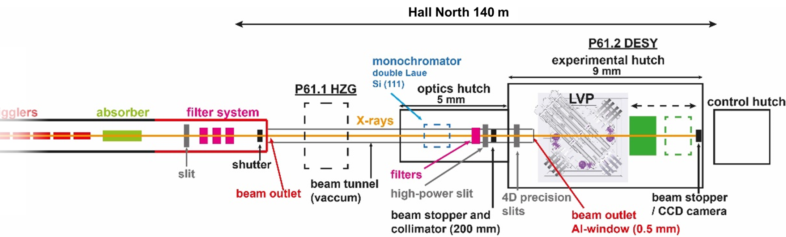
Beamline characteristics
CH HZG
Source: 10 Wigglers
Energy range: 30-200 keV
Flux: ~10¹¹ – 10¹² ph/s
Max. beam size (mm²): 1.5x1.5
Distance from last wiggler:
133 m
First beam:
expected early 2019
EH HZG
EH LVP
OH LVP
CH LVP
Hall North (140 m)
P61B LVP
(50%)
Front End
(50%)
P61A HZG
10x Wigglers
Absorber
Detector table
2 mm (v)
x 3 (h) mm
1 x 1 mm²

Slide 8
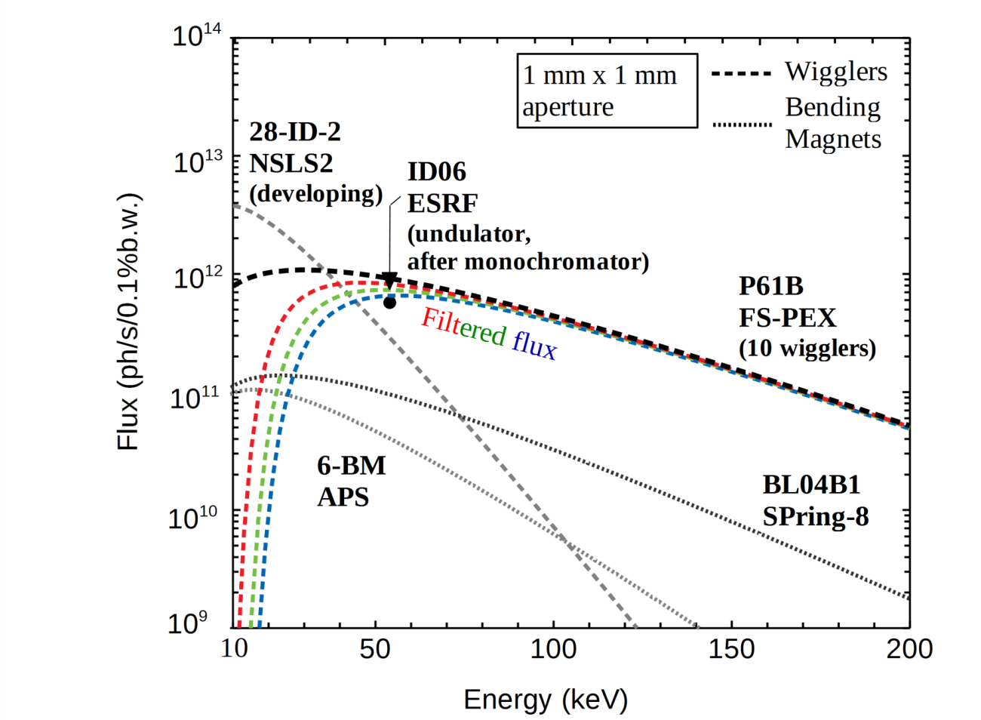
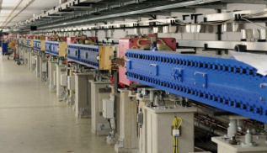
Beamline characteristics
Flux for 1 mm² beam
Source: 10 Wigglers
Energy range: 30-200 keV
Flux: ~10¹¹ – 10¹² ph/s
Max. beam size (mm²): 1.5x1.5
Power density:
12 W/mm² (1x CVD+Cu filter)
9 W/mm² (3x CVD+Cu filters)
7 W/mm² (3x CVD+Cu,1xC)
10 wigglers in the ~100 m straight section

Slide 9
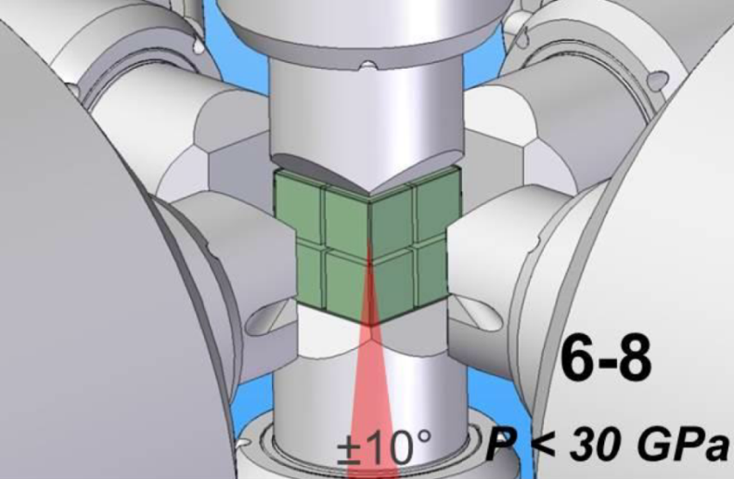
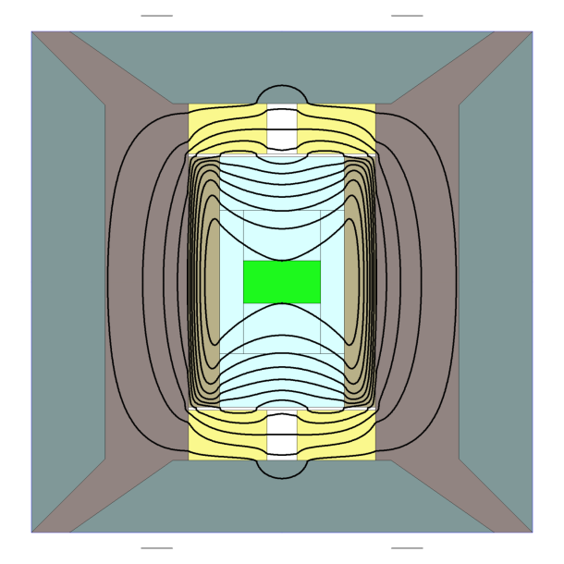
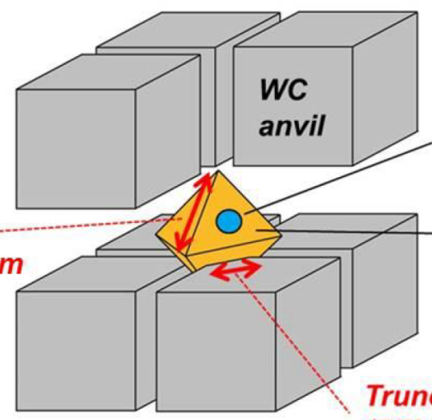

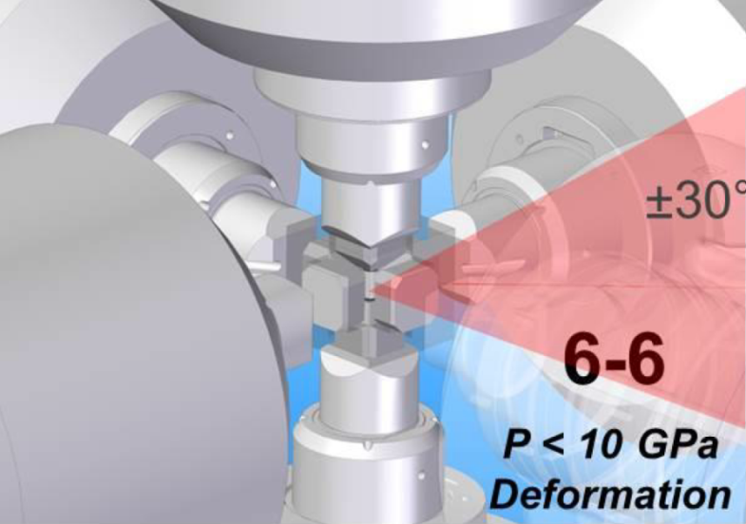
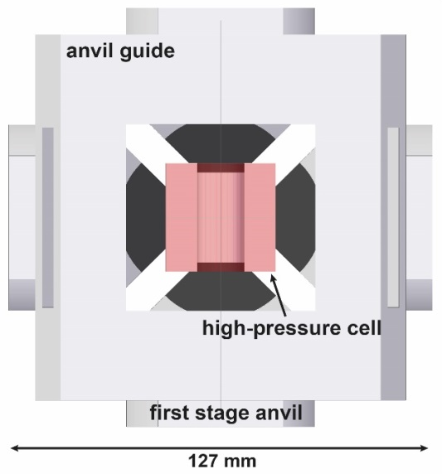
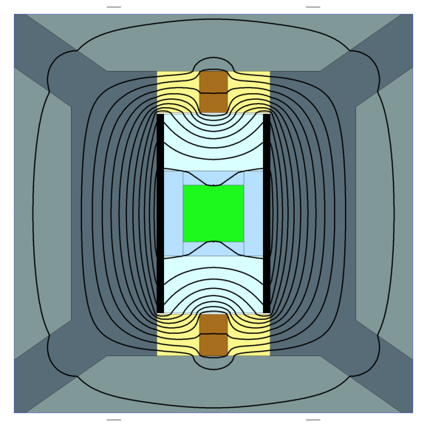
High-pressure techniques
Large chamber between 6 rams to accommodate various multi-stage set ups
Compression geometry
Assembly & heating
6-8 geometry
14/7 assembly
Mo
200 °C
ZrO₂
WC
Sample ø
1 - 3 mm
LaCrO₃
1200 ± 30 °C
Diffracted
X-rays
OCT
MgO
60 GPa
Anvil TEL
Power = 720 W
6-6 geometry
20/15 assembly
1 mm
Sample ø
6 mm
Cu
ZrO₂
WC
Diffracted
X-rays
1200 ± 30 °C
graphite
MgO
2
pyrophyllite
2nd
Power = 740 W
100 °C
Numerical simulations using CellAssembly (Hernlund et al. 2006)
2 mm

Slide 10
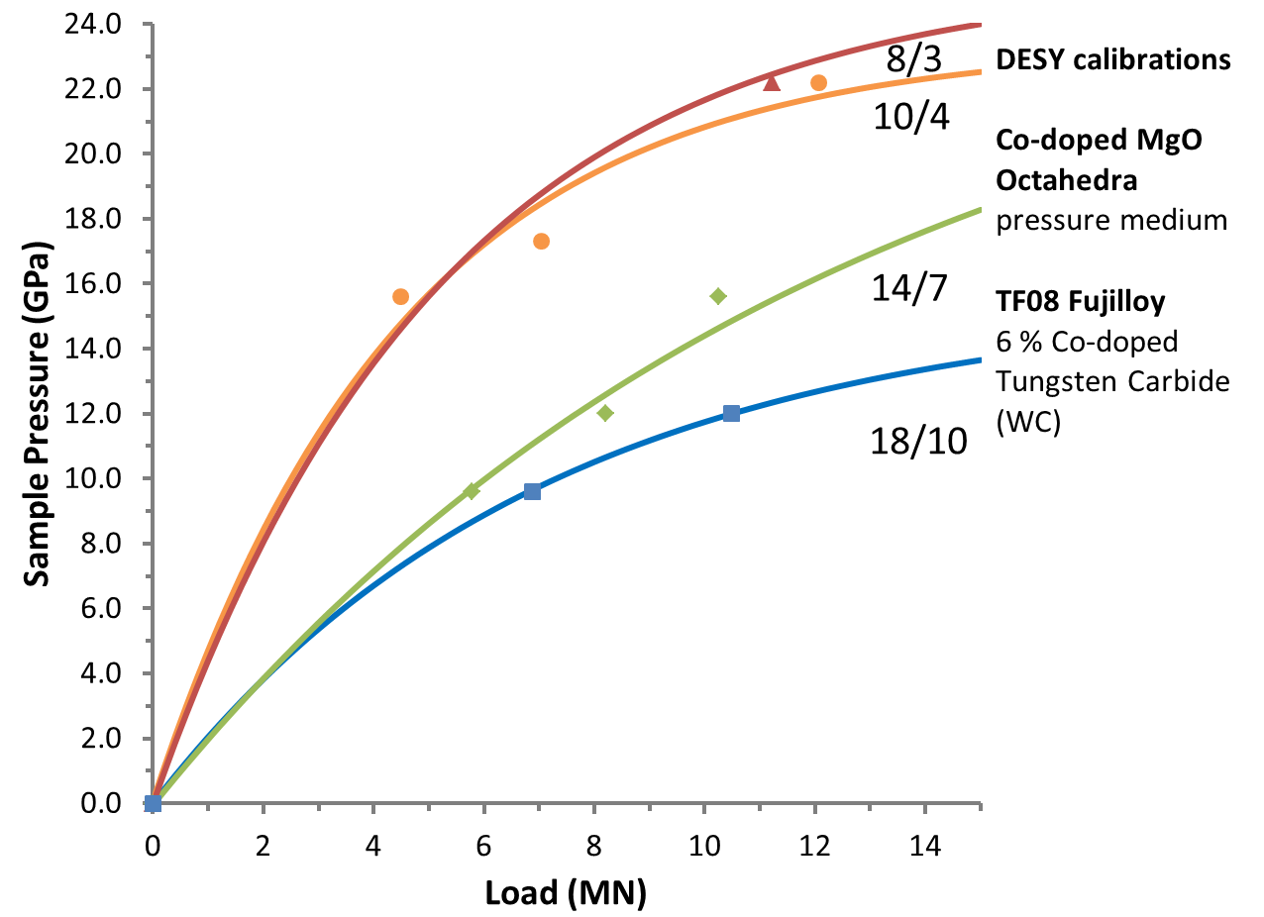
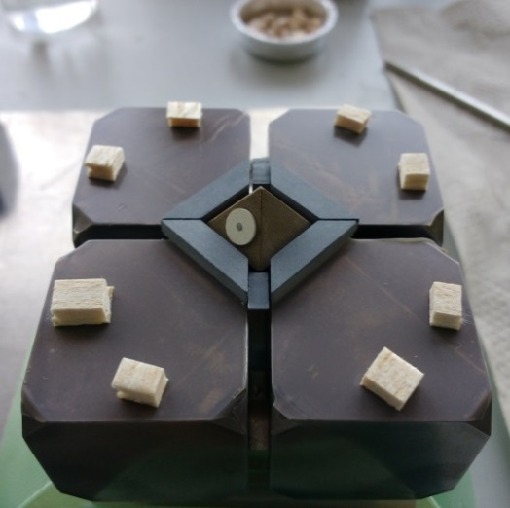
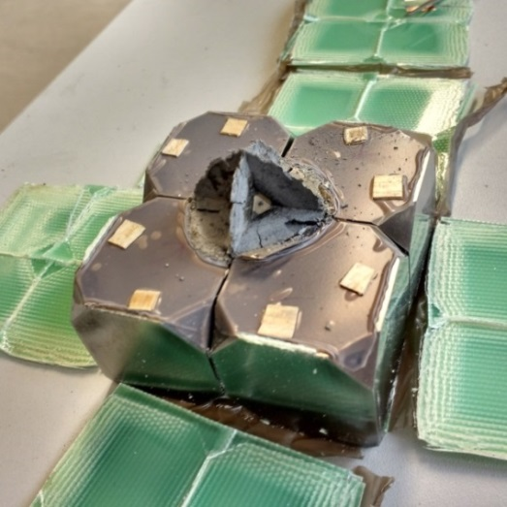
‘Kawai’ octahedral geometry (6-8)
Isotropic compression
Room temperature
GaP ➔
Sample sizes:
8/3 ~ 1 mm
10/4 ~ 1.5 mm
14/7 ~ 2 mm
18/10 ~ 2.5 mm
GaAs ➔
ZnS ➔
ZnTe ➔
ZnTe ➔
Before compression
After compression

Slide 11
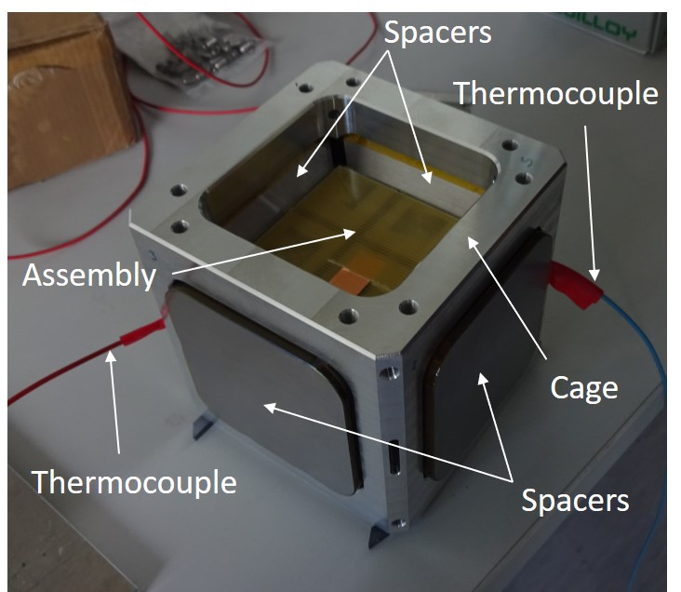
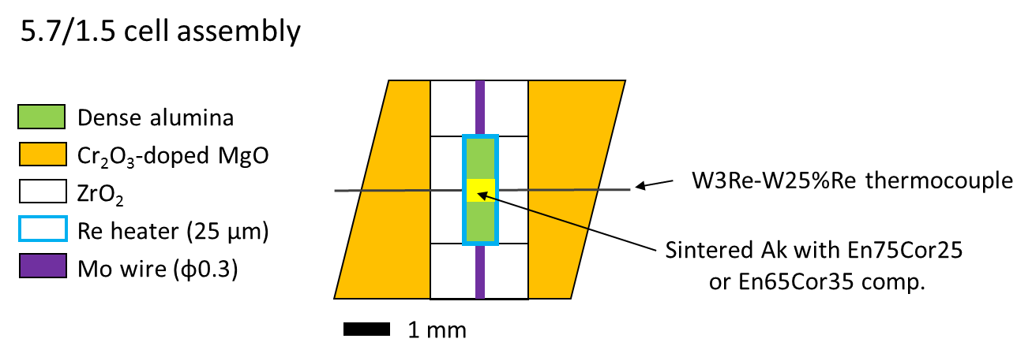
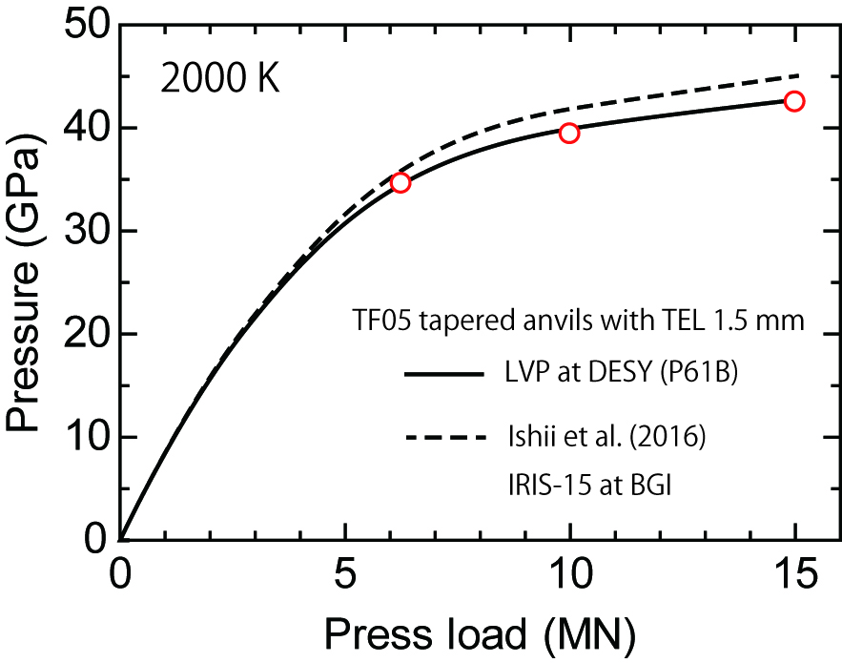
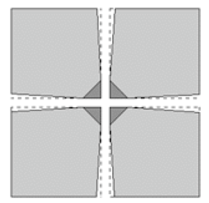
‘Kawai’ octahedral geometry (6-8)
Targeting pressures > 40 GPa at high temperatures in the LVP
Spacer system with cage to shrink 1st stage anvil EL from 60 mm to 50 mm for smaller WC anvils
(27 mm EL).
Fujilloy F05 anvils with negative tapers (-1°)

Slide 12
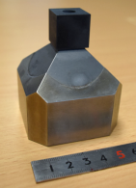
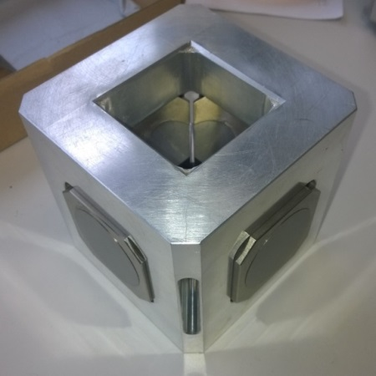
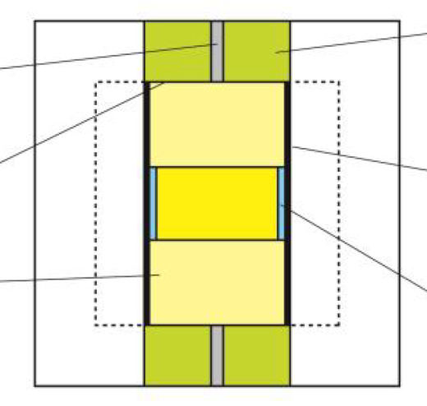
Cubic geometry (6-6)
Isotropic compression of very large sample volumes
Pyrophyllite cube
(pre-fired @ 500 °C overnight)
ZrO₂
Mo
Mo (disc)
graphite
MgO
MgO/hBN
50 mm ø base!
Sample sizes:
20/15 ~ 6 mm
30/20 ~ 10 mm
WC Anvils may not survive up to 15 MN…

Slide 13
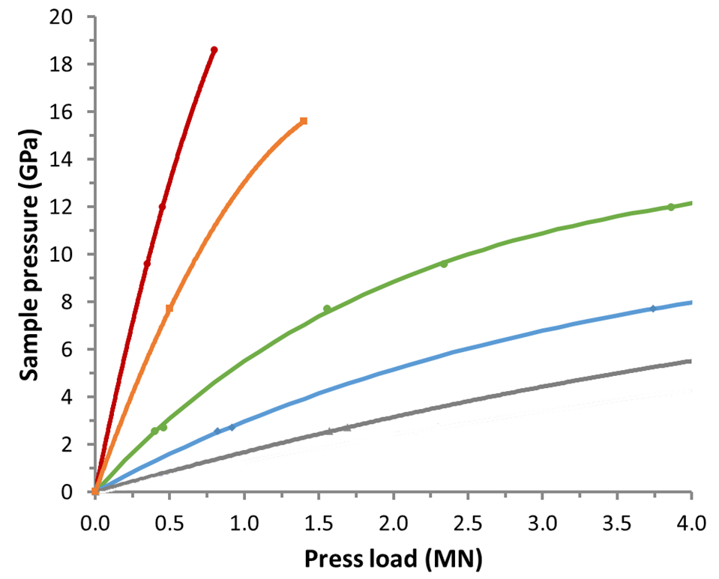
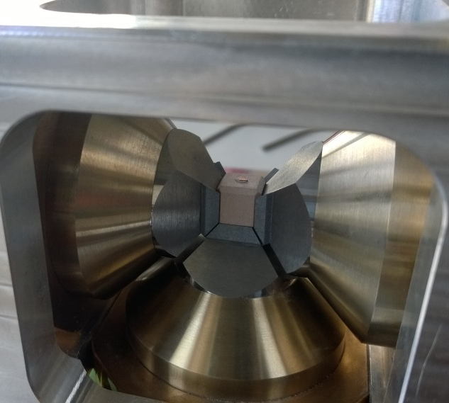
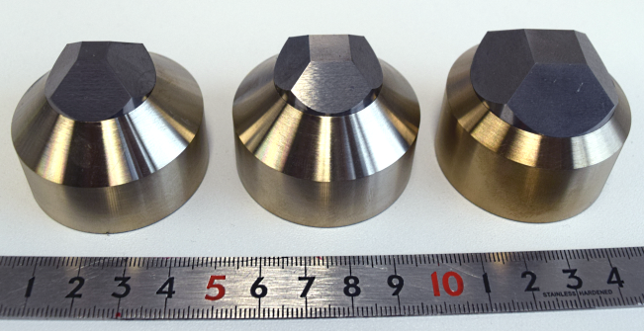
Cubic geometry (6-6)
Pressure calibrations for “smaller” sample volumes at higher pressures
4/2.5
18+ GPa
To do
Room temperature
5/3
15+ GPa
⬅ ZnS
12 GPa
Kawazoe et al. 2010,2016
8/6
⬅ ZnTe ➔
Manthilake et al. 2008
⬅ ZnTe ➔
8 GPa
12/9
⬅ Bi III-V ➔
6 mm
9 mm
12 mm
> 5 GPa
⬅ Bi I-II-III
16/12
Sample sizes:
16/12 ~ 5 mm
12/9 ~ 3 mm
8/6 ~ 2 mm
5/3 ~ 1 mm
Load limit for WC 7% Co anvils with 25 mm ø

Slide 14
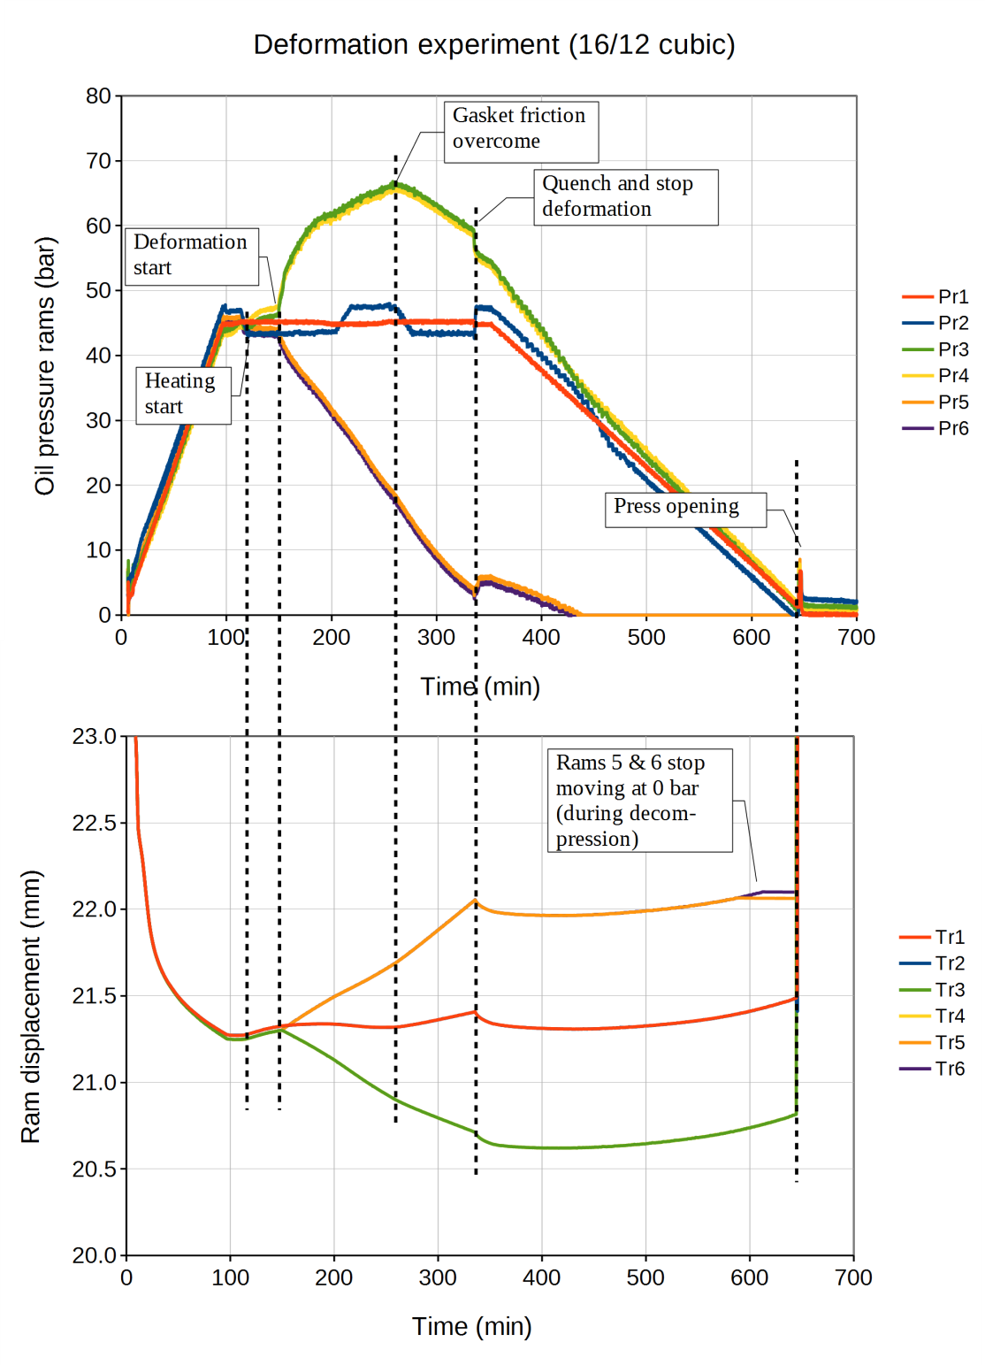
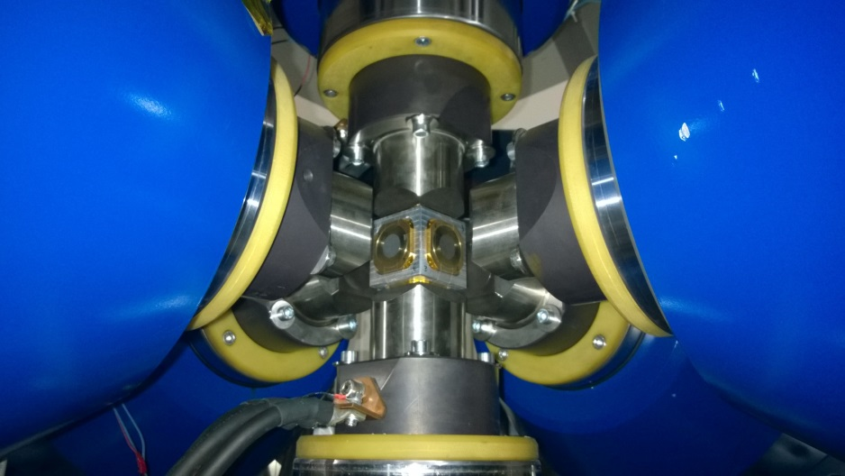
Cubic geometry (6-6)
Anisotropic compression (deformation)
3
2
6
5
1
4
Controlled displacement rate of rams:
3,4: -7.2 µm/min (move in)
5,6: +7.2 µm/min (move out)
1: holds pressure at 45 bar (profile)
2: follows position of ram 1
This is constant volume anisotropic compression. Is sample pressure constant??

Slide 15
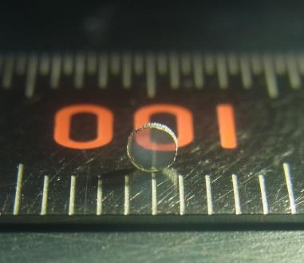
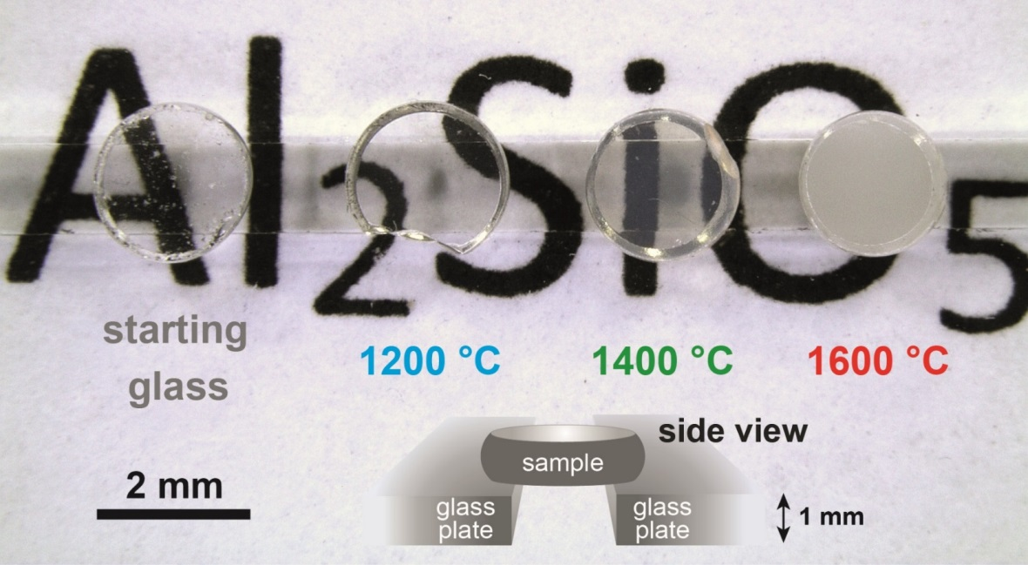
Beamline highlights (ex situ)
- Synthesis of transparent cubic silicon nitride
Nishiyama N, Ishikawa R, Ohfuji H, et al. Scientific Reports 7:44755 (2017)
- Synthesis of transparent kyanite
Gaida N, Nishiyama N, Masuno A, et al. J Am Ceram Soc 100:323-332 (2017)
Transparent cubic silicon nitride (c-Si₃N₄)
Transparent cubic kyanite (Al₂SiO₅)
Synthesis conditions: P ≈ 15.6 GPa, T > 1500 °C
Attractive choices for creating optical windows with supreme durability.

Slide 16
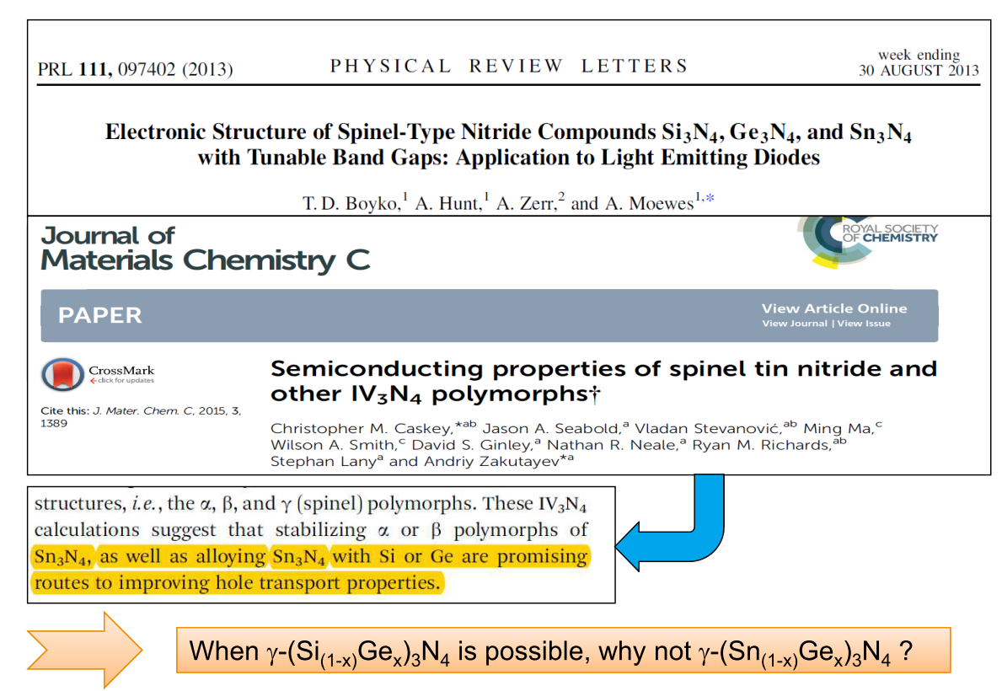
Beamline highlights (ex situ)
Synthesis of Sn-Ge-N compounds (courtesy of Dr. Bhat)
Band-gap tuning semi-conductors for solar-energy conversion and light emitting diodes

Slide 17
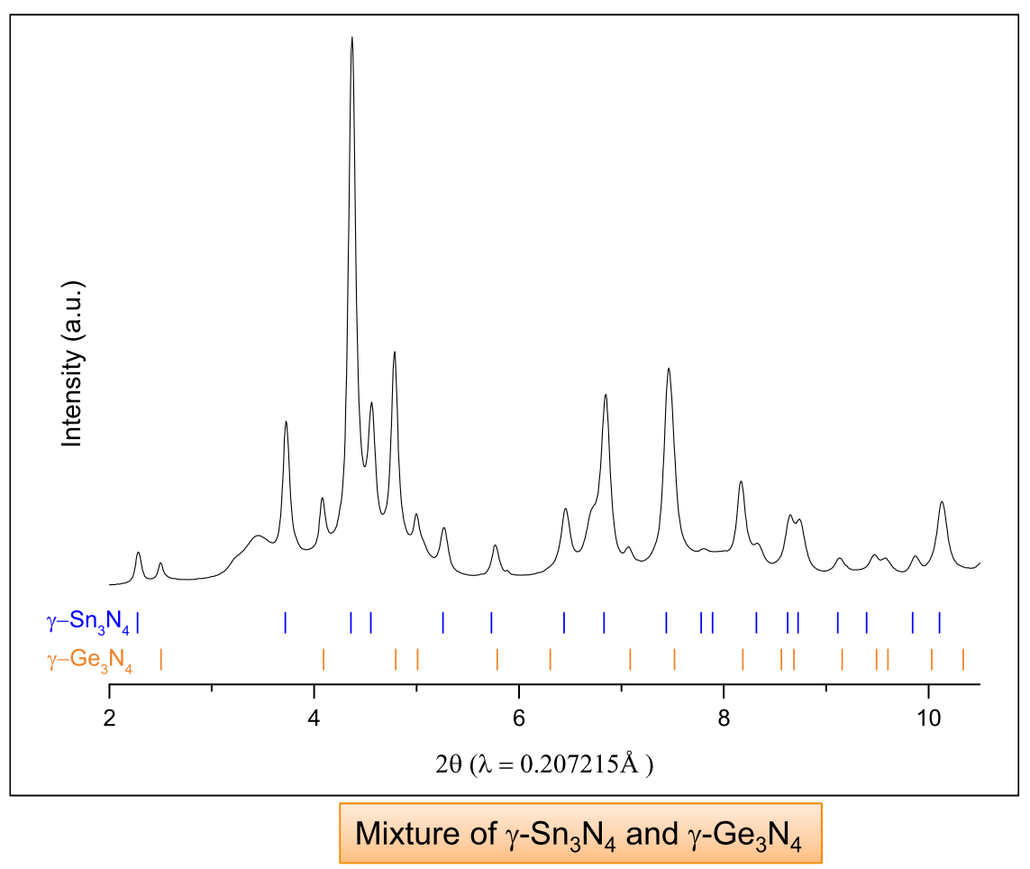
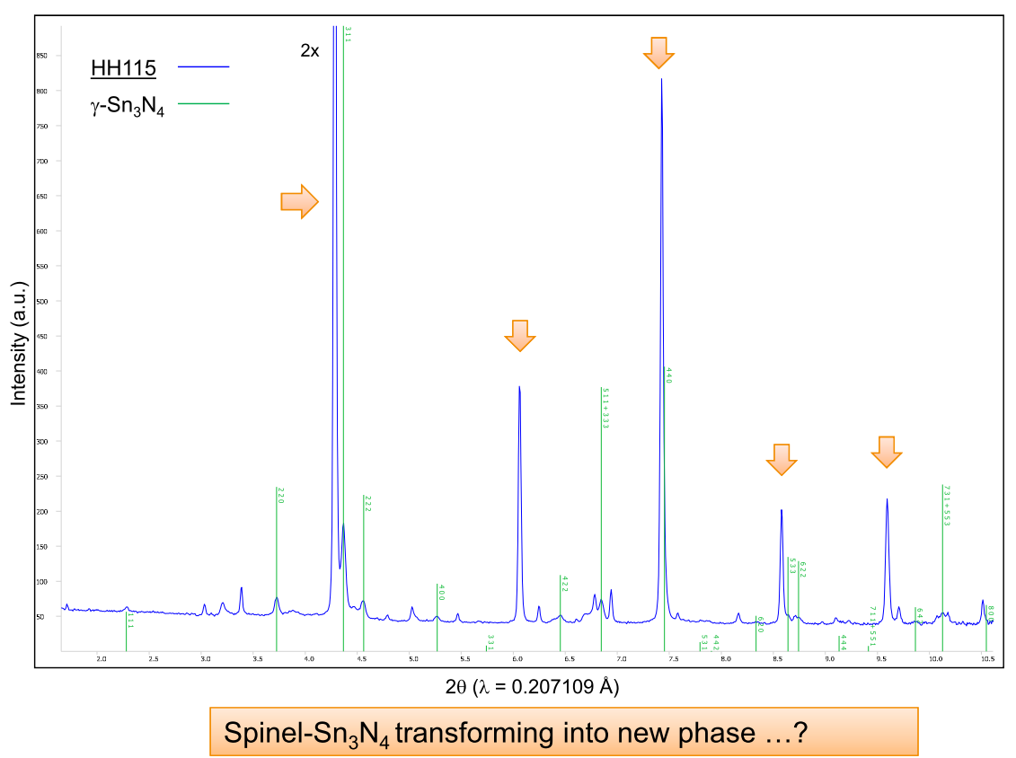
Beamline highlights (ex situ)
Synthesis of Sn-Ge-N compounds (courtesy of Dr. Bhat)
At 15.6 – 20 GPa and 800 – 1000 °C
At 20 GPa and > 1000 – 1500 °C
Measurements done at P02.1, the powder diffraction beamline

Slide 18
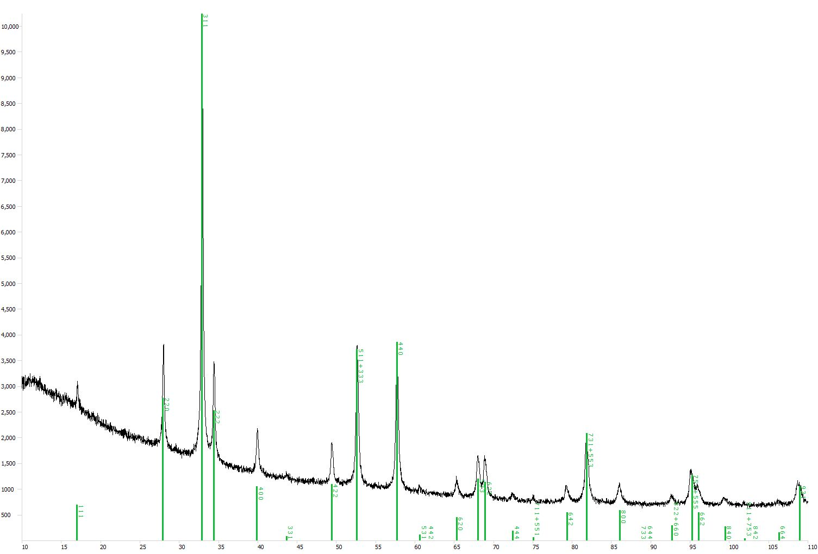
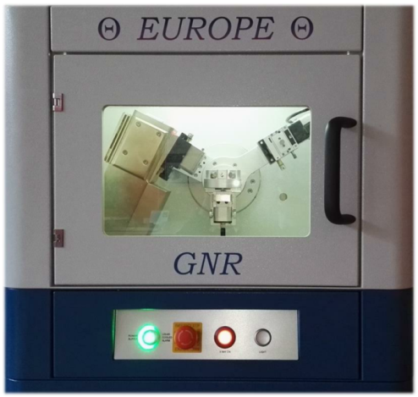
Beamline highlights (ex situ)
Synthesis of Sn-Ge-N compounds (courtesy of Dr. Bhat)
At 15.6 GPa and 800 – 1000 °C
γ- Sn₃N₄
GNR θ-θ Europe XRD
(600 W)
Measurement below
Range: 10 – 110°
Anode: Cu, kα
Acquisition time: 2 hrs
Throughput: > 10 kcps
At > 20 GPa and > 1100 °C
Measurements done at P02.1, the powder diffraction beamline
2 theta (Cu, Kα )

Slide 19
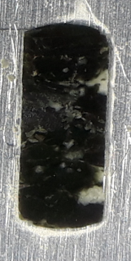
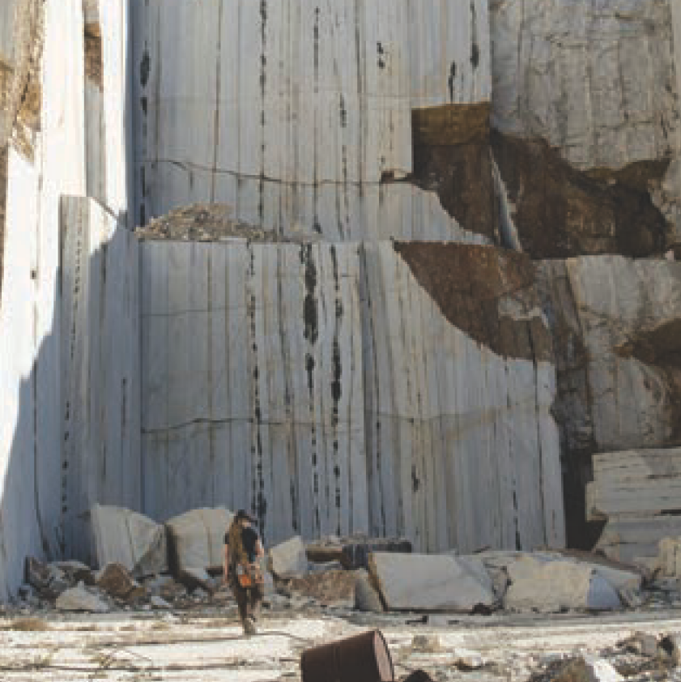
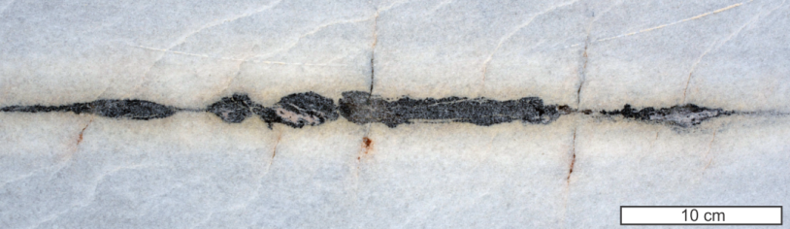
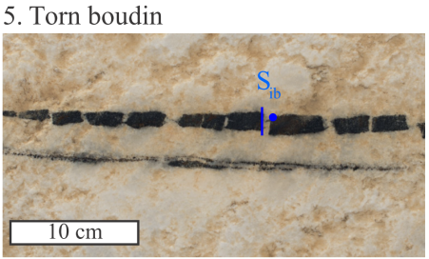
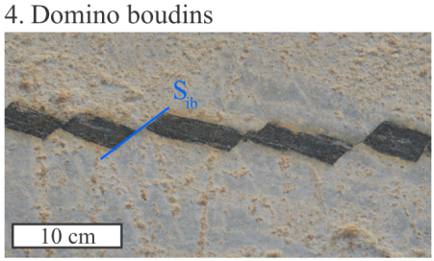

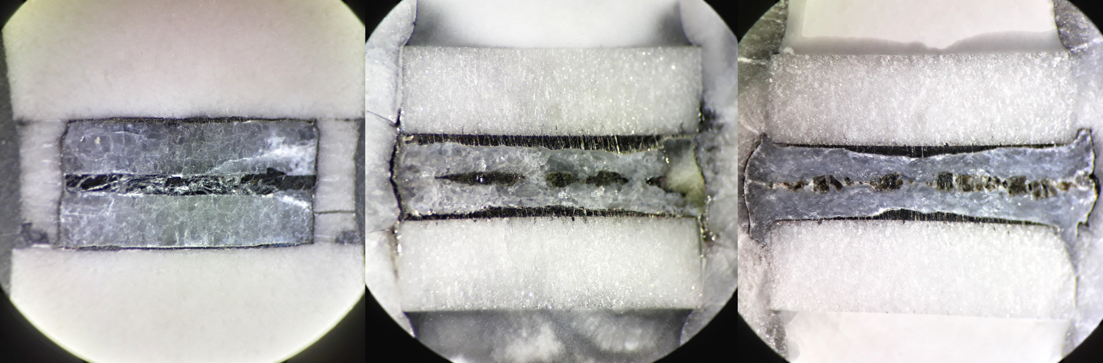
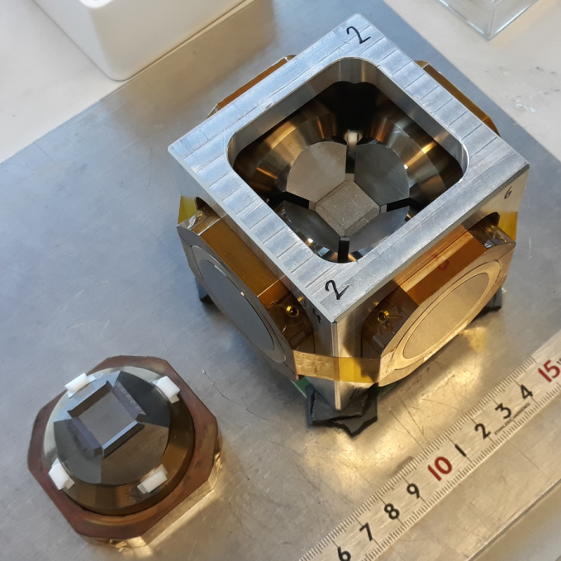

Beamline highlights (ex situ)
Pinch-and-swell structures of deformed amphibolite in marble (R. Farla)
Experimental observations
Natural observations
Naxos, Greece
(Virgo et al.
Solid Earth 2018)
Amphibolite
3
Side
view:
Marble
Top
view:
Viscous boundinage
Amphibolite ~ 0.3 mm
MgO
sample
stack
Marble
5
Sample
stack
6
4
MgO
2 mm
5 mm
5 mm
5 mm
P ~ 2 GPa T ~ 750 °C
P ~ 1.5 GPa T ~ 700 °C
P ~ 1.5 GPa T ~ 500 °C
Undeformed
ε_{stack} ~50%, ε_{stack} ~6 x 10⁻⁵ s⁻¹
ε_{stack} ~50%, ε_{stack} ~6 x 10⁻⁵ s⁻¹
Notes:
For 700 C: Boudin wavelength is 1000 um (1 mm), and n_marble = 11, and m ~ 2.5, then n_amph ~ 8 to 9 (ductile behaviour)
For 500 C: Boudin wavelength is 280 um, and n_marble = 11, and m ~ 2 to 3, then n_amph > 100 (brittle behaviour)!

Slide 20


Synchrotron X-rays for the LVP
First light in the Front End of P61 (21 Aug 2018)
Press hydraulics
Incident
X-rays and slits
2x Ge-detectors
sCMOS camera
(not shown)
5-axis stage
Detector table
2 HP Ge-detectors for ED-XRD measurements, sCMOS camera for radiography
X-ray transport tube with adjustable slits (W, 10 mm thick blades)
5-axis stage [x, y1, y2, z (± 100 mm), rotation (± 20°)]

Slide 21



Measurement techniques
Energy-dispersive X-ray Diffraction using 2 Ge-SSD
Anticipated features:
Fast acquisition (10s of seconds)
Choice of diffraction angles
High throughput:
> million cps at 50 keV
> 700 kcps at 122 keV
Electrically cooled: no maintenance
Advantageous for studies on low Z & amorphous materials
Possible implementation of CAESAR data acquisition for combined AD/ED-XRD
Principle:
Bragg’s law;
$$λ=hc/E$$
where
$$n\frac{hc}{E_{hkl}}={2d}_{hkl}\sin{θ}$$
incident slits
(e.g. 50 µm)
receiving
slits
Scanned variable
(by ED detector)
Fixed
(by collimator)
Gauge (sample) volume
Determined variable
http://pd.chem.ucl.ac.uk/

Slide 22



Detector table
Call for tender out
Table can move backwards to make room (1.7 m) for a smaller roll in – roll out instrument (e.g. Paris-Edinburgh press from P02.2)

Slide 23

Detector-collimator-slit system
Horizontal scanning detector #1

Slide 24

Detector-collimator-slit system
Horizontal and vertical scanning detector #2

Slide 25




Detector positioning
Distance sample to first slit in collimator
Receiving cross-slits
(10 mm
tungsten blades)
Minimum angles
Detector movements:
x,y,z translations,
z-axis rotation,
y-axis rotation (vert. detector only)
Angular res: ± 0.0001 °
For CAESAR:
Angle step size: 0.001°
Movement precision:
< 5 µm
Top view
At -5°H and 5°H
Side view
At 5°H and 5°V

Slide 26



Detector positioning
10°
Adjustable
slits
Energy-dispersive
X-ray Diffraction
using two Ge-SSD
Maximum angles
Incident X-rays
10°
Detector 1
Isometric view
Both detectors at max. 10° in horizontal plane
Top view
Max. 10° in horizontal without press rotation

Slide 27

Detector positioning
23.5°
Adjustable
slits
Energy-dispersive
X-ray Diffraction
using two Ge-SSD
Maximum angles
Incident X-rays
10°
Detector 1
Isometric view
Both detectors at max. 10° in horizontal plane
Top view
Max. 10° in horizontal without press rotation

Slide 28

Detector positioning
23.5°
Adjustable
slits
Energy-dispersive
X-ray Diffraction
using two Ge-SSD
Maximum angles
11.5°
Incident X-rays
20°
Detector 1
Isometric view
Both detectors at max. 10° in horizontal plane
One horizontal detector at max. to 20° with press rotation (max. 11.5°)

Slide 29




Imaging
100 fps @ 5.5 MP or
> 1600 fps @ 2560 x 128
> 1 GB/s!
X-ray radiography using a white-beam microscope with double objectives
(10x, 20x)
Example: X-ray radiography images of falling Pt sphere
(Kono et al. 2014)
sCMOS camera PCO.edge 5.5 MP
Scintillator and objectives
Camera and detectors set up in measurement positions

Slide 30




User support
Plus:
Ovens (storage and vacuum)
Firing furnace
Stereoscope, sensitive balance, low-speed diamond saw, drill, etc.
User-friendly operations with laboratory support
Benchtop X-ray
diffractometer (600 W)
for ex situ sample analysis
High-precision (20 µm)
CNC milling machine
for assembly parts
manufacture
Lathe
for assembly parts
manufacture
PUK welder
for precision
welding

Slide 31




Future plans (with X-rays available)
Expansion possibilities
Design of mono from P21.2
Angle-dispersive XRD capability
  Installation of a double crystal Laue monochromator and 2D detector.
Impedance analyser for electrical conductivity measurements
  In situ technique also available without X-ray beam.
Energy selection (> 40 keV), high bandwidth,
uses benders for Si crystals.
2nd LVP (< 1.7 m wide)
  Paris-Edinburgh press
  (ECB beamline P02.2)
  (rotational) Drickamer press?
RDA
Yale Univ.
P-E press
(at P02.2,
PETRA III)

Slide 32
Summary
Maximize 6-ram LVP capability:
  Pressure-temperature generation (> 60 GPa) ( > 2000 K)
  Sample size - cell assembly optimization
  Deformation mode (anisotropic compression)
Provide standard assemblies for users
Offer flexible experiment and measurement set ups
Easy-to-use graphical user interfaces

Slide 33
Closing statements
A high-energy, extreme conditions beamline to serve a large community worldwide
Website: http://tiny.cc/petra3p61
Beamtime scheduling:
  With beam: 50%, shared with P61A
  Without beam: 50%, also open to proposals
Commissioning: ~ 1st half of 2019
User runs: late 2019, early 2020?
Thank you for listening!

Slide 34
FARLA, Robert
FS-PEX
robert.farla@desy.de
+49-40-8998-4470

Slide 35

High-pressure techniques
Upper
Mantle
Transition zone
Lower Mantle
Why a 6-rams Large Volume Press (LVP)?
Large samples (1-10 mm) (vs DAC samples < 0.1 mm)
Polycrystalline materials (incl. grain boundaries)
diffusion, deformation, nucleation, seismic cracking,…
Further testing/analysis
(e.g. hardness testing,…)
Highest pressures for
6-ram and DIA-type LVP
Isotropic & anisotropic compression (controlled rock deformation)
WC-anvils

Slide 36


Measurement techniques
Complete agreement of the post-
spinel transition with the 660-km
seismic discontinuity
23.5°
Adjustable
slits
Energy-dispersive
X-ray Diffraction
using two Ge-SSD
Sample compositions
23.70 GPa
Maximum angles
MgO pressure marker
2θ = 7.2°
23.38 GPa
Incident X-rays
Rw
Rw
20°
Rw
Rw
Rw
Isometric view
Both detectors at max. 10° in horizontal plane
Press pre-rotated to max. 11.5 ° to position one detector at up to 20°
Ishii et al. (Farla, Kulik, Bhat) Scientific Reports. 2018

Slide 37

CWS-DESY: Fate of water in the deep mantle
Stability of dense hydrous magnesium silicates: ‘alphabet phases’ & others
MgO-SiO₂-H₂O system
Relatively cold oceanic crust carries water into the Earth as OH in hydrous phases, transformed by pressure.
→ Extending pressure range of 6-ram LVP to 65+ GPa at DESY
Conventional LVP
Phases:
A, super-hydrous B (suB) = C,
D = F & G, E, H, … and 10 Å, egg, δ-ALOOH,…
Ohtani et al.
Geophys. Res. Lett. 2014

Slide 38



Published ex situ studies (since 2015)
1. Synthesis of transparent cubic silicon nitride
Nishiyama N, Ishikawa R, Ohfuji H, et al. Scientific Reports 7:44755 (2017)
2. Transparent polycrystalline nanoceramics consisting of triclinic Al₂SiO₅ kyanite and Al₂O₃ corundum
Gaida N, Nishiyama N, Masuno A, et al. J Am Ceram Soc 101:998-1003 (2017)
3. A Complete Solid Solution with Rutile-Type Structure in
SiO₂ – GeO₂ System at 12 GPa and 1600 °C
Kulik E, Nishiyama N, Masuno A, et al.
J Am Ceram Soc 98:4111-4116 (2015)
GeO₂
(Si_{0.3},Ge_{0.7})O₂
(Si_{0.5},Ge_{0.5})O₂
(Si_{0.8},Ge_{0.2})O₂
(Si_{0.9},Ge_{0.1})O₂
SiO₂

Slide 39

Highlight (Dr. Bhat)
Crystalline ternary B-C-N, a superhard phase?
Predicted by theory
Good chemical stability and oxidation resistance
High-T stability
Commercially hugely attractive
($20 billion market)
Yeung et al. Annual Review of Materials Research (2016)

Slide 40

Highlight (Dr. Bhat)
BC₄N and BC₂N compounds
Amorphous BC₄N and BC₂N compounds decompose into c-BN and diamond.
Thus, B-C-N materials remain elusive.
New boron oxynitrides (BON) compounds, e.g. B₆N₄O₃ were discovered with yet unknown properties.

Slide 41

Highlight (Dr. Bhat)
Sn₃N₄ and Ge₃N₄ (1:1) recovered from 15.6 GPa, 1000 °C – no solid solution…

Slide 42

Highlight (Dr. Bhat)
XRD: Sn₃N₄ recovered from 20 GPa, > 1100 °C – new phase formation!

Slide 43

Highlight (Nico Gaida)
Transparency of the nanoceramic
λ = 645 nm
d = 0.8 mm
12/17

Slide 44

Highlight (Eleonora Kulik)
Fracture-induced amorphization leading to tougher ceramics

Slide 45

Micro-mechanical bending test
Highlight (Eleonora Kulik)
Micro-mechanical bending test
Bridgmanite (MgSiO₃)
Vickers hardness ~ 17 Gpa
(versus stishovite (SiO₂) at 30 Gpa)

Slide 46

From ex situ to in situ studies – an eye opener
Tools for investigating Geophysical and Geochemical Processes
  Cook and look experiments => create the P-, T- conditions, quench the sample and hope it stays the same
  In Situ experiments => create P-, T- conditions and measure the properties directly
In Situ techniques
  Raman/Infrared, Fluorescence, Brillouin Scattering, Electrical conductivity, Acoustic Emissions testing…
  X-ray Diffraction and X-ray Spectroscopy (synchrotron)
    Powder diffraction => phase identification and
    structural analysis (Rietfeld), deformation…
    Single crystal diffraction => full crystal structure
    characterization
    Fluorescence spectroscopy => chemical composition
    Imaging (radiography, phase contrast, tomography)
+

Slide 47



Example study: Dehydration of subduction zone minerals
From Zeolith to Greenshist, Blueshist and Eclogite facies
https://upload.wikimedia.org/wikipedia/en/d/d1/Metamorphic_pathway_of_pressure-temperature_conditions_in_subduction_zones.jpg
10¹² kg/year
Dehydration reactions in the subducted lithosphere:
Cause melting and volcanism
Trigger Earthquakes
Impact mantle convection
How much water is carried down?
Which hydrous and nom. Anhydrous minerals?
aus Winter 2001
Notes:
One way of looking at what happens in more complex system in a simplified way is to look at the .so called facies => regions of the P-T phase diagram for all rocks.

Slide 48




High-pressure techniques
Pressure media Heaters Refractory filling materials
10 mm
(Cr-MgO)
14 mm
(Cr-MgO)
LaCrO₃
Graphite
ZrO₂
MgO
h-BN
18 mm
(Cr-MgO)
Resistive heating
~20 Ohm ~0.03 Ohm
Melting point
(At room pressure)
2715 °C 2852 °C 2973 °C
25 mm
(Co-MgO)
Sample capsule
Pt, Re, Mo, Ni, Ta
Sample
Thermocouple
20 mm
Al₂Si₄O₁₀(OH)₂
1-5 mm
Type-C
W-5%Re – W-26%Re
(up to 2300 °C)
Type-B
Pt-30%Rh – Pt-6%Rh
(up to 1700 °C)
Preformed
gaskets
Al₂Si₄O₁₀(OH)₂
1-8 mm

Slide 49


Beamline characteristics
Schematic overview of the beamline (P61B)
5 m
9 m
Wigglers (x10)
The last wiggler is
~133m away from the LVP

