Slide 1
Envisioning the Next Generation of In-situ Synchrotron X-ray Techniques in Large-Volume High Pressure Apparatus for Mineral and Rock Physics
Opportunities at NSLS-II
E. Dooryhee
NSLS-II Diffraction & In Situ Program Manager
COMPRES workshop, September 28-30 2018

Slide 2
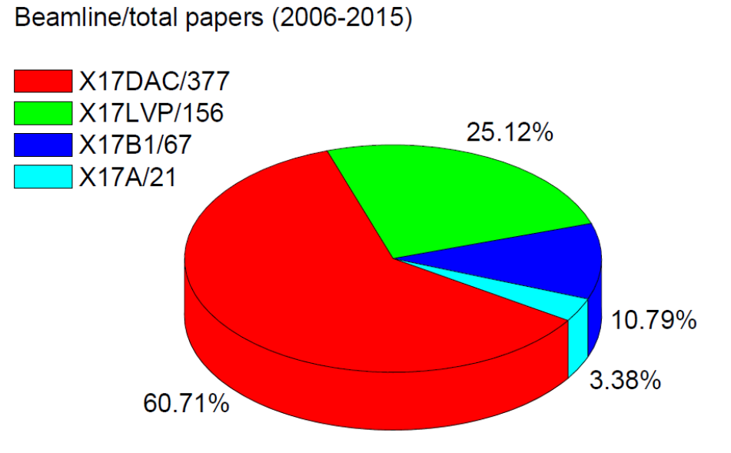
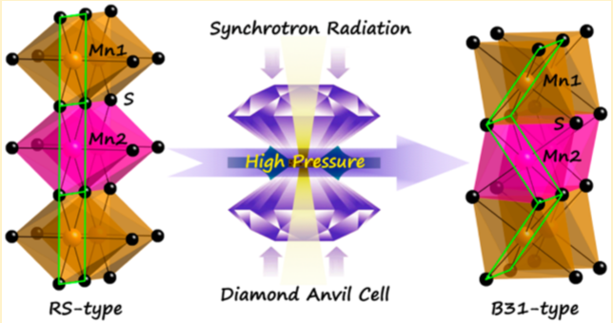
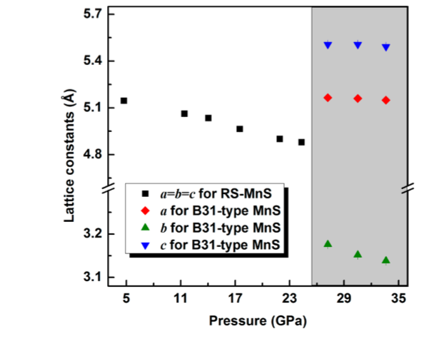
High-Pressure Research Track Record at NSLS
NSLS X17
NSLS
1982 - 2014
Xiao et al. JACS 137, 10297 (2015)
MnS nanocrystals
Very productive DAC program at former NSLS X17C
Broad and active user community
Complemented LVP program well at X17B2
Leading role in MAC-based research
Many high-impact papers
Strong support by COMPRES and CIW

Slide 3
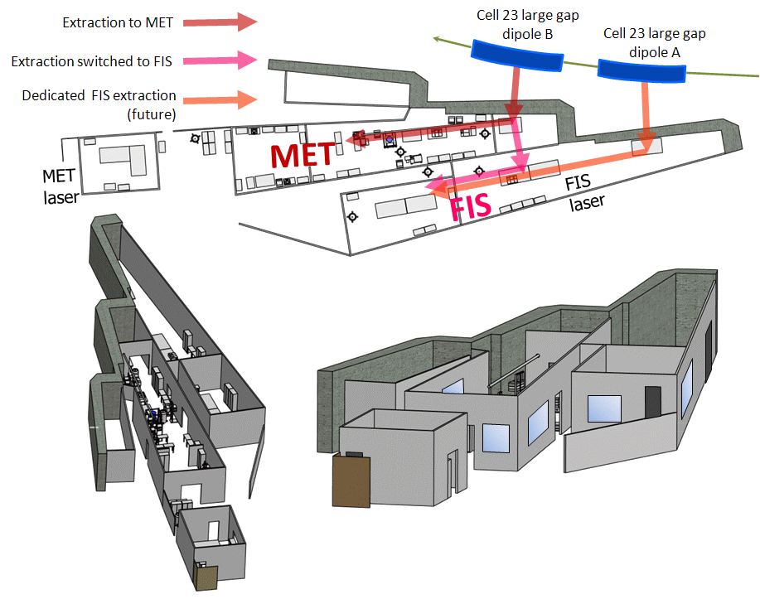
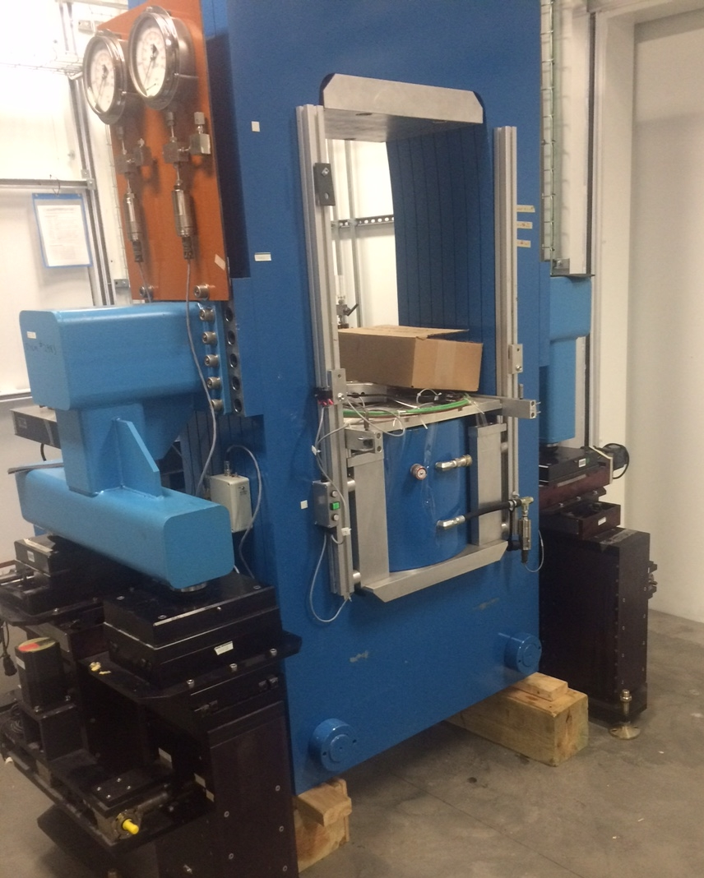
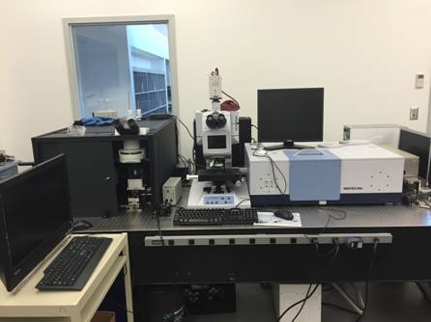
Ongoing NSLS-II / COMPRES Partnership
28-ID-A
28-ID-B
28-ID-C
28-ID-D
Multi-anvil press program going live at XPD
Partner User Agreement at FIS/MET for IR high-pressure program – interim plan to use IR Lab before FIS/MET cabin is completed in 2018
Initiatives with DACs at different beamlines
IR Lab

Slide 4
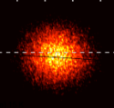
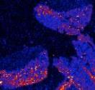
NSLS-II Strategic Scientific Directions
Quantum and Complex Materials:
    Complexity and dynamics of emergent interacting phases and intrinsically heterogeneous systems
    NSLS-II: coherence, nano-imaging, & inelastic scattering ideal for studies of heterogeneities and dynamics
Operando Structural Chemistry:
    Understandings of how things function in real environment and under working conditions in actual devices & systems
    NSLS-II: high flux in broad spectral range for in-situ and operando studies of functional systems
Multiscale Structures and Functions:
    Structural, electronic, and chemical behavior on length and time scales between atomic and macroscopic world
    NSLS-II: suite of tools for structural, chemical, & electronic imaging and characterization across multiple spatial and temporal scales
Notes:
Quantum Materials. Much like the solid state research that led to the discovery of the transistor, quantum materials research and quantum information science are receiving increasingly intense worldwide attention in recent years due to their potential to enable the next-generation computing based on novel quantum electronic devices. Significant complexity exists in these materials due to the coexistence of multiple microscopic degrees of freedom at similar energetic scales near the Fermi surfaces which often lead to emergent macroscopic structural, electrical, magnetic, and thermodynamic properties and may play an intriguing role in quantum information processes such as entanglement and decoherence. Further advances in these areas require better understanding of the nanoscale origin and nanoscale dynamics of the macroscopic properties of heterogeneous quantum matter.
With its suite of cutting-edge soft x-ray scattering and spectroscopic tools, NSLS-II is in an opportune position to develop impactful science programs in quantum materials leveraging such advanced tools as coherent soft x-ray scattering at CSX (23-ID-1), micro-ARPES and XPEEM at ESM (21-ID), micro-RIXS at SIX (2-ID), and IR spectroscopy at FIS/MET (22-IR) that are already or soon to be in user operations. These cutting-edge capabilities are already attracting key condensed-matter researchers in the field, and when fully commissioned, will likely place NSLS-II soft x-ray program at the forefront of quantum materials research. Our main strategy in the near term is to conduct targeted outreach to well-known research groups in the quantum materials community to work with us and utilize our capabilities and expertise to conduct research in this area.
Complex Materials and Processes. From simple material systems with self-organized interacting domains and phases to intrinsically heterogeneous functional soft matter systems, structural complexity along with its kinetics and dynamics has been, and will continue to be, one of the key themes in materials science studies in the 21st century. NSLS-II strengths in coherence, imaging, and inelastic scattering capabilities are ideally suited for fundamental understanding, and ultimately control, of intrinsic and emergent heterogeneities and associated naturally-occurring, unclocked, and irreversible processes in materials synthesis and processing, and driven dynamics in complex hierarchical materials structures.
NSLS-II has developed a suite of cutting-edge tools to enable broad range of research activities in complex materials and synthesis processes. The current capabilities already in operations include X-ray photon correlation spectroscopy at CHX (11-ID), non-resonant inelastic hard X-ray scattering at IXS (10-ID), soft-matter interface at SMI (12-ID), complex materials scattering at CMS (11-BM), and in-situ and resonant scattering at ISR (4-ID). Our main strategy here is to fully ramp up the users programs at these beamlines and conduct scientific programs in collaboration and partnerships with a wide range of materials scientists from thin-film growers to soft-matter physicists and engineers. In addition, we plan to pursue the new development projects discussed below to provide optimized x-ray photon flux and to establish a number of ancillary sample environments to broaden the research activities, particularly in the areas of additive manufacturing, nanoparticle self-assembly and dynamics, and soft matter-liquid interfaces, on our beamlines.
Operando Chemistry and Structural Science
In almost all scientific disciplines, especially in chemical sciences, one of the most challenging research goals is to understand how things work in real functional environment and under working conditions, which is often the key to connect the basic knowledge of materials properties to actual working devices and engineering systems. This is particularly true when materials systems increasingly become more complex – often composed of multiple heterogeneous chemical components and impurities with complex interfaces. Therefore there is a clear need and demand in the scientific community for advanced characterization tools to allow investigations of real or realistic functional materials systems under working conditions relevant to natural or industrial processes.
Our strategy to tackle these challenges is to develop suitable scientific tools to enable in-situ and operando studies of molecular and structural chemistry in material systems while undergoing chemical reaction. Our scientific objective is to enable better understanding and ultimately control of chemistry of complex and heterogeneous interfaces, charge transfer and reactivity in catalysis and energy conversion systems, and reaction pathways and products in complex diverse environments. In addition, these in-situ and operando approaches will be supplemented by high-throughput materials genome tactics through which likely materials candidates from a vast number of possible systems are identified for real-time operando experiments and theoretical modelling.
NSLS-II high brightness and flux in a broad synchrotron spectrum allows highly efficient and effective correlated studies using hard X-ray spectroscopy, diffraction, and scattering to reveal how things work in a variety of functional chemistry systems, including energy storage, catalysis, fuel cells, corrosion protection, and many others. Our development strategy in this area focuses on integrating high-throughput measurements, database-enabled mining and analysis, and density functional theory (DFT) modelling with optimally designed in-situ and operando experiments at NSLS-II beamlines. Together this strategy offers a well balanced portfolio of experimental capabilities that will enhance chemical science research on diverse and heterogeneous materials systems.
The key beamline facilities at NSLS-II that focus on in-operando and high-throughput molecular and structural chemistry research include: Inner-shell spectroscopy (ISS) at 8-ID, quick absorption and scattering (QAS) at 7-BM, in-situ and operando soft x-ray spectroscopy (IOS) at 23-ID-2, X-ray powder diffraction (XPD) at 28-ID-2, pair distribution function (PDF) beamline at 28-ID-1, and NIST partner beamlines soft and tender spectroscopy (SST-1 and SST-2) at 7-ID and materials measurements (BMM) at 6-BM. Planned development projects at these beamlines, including a new high-energy X-ray beamline under construction, are described below.

Slide 5


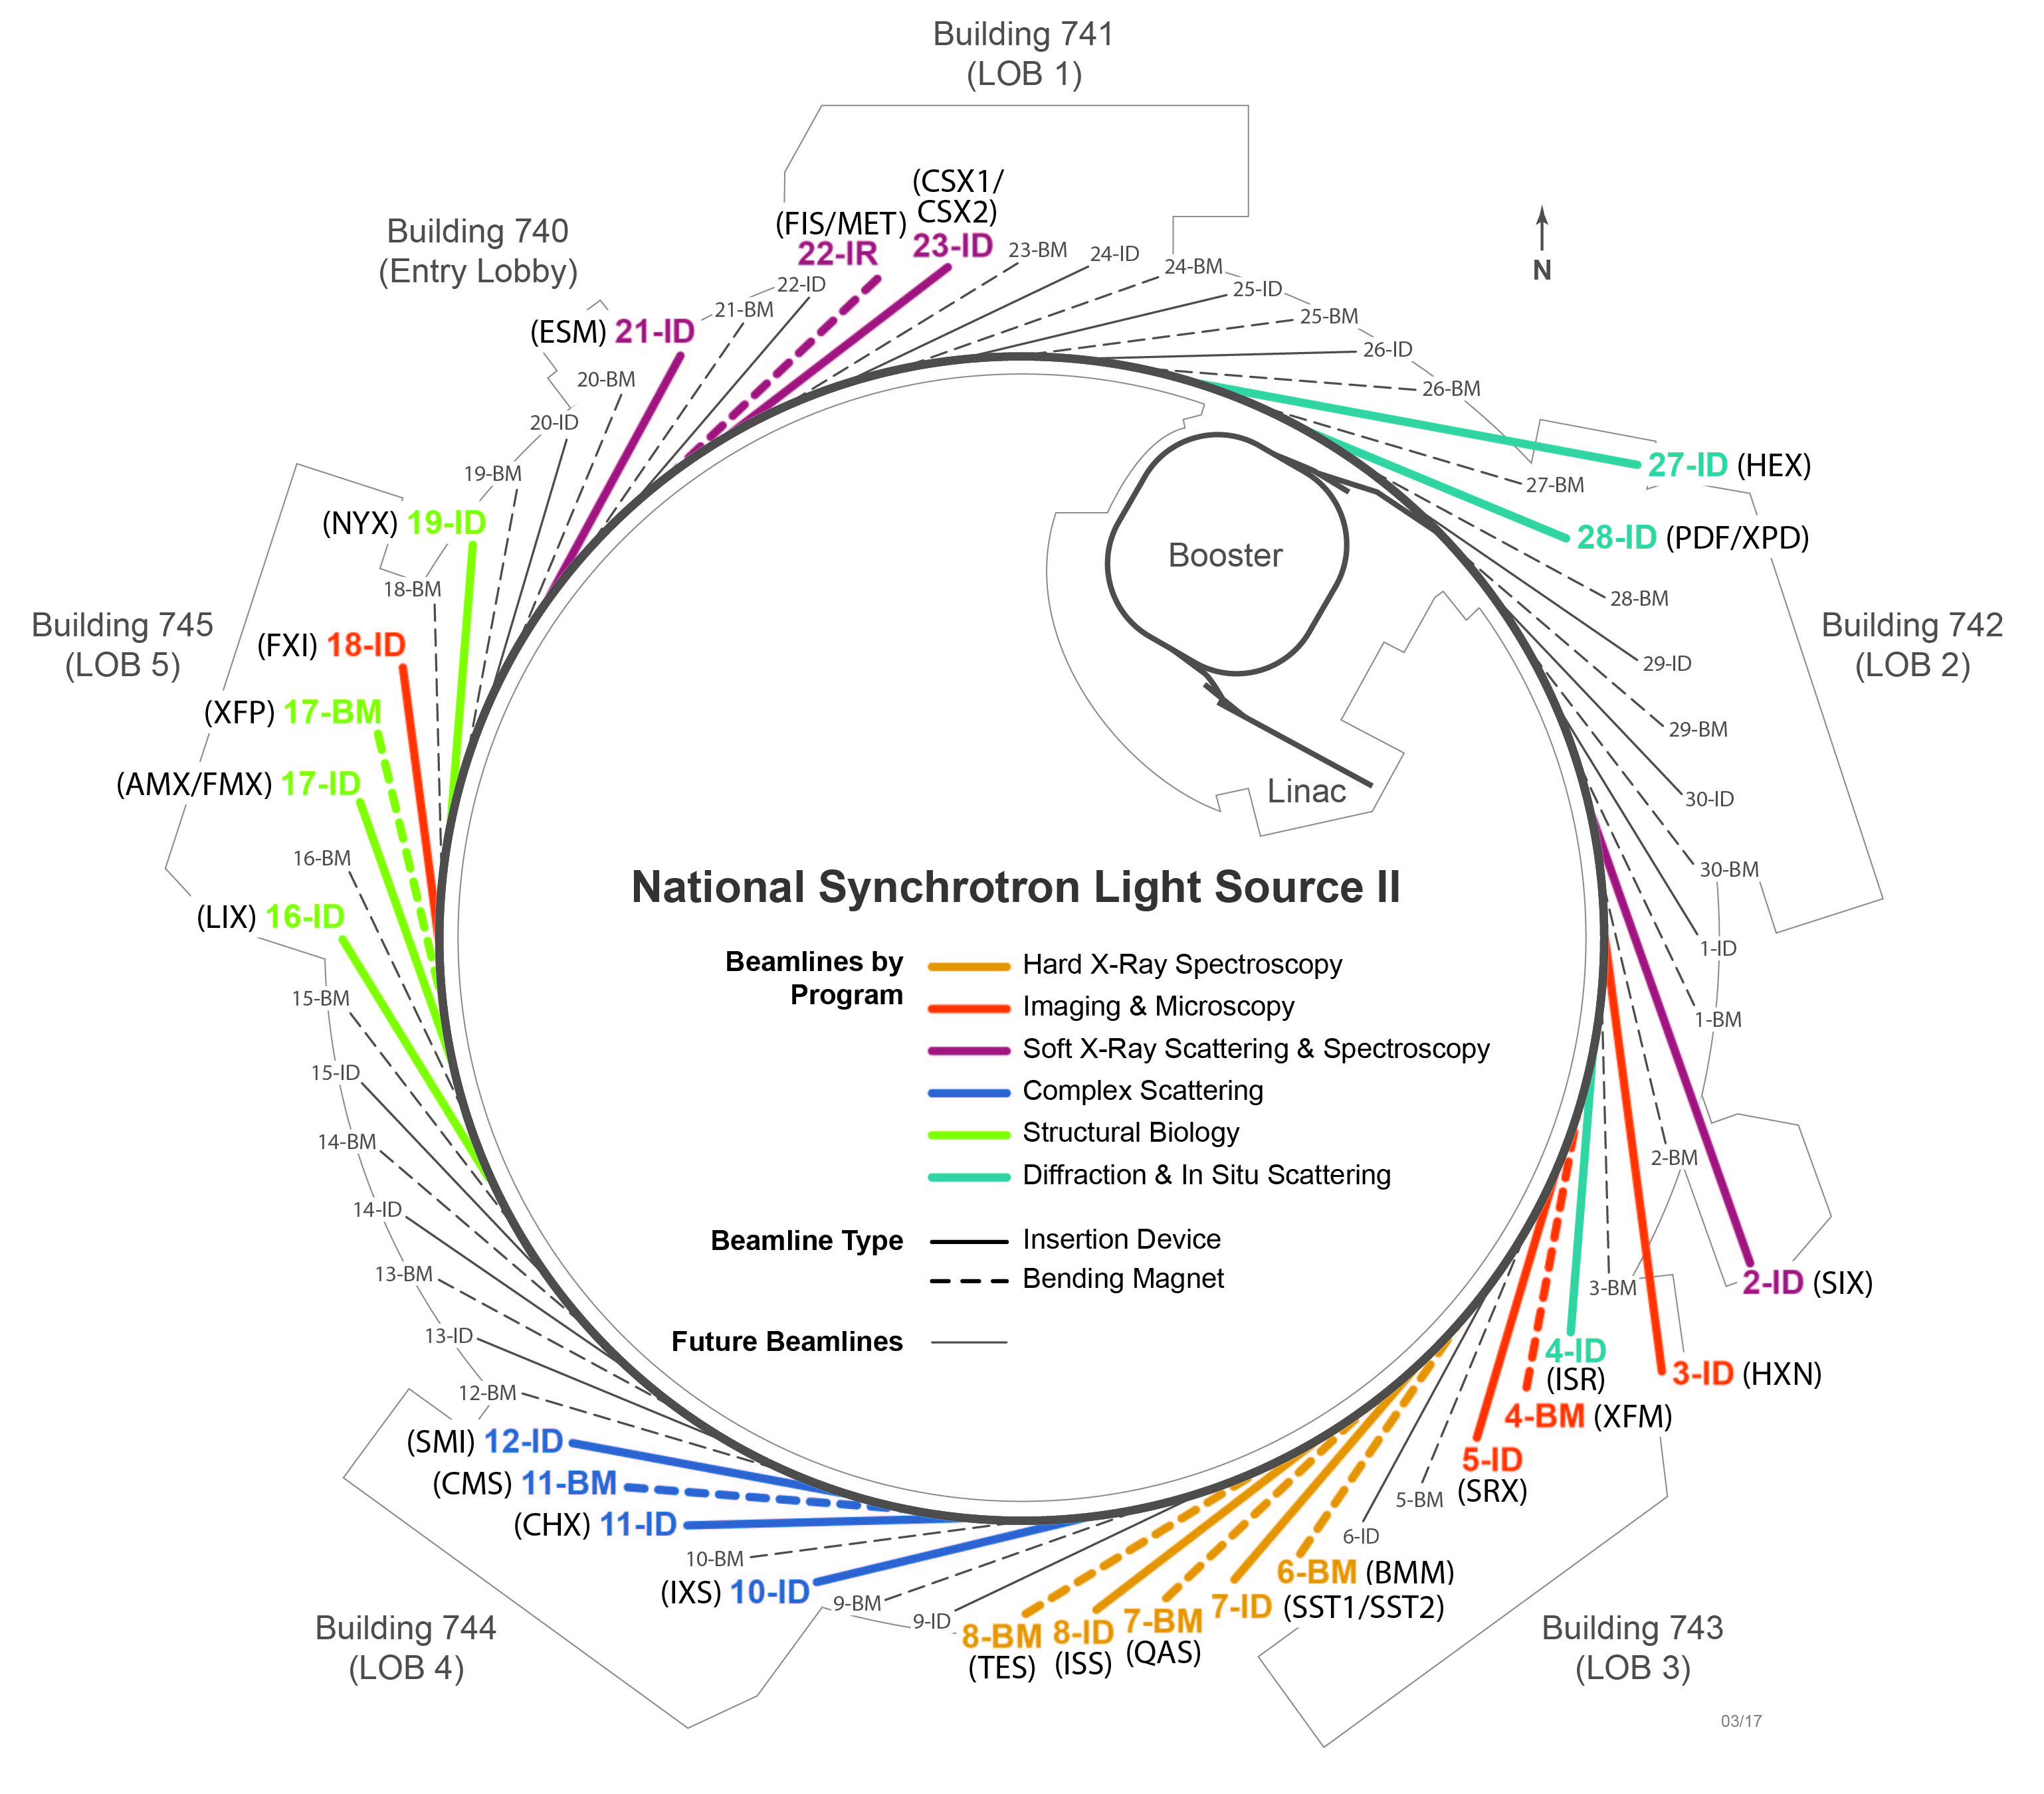




NSLS-II current Suite of Beamlines
Soft X-Ray Scattering & Spectroscopy
23-ID-1: Coherent Soft X-ray Scattering (2015)
23-ID-2: Soft X-ray Spectro & Polarization (2015)
21-ID: Photoemission-Microscopy Facility (2016)
2-ID: Soft Inelastic X-ray Scattering (2017)
22-IR-1/-2: Magneto, Ellips, HP Infrared (2019)
Complex Scattering
10-ID: Inelastic X-ray Scattering (2015)
11-ID: Coherent Hard X-ray Scattering (2015)
11-BM: Complex Materials Scattering (2016)
12-ID: Soft Matter Interfaces (2016)
Diffraction & In Situ Scattering
28-ID-1: Pair Distribution Function Studies (2018)
28-ID-2: X-ray Powder Diffraction (2015)
4-ID: In-Situ & Resonant X-Ray Studies (2016)
27-ID: High Energy X-ray Diffraction (2021)
Hard X-Ray Spectroscopy
8-ID: Inner Shell Spectroscopy (2016)
7-BM: Quick X-ray Absorption and Scat (2017)
7-ID-1: Spectroscopy Soft and Tender (2018)
7-ID-2: Spectroscopy Soft and Tender (2018)
6-BM: Beamline for Mater. Measurement (2017)
Imaging & Microscopy
3-ID: Hard X-ray Nanoprobe (2015)
5-ID: Sub-micron Resolution X-ray Spectro (2015)
4-BM: X-ray Fluorescence Microscopy (2017)
8-BM: Tender X-ray Micro-spectroscopy (2016)
18-ID: Full-Field X-ray Imaging (2018)
Structural Biology
17-ID-1: Frontier Macromolec Cryst (2016)
17-ID-2: Flexible Access MacromolCryst (2016)
16-ID: X-ray Scattering for Biology (2016)
17-BM: X-ray Footprinting (2016)
19-ID: Microdiffraction Beamline (2017)
26 Operating/Commissioning
3 Under Development
http://www.bnl.gov/ps/nsls2/beamlines/map.php

Slide 6
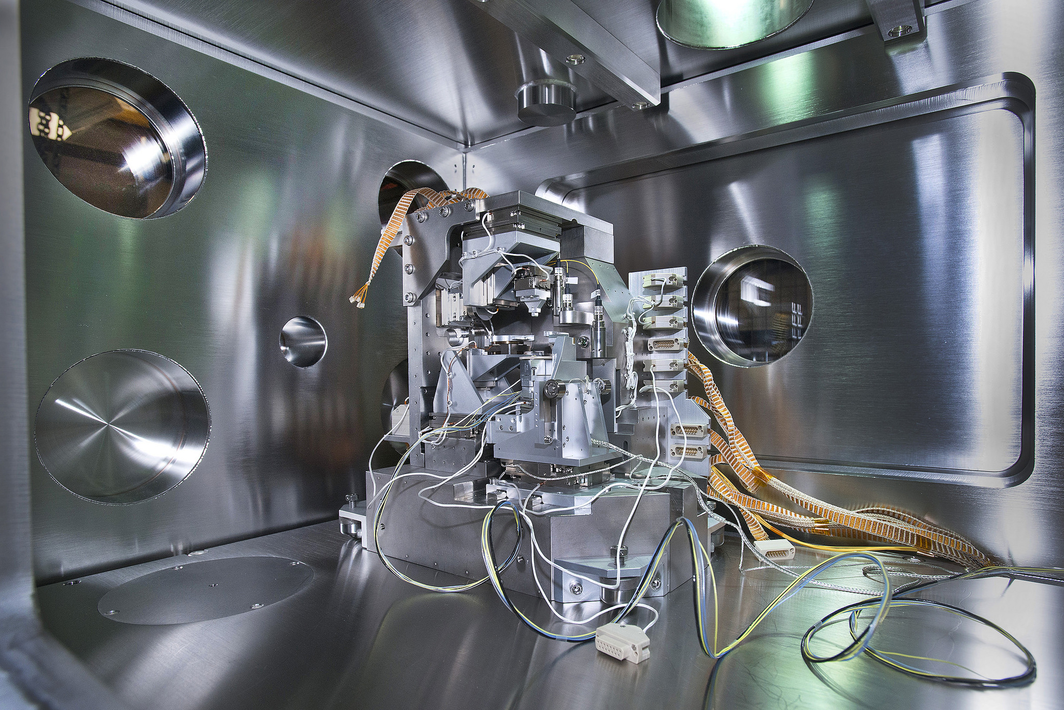
Beamline Operations Status
General User Operations (19)
CSX, IOS, XPD, HXN, SRX, IXS, CHX, LIX, AMX, FMX, ISS, XFP, CMS, ISR, TES, SMI, ESM, BMM, QAS
Science Commissioning (4)
XFM, FXI, PDF, SIX
Technical Commissioning (3)
NYX, SST-1, SST-2
Beam readiness in FY19 (2)
FIS, MET
26 beamlines operating/commissioning
28 beamlines operating by end CY18
4 of them passed first triennial review

Slide 7
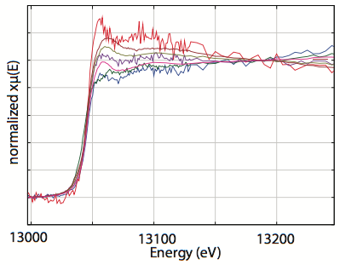
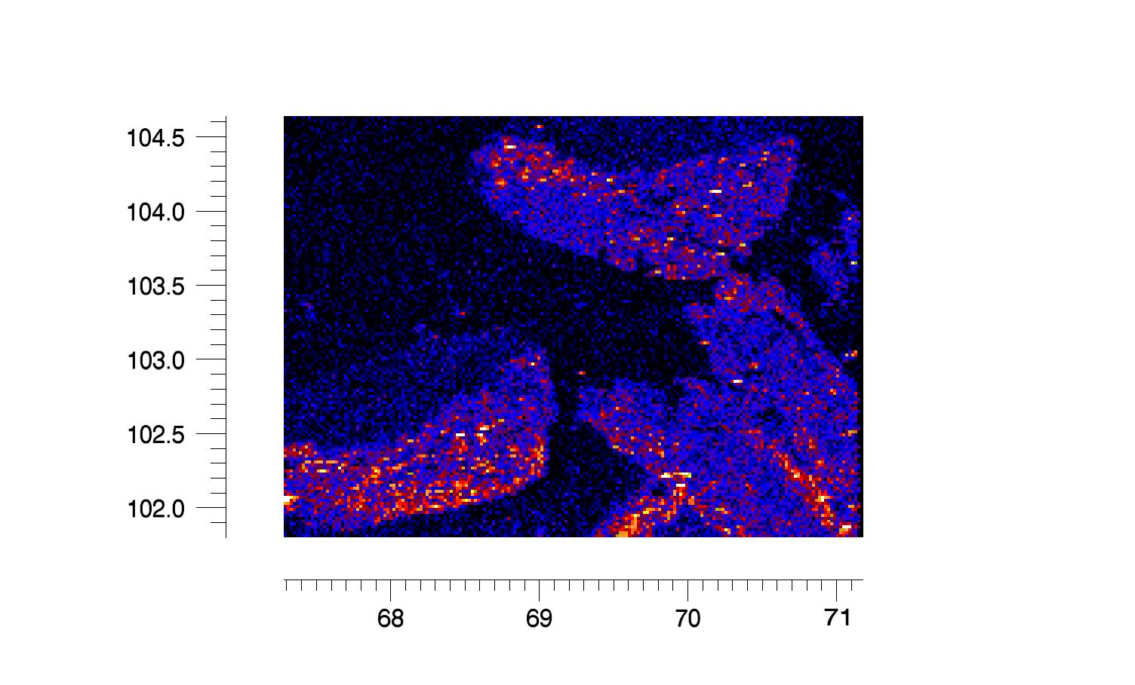
Imaging and Microscopy Program
Science emphasis on spatially heterogeneous systems benefiting from imaging with multiple contrast mechanisms (absorption, fluorescence, phase, and diffraction) at multiple length scales from nm to μm to mm
  Wide range of scientific disciplines take advantage of multi-modal imaging and microscopy beamlines for 2D, 3D, time-dependent, in situ, operando, and high-resolution, sensitive measurements of morphology, structure, and chemical variation in these systems
Pu
HXN Hard X-ray Nanoprobe
FXI Full-field X-ray Imaging
TES Tender Energy x-ray absorption
SRX Sub-µm Resolution X-ray spectro
XFM X-ray Fluorescence Microprobe
0.5 mm
Chemical analysis of aerosol particles in human health (R. Moffet, U Pacific; M. Schoonen, BNL)
R. Tappero, P. Northrup
M. Maloubier & B. Powell
Notes:
Imaging and Microscopy program operates and develops a suite of advanced imaging beamlines that take full advantage of the NSLS-II high brightness and small source size, and provide world-leading capabilities in in-situ multiscale imaging of heterogeneous structures and chemistries.
Hard X-ray Nanoprobe (HXN) is a state-of-the-art 110m-long beamline for structural and fluorescence imaging and ptychography with world-leading 10 nm spatial resolution.
Submicron Resolution X-ray Spectroscopy (SRX) beamline offers world-leading high-throughput chemical imaging capability with sub-100 nm and sub-mm spatial resolution.
Full-field X-ray Imaging (FXI) is a state-of-the-art beamline under development for transmission hard X-ray microscopic imaging at 10-20 ms time-resolution and better than 30 nm spatial-resolution, with full 3D nano-tomography in <1 minute.
X-ray Fluorescence Microscopy (XFM) is a beamline currently under development for high-throughput X-ray fluorescence imaging and tomography with ~um resolution.

Slide 8
Imaging and Microscopy Program
Field of View
Scanning Microscopy
10-500 nm/2-20 keV
operando imaging
Cryogenic imaging
100 mm
10 mm
HEX
1 mm
Full-field Microscopy
~1 um/10~30 keV
High speed 3D imaging
White beam (speed)
Mono beam (phase-contrast)
XFM
100 um
SRX
TES
SRX Upgraded
FXI
10 um
HXN
Resolution
1 nm
10 nm
100 nm
1 um
10 um
Notes:
NSLS-II capabilities in nanoscale and multiscale imaging will help studies on heterogeneous and multi-materials high-pressure systems under in-situ conditions
Nanoscale focused X-rays potentially allow measurements to be done on smaller specimens → access to higher P range, for materials/HP science
Earth is a heterogeneous substance in many aspects. e.g. Rocks (geology) are inherently heterogeneous, usually occurring at the micro-scale and mini-scale. Subsequently, in studying ore bodies and mineral deposits, hydrocarbon accumulation and reservoir characterization, geoscientists always face heterogeneous and uncertain situation. Also in structural geology and many other earth-science fields, experts have to cope with heterogeneity in their investigations

Slide 9
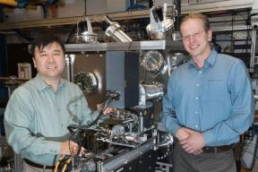

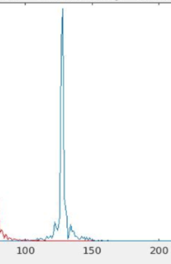
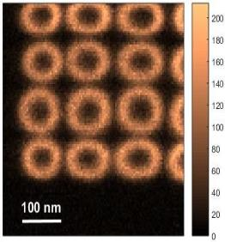

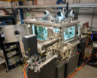
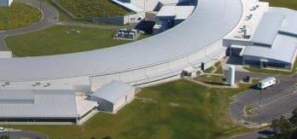


Award-winning, World-leading Hard X-ray Nanoprobe (HXN) at < 10 nm Spatial Resolution
HXN: 12 keV @ 50 mA
7.5 nm
2016
MLL Microscope
Smallest focal spot in working hard x-ray microscope in the world
Fast scanning like an SEM, with x-ray penetration
110m long BL
HXN
2017

Slide 10
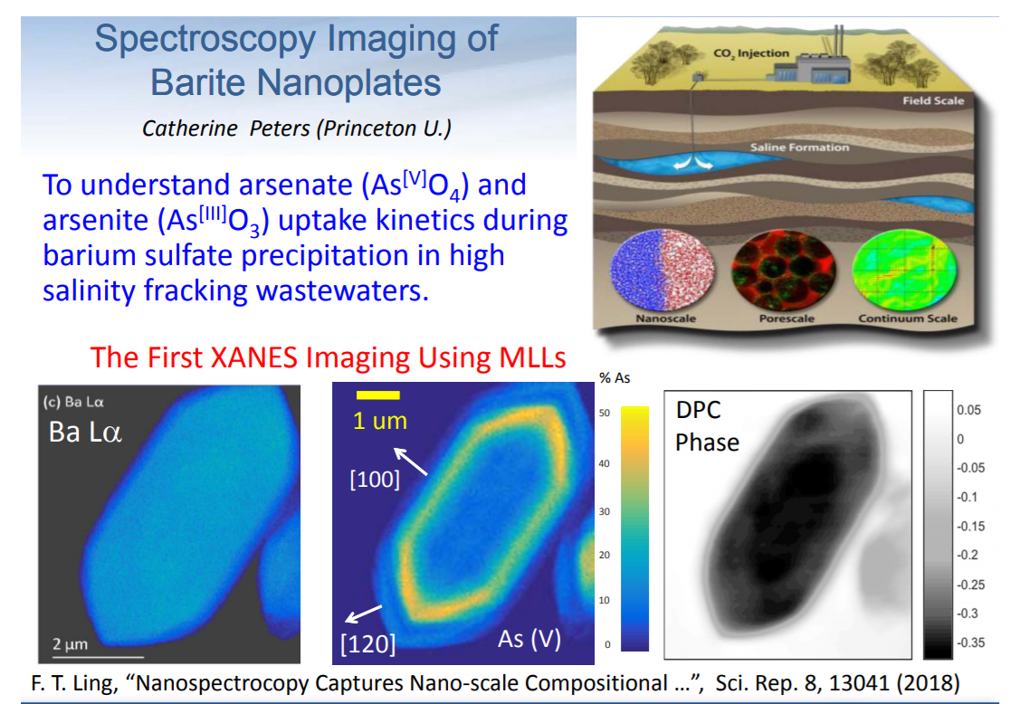
Imaging and Microscopy
Multimodal Imaging: XRF (chemical mapping), absorption or phase contrast (DPC, ptychography), diffraction (conventional or Bragg ptychography)
Spectroscopy & Tomography
Notes:
The fluorescence x‐rays from the sample is used to produce element maps. The transmitted x‐rays are used for producing absorption and phase contrast images either using differential phase contrast (DPC) or transmission ptychography. For the crystalline samples, diffracted x‐rays can be analyzed using a conventional nanodiffraction or Bragg ptychography method. Significant number of user experiments are taking advantage of multimodal imaging capability. The most common modalities are XRF and DPC/ptychography, and XRF and diffraction (conventional nanodiffraction and Bragg ptychography), both of which are carried out using a continuous fly‐scan mode.

Slide 11
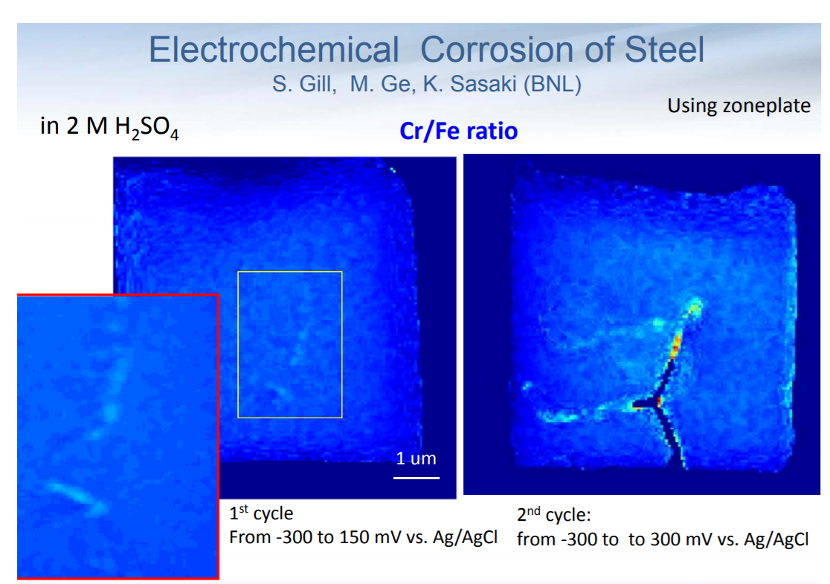
Imaging and Microscopy
Notes:
Multimodality Imaging (nano‐XRF, nano‐XRD, DPC, ptychography, Bragg ptychography) for Broad Science Applications • Spectroscopy & Tomography

Slide 12
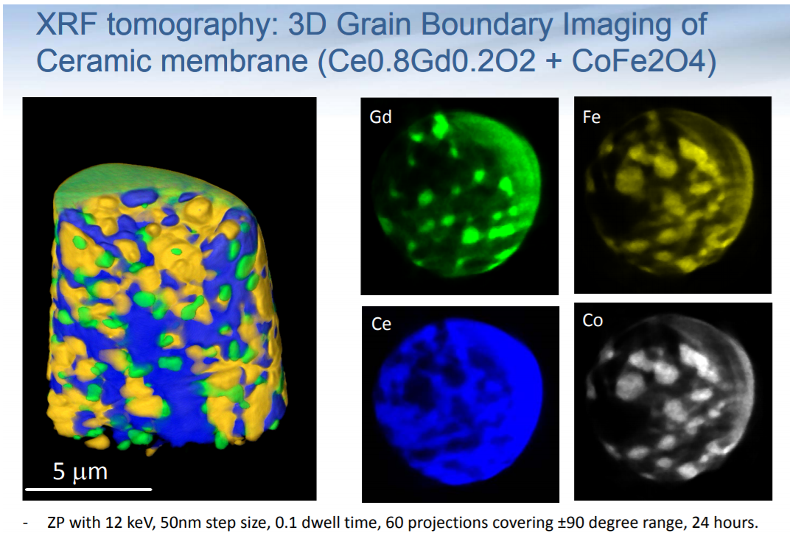
Imaging and Microscopy

Slide 13
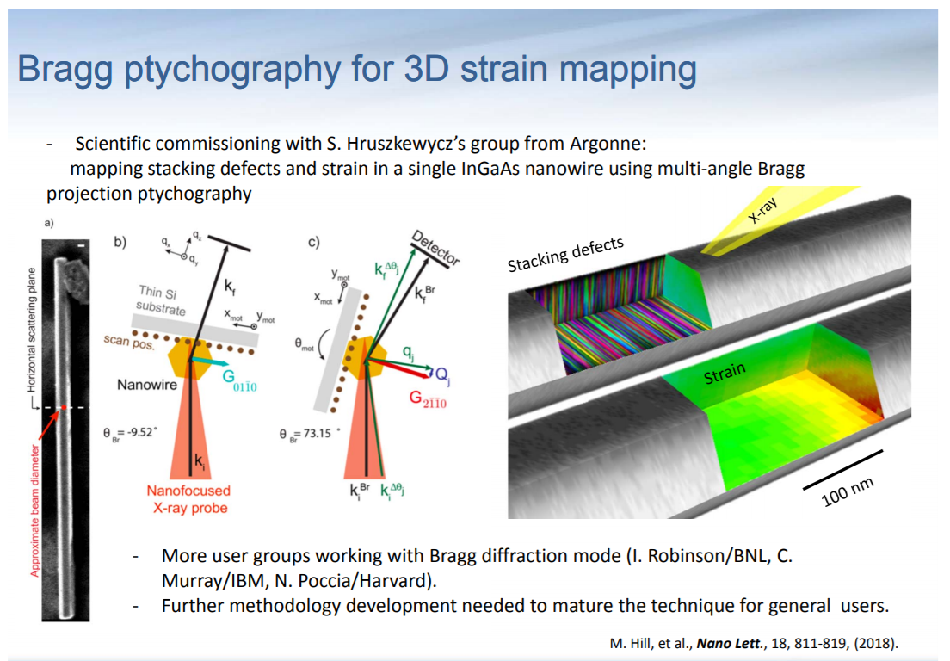
Imaging and Microscopy
Mapping stacking faults and strain in a single InGaAs nanowire
(S. Hruszbewycz, Argonne)
M. Hill et al. Nano Lett. 18, 811-819 (2018)
Notes:
Mapping stacking defects and strain in a single InGaAs nanowire (S. Hruszbewycz, Argonne)

Slide 14
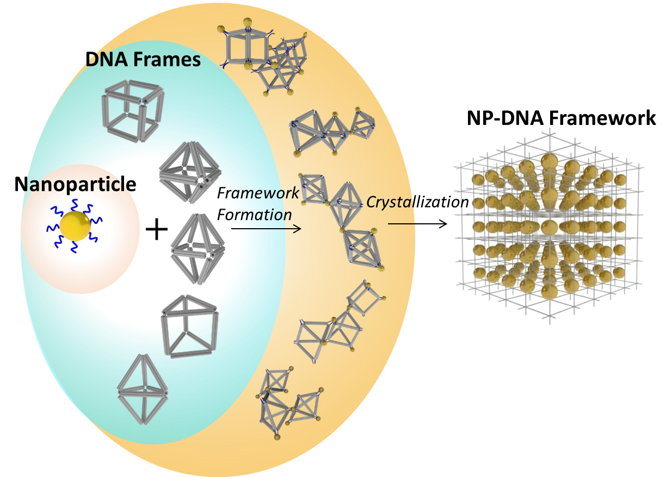

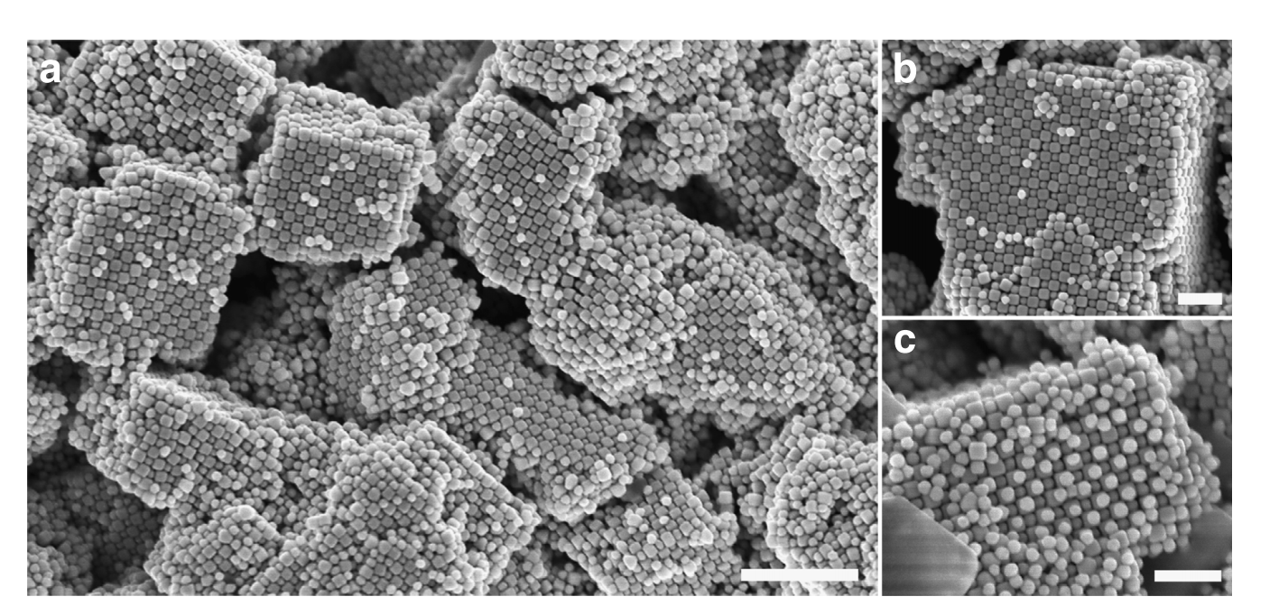
3D tomography of DNA-guided superlattice
SEM
X-ray Tomography
F. Lu, et al, (2015), 6, 6912 Nature Communications
Y. Tian et al. Nature Materials 15, 654 (2016);
D. Nykypanchuk et al, Nature, 451, 549 (2008)
HXN, NSLS-II

Slide 15
Ultra-High Pressure and Nano-Imaging
a nanometer-sized x-ray beam to map a few microns or less of sample in a DAC (e.g., Dubrovinsky et al. Nature Comm, 2012).
Expanding the static pressure range in a DAC toward Earth’s core (1 TPa and beyond !!!)
DAC micro-imaging at SRX is “more accommodating”
Transmission X-ray microscopy at FXI offers high-throughput with 30-nm resolution imaging for DAC recovered samples

Slide 16
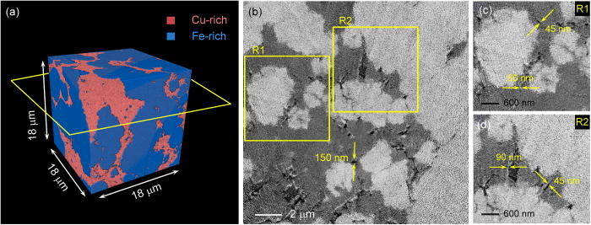

FXI: one-minute nano-tomography
  Fast 3D tomography (30 nm spatial resolution)
  Wah-Keat-Lee, Xianghui Xiao
Fe-Cu alloy
  X-ray: 8.95 keV,
  0.03 s exposure time,
  1 deg/s (0-180 deg),
  1440 projection images
In-situ Ag growth
  Cu + Ag⁺ → Ag + Cu²⁺
  X-ray: 8.96 keV,
  0.02 s exposure time,
  3 deg/s (0-180 deg),
  1060 projection images
First FXI Publication: “One-minute nano-tomography using hard X-ray full-field transmission microscope”,
M. Ge et. al. Appl. Phys. Lett. 113, 083109 (2018)

Slide 17
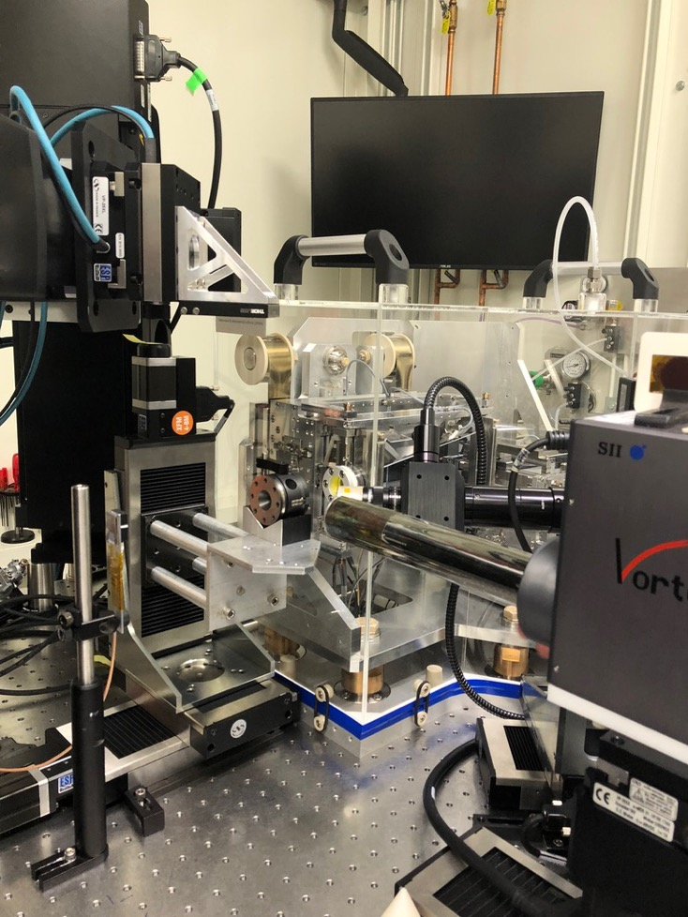
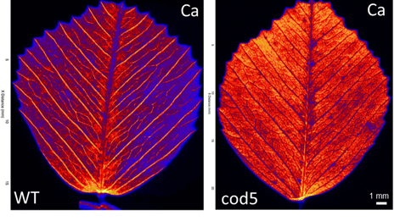
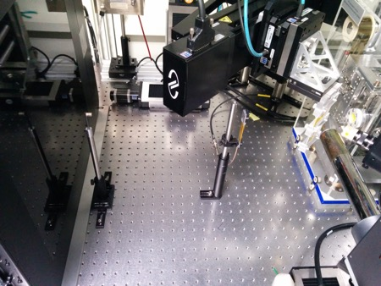
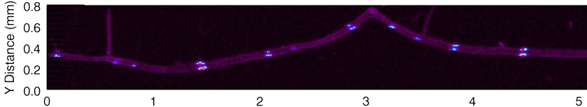
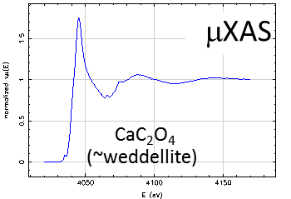
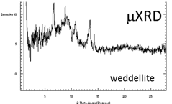
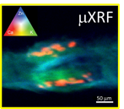
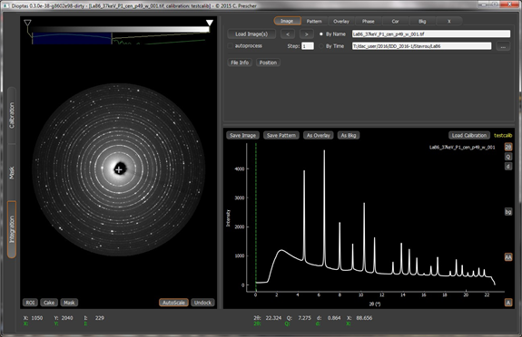
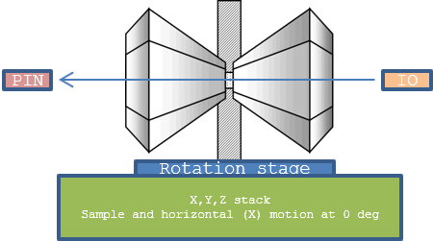

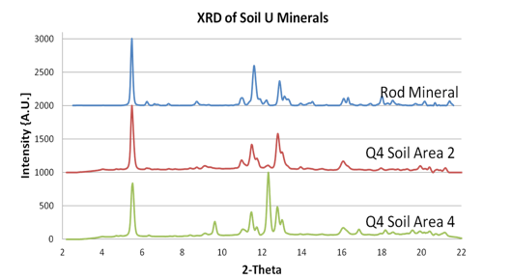
4-BM: X-ray Fluorescence Microprobe (XFM)
XFM CORE CAPABILITIES
HIGH PRESSURE DAC XRD AND XANES
XRD panel
sample
beam stop
+ diode
KB exit
aperture
Ca
WT
1 mm
XRF
detector
Alvin Acerbo, Zhenxian Liu
Punshon et al., 2013, Plant Journal 76:627-633
MICRODIFFRACTION FOR MINERALS
Dioptas: online data reduction software
XRD commissioning is ongoing:
KB box d/s port to focal point is 85 mm
Monochromatic X-rays 4-23 keV, 5×5 µm beam
d-spacing = ~1.5 to 150 Å with 550 mm sample-detector
Motorized sample mount for DAC for “easy” alignment
X-ray transparent gaskets allow 90° fluorescence detection
Notes:
Kopittke, P.M., T. Punshon, D. Paterson, R. Tappero, P. Weng, P. Blamey, A. van der Ent, and E. Lombi. 2018. Synchrotron-based X-ray fluorescence microscopy as a technique for imaging of elements in plants. Plant Physiology (DOI: 10.1104/pp.18.00759).
4-BM (XFM): X-ray Fluorescence Microprobe beamline, power diffraction capability will commission in the cycle of Sep.-Dec. 2018;

Slide 18
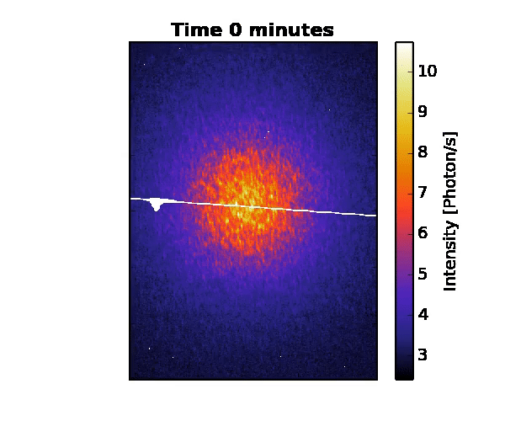
Soft X-ray Scattering & Spectroscopy
Emphasis includes Scattering, Spectroscopy and Imaging for Quantum Materials and Catalysis & Energy Research, including:
  Understanding and controlling the physics of quantum materials and their behavior on the nanoscale, electronic properties and texture.
  Studies of complex oxides exhibiting competing phases and emergent phenomena (e.g. multi-ferroics, topological insulators, high-Tc and conventional superconductors)
  The study of energy relevant catalysis in their operating conditions using real catalyst materials in realistic pressures such as near ambient pressure.
  The structure and behavior of materials under conditions of extreme pressures and temperatures.
La_{2−x}Ba_{x}CuO₄
SIX Soft Inelastic X-ray scattering
CSX Coherent Soft X-ray scattering
IOS Soft X-ray Spectroscopy & polarization
ESM Electron Spectro-Microscopy
FIS/MET Frontier synchrotron Infrared Spectroscopy
Charge Stripes
Notes:
XPCS
Complete construction of FIS/MET and transition into operations
Soft X-Ray Scattering and Spectroscopy program develops and operates six beamlines that exploit the best source properties of the NSLS-II in the soft x-ray spectral region, with a scientific emphasis that includes characterization of electronic structures in correlated electron systems, ambient pressure chemistry studies, and understanding and control of low-energy excitations in real materials systems.
Coherent Soft X-ray Scattering (CSX-1) – Coherent soft x-ray scattering and imaging with world-leading high-coherent flux and detector for probing electronic textures and dynamics.
Coherent Soft X-ray Scattering and Spectroscopy (CSX-2) – allows studies of ambient pressure photoelectron spectroscopy (AP-PES) with world-leading soft x-ray beam size and flux enables chemical activity studies at realistic ambient conditions.
Electron Spectro-Microscopy (ESM) – Combined LEEM /PEEM as well as m-ARPES provide world-class spatially resolved photoelectron spectroscopy and imaging capabilities for electronic structures in crystals as well as in polycrystalline materials.
Soft Inelastic X-ray Scattering (SIX) – a long beamline under development for inelastic soft X-ray scattering with a state-of-the-art spectrometer located in a satellite building providing world-leading ~14 meV energy resolution at 1 keV for probing low-energy correlated electronic excitations with high sensitivity.
Frontier Synchrotron Infrared Spectroscopy (FIS) and Magneto, Ellipsometric and Time-Resolved Optical Spectroscopy (MET) are a pair of IR beamlines currently under development for in-situ optical studies of condensed matter and materials under high-pressure environment.

Slide 19


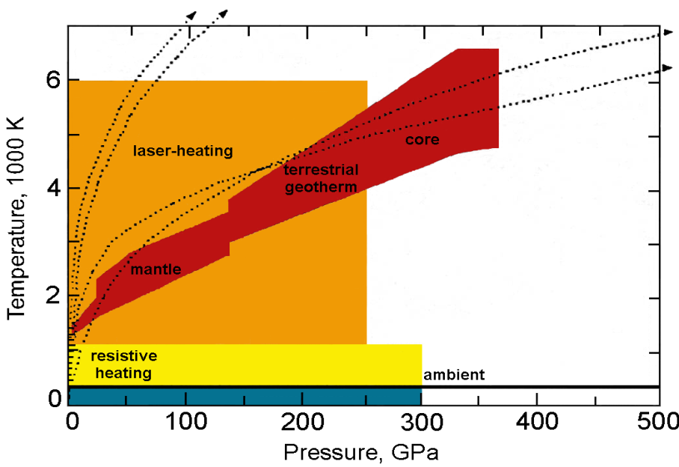


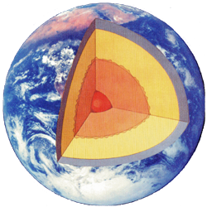
Frontier Synchrotron Infrared Spectroscopy under Extreme P-T Environments
Earth and Planetary Sciences: mimic the mantle extreme conditions and study the Earth’s deep water cycle
Material Sciences: study the metallization of hydrogen and hydrogen-rich materials such as methane, silane, and germane under extreme high pressure and low temperature
Deep Carbon Cycle Research: study behavior of carbon-bearing materials in Earth’s deep interior conditions
Optical studies of nano-crystalline materials and porous materials including BN nanotubes and zeolites/natrolites for applications in energy efficiency, production, and storage
FIS provides basic infrastructure for all HP users: non-laser portable ruby system, micro-Raman system, sample preparation,…
Contact: Zhenxian Liu
Notes:
More infrastructure developments are needed for the HP user community:
Gas loading system for all DAC users;
Laser heating system with fiber lasers, complementary to existing CO2 laser heating system and potential for other x-ray beamlines;
Low-frequency micro-Raman system (<10 cm⁻¹);

Slide 20
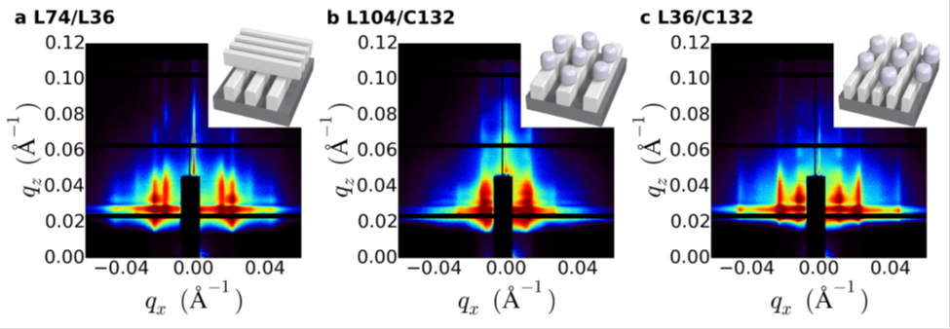
Complex Scattering Program
Emphasis on structure and dynamics of soft/bio/hard-material architectures with enhanced or emergent properties that drive transformative technologies
Relationship between function, structure and equilibrium and non-equilibrium dynamics in hierarchically ordered and engineered nanomaterials
Advanced processing approaches to develop soft/bio/hybrid materials (films & fibers) for energy, advanced manufacturing & filtration applications
IXS Inelastic X-ray Scattering
CHX Coherent Hard X-ray scattering
SMI Soft Matter Interfaces
CMS Complex Materials Scattering
A. Rahman et al. Nature Comm. (2016)
Notes:
Complex Scattering program operates four advanced beamlines that take full advantage of the NSLS-II high brightness and coherence for coherent scattering, inelastic scattering, and in-situ structural studies of mesoscale complexity and dynamics in heterogeneous and non-equilibrium systems.
Coherent Hard X-ray Scattering (CHX) – X-ray photon correlation spectroscopy with world-leading hard x-ray coherent flux and detection system for fast dynamics into the ms regime.
Soft Matter Interface Beamline (SMI) – Simultaneous small-angle and wide-angle x-ray scattering at grazing incidence, and specialized x-ray reflectometry for liquid interfaces, including a wide x-ray energy range of 2-24 keV to access element edges important to soft matter e.g. P, S, K, Ca.
Complex Materials Scattering (CMS) – High-throughput small-angle and wide-angle x-ray scattering in transmission and reflection mode covering broad q-range from 4x10⁻⁴ to 7 A⁻¹, with an auto-sample-changer and versatile sample environment for stimuli-responsive in-situ experiments, and micro-beams for heterogeneous sample mapping of complex hierarchical materials.
Inelastic X-ray Scattering (IXS) – Inelastic X-ray scattering with a goal of world-leading sub-meV energy resolution at 9.1 keV for studying low-energy excitations from nanoscale heterogeneity and disorder, particularly well-suited to the study of soft matter systems.

Slide 21
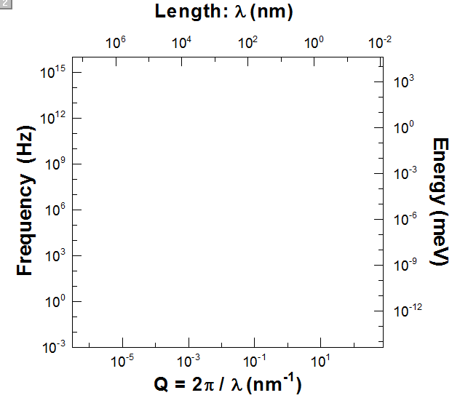
Closing the dynamics gap with IXS and XPCS
Inelastic X-ray
Scattering
Raman Scattering
IXS@NSLS-II
Brillouin Scattering
Inelastic
Neutron
Scattering
IUVS
GI-XPCS
XPCS@NSLS-II
Laser-PCS
(DLS)
XPCS
(currently)
Notes:
Sound velocities. What is the advantage of the IXS beamline for these sound velocity measurements compared to 3-ID and 30-ID at the APS which COMPRES is already supporting?
Sound Velocities: Measuring bulk acoustic wave velocities, Vp and Vs, and elastic properties of opaque metallic samples at the core P-T conditions has been extremely challenging and nearly impossible using common light scattering or ultrasonic methods. The project establishes a high-pressure synergy infrastructure to facilitate the application of DACs at the IXS and SRX beamlines. The enabled science includes the study of core composition and identifying the light elements in the core by measuring and comparing sound velocities of candidates for core materials at high P-T conditions with seismic velocity models of the core (e.g., Fiquet et al. Science, 2001). The study of the spin state of iron in mantle minerals under high pressures, through the use of x-ray emission, is also a priority.

Slide 22
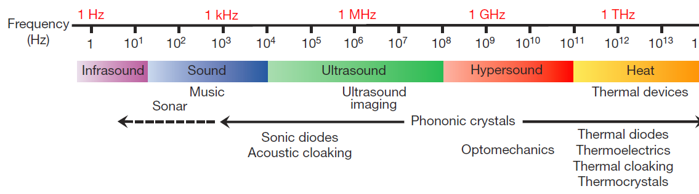
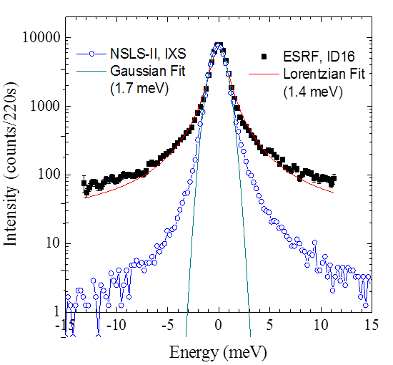
IXS: Inelastic X-ray Scattering Beamline
to achieve best-in-class performance for THz vibrational dynamics:
  Angular dispersive crystal optics for cutting-edge resolution (~ 2 meV) with sharp tails in resolution function and high Q resolution (~0.1 nm⁻¹) and a focused beam <10μm.
  Operation energy (9.1 keV) capitalizing on NSLS-II’s strengths in flux and brightness
  Nanoscale (5~50 nm), THz (ps to sub-ps) dynamics in disordered and low-Z materials
  Phononics of nanoparticle self-assemblies, systems with engineered heterogeneities, and biomaterials
  Systems under high pressure using diamond anvil cells
Yong Cai, Alessandro Cunsolo, Alexey Suvorov
Notes:
Comparison with ESRF

Slide 23
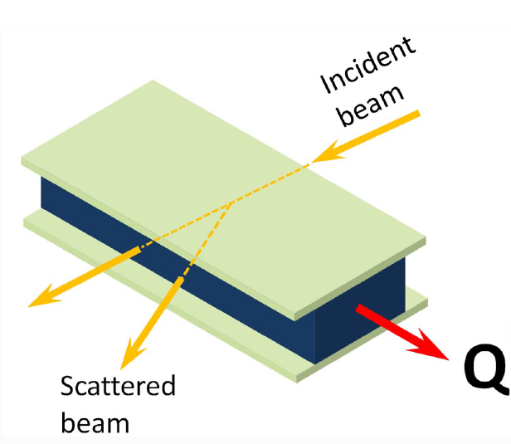
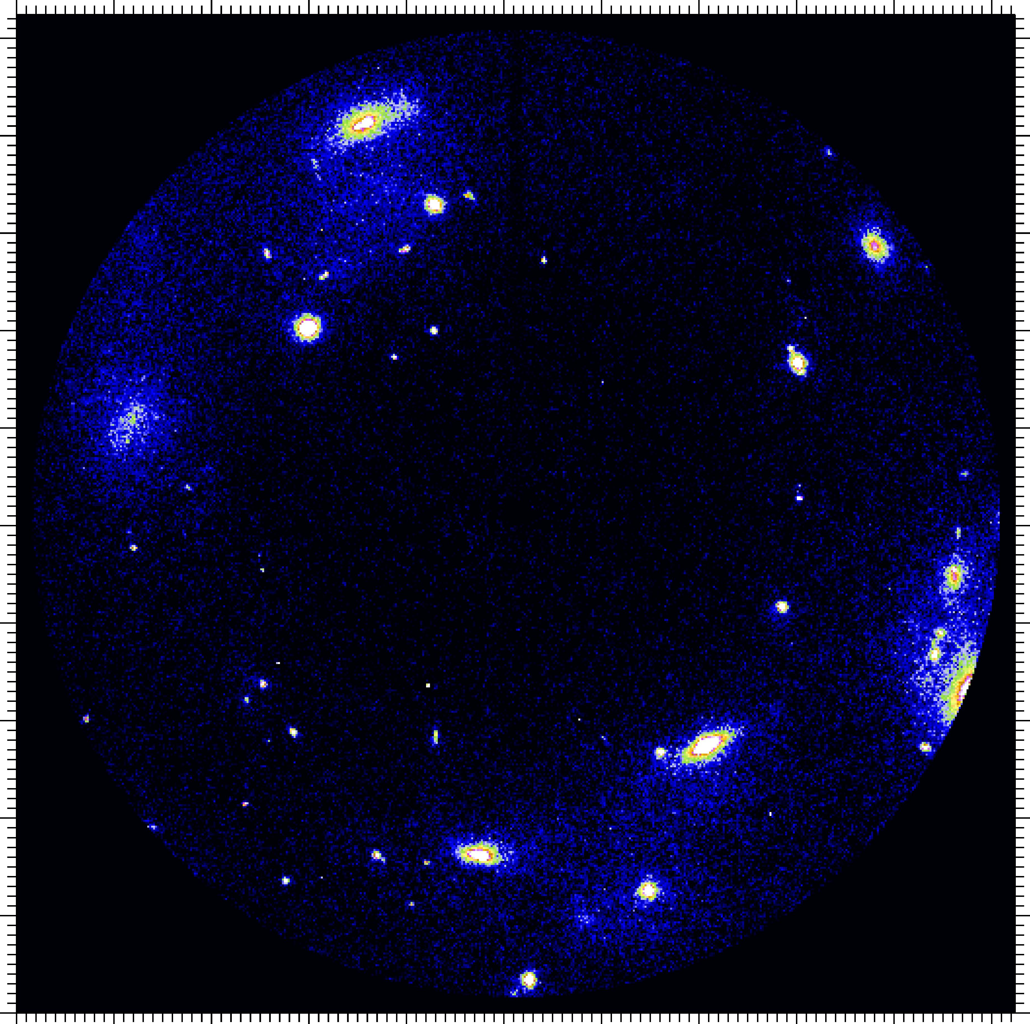
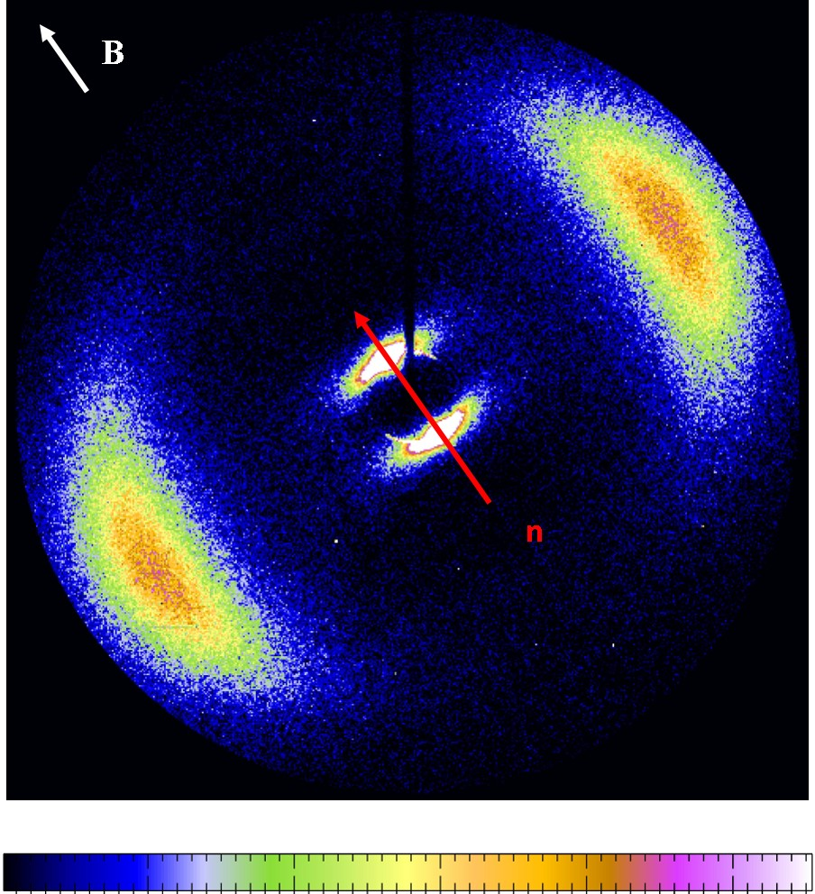
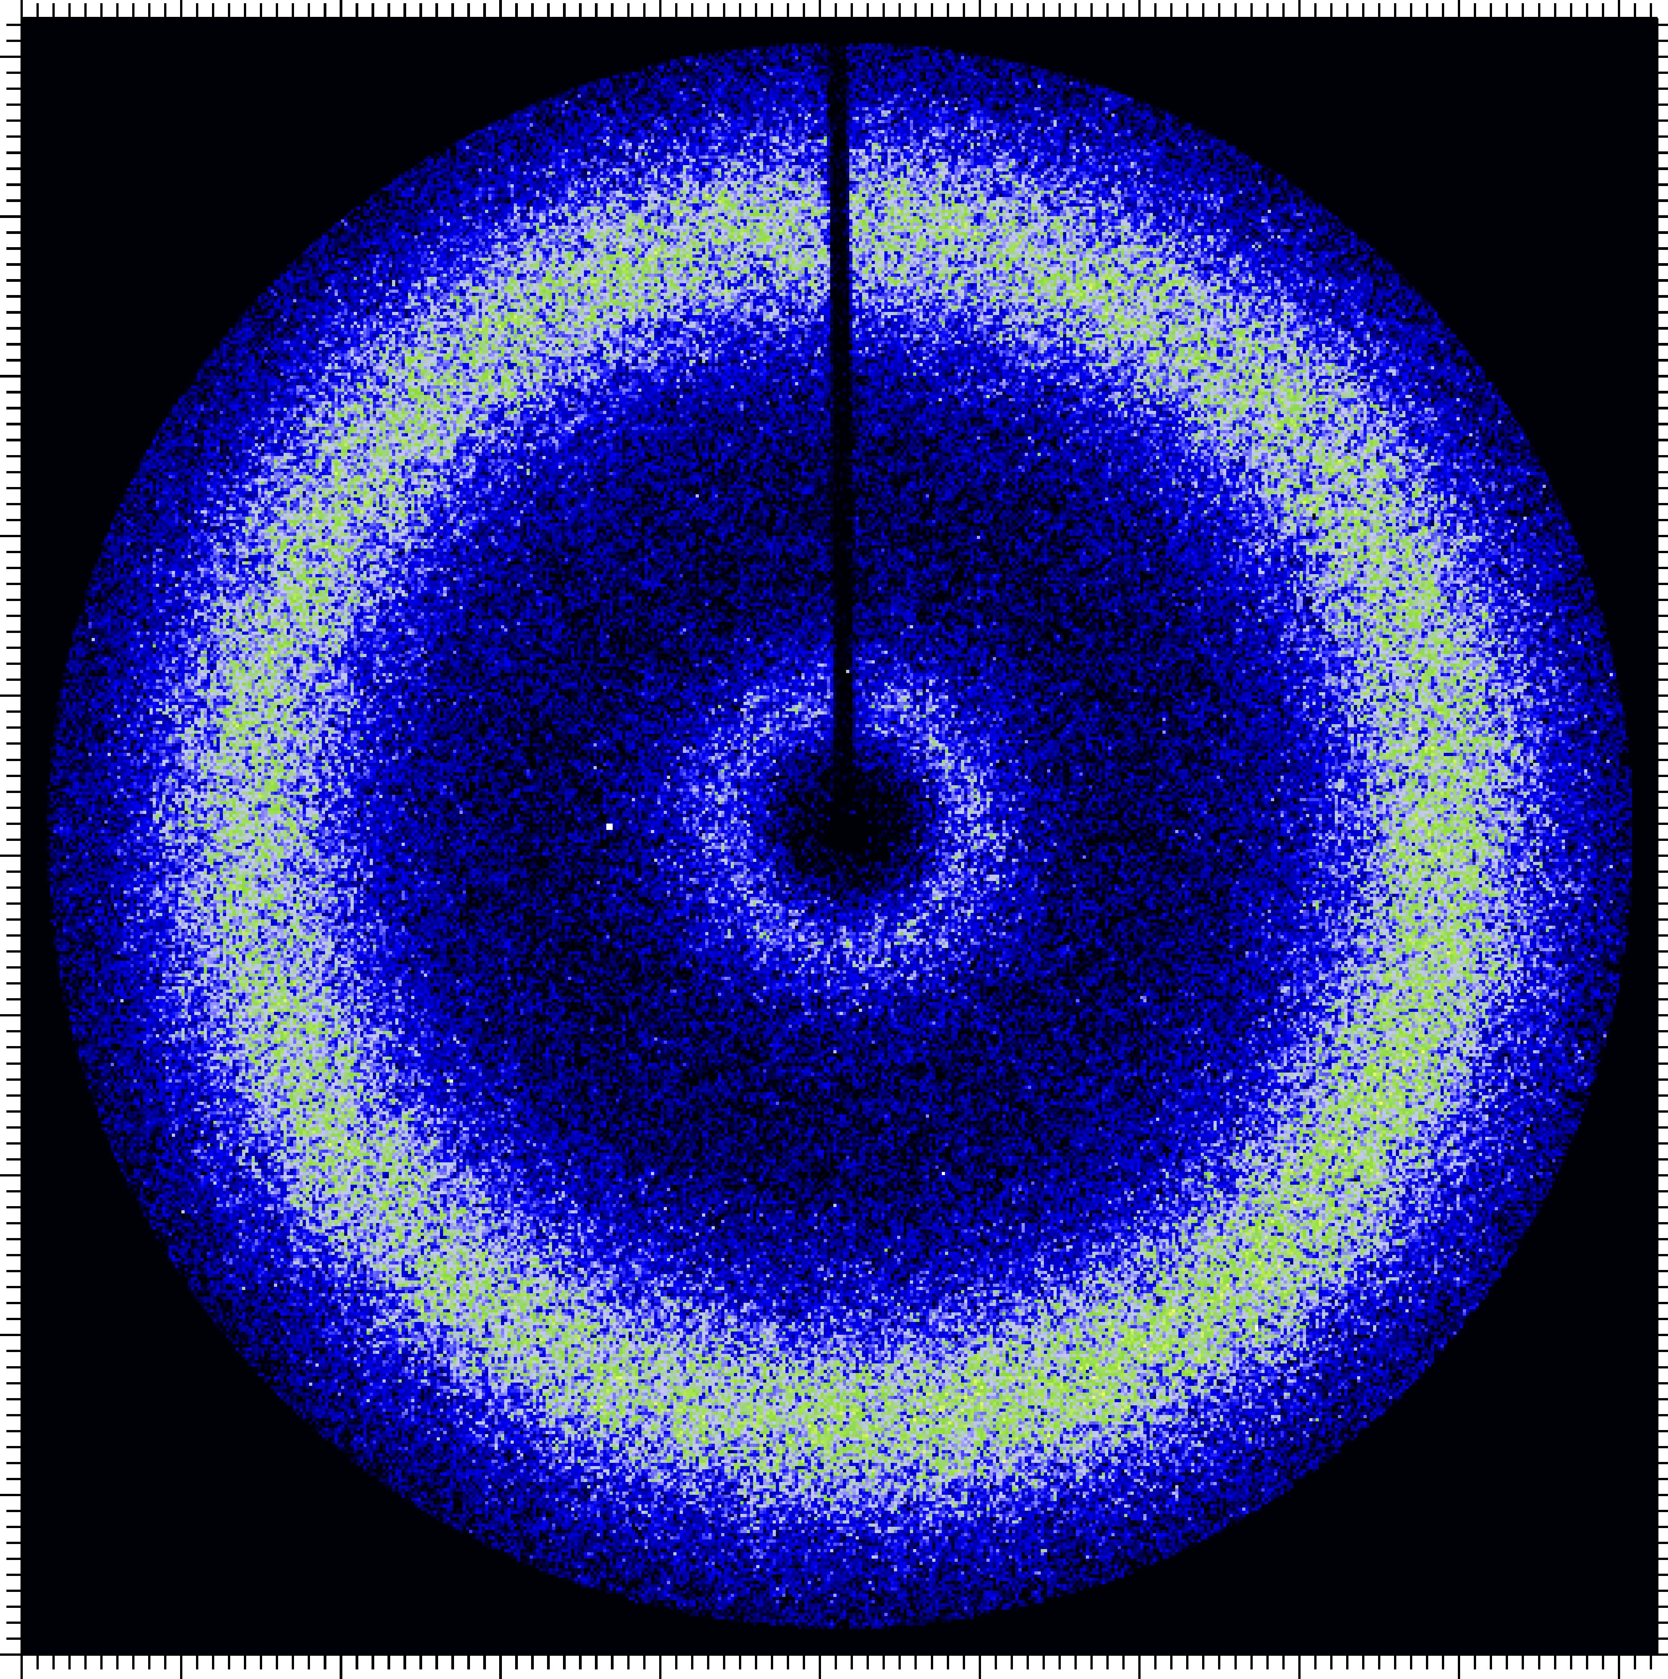
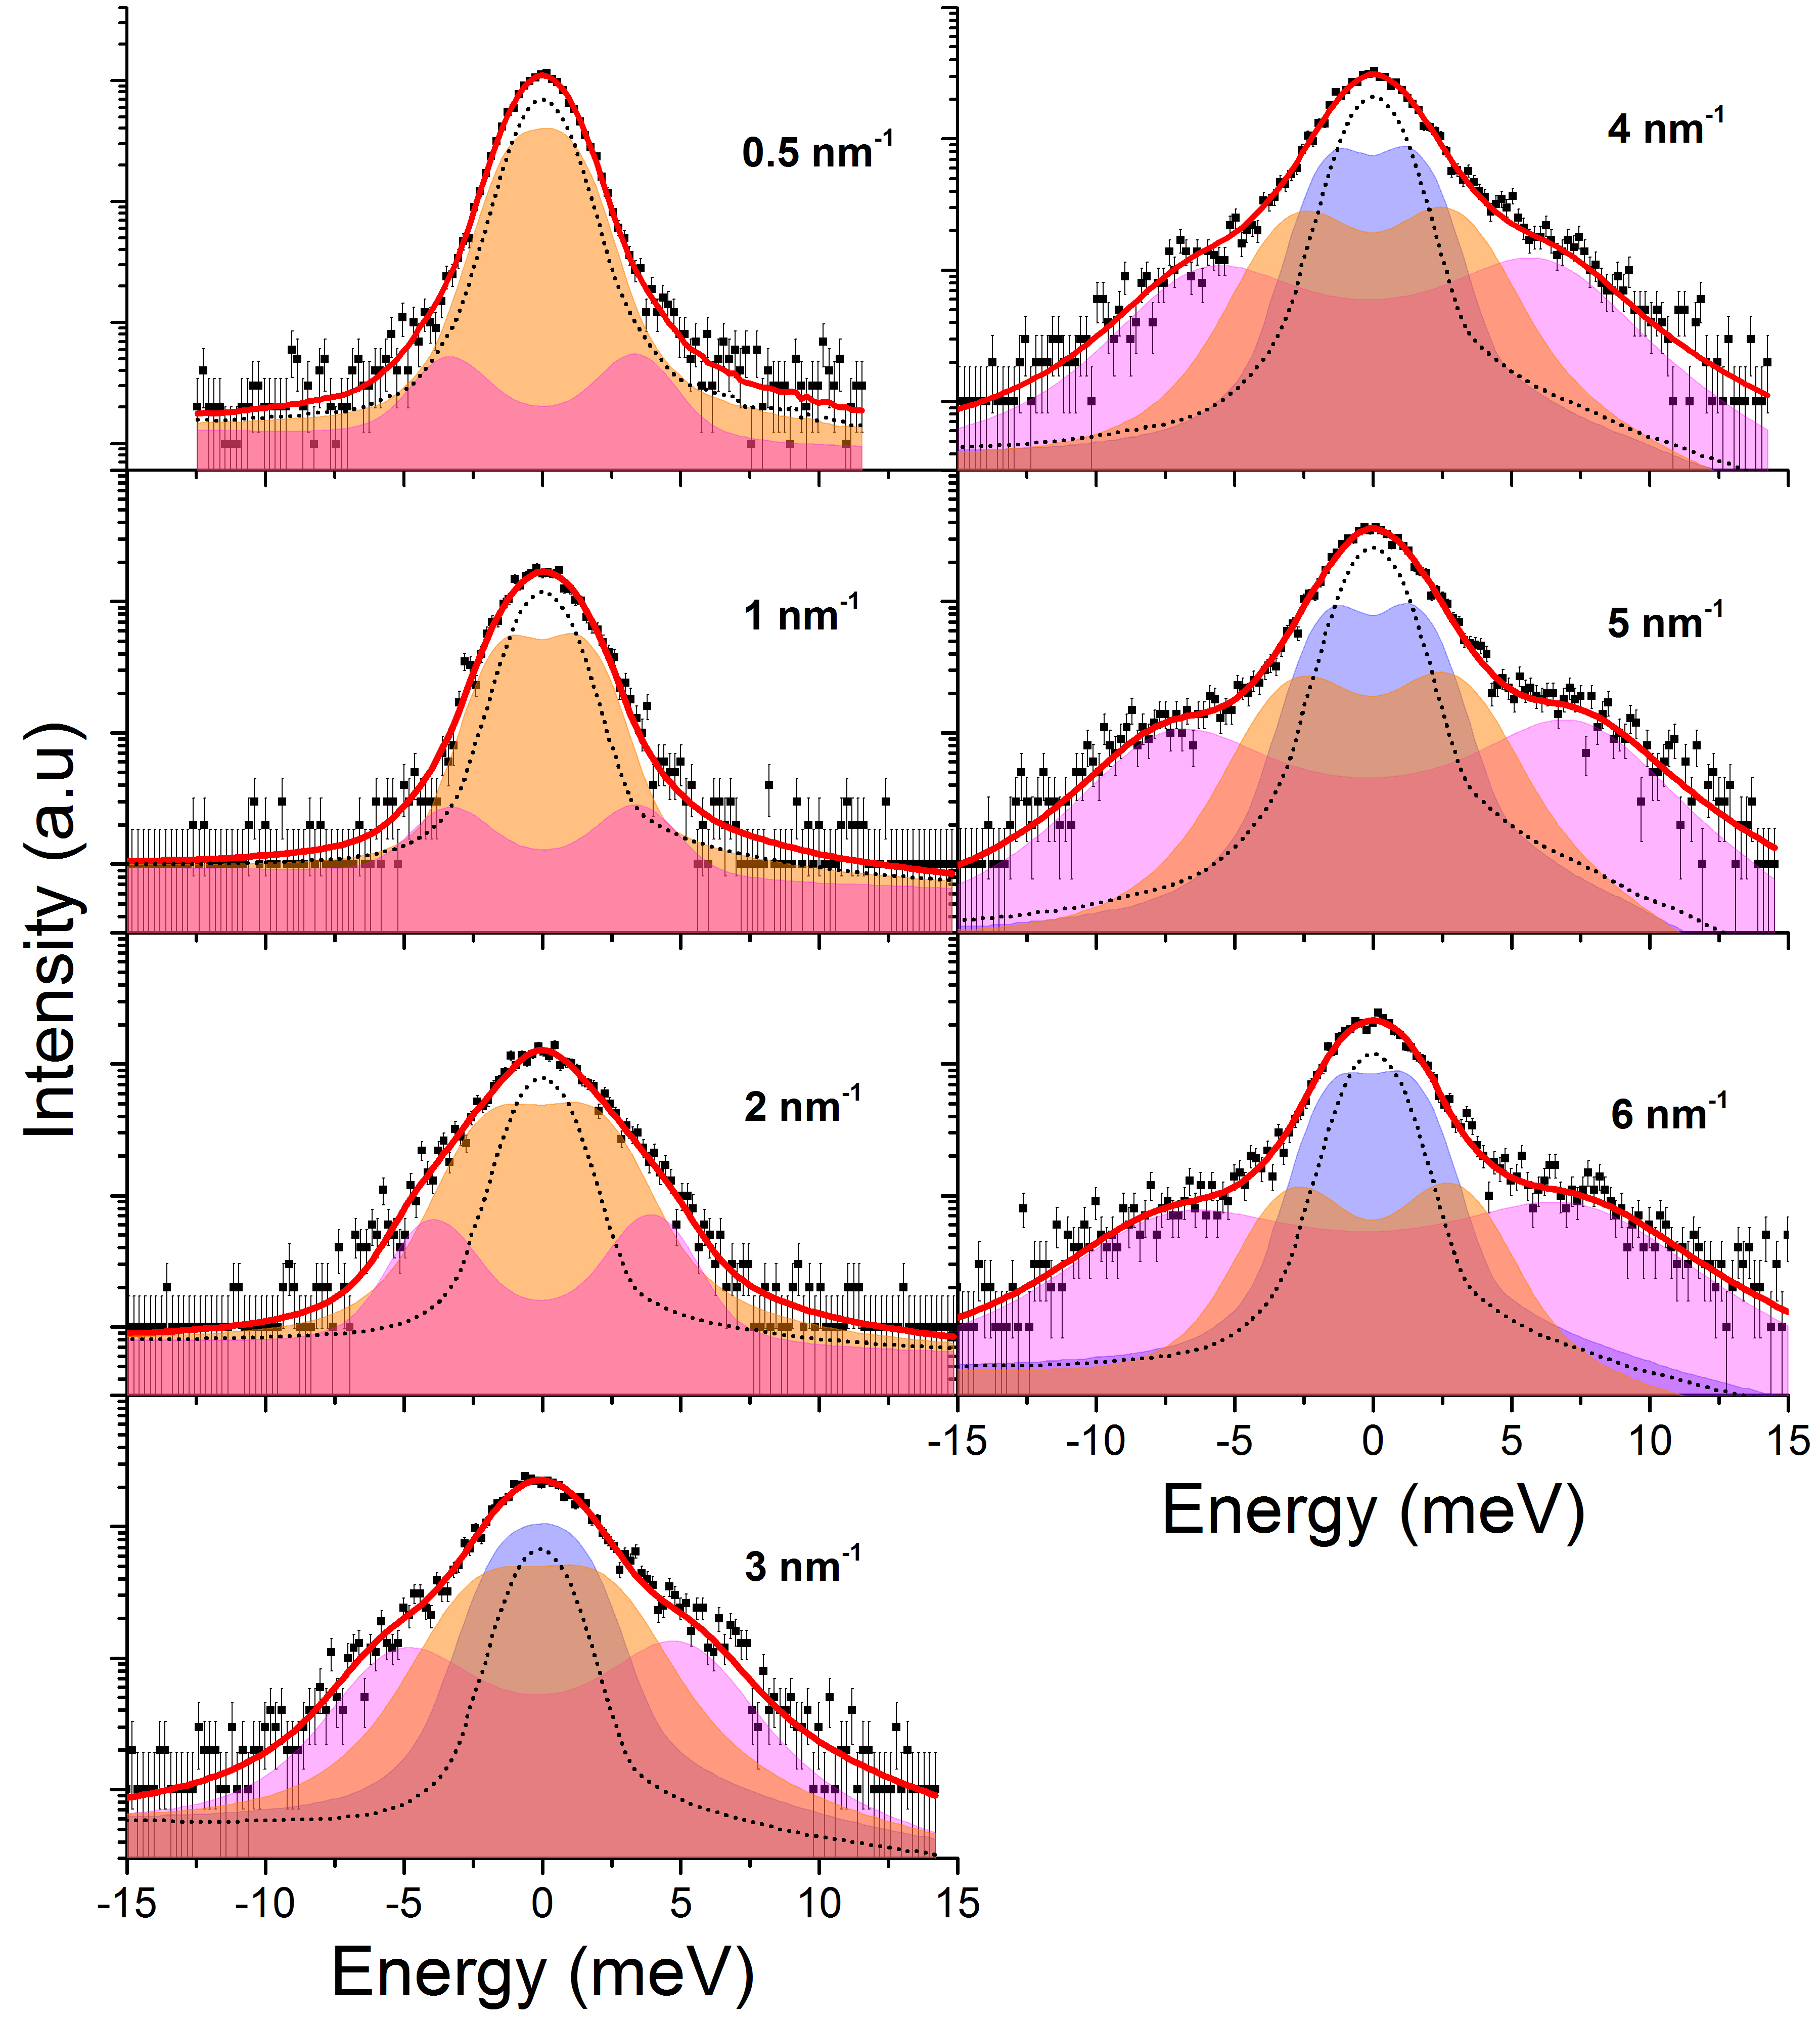
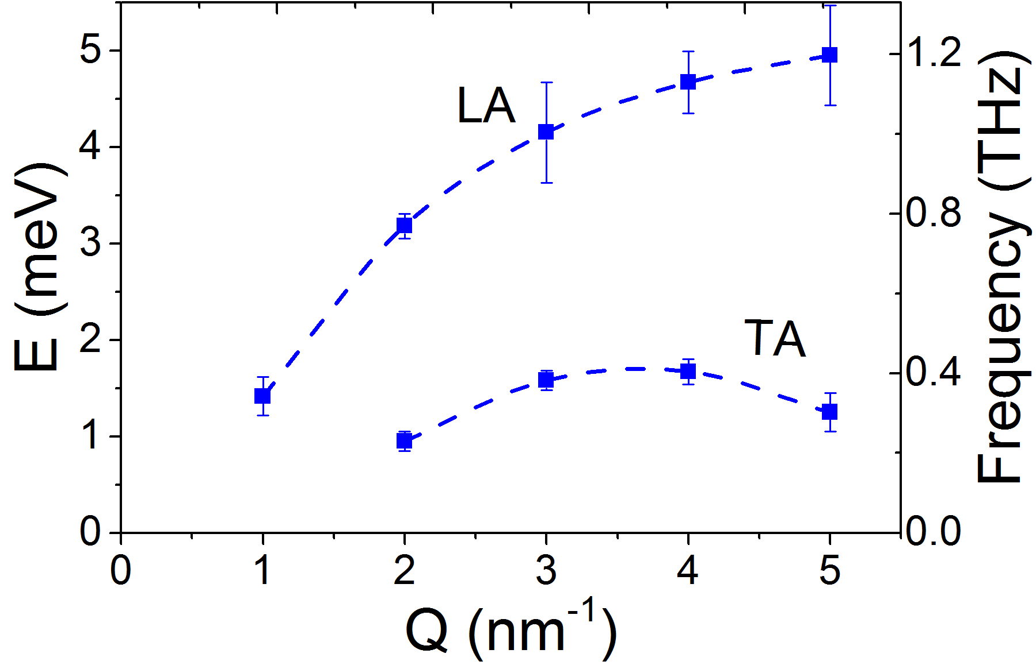
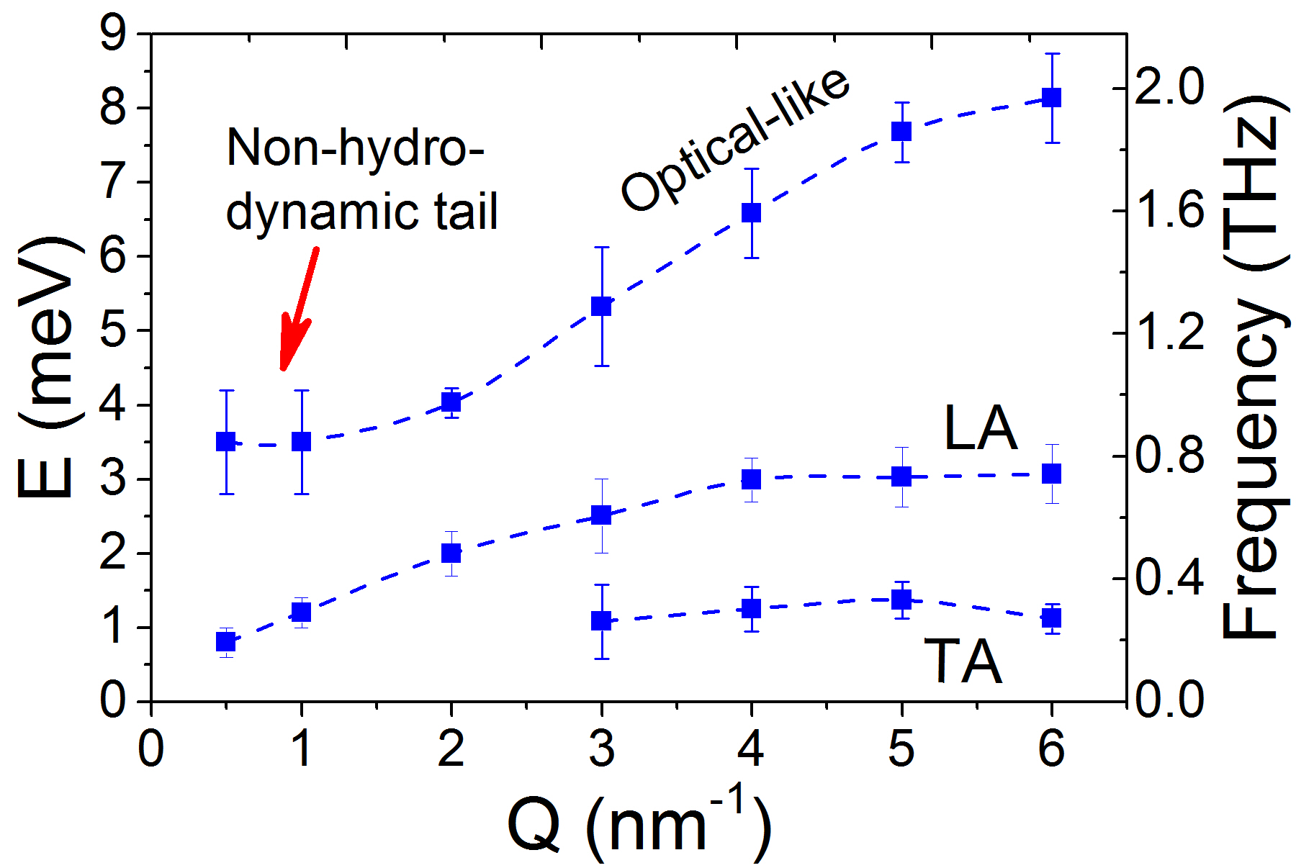
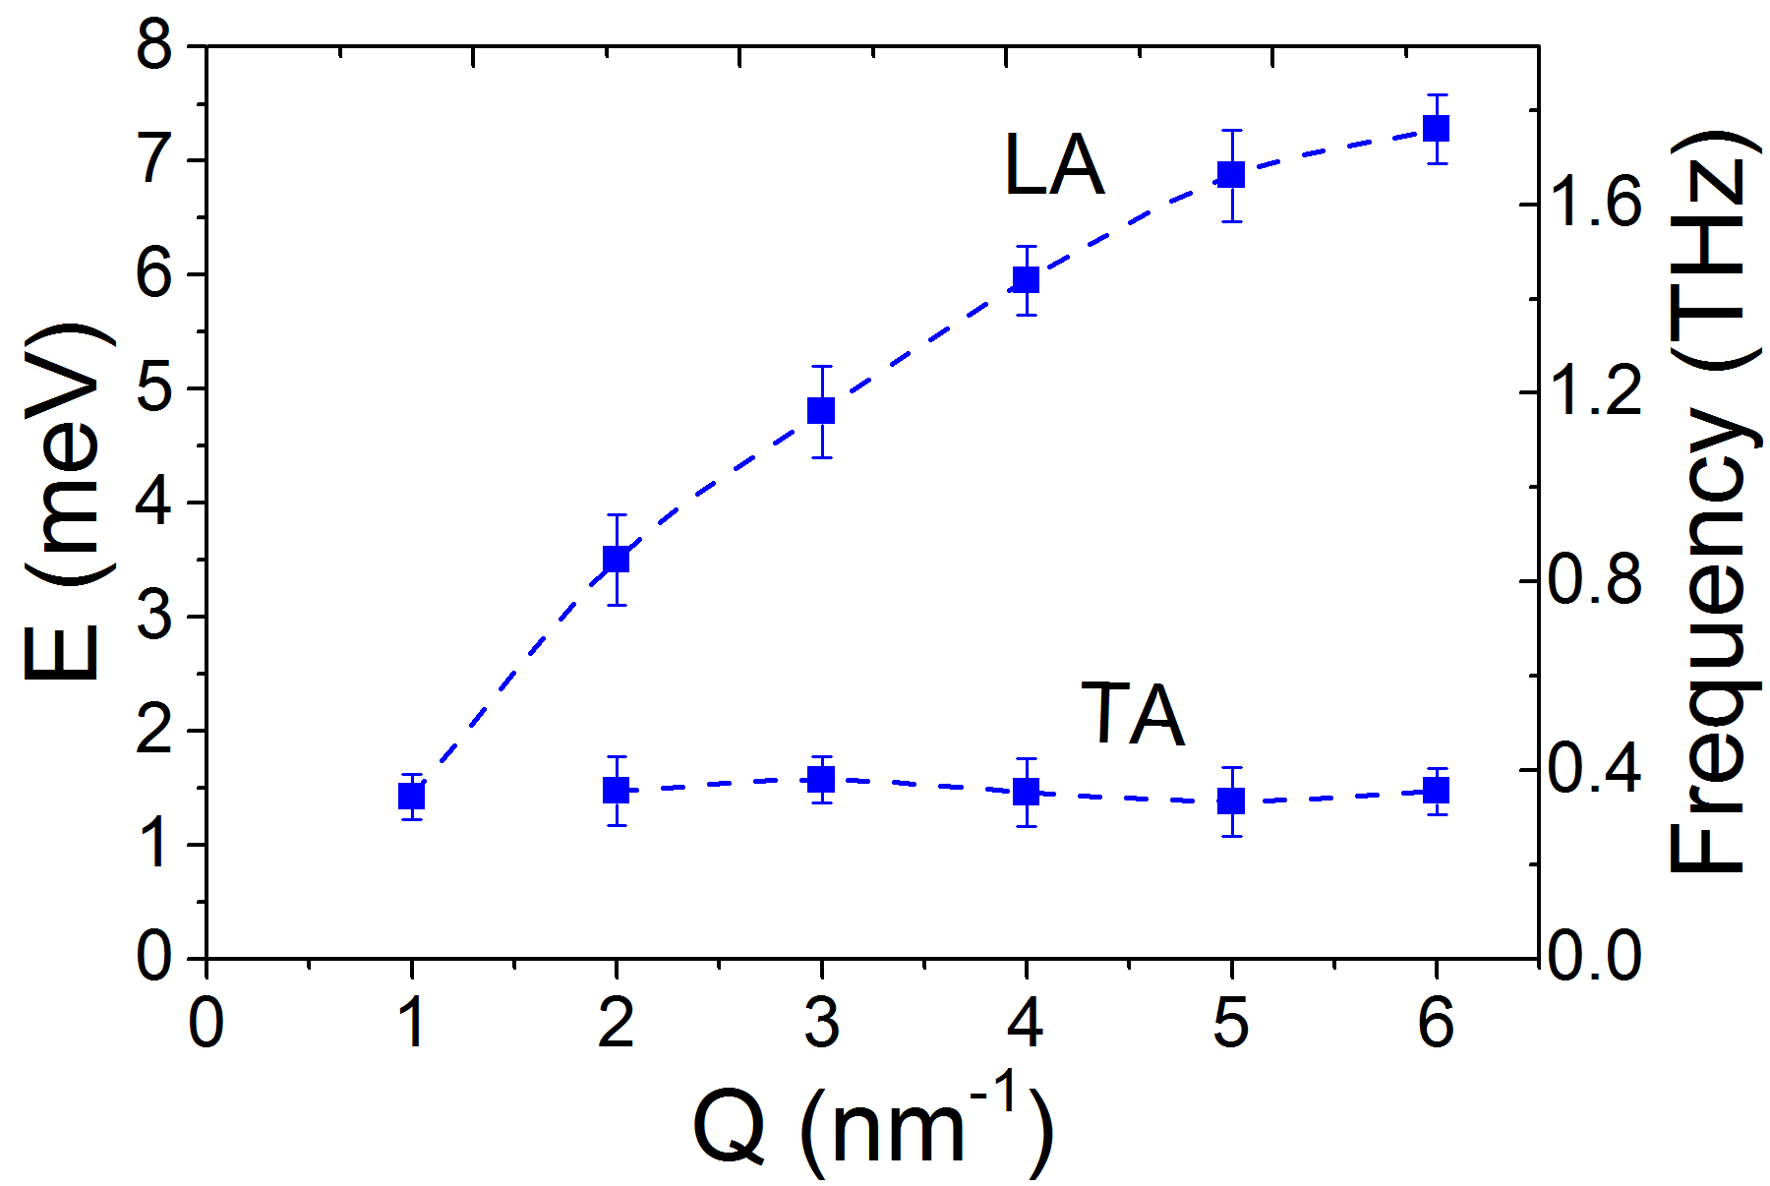
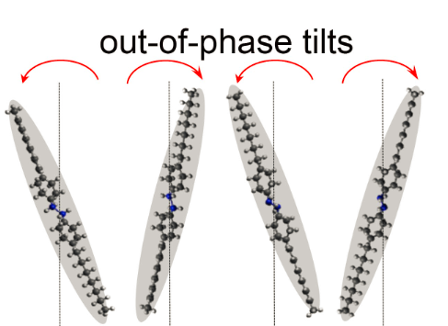


THz Phononics in Liq Crystals
Sample size:
2 x 25 x 0.05 mm³
Smectic layers aligned in scattering plane
D7AOB (4,4’-diheptylazoxybenzene)
Crystal (25 °C)
Smectic A (48 °C)
Isotropic (75 °C)
Smectic A (48 °C)
Q-gap in TA modes signifies characteristic correlation length
Optical-like phononic mode in smectic A phase due to the tilt motions of the mesogenes, consistent with IR data.
Results indicate tunability of collective excitations at nm-THz scales via selection of mesogenic phases and a possible route for manipulation of optomechanical properties.
D. Bolmatov, et al., Nano Letters, 2017, DOI: 10.1021/acs.nanolett.7b01324
Notes:
Q-gap in TA modes signifies characteristic correlation length beyond which transverse mode does not propagate.
Optical-like phononic mode in smectic A phase is due to the out-of-phase tilt motions of the mesogenes, consistent with IR absorption data reported from liquid crystals with similar molecules, pointing to possible optomechanical effects.
The investigation of phononic collective excitations in soft matter systems at the molecular scale has always been challenging due to limitations of experimental techniques in resolving low-energy modes. Recent advances in Inelastic X-ray Scattering (IXS) enabled the study of such systems with unprecedented spectral contrast at meV excitation energies. In particular, it has become possible to shed light on the low-energy collective motions in materials whose morphology and phase behavior can easily be manipulated, such as mesogenic systems. The understanding of collective mode behavior with a Q-dependence is the key to implement heat management based on the control of a sample structure. The latter has great potential for a large number of energy-inspired innovations. As a first step towards this goal, we carried out high contrast IXS measurements on a liquid crystal sample, D7AOB, which exhibits solid-like dynamic features, such as the coexistence of longitudinal and transverse phononic modes. For the first time, we found that these terahertz phononic excitations persist in the crystal, smectic A and isotropic phases. Furthermore, the intermediate smectic A phase is shown to support a van der Waals-mediated non-hydrodynamic mode with an optical-like phononic behavior. The tunability of the collective excitations at nanometer-terahertz scales via selection of the sample mesogenic phase represents a new opportunity to manipulate optomechanical properties of soft metamaterials. [DOI: 10.1021/acs.nanolett.7b01324]

Slide 24












CMS: high-pressure SAXS/WAXS
Masa Fukuto
Ruipeng Li
WAXS
PbSe nanoparticle
FCC superlattice
SAXS
Self-assembly
DAC
X-ray
Solution process
8nm
14nm
SAXS
WAXS
Simultaneous SAXS/WAXS on DAC @ 17keV
Structural characterization from atomic to nanometer scale
FCC superlattice starts expansion along <111> with pressure >8 GPa.
Phase transition of PbSe superlattice happens at 8 GPa (FCC to orthorhombic). Transition in bulk occurs at 3 GPa.
The soft organic ligand is compressed with pressure <8 GPa.
The structure recovers at 2 GPa by decreasing pressure.
Q (Å⁻¹)
Q (Å⁻¹)
Notes:
Structural characterization from atomic to tenth nanometer scale
WAXS: atomic structure
SAXS: nanoscale structure
PbSe superlattice phase transition happens at 8GPa, in both atomic and nanoscale structure.
PbSe nanoparticles shows phase change from FCC to Orthorhombic at 8GPa, much larger than the powder sample at 3GPa. The soft organic ligand is compressed with pressure <8GPa.

Slide 25
CHX: high-pressure XPCS
A. Fluerasu
L. Wiegart
X-ray photon correlation spectroscopy (XPCS): by taking a series of speckle patterns with coherent beam, the characteristic relaxation times can be determined from sub-millisecond to thousands of seconds (Sutton et al. Nature 1991).
diffusion coefficient in glass materials, and viscosity change during melting or solidification
Measurement of diffusion coefficients at high pressure is of great interest for understanding the dynamics of Earth’s interior (melts and glasses at conditions of Earth’s deep interior).
Unique simultaneous small-angle (10µm) and wide-angle (2-3µm) XPCS with energy up to 18 keV
unique to study motion of nano-particles or clusters at slow viscous state with SA-XPCS, and the atomic motion in the lattice using WA-XPCS.
Integrate DAC science.
Notes:
The Coherent Hard X-ray Scattering (CHX) beamline is dedicated to studies of nanometer-scale dynamics in materials using x-ray photon correlation spectroscopy (XPCS) with world-leading hard x-ray coherent flux and a state-of-the-art detection system for fast dynamics. CHX enables researchers to investigate nanoscale and mesoscale dynamics of complex materials on timescales ranging from below milliseconds to minutes or hours. Examples of XCPS studies include polymer dynamics in bulk and thin-films, colloidal suspensions and gels, domain dynamics in metallic systems, capillary waves, etc.
XPCS is based on measuring time correlation functions of the speckle fluctuations that occur when a coherent x-ray beam is scattered from a disordered sample. It can be used to measure equilibrium dynamics via the “usual” single- speckle intensity-intensity autocorrelation functions g⁽²⁾(q, t). When combined with 2-D area detectors and a multispeckle detection technique, it can also be used to measure non-stationary, non-equilibrium dynamics via two-time correlation functions g⁽²⁾(q, t1, t2). Higher-order correlation functions g^{(n)(q, t)} can be used to characterize heterogeneities in the dynamical properties. The key quantity that enables XPCS experiments is the source brightness. This determines the flux of coherent x-ray photons and ultimately the signal-to-noise ratio (SNR) of the measured correlation functions. With the unprecedented brilliance of the NSLS-II storage ring exceeding 10²¹ ph/s/mrad2/mm2/0.1% bandwidth at 8 keV, the CHX beamline will allow studies of dynamics on time scales that can be 100 times faster and on shorter length scales than currently achievable elsewhere.
XPCS can be used in a variety of scattering geometries, including transmission and grazing incidence small-angle scattering (SAXS/GISAXS) and wide-angle diffraction (WAXS/GIWAXS). In addition to the dynamic information about the sample, every XPCS dataset also contains the (time-resolved) structural information provided by the respective scattering geometry.
11-ID (CHX): Coherent Hard X-ray Beamline, already accepting high-pressure GU proposals;
Transport properties of melts and glasses: The measurement of diffusion coefficients at high pressure is of great interest for understanding the dynamics of Earth’s interior. X-ray photon correlation spectroscopy (XPCS) provides a great tool to detect slow dynamic events. By taking a series of speckle patterns at small angle or Bragg angle with coherent synchrotron illumination, the characteristic relaxation time can be determined from sub-millisecond to thousands of seconds (Sutton et al. Nature 1991). It is particularly useful to study the diffusion coefficient in glass materials, and viscosity change during melting or solidification. The CHX beamline provides both small angle (SA) and wide angle (WA) XPCS with incident energy up to 18 keV, which makes it a unique one-stop beamline to study motion of nano-particles or clusters at low viscous state with SA-XPCS, and the atomic motion in the lattice using WA-XPCS. The infrastructure of this project will facilitate coupling these techniques with a DAC. It provides a unique technique for studying melts and glasses at conditions of Earth’s deep interior.

Slide 26

Hard X-ray Spectroscopy Program
Emphasis on operando, structural and chemical surface reactions including:
  Heterogeneous and electro-catalysis for selective oxidation of light hydrocarbon activation, ammonia synthesis, and catalysis combined with separation (rational design of “smart” nanoporous membranes)
  Materials growth, device fabrication and device physics such as film growth on specific substrates and device structures (ALD)
ISS Inner Shell Spectroscopy Spectroscopy
QAS Quick x-ray Absorption and Scattering
SST-1,2 Spectroscopy Soft and Tender – NIST
BMM Materials Measurement – NIST
Notes:
Hard X-ray Spectroscopy program develops and operates a suite of cutting-edge x-ray spectroscopy beamlines enable research on real systems in complex environments over extended duration of systems operations.
Inner Shell Spectroscopy (ISS), Quick Absorption & Scattering (QAS), and Tender Energy Spectroscopy (TES) beamlines, offer an advanced suite of in-situ X-ray spectroscopy capabilities, including a state-of-the-art confocal X-ray spectrometer at ISS, with a set of specimen environments and a hazardous gas handling system for characterization of catalytic reactions and processes under industry relevant conditions.
NIST Spectroscopy Soft and Tender (SST-1, SST-2) beamlines, under development in partnership with NIST, enable X­‐ray photoelectron spectroscopy and near edge X‐ray absorption fine structure (NEXAFS) spectromicroscopy for materials science. The BMM beamline on a 3-pole wiggler port is also being developed in partnership with NIST and adds a diffraction/scattering capability.

Slide 27

Diffraction & In-situ Scattering Program
In-situ, real time Diffraction & Scattering for structural characterization of both crystalline materials and materials with limited LRO in complex environments
Functional Interfaces & surfaces, 3D structures, and thin film growth and processing
Scientific emphasis in materials engineering, chemistry, earth and environmental science, physics, materials in complex environments, synthesis and reaction processes
Materials and systems include batteries (BNL Battery Solution Center), fuel cells, catalysts, multiferroics, nanocomposites, photovoltaics, strongly correlated electron materials (electronic order)
XPD X-ray Powder Diffraction
PDF Pair Distribution Function measurements
ISR Integrated in-Situ and Resonant hard x-ray
HEX High Energy Engineering x-ray
K. M. Jensen and P. Juhas, M. A. Tofanelli, C. L. Heinecke, G. Vaughan, C. J. Ackerson, and S. J. Billinge, Nature Communications, 7 11859 (2016).
Notes:
Diffraction and In-Situ Scattering program develops and operates four world-class scattering & diffraction beamlines that enable advanced in-situ and operando studies for a wide range of fundamental and applied materials research problems.
X-ray Powder Diffraction (XPD) is a powder diffraction beamline that offers cutting-edge capabilities with a wide suite of in-situ sample cells under extreme conditions and real-world in-operando sample environments.
X-ray Pair Distribution Function Scattering (PDF) beamline is currently under development and will provide dedicated PDF capability for in-situ studies of nanoscale deformations in many materials systems.
In-situ and Resonant Scattering (ISR) beamline enables real-time studies of thin-film synthesis and growth that aims to control the nucleation kinetics during the growth process and allows polarization dependent diffraction studies of variety of materials under high magnetic field.

Slide 28

High Pressure Capabilities and Opportunities
ISR: structural investigation of materials at combined high pressure, low temperature and magnetic field
XPD: large volume press (maxpd = novel uniaxial deformation HP tooling >20 GPa )
  Deformation measurements at pressure and temperature conditions of the Earth’s lower mantle possible
HEX: high energy diffraction and
imaging of large samples in large
volume devices
(monochromatic and white beam)
PDF: appl. on melts and glasses
Notes:
Adaptation of diamond anvil cells needed to fit into magnet
in identifying new phases and/or intermediate phases during phase transition (e.g., Hu et al., Nature, 2016). This project will offer an experimental routine for multi-grain XRD at the DAC platform of XPD beamline including data analysis software (FABLE). Popularizing such a state-of-the-art technique among the COMPRES community will enable more discoveries of mantle phases in Earth’s deep mantle, as well as better insight into well known ones (e.g., Zhang et al., PNAS, 2013). The setup will also allow EOS and phase diagram determination from typical XRD experiments (e.g., Gu et al., Nature Geosci., 2016).
PDF on melts. This is very challenging for several reasons. The amorphous scattering is weak and must be measured to high precision. This requires long acquisition times, but maintaining a stable melt in the DAC for those times is difficult. Because the scattering is weak it can be swamped by the scattering from the diamonds which are orders of magnitude thicker than the sample. For both of these reasons the melt scattering at the APS is being done in a Paris Edinburgh cell, not a DAC. The PE cell allows using a soller slit to remove the non-sample scattering, but this does not have the resolution for the smaller DAC samples. It is also much easier to maintain stable liquid with resistive rather than laser heating.
properties of melts have gained increasing attention for comprehensively understanding Earth’s interior. Additionally, the study of melts will help to further our understanding of the magma ocean and early Earth evolution.

Slide 29



PDF: growth of Upconverting Nanocrystals
Scientific Achievement
  Mechanism of formation of NaGdF4:Yb:Er nanocrystals (∼10 nm) in organic media and their crystal structures.
Significance
  Capacity to convert near-IR photons into near-UV or visible light. Depends on size, morphology and chemical composition.
D. Hudry; D. Nykypanchuk; J. H. Dickerson.
Chem. Mater., 2016, 28, 8752
Notes:
It is essential to achieve a comprehensive understanding of the crystal structure of upconverting nanocrystals (UCNCs) as well as mechanisms governing their formation in organic media. The former is needed to explain the relationship between atomic scale structure and upconversion (UC) properties of UCNCs, while the latter is essential to finely tune the size, morphology, chemical composition, and architecture of well-defined upconverting nanostructures, which constitute the experimental levers to modify the optical properties. Such rationalization will ultimately help to design and synthesize more efficient upconverting nanostructures. X-ray diffraction studies coupled to Rietveld and PDF analyses revealed a complex mechanism of the formation of NaGdF₄:Yb:Er UCNCs based on chemical reactions involving in situ generated molecular clusters and microcrystalline sodium fluoride. A detailed crystallographic investigation show that the space group $P\overline{6}$ is the one that best describes the crystal structure of NaGdF₄:Yb:Er UCNCs contrary to what has been recently proposed. Further, our Rietveld and PDF data reveal the formation of bulk-like crystal structure down to 10 nm with limited distortions. In-depth structural characterizations based on diffraction experiments pave the way toward a comprehensive understanding of size-dependent UC properties and will be of major interest when dealing with multishell architectures.
Sample set #1
Nature: Lanthanide-based nanocrystals either as dry powder or liquid (i.e. nanocrystals dispersed in toluene)
Measurement: room temperature / PDF
Objective: Crystal structure of the nanocrystals compared to their bulk counterparts. These samples will also be used as references for the in situ experiments in order to validate the nature of the obtained materials.
Set #1 - samples details: (1) Eu2O3 NCs (Figure 1) (2) Eu doped Y2O3 NCs (Figure 2), with various Eu concentration (5, 10, 20, 30, 40, 50 mol.%) (3) NaGdF4 NCs – 5 nm (Figure 3) (4) NaGdF4:Yb,Er NCs – 20 nm (Figure 4) (5) NaGdF4:yb,Er@NaYF4 core-shell NCs (Figure 5), with various shell thicknesses (from 1 to 5 nm).
Sample set #2
Nature: Organic reactive mixtures
Measurement: in situ high temperature / set #2a for PDF measurements and set #2b for SAXS measurements (sets #2a and 2b will be identical)
Objective: In situ formation and growth of the nanocrystals (PDF) and high temperature self assembly (SAXS)
Set #2 - samples details: (1) Europium acetate, oleic acid, oleylamine and tri-n-octylamine (2) Europium and yttrium acetates, oleic acid, oleylamine and tri-n-octylamine (3) Gadolinium acetate, oleic acid, octadecene, sodium hydroxide and ammonium fluoride (4) Gadolinium acetate, oleic acid, octadecene, sodium trifluoroacetate

Slide 30




XPD: HP Flow Cell
High Pressure Flow Cell up to 1,000 bar
Commissioned: 150 bar, -196°C to 600°C
Operates with :
Cryostream: -196°C to 300°C
Resistive heater: ambient - 600°C
Mirror furnace: < 1000°C
Application to clathrates important in energy (methane gas) storage and sequestration
(CO2 gas) (T. Koga; L. Ehm; J. Parise)

Slide 31


XPD: Large Volume Press (MAXPD)
1,100-ton Hydraulic Press
DT-25 (Differential Kawai)
D-DIA Module Also Available
Differential Hydraulic Pumps for Deformation (1-10MHz)
Monochromatic Beam 52, 67keV
Diffraction Area Detector
X-Radiographic Imaging
Notes:
DT-25 Kawai: Novel uniaxial deformation HP tooling >20 GPa (upscale of DT-10 at X17B2 - 16-18 GPa)
to probe the entire range of
conditions within the Transition Zone
(~13-23 GPa)
Full-field radiographic imaging, precise measurement of stress-strain-time, texture, size-strain measurements
DT-25 Kawai: Novel uniaxial deformation HP tooling >20 GPa (upscale of DT-10 at X17B2 - 16-18 GPa) - 15-150mm³
2 × pressure range of existing D-DIAs (~12 GPa): APS 6-BMB & 13-IDD (Gsecars), ESRF ID06, SPring-8 BL04B1, Photon Factory 14C2
Only other comparable facility is at BL04B1 of SPring-8: < 90GPa, BUT no deformation capability and “small” sample size
Rheology experiments in DAC can
reach these pressures, but variables not
easily controlled

Slide 32



XPD: iodine in Metal-Organic Frameworks
First high pressure Diamond Anvil Cell experiment at XPD
Understanding the storage mechanism of highly volatile iodine in MOFs
Straight channels
Reversible pressure induced amorphization
Framework flexing compression mechanism - flexible C-S-C hinge in the center of the sdb linker
Notes:
energy storage and conversion, hybrid materials, clathrate research and correlated electron materials research
4,4`-sulfonyldibenzoate
monoclinic (P2₁/n and C₂/c)
Straight channels in SBMOF-1 (A) and sinusoidal in SBMOF-3 (C). Carbon atoms are black, and sulfur is yellow. Oxygen, hydrogen, and calcium/cadmium atoms are omitted for clarity. Large green spheres depict iodine sorption sites. (B) “Wine-rack” topology of SBMOF-1. Red line is the sdb linker with all sulfonyl groups (yellow) bonded with Ca to form CaO₆-octahedra (gray). All carboxyls also participate in CaO₆-ocathedra and are not shown for clarity. (D) “Wine-rack” topology of SBMOF-3. Black (z = 0) and red (z = 1/2) lines are the sdb linker with only half of the sufhonyl groups bonded with Cd to form CdO₆-octahedra (gray). All carboxyls also participate in CdO₆ and are not shown for clarity.

Slide 33



XPD: In Situ Study of Corrosion Resistance
400°C – 1,500 psi
Steam environment, supercritical CO2
Appl. to understanding how protective passive films develop and operate in engineering materials (Zr alloys, steels) for accident tolerant nuclear fuel cladding
Raul Rebak GE Global Research
S. Gill BNL
J. Rev. Sci. Instrum. (2016)
350°C, 50psi
Notes:
Initial oxidation stages of Zr alloy in steam 350deg C and 50psi

Slide 34



HEX: Passivation of an Anode material (in situ)
Metallographic slice through a used anode material
Surface plot of EDD spectra taken as a function of electrolysis time, showing the formation of rutile (TiO₂) passivation layers on Magnéli-phase (Ti_{n}O_{2n-1}; n = 4-6) anodes
M R Rowles et al. CSIRO and University of Melbourne, Australia

Slide 35

HEX: Flow Dynamics during Electro-Welding
H. Dong (Leicester), S. Wen (Tata Steel), Robert Atwood (DLS)
Electro-welding is the most frequently used method of joining metal. Its flow dynamics is poorly understood because in-situ bulk observation has not been possible so far.
Feed wire
Weld pool
Courtesy of M. Drakopoulos, UK
1 mm

Slide 36

HEX: crack Strain in polygranular Nuclear graphite
S.M. Barhli et al. U. of Oxford, UK (2017)
Notes:
UK's advanced gas cooled (AGR) nuclear fission reactors as a neutron moderator and reflector.
integrity is critical to the safe operation of the reactor.
81keV

Slide 37
Diffraction/scattering micro-tomography under pressure
a) 5 glass blobs embedded in h-BN pressure medium, and (b) 3D rendered volume at 0.9 GPa, 300K.
Bottom: melt distribution (brown) in an iron bead at 3 GPa and 1600 K
3D view of the 450 ton V7 Paris–Edinburgh press with the RoToPEc Module (J-P. Itié).
A full dataset of 1500 radiographs in 3.8 s.
J. Synchrotron Rad. (2017). 24, 240

Slide 38
NSLS-II: an extended Portfolio for High Pressure
XPD: high energy diffraction, PDF
HEX: white beam diffraction, imaging large samples
FIS: IR spectroscopy
ISR: single-crystal, diffuse scattering, magnetic field
IXS: phonons, sound velocity
CMS: wide-angle (atomic) and small-angle (nm-meso)
CHX: coherent beam, dynamics (XPCS)
HXN: nano-probing
Labs: support infrastructure
Pa-TPa
10 K ≤ T≤ 5000 K
10⁻³ s ≤ t ≤ 10⁷ s
Notes:
HEX, IXS, HXN, SRX, CHX etc
The new techniques (XPCS, nanoprobe) will open up new scientific areas.

Slide 39


Outlook
Ramping up unique capabilities for High Pressure research at key beamlines, e.g. diffraction, XAS, IR, inelastic scattering and comprehensive support infrastructure
Particular strengths in:
  Imaging with world-leading resolution down to sub-10 nm (incl. structure, morphology, chemical and electronic mapping)
  Dynamics (structural, electronic and magnetic)
  Atomic structure solution, including robotic sample handling for high-throughput or hard-to-handle (e.g. radioactive) samples
World-leading R&D activities in
  X-ray detectors (P. Siddons)
  Nanofocusing optics and metrology
  Precision nanopositioning
Notes:
Access to higher pressure range with DACs
In-situ heterogeneous multi-grain & multi-materials systems
Address inhomogeneity induced by P-T gradients
Imaging volume changes in amorphous systems
Multi-modal multi-technique approach, with HP support staff infrastructure

Slide 41

Next steps for beamline construction
New beamlines already identified (2016)
  CDI: Bragg-CDI for world-class lensless imaging down to 5 nm
  ARI: Scanning probe with simultaneous nano-APPES/nano-RIXS capabilities at ~100 nm resolution
  SMF: Soft x-ray STXM with nm-scale resolution via ptychography
  QIX: Quick RIXS for snapshots of chemical reactions in-operando
  PLS: GISAXS/WAXS for liquid interfaces and polymer processing
  INF: Nano-IR spectroscopy of heterogeneous solid state materials
Strategic planning and brainstorming sessions (2018):
  Identified new capabilities and new beamlines that should be developed to meet science needs, taking into account the capability gaps in the current portfolio
Current activities:
  MIE CD-0 proposal to build three state-of-the-art imaging beamlines
  Working on concepts of add’l beamlines
  Will engage SAC and user community in coming months to further discuss these concepts

Slide 42
Comparison with APS
APS-6BM – shutdown in Summer 2018 ?
APS-Gsecars
  - strong DAC and LVP programs
APS-HPCAT
  strong program with DACs
  doesn't have a full LVP program.
  a hydraulic Paris-Edinburgh press that enables tomography studies (nearly full rotational access to the sample)
  can be combined with acoustic measurements.
4. APS 11-IDC
  D. Mao’s PUP: high energy X-ray micro-diffraction (XRμD) capability for materials under extreme HP condition (20μm at 107keV using kinoform lenses, KB system at 60keV): diamond anvil cell assembly, portable Ruby system, Raman system, laser heating system, cryogenic XRD and transport measurement system etc.
  Application to pressure induced amorphization, metallic glasses, nanomaterials, etc
Notes:
GeoSoilEnvironment
PCAT

Slide 43
Structural Biology Program
Emphasis on the atomic structure, function and dynamics of molecules of importance in fundamental function of all biological systems.
Structural biology, using micro-diffraction, anomalous dispersion, automatic data collection and structure interpretation, time resolved measurements.
Dynamics and imaging, using ptychography and scattering-based imaging for bio-materials, proteins in solution, and dynamics through X-ray foot printing (XFP beamline)
AMX Automated Macromolecular X-ray crystallography
FMX Frontier Macromolecular X-ray crystallography
LIX Life science X-ray scattering
XFP X-ray Footprinting – in partnership with Case Western Reserve University
NYX New York structural biology – in partnership with New York Structural Biology
Notes:
Structural Biology program operates five state-of-the-art X-ray crystallography, X-ray scattering, and X-ray footprinting beamlines that provide microfocused X-ray beams with world-leading X-ray photon densities for a wide range of cutting-edge investigations in molecular structural biology and enzymology. This suite of world-class structural biology beamlines at NSLS-II brings structural biology at storage rings to a new level, enabling discovery-class as well as hypothesis-driven projects with potentially large numbers of samples in life science research.
Frontier and Automated Macromolecular Crystallography (FMX/AMX) are a pair of micro biological crystallography beamlines on canted undulators with world-leading micron-sized x-ray flux densities in the 5-30 keV range, and a suite of automated novel crystal mounting and handling systems (Figure 4), including an acoustic-droplet ejected system and a dynamic slit system to adapt beam to crystal size, to enable high-throughput, and challenging projects using multi-crystal serial crystallography at cryo- or room temperatures.
NYSBC Biological Microcrystallography (NYX) – Developed in partnership with New York State Structural Biology Consortium (NYSBC), the NYX beamline provides cutting-edge optimized single- and multiple-wavelength anomalous scattering (SAD and MAD) capabilities in the 6-17.5 keV range.
X-ray Scattering for Life Science (LIX) – Time-resolved solution scattering for studying macromolecule conformational changes in solution and advanced grazing-incident scattering for structural studies of membrane complexes.
X-ray Foot-printing (XFP) – Developed in partnership with Case Center for Synchrotron Biosciences, the XFP beamline provides a unique X-ray coupled mass spectroscopy capability for structural studies from non-crystalline macromolecule specimens, enabling investigations of more complex biological systems and allowing access to timescales in the microseconds range.

Slide 44

The Phononic Spectrum
meV phonons
M. Maldovan, Nature 503, 209 (2013)
THz (meV) phonons are primary carriers of heat in dielectric materials
Liquid crystals: Rich mesophases offer an unique opportunity to study the effect of mesogenic structure on the phononic dispersion, and the potential for heat manipulation and other applications through structure engineering.
Smectic A
Smectic C

Slide 45

THz Phononics in Liquid Crystals
D. Bolmatov, et al., JPCL, 2018
DOI: 10.1021/acs.jpclett.8b00926
5CB (4-cyano-4′-pentylbiphenyl), in nematic phase

Slide 46

New Way to Control Molecular Vibrations that Transmit Heat
Liquid crystal D7AOB in Smectic A Phase
(b)
Scientific Achievement
  Using inelastic x-ray scattering three distinct terahertz vibrations, which are common in solid matter, were detected moving through the layers of the Smectic A liquid crystal phase and were linked to the nanoscale structure of the material.
Significance and Impact
  Understanding the dynamic molecular features in soft materials such as liquid crystals could offer a new pathway to control the vibrations, and hence the flow of heat, sound or other forms of energy coupled with those vibrations.
  Research Details
  Studies showed that modulating the amount of structural disorder using different phases of a liquid crystalline material can create a variety of terahertz vibrational effects.
  Studies used beamline 10-ID (IXS) at NSLS-II, which features an unprecedented energy resolution of 2 meV with sharp instrumental resolution at 9 KeV, providing a unique capability for studies of complex materials with nanoscale inhomogeneities.
IXS spectra of a liquid crystal D7AOB in the layered smectic A phase (T=48°C), showing two acoustic (purple and orange) and one optical (pink) vibrational modes. The latter mode is linked to the out-of-phase tilt motion of the molecules (bottom right).
D. Bolmatov, M. Zhernenkov, L. Sharpnack, D. Agra-Kooijman, S. Kumar, A. Suvorov, R. Pindak, Y. Cai, & A. Cunsolo, Nano Letters 17, 3870−3876 (2017).
Work was performed at Brookhaven National Laboratory
Notes:
The investigation of phononic collective excitations in soft matter systems at the molecular scale has always been challenging due to limitations of experimental techniques in resolving low-energy modes. Recent advances in Inelastic X-ray Scattering (IXS) enabled the study of such systems with unprecedented spectral contrast at meV excitation energies. In particular, it has become possible to shed light on the low-energy collective motions in materials whose morphology and phase behavior can easily be manipulated, such as mesogenic systems. The understanding of collective mode behavior with a Q-dependence is the key to implement heat management based on the control of a sample structure. The latter has great potential for a large number of energy-inspired innovations. As a first step towards this goal, we carried out high contrast IXS measurements on a liquid crystal sample, D7AOB, which exhibits solid-like dynamic features, such as the coexistence of longitudinal and transverse phononic modes. For the first time, we found that these terahertz phononic excitations persist in the crystal, smectic A and isotropic phases. Furthermore, the intermediate smectic A phase is shown to support a van der Waals-mediated non-hydrodynamic mode with an optical-like phononic behavior. The tunability of the collective excitations at nanometer-terahertz scales via selection of the sample mesogenic phase represents a new opportunity to manipulate optomechanical properties of soft metamaterials. [DOI: 10.1021/acs.nanolett.7b01324]
The work at the National Synchrotron Light Source-II, Brookhaven National Laboratory, was supported by the U.S. Department of Energy, Office of Science, Office of Basic Energy Sciences, under Contract No. DE-SC0012704.

Slide 47
Future Opportunities
High Pressure Research Ecosystem
Connecting Tools and Science through Support Infrastructure
28-ID
High Resolution Diffraction
27-ID
White Beam Diffraction
Imaging Large Samples
22-BM
IR Spectroscopy
10-ID
Phonons
Lab
Support Infrastructure
PDF
4-ID
Single-crystal
HP, low T, B
Diffuse Scattering
Earth & Planetary Science
Shallow Earth
Fast Phenomena
Physics
HCE Systems
Ferroic Materials
Chemistry
Reactions
Crystallization
Material Science
New Materials
Complex Crystal Structures
Life Sciences
Extremophiles
Earth & Planetary Interiors
Warm Dense Matter
Pa-TPa
10 K ≤ T≤ 5000 K
10⁻³ s ≤ t ≤ 10⁷ s
Ex situ Capabilities
8-BM, 8-ID, 5-ID, 3-ID, CFN, C3D + Tandem Van der Graaf
Notes:
28-ID—XPD, 27-ID---HEX, 22-BM FIS, 4-ID—ISR, 10-ID---IXS, and more

Slide 48


Slide 49
Revealing new properties of Ni-based functional materials
Scientific Achievement
  Resonant inelastic x-ray scattering (RIXS) revealed that
  electrons from oxygen atoms in Ni-compounds such as NdNiO₃ are responsible for their metal-to-insulator transition properties.
Significance and Impact
  Revealing the electronic structure of NdNiO₃ shows that it is a candidate for an exciting new transistor material.
Research Details
  NdNiO₃ is either a metal or an insulator, depending on its temperature. This characteristic makes the material a potential candidate for transistors.
  Several theories tried to explain how the transition from metal to insulator happens, without final consensus.
  High resolution RIXS experiment provides unambiguous information on the electronic structure of NdNiO₃: this finding represents a solid base for modeling the material.
3D map of RIXS plane (bottom), measured across the Ni L₃ absorption edge (XAS on the left). The finding of fluorescence excitations in the RIXS plane down to low energy loss (magenta) supports the presence of delocalized electronic states across the Fermi level, with a dominant oxygen character (right).
V. Bisogni, S. Catalano, R. J. Green, M. Gibert, R. Scherwitzl, Y. Huang, V. N. Strocov, P. Zubko, S. Balandeh, J.-M. Triscone, G. Sawatzky and T. Schmitt; Nat. Comm. 13017 (2016).
Work was performed at the Swiss Light Source.
Notes:
The metal–insulator transition and the intriguing physical properties of rare-earth perovskite nickelates have attracted considerable attention in recent years. Nonetheless, a complete understanding of these materials remains elusive. Here we combine X-ray absorption and resonant inelastic X-ray scattering (RIXS) spectroscopies to resolve important aspects of the complex electronic structure of rare-earth nickelates, taking NdNiO3 thin film as representative example. The unusual coexistence of bound and continuum excitations
observed in the RIXS spectra provides strong evidence for abundant oxygen holes in the ground state of these materials. Through modeling, we show that distinct spectral signatures arise from a Ni 3d8 configuration along with holes in the oxygen 2p valence band. From the differences found between data below and above metal-to-insulator transition (T=150K), the electronic structure of the material was extracted. Results showed that electrons belongings to oxygen atoms are found to be responsible for the main changes between low and high temperature, thus supporting the direct role of oxygen atoms in the metal-to-insulator transition of NdNiO₃. [DOI: 10.1038/ncomms13017]
Work was funded by the Swiss National Science Foundation, the European Community’s Seventh Framework Program (FP7/2007–2013), Canadian funding agencies NSERC, CRC,
and the Max Planck/UBC center for Quantum Materials. This research also used resources of the National Synchrotron Light Source II at Brookhaven National Laboratory under Contract No. DE-SC0012704.

Slide 50

CMS: nanoscale Structure of the Oil-Water Interface
Scientific Achievement
  X-ray reflectivity (XR) and molecular dynamics (MD) simulations provide new insight into the nanoscale structure of liquid alkane-water interfaces.
Significance and Impact
  Understanding alkane-water interfaces, the simplest hydrophobic-hydrophilic interfaces, is of fundamental importance to basic science and Energy-Water Nexus.
Research Details
  XR alone reveals good agreement with a sharp density profile, broadened by thermal capillary waves, independent of alkane chain length.
  XR and MD together show that the interfacial depletion layer is no more than 0.5 Å thick, significantly (3-8 times) smaller than obtained previously for methyl-terminated self-assembled monolayer-water interfaces.
  MD suggests that the relative insensitivity of the interfacial width to alkane chain length arises from the chain’s propensity to lie parallel to the interface.
(top) Molecular Dynamics (MD) and (bottom) Fresnel-normalized reflectivity R/R_{F} for three alkane/water interfaces: pure capillary-wave theory (CWT) and MD with CWT are nearly indistinguishable(solid lines). Previous measurements (dashed lines are their best fits) show vastly different behavior [Mitrinovic et al. PRL 85, 582 (2000)].
M. Fukuto, B. M. Ocko, D. J. Bonthuis, R. R. Netz, H.-G. Steinrück, D. Pontoni, I. Kuzmenko, J. Haddad, M. Deutsch, Physical Review Letters 107, 256102 (2016)
Work was performed at Brookhaven National Laboratory, Argonne National Laboratory, and European Synchrotron Radiation Facility.
Notes:
Interfaces of hydrophobic with hydrophilic matter are ubiquitous in nature and in science, and understanding their structure is of fundamental importance in biology, chemistry, materials science, and physics and to the Energy-Water Nexus. Using x-ray reflectivity (XR) and atomistic molecular dynamics (MD) simulations, a team led by researchers at DOE's Brookhaven National Laboratory obtained new insight into the nanoscale structure of the oil-water interface, the archetypical hydrophobic-hydrophilic interface as well as the simplest liquid-liquid interface. For hexane, dodecane, and hexadecane oils, the XR measurements carried out using a high-energy liquid surface reflectometer at the Advanced Photon Source and the European Synchrotron Radiation Facility, show very good agreement with a locally sharp, monotonic oil-water interfacial density profile broadened by thermally excited capillary waves. This result mends a long-standing apparent discrepancy of previous XR measurements with the capillary-wave theory. The new XR results, together with MD simulations, places stringent upper limits on the magnitude of a potential sub-Å thick electron-depletion layer separating the oil and the water as well as on the nonthermal (intrinsic) contribution to the interfacial width. The XR and MD derived depletions, which agree with each other, are much smaller than reported for the interface between solid-supported hydrophobic monolayers and water. [DOI: 10.1103/PhysRevLett.117.256102]
Work was funded by the U.S. Department of Energy, Office of Basic Energy Sciences, under Contracts No. DE-SC0012704 (M. F., B. M. O) in the CMPMS and NSLS II Departments at BNL and DE-AC02-06CH11357 for beamtime and support at 9ID at the APS at ANL, the U.S.-Israel Binational Science Foundation, Jerusalem (M. D.) and the ESRF for beamtime at ID15A and for PSCM support.

Slide 51




Imaging and Diffraction: space/time slicing
Development of environmentally friendly H₂-based technologies e.g. auto propulsion. Study of the proton-exchange-membrane in a running Fuel Cell.
Diffraction in real working conditions vs. polarization of the PEMFC. ESRF-ID15, 90 keV.
V. Rossi Albertini et al. Adv. Mater. 21 (2009).

Slide 52








MAXPD: CaSiO₃ Perovskite Under Extreme Conditions
Scientific Achievement
  Recently commissioned high pressure set-up at NSLS-II (XPD beamline) delivers first results. the first of its kind in the world.
Significance and Impact.
  The XPD beamline pressure rig is the first of its kind in the world capable of performing deformation studies on Earth, ceramic, novel, and functional materials at higher pressures than anywhere else.
Research Details
  COMPRES Partner User researchers from Stony Brook University developed, installed, and commissioned the high pressure multi-anvil endstation at beamline 28-ID-2-D at NSLS-II.
  this unique equipment is capable of achieving pressures >20 GPa and temperatures >2000°C. DT-25 can then be used to deform samples uniaxially at high T over ~2x pressure available in other systems.
Room P & T
18 Gpa, 1000°C
Pseudowollastonite
CaSiO₃ Perovskite
X-ray diffraction patterns of (left) starting sample material at ambient conditions, (right) sample at high pressure and temperature on the right. CaSiO₃ perovskite requires high P & T to form, and is an unquenchable phase. Once phase transformation was complete, the differential hydraulic system was engaged and sample was uniaxially deformed to ~15% strain;
Work was performed at Brookhaven National Laboratory by R.S. Triplett, D.J. Weidner, M.L. Whitaker, K.J. Baldwin, W.B. Huebsch, and M.T. Vaughan
Notes:
first measurements on the rheological properties of CaSiO₃ perovskite
First study of the rheological properties of CaSiO3, an important phase found in the Earth’s mantle

