Slide 1


High Speed X-ray Imaging at High Pressure and Temperature
Eglantine Boulard
Sorbonne Université, IMPMC
Soleil Synchrotron
N. Guignot, A. King, J-P Deslandes & J-P Itié (Soleil Synchrotron)
J-P Perrillat ; P. Garcia del Real; E. Giovenco (Lyon University)
Y. Le Godec (IMPMC)
A. Dewaele & C. Denoual (CEA)

Slide 2
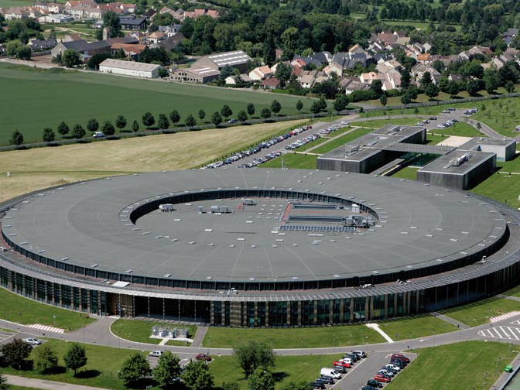
The French national synchrotron radiation source
Located at St Aubin, 25 km south of Paris
First electrons accelerated in 2006
2.75 GeV storage ring, 354 m circumference
450 - 500 mA top up
29 beamlines, 3 tomography beamlines:
  PSICHE
  ANATOMIX – dedicated imaging beamline
  PUMA – dedicated to cultural heritage and ancient materials

Slide 3
Psiché Beamline
Pression, Structure et Imagerie
par Contraste à Haute Energie
Highest energy beam line at SOLEIL
Diffraction at extreme pressures:
  Diamond anvil Cells, Paris-Edinburgh, Multi-anvil
  Monochromatic / angular dispersive XRD
  White beam / energy dispersive XRD (CAESAR)
Tomography
  Polyvalent and flexible
  Combine techniques

Slide 4
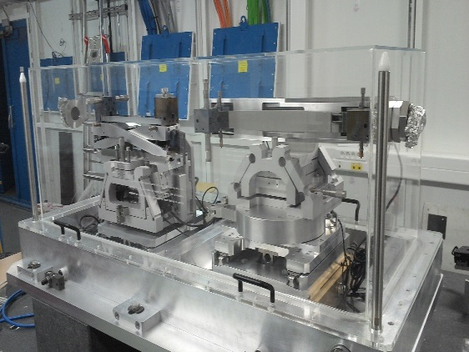
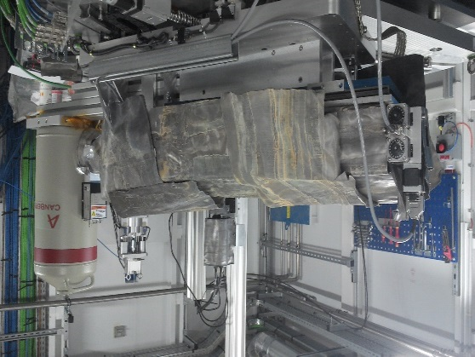
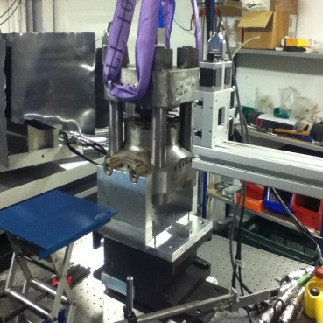
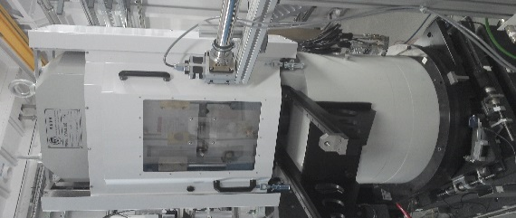
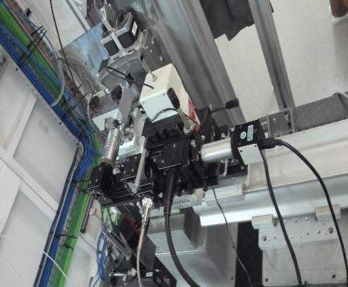
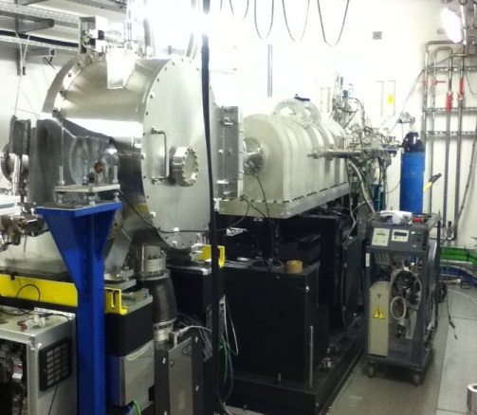
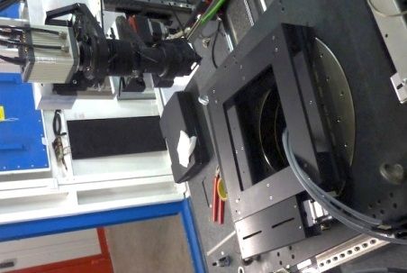
or
Paris-Edinbourgh press
Multi-anvil press
37 m from Wiggler souce
CAESAR
D2
KB
D1
shutter
DAC
C
Tomo
LVP
DCM
VFM
F
slits
Table 2
Primary slits
Table 3
Table 1
Experimental hutch
31 m from Wiggler souce
Optics hutch
26 m from Wiggler souce

Slide 5
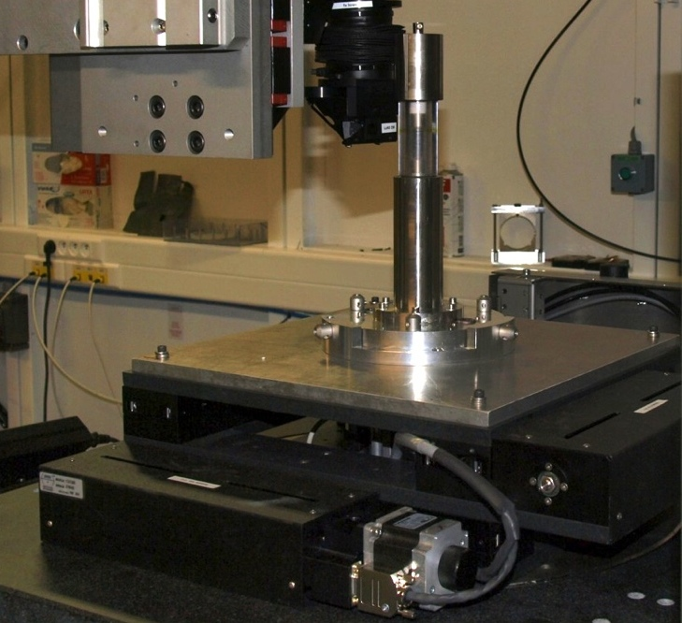
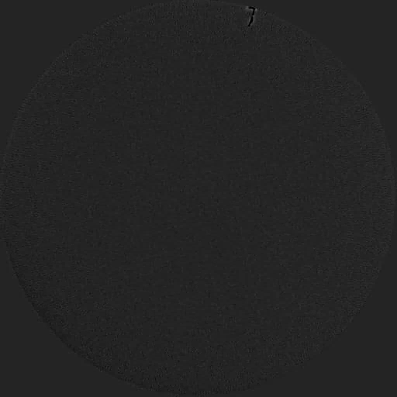
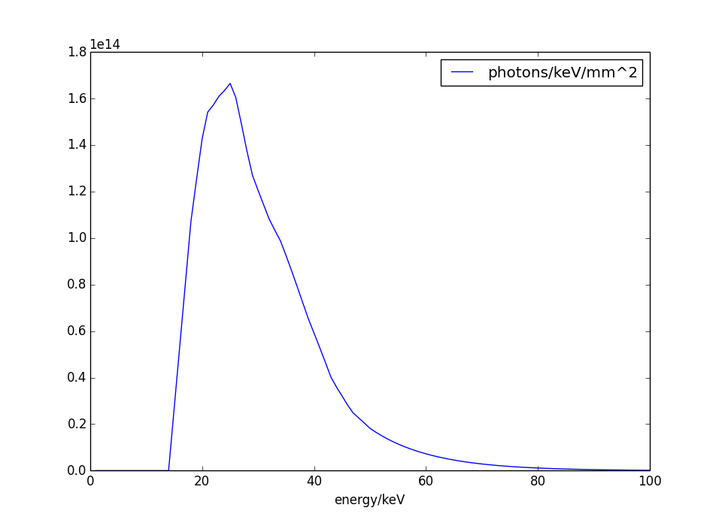
Tomography at Psiché
Designed for material science
Fast: <5 seconds/scan
High resolution:
0.5 μm (0.127 μm pixels)
High energy: >80keV pink beam
Monochromatic range
Pink beam range…
Notes:
In situ experiments : Stress rig
Can go fast : "video" Al Cu, cristallisation
High resolution: dist + phase contrast

Slide 6
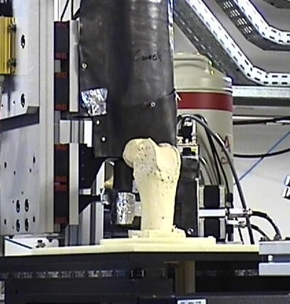
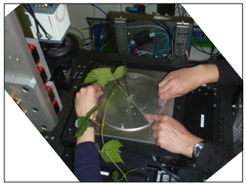
Rotation Stage
high precision - high load - large aperture
Large and/or heavy samples (up to 50 Kg) and in-situ setups
S. Delzon et al (INRA)
H. Coqueugnoit et al (Bordeaux)
Notes:
high load,large samples = important for being able to do it in a LVP

Slide 7
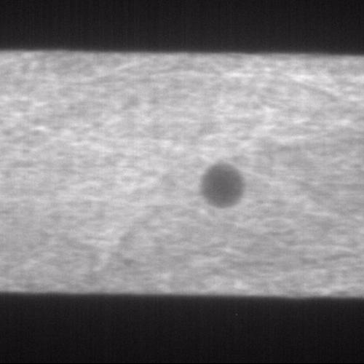
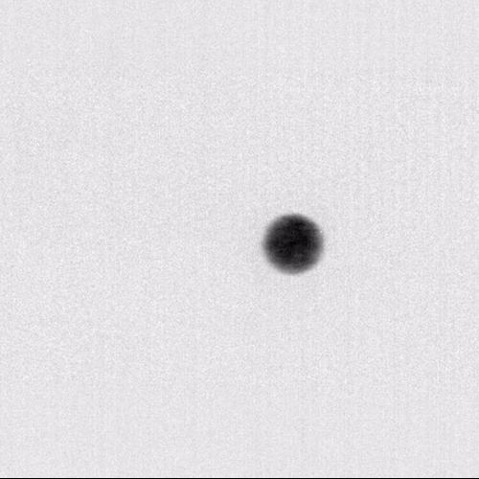
Radiography in Multi-Anvil Press
Alignment tool for diffraction
Primary diagnostic: falling sphere viscosity measurements
High speed pco.dimax camera from ANATOMIX beamline
(KHz frame rate)
As measured
Background corrected
A. Yoneda, Okeyama University, SOLEIL proposal 20160333

Slide 8
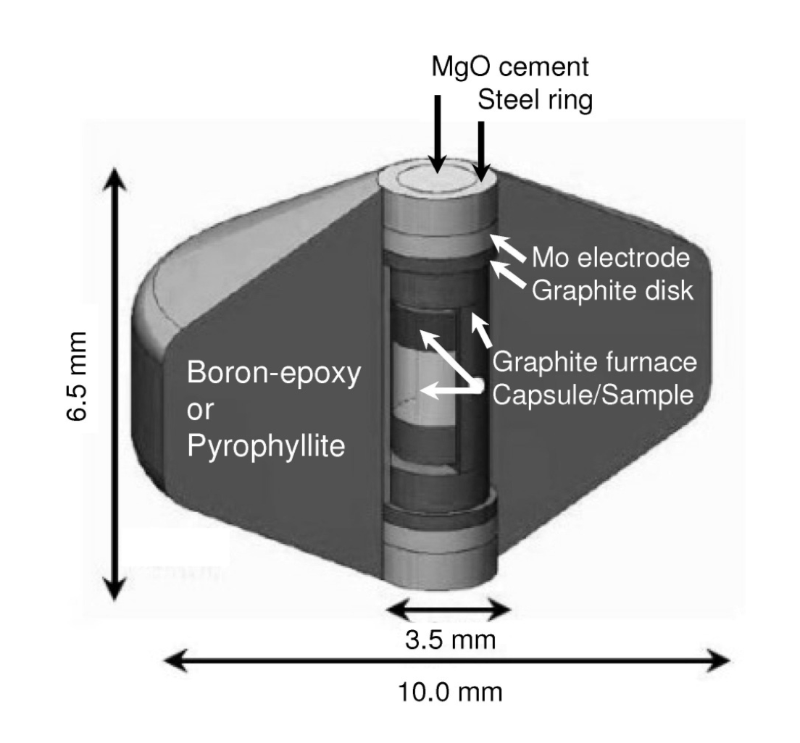
Paris-Edinburgh Press
Jouini et al., J. Superhard Mater, 2016
Klotz et al., Applied Physics Letters, 2005

Slide 9
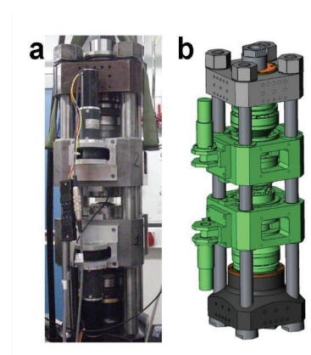
Tomography Through Paris-Edinburgh Press
RoToPEC
Philippe et al. 2016
A. Clark et al.
Pros : High quality images
Cons: necessitates long acquisition time (20 min)

Slide 10
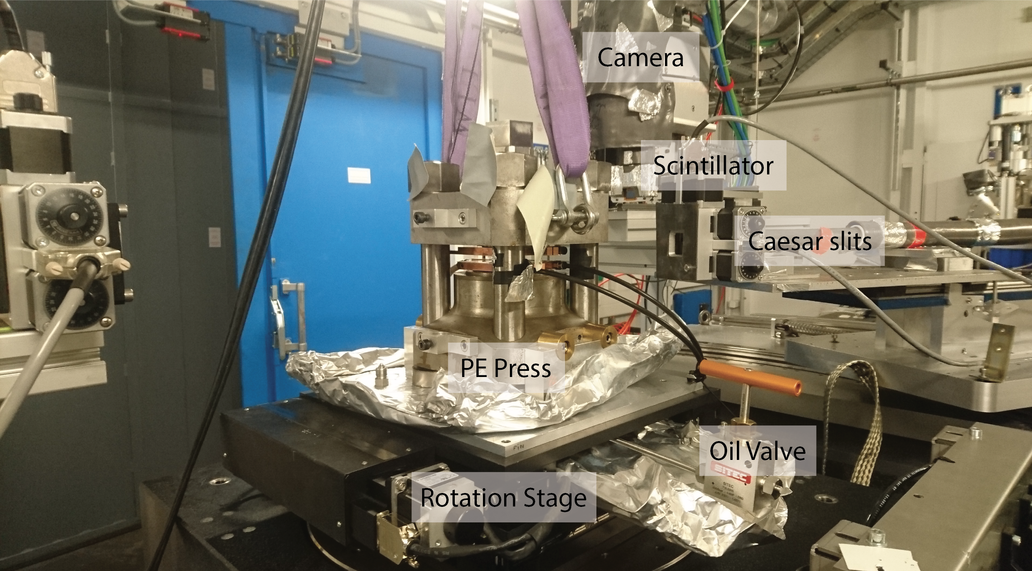
High-Speed Tomography at HPHT: ~10s
4 columns PE Press (135 ° opening, P constant )+ Pink Beam
Boulard et al., JSR, 2018

Slide 11
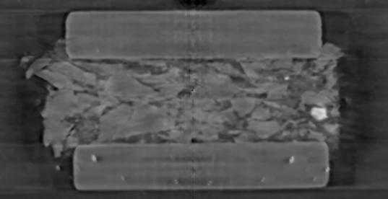
High-Speed Tomography at HPHT
Powdered Rhyolite + Olivine Cristals
Image liquids
Vesiculation/Cristalization rate
Diffusion Profile

Slide 12
Ex#1: Liquid Carbonate Percolation
Naif et al., 2013
Dasgupta & Hirschmann 2010
High mobility of carbonate liquids:
Hammouda & Laporte 2000

Slide 13

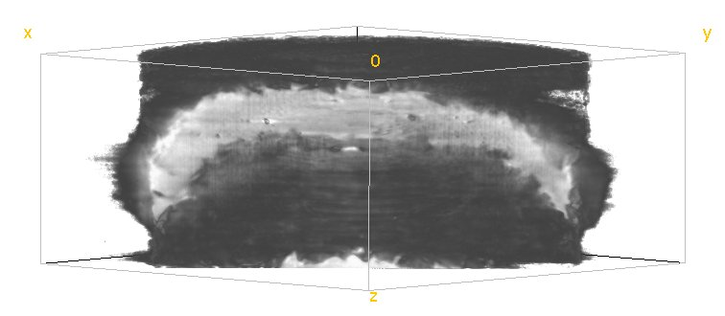
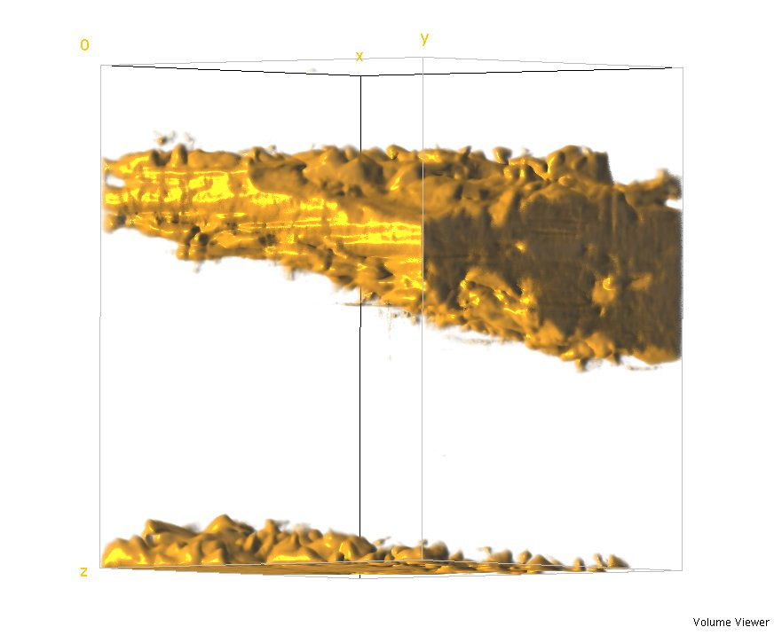
Ex#1 : Liquid Carbonate Percolation
olivine
650 µm
carbonate
J-P Perrillat
P. Garcia del Real
E. Giovenco
olivine
650 µm
1.7 GPa – 1150 K

Slide 14
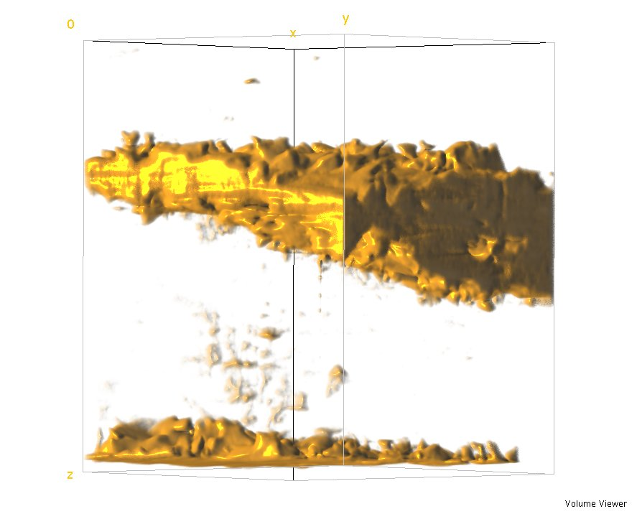
Ex#1 : Liquid Carbonate Percolation
olivine
650 µm
carbonate
J-P Perrillat
P. Garcia del Real
E. Giovenco
olivine
650 µm
650 µm
1.7 GPa – 1150 K
1.7 GPa – 1300 K

Slide 15
Ex#1 : Liquid Carbonate Percolation
olivine
650 µm
carbonate
J-P Perrillat
P. Garcia del Real
E. Giovenco
olivine
Diffusion Profiles:
Distance in m²
650 µm
650 µm
1.7 GPa – 1150 K
1.7 GPa – 1300 K
Diffusion coefficient : 6.5 10⁻¹¹ m²/s at 1300 K

Slide 16
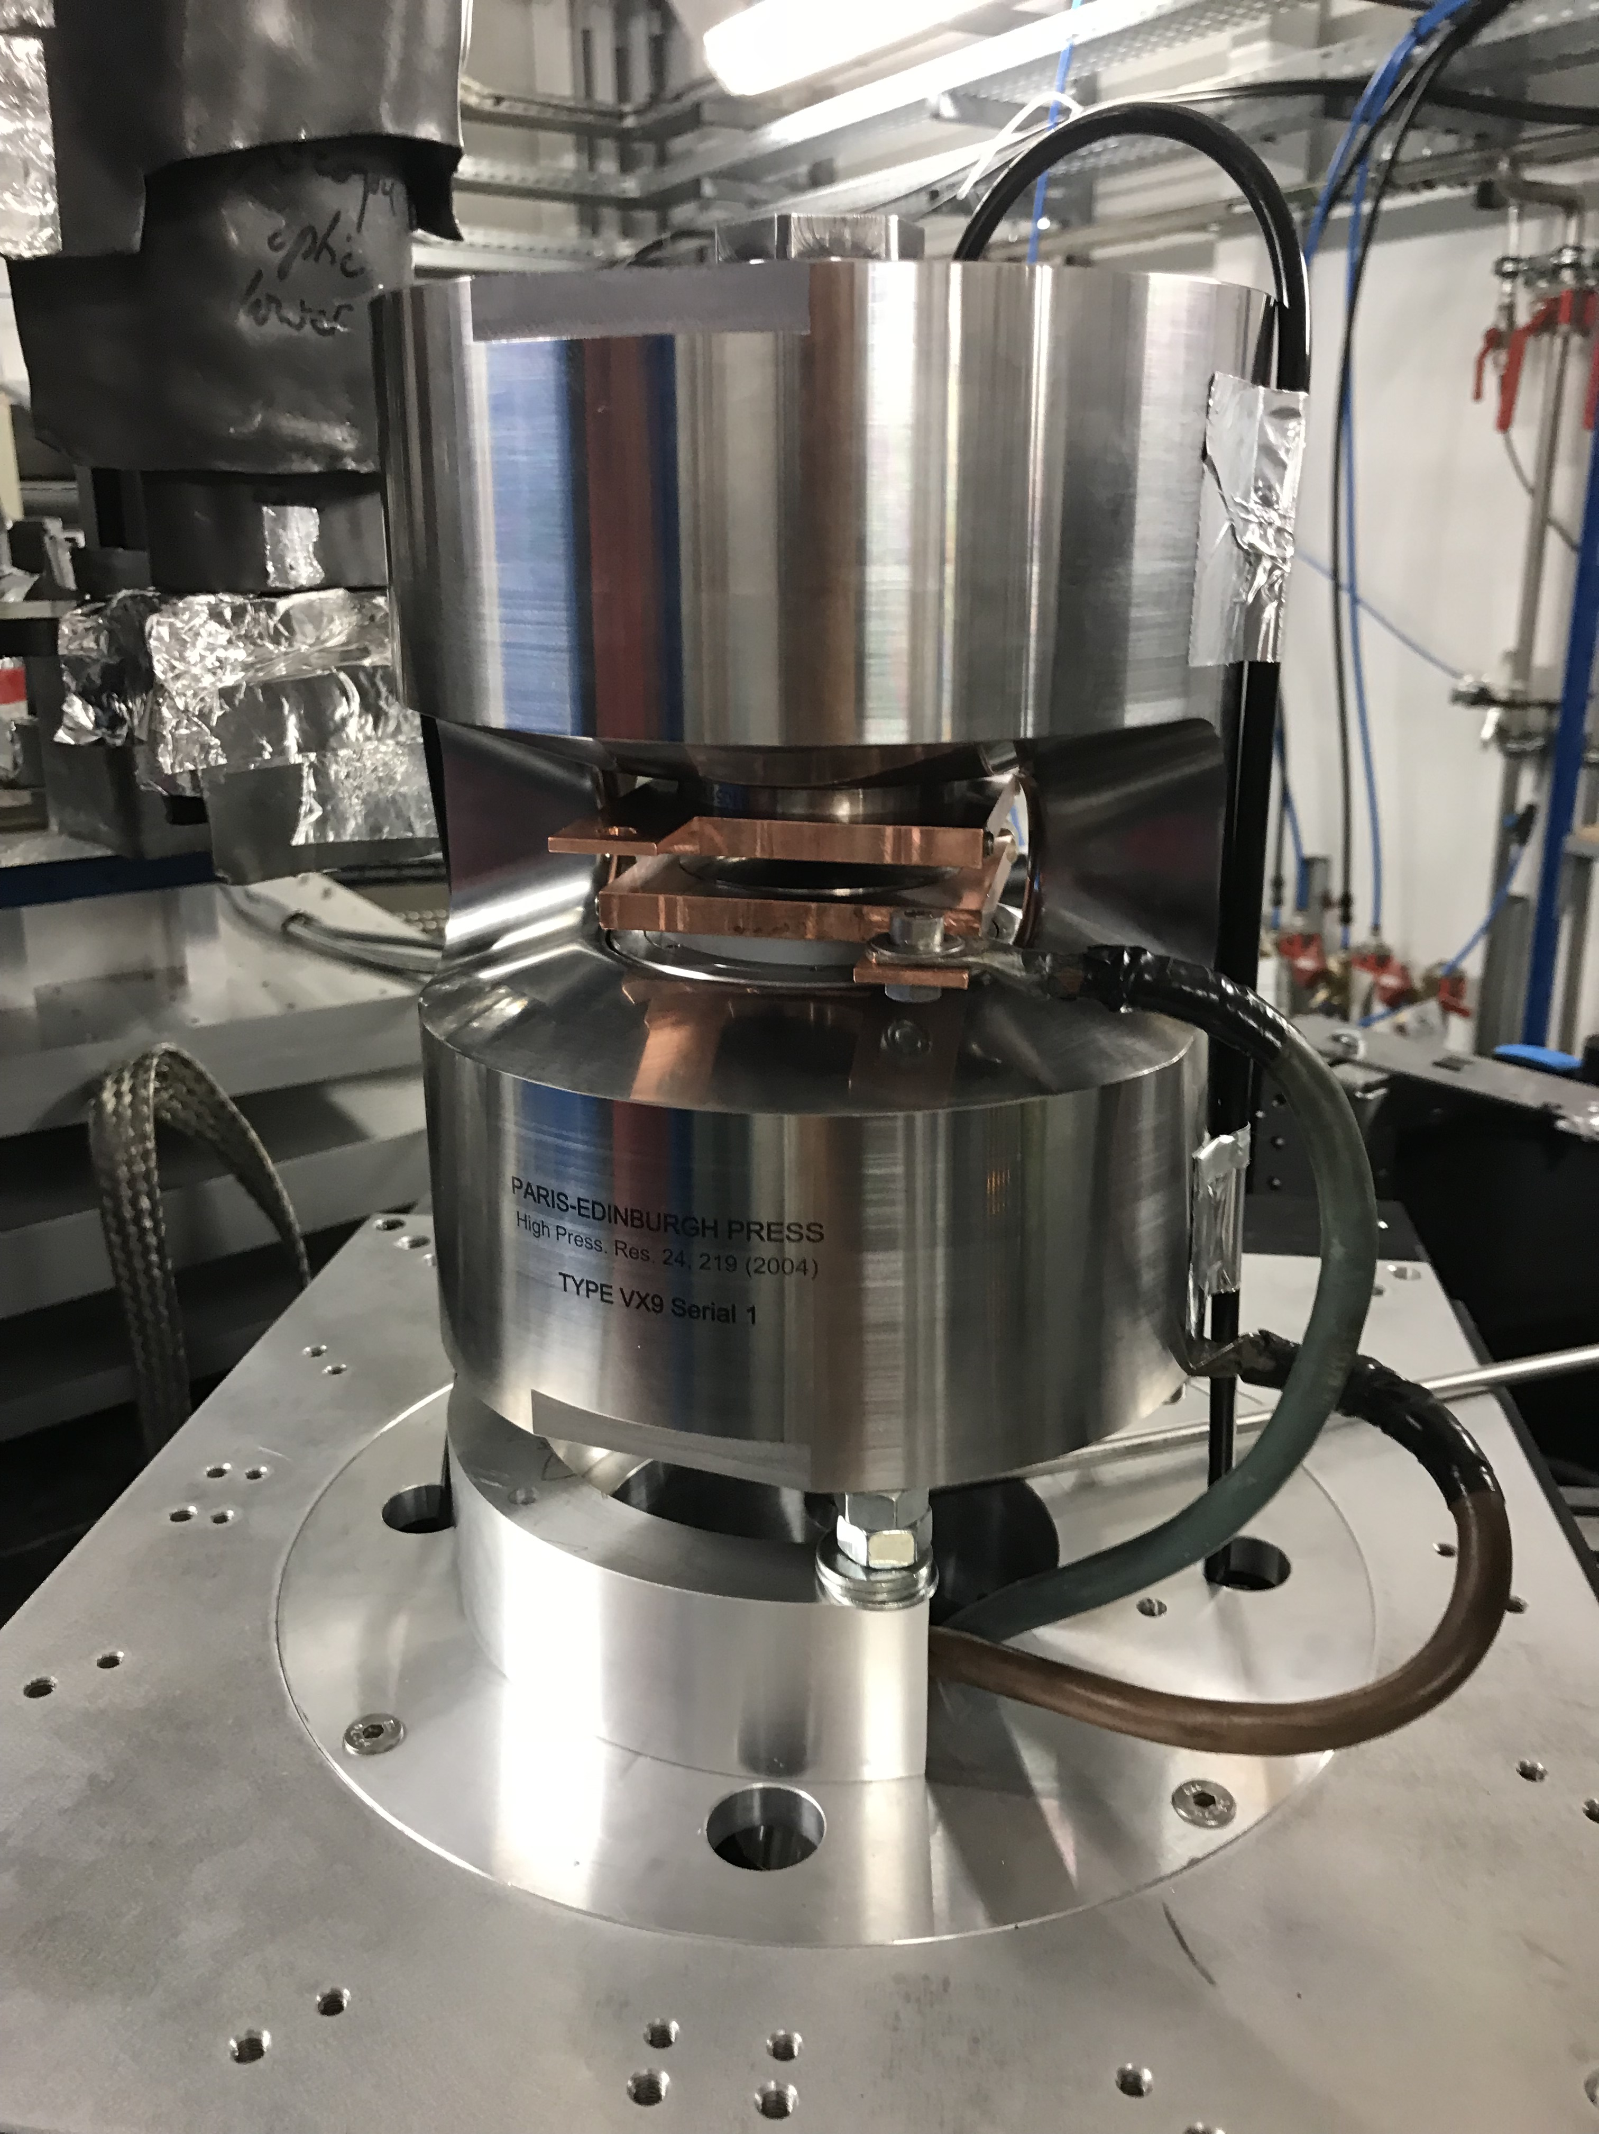
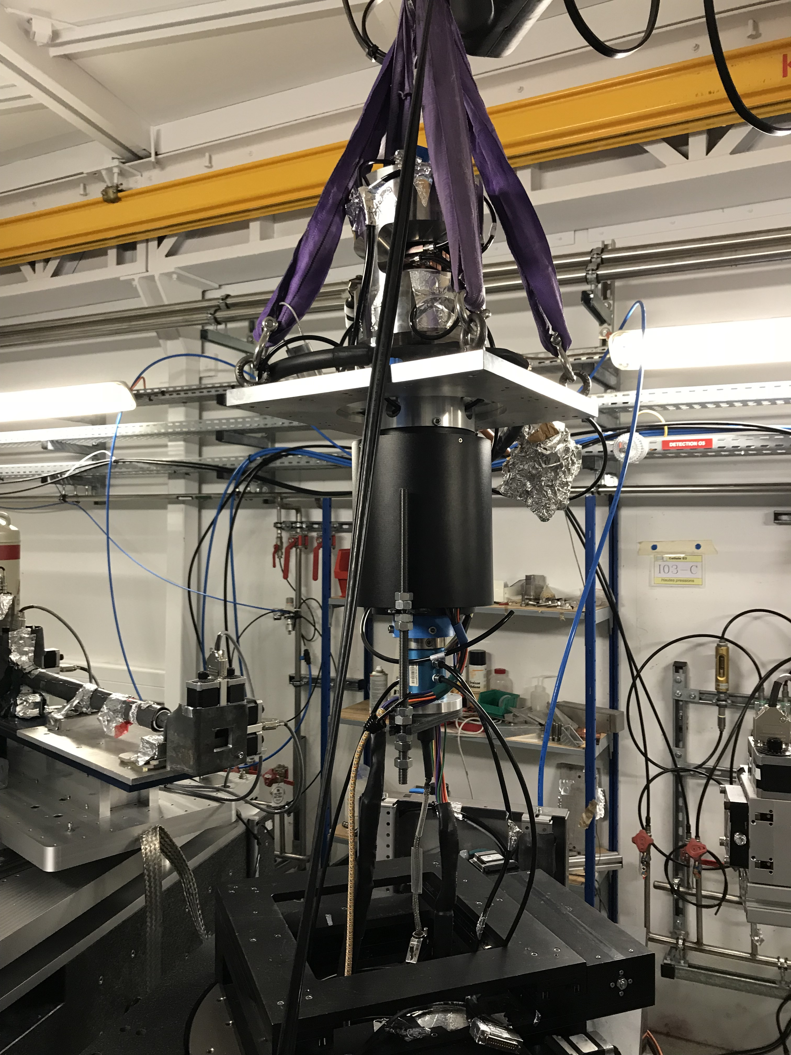
Modified PE Press: UToPEC <10s
170 mm ⌀
165° opening
﻿rotary coupling

Slide 17
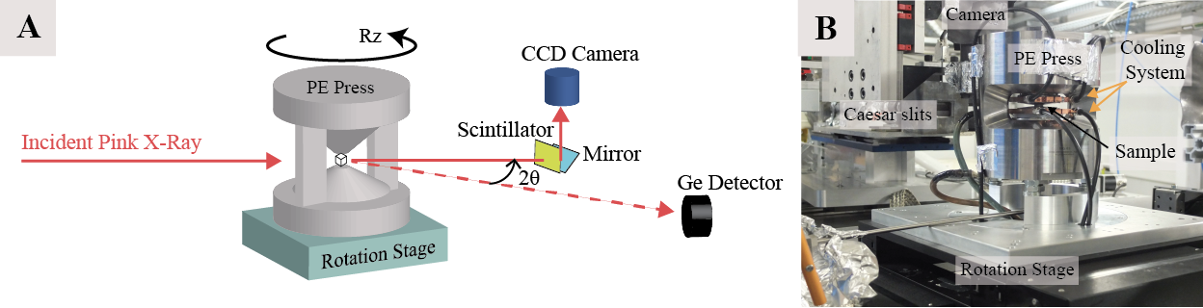
Ex#2: In Situ Analyses of Microstructures in the α-γ-ϵ Fe Phase Transitions
Dewaele
Y. Le Godec (IMPMC)
Possibility to collect simultaneously XRD and Tomography:
Tomography
XRD: CAESAR detector

Slide 18
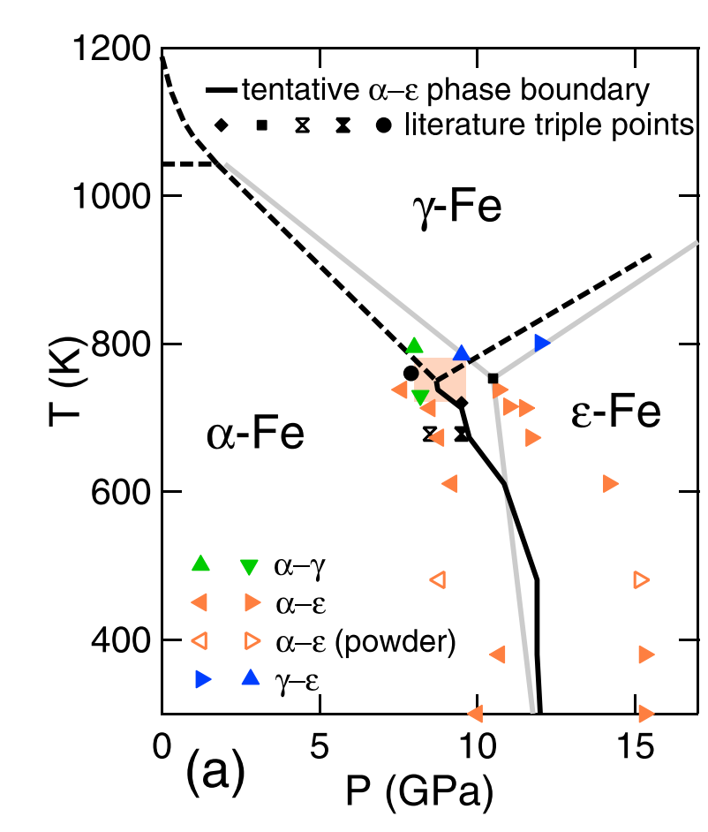
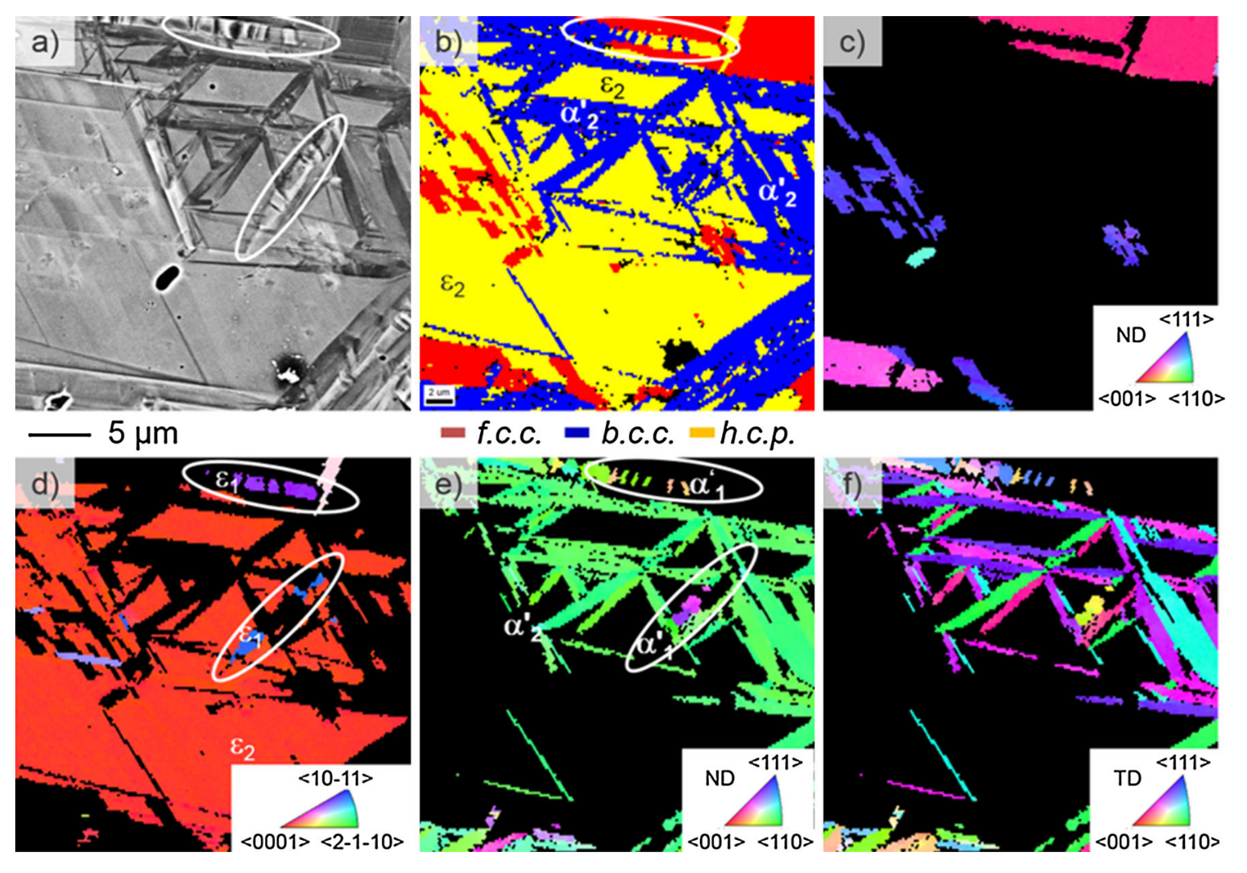
Ex#2: In Situ Analyses of Microstructures in the α-γ-ϵ Fe Phase Transitions
Mechanisms involved in phase transitions:
Orientation Relationship
Interface/habit planes between phases
﻿CrMnNi cast steel
Ackermann, metal. Mater. Trans. a., 2016
Dewaele et al., ﻿Appl. Phys. Lett., 2018

Slide 19
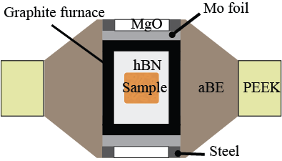
Ex#2: Material & Method
Single cristal of Iron
XRD analyses : orientation of the single cristal
001 oriented
Rz: rotation angle/Xrays
Upon phase transition : XRD + Tomography analyses
    orientation relationship + microstructures

Slide 20
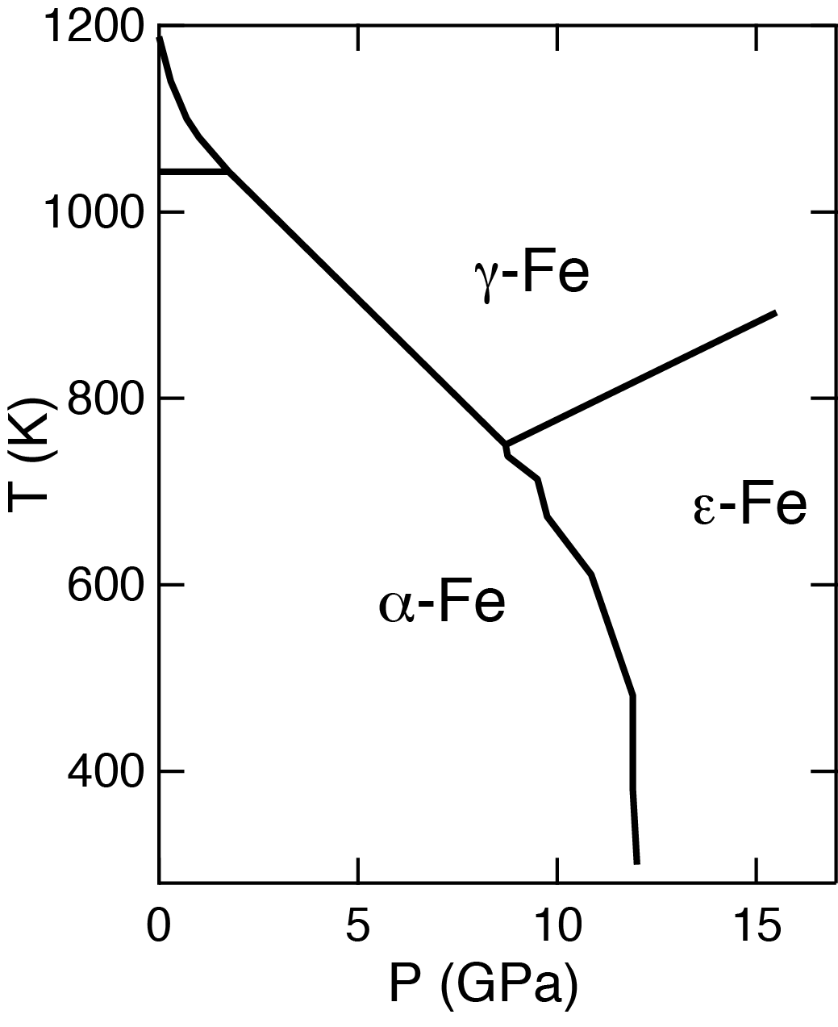
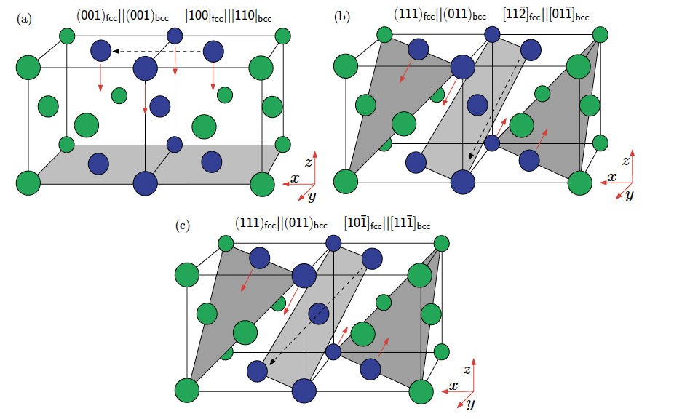
Ex#2: α-γ Fe Phase Transition
γ grows as few large single crystals with different orientations
{011}α // {111}γ planes
~2 Gpa - 1000 K :
Transformation paths:
γ
α
Nishiyama–Wasserman
Kurdjumow - Sachs
Boulard et al., in prep.

Slide 21
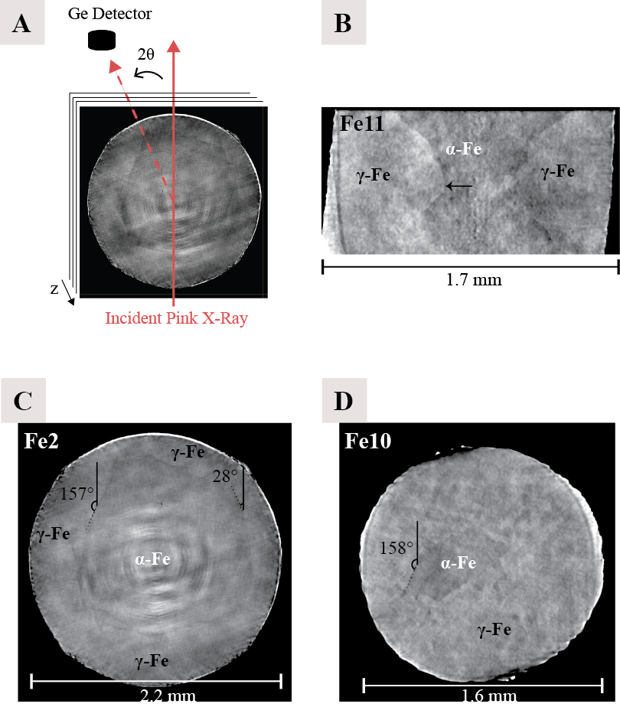
Ex#2: α-γ Fe Phase Transition
~2 Gpa - 1000 K
α-Fe and γ-Fe phases can be detected by absorption contrast (density difference ~2.2%)
The α-Fe and γ-Fe interface approximately follows an isotherm
~5 Gpa – 900 K
Interface ~ parallel with (110)α (expected) or (310)α planes (not expected)
suggest a mechanism with a relatively low energy cost
Boulard et al., in prep.

Slide 22
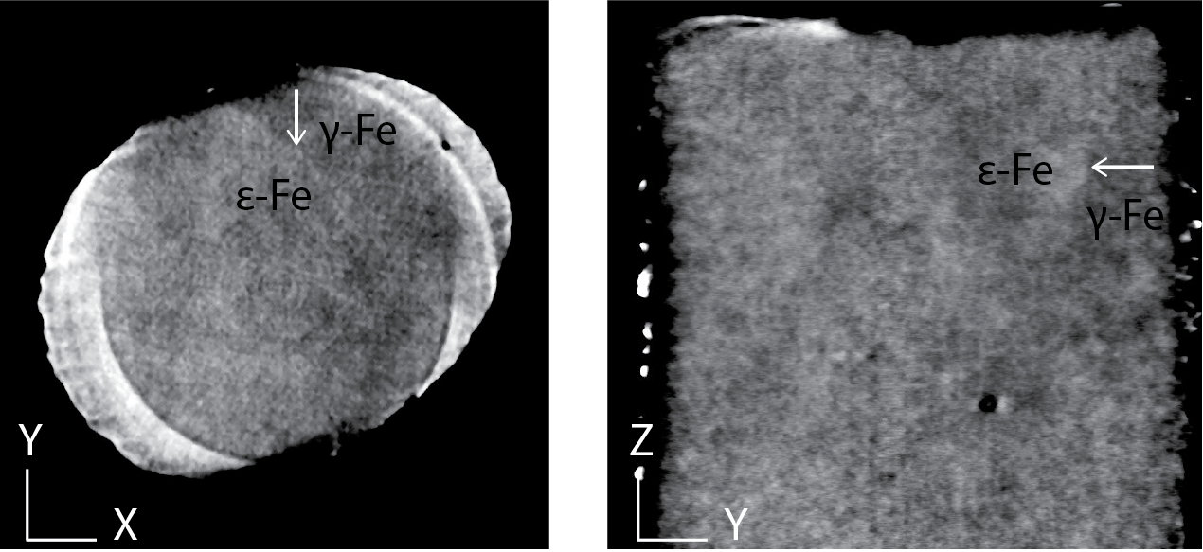
Ex#2: γ- ϵ Fe Phase Transition
~8 Gpa - 800 K :
γ-Fe ϵ-Fe phases hardly detectable by absorption contrast
The γ-ϵ interface irregular

Slide 23
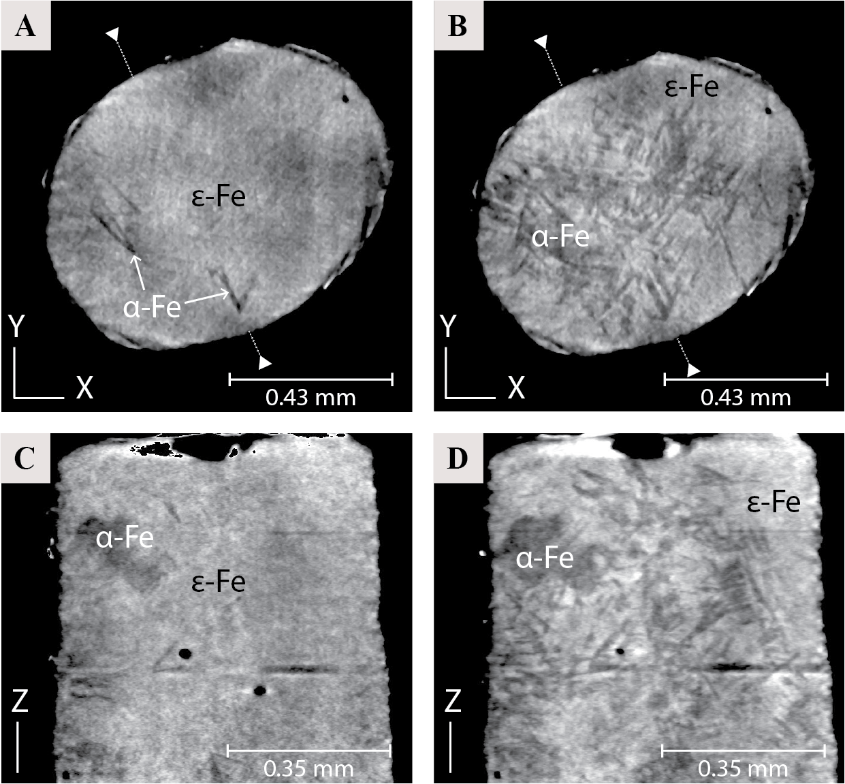
Ex#2: α-ϵ Fe Phase Transition
~8 GPa - 725 K
~6 GPa – 680 K
α-Fe grows as thin plates, multiple orientations
(multiple grains of ϵ-Fe )
Boulard et al., in prep.

Slide 24
Ex#2: α-ϵ Fe Phase Transition
~10 Gpa - 700 K :
Dewaele et al., ﻿PRB, 2015
C_{hcp-ϵ} axis parallel to the two (110)α
as expected by Burgers mechanism
Boulard et al., in prep.

Slide 25
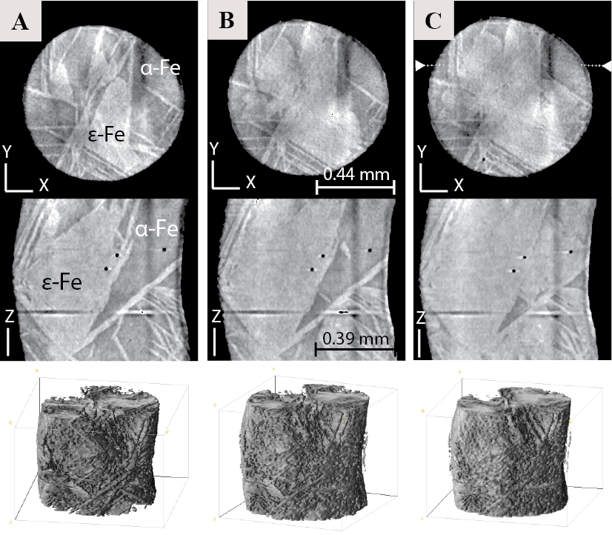
Ex#2: α-ϵ Fe Phase Transition
ϵ-Fe grows as thin plates bursting everywhere in the sample
Eventually, the space between the plates also transforms to ϵ-Fe
The size of these domains adapts to the size of the sample
time
~10.6 GPa - 800 K
Boulard et al., in prep.

Slide 26
Ex#2: α-ϵ Fe Phase Transition
Orientation of ϵ-Fe plates:
3D Fourier transform calculated for a tomography
maxima correspond, within 5°, to the directions of (112)α planes
expected habit planes for Burgers paths
Boulard et al., in prep.

Slide 27
Conclusions
By combining :
Adapted tomograph stage (high load, high speed, high precision)
Fast detectors
Pink Beam
we collected tomography “continuous” scans in ~10s at HP-HT
New PE press (UToPEC) :
increase the quality of the images (smaller, wider opening)
perform scans <10s (rotary coupling)
Fast processes
Liquids behavior
Reactions/Crystallisation/Vesiculation rates
Phase Transition mechanisms

Slide 28


Aknowledgments
Andrew King
Nicolas Guignot
Jean-Pierre Deslandes
Jean-Paul Itié
Jean-Philippe Perrillat
Pablo Garcià Del Real
Elena Giovenco
Yann Le Godec
Alisha Clark
Guillaume Morard
INSU PNP - 2017
DIM OxyMORE, île de France Region - 2016

