Slide 1

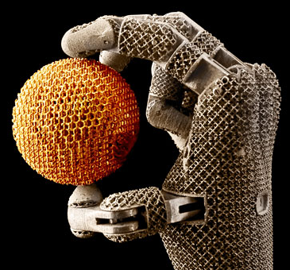
High-energy diffraction microscopy and tomography at 1-ID
Jonathan Almer, Peter Kenesei, Jun-Sang Park, Hemant Sharma, Sarvjit Shastri, Siddarth Maddali and Stephan Hruskewicz
Argonne National Laboratory
Hanna Leemerize and Henrik Birkedal
Aarhus University
Mike Sangid and Diwakar Naragani
Purdue University
Chanyong Park, Dmitri Popov and S. Sinogeikin
HP-CAT
COMPRESS Workshop, APS, Sept 28-30, 2018

Slide 2
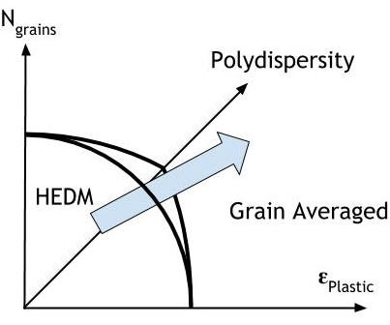
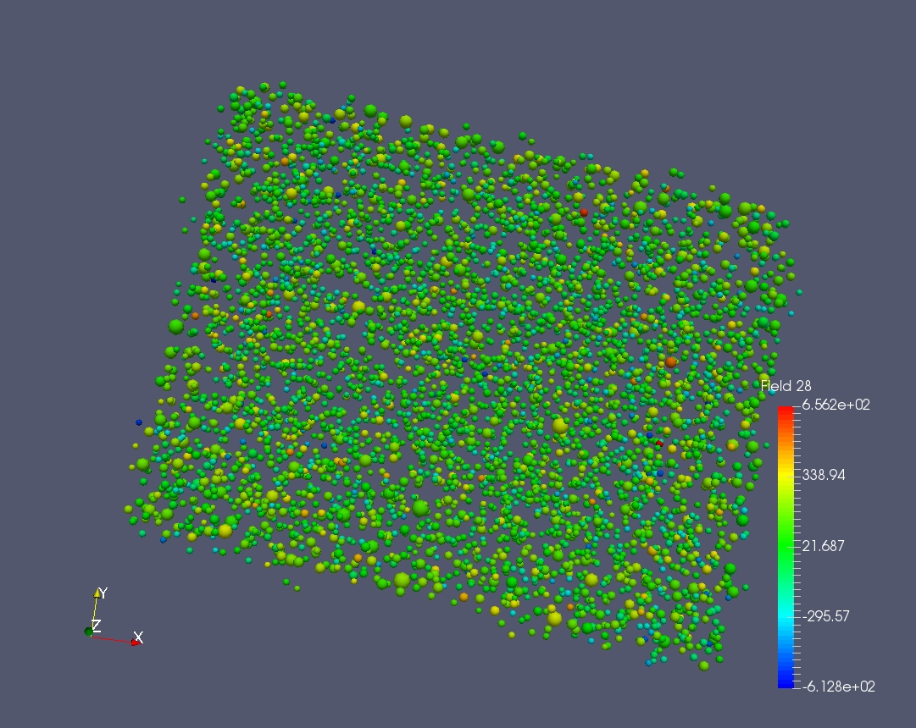
Boundaries of grain-resolved techniques
Diffraction intensity proportional to grain volume:
GE-RT41 with dynamic range 2e12
  10:1 max radial dispersity
Pilatus (CdTe) with dynamic range 2e20
  100:1 max radial dispersity
Monodispersed LaB6 ~1um grain size reconstructed with 10,000 grains
Grain
Resolved
Typically ~3-5% for full field techniques in metals. Up to 10% shown using focused beams and raster scanning (Toyota@Spring-8, ESRF-ID-11, nascent at APS)
Grain Averaged: scattering tomography
Additional means to expand envelope (>micron sized grains)
Software to treat spot overlap (MIDAS, etc)
Increased energy resolution (typical dE/E=1e-3, optional 5e-5)
For submicron grains
Dark-field microscopy
BCDI

Slide 3
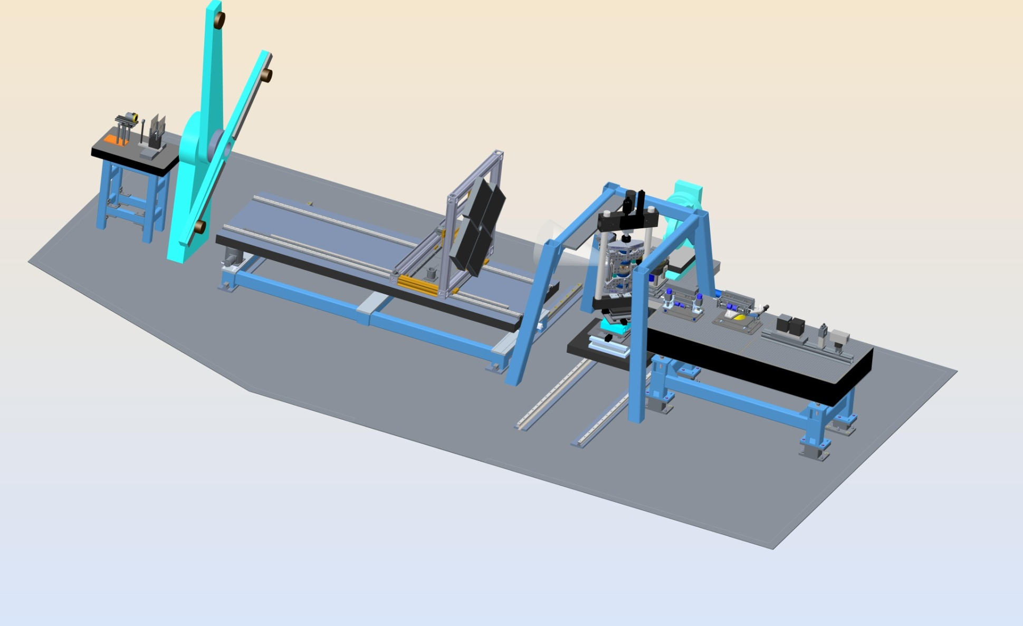
1-ID: HEDM, SAXS/WAXS, u-CT
Ability to handle large/custom environments
Servo-hydraulic load frame + furnace (~30%)
RAMS in-grip load frame (~20%)
Activated materials (~20%)
“Whatever else users dream up” (~30%) – RotoDAC, uwave, biaxial
SAXS
6m
5.5m
4.5m
Very far-field
Highest q-resolution
1m
E=40-140keV
SCU source
Far-field detectors
4 GE-RT41 detectors
@1m: qmax~25 1/A
Center-hole (SAXS)
0
Overhead Rail
NF-HEDM
Conical slit
Tomography
Lasers
Beam-conditioning system
Focusing optics for <um beams
White and mono capable
BPMs, slits, DIC, etc
APS-U: Dark field microscopy+SAXS extension

Slide 4
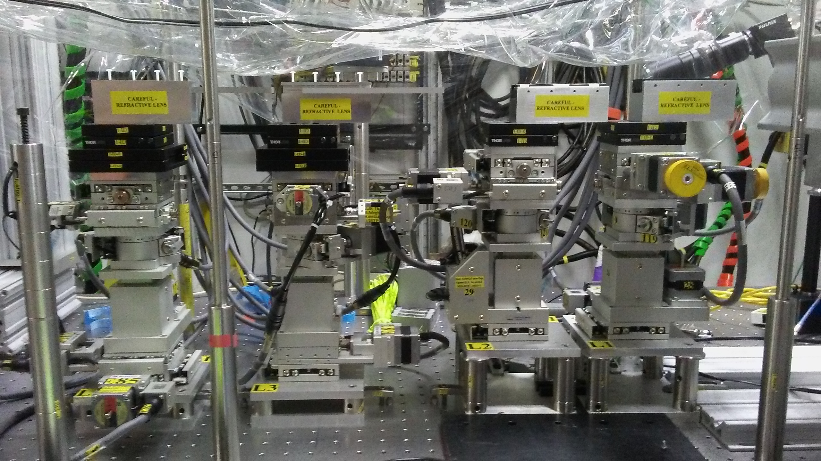
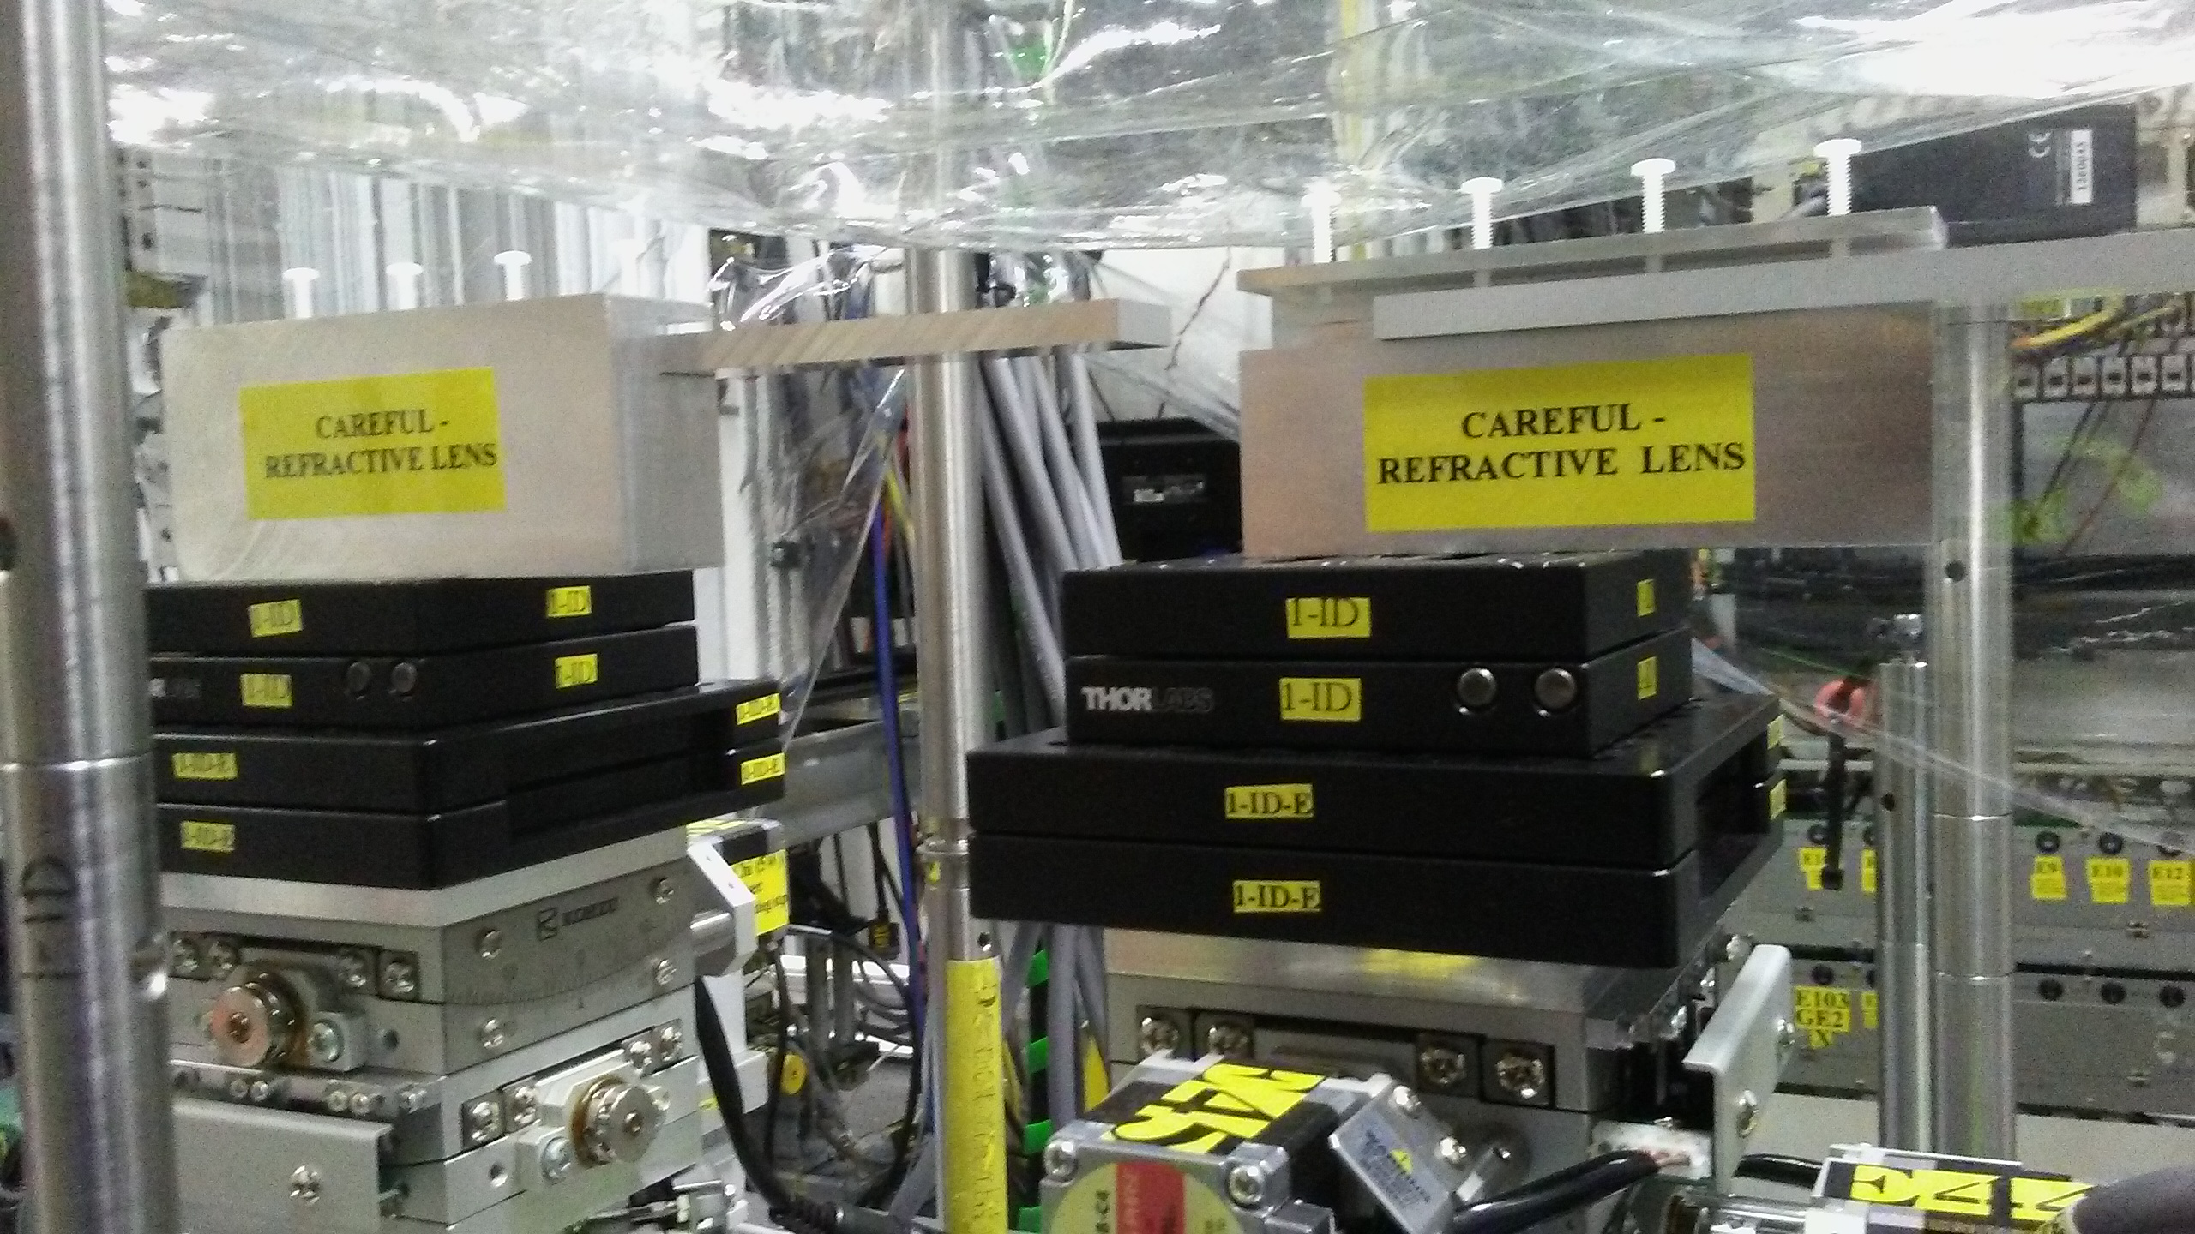
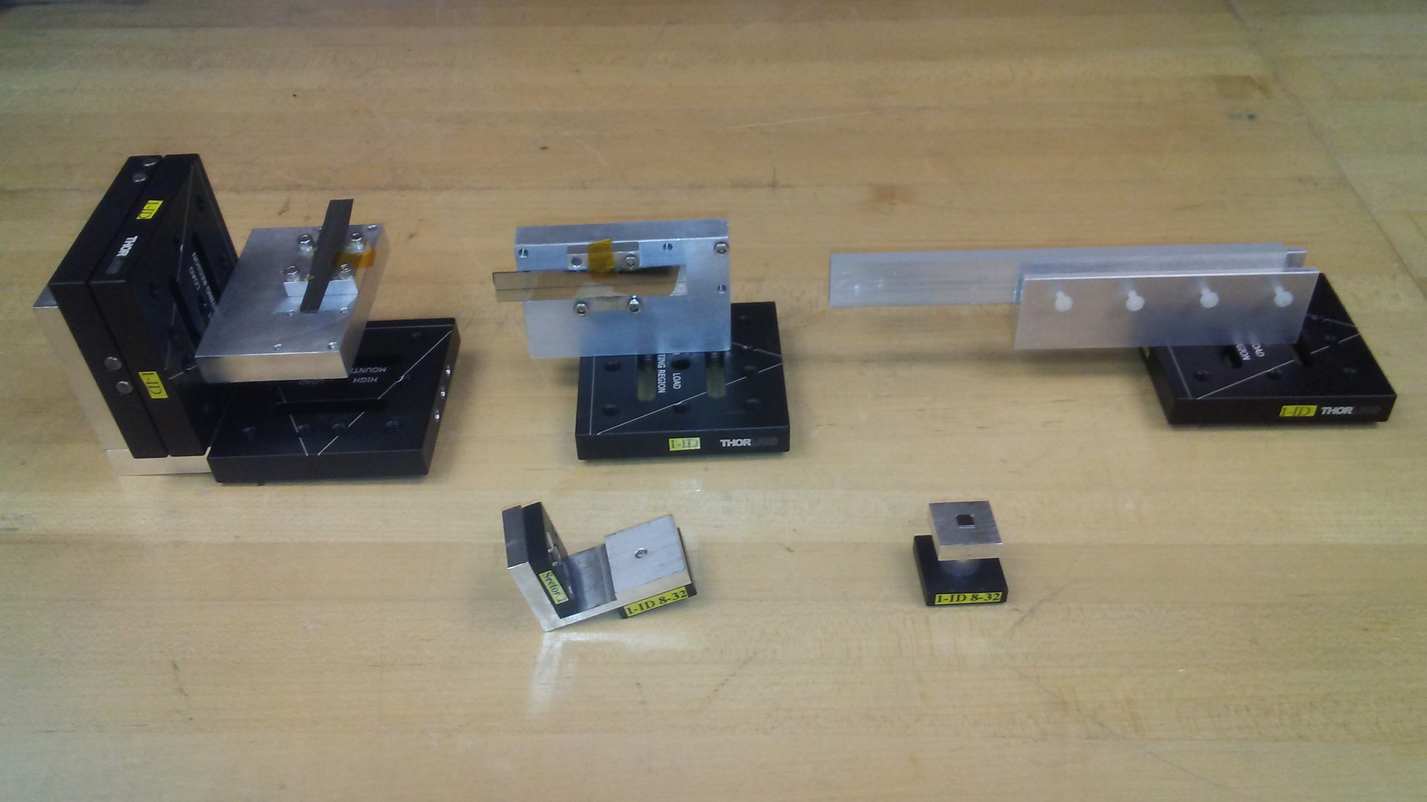
Focusing Optics Set-Up in APS 1-ID-E
focusing saw-tooth
refractive lenses
13 x 1.4 μm² FWHM
beam from
superconducting
undulator
Si,
vert.
Al,
horiz.
point focus
bent double-Laue
monochromator
1.2 m
70 m from source
1.6 m
Fast change kinematic mounts facilitate
swapping lenses, focusing direction

Slide 5
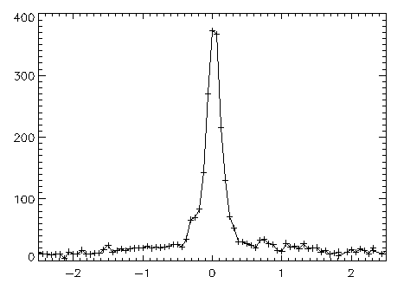
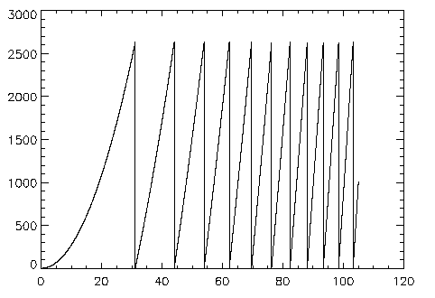
Kinoform: 51.2 keV , f = 0.25 m 230 nm FWHM
focus profile
Shastri, Evans-Lutterodt, Sheffield, Stein, Metzler,
& Kenesei, SPIE 9207, 920704-1–9 (2014)
S₁ = 71 m
4 stacked kinoforms, 20 x 2π phase jumps
incident beam: 90 (h) x 210 (v) μm²
focus, measured (expected): 230 (126) nm
expected contribution breakdown –
demag, chromatic aberr, diffr limit : 92, 83, 24 nm
gain, measured (expected): 87 (1000)
efficiency, measured (expected): 17% (64%)
230 nm FWHM
( μm )
kinoform projected thickness profile
thickness ( μm )
( μm )

Slide 6
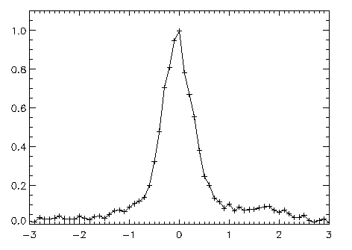
Kinoform: 102.4 keV , f = 1.0 m 660 nm FWHM
focus profile
660 nm FWHM
Use previous 51.2 keV kinoform at doubled energy:
E = 51.2 keV → x 2 = 102.4 keV
f = 0.25 m → x 4 = 1 m (since f ~ 1 / δ ~ E²)
Phase jumps 20 x 2π → x ½ = 10 x 2π
(since phase advance ~ δ / λ ~ 1 / E)
S₁ = 69 m
4 stacked kinoforms, 10 x 2π phase jumps
incident beam: 50 (h) x 210 (v) μm²
gain, measured: 69
( μm )
kinoform projected thickness profile
thickness ( μm )
( μm )

Slide 7
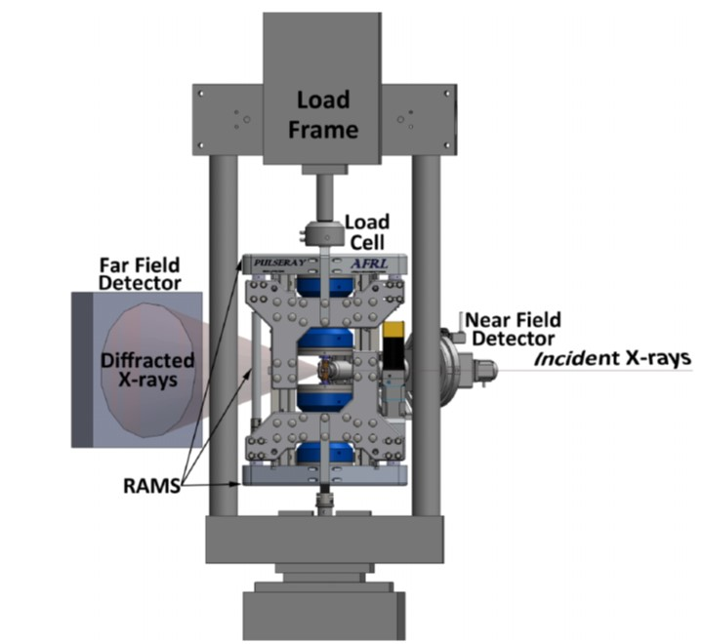
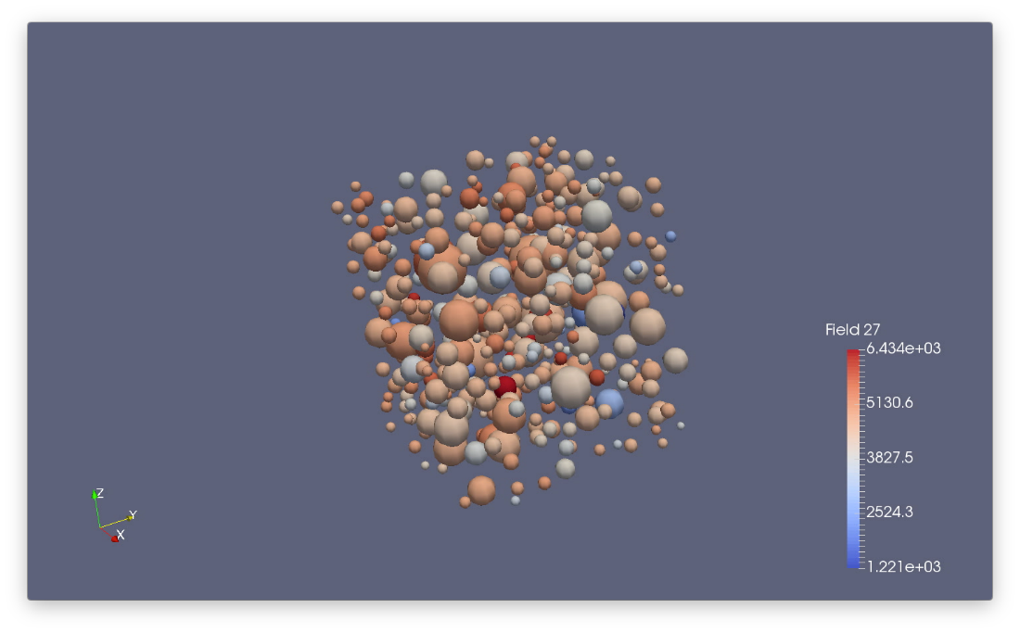
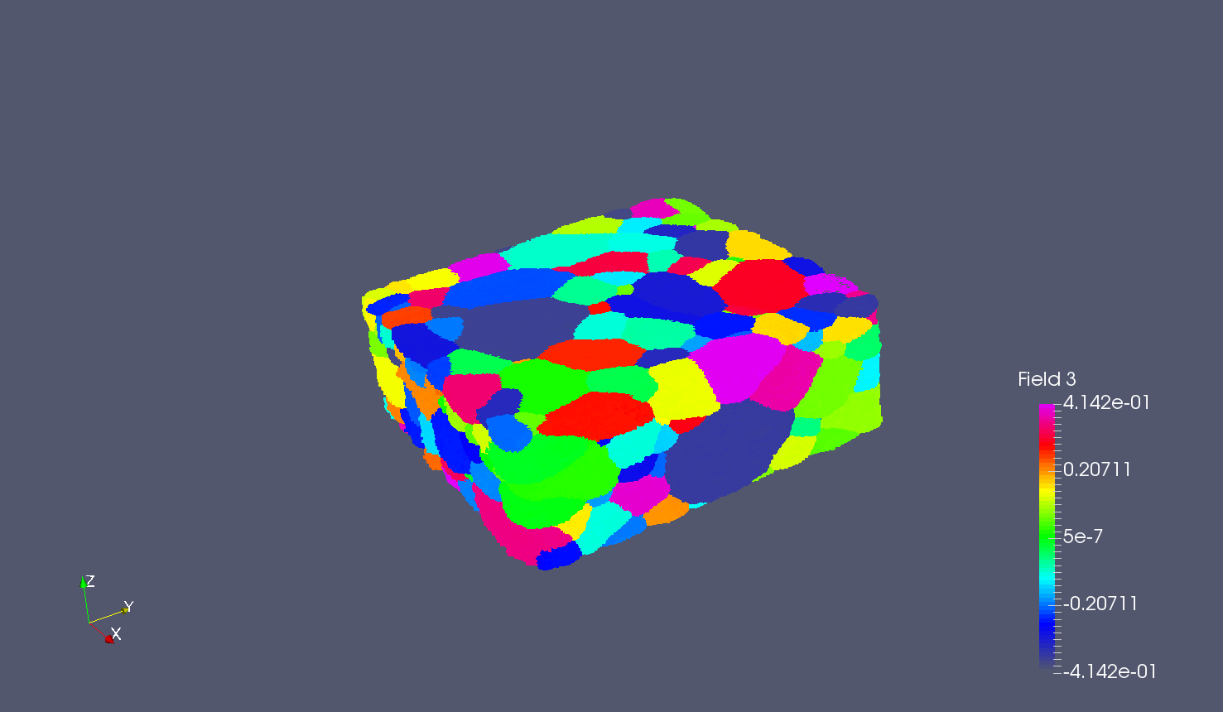
Combined in-situ techniques:
ff-HEDM, nf-HEDM, tomography
RAMS: loading with
in-grip rotation
E=61 keV
Ni-Ti superalloy under tension (in-situ loading)
Volume ~1 mm^3
Concurrent nf- ff- and u-CT
ff-HEDM
Grain volumes, orientation and strains
552 grains here (up to 10k possible)
Real-space resolution depends on grain size distribution (few-tens of um)
nf-HEDM
Grain shapes and orientation
Resolution ~1 μm³
Gb-Tb datasets with multi-core machines for reconstructions

Slide 8
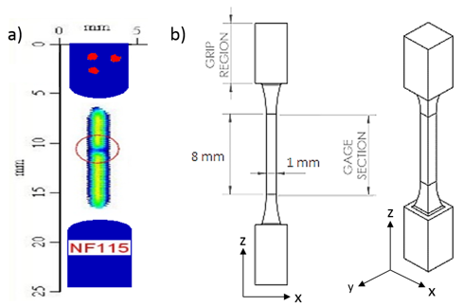
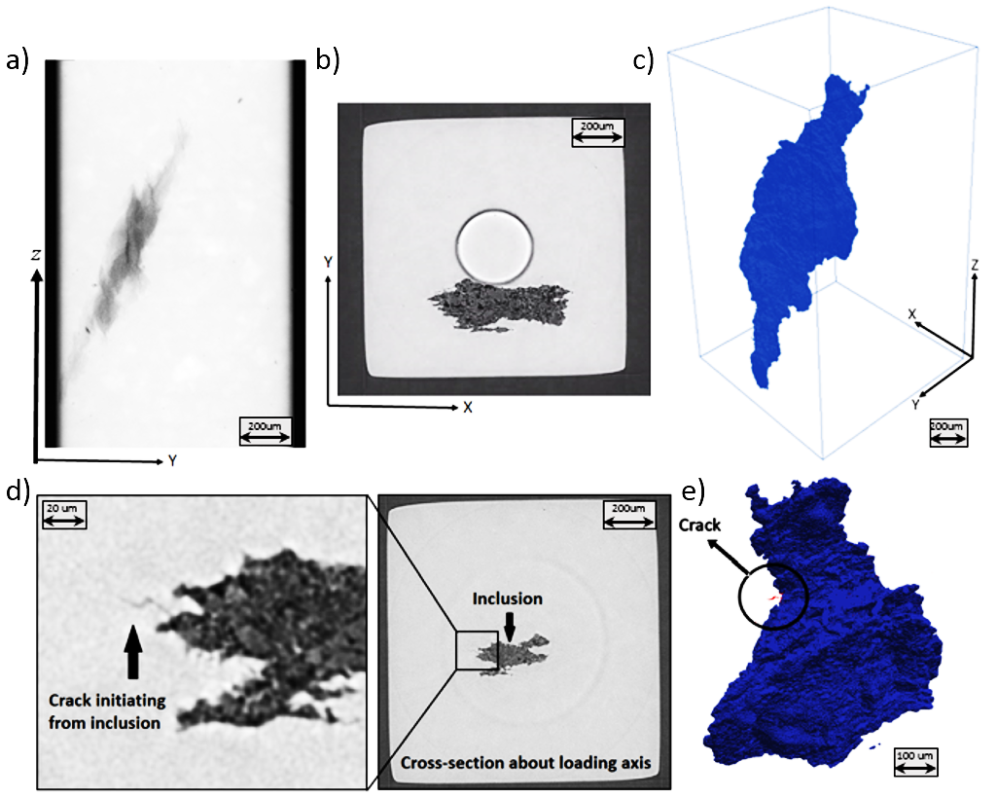
Inclusion driven failure —
Crack initiation in fatigue tests
RR1000 Ni-based superalloy
Produced with Powder Metallurgy
Contains L1₂ γ’ precipitates
Grain size ~30 µm
Seeded with inclusions, localized by ultrasonic inspection
Cored out by EDM
Cut to the final shape to fit into RAMS1
Inclined inclusion: ~1300 µm tall
Fractures from crucible: AlO₃
Fatigue test interrupted at 1, 2, 5, 10, 20, 50 , 100, … , 5000, 10000 cycles for ff-HEDM + Tomo measurements
Load control, ~60% of yield stress, 1 Hz
Naragani, Sangid et al, Acta Met 137 (2017)

Slide 9
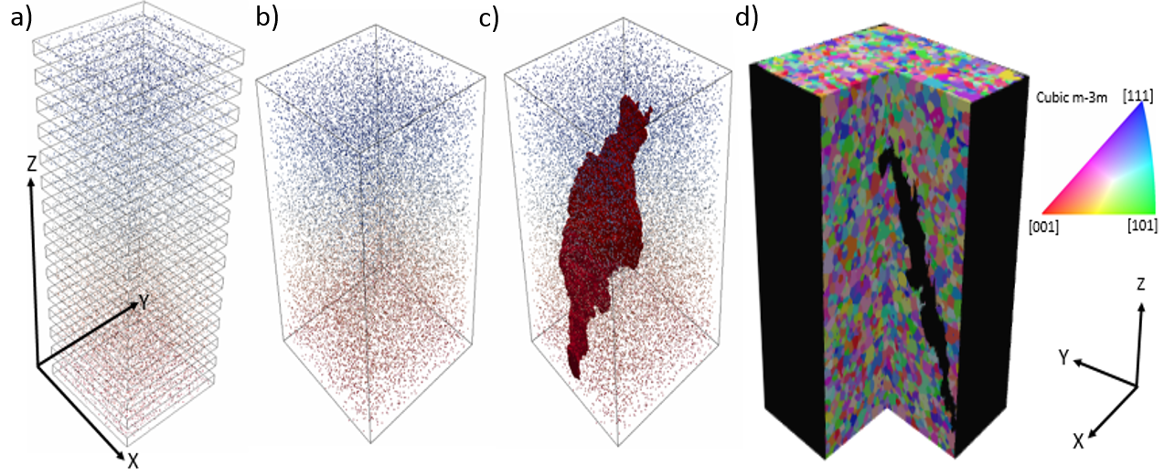
Merging the HEDM and Tomo results in 3D
Center of mass of the grains in 15 box scans
Merged dataset into one consolidated volume
From tomography the shape of the inclusion can be precisely overlaid after registration
Complete 3D rendering of the microstructure generated by Laguerre tessellation, colored by inverse pole figure color map
Naragani, Sangid et al, Acta Met 137 (2017)

Slide 10
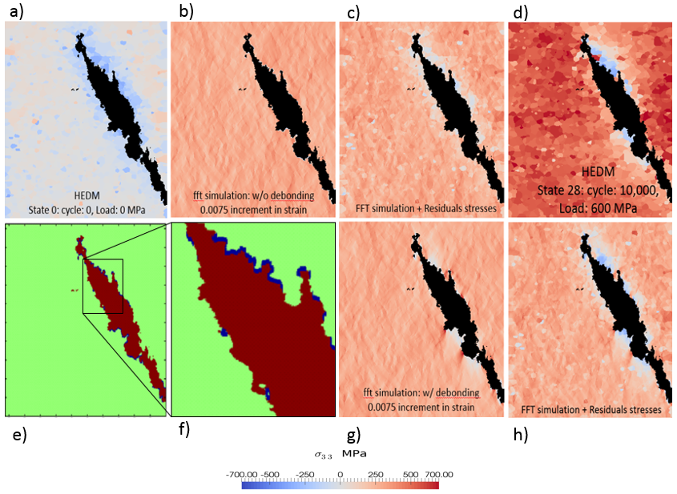
Fatigue in embedded inclusion: HEDM to validate EVP-simulated strains
Stress component in loading direction via a) HEDM at initial state (prior to loading), b) EVP-fft simulation to study effect of inclination of the inclusion, c) superposition showing the results of the EVP-fft simulation with the residual stresses, d) HEDM at peak load after 10,000 cycles of loading, e) and f) initialization of the EVP-fft simulation depicting location of de-bonding in the sample determined based on the HEDM results, g) EVP-fft simulation results with a partially bonded inclusion, and h) EVP-fft simulation results of the partially bonded inclusion superimposed with residual stresses.
Naragani, Sangid et al, Acta Met 137 (2017)

Slide 11
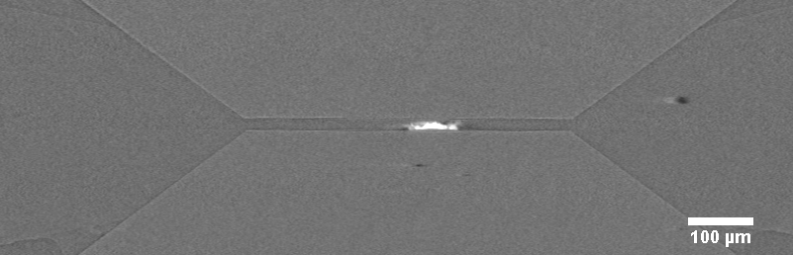
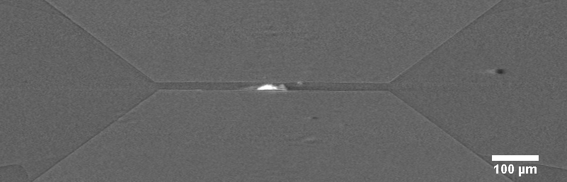
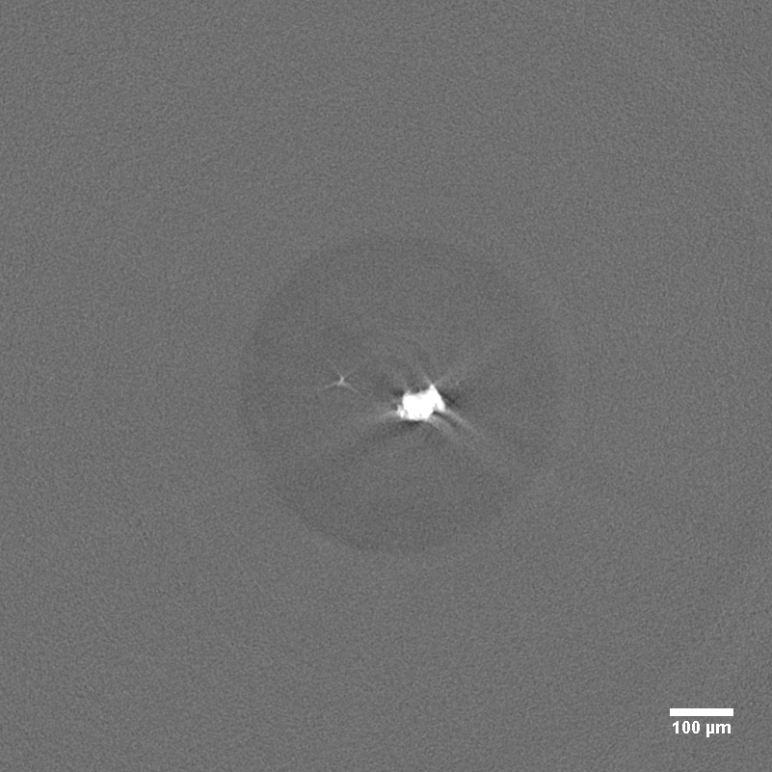
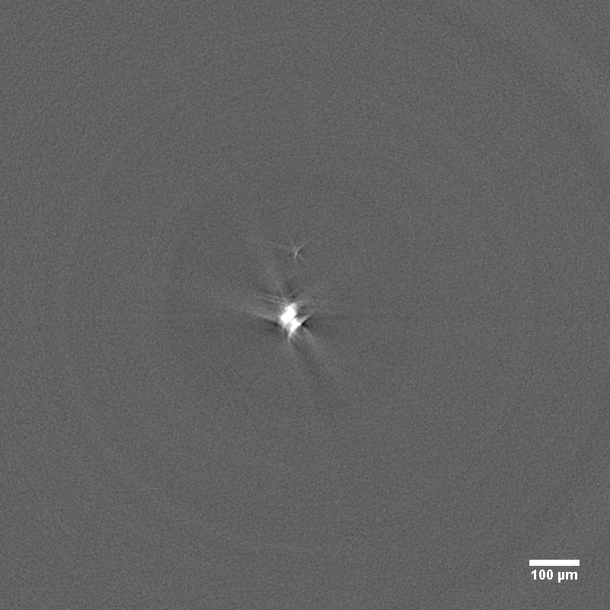
HP-HEDM and tomo
First results from 2017-2 experiments:
C. Park, D. Popov, S. Sinogeikin, HP-Cat; P. Kenesei, J.S. Park and H. Sharma, MPE
Custom-built ‘rotoDAC’ (from HP-Cat) operated at 1-ID-E beamline
5.6 GPa
7.6 GPa
Zr sample ~70 um x 15 um
E=65 keV
Monitor below and above crystallographic transition (alpha-omega)
μ-CT with ~1x1 mm^2 beam
  results for 2 states shown here
Diffraction with 1.5um focused beam
  Monitoring showed cell pressure increased w/o increasing membrane pressure after phase transition started
  HEDM analysis (Sharma)

Slide 12
Boundaries of grain-resolved techniques
Diffraction intensity proportional to grain volume:
GE-RT41 with dynamic range 2e12
  10:1 max radial dispersity
Pilatus (CdTe) with dynamic range 2e20
  100:1 max radial dispersity
Monodispersed LaB6 ~1um grain size reconstructed with 10,000 grains
Grain
Resolved
Typically ~3-5% for full field techniques in metals. Up to 10% shown using focused beams and raster scanning (Toyota@Spring-8, ESRF-ID-11, nascent at APS)
Grain Averaged: scattering tomography
Additional means to expand envelope (>micron sized grains)
Software to treat spot overlap (MIDAS, etc)
Increased energy resolution (typical dE/E=1e-3, optional 5e-5)
For submicron grains
Dark-field microscopy
BCDI

Slide 13
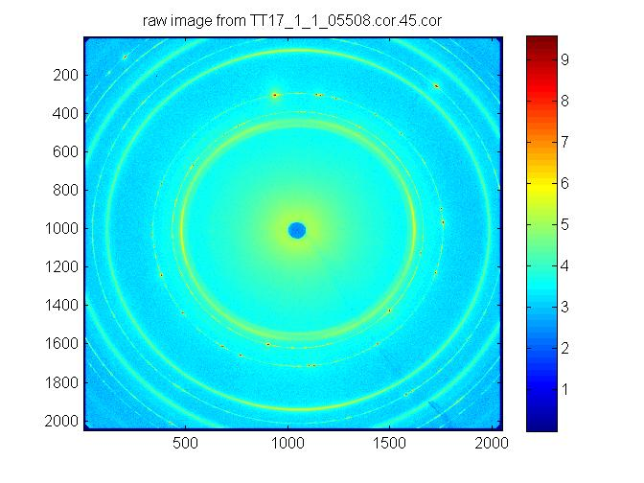
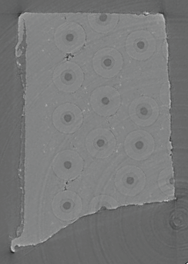
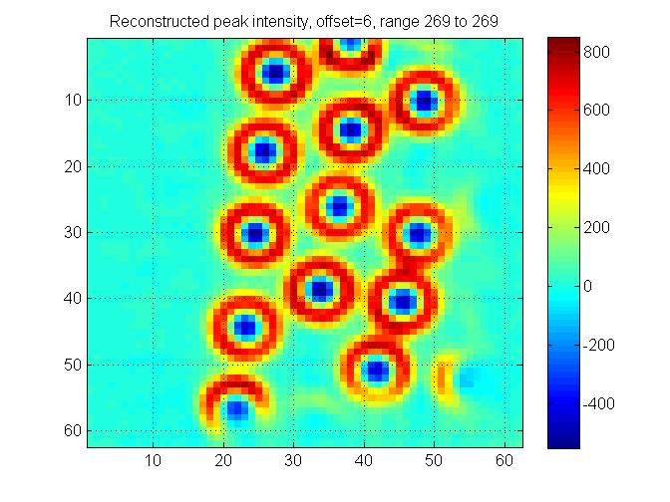
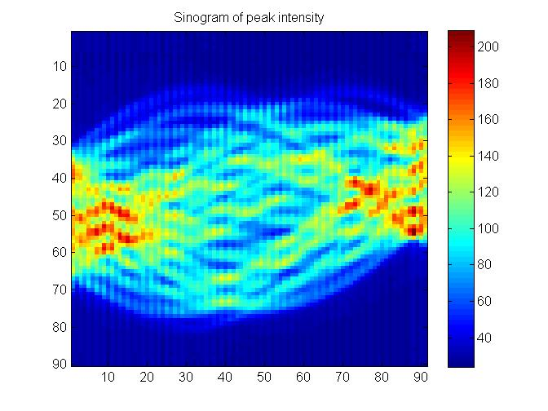
Diffraction/scattering tomography
1um min beamsize
RED=ROI intensity for a given DR, Deta.
During ROI calculation, detector calibrations are applied (tilt, beam center, etc)
xrays
x
DEta
Repeat for each DR
and DEta of interest
Do this for each x, phi measured to build up sinogram representing DR+DEta
DR
Filtered backprojection
x,Position (25um/step)
Phi, Angle bin (2deg/bin)

Slide 14
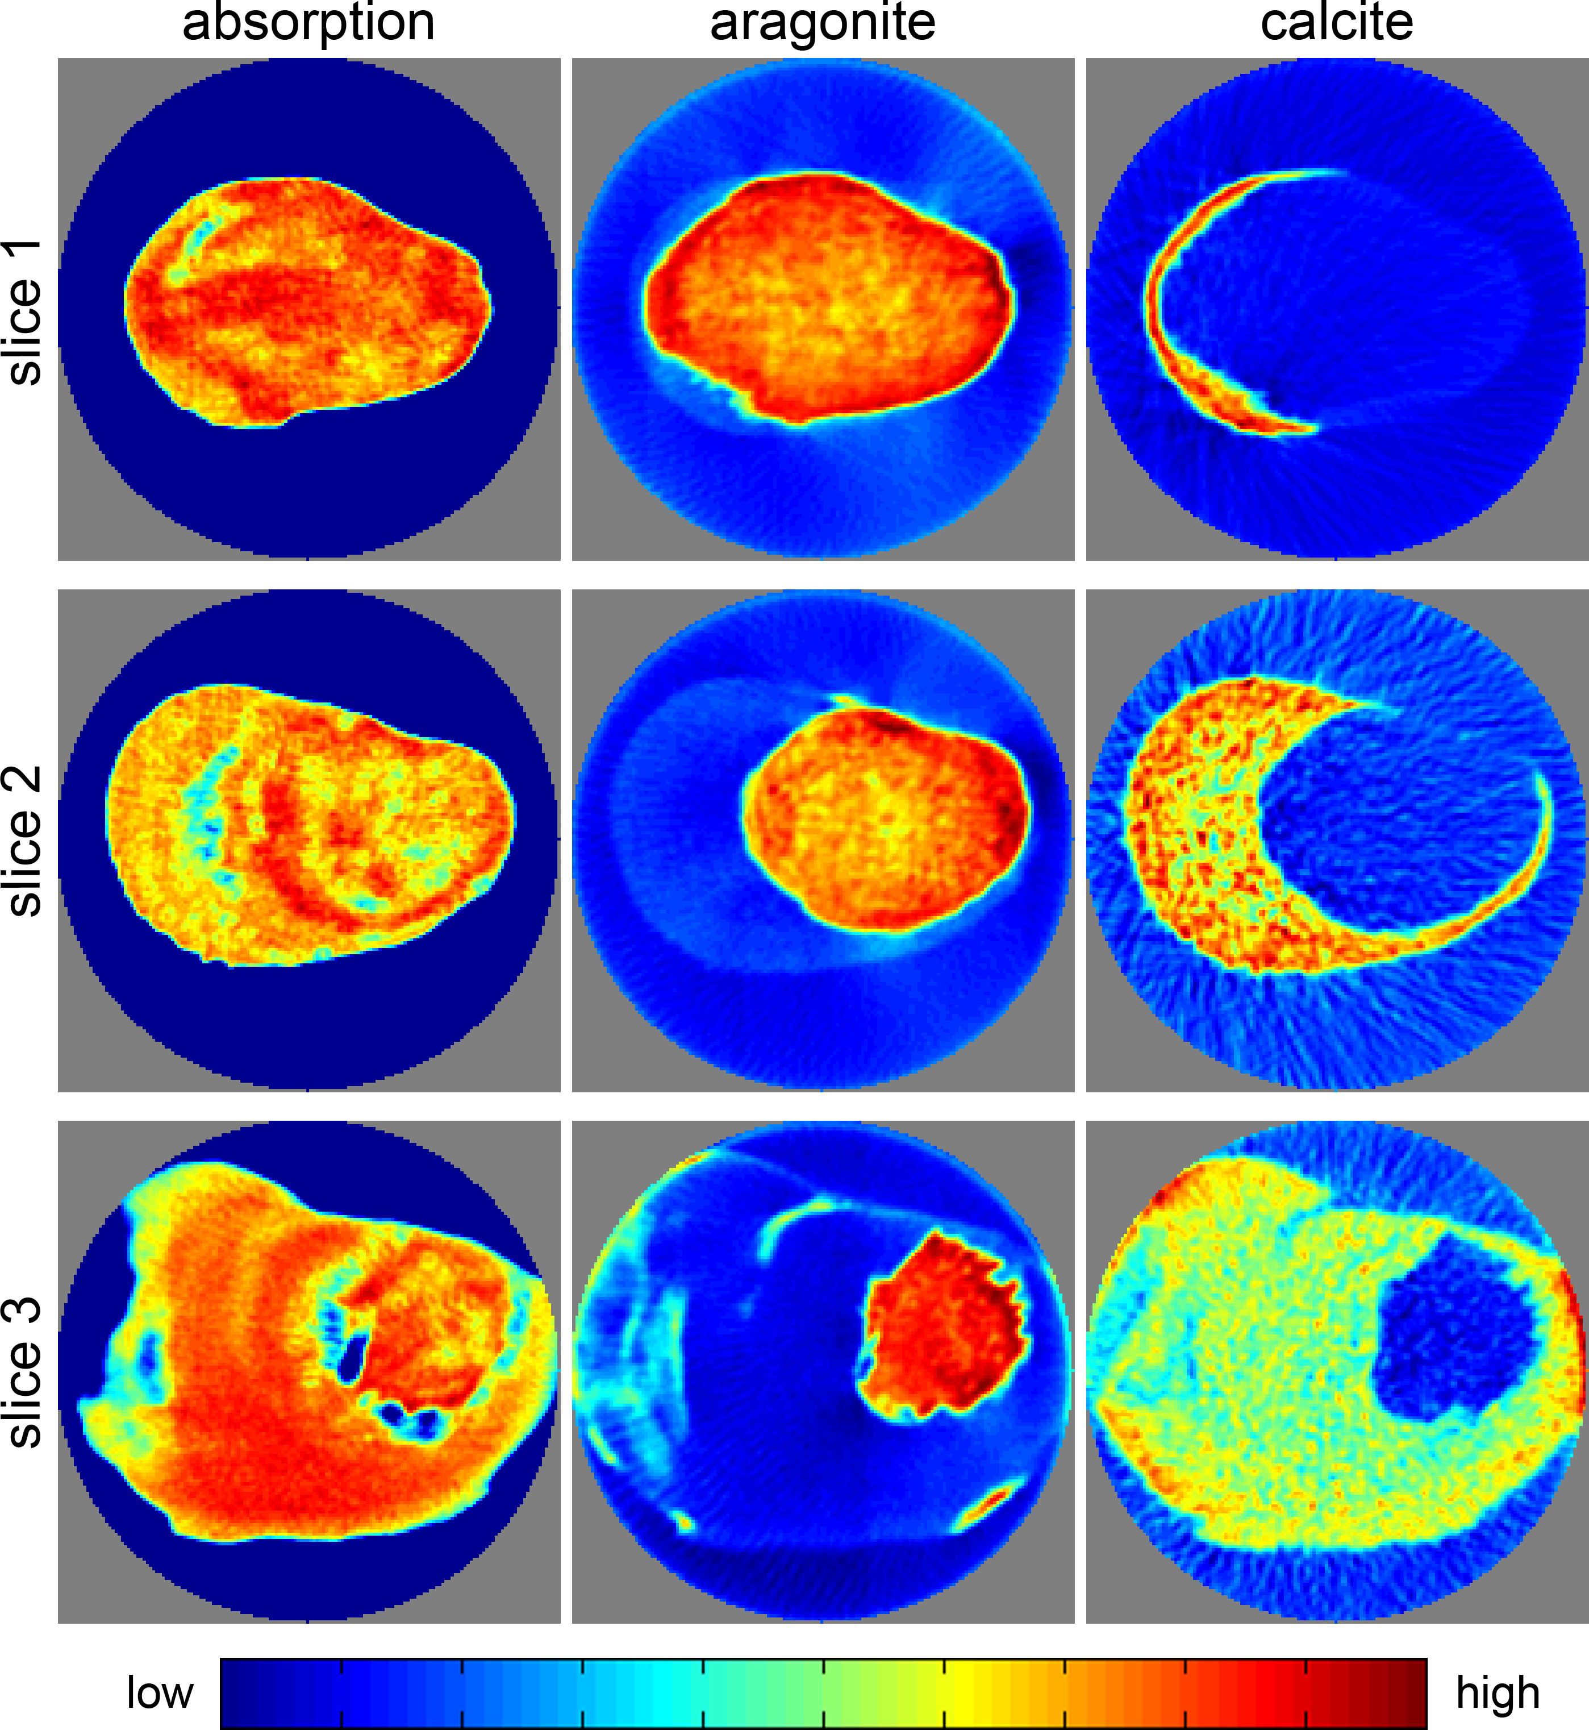
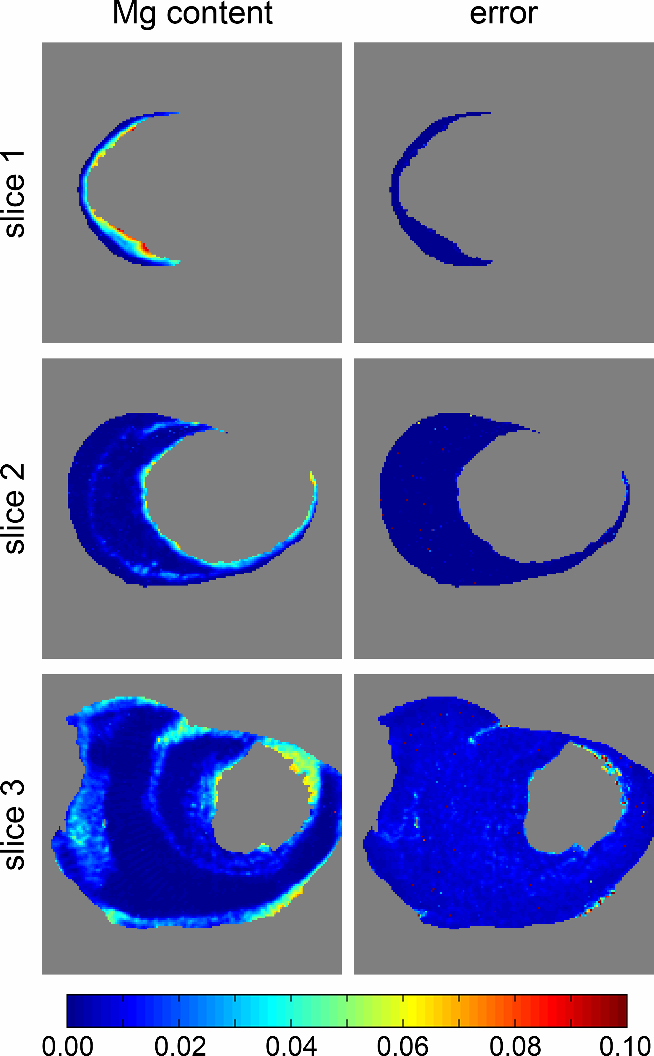
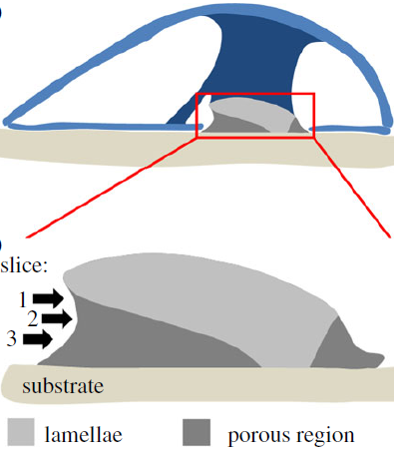
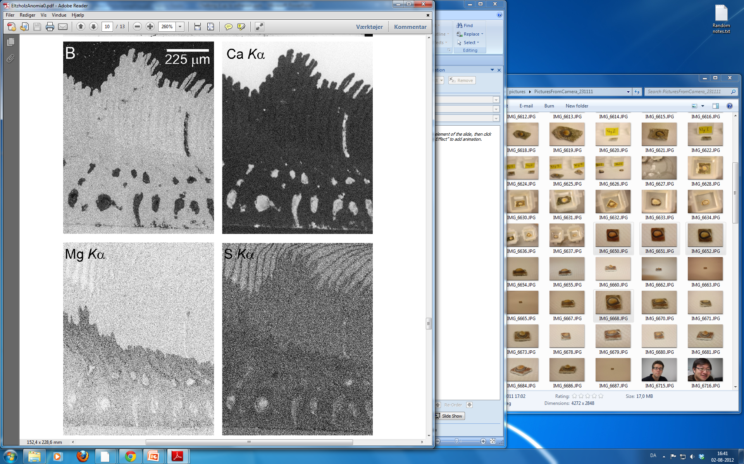
Birkedal group, Aarhus University, Denmark
Diffraction Tomography: Calcified Attachment
High Mg content in interface
Bands of high Mg content
Leemreize et al., J. Roy. Soc. Interface 2013, 10, 20130319

Slide 15
Boundaries of grain-resolved techniques
Diffraction intensity proportional to grain volume:
GE-RT41 with dynamic range 2e12
  10:1 max radial dispersity
Pilatus (CdTe) with dynamic range 2e20
  100:1 max radial dispersity
Monodispersed LaB6 ~1um grain size reconstructed with 10,000 grains
Grain
Resolved
Typically ~3-5% for full field techniques in metals. Up to 10% shown using focused beams and raster scanning (Toyota@Spring-8, ESRF-ID-11, nascent at APS)
Grain Averaged: scattering tomography
Additional means to expand envelope (>micron sized grains)
Software to treat spot overlap (MIDAS, etc)
Increased energy resolution (typical dE/E=1e-3, optional 5e-5)
For submicron grains
Dark-field microscopy
BCDI

Slide 16
APS-U @ 20-ID: High-Energy X-ray Microscope
Optimized for zoom in/out capabilities: ‘real world’ samples at high resolution
0
~30m
~70m
Ion source
~140m
MBA e-beam
SCU, max length, period 1.6-1.8cm?
WAXS det
NF/tomo detector(D1), diffracted beam aperture, and/or focusing lens.(L7)
Filters
Mono-beam focusing/ condensing lenses(L2)
Mono-beam focusing lenses(L4)
Mono-beam focusing lenses(L5)
Guard slits
WAXS det 1(D2).
SAXS det (D6)
WB-slits
WAXS det3&4 (D4), HR imaging detector (D5)
Mono-beam expansion lenses(L3)
WAXS det 2 (D3)
High-energy mono M1, 35<E<120 keV, dE/E~8e-4
High-resolution mono system, M2: dE/E~5e-5, M3: dE/E~1e-5
Mono-beam focusing lenses (L6)
WB-capable lenses (L1)
Sample & environment
Primary slits
Sample & environments
Consideration | High-energy x-ray benefits from:
 | low MBA emittance | long beamline
focusing | small spots / high demags at long focal (working) lengths
 | σ_{y} , σ_{y'} reductions (and not just from σ_{x} , σ_{x'}) discernible at high energies, enhancing gains
coherence | higher coherent fraction | enables low-demag or magnification geometries for large, coherent focal spots
beam-expanding refractive optics | efficient due to small initial beam size, aperture | efficient due to low refractive power needed over long distance
External building for end-station will be shared with ISN –enabling hazardous materials studies

Slide 17
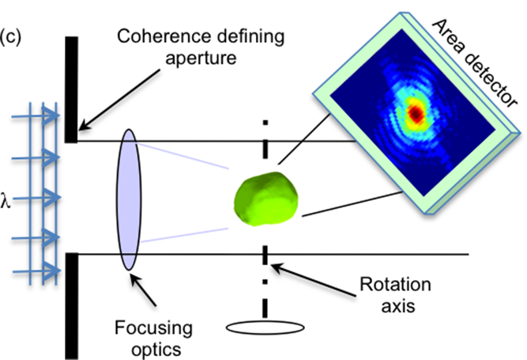
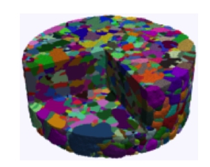
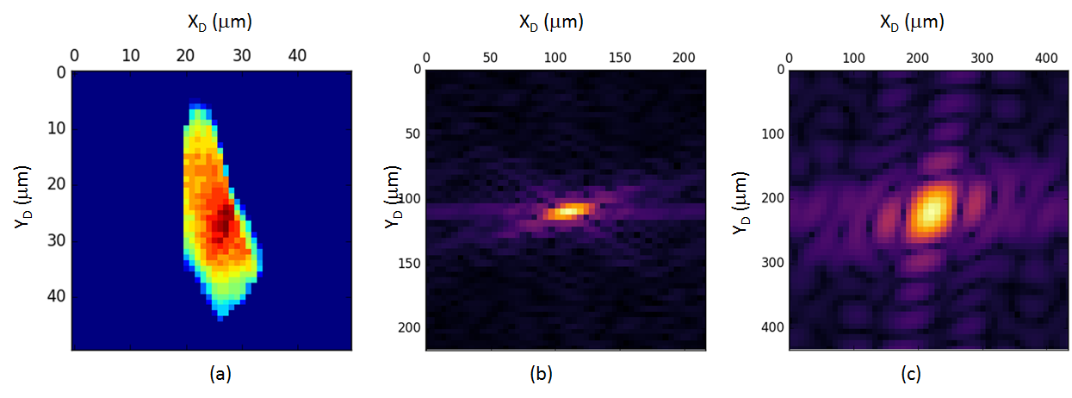

Bragg Coherent Diffraction Imaging @ High Energies
Enabled by new sources such as APS-U
  Coherent volume at 50 keV will match that of today at 10keV
  Higher energies capable of penetrating larger samples and illuminate larger grains
  Combine FF / NF HEDM information with new reconstruction algorithms
  New measurement strategies
  Large hutch, high E resolution, high resolution detectors
Simulations of BCDI patterns at E = 40 keV, sample-detector = 14 m, detector resolution = 10 μm, 2θ = 10º, grain size = 10 μm. (a) 2D shape of the grain along the projection direction. (b) The grain is fully illuminated using perfectly coherent 50 μm. (c) The grain is partially illuminated with pytchographic measurement strategy in mind.
FF/NF HEDM
Strain and orientation information
Notes:
“Grain” in quotes because one typically talks about grains as a domain with the same crystal lattice orientation. But if it has intragranular gradient or substructures then what is a grain?

Slide 18
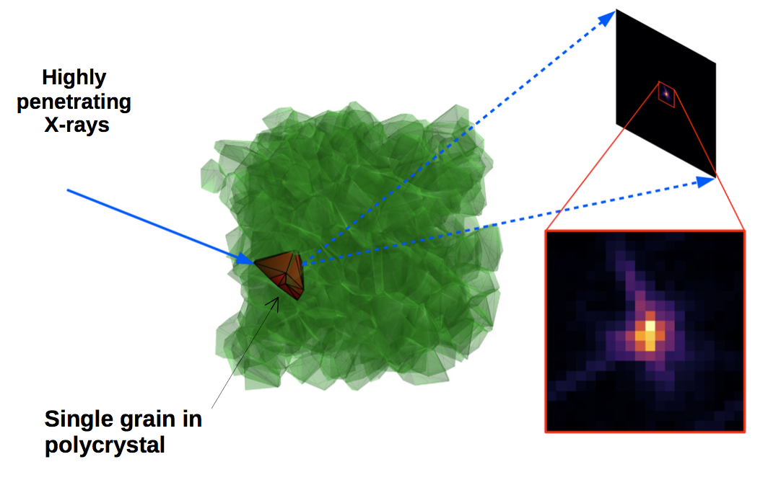
Compression of reciprocal space
At >50keV x-ray energies, fringe spacing falls below typical detector pixel

Slide 19
sub-pixel detector translations
Numerical test, underlying diffraction pattern
Recovered from overbinned data set with detector shifting.
With sparsity constraint, fine detail can be recovered from overbinned data
Maddali, S., et al. (2018). Scientific Reports, 8:49-59.

Slide 20
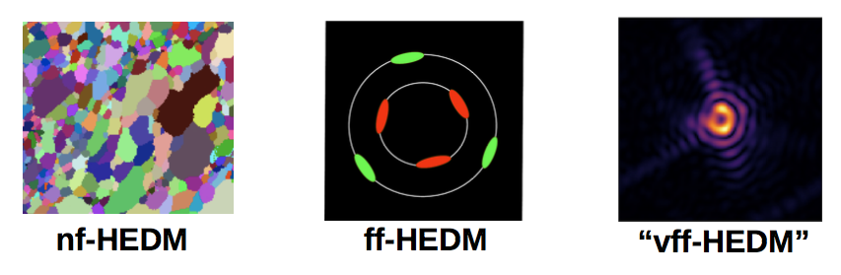
Proof of concept HEDM integration
Detector distance: 5 mm 1 m 6.5 m
Sample rotation: 360˚ 360˚ 0.2˚
Can peak indexing of existing ff-HEDM workflow be used for BCDI?
Can we satisfy sampling requirements with a long hutch?

Slide 21
Polycrystalline Au film
54 keV beam
  2 x 500 micron beam size
  100 x 100 nm transverse coherence
  dE/E=1e-5
Au film with ~300 nm grain size
64,560 different (111) Bragg peaks measured in 360 scan
Indexed to 6,768 individual grains in illuminated volume
111 Bragg peaks
on Ewald sphere

Slide 22
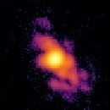
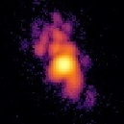
Polycrystalline Au film
111
Pick single Friedel pair for BCDI
111
Initial results are promising, reconstructions in progress

Slide 23
Polycrystalline Au film
ff-HEDM indexes higher order reflections for each grain
  111
  200
  222
  311
Potential to provide unprecedented strain sensitivity in a 3D BCDI image.
Ability to interrogate outliers within a vast population.
There are so many more to choose from!

Slide 24
Boundaries of grain-resolved techniques
Diffraction intensity proportional to grain volume:
GE-RT41 with dynamic range 2e12
  10:1 max radial dispersity
Pilatus (CdTe) with dynamic range 2e20
  100:1 max radial dispersity
Monodispersed LaB6 ~1um grain size reconstructed with 10,000 grains
Grain
Resolved
Typically ~3-5% for full field techniques in metals. Up to 10% shown using focused beams and raster scanning (Toyota@Spring-8, ESRF-ID-11, nascent at APS)
Grain Averaged: scattering tomography
Additional means to expand envelope (>micron sized grains)
Software to treat spot overlap (MIDAS, etc)
Increased energy resolution (typical dE/E=1e-3, optional 5e-5)
For submicron grains
Dark-field microscopy
BCDI

