Slide 1
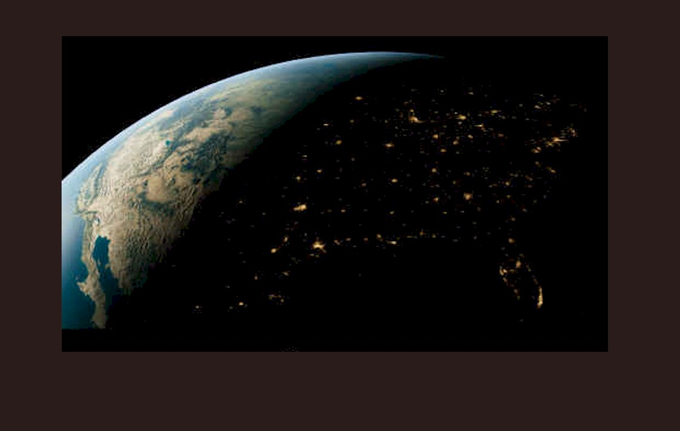
SEES Facility Overview
and
Tomography and Rock Mechanics at SEES
Mark Rivers
GeoSoilEnviroCARS
Center for Advanced Radiation Sources
University of Chicago

Slide 2
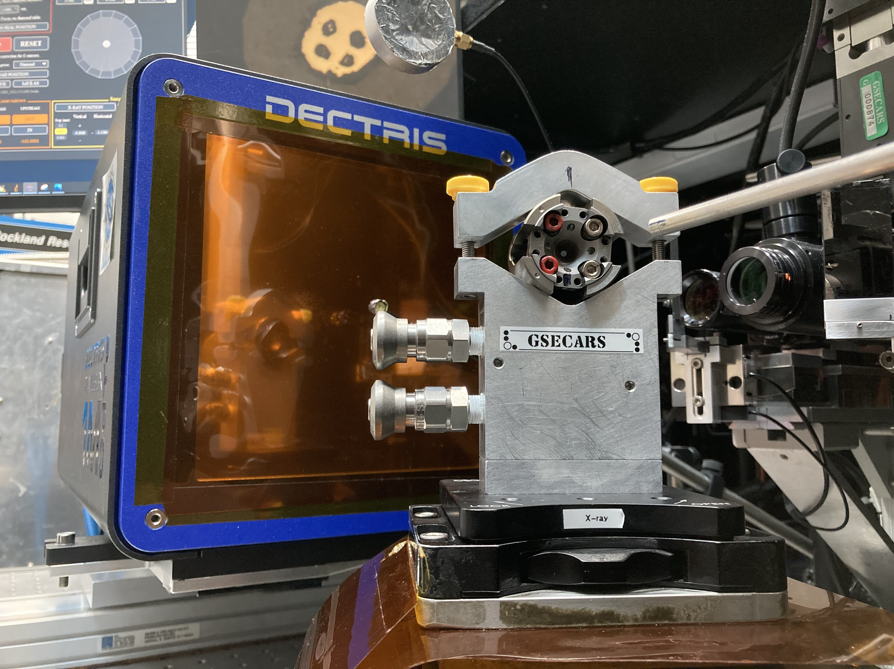
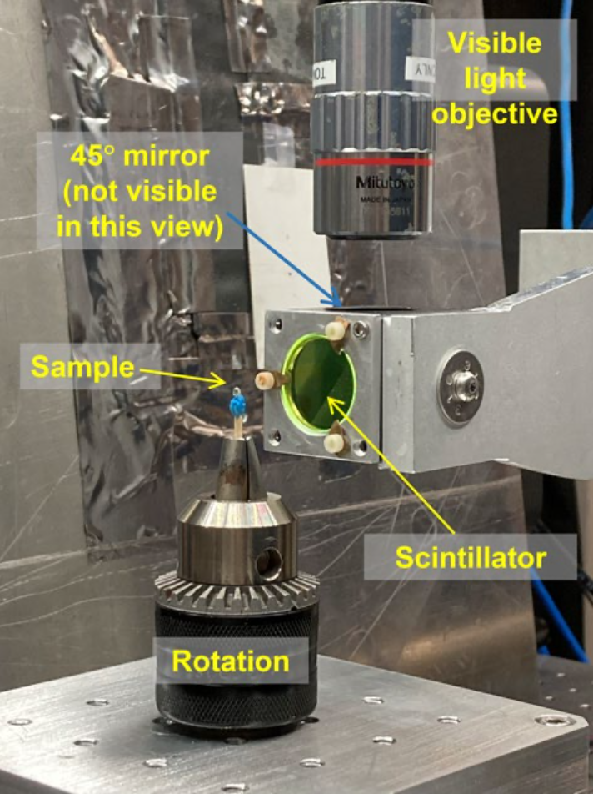
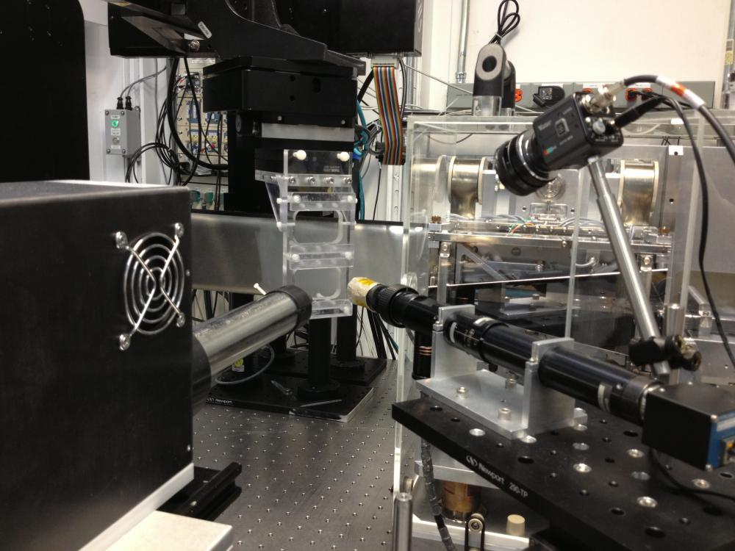
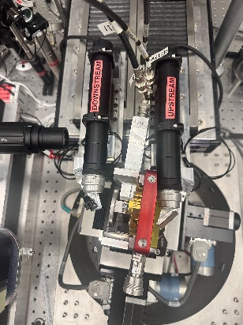
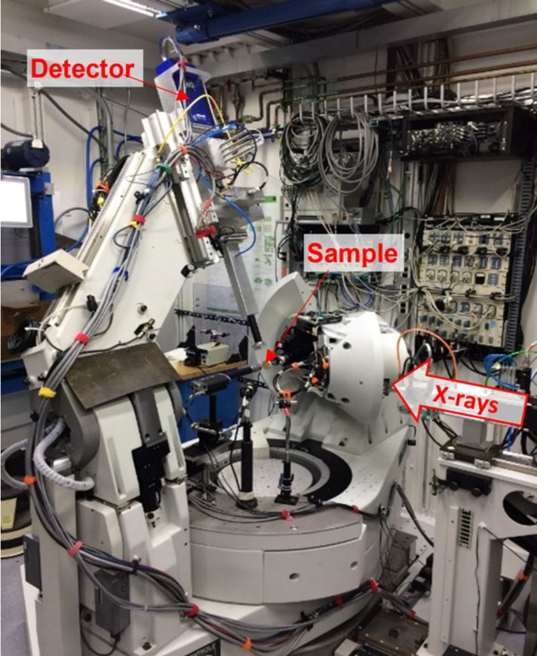
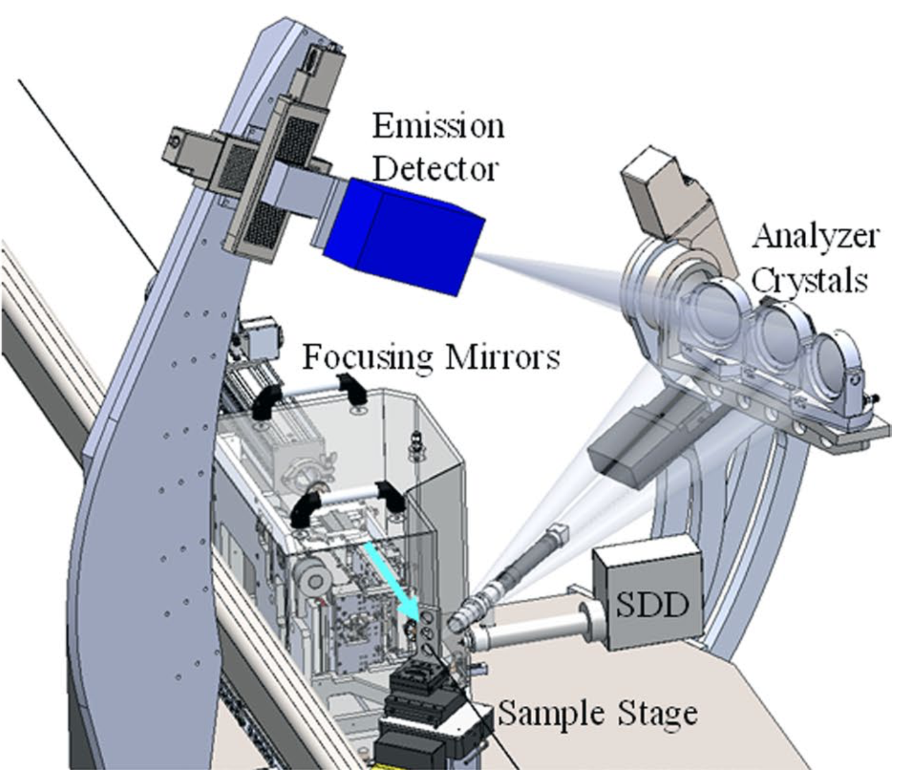
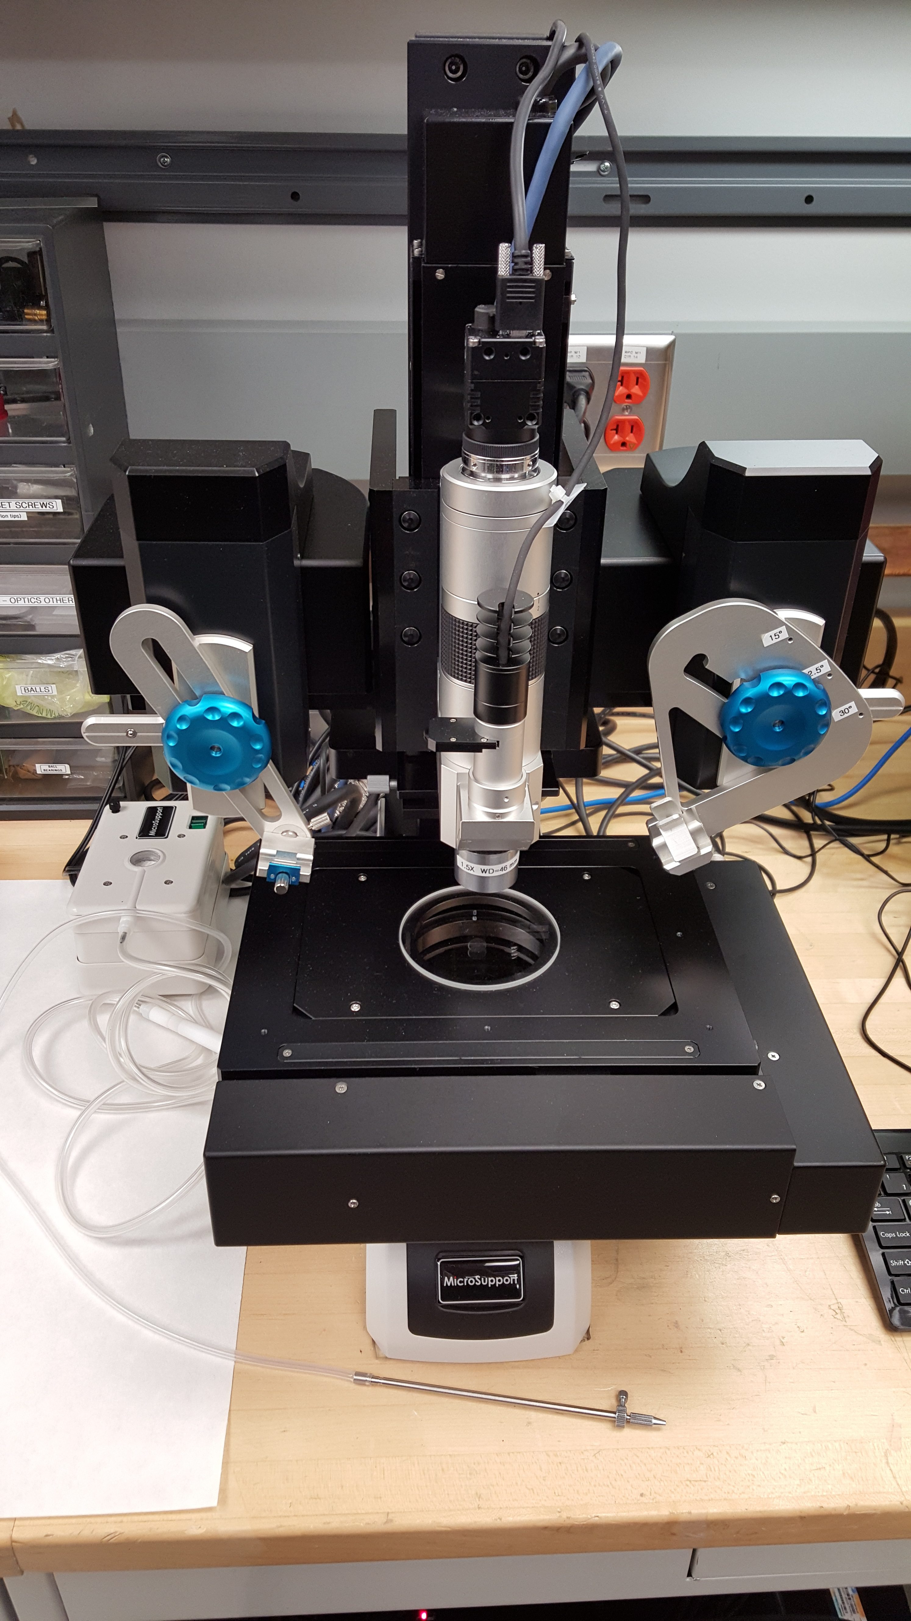
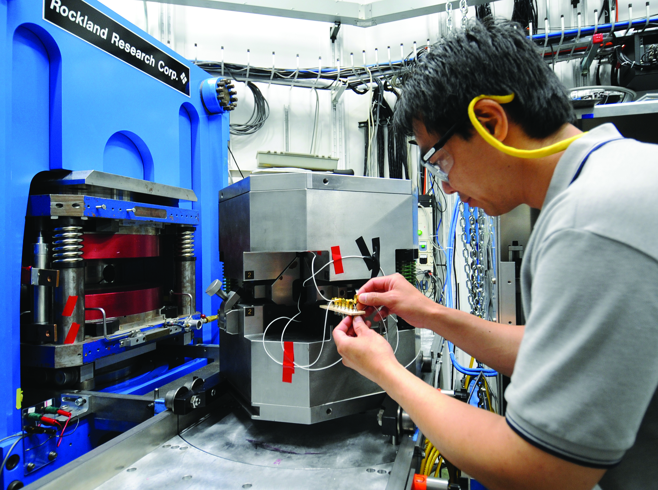
SEES at APS: Sectors 3, 6, and 13 (~20 FTE)
10
12
Diamond anvil cell
high pressure (DAC)
Computed micro-tomography (CMT)
X-ray absorption
spectroscopy (XAS)
Nuclear resonance scattering (NRS)
8
7
1
←X-rays
2
Large volume press
high pressure (LVP)
Surface/interface scattering
X-ray microprobe (XRM)
Offline user laboratories
3
11
11
4
5
6

Slide 3
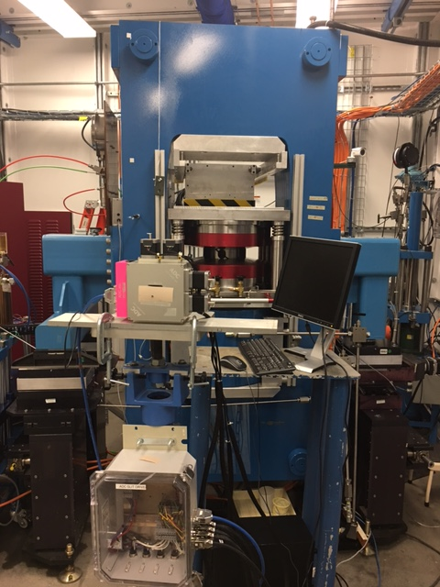
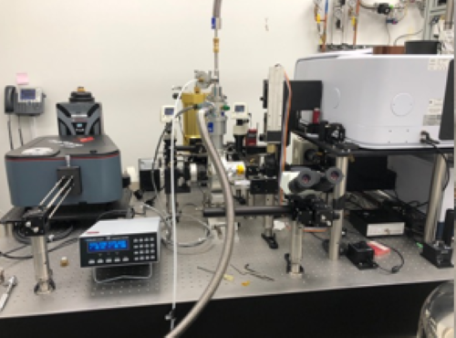
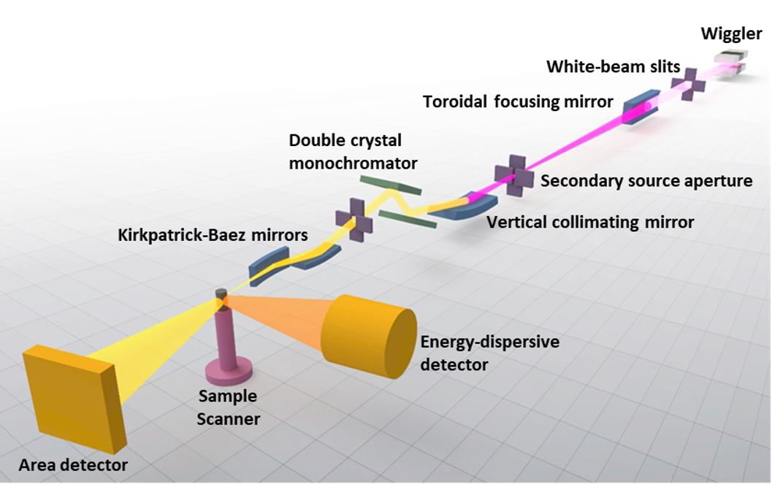
SEES at NSLS-II (3 FTE)
10
12
XPD (28-ID-2): High P,T
Mineral Physics
FIS (22-IR-1): High P Infrared spectroscopy
XFM (4-BM): X-ray Fluorescence Microscopy
6

Slide 4
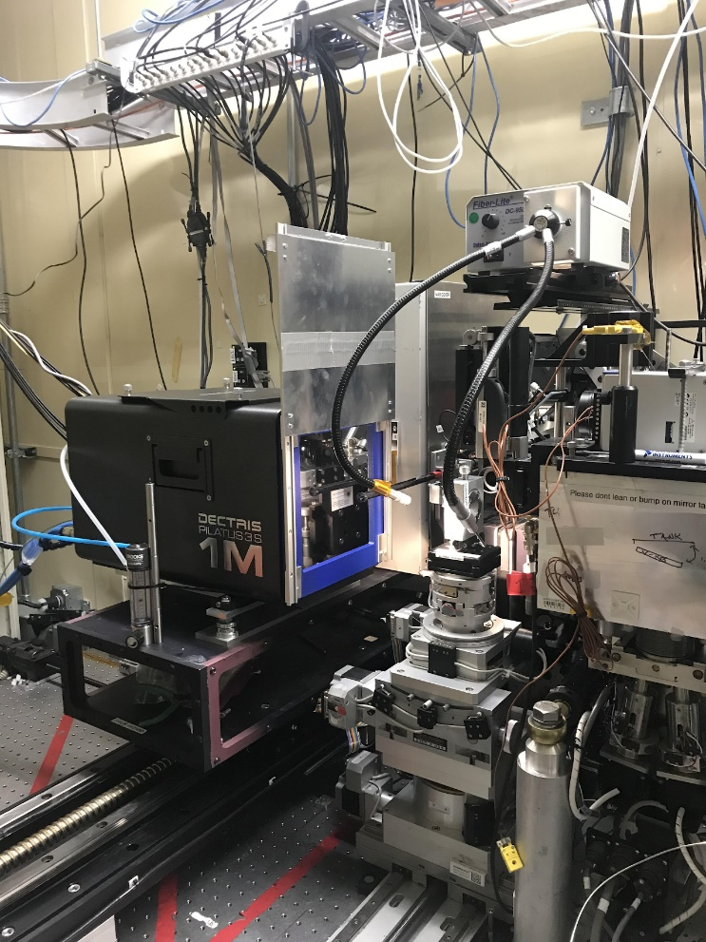
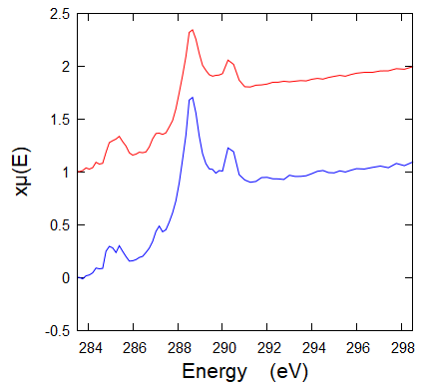
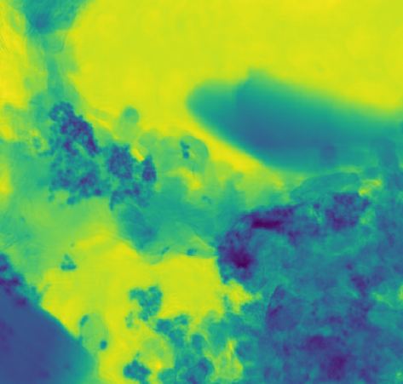
SEES at ALS (5 FTE)
10
12.2.2: High P,T
Mineral Physics
8.3.2: Tomography
In Situ Rock Deformation
5.3.2, 7.0.1.2, 11.0.2.2: SYSTER
SYnergy of Soft and Tender X-rays for Earth Research
Inorganic
Organic
0.1 µm
Haboub et al. 2014

Slide 5
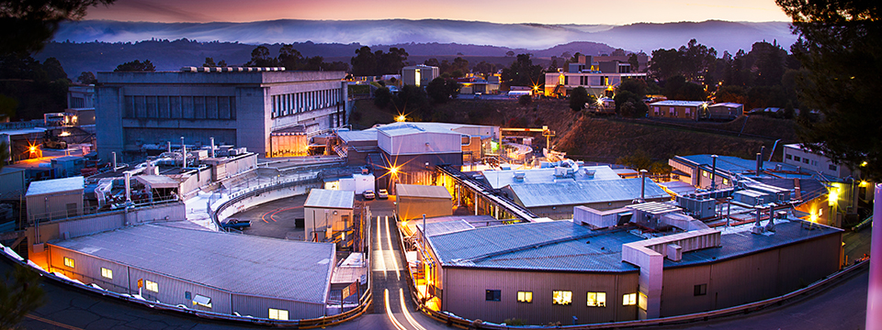

SEES at SSRL (1 FTE)
10
Imaging beamlines: 2-3, 6-2b, 7-2, 14-3b
XAS beamlines: 4-1, 4-3, 7-3, 9-3, 11-2, 14-3a

Slide 6
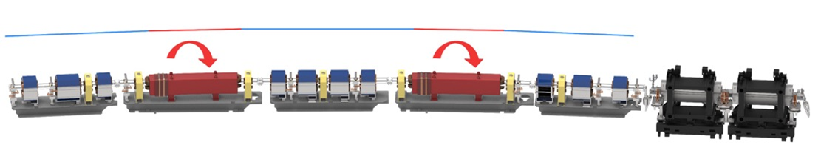
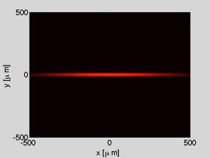
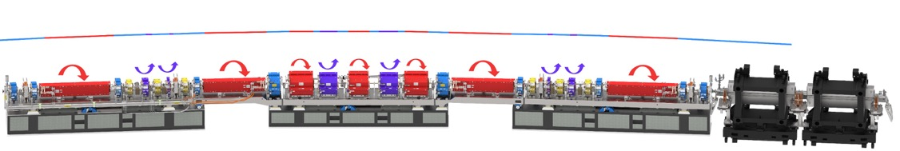
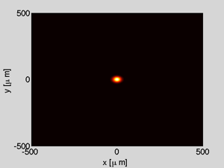
APS-U High-Brightness Storage Ring Lattice
10
Electron beam profile in undulator straight section
Magnetic lattice in one sector
Original APS
Original APS, double-bend lattice
ε_{ο} = 3100 pm.rad
APS Upgrade
Upgraded APS, 7-bend lattice
Increasing the number of bending magnets results in much lower emittance and much higher X-ray brightness
ε_{ο} = 42 pm.rad

Slide 7
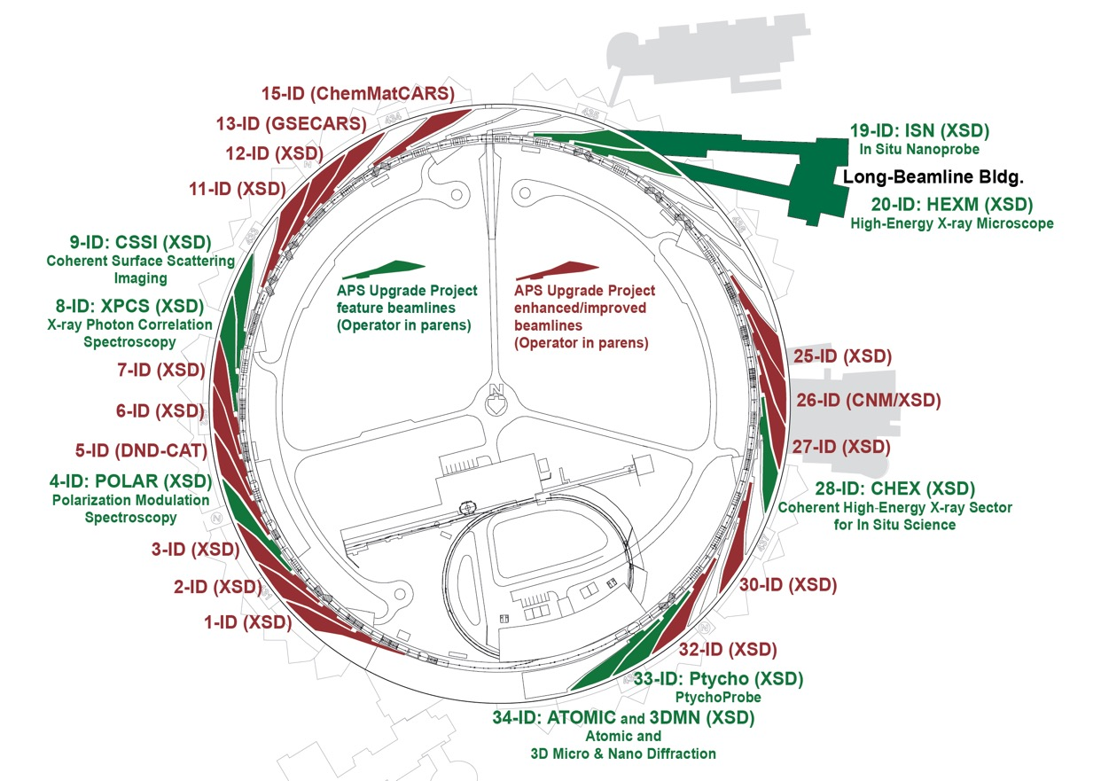
APS-U Beamline Upgrades
10
New and updated insertion devices for optimum spectral performance.
9 new feature beamlines + Long Beamline Building (green)
14 enhanced and improved beamlines
SEES beamlines 3-ID and 13-ID received funding for upgrades from APS-U project
NSF-SEES funding provided additional upgrades for all SEES beamlines
18 bending magnet beamline relocations

Slide 8
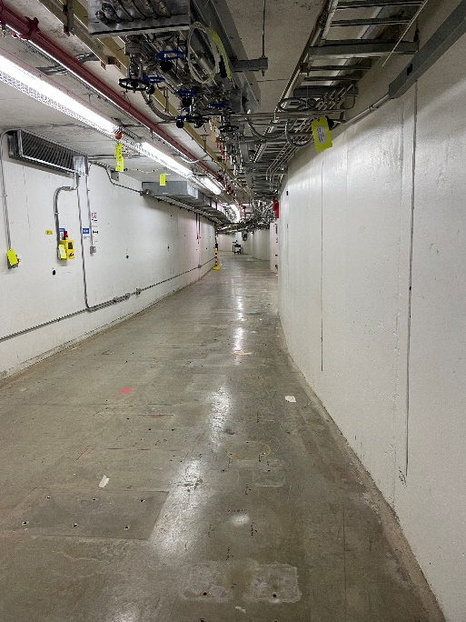
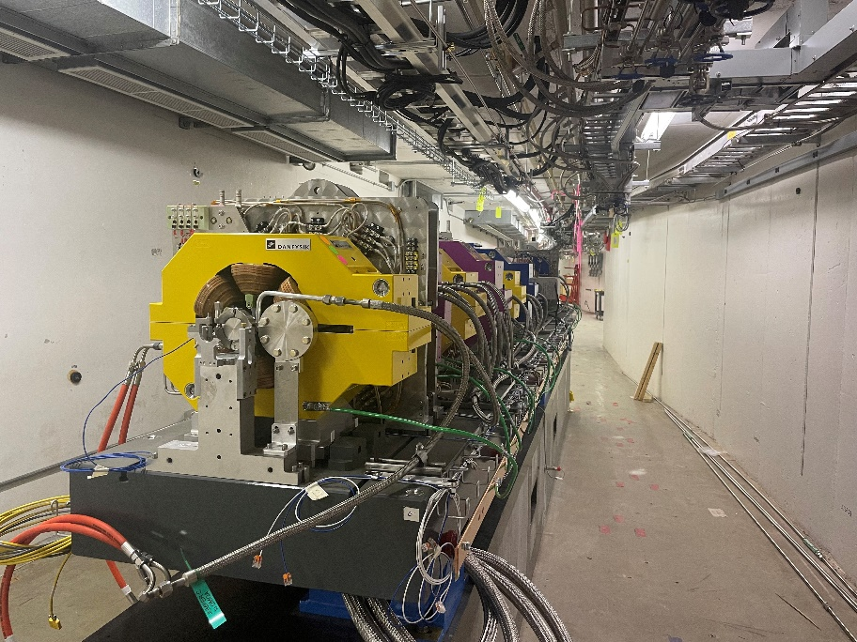
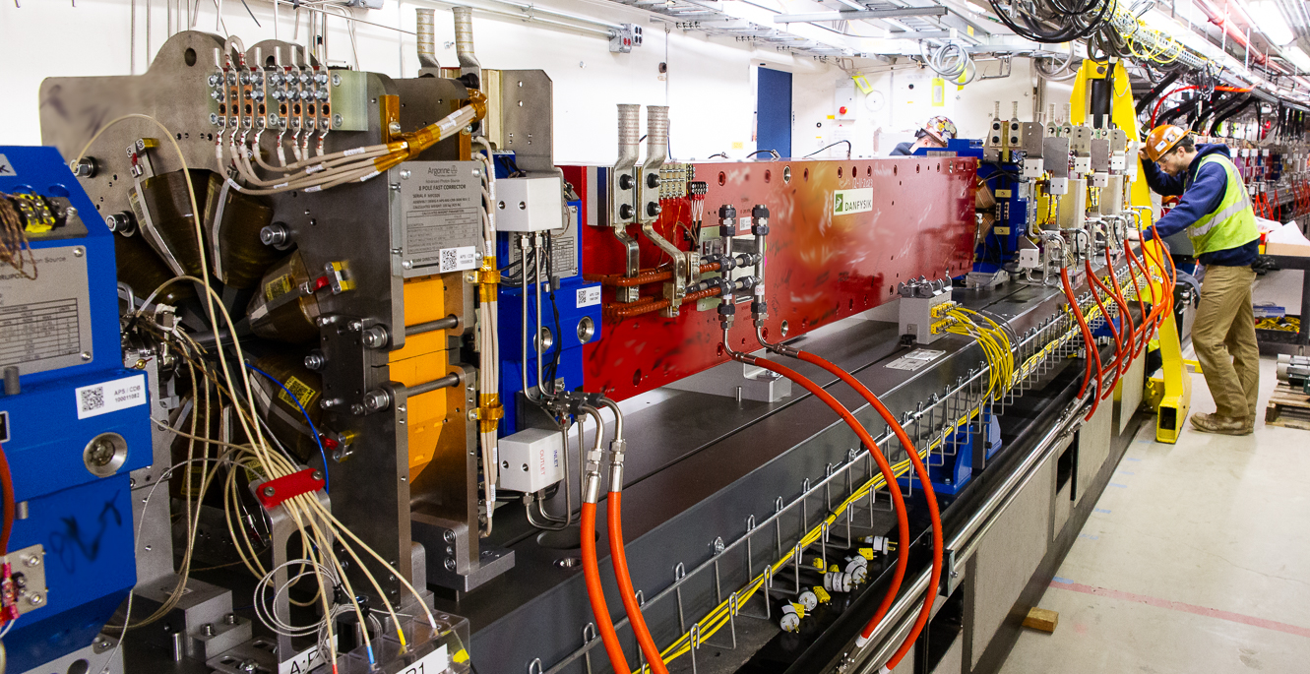
The APS Upgrade
10
Project cost: $815M
Machine shut down: April 17, 2023
First beam in new machine: April 10, 2024
Beamlines started commissioning: June 17, 2024
Final module installation
December 2023
June 29, 2023
July 20, 2023

Slide 9
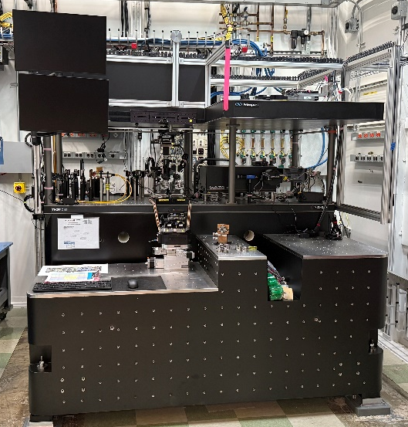
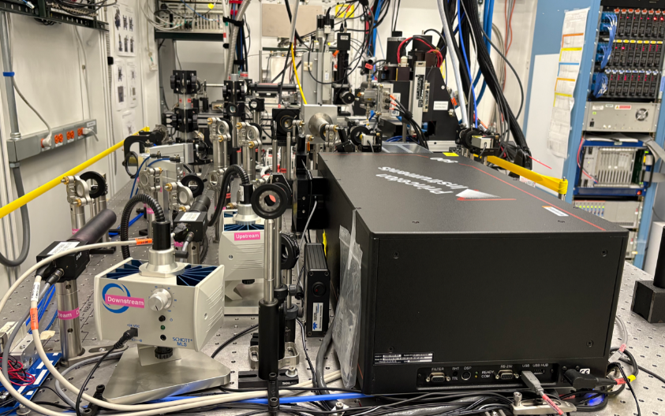
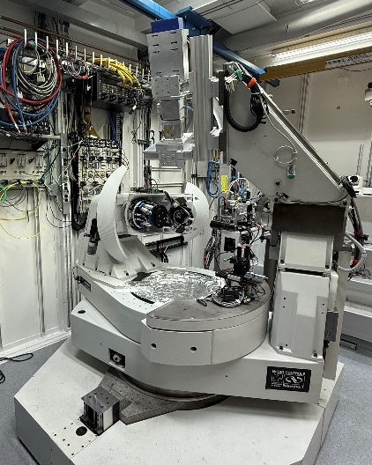
The APS Upgrade
10
APS is now the brightest synchrotron in the world!
Current in 324 bunch mode: 200 mA (twice the old APS)
Current in 48 bunch mode: 140 mA (implementing plan to reach 200 mA)
Number of beamlines returned to General User Operation: 26
Number of beamlines in Technical and Scientific Commissioning: 30
All SEES APS beamlines back in General User Operation for 2025-3 except 13-ID-C/D which is commissioning a new DAC table, focusing optics, and rebuilt diffractometer.
Still installing new X-ray optics and instrumentation
13-ID-D DAC system
3-ID-C
laser heating system
13-ID-C Diffractometer

Slide 10
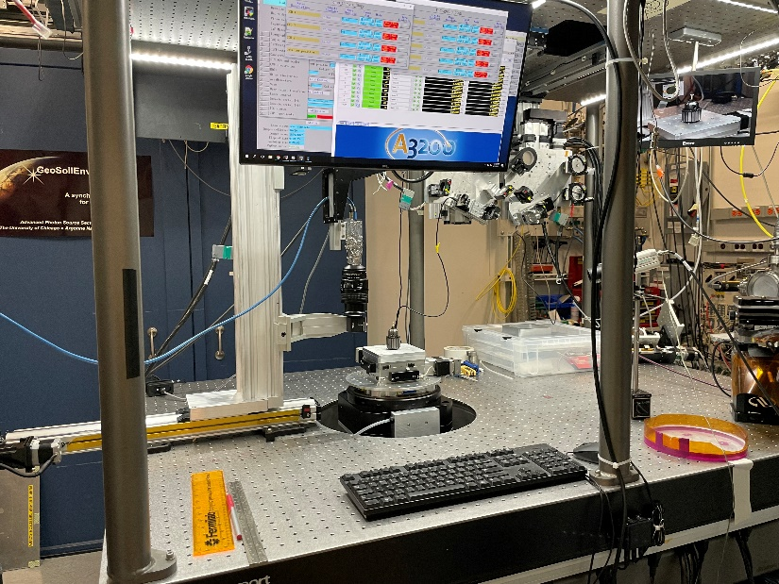
SEES Tomography Facility at APS Beamline 13-BM-D
10
10
User facility with a broad range of geoscience applications (soils, fossils, meteorites, etc.)
Bending magnet source, critical energy 15.6 keV
Beamline modes, unique to this beamline:
Monochromatic beam, 10-80 keV, Si (111)
Pink beam, 1.1 m long vertical mirror
Can be bent to focus or defocus
High energy cutoff 15-100 keV
White beam with low-energy cutoff filters
Both ambient/low-pressure and very high-pressure tomography
Tomography runs about 30% of the time
Several non-tomography techniques share this station
12
8
7
1
←X-rays
2
3
11
11
4
5
6

Slide 11
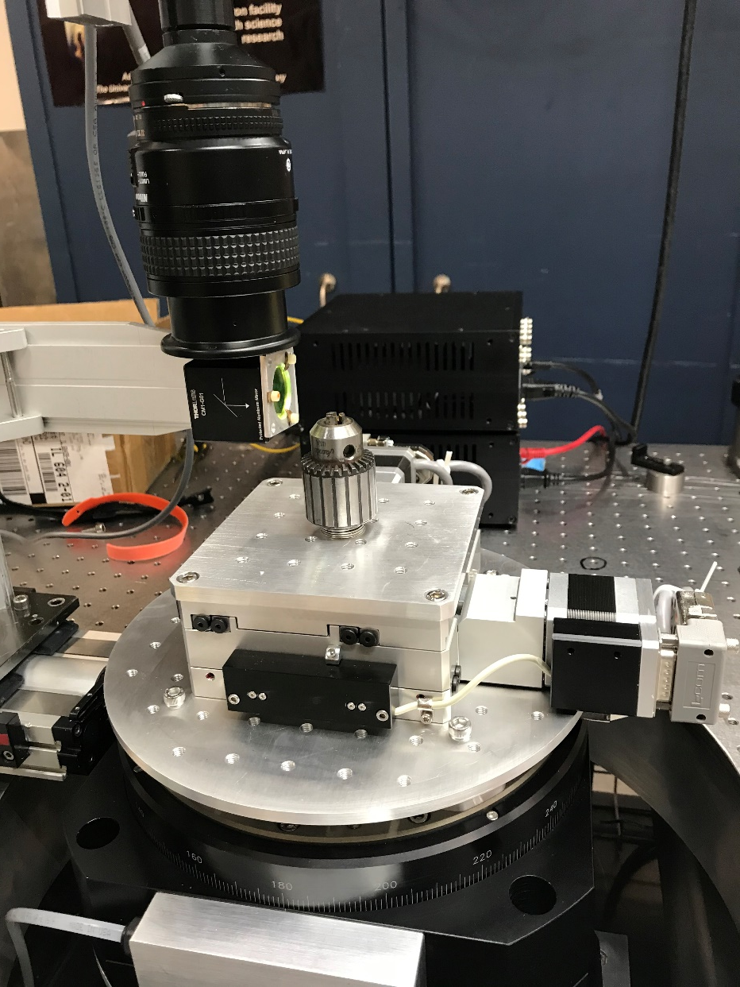
SEES Tomography Facility at APS Beamline 13-BM-D
10
10
Sample stage:
Aerotech air-bearing rotation stage with slip-ring to X-Y stage for continuous rotation
Mounted on Aerotech hexapod for X-Y-Z translation and 3 rotations
25 kg load capacity
Optics:
Nikon macro lens and Mitutoyo 5X and 10X objectives for 1.4-15 mm field of view
Cameras:
FLIR Grasshopper (1920x1200 pixels) and Oryx (2448x2048), each up to 163 frames/s.
Mikrotron CoaXPress camera (1920x1080) up to 2,247 frames/s.
12
8
7
1
←X-rays
2
3
11
11
4
5
6

Slide 12
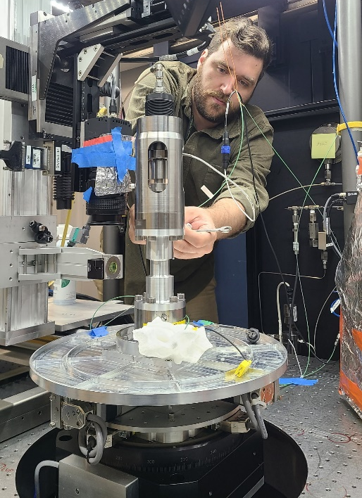
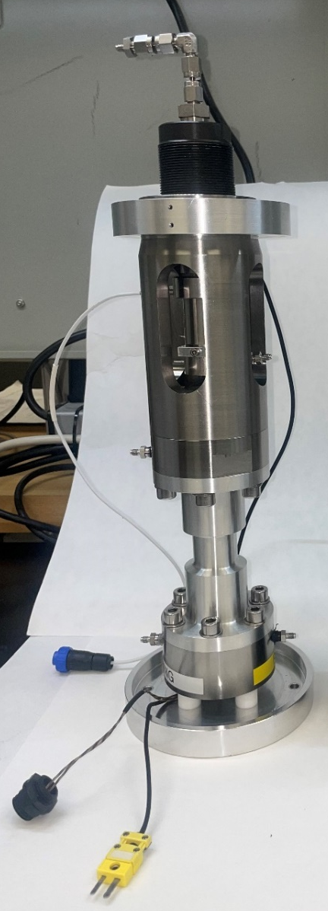
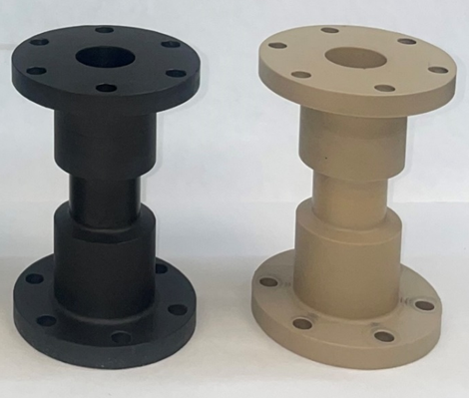
In-Situ Cells used at 13-BM-D Heitt Mjolnir Cell (Freitas et al., 2023)
30 MPa confining pressure
600 MPa axial load
10 mm sample diameter, 20 mm length
Sample temperature to 300°C
Continuous fluid flow through sample
Aluminum sample chamber for good X-ray transmission.
Commissioned with Wenlu Zhu’s group in May and July 2025
New carbon-fiber and glass-fiber sample chambers for better X-ray transmission at lower confining and axial pressure.
Axial fluid
LVDT
Load cell
Pore pressure
Confining pressure
Lower thermocouple
Lower heater

Slide 13
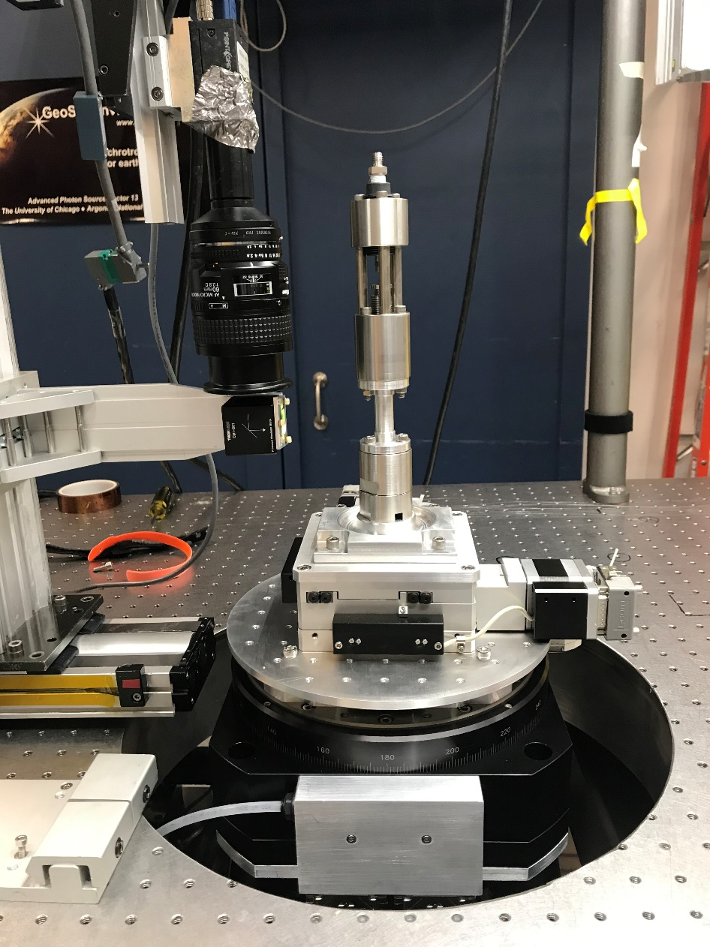
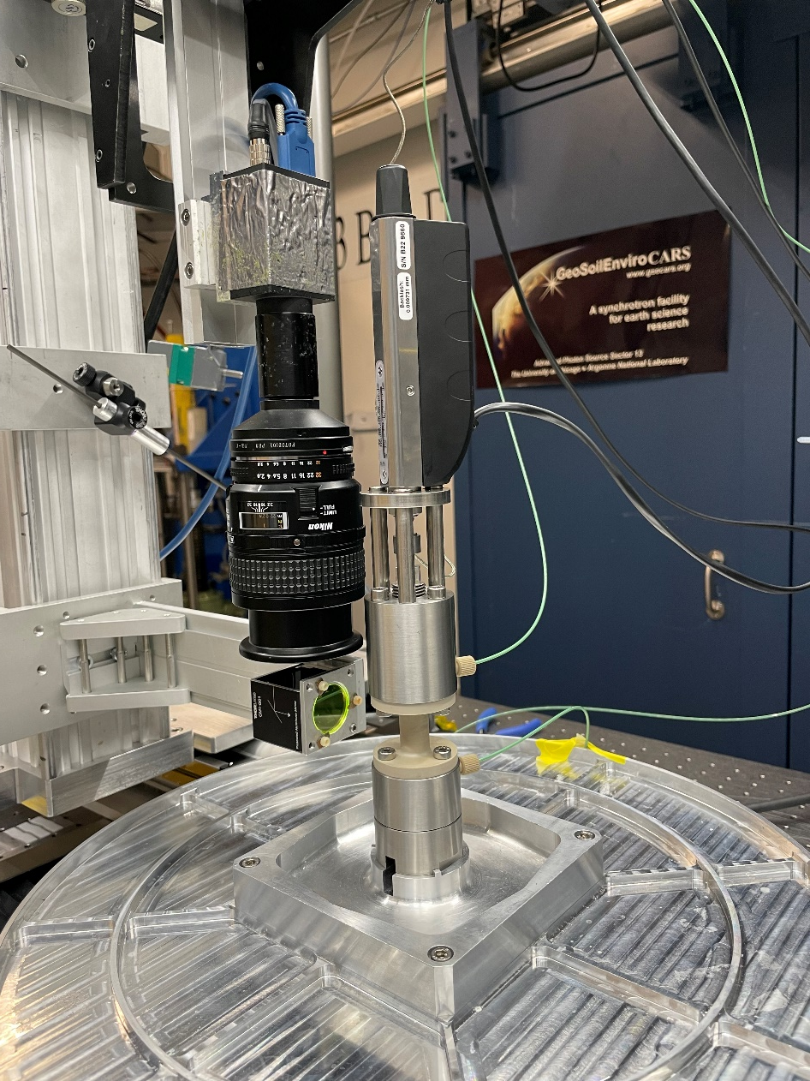
In-Situ Cells used at 13-BM-D
Mjolnir tri-axial cell
After Butler et al. 2020.
3mm diameter, 10 mm long
50 MPa confining pressure, 600 MPa axial load
Modified Mjolnir
For granular media studies
PEEK sample chamber, 11mm chamber ID.
Stepper motor axial load

Slide 14
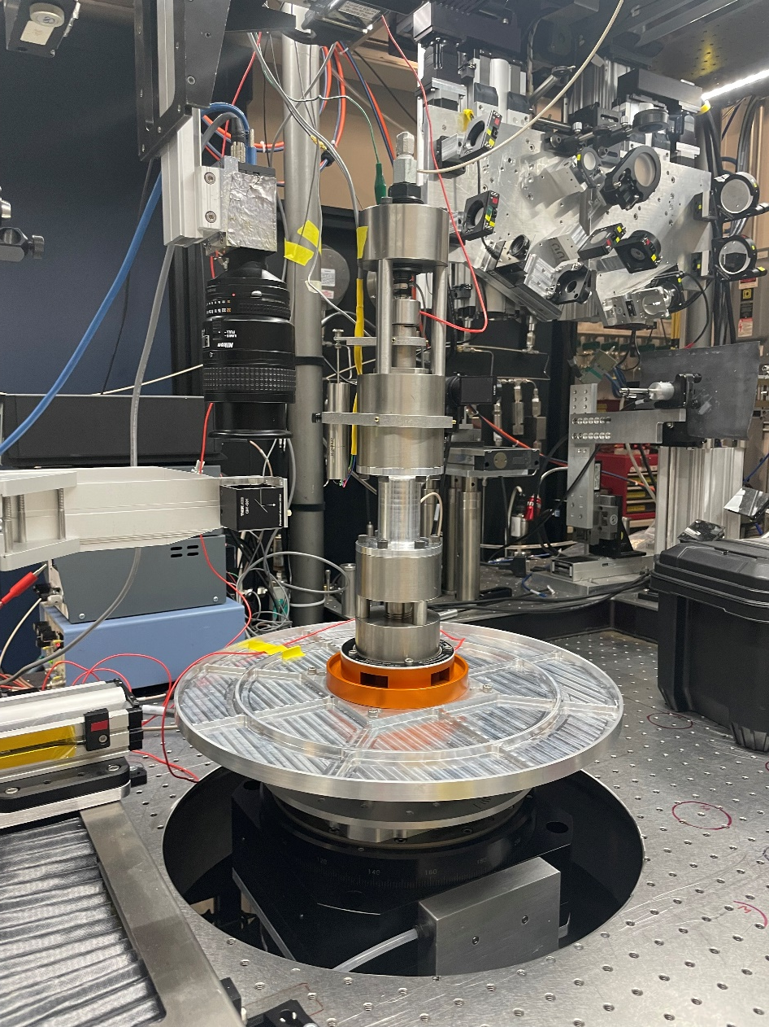
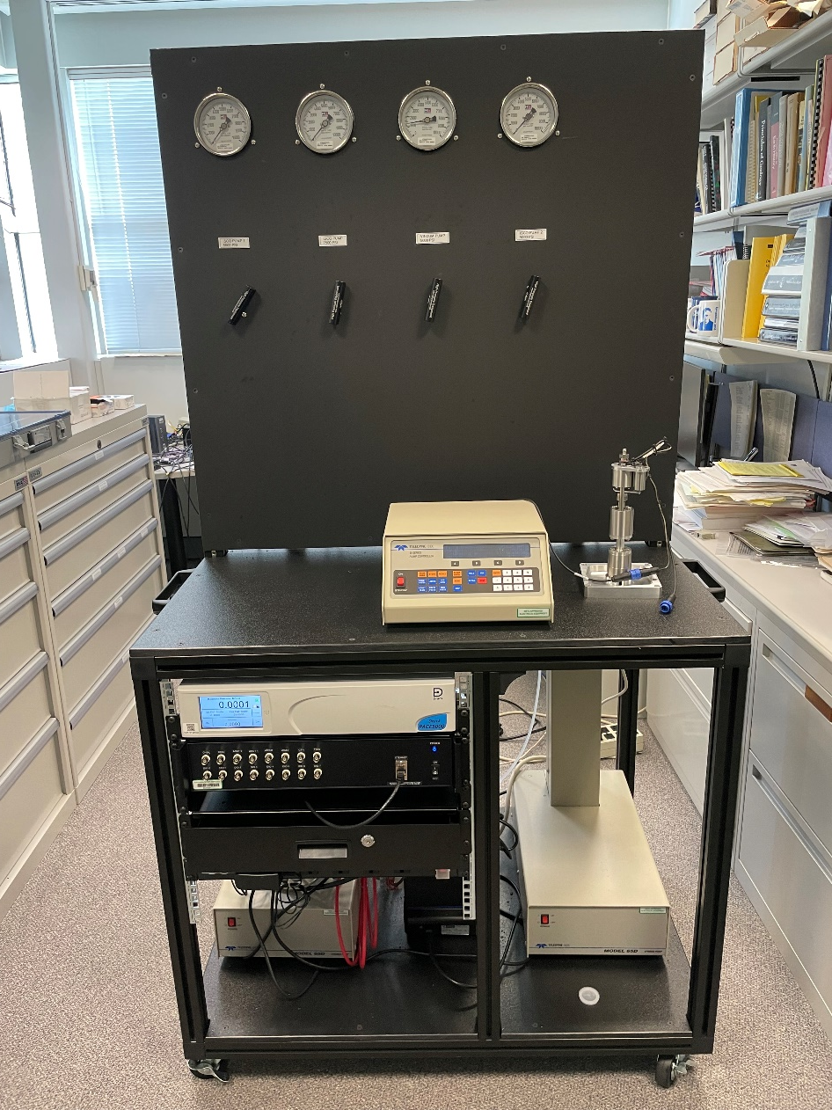
In-Situ Cells used at 13-BM-D
Mjolnir-like cell
From Parisa Shokouhi’s group at Penn State
Ultrasonic velocity and acoustic emission capabilities
Pumping cart
Used for Mjolnir and other cells
2 ISCO 65D pumps for confining and axial load
Vindum VP-12K dual pump for continuous fluid flow
GE Druck PACE-5000 for gas pressure to 15 MPa

Slide 15
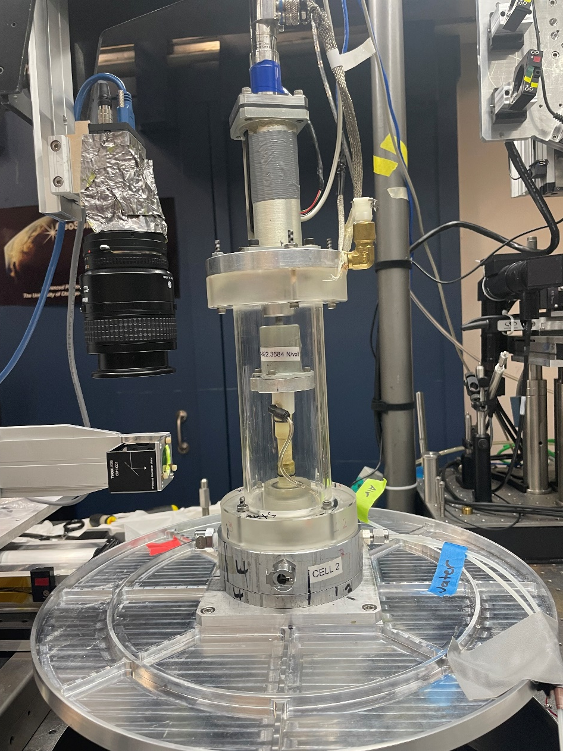
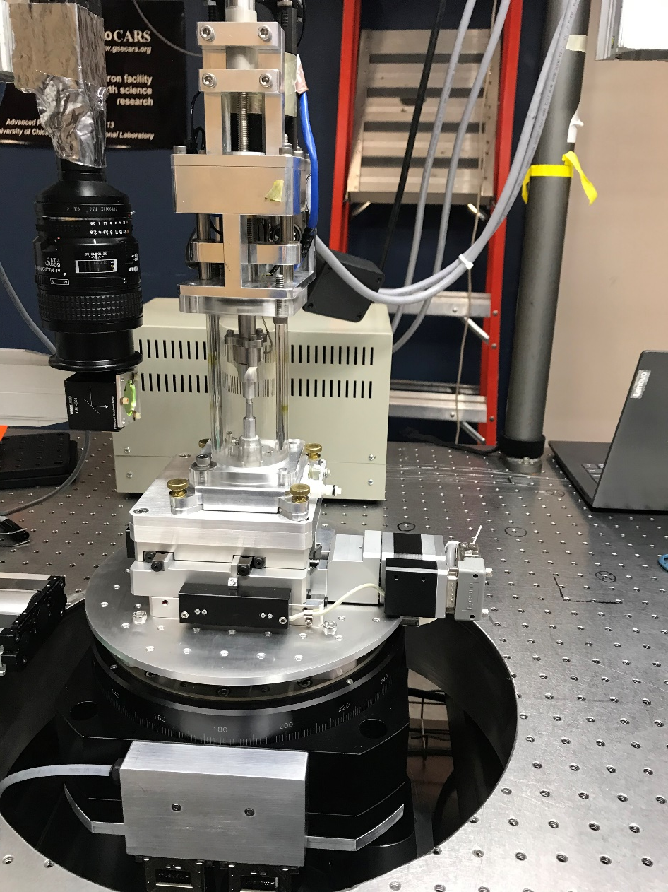
In-Situ Cells used at 13-BM-D
Tri-axial cell
From Giuseppe Buscarnera’s group at Northwestern University
Flexible membrane containment.
Sample loaded under vacuum.
Used for studies of granular media like sands.
Tri-axial cell
From Giuseppe Buscarnera’s group at Northwestern University
Used for oedometric studies (rigid walls) of granular media

Slide 16
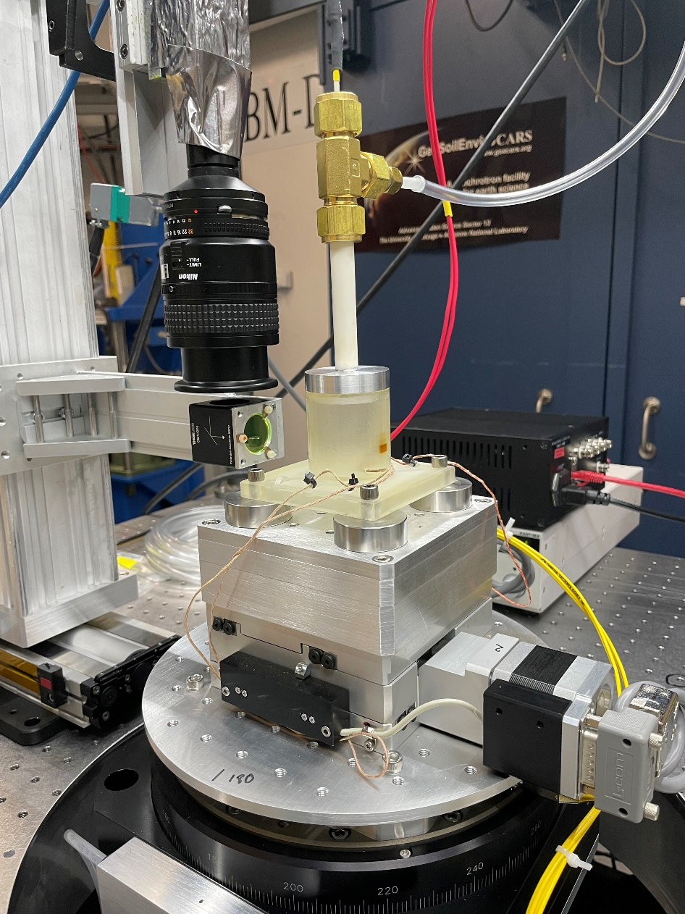
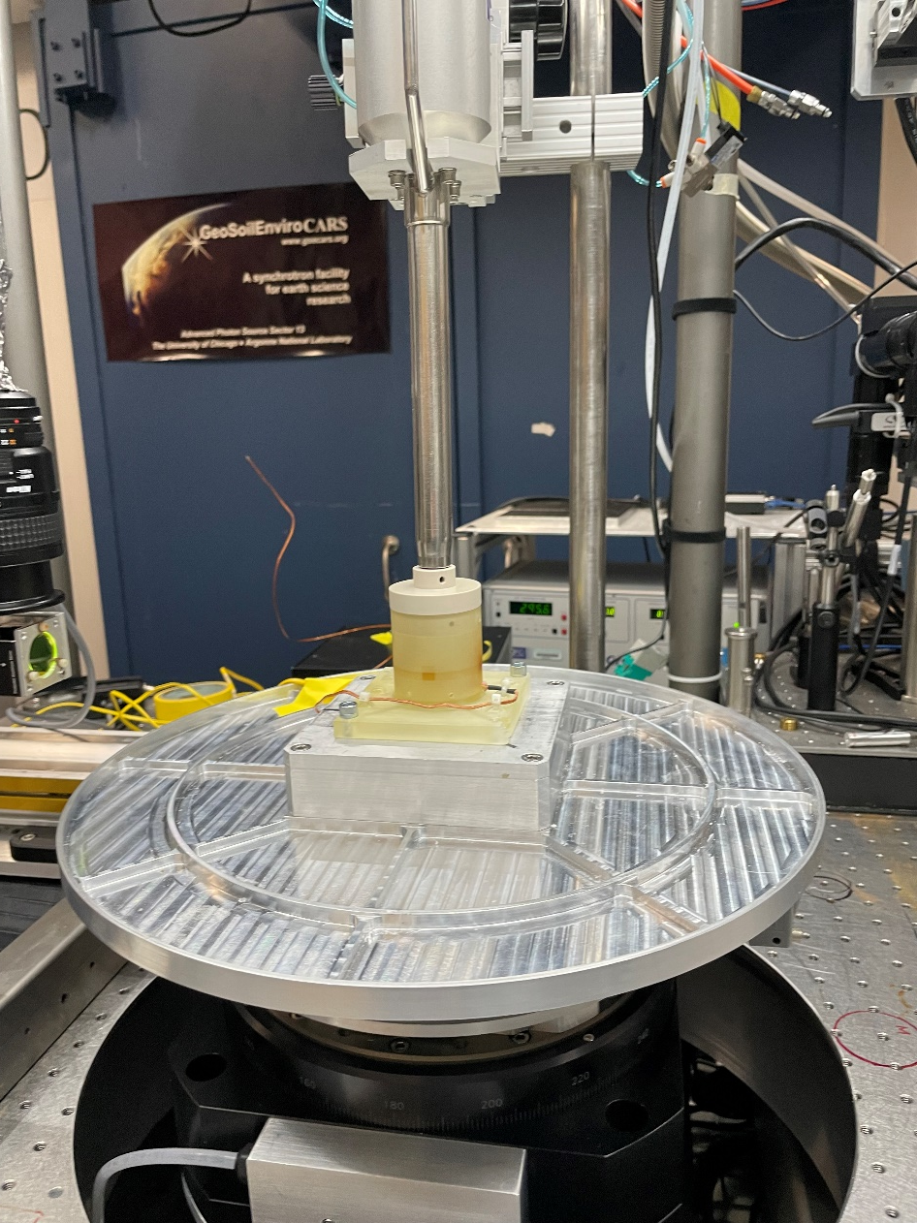
In-Situ Cells used at 13-BM-D
High-temperature cell
Used for studies of thermal deformation granular media up to 140°C.
Gas flows through ceramic tube with heating element.
Cryogenic cell
Used for studies of thermal deformation granular media from -120°C to +20°C
Cold nitrogen gas from an Oxford CryoJet flows down the metal tube into the sample chamber.

Slide 17
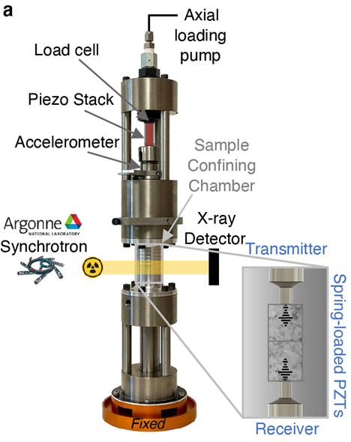
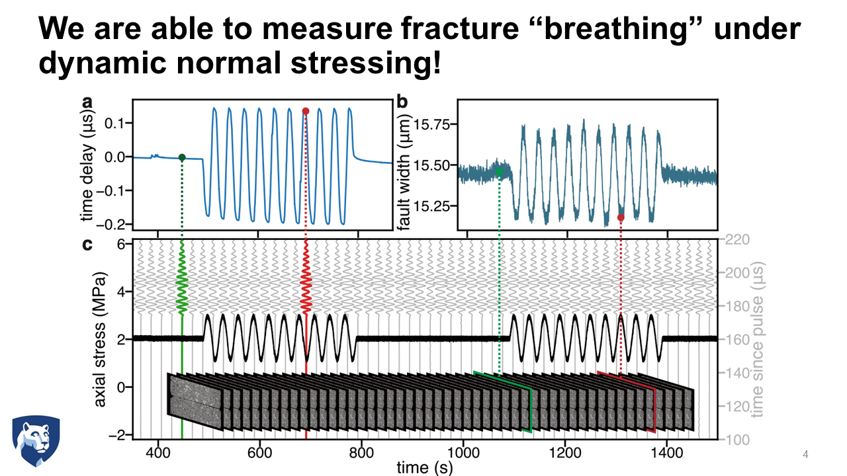
X-ray Radiography and Ultrasonic Velocity Studies of Rock Fractures in a Triaxial Cell Parisa Shokouhi and Jacques Riviere (Penn State U.)

Slide 18
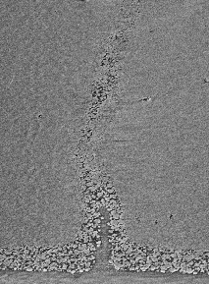
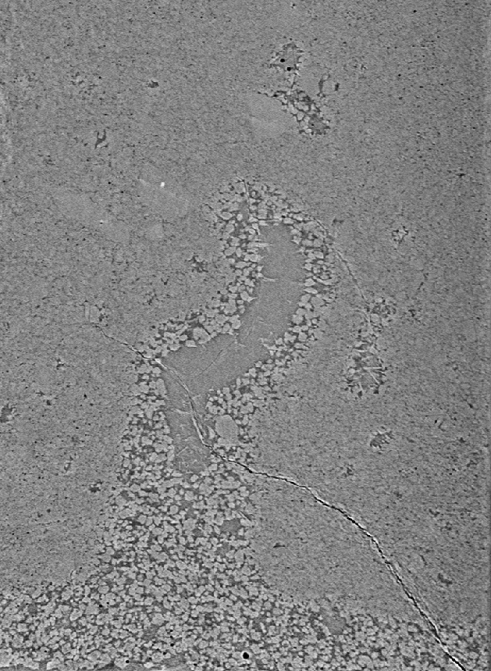
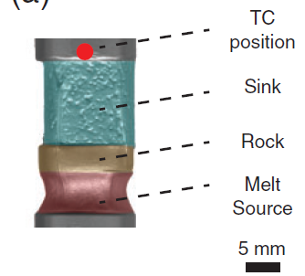
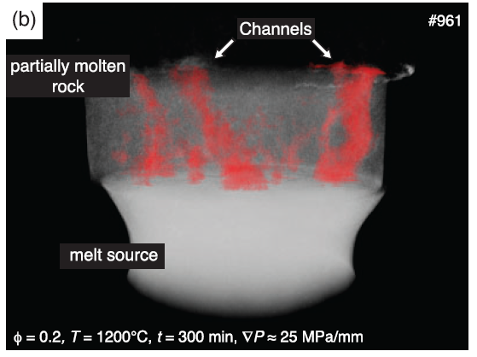
Tomography for Reaction-Driven Melt Channeling Megan Ryan and Wenlu Zhu (Univ. of Maryland)
Experimental
Melt source – partially molten rock – sink triplets after experiment (Pec et al., 2017)
Melt channel
Melt channel
3-D X-ray microtomography of melt channels is used to identify fine details of melt microstructures. Once segmented, digital permeability experiments can be used to quantify the permeability of reactive melt channels.
Reaction layer
Reaction layer
Previous CT scans were unable to resolve fine details of 3-D melt microstructures.
Reaction-driven melt channel in rock with initially 4 vol % melt
Reaction-driven melt channel in rock with initially 20 vol % melt
For more information, see Ryan et al., Poster #29

Slide 19
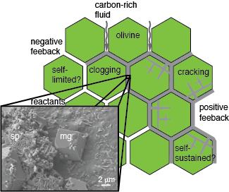
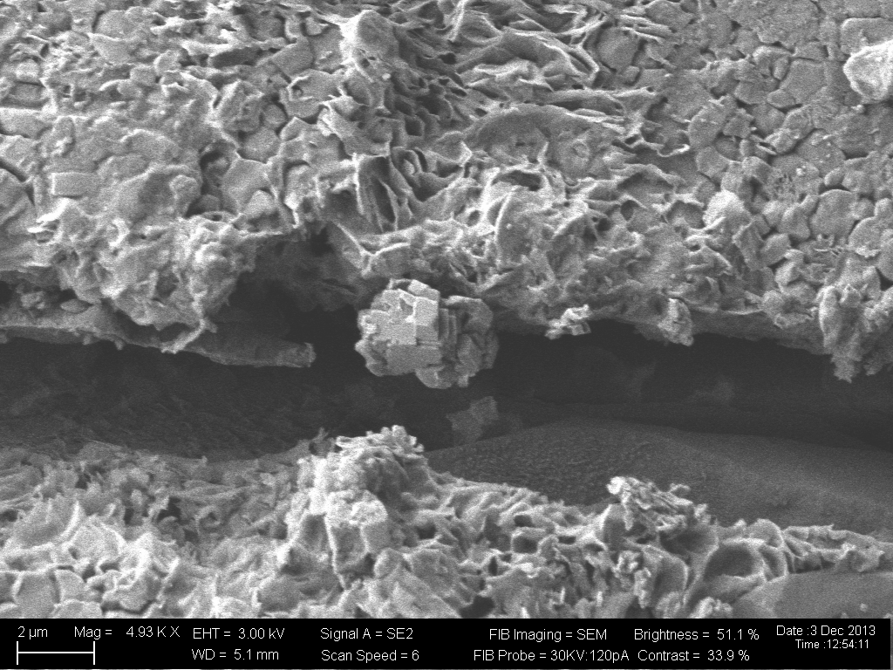
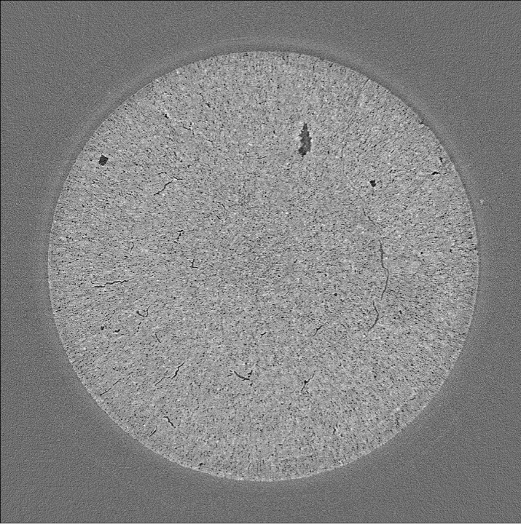
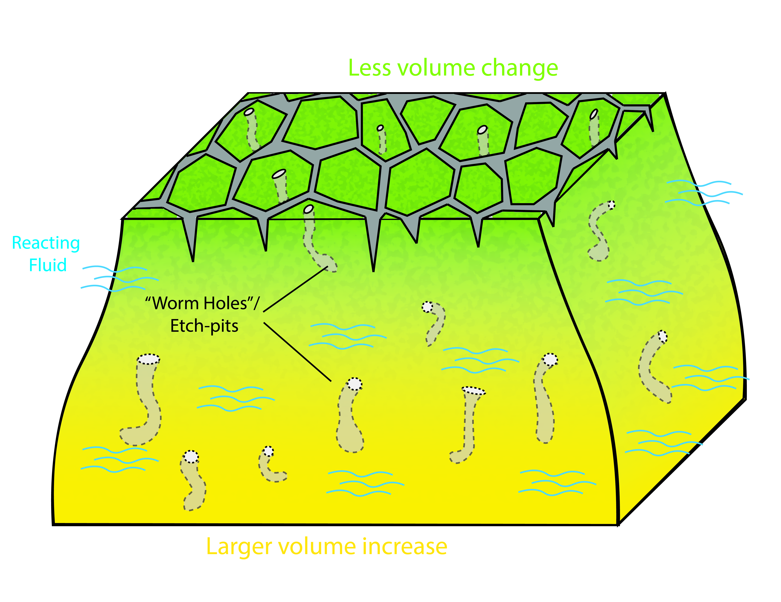
Capturing Reaction-Induced Fracturing due to Carbonation Reaction in Rocks Tommaso Mandolini, Travis Hager, and Wenlu Zhu (Univ. of Maryland)
MgO + H₂O
Mg(OH)₂
Brucite
Carbonation: clogging vs cracking in ultramafic rocks
MgO + 2NaHCO₃
MgCO₃ + Na₂CO3 + H₂O
Magnesite
Magnesite
Zhu et al., 2016
2 µm
Example of Magnesite precipitation along crack walls (modified after Lisabeth et al., 2017)
∼2.5 mm
Xing et al., 2018
Carbonation facilitating cracking: interplay between the “mudcracks” on the surface and the dissolution etch-pits inside an ultramafic rock.
In-situ, synchrotron-based X-ray tomography showing evolution of reaction-induced fracturing due to carbonation in periclase (MgO)

Slide 20





High-P tomography: 3D imaging at P-T
803 µm
250 T press frame
Die set
33% SiO₂
(v-forsterite)
Radiographs
(180º @ 0.5º)
Reconstruction
Harmonic
Drive
Transport
Rails
Measure density of amorphous materials by directly measuring volume
Hydraulic
ram
APS 13-BM-D
Wang et al., RSI, 2005

Slide 21




Simulate Volcanic Degassing under High Pressure Tomography and Acoustic Emission in a Paris-Edinburgh cell
T. Hammouda, T. Officer, T. Yu, M. Yakovlev, Y. Wang (Blaise Pascal Univ. and U Chicago) in prep.
In-situ tomo shows bubble formation during decompression at high T
Cell assembly
PE anvil
AE transducer
Approx. locations of AE events
Decompression-induced degassing and melting produce acoustic emissions (micro-eruptions), which are located within and around the sample.
Phase diagram of carbonated, fertile peridotite
Falloon & Green, EPSL, 1989

Slide 22

Correction of Motion Artifacts in High-Pressure Tomography
Max Yakovlev, University of Chicago
High-pressure tomography frequently has motion artifacts:
Sample vertical motion during scan due to compaction of the media or sample
Sample horizontal wobble during scan due to imperfection in high-load thrust bearings
Max has developed software to correct these artifacts, resulting in dramatically improved reconstructions
For more information, see Yakovlev et al., Poster #38

Slide 23


Tomography at ALS Beamline 8.3.2
Superconducting bending magnet source
SEES is providing post-doctoral scientist through UC Santa Cruz (offer accepted, awaiting visa)
Collaboration with ALS and LBNL BES Geosciences Division
Also have nano-CT capabilities on beamline 11.3.1, not in general-user program
ALS will shut down for ALS-U, perhaps starting in summer 2026 with expected 2-year dark time
In-Situ Environments
Low temperature triaxial cell:
Up to 80 C, 24 MPa confining pressure, 40 MPa axial stress, 2-phase fluid injection
High temperature triaxial cell:
Up to 400 C, 24 MPa confining pressure, 40 MPa axial stress
Cryo/lunar cell:
Down to -180C, high vacuum, in-situ ultrasonic measurement
Hot stage:
Up to 2000 C with parabolic lamps, compression and tension
Low-T triaxial cell
Cryo/lunar cell

Slide 24




Future Plans – APS 6-BM-B Station
Plan to add tomography capabilities at SEES APS 6-BM-B station
Instrumentation for both lower-pressure (brittle) and higher-pressure (ductile) regimes
Up to 100 kg load capacity for larger in-situ cells like Paris-Edinburgh.
Major components:
New press base for SAM-85 press and tomography experiments combined with energy-dispersive diffraction (Received, installation soon)
Upstream table optimized for tomography and brittle deformation. Hexapod base, optimized imaging system. (Design phase)
Air bearing rotation stage with ~100 kg load capacity (Received)
Pumping system with 4 syringe pumps for confining pressure, axial load, and continuous fluid flow. (Components received)
X-ray vertical deflecting mirror to provide focused beam for diffraction and defocused beam for tomography. (Design phase)

Slide 25


Possible Future Plans – NSLS-II HEX Station
Characteristics
Superconducting wiggler, 29 poles, 4.3 Tesla
Double bent Laue monochromator with large bandwidth
100 mm x 20 mm beam in station 100 m from source
Mono or white beam modes
Group from UChicago, U Maryland, and Stony Brook ran at HEX in 2023 and 2024 to test it for triaxial cell experiments
Tomography with monochromatic beam at 40 and 60 keV
White beam tomography, adjusting wiggler field for optimum contrast
Energy-dispersive diffraction with the strip detector
Conclusions
HEX is a unique beamline in the U.S. with high energy, large beam, high flux.
The SEES NSLS-II Partner User Proposal now includes HEX, but with no guaranteed time.
It is a station we should consider carefully for future SEES plans.
Wenlu Zhu mounting Mjolnir cell
Granite after failure in triaxial cell

Slide 26
Getting Beam Time
10
10
12
All SEES beamtime is awarded through the facility-specific general user proposal systems, with a preference for earth and environmental science research.
Potential tomography users should contact the beamline scientists to discuss feasibility and beamtime requirements.
We will work with you to accommodate and help design sample cells.
Thanks for your attention!!!
8
7
1
←X-rays
2
3
11
11
4
5
6

