Slide 1

Environmental Science Applications at SEES Beamlines Joanne Stubbs GSECARS, The University of Chicago Contributions from: R. Colina-Ruiz, P.J. Eng, A. Lanzirotti, M. Newville (UChicago); R. Tappero (NSLS-II); B. Toner, K. Kang, E. R. Meraz (U. Minnesota); S. Webb (SSRL)

Slide 2
Techniques used by environmental scientists at SEES facilities
X-ray absorption spectroscopy (XAS)
X-ray fluorescence (XRF)
X-ray powder diffraction (XRD)
Scanning transmission X-ray microscopy (STXM)
Ptychography
Crystal truncation rod (CTR) diffraction
X-ray reflectivity (XRR)
Resonant anomalous X-ray reflectivity (RAXR)
Long-period X-ray standing waves (LP-XSW)
3D Reciprocal space maps (RSM)
Coherent surface scattering (coming soon!)
available with microbeam mapping or at grazing incidence for surface-specificity

Slide 3
Lightsource | Beamline(s) | SEES Program | Techniques
ALS | 5.3.2.1 (BM) 5.3.2.2 (BM) 11.0.2.2 (ID) | SYSTER U. Minnesota | STXM, XAS
ALS | 7.0.1.2 (ID) “COSMIC” | SYSTER U. Minnesota | STXM, XAS, XRF, Ptychography, Fluorescence Nanoprobe
APS | 13-BM-C | GSECARS U. Chicago | CTR, XRR, Time-resolved powder XRD
APS | 13-ID-C | GSECARS U. Chicago | CTR, XRR, RAXR, LP-XSW, RSM, Grazing-incidence XRF/XAFS/XRD, Coherent scattering (soon)
APS | 13-ID-E | GSECARS U. Chicago | Microprobe XRF, XAS, XRD
NSLS-II | 4-BM “XFM” | GSECARS U. Chicago | Microprobe XRF, XAS, XRD
SSRL | 11-2, 4-1, 4-3, 14-3a, 7-3 | SSRL Stanford | Microprobe, mini-beam, and bulk XRF, XAS, XRD
Beamlines offer complementary energy ranges, spatial resolutions, and other capabilities
Where overlaps exist, they enable access and support for more EES users in techniques for which demand significantly exceeds available beam time

Slide 4
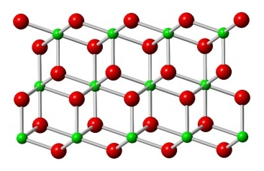
Crystal Truncation Rod (CTR) Diffraction
L
Bragg peak
Bragg peak
Bragg peak
CTR
Bragg peak
H
K
|F_{HKL}|
surface unit cell
Bulk termination
Move top atoms down
Top atoms occ = 70%
bulk unit cell
Atomic-scale structures of surfaces and interfaces
Highly sensitive to surface termination
High-energy x-rays enable work under liquids and gases
L (reciprocal lattice units)

Slide 5
CTR Science Highlight: Pyrite oxidation under suboxic conditions
Pyrite (001) interface chemistry is controlled by a sulfoxy termination.
Wanhala et al. (submitted), J. Amer. Chem. Soc.
Pyrite (FeS2) - most common sulfide mineral on Earth
Oxidation produces sulfuric acid, generates radicals, and leads to release of toxic metal(loid)s
Affects geochemistry of natural waters and influences atmosphere through interactions with global C and O₂ cycles
Study combines CTR, DFT, XPS, AFM to investigate pyrite (001) termination under suboxic conditions in nominally deoxygenated DI water
Surface S bind O⁻, Surface Fe bind H₂O
Contrary to previous assumptions, sulfur plays significant role in early stages of pyrite oxidation while surface Fe remains divalent
Fe
S
O-
O (water)
CTR Data
Unrelaxed surface
Best fit
APS 13-ID-C

Slide 6
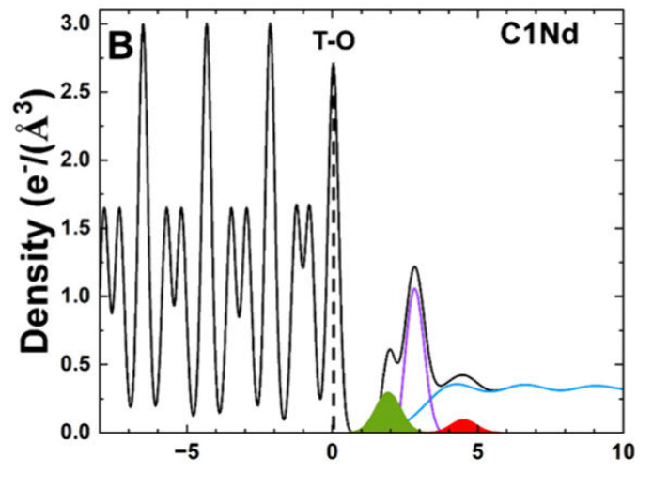
Resonant Anomalous X-ray Reflectivity (RAXR)
RAXR
CTR
Interfacial electron density
Total (CTR)
Element-specific (RAXR)
Height (Å)
Scan energy across absorption edge for element of interest at several points along a CTR
Combines spectroscopy with scattering
Data from Fang et al., 2025, Environ. Sci. Technol.
APS 13-ID-C

Slide 7
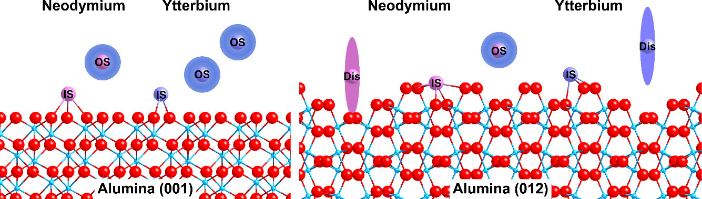
RAXR Science Highlight: REE binding on mineral surfaces
Complex Adsorption Behavior of Neodymium and Ytterbium on Structurally-Distinct Alumina Surfaces
Fang et al., 2025, Environ. Sci. Technol.
Rare Earth Elements adsorbed to aluminum-rich clays are important resources but mechanisms for retention and release are unresolved
Alumina (001) and (012) surfaces provide single crystal analogs for basal planes and edge sites on common clay minerals
Nd and Yb represent light and heavy REEs, respectively
REEs showed similar total adsorption on (001) as inner- and outer-sphere complexes, with Nd showing more inner-sphere than Yb
REE binding on (012) lower than on (001) and shows more disorder.
Leaching procedures need to account for co-existence of inner- and outer-sphere complexes
APS 13-ID-C

Slide 8
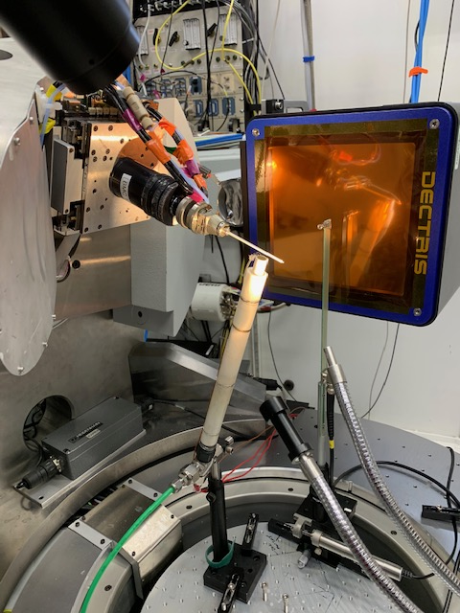
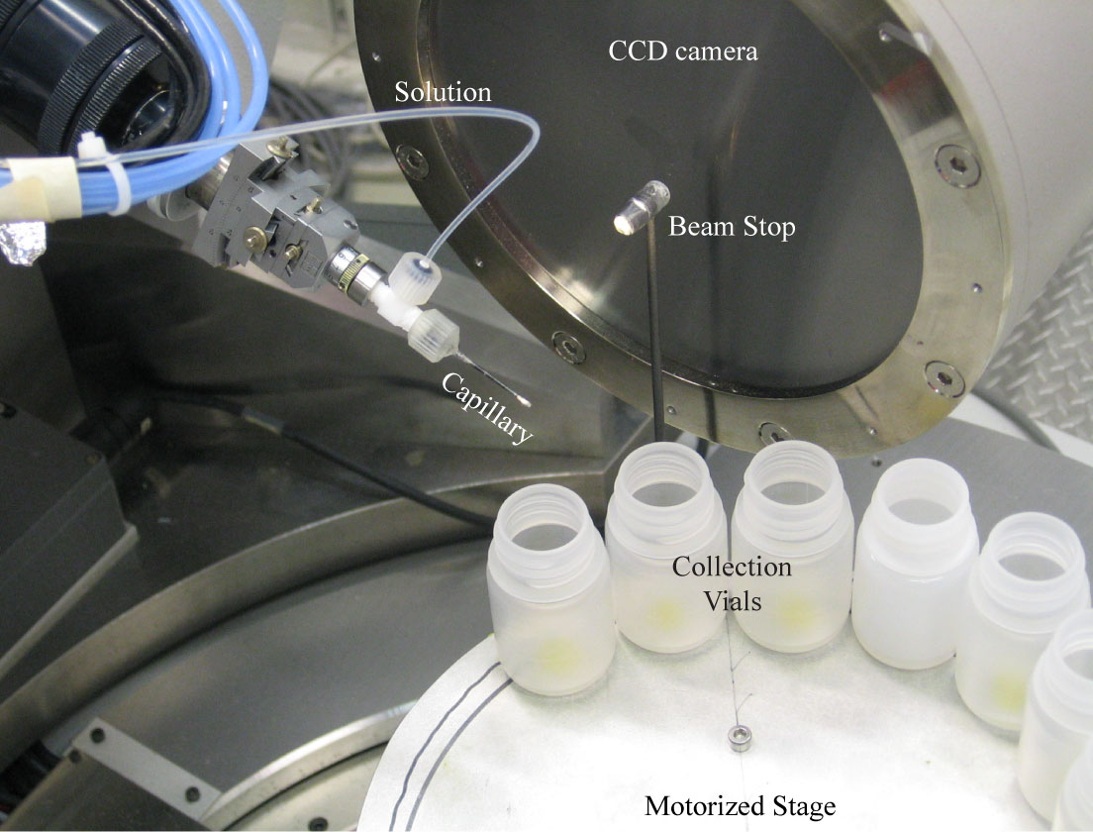
Time-resolved powder X-ray diffraction (TRXRD)
Temperature control
Nested ceramic tubes with tungsten wire filament for resistive heating
Flow helium or cold nitrogen through tubes, control capillary temperature
Temperatures from near 0 °C to 1000 °C
Heating rates up to 200°/sec
Aqueous solution flow
Powdered sample loaded into capillary packed with glass wool or cotton
Solution flows through capillary
Reacted solution caught in collection vials for subsequent chemical analysis
Motorized vial stage advanced automatically, coordinated with collection of diffraction patterns
Dectris Pilatus3 S 1M detector enables XRD data collection up to 25 Hz
Transformation of ferrihydrite to goethite and “hydrohematite” at 90 °C, pH 11. Chen et al., 2023 Amer. Mineral. 108:1720
APS 13-BM-C

Slide 9
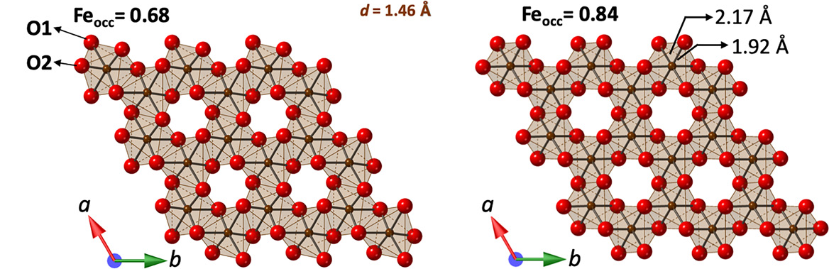
TRXRD Science Highlight: Iron oxide mineral reactions and transformations
Hematite (α-Fe₂O₃) plays central roles in many systems:
biogeochemical cycling
redox processes
contaminant sequestration
Martian regolith
industrial material (catalysts, pigments, semiconductors)
Often forms through thermal or hydrothermal transformations of iron oxyhydroxides (ferrihydrite, goethite, akageneite)
Retention of residual H₂O, OH⁻ by “hydrohematite” is common and has important geochemical and structural implications
Hydrohematite structure evolution with increasing vacancy inoculation. Chen et al., 2022 Geology 49:1343
Heaney group at Penn State has used TRXRD at APS 13-BM-C to explore this system > 10 years, generating substantial new understanding:
Phases formed are sensitive to temperature and starting pH of solutions.
Initial products are highly defective, Fe octahedra are distorted, and hydrohematite crystallizes by nonclassical pathways via infilling of vacancies. Final Fe occupancies 0.8-0.9; water contents 3.6-7.8 mol%.
Hydrohematite is likely common on Earth and may hold large quantities of water on Mars.
Compositional relationships in Fe-O-OH system
Chen et al., 2023 Amer. Mineral. 108:1720
Upcoming GSA Session - Minerals in Motion: Tracking Mineral Reactions Using In Situ and Synchrotron Techniques,
A Celebration of the Career of Peter Heaney. Organized by several current and former GSECARS/SEES users.
APS 13-BM-C

Slide 10
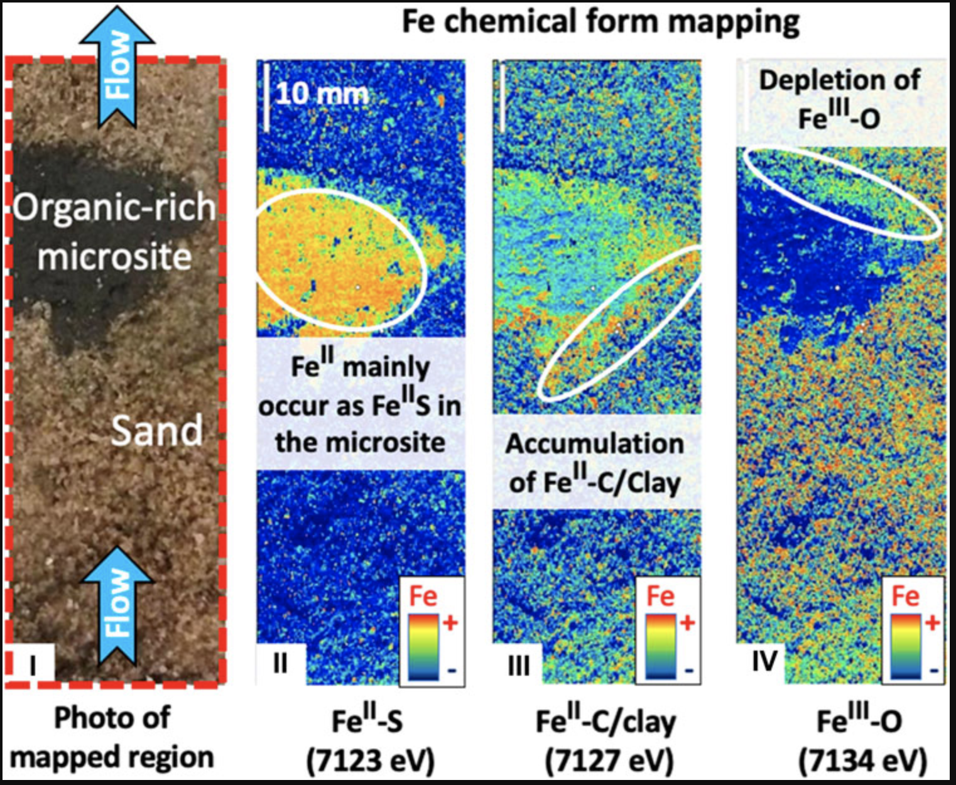
Microprobe Highlight: Anaerobic microsite characterization in aerobic aquifers
X-ray chemical imaging for assessing redox microsites within soils and sediments
Noel et al., 2024, Frontiers in Environmental Chemistry
Redox reactions underlie several biogeochemical processes and are typically spatiotemporally heterogeneous in soils and sediments. However, redox heterogeneity has yet to be incorporated into mainstream conceptualizations and modeling of soil biogeochemistry.
Examine Fe oxidation state transformations to model organic carbon rich microsites (reducing zones) in aerobic synthetic aquifer sand columns.
Shows reduction of Fe in microsite and scavenging by sulfide
Accumulation of Fe(II) clays in transition zones and depletion of Fe(III) at trailing edge of aquifer flow
Shows suitability of XRF imaging to investigate local dynamic systems where microsite anaerobic zone can dominate chemical transformations
SSRL BL7-2

Slide 11
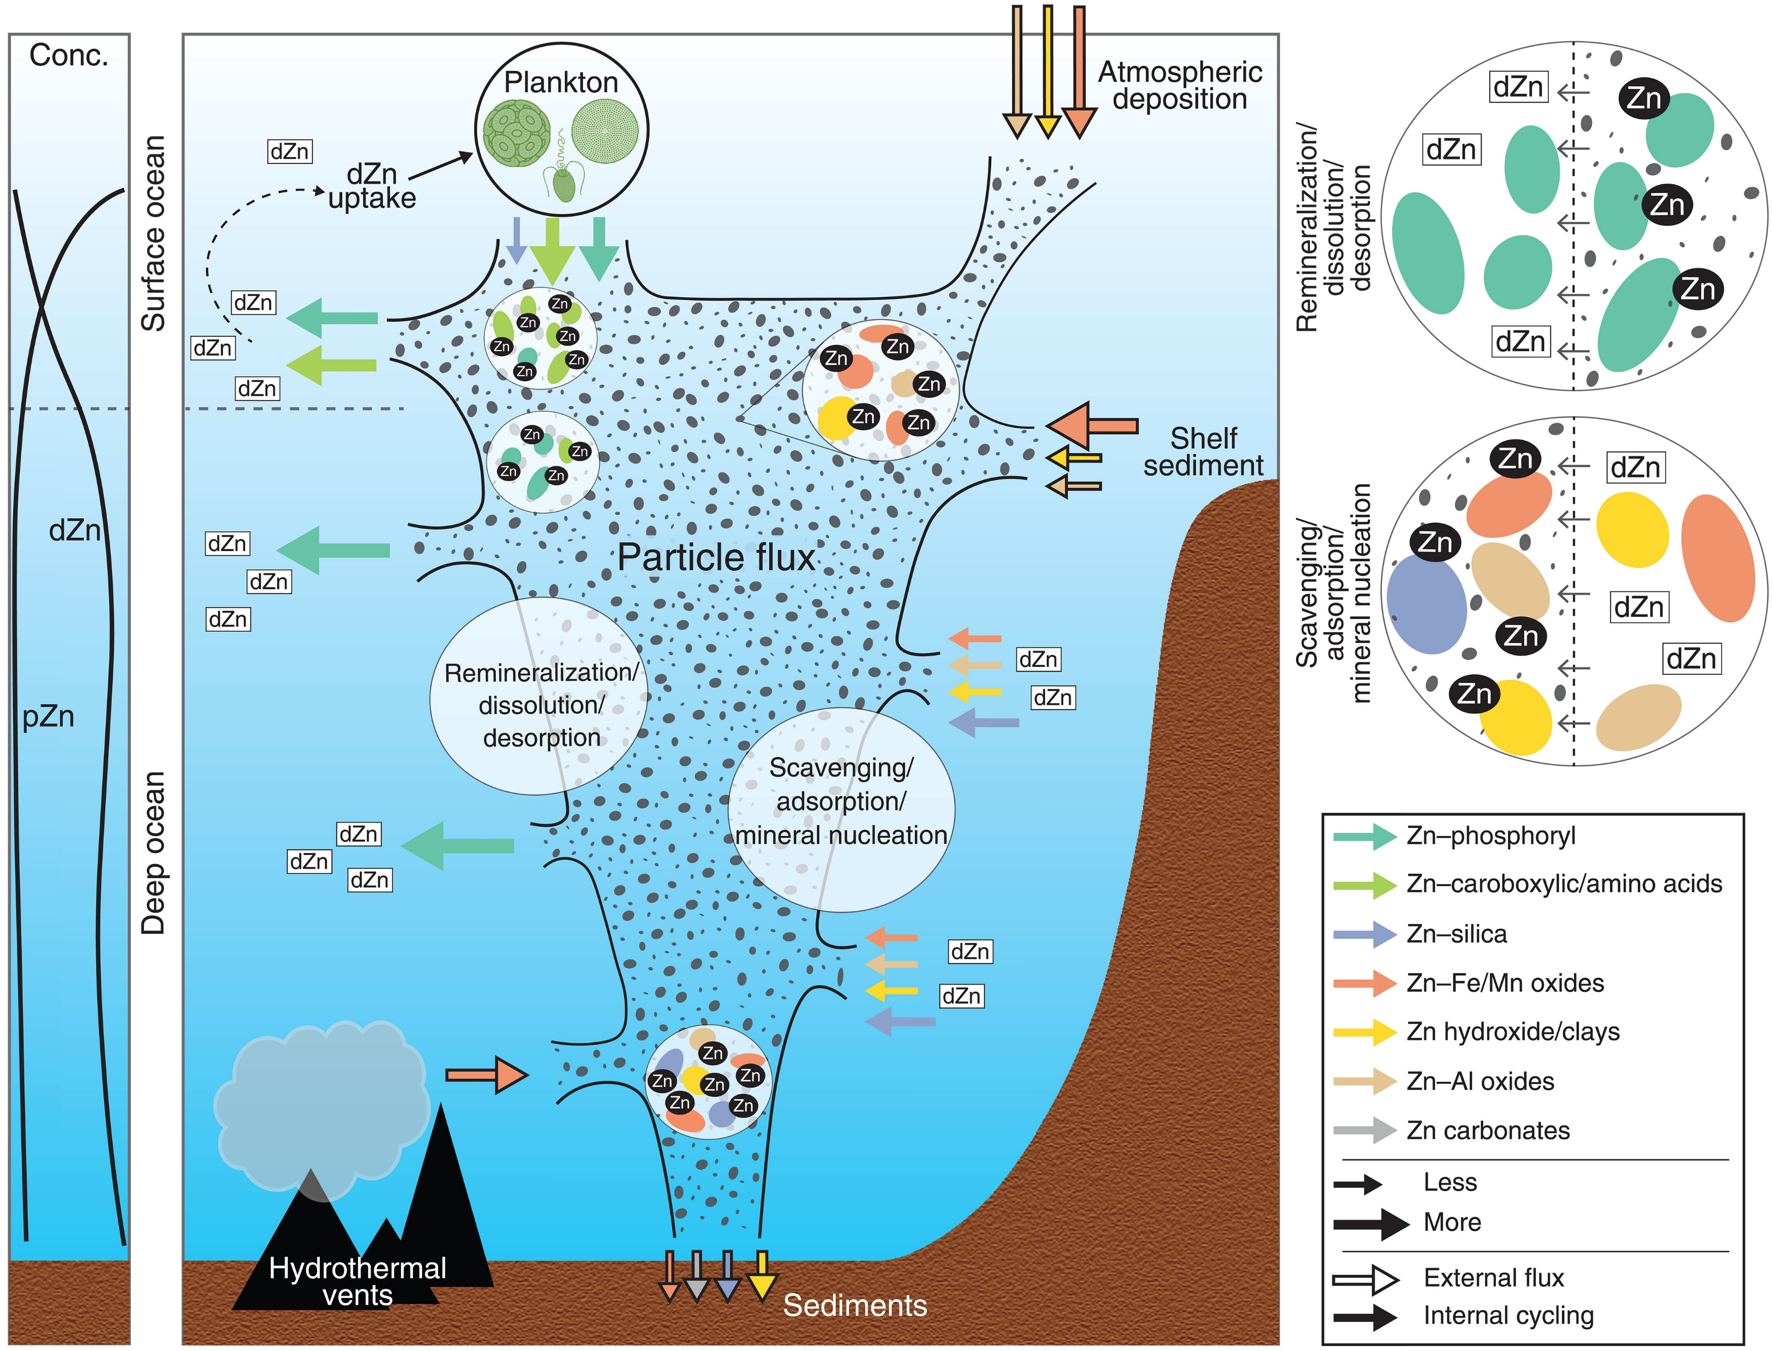
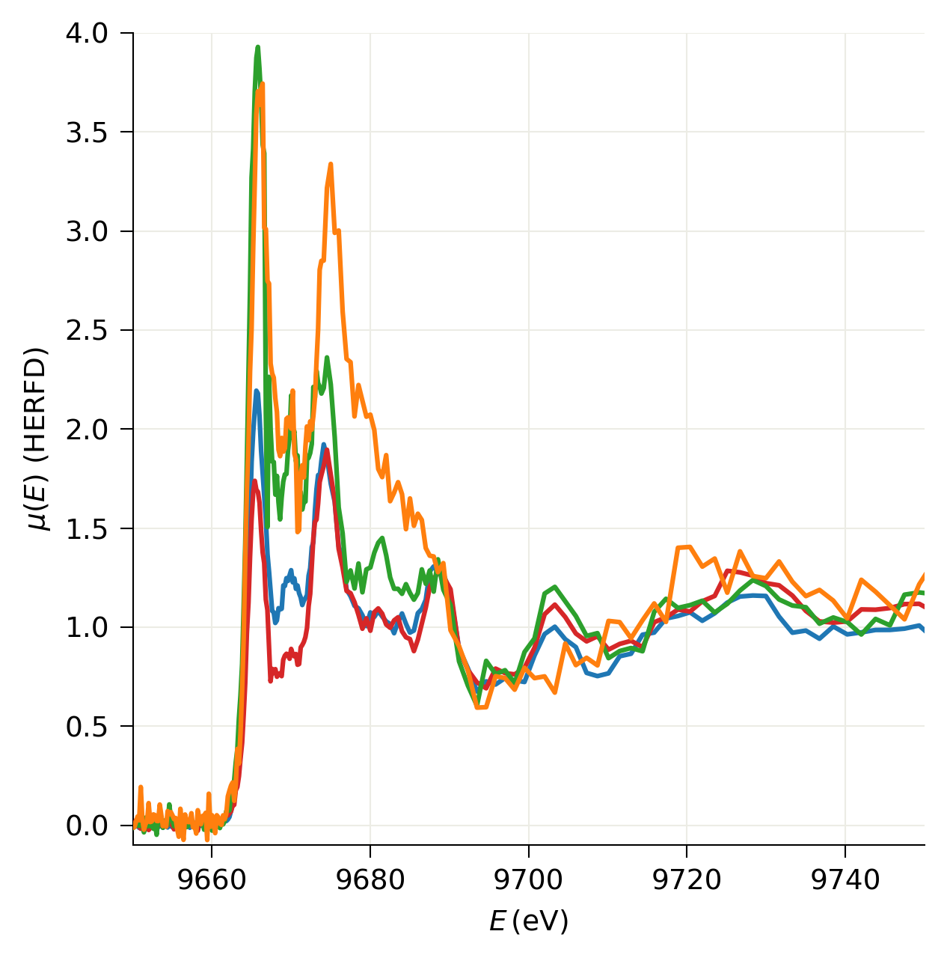
Microprobe Highlight: Cycling of Zinc in the Southern Ocean
Biogenic-to-lithogenic handoff of particulate Zn affects the Zn cycle in the Southern Ocean
Duan et al., 2024, Science
Zinc is vital to marine organisms. Phytoplankton use a substantial amount of dissolved Zn in the oceans, and Zn bound to particulate organic matter in them replenishes dissolved Zn in the ocean through remineralization
Using XRF Mapping and Zn K-edge High-energy resolution Fluorescence-detected XANES, Duan et al found that Zn speciation changed from phosphoryl-bound Zn in cells to recalcitrant inorganic pools that include biogenic silica, clays, and iron, manganese, and aluminum oxides in the Southern Ocean water column.
Inorganically-bound Zn increases with depth and is the only phase found in ocean sediments. This dramatic change in Zn speciation influences Zn bioavailability and explains the decoupling of Zn and phosphorus and the correlation of Zn and silicon in the water column.
At 13-ID-E, the APS upgrade improves spatial resolution and speed for XRF maps and improves count rates and efficiency for HERFD XANES.
NSLS-II XFM & APS 13-ID-E

Slide 12
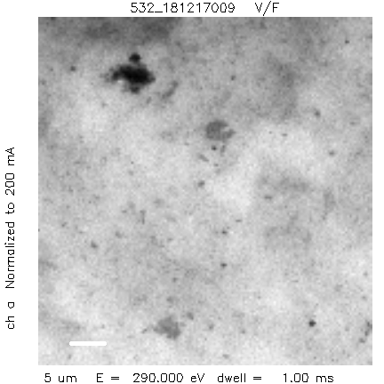
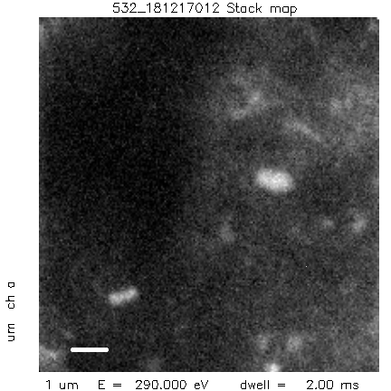
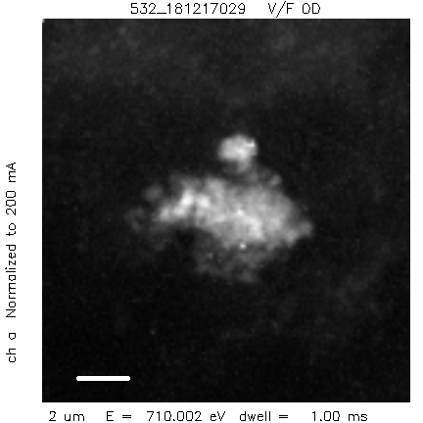
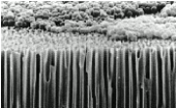
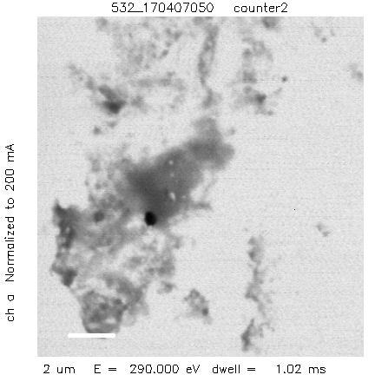
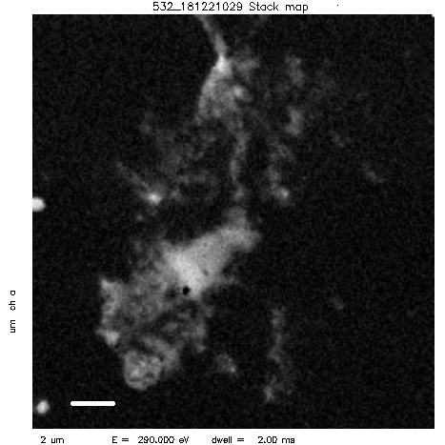
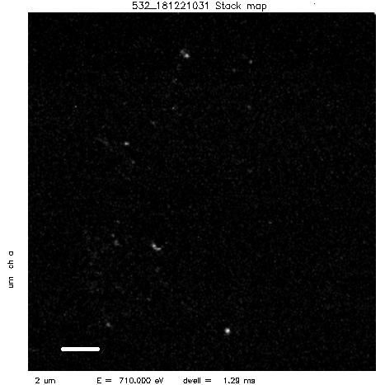
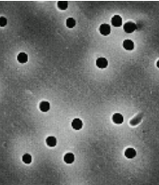
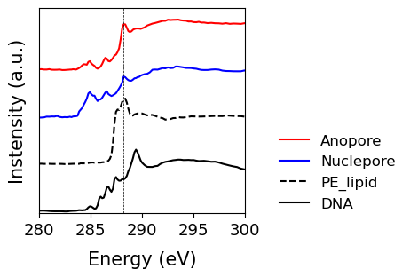
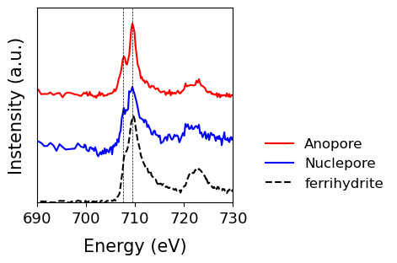
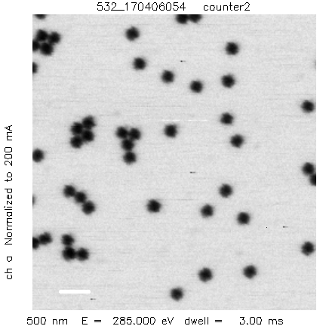
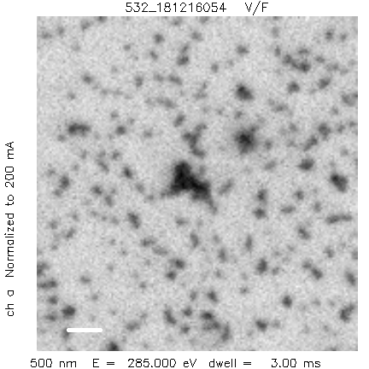
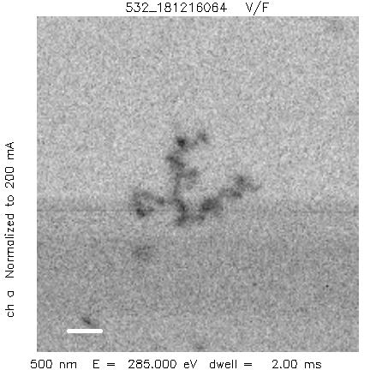
SYnergy of Soft and Tender X-rays for Earth Research (SYSTER) Highlight: Chemical Imaging of Marine Iron Colloids Using Scanning Transmission X-ray Microscopy (STXM)
Dr. Kyounglim Kang (see poster session)
Problem: Marine colloids—solids 200-2 nm—are reactive & have high transport potential. But the chemical speciation of iron & carbon are unknown. Low iron concentrations, small size, and seasalts complicate analysis.
Filter
Image
Carbon Map
Iron Map
Anopore filtration
5 µm
1 µm
2 µm
Solution: Develop methods for sample collection, preparation & spectro-microscopy using soft X-ray STXM beamline, Advanced Light Source
Nucleopore filtration
2 µm
2 µm
2 µm
Calibration with Carbon Beads:
200 nm
80 nm
28 nm
Carbon 1s spectra
Iron 2p
spectra
0.5 µm
0.5 µm
0.5 µm

Slide 13
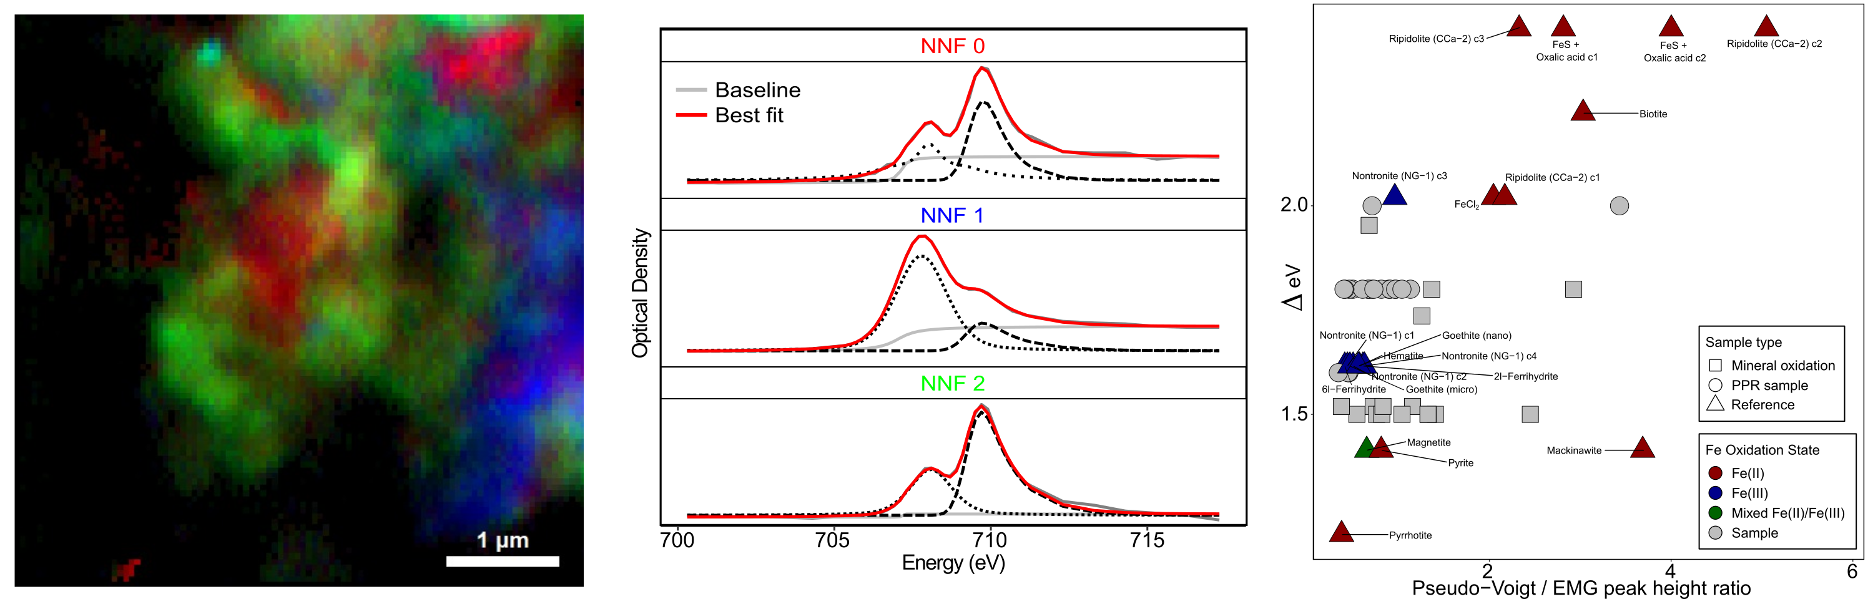
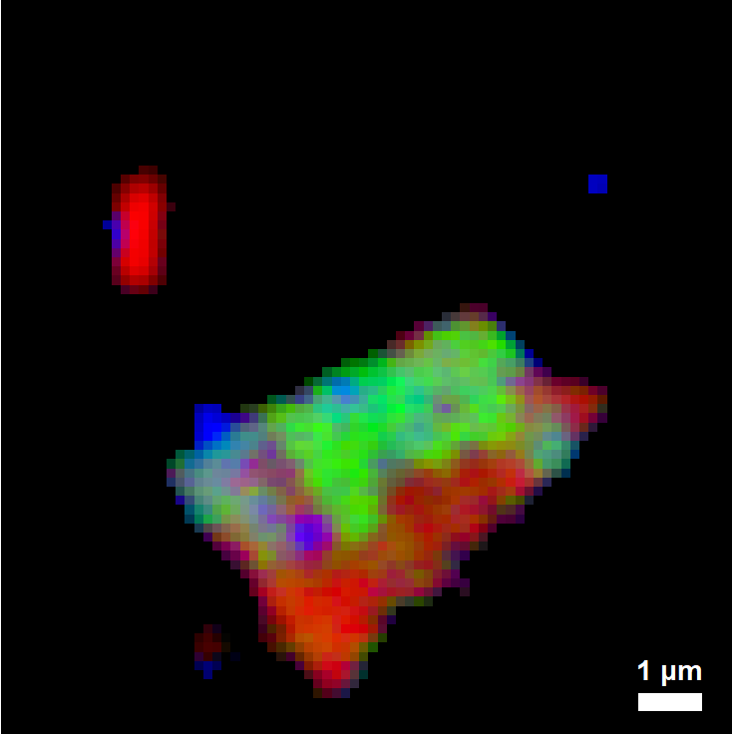
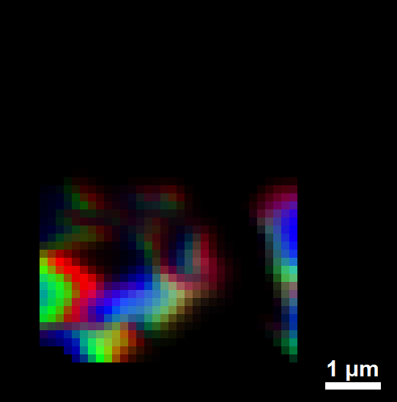
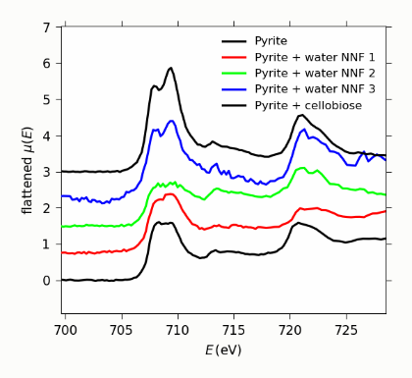
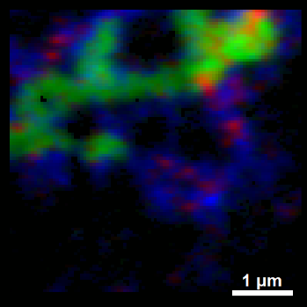
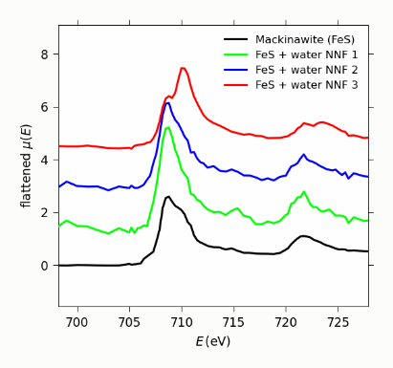
SYSTER Highlight: Carbon, Iron & Sulfur Speciation in Prairie Pothole Sediment with Synchrotron Spectromicroscopy
Dr. Edwin Rivas Meraz (see poster session)
Context: Prairie pothole wetlands have high concentrations of organic C, Fe & S. Biotic & abiotic processes link the bio-geochemical cycles of these elements. At the sediment-water interface, dissolved oxygen reacts with chemically reduced S & Fe to produce reactive oxygen species (ROS).
Iron in Sediments (NNF clusters, 2p spectra & fitting)
Question: How do ROS species affect speciation of C, Fe & S? soft X-ray STXM beamline, Advanced Light Source
Carbon in Sediments
(NNF clusters & 1s spectra)
Iron Sulfide Experiments
(NNF clusters & 2p spectra)
Approach:
Measure element speciation in natural sediments
Conduct ex situ & in situ experiments
Soft & tender X-ray spectro-microscopy (C 1s, Fe 2p, S 1s)
Advanced Light Source BLs 5.3.2.2, 11.0.2.2 & 7.0.1.2
NNF 1
NNF 2
NNF 3

Slide 14
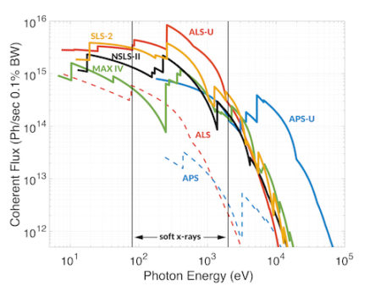
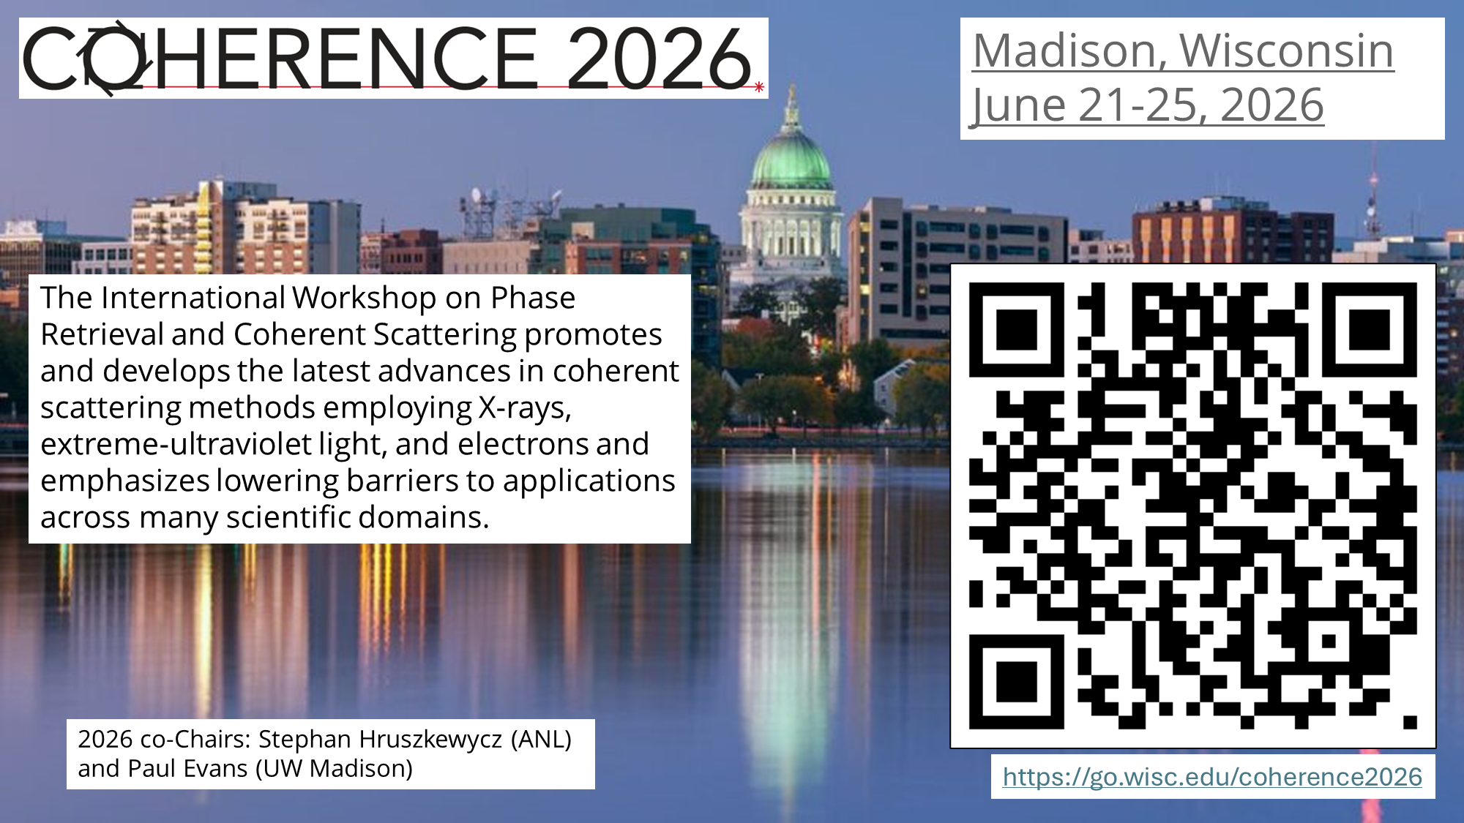
Looking ahead: Benefits of APS and ALS upgrades to SEES environmental science users
APS Sector 13
2-5x more flux
Smaller focus driven by APS-U and upgraded optics
APS 13-ID-E, eventual spot size ~ 0.3 um
(currently ~0.7 um, was ~2 um before APS-U)
APS 13-ID-C, eventual spot size < 1um
(currently ~ 20 um, was 30 um before APS-U)
APS and ALS
100x increase in coherence (extent to which X-rays are in phase)
Enable new coherent scattering capabilities at APS 13-ID-C
Enhance ptychography capabilities at ALS “COSMIC”
https://als.lbl.gov/als-u/als-u-approach/
Want to learn more about coherence?

Slide 15
Conclusions
Environmental scientists use SEES-supported facilities to explore mineral-water interfacial reactions, mineral transformations, biogeochemical and abiotic redox processes, contaminant fate and transport, terrestrial and ocean systems, …
SEES supports environmental science at all 4 DOE storage rings:
ALS, APS, NSLS-II, SSRL
SEES provides direct facility support and enhanced access to additional beamlines with a broad suite of capabilities that are essential tools for environmental scientists
Recent, ongoing, and upcoming upgrades to APS and ALS will yield more X-ray flux, smaller focal spots, and access to methods that leverage extraordinary enhancements in X-ray coherence

Slide 16












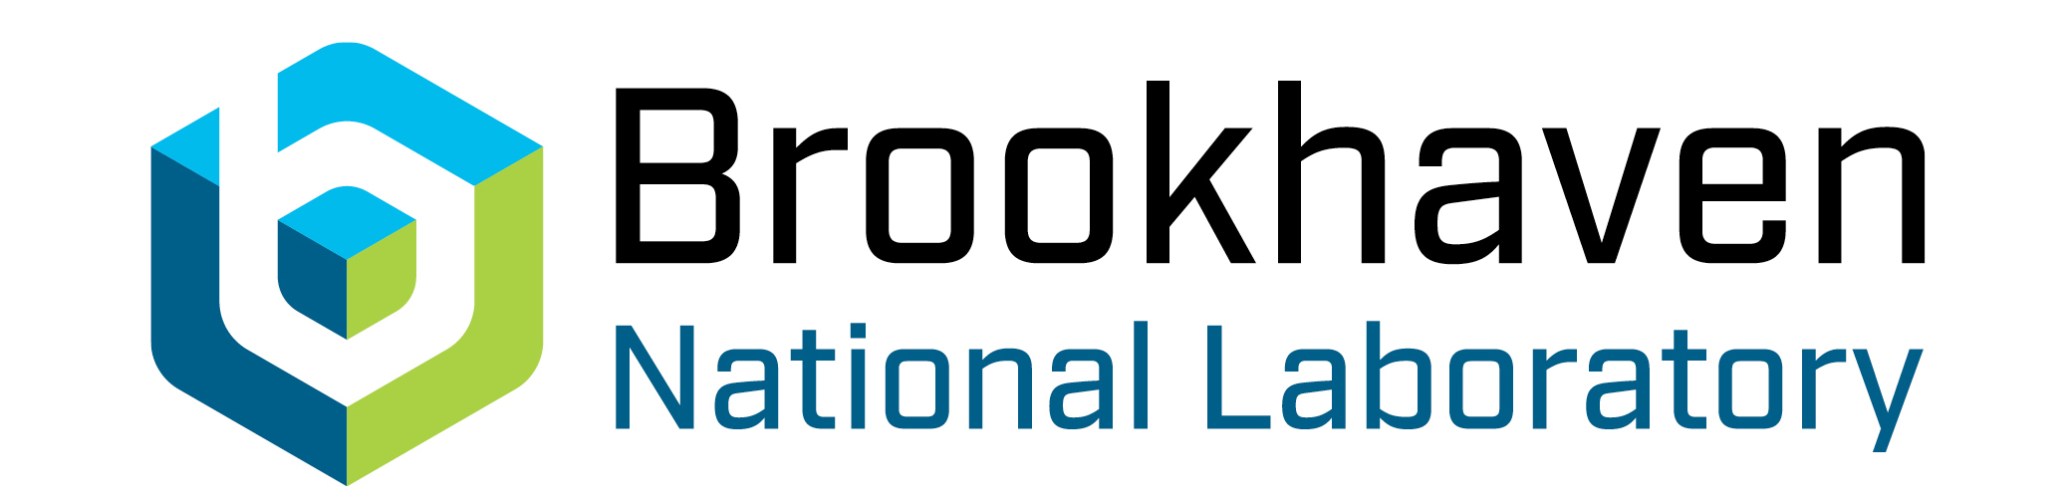
Acknowledgments

