Slide 1







Mineral Physics at SEES Andrew Campbell, University of Chicago SEES-ISRD Meeting, August 2025

Slide 2
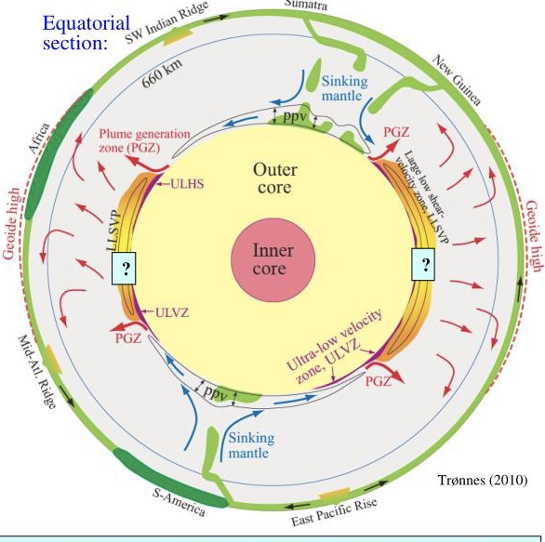
Mineral Physics at SEES
Phase equilibria
Equations of state
Vibrational spectroscopy
Rheology, viscosity
Faulting / brittle failure
Acoustic properties
Electrical and transport properties
DAC beamlines:
APS 3-ID, 13-ID-D, 13-BM-C, 13-BM-D
NSLS-II 22-IR-1
ALS 12.2.2
DAC scientists:
Kat Armstrong, UC Santa Cruz
Bora Kalkan, UC Santa Cruz
Quentin Williams, UC Santa Cruz
Vitali Prakapenka, UChicago
Stella Chariton, UChicago
Barbara Lavina, UChicago
Dongzhou Zhang, UChicago
Young Jay Ryu, UChicago
Rus Hemley, UIC
Zhenxian Liu, UIC
LVP beamlines:
APS 6-BM-B, 13-ID-D, 13-BM-D
NSLS-II 28-ID-2
LVP scientists:
Matt Whitaker, Stony Brook
Haiyan Chen, Stony Brook
Don Weidner, Stony Brook
Yanbin Wang, UChicago
Tony Yu, UChicago
Qi Chen, UChicago
Tim Officer, UChicago

Slide 3
Mineral Physics at SEES
Large volume press experiments:
Pressures reaching Earth’s lower mantle
Variety of anvil / sample configurations
Resistive heating to >2000 K
Energy dispersive X-ray diffraction
Angle dispersive X-ray diffraction
Radiographic imaging
Deformation studies
Ultrasonic measurements
Acoustic emission measurements
Electrical conductivity
Diamond anvil cell high pressure experiments:
Up to Earth’s core pressure and beyond
Cryogenic
Room temperature
Externally heated (to 1400 K)
Laser heated (to >5000 K)
Powder X-ray diffraction
Single crystal X-ray diffraction
Infrared spectroscopy
Brillouin spectroscopy
Optical and transport measurements
Nuclear resonant X-ray scattering
LVP beamlines:
APS 6-BM-B, 13-ID-D, 13-BM-D
NSLS-II 28-ID-2
DAC beamlines:
APS 3-ID, 13-ID-D, 13-BM-C, 13-BM-D
NSLS-II 22-IR-1
ALS 12.2.2

Slide 4
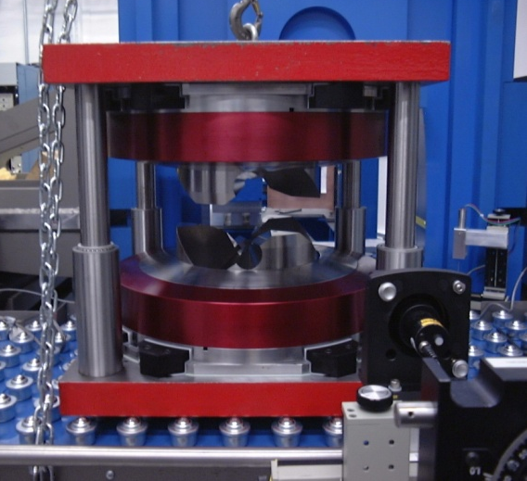
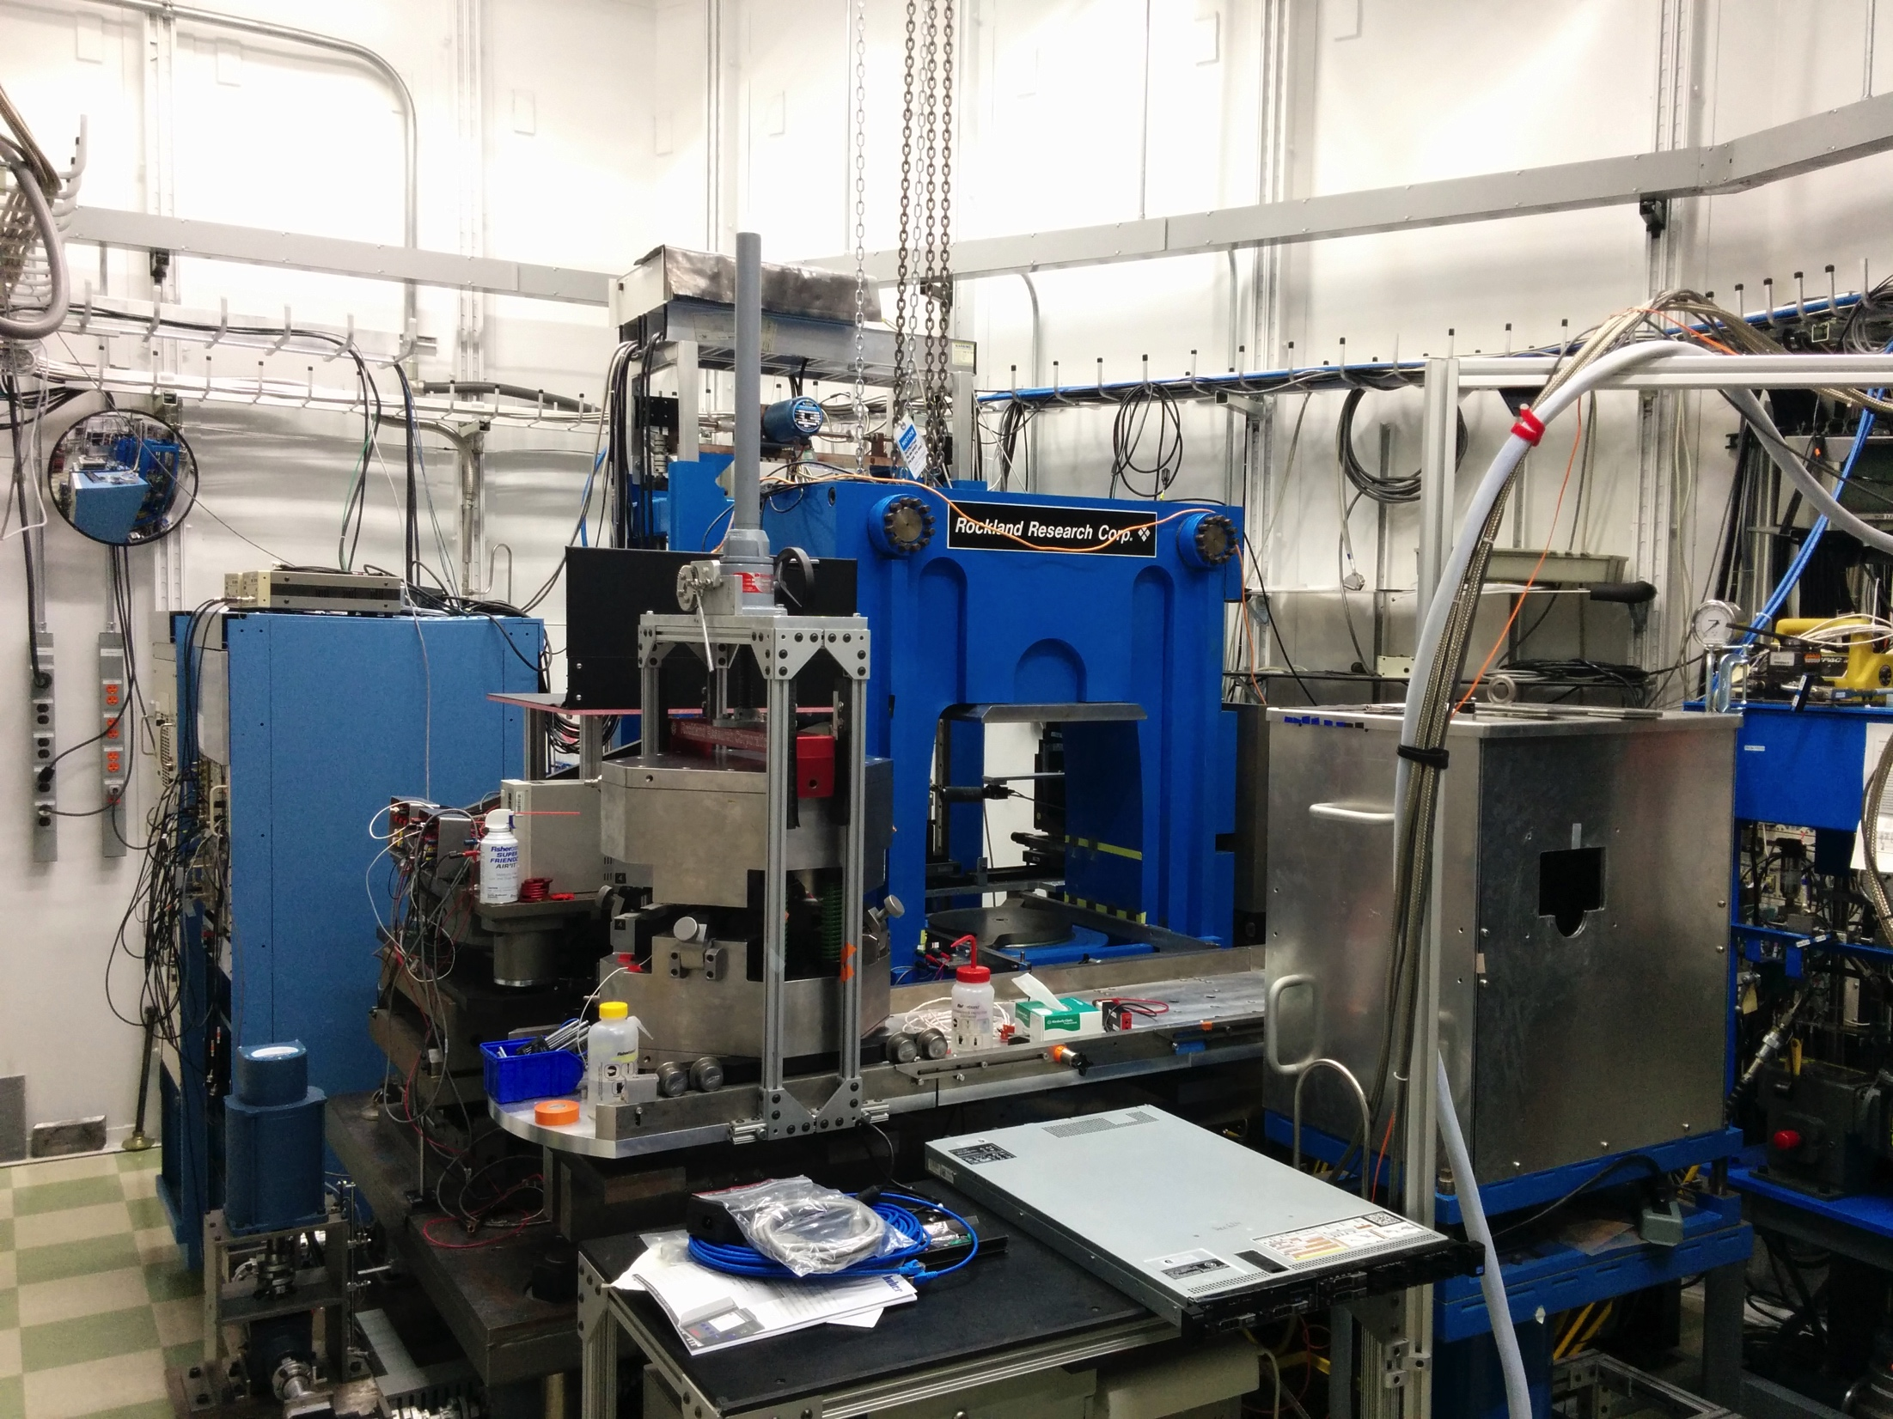
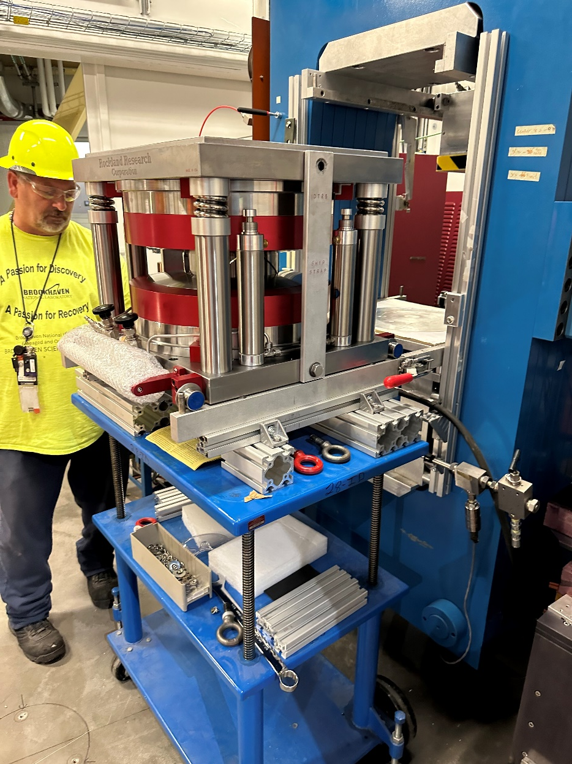
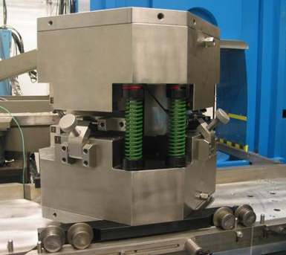
Examples of large volume presses at SEES
MAXPD at NSLS-II
APS 13-ID-D (GSECARS)
T-25
DDIA-30

Slide 5
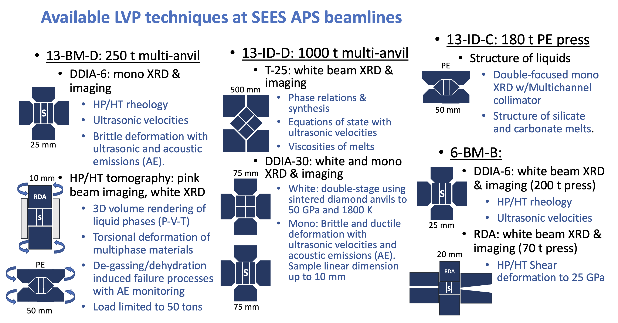

Slide 6
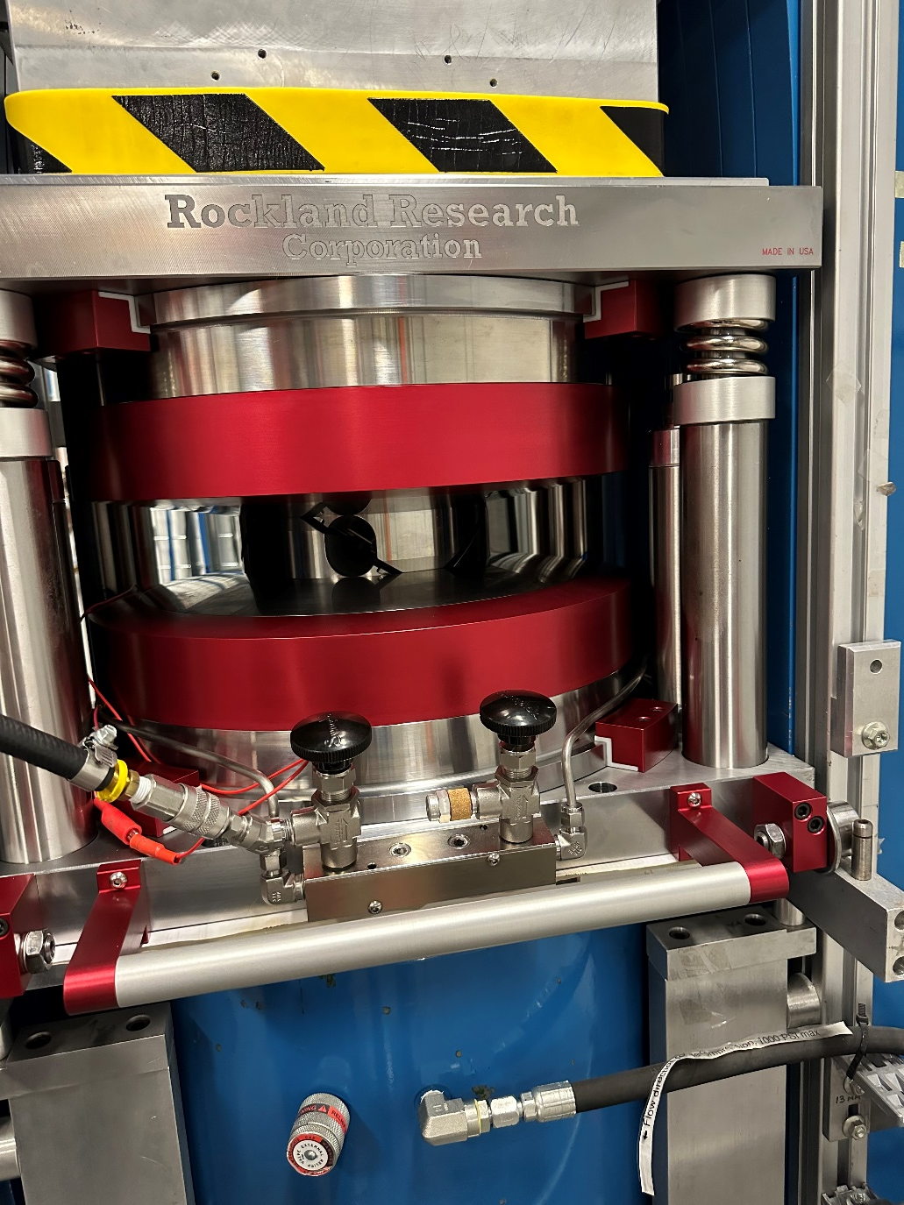
MAXPD recent and upcoming upgrades
Recent:
Realignment of beamline components and optical system for best image resolution
New acoustic-enabled pressure module (ADT-25) fully commissioned; 500 tons (23 GPa), 2100°C, 60% total strain (NSF-COMPRES & NNSA/ LANL partnership)
Complete computer and control systems upgrade (NSLS-II)
Commissioned new high current power supply to enable high T, lower pressure runs (NSLS-II)
Upcoming:
New scintillator materials more appropriate for high energy X-ray beam for faster imaging experiments; going from 1 to 70 fps (SEES/NSLS-II)
New acoustic velocity system as part of standard MAXPD toolkit (BNL NST and NSLS-II partnership)
More robust power cables for heating to reduce warming of the wires
Upgrade cables and switching box for high current and high voltage power supplies

Slide 7
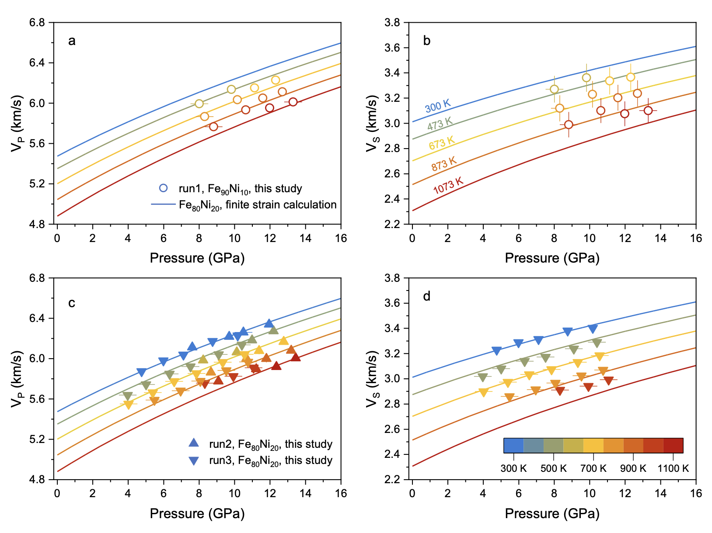
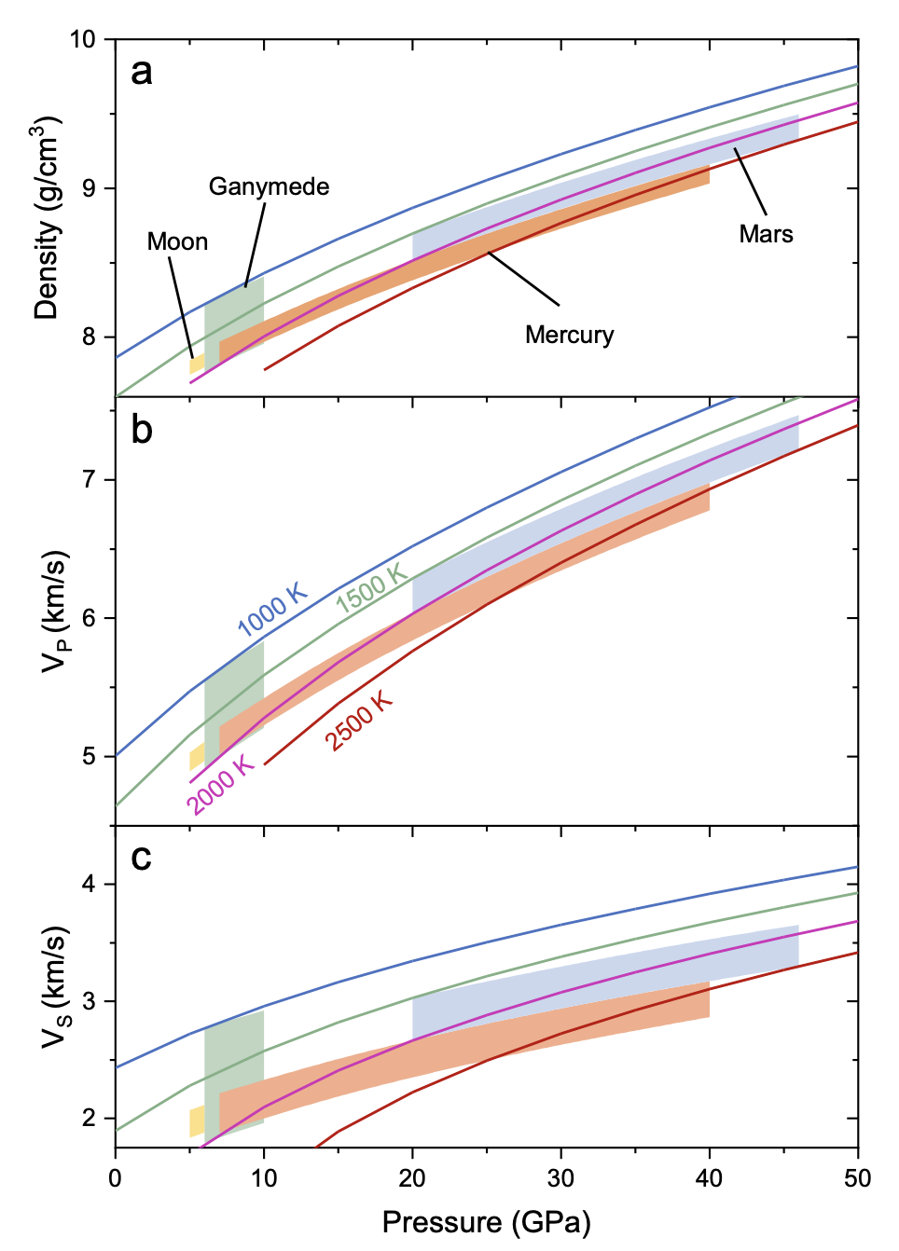
Highlight from GSECARS 13-ID-D Wang et al., EPSL 2024 Sound Velocities of fcc Fe-Ni alloys: composition of cores of Mars, Mercury, and Moon
Vp and Vs of fcc Fe90Ni10 (top) and fcc Fe80Ni20 (bottom) determined from ultrasonic interferometry.
Vp is insensitive to T, while Vs decreases significantly with T.
Vs is an important parameter to constraint compositions of planetary cores.

Slide 8
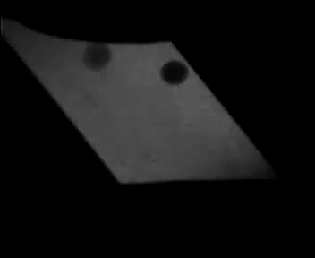
Highlight from GSECARS 13-ID-D Ashley et al., JGR 2025 Viscosity of albite melt shows anomalous mobility of crust-forming magmas
Re
W
Viscosity of albite melt decreases to a minimum at ~6 GPa and 2000 K, then increases with continued compression. The data suggest that tonalite-trondhjemite-granodiorite magma originating from deeper or hotter conditions may pond at ~50-100 km depths, due to the anomalous pressure‐effect on melt viscosity. Eruptions of cumulated TTG magmas at depth form the early crust.
An example of a falling sphere experiment at high P and T

Slide 9
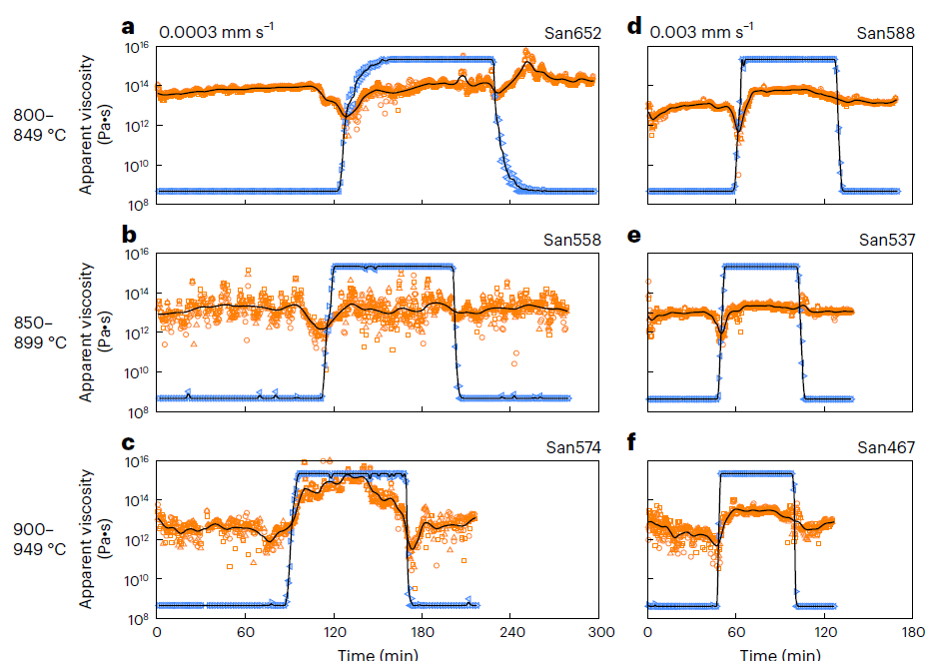
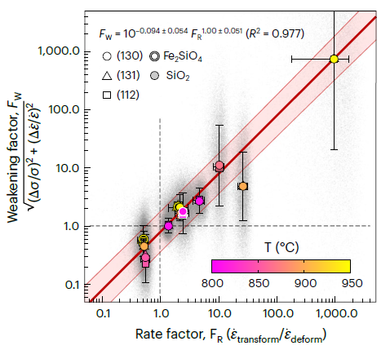
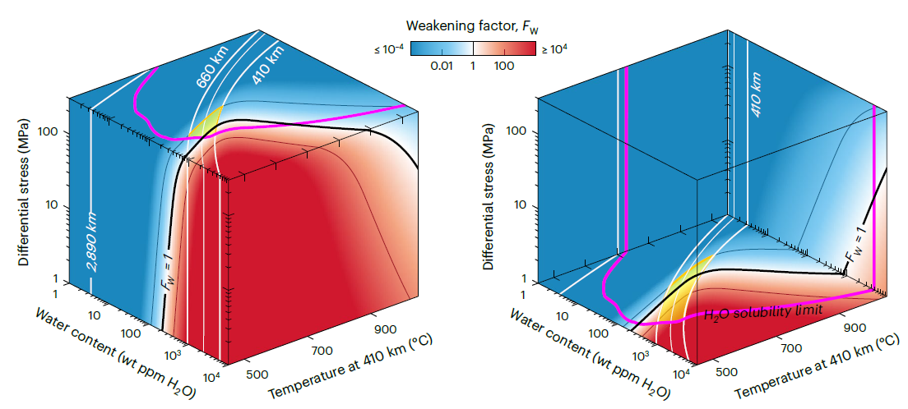
Highlight from APS 6-BM-B Cross et al., Nature Geoscience 2025
Direct observations of transient weakening during phase transformations in quartz and olivine
Evolution of apparent SiO2 viscosity as a function of temperature and deformation rate.
Magnitude of transient weakening FW vs the ratio between the transformation and deformation strain rates, FR.
Transient weakening factor, FW, as a function of water content, temperature and differential stress in a subducting slab.
The likelihood and magnitude of phase transformations for rheological weakening during geodynamic processes are poorly constrained.
Synchrotron-based techniques reveals transient weakening of up to three orders of magnitude during the polymorphic quartz to coesite (SiO₂) and olivine to ringwoodite (Fe₂SiO₄). The weakening may be broadly applicable to silicates, for example those undergoing transformation during subduction.
Modelling suggests that cold, wet slabs are most susceptible to transformational weakening, consistent with geophysical observations of slab stagnation in the mantle transition zone beneath the western Pacific.

Slide 10
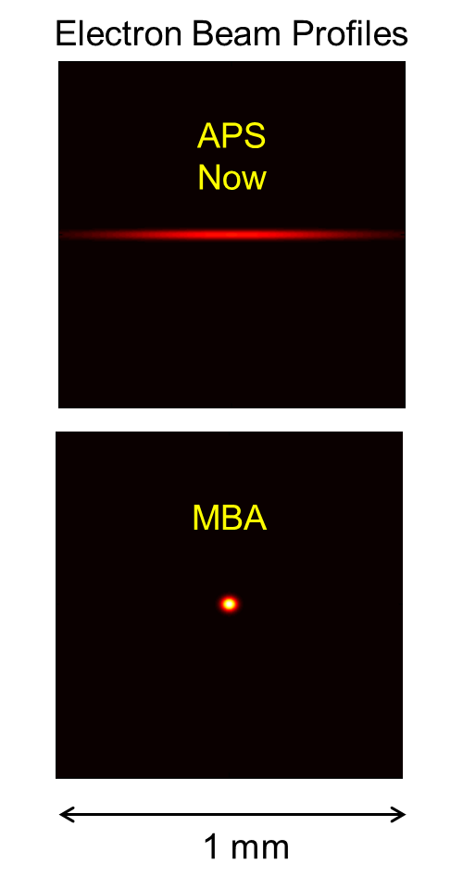
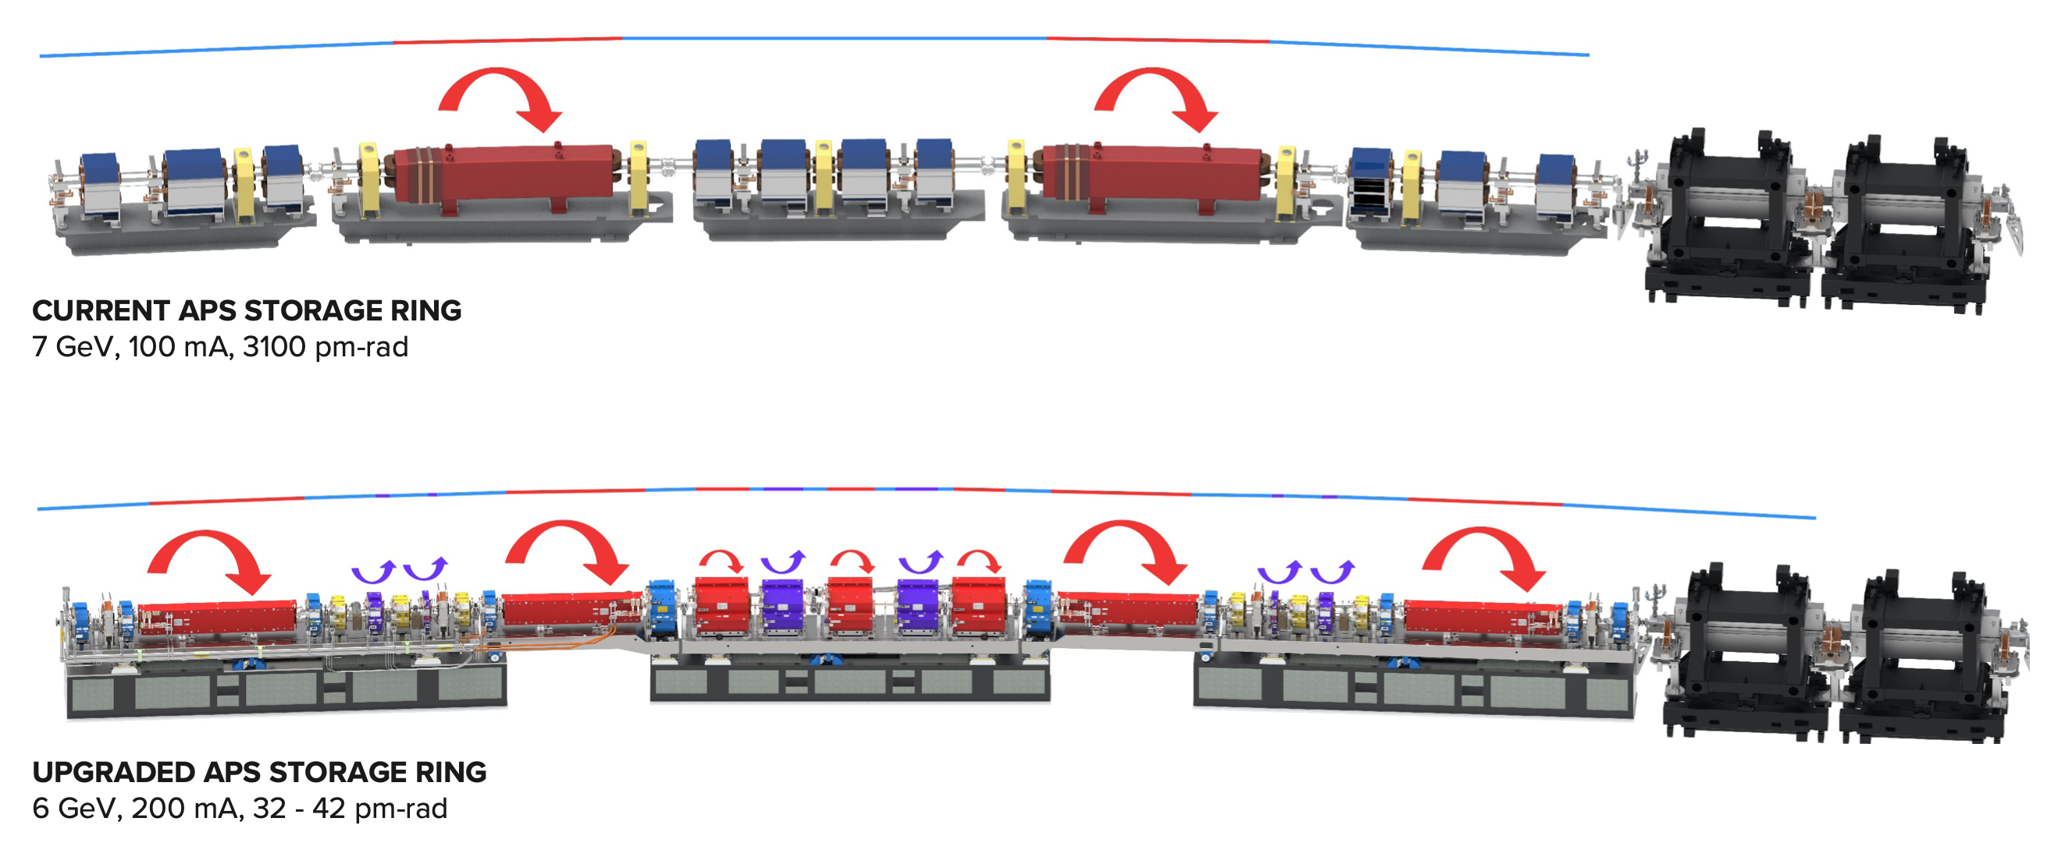
APS Upgrade 2023-2024
The Advanced Photon Source upgrade replaced its original electron storage ring with a new multi-bend achromat lattice to provide extremely enhanced coherent flux and increased hard X-ray brightness by a hundred times
To take full advantage of these improved capabilities we are implementing comprehensive technical improvements and developments of multi-probe techniques across a suite of beamline stations at GSECARS and other SEES stations at APS.
2023
2024

Slide 11
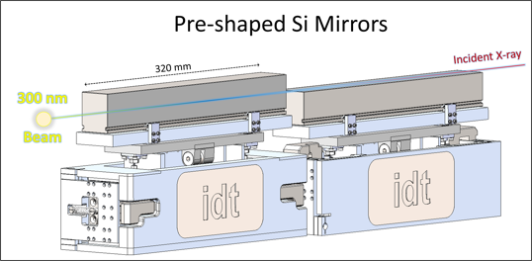
GSECARS 13-ID-D DAC system upgrade
courtesy Peter Eng
The unique long working distance (300 mm) pre-shaped elliptical Si double K-B mirrors system was designed at GSECARS and built at IDT
The 320 mm-long reflecting surfaces of these mirrors are polished to better than 1 nanometer surface roughness over their entire length
Capable of focusing high energy X-rays (up to 50 keV) to a 300 nm diameter spot

Slide 12
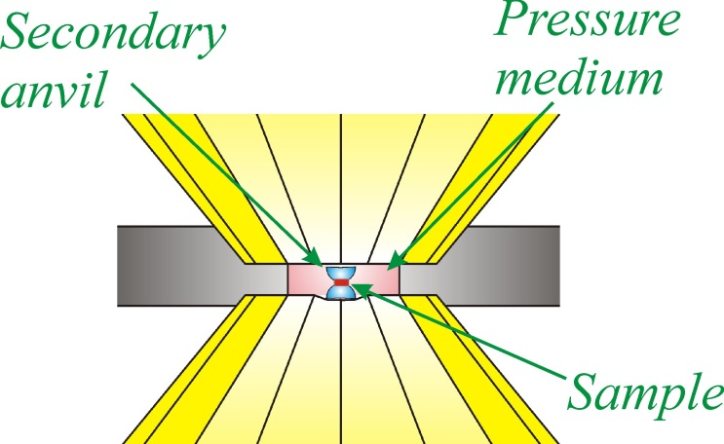
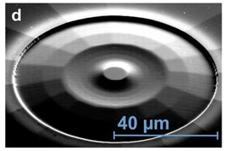
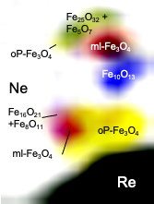

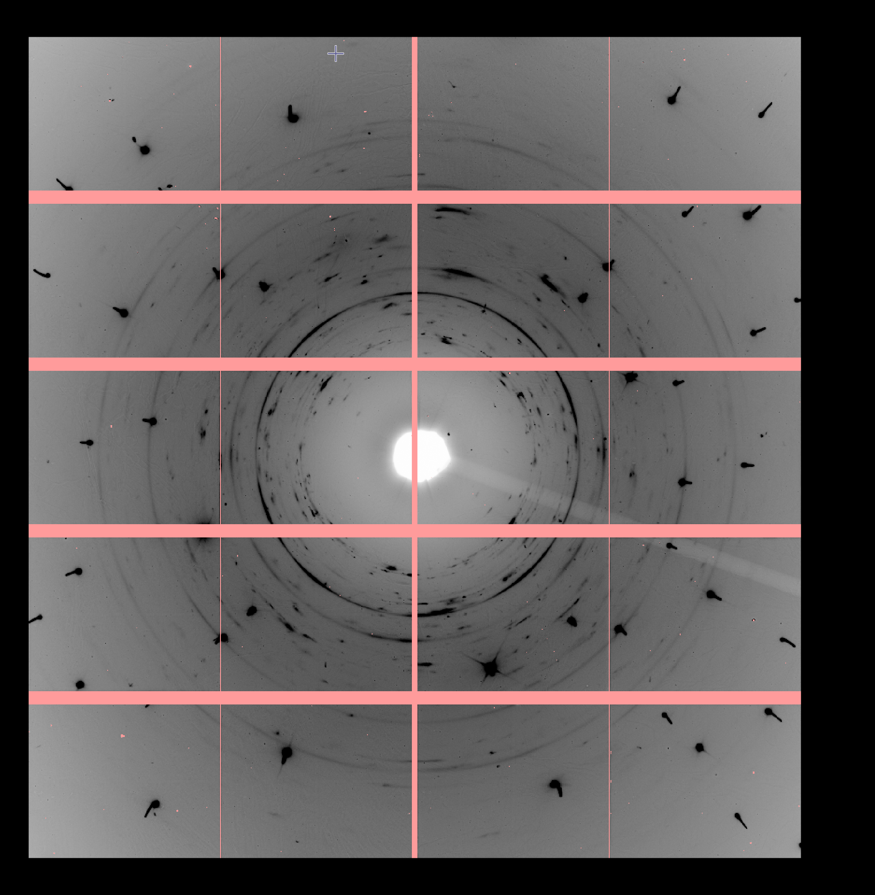
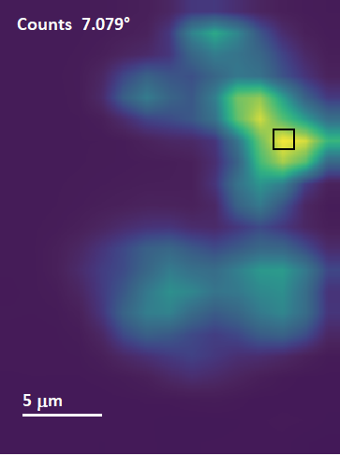
GSECARS 13-ID-D DAC system upgrade
TPa
The spatial resolution and brightness afforded by the APS-U upgrade will provide tremendous benefits to high P,T diamond anvil cell research!
Ultra high pressure (TPa) techniques require a submicron X-ray beam to resolve within the sample chamber
Multigrain single crystal methods will also see outstanding benefit from the improved focusing, because fewer crystals will intersect the beam
=> Better crystallographic information at deeper planetary conditions!
~1 µm
sXRD + mapping

Slide 13
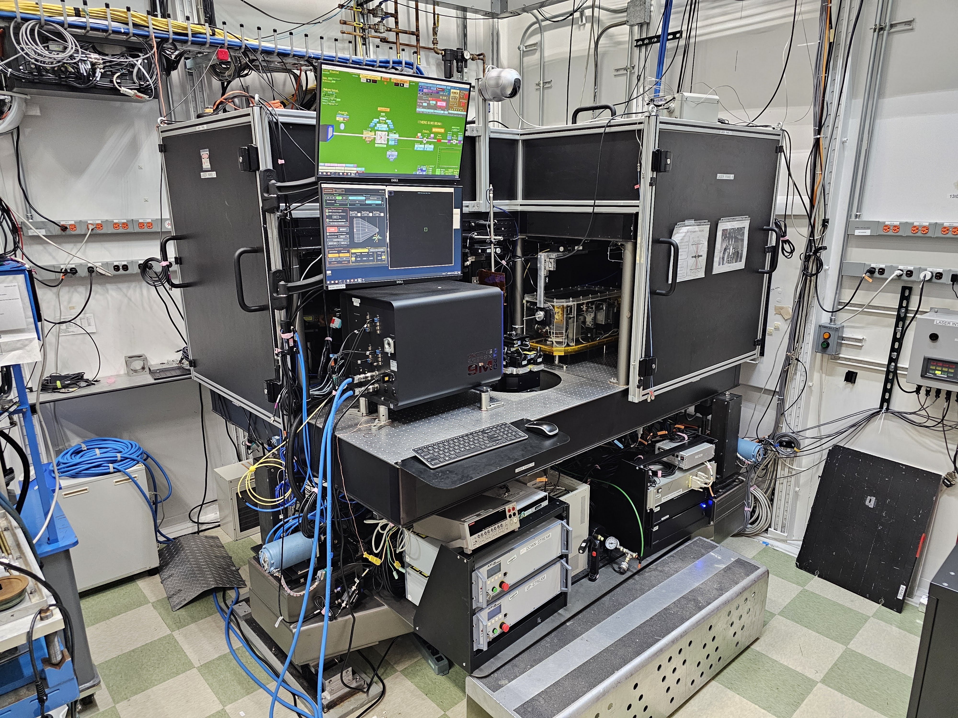
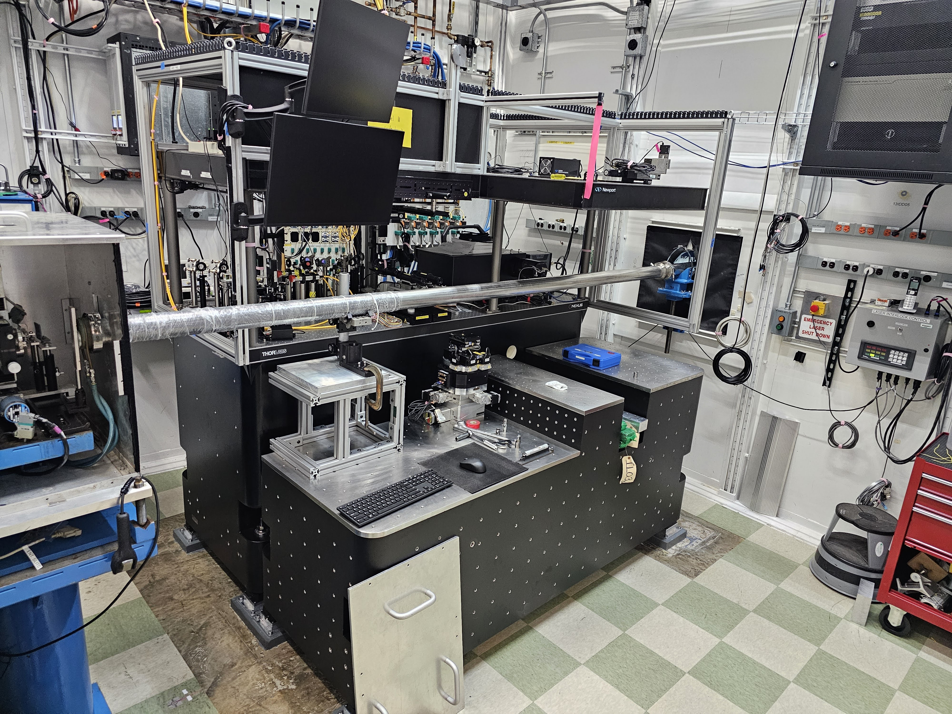
GSECARS 13-ID-D DAC system upgrade
March 2025
July 2025
Granite table for vibrational stability
Upgraded stages for precise positioning, 100 nm steps
Upgraded optical components for stability
New K-B mirrors for precise X-ray focusing, down to 300 nm spot

Slide 14
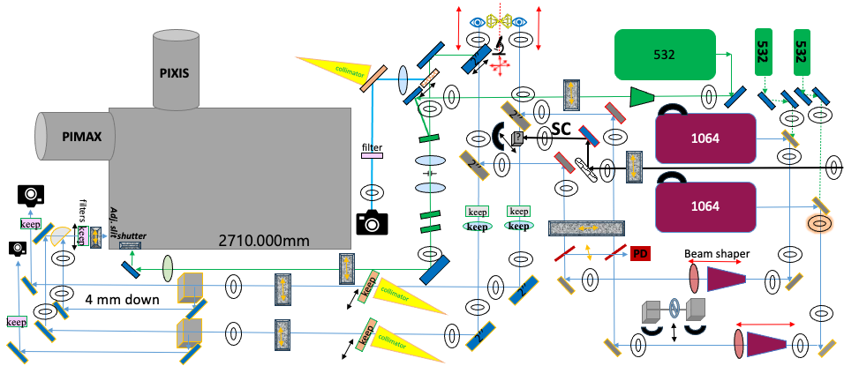
GSECARS 13-ID-D DAC system upgrade
Upgraded optical system being commissioned in the 2025-3 cycle.
General User access expected in 2026-1!

Slide 15
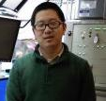
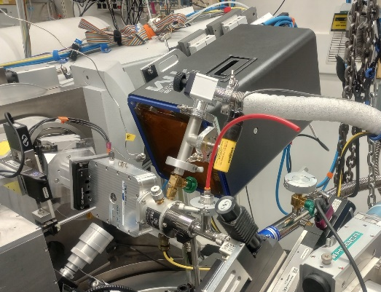
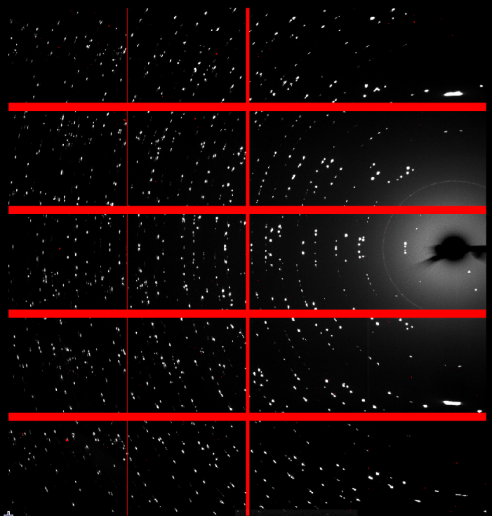
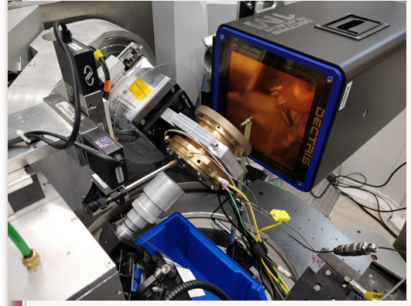
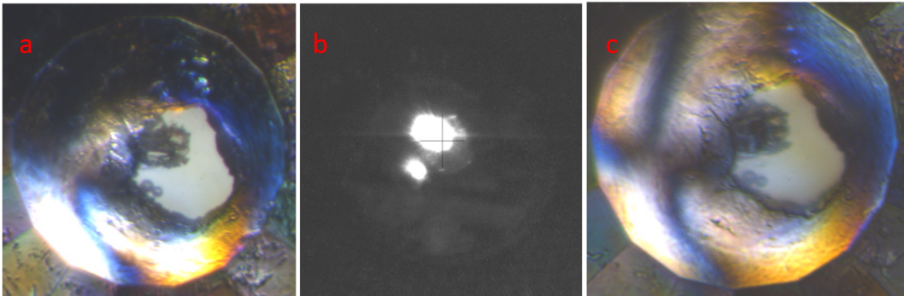
13-BM-C: crystallography under extremes
6-circle diffractometer, great for high resolution crystallography
29 keV X-ray focused to ~10 um
Pilatus 1M Si/CdTe
Versatile sample environment control
Dongzhou Zhang
High P, low T with compact cryostat
Single crystal NaYbO₂
High P-T, resistive heating
High PT, laser heating
Zhang et al., PCM 2022
Sutton et al., PCM 2022

Slide 16
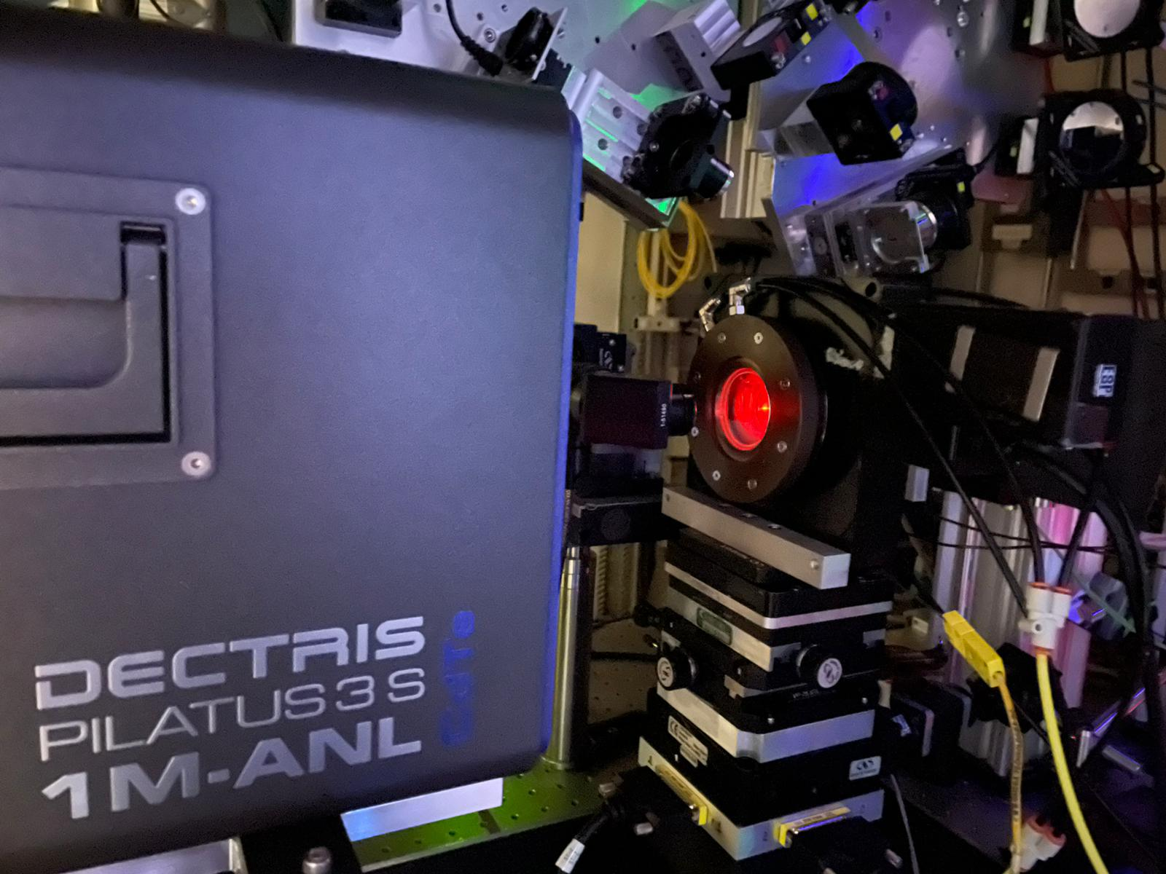
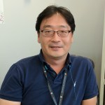
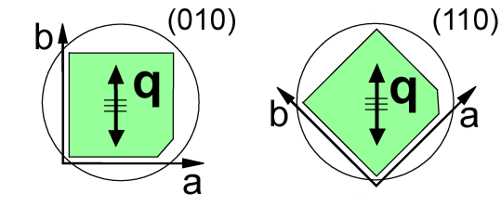
13-BMD: Brillouin spectroscopy with XRD
M
Interferometer
L
M
M
Laser
M
F
P
Scattered
light
Young Jay Ryu
M
Laser
M
M
Synchrotron
APS, ANL
L
L
X-ray detector
B
S
X-ray
Scattered x-ray

Slide 17
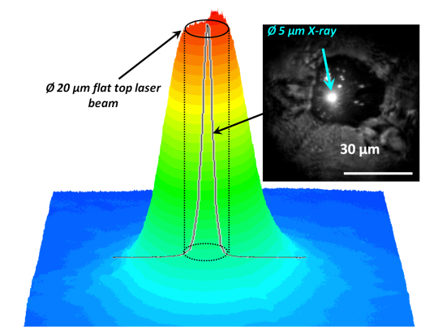
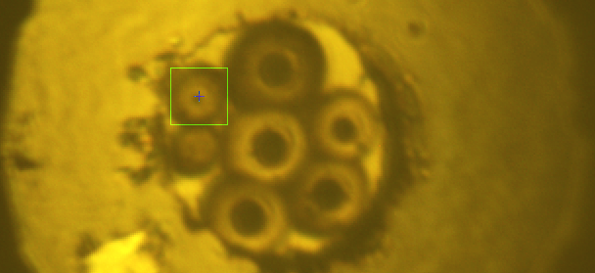
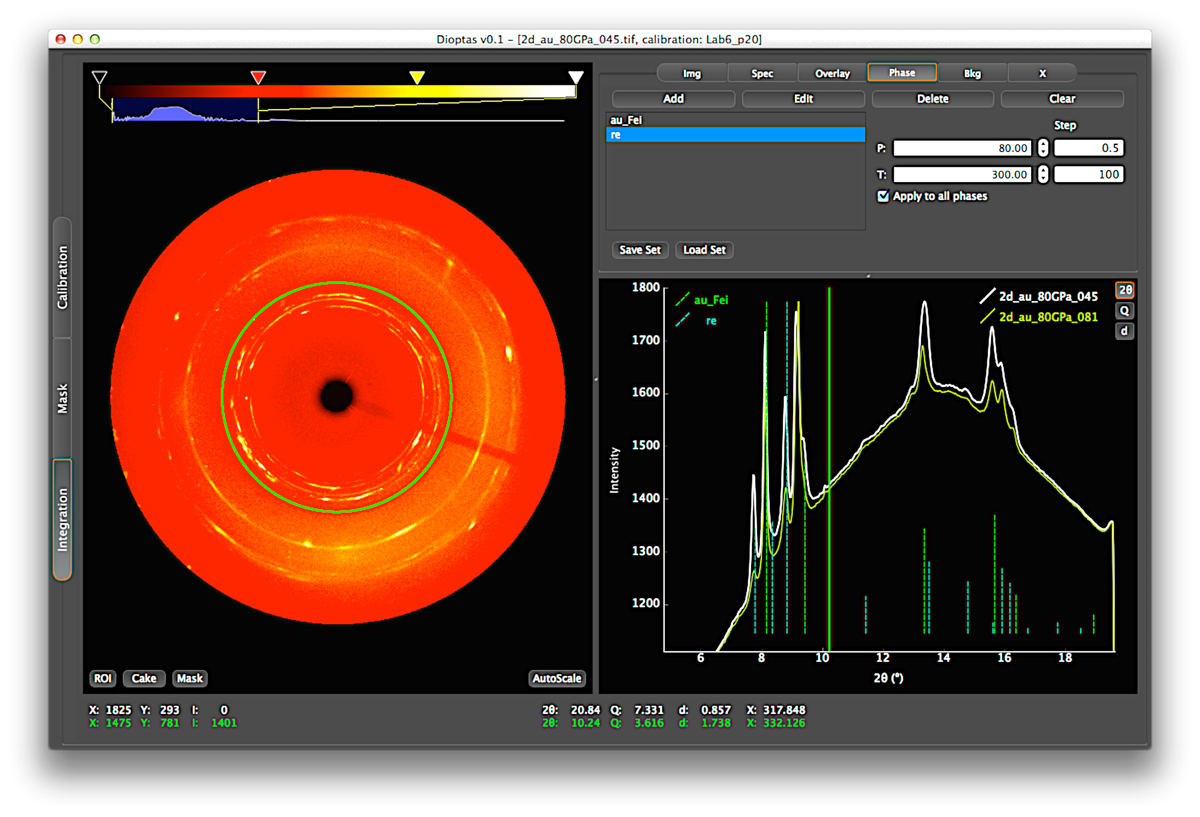
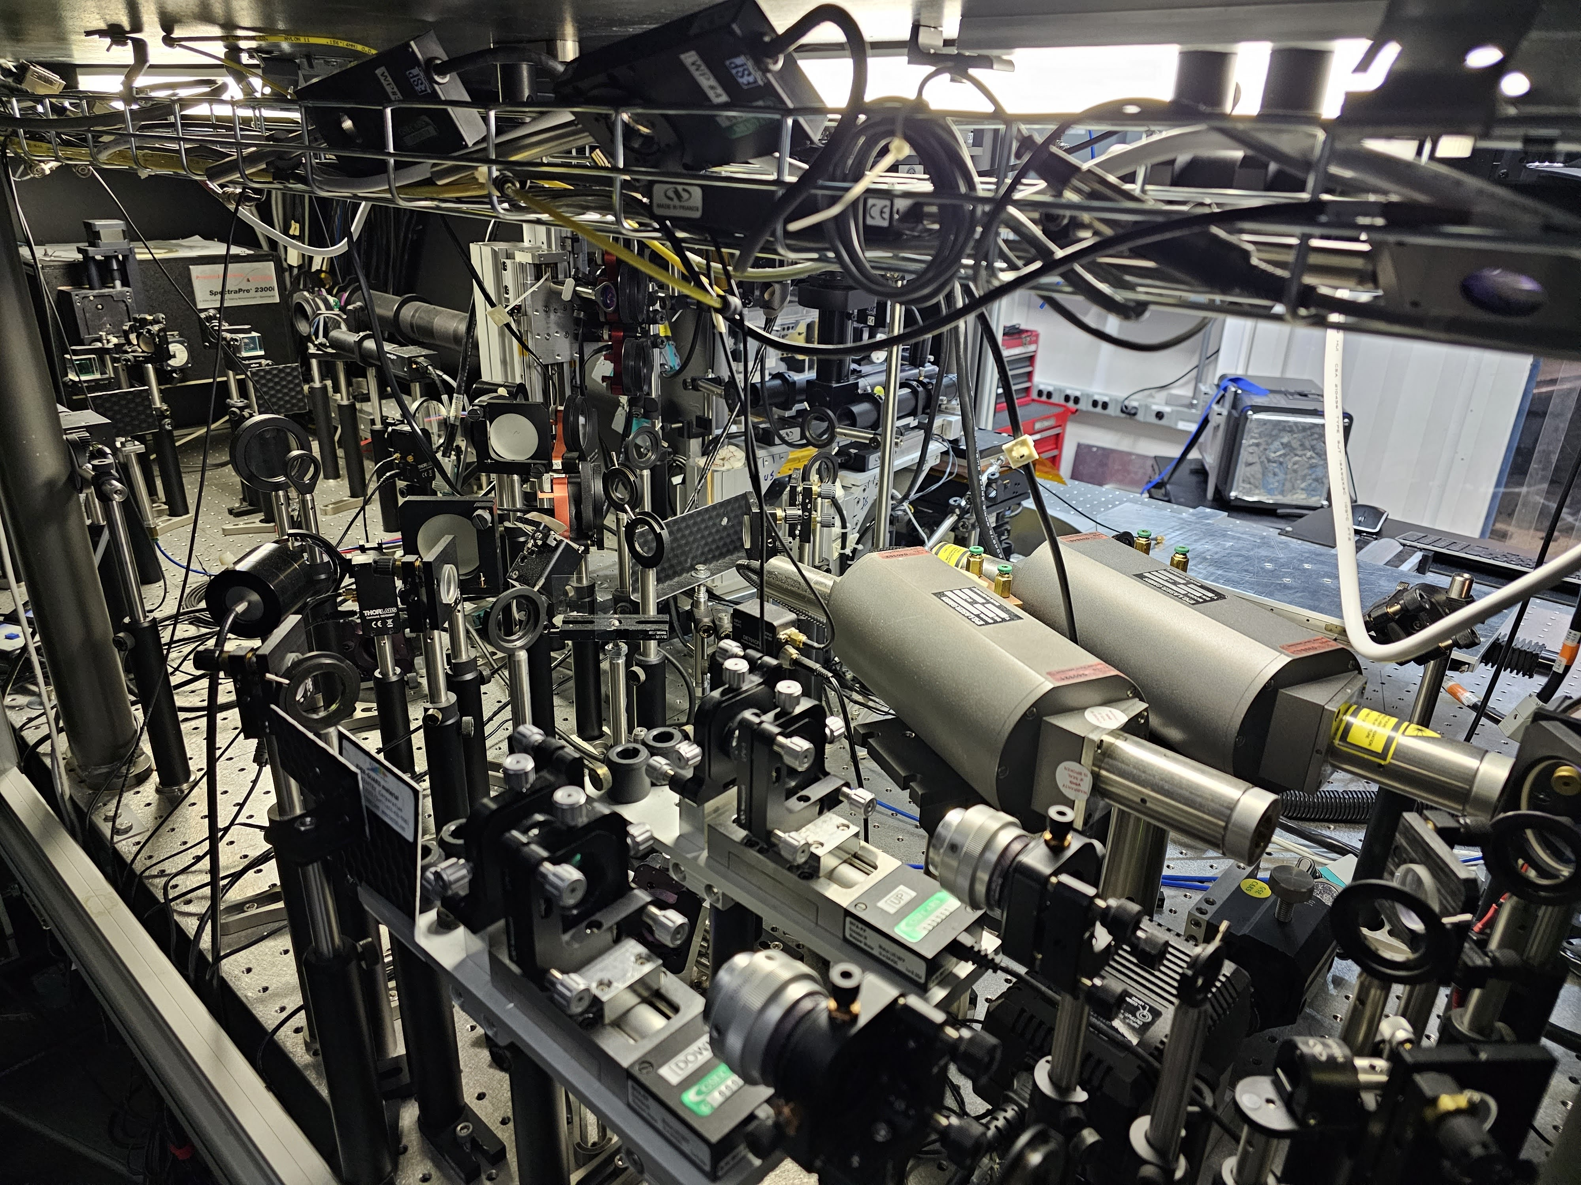
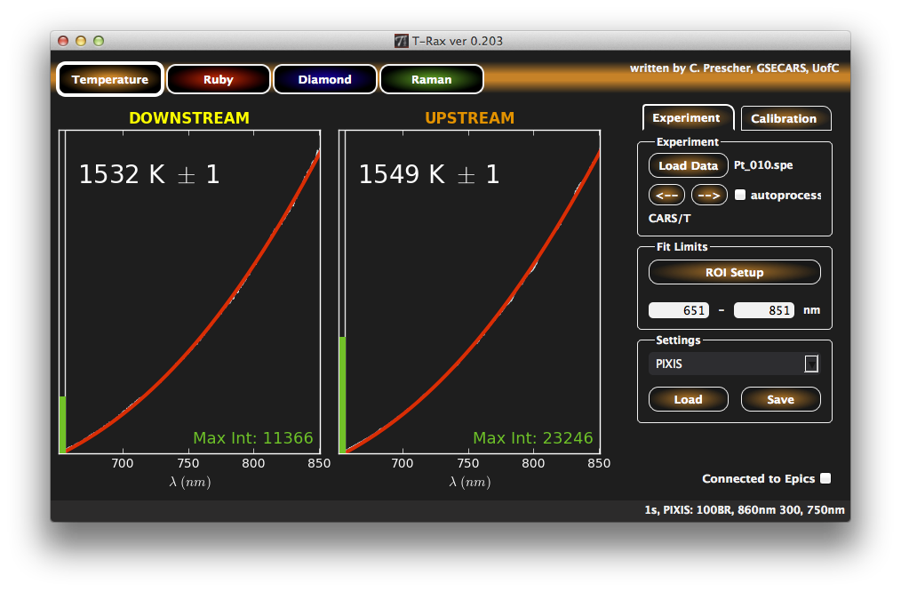
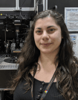
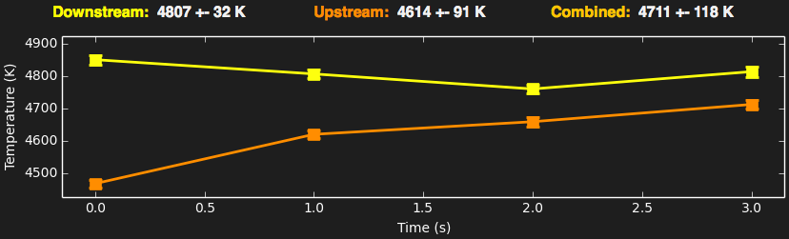
13-ID-D: Double-sided CW/pulsed LH
DAC experiments benefit from ID:
high energy x-ray, tight focus, high flux, plus combination with laser heating, high resolution spectroscopy and imaging
Typical sample alignment ~5 minutes
1 - 3 shifts (8-24 hours)
per proposal
Stella Chariton

Slide 18
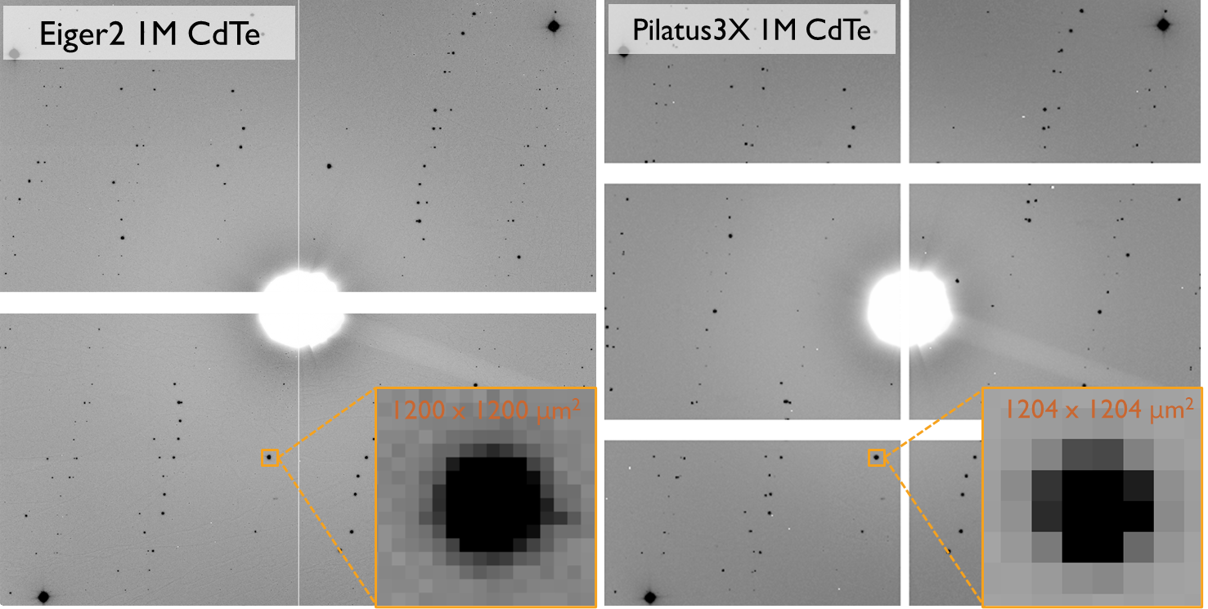
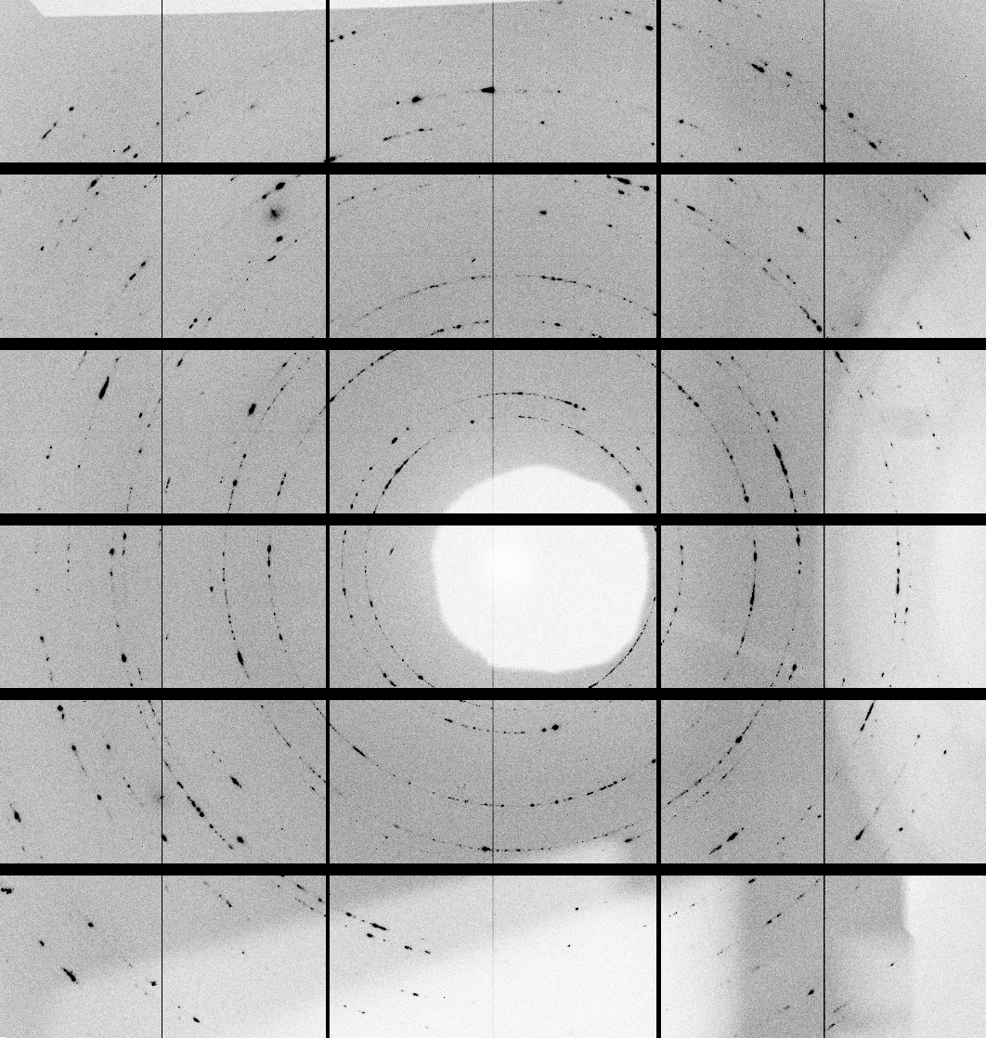
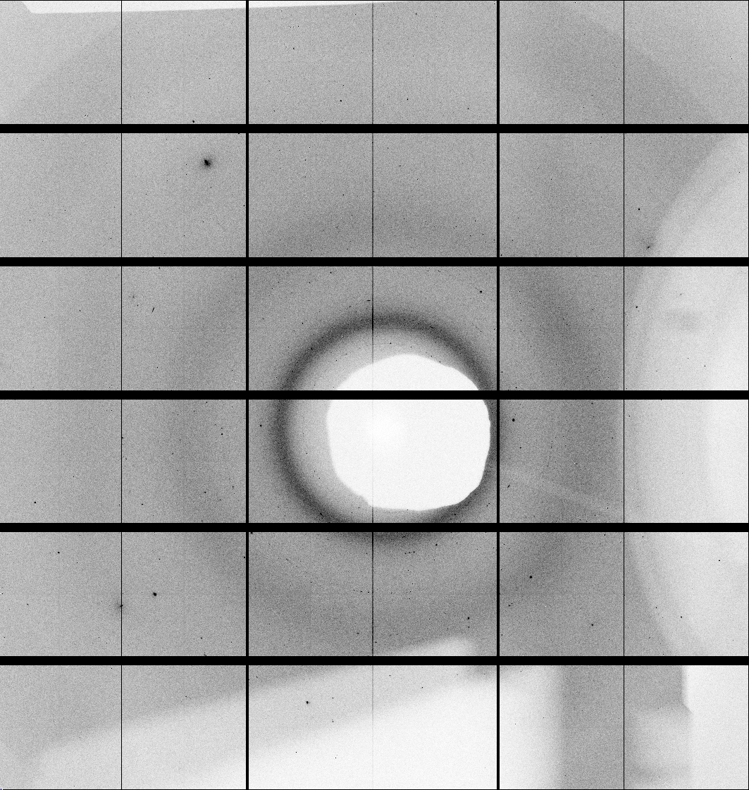
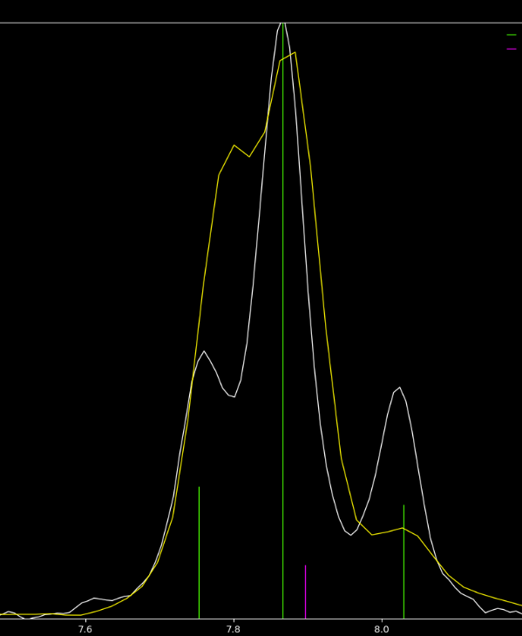
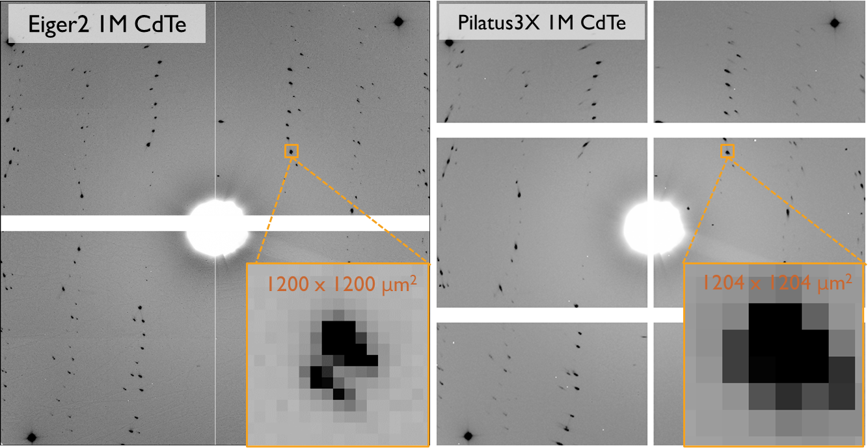
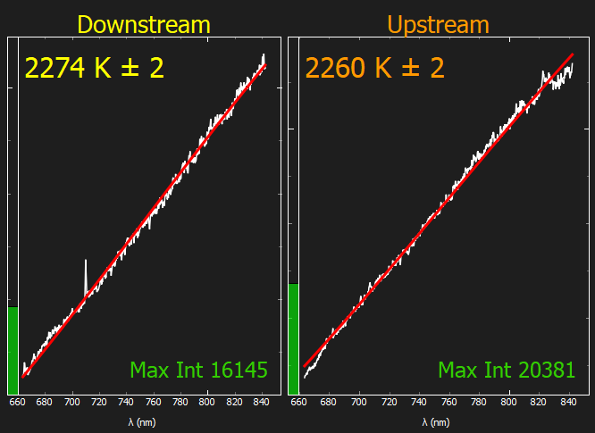
13-ID-D: Eiger2 X CdTe 9M X-ray detector
We have acquired a new Eiger2 X CdTe 9M X-ray detector with high count and frame rates:
detect photons with energies of up to 100 keV
spatial resolution at the single-pixel level of 75 µm
fast frame rate, dead-time free readout
the second energy discriminating threshold allows imaging of samples in two energy bins or cut higher harmonics to reduce background
Pt + SiOOH
at 20 GPa
Melting Pt
with Eiger 9M
Pilatus 1M
Eiger 9M
Courtesy of T. Kim, ASU
Commissioning at GSECARS
37 keV
10 sec
LaB₆
NSF MRI EAR-2320309

Slide 19
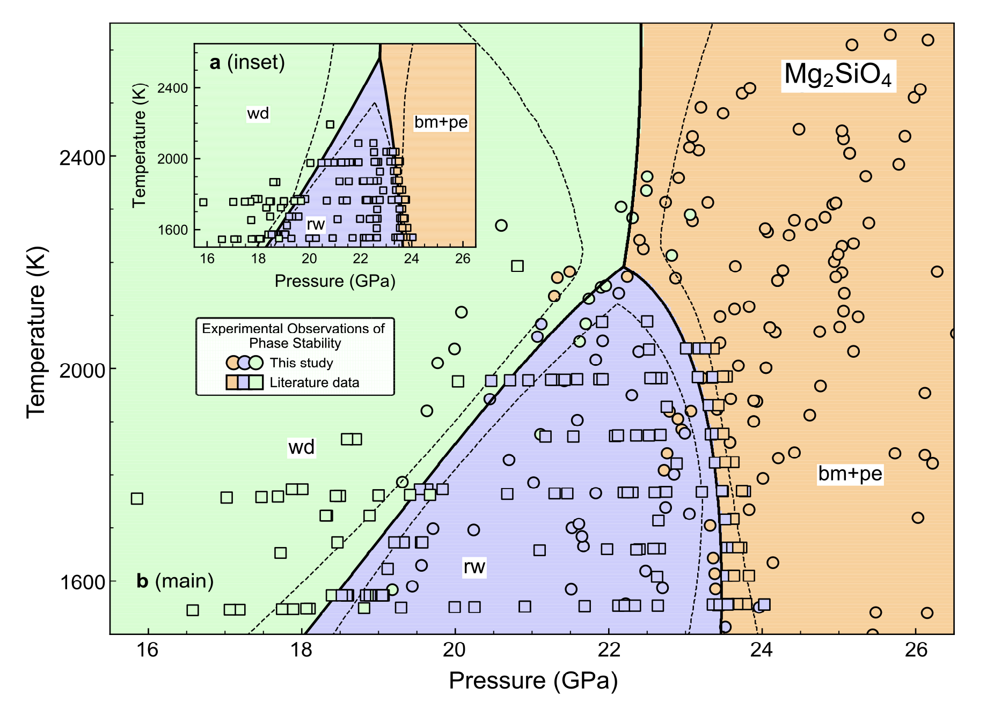
Highlight from GSECARS 13-ID-D DAC system Dong et al., Nature Comm. (2025)
X-ray diffraction of laser heated DAC experiments reveal the nonlinear phase boundary between ringwoodite and bridgmanite+MgO
This previously unrecognized curvature in the postspinel transition can impact the dynamics of mantle convection, slab subduction and upwelling plumes

Slide 20
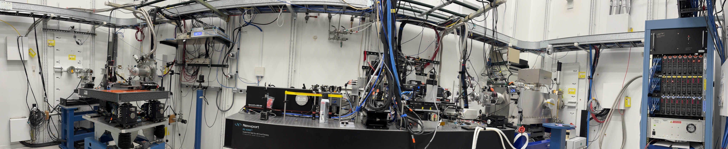
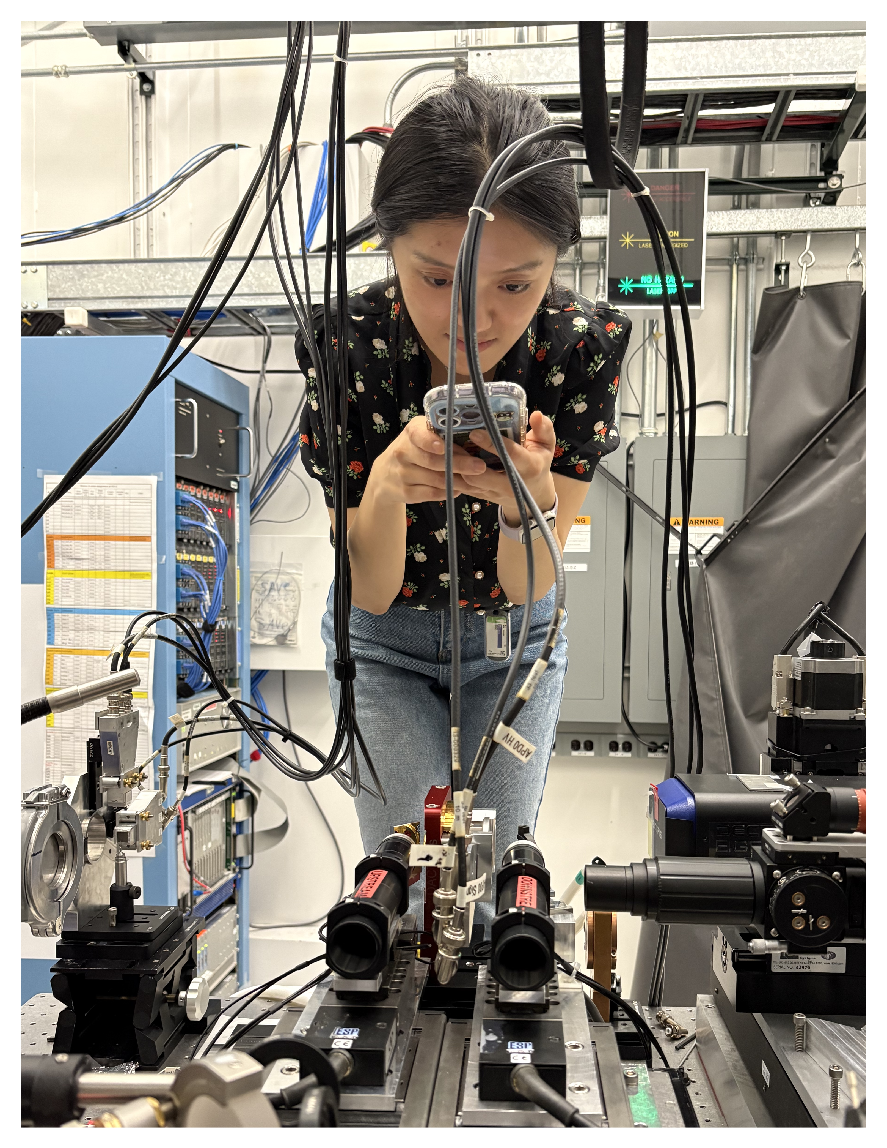
APS 3-ID Nuclear resonant spectroscopy program
⁵⁷Fe, ⁸³Kr, ¹⁵¹Eu and ¹⁶¹Dy
Mössbauer spectroscopy: NFS and SMS
Nuclear resonance vibrational spectroscopy
Renovated hutch for 57Fe NRS
Improved stability, energy and sample for improved accuracy in energy scans and sample stability.
Improved focusing, 1 um eV, 2x12 meV beam.
New laser heating system allowing to measure SMS and NRVS spectra of samples under high pressures and temperatures
Newly commissioned laser heating system
Cijin Zhou

Slide 21
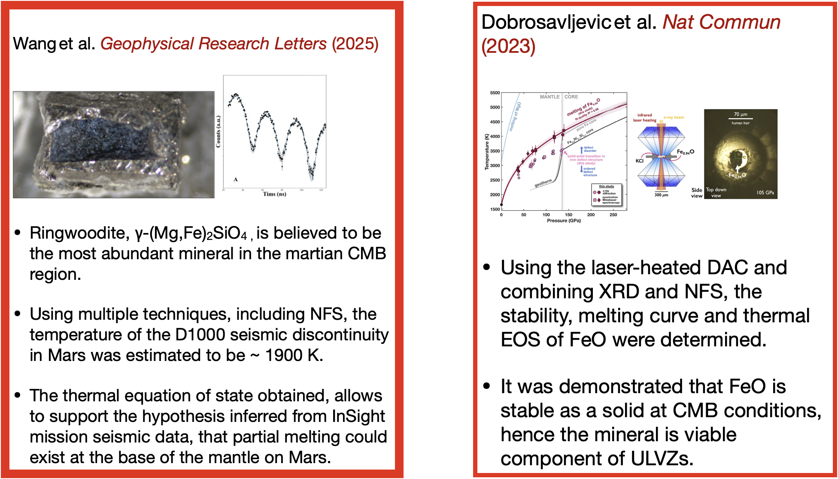
APS 3-ID Nuclear resonant spectroscopy program

Slide 22
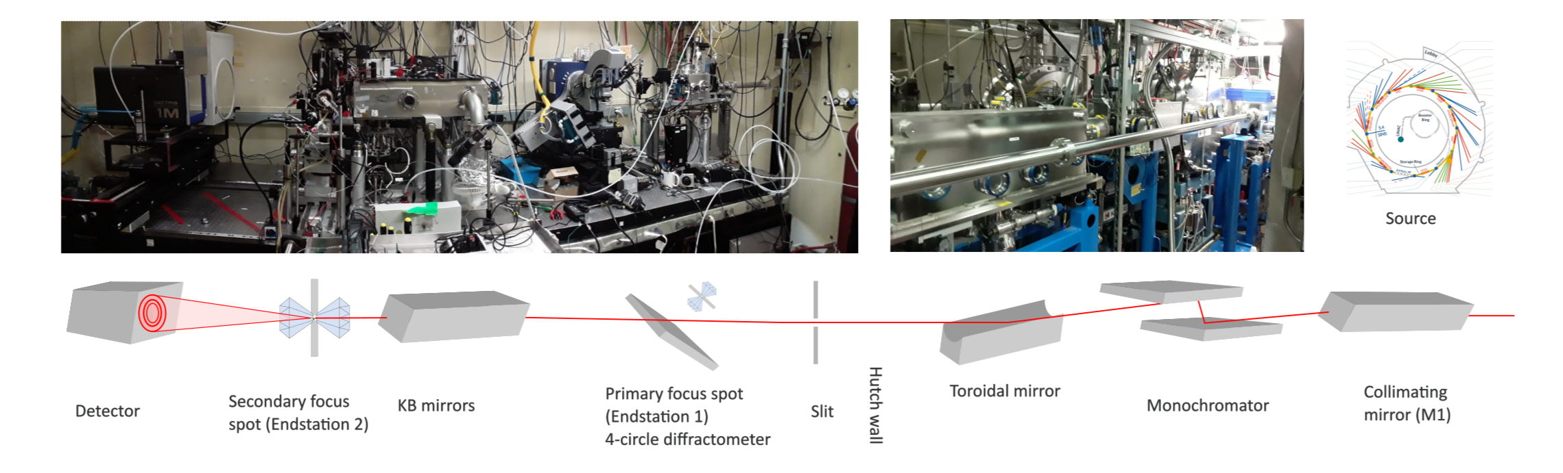

ALS 12.2.2 overview
Superbend, hard X-ray beamline
6–35 keV; 2–0.35 Å

Slide 23


ALS 12.2.2 overview
Laser-heated high pressure axial and radial powder diffraction
Resistively-heated high pressure PXRD (ambient – 1000 °C)
High pressure single crystal diffraction
High temperature, controlled atmosphere powder diffraction
Coming soon: up to 50 bar of vapor pressure

Slide 24

ALS 12.2.2 Laser heated radial diffraction
Hydrous
Stishovite
Egg
δ-AlOOH
Recent work:
Deformation of hydrous mantle phases Egg, [AlSiO3(OH)], δ [AlO(OH)] and Stishovite
First deformation study of Egg and δ-AlOOH
Egg deforms by (100) slip, δ by (010)
Notable preferred orientation of shear waves, implications for mantle seismic anisotropy
Kattemaladavi et al., (2025) JGR Solid Earth

Slide 25


ALS 12.2.2 External DAC heating
Vacuum / inert atmosphere enclosure

Slide 26



Frontier Infrared Spectroscopy (FIS) program, NSLS-II
FIS
22-IR-1/FIS Beamline End-Stations
High Pressure Problems/Questions
• Speciation of molecules in dense materials
• Thermodynamics at extreme conditions
• Water and carbon storage mechanisms in planets
• Phase transitions and bonding of planetary constituents
• Thermal and radiative conductivity
• Insulator-metal transitions
• Probes of superconducting gaps and mechanisms
Capabilities
Synchrotron FTIR IR microspectroscopy with broad energy range: 8 meV~3eV
Reflection/absorption/imaging/polarized
THz Raman spectroscopy
NIR-Visible spectroscopy (including PL)
External/laser heating techniques
Cryogenic techniques

Slide 27

New capabilities at FIS IR program, NSLS-II
EHDAC enclosure with membrane system for in-situ IR measurements with precision P control under extreme high P-T conditions
Project partnered with SNL-SEES
First GU experiments in April 2025 expanded the P-T range over 50 GPa and 1400 K.
Micro-Raman system
FTIR microscope system
Enclosure system
Membrane controller
Preliminary results on Mg(OH)2: P,T-induced decomposition observed via the O-H stretching vibrations (Courtesy of Bin Chen, University of Hawaii at Manoa).

Slide 28
New capabilities at FIS IR program, NSLS-II
Coupling CO₂ laser heating to the IR microscope system for high P-T measurements
A capability to greatly expand the P-T range to address numerous new problems in Earth and planetary science

Slide 29
Getting beam time at SEES mineral physics facilities
Apply for beam time!
All SEES beamtime is awarded through facility-specific proposal systems. Preference is given to Earth and environmental science research.
Potential users should contact the beamline scientists to discuss feasibility of experiments and beamtime requirements.
Ask also about techniques under development!

