Slide 1

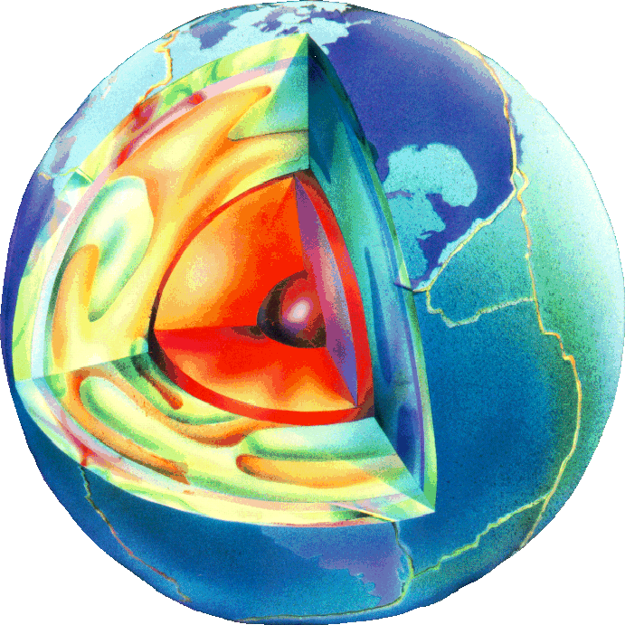
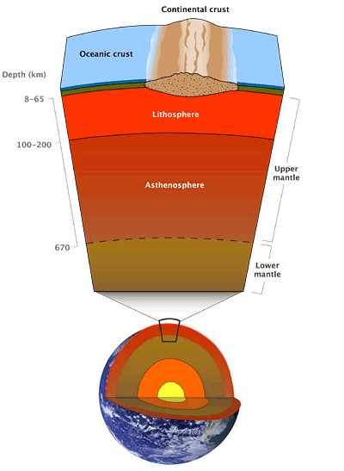
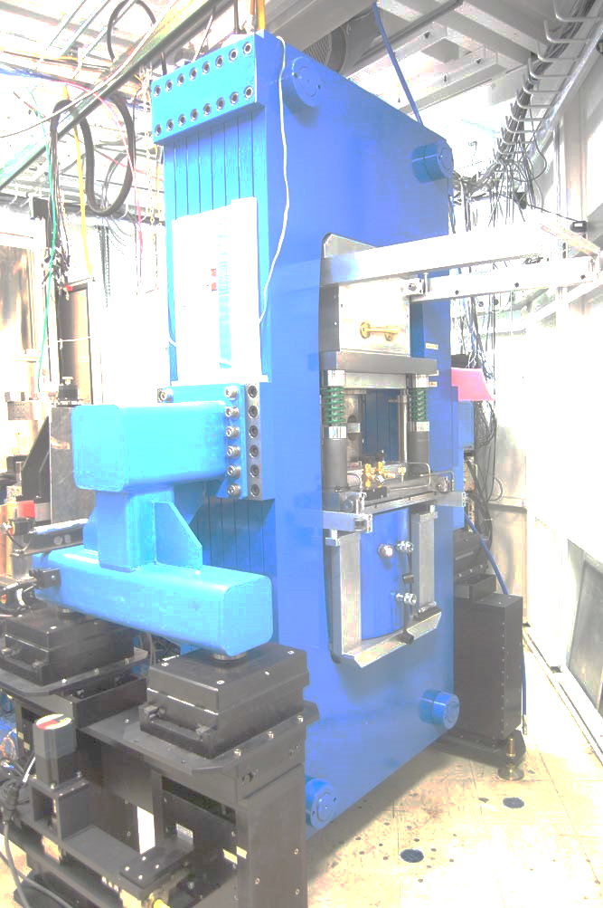
Three Facilities for Studying Rock and Materials Deformation Using In Situ X-Ray Diffraction and Imaging
Matthew L. Whitaker, Haiyan Chen, Kenneth J. Baldwin,
William R. Huebsch, Donald J. Weidner
Mineral Physics Institute & Department of Geosciences
Stony Brook University

Slide 2
Alphabet Soup
The SEES-SBMAX Program is charged with operating three separate synchrotron facilities supporting Users studying Earth, analog, novel, functional, and other materials under high pressures and temperatures
SEES – Synchrotron Earth and Environmental Science
SBMAX – Stony Brook Multi-Anvil X-ray
6-BM-B – Dedicated Multi-Anvil beamline at APS (55-75%)
MAXPD – Multi-Anvil X-ray Powder Diffraction endstation at XPD Beamline at NSLS-II (6% min. beamtime, no cap)
HEX – High Energy Engineering X-ray beamline, NSLS-II (no guaranteed time, all proposal driven)

Slide 3
Three Beamlines, One Program
6-BM-B
White (energy dispersive) X-ray beam (up to ~100 keV)
DIA geometry; nice and simple, but limited in pressure
Diffraction volume limited (tunable) by conical slits
MAXPD
Monochromatic (angle dispersive) X-ray beam (~68 keV)
Kawai geometry; complex, but higher achievable pressure
EVERYTHING in the beam path diffracts
HEX
Monochromatic or white X-ray beam (up to ~200 keV)
No permanent installation; large hutch to allow for different sample environments
Large beam size allows study of large samples at lower pressures

Slide 4
Science Enabled by SBMAX Program
Stress – strain – time relationships for Earth and other materials
Elastic, anelastic, plastic properties from MHz to mHz
Kinetics of phase transitions
Atomic structure
Crystalline phases & liquids and amorphous materials
Thz to mhz elastic, viscous properties
Equation of state
Metallurgical and ceramic phase relations
Physics of fracking
Solidus of the lower mantle
Water/Volatiles in the Earth
Properties of melts
Rock mechanics
Carbon sequestration
Mechanical and chemical interaction of rocks and fluids
Earthquake faulting
Effects of/on Q (attenuation)
Cation coordination, order / disorder relationships
Extreme petrology
Petrology of the whole Earth

Slide 5
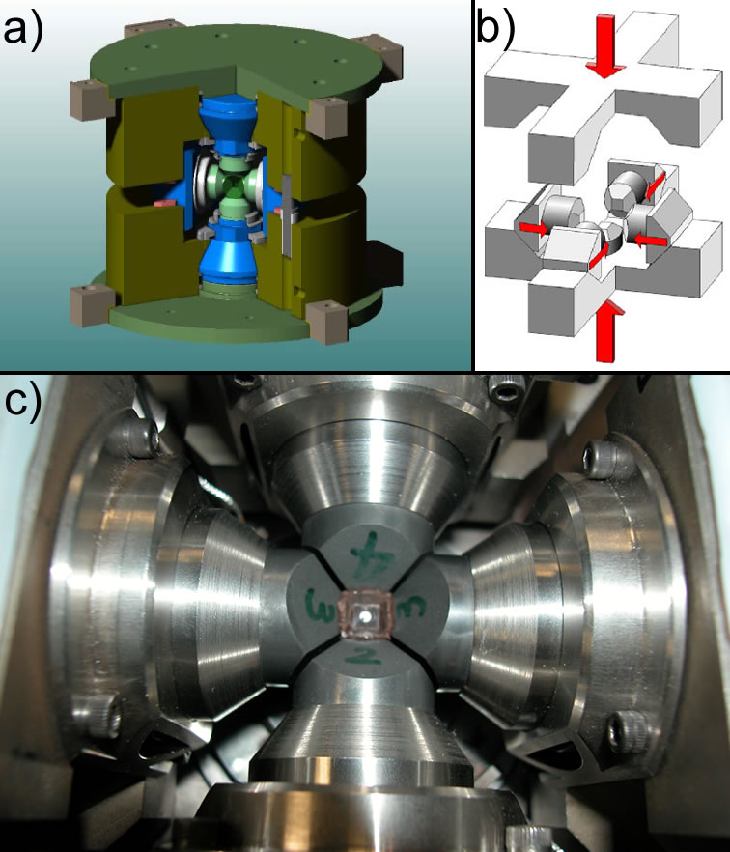
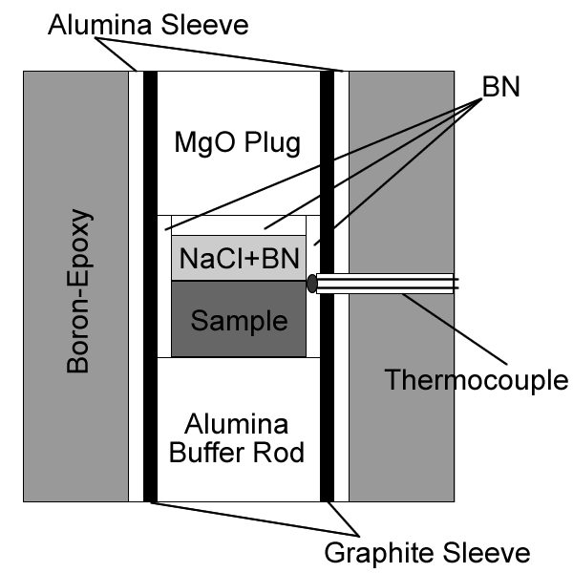
Multi-Anvil Geometry – DIA Type (6-BM-B)

Slide 6
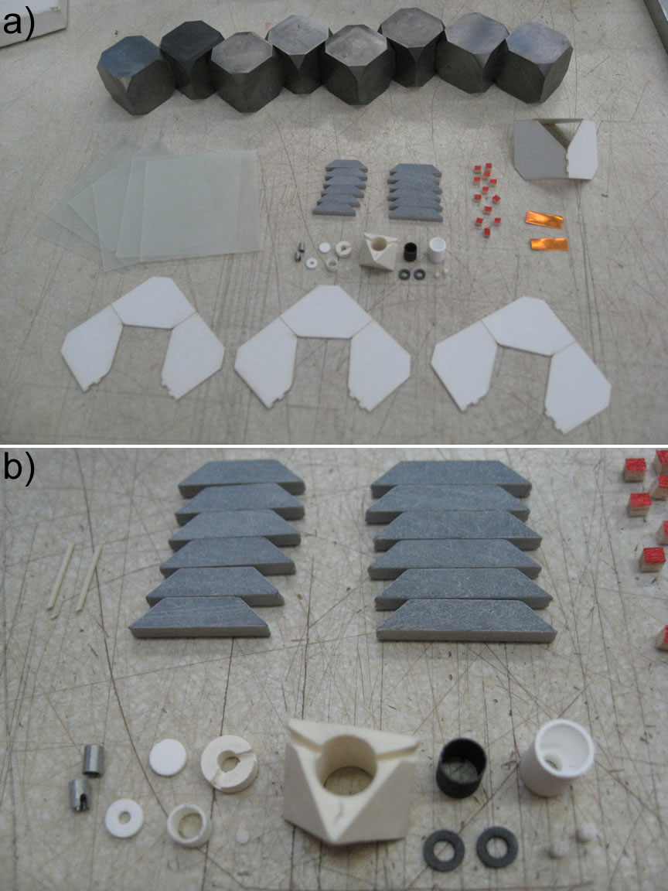
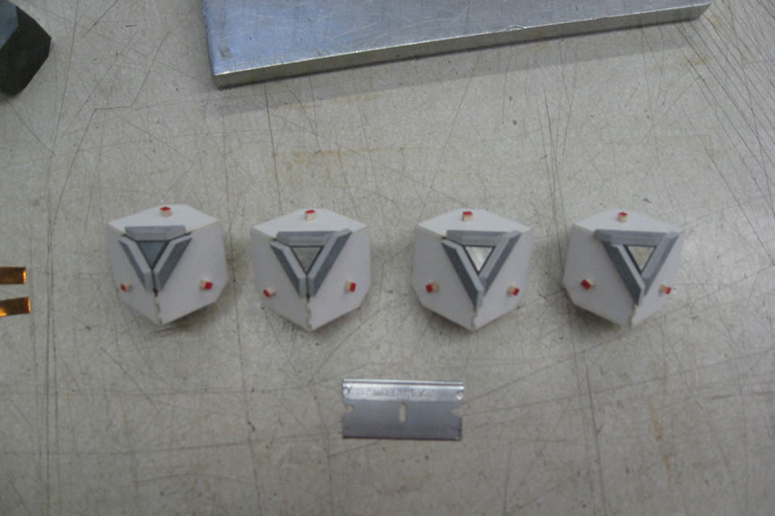
Multi-Anvil Geometry – Kawai Type (MAXPD)

Slide 7
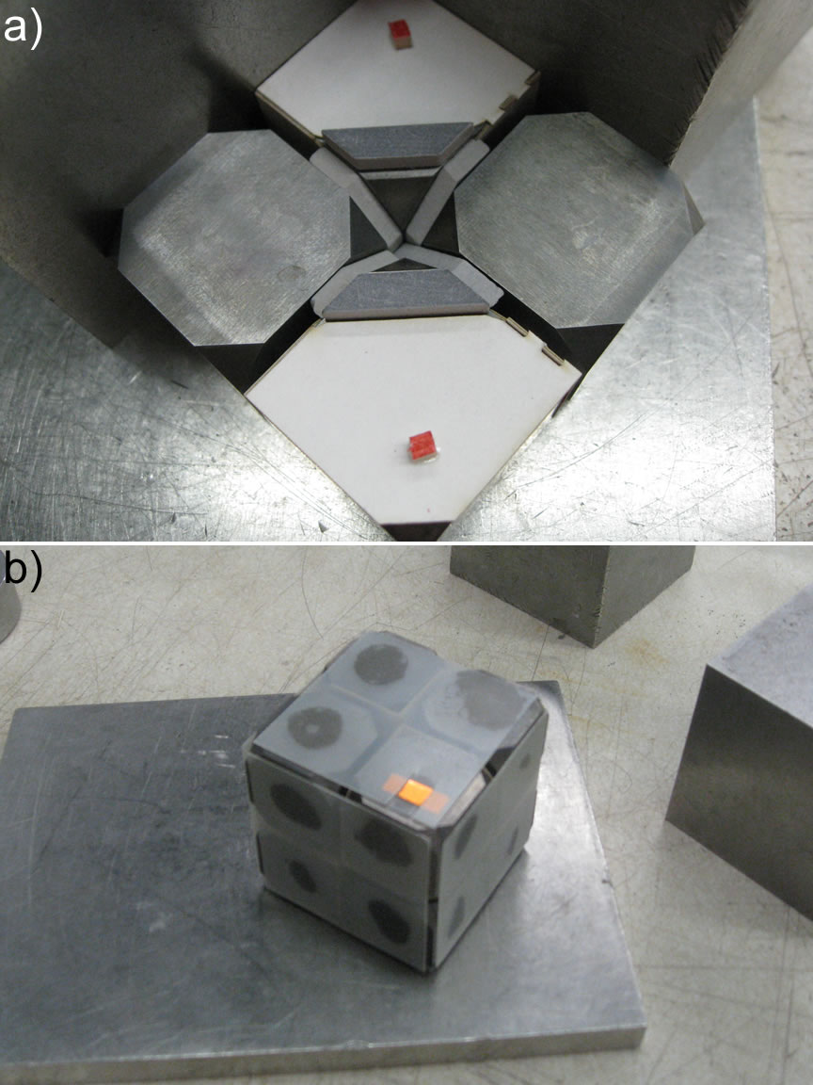
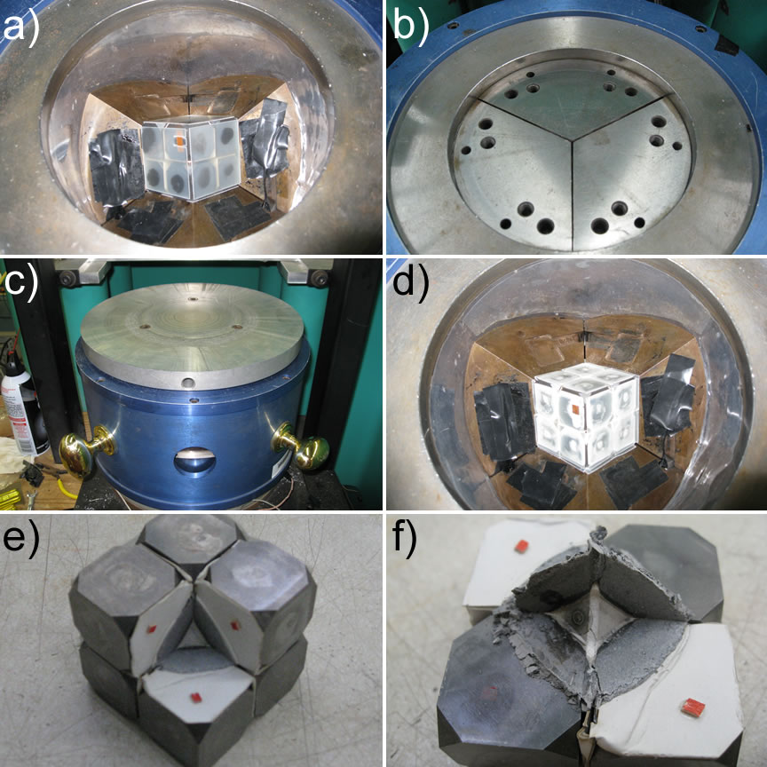
Multi-Anvil Geometry – Kawai Type (MAXPD)

Slide 8
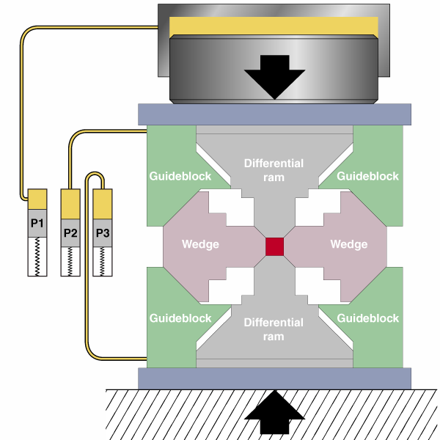
Multi-Anvil Techniques
DIA geometry simpler, Kawai complex
DIA limited in achievable pressure range; Kawai capable of much higher pressures
Both systems good for studying materials under extreme conditions of P & T
In order to study rheological properties of (Earth) materials under these extreme conditions, new experimental apparatus were needed
Development of the Deformation-DIA, now widespread and commonly called D-DIA
Designed and pioneered at beamline X17B2 at NSLS-I

Slide 9
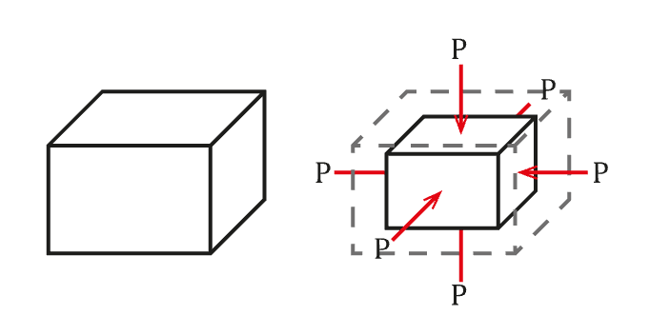
Elasticity vs. Plasticity
Elastic Deformation
Starting Sample
Ambient Conditions
Sample Under Stress
(Pseudohydrostatic)
Release Stress
Sample Reverts

Slide 10
Elasticity vs. Plasticity
Plastic Deformation
+
+
Starting Sample
Ambient Conditions
Sample Under Stress
(Non-hydrostatic)
Release Stresses
Sample is Changed

Slide 11
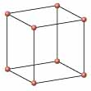
X-Ray Diffraction Behavior with Deformation
P

Slide 12
6-BM-B: White Beam Multi-Anvil Facility
Bending Magnet Beamline at Sector 6 at APS
Energy Dispersive X-Ray Diffraction; ~20-100 keV X-Ray Energy Range
10-Element Array of Solid State Ge Detectors
X-Radiographic Imaging w/ YAG & Manta CMOS Camera
250-ton Hydraulic Press Installed; D-DIA Module Standard Installation
Differential Hydraulic Pumps for Deformation Studies
Press also accommodates T-10/Tcup (Kawai)
SAM85 can be temporarily removed for Rotational Drickamer Apparatus
Steady State and Dynamic Stress Studies
Integrated Acoustic Velocity System – DIASCoPE
We’re in GUP operation!!!

Slide 13
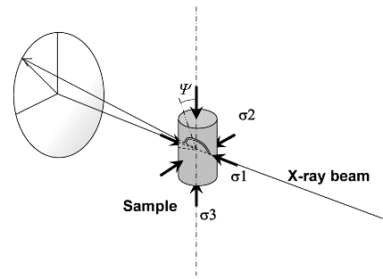
Schematic of Synchrotron D-DIA Experiment

Slide 14
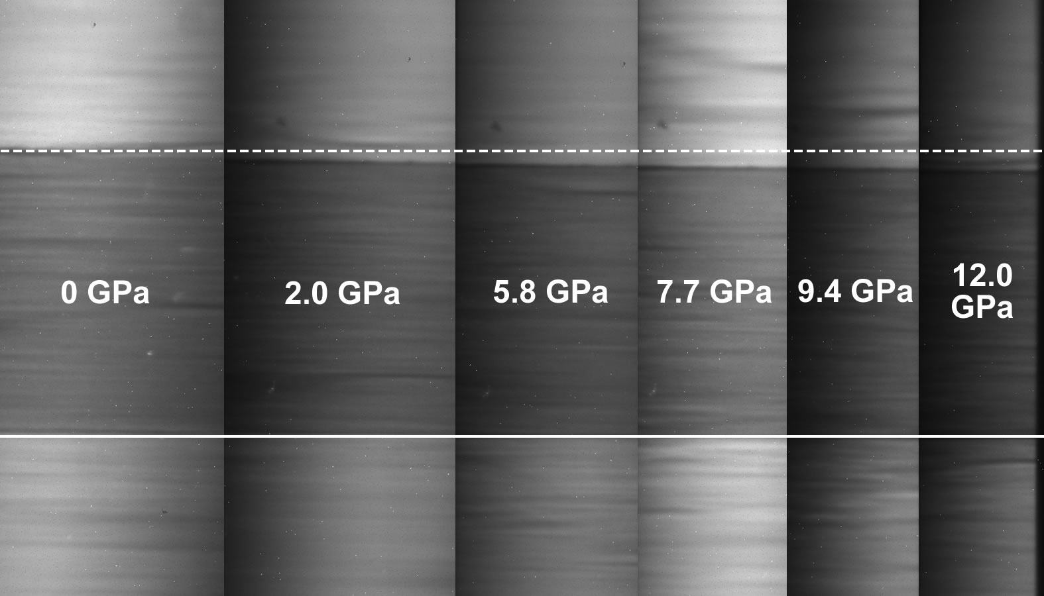
X-Radiographic Imaging

Slide 15
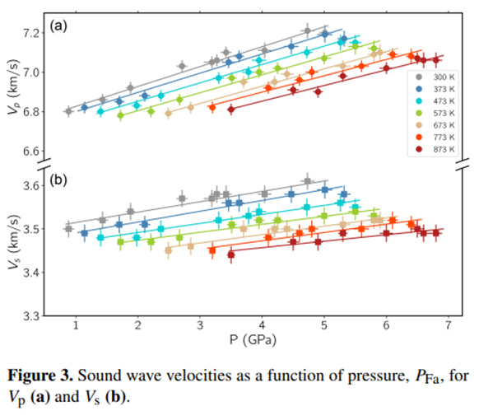
Ultrasonic Signal
Whitaker, Baldwin & Huebsch (2017) RSI

Slide 16
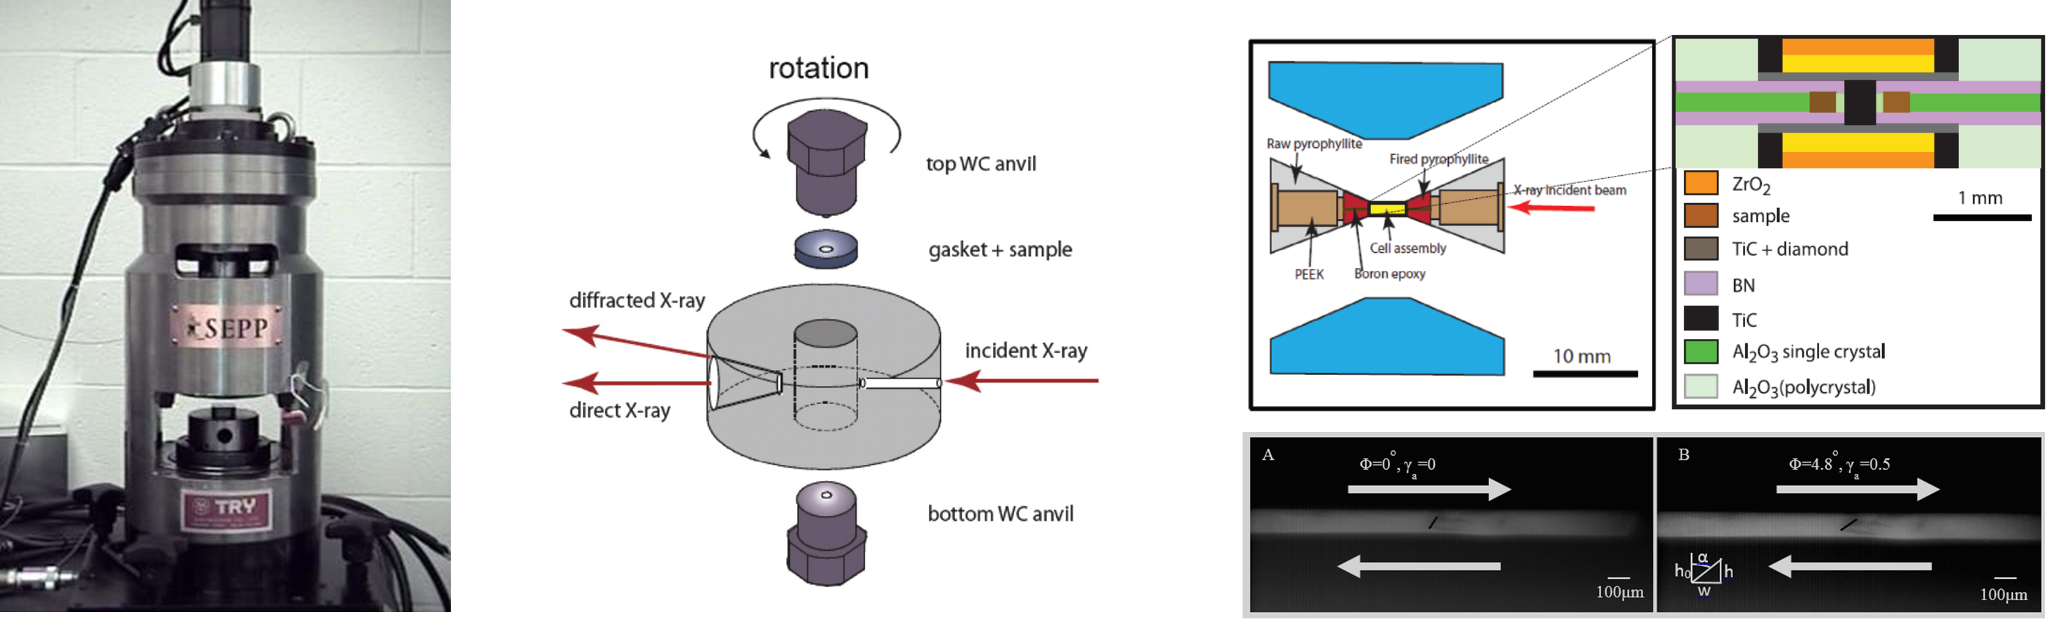
Rotational Drickamer Apparatus
Pioneered by Karato group from Yale University
Capable of shear deformation up to 300% strain
Can reach upper lower mantle conditions (27 GPa, 2200K)

Slide 17
MAXPD: Mono Beam Multi-Anvil Facility
Insertion Device Beamline; Sector 28-ID-2-D
1.8 Tesla Damping Wiggler Source
1100-ton Hydraulic Press Installed
ADT-25 (Acoustic Differential Kawai) Standard Module (~0.5-23+ GPa)
D-DIA Module Also Available (up to 10-12 GPa)
Differential Hydraulic Pumps for Deformation
Monochromatic Beam; Tunable ~30-70 keV (usually ~68 keV)
Angle Dispersive XRD; Perkin-Elmer Area Detector
X-Radiographic Imaging; YAG (and others!) & Point Gray Camera
We Are Open for Business!!!

Slide 18
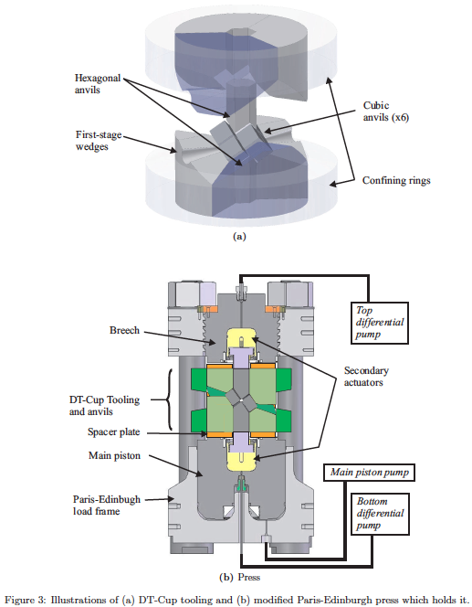
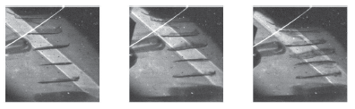
Deformation in Kawai Geometry
Development and commissioning of D-Tcup (DT-10); Collaboration of SBU and UCL
Kawai-type 6-8 geometry deformation apparatus; higher P range than D-DIA
Limited to 18 GPa, 1600 K w/ X-Ray Imaging and Diffraction
Up to 60% Strain
Hunt et al. (2014) Rev. Sci. Instr.

Slide 19
Scale It Up! DT-25 Schematics

Slide 20
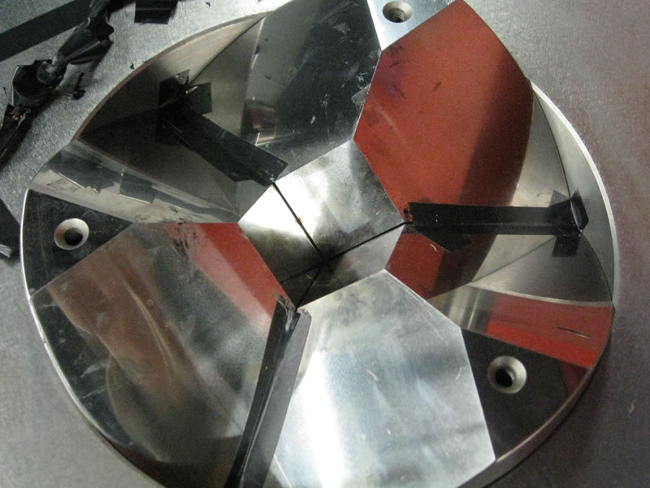
From T-25 to DT-25 First Stage Anvils

Slide 21
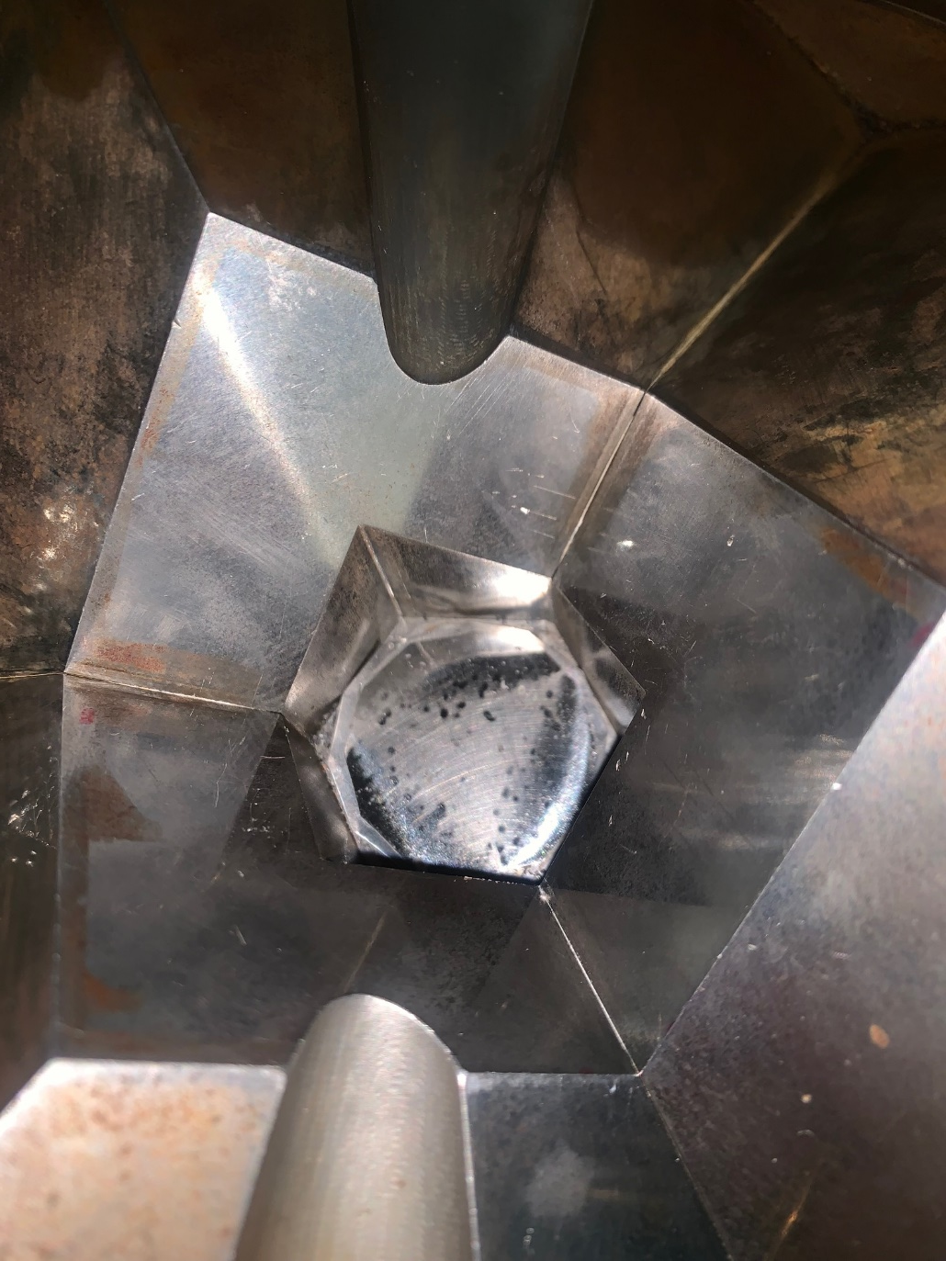
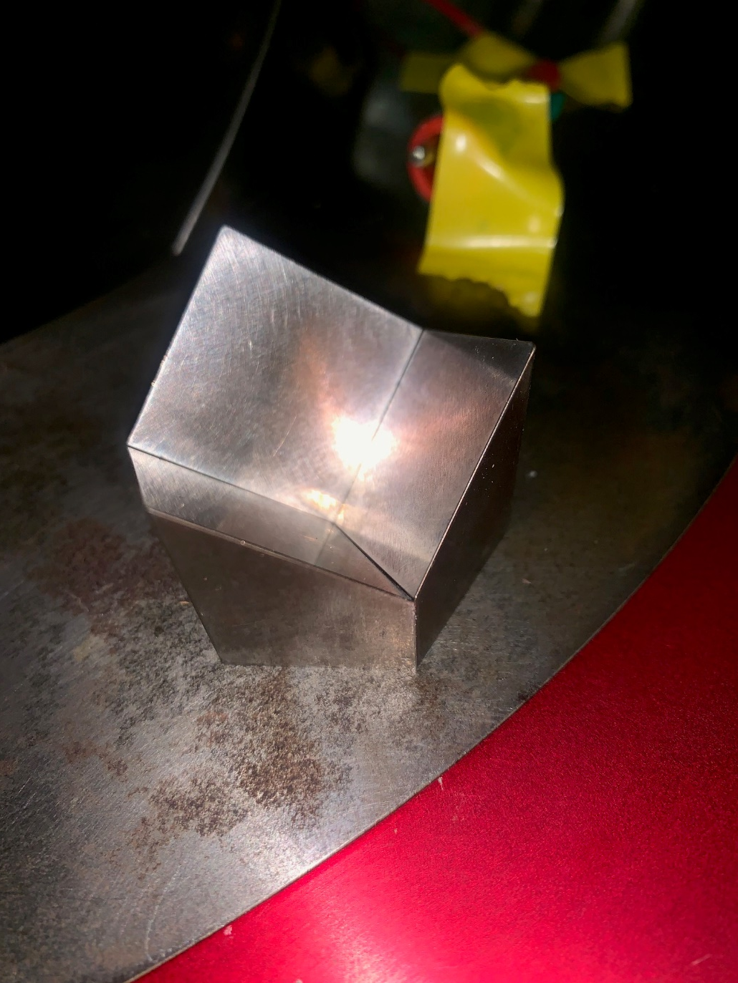
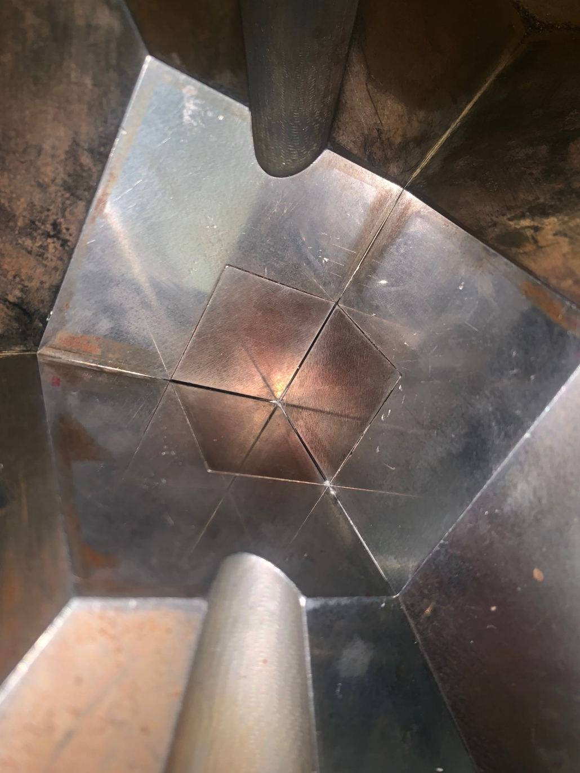
From T-25 to DT-25 First Stage Anvils

Slide 22
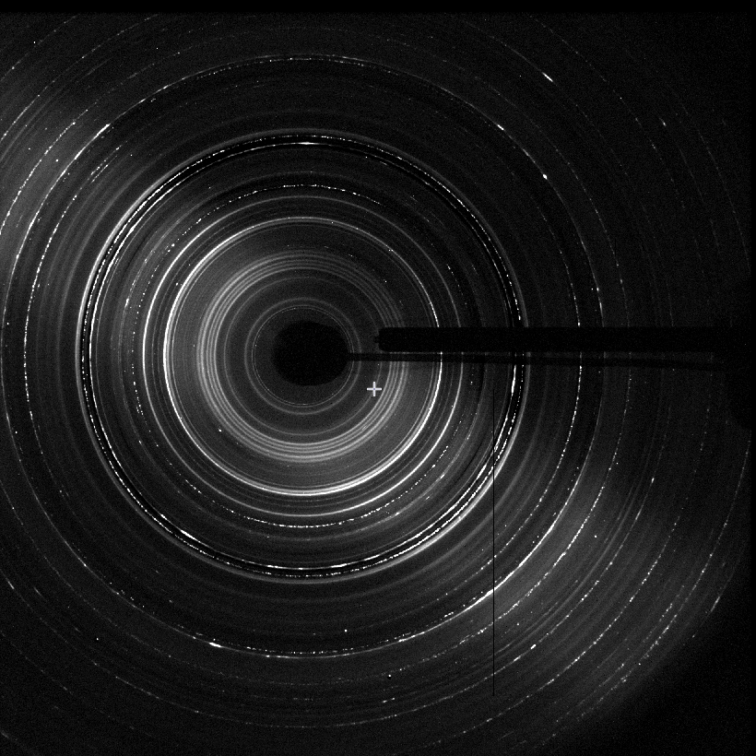
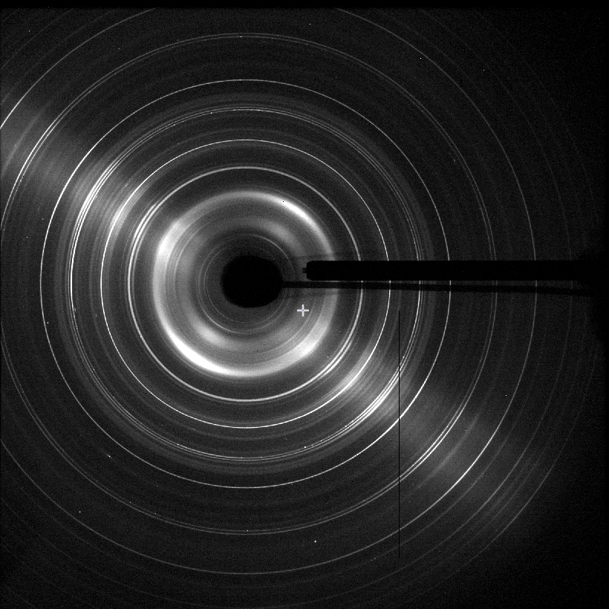
Formation of CaSiO₃ Perovskite
Experimental Conditions:
~18 Gpa
300 tons
(30% Max!)
~1000°C
Pseudowollastonite
to
CaSiO₃ Perovskite

Slide 23
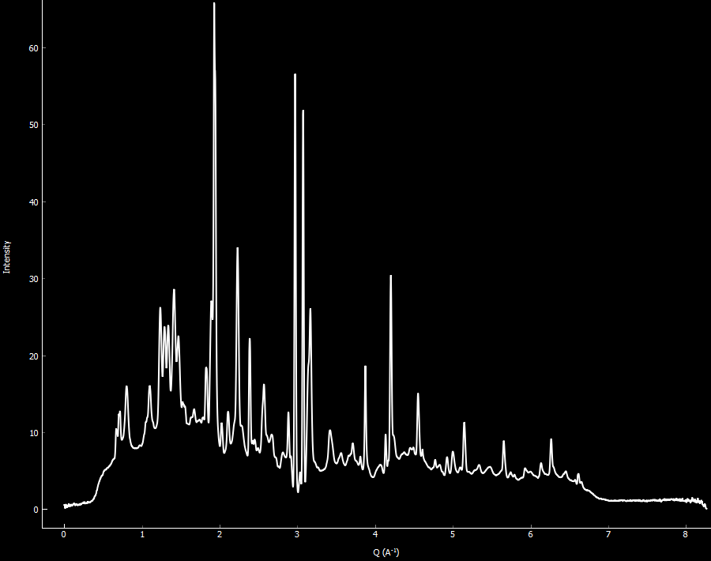
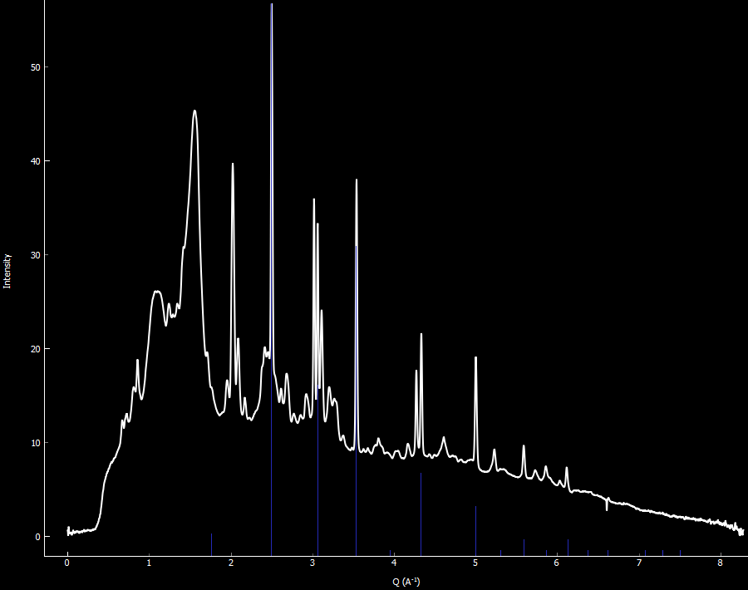
Formation of CaSiO₃ Perovskite
Room P & T
Pseudowollastonite
18 Gpa, 1000°C
CaSiO₃ Perovskite

Slide 24
Remember This?
P

Slide 25
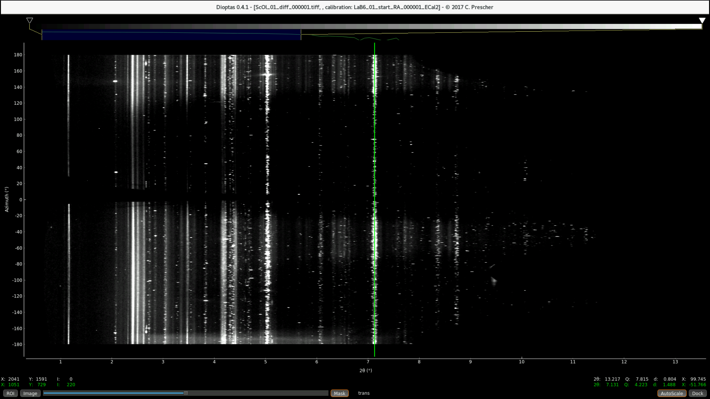
CAKE Plot – Before Deformation

Slide 26
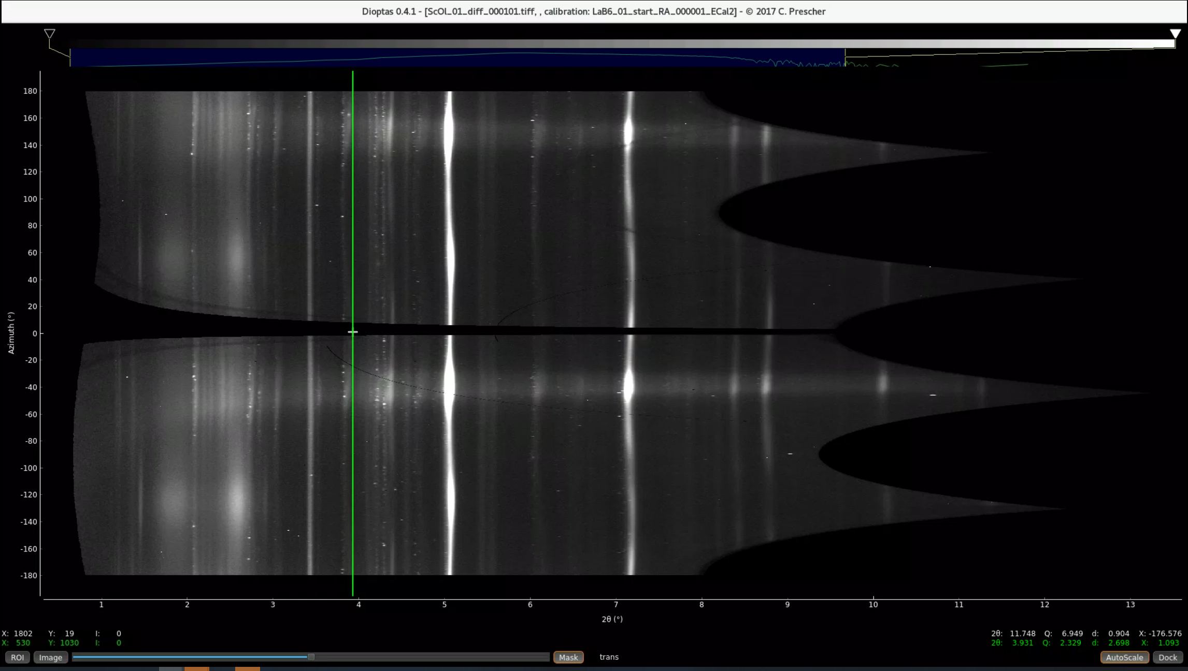
CAKE Plot – After Deformation

Slide 27
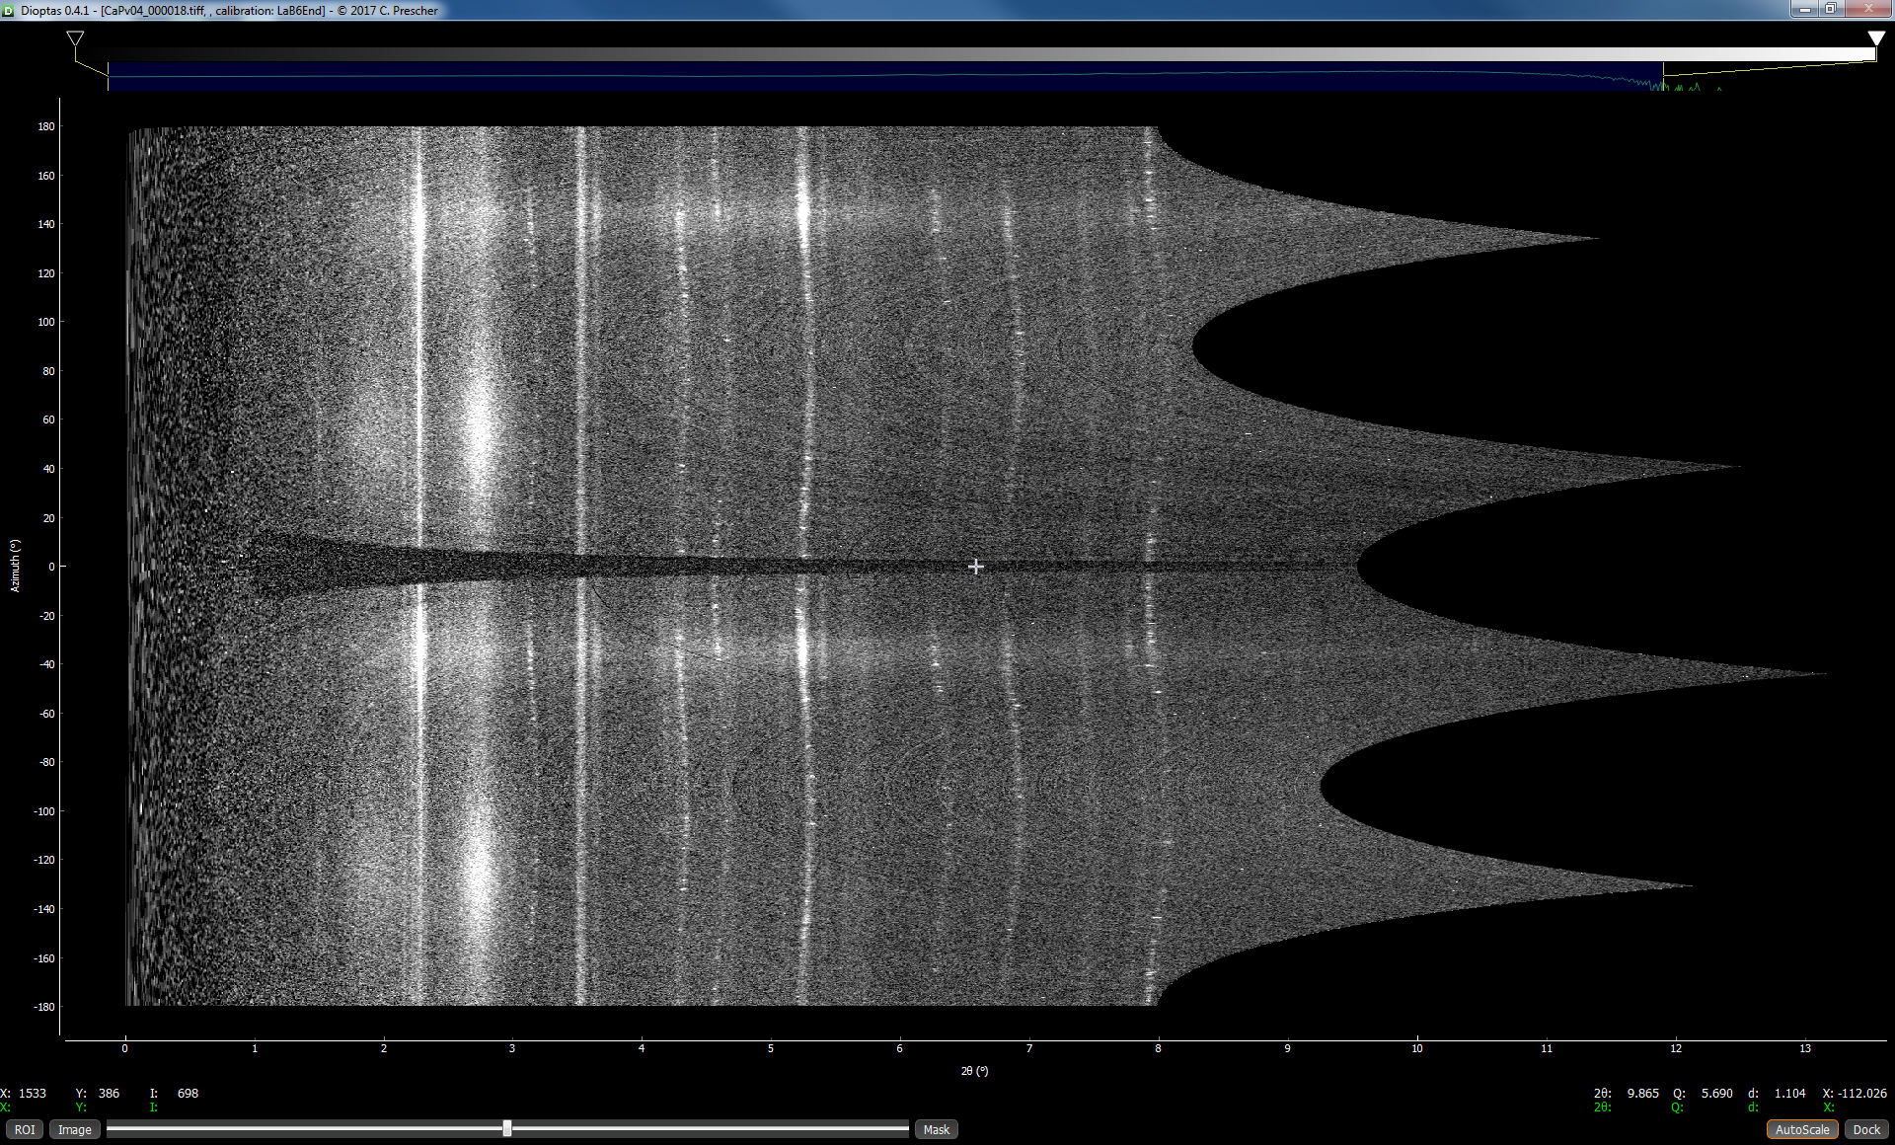
CAKE Plot – Deformation of Bragg Rings

Slide 28
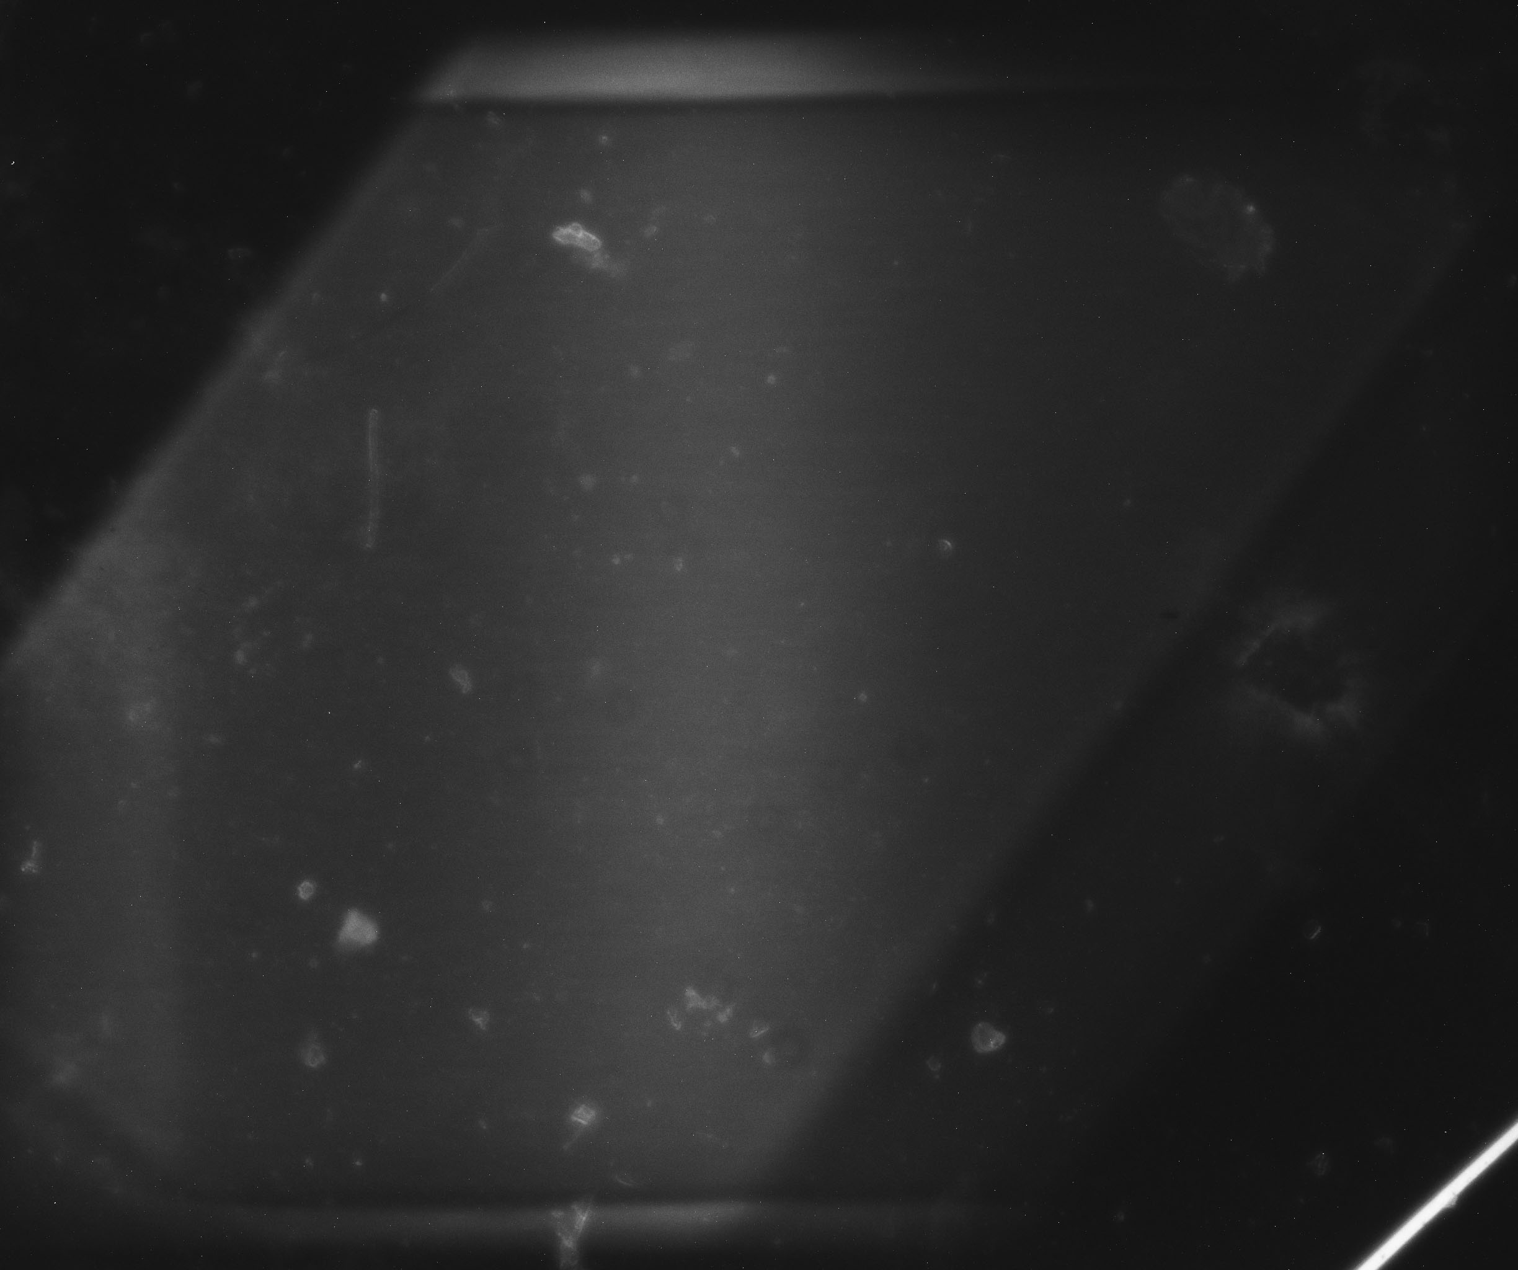
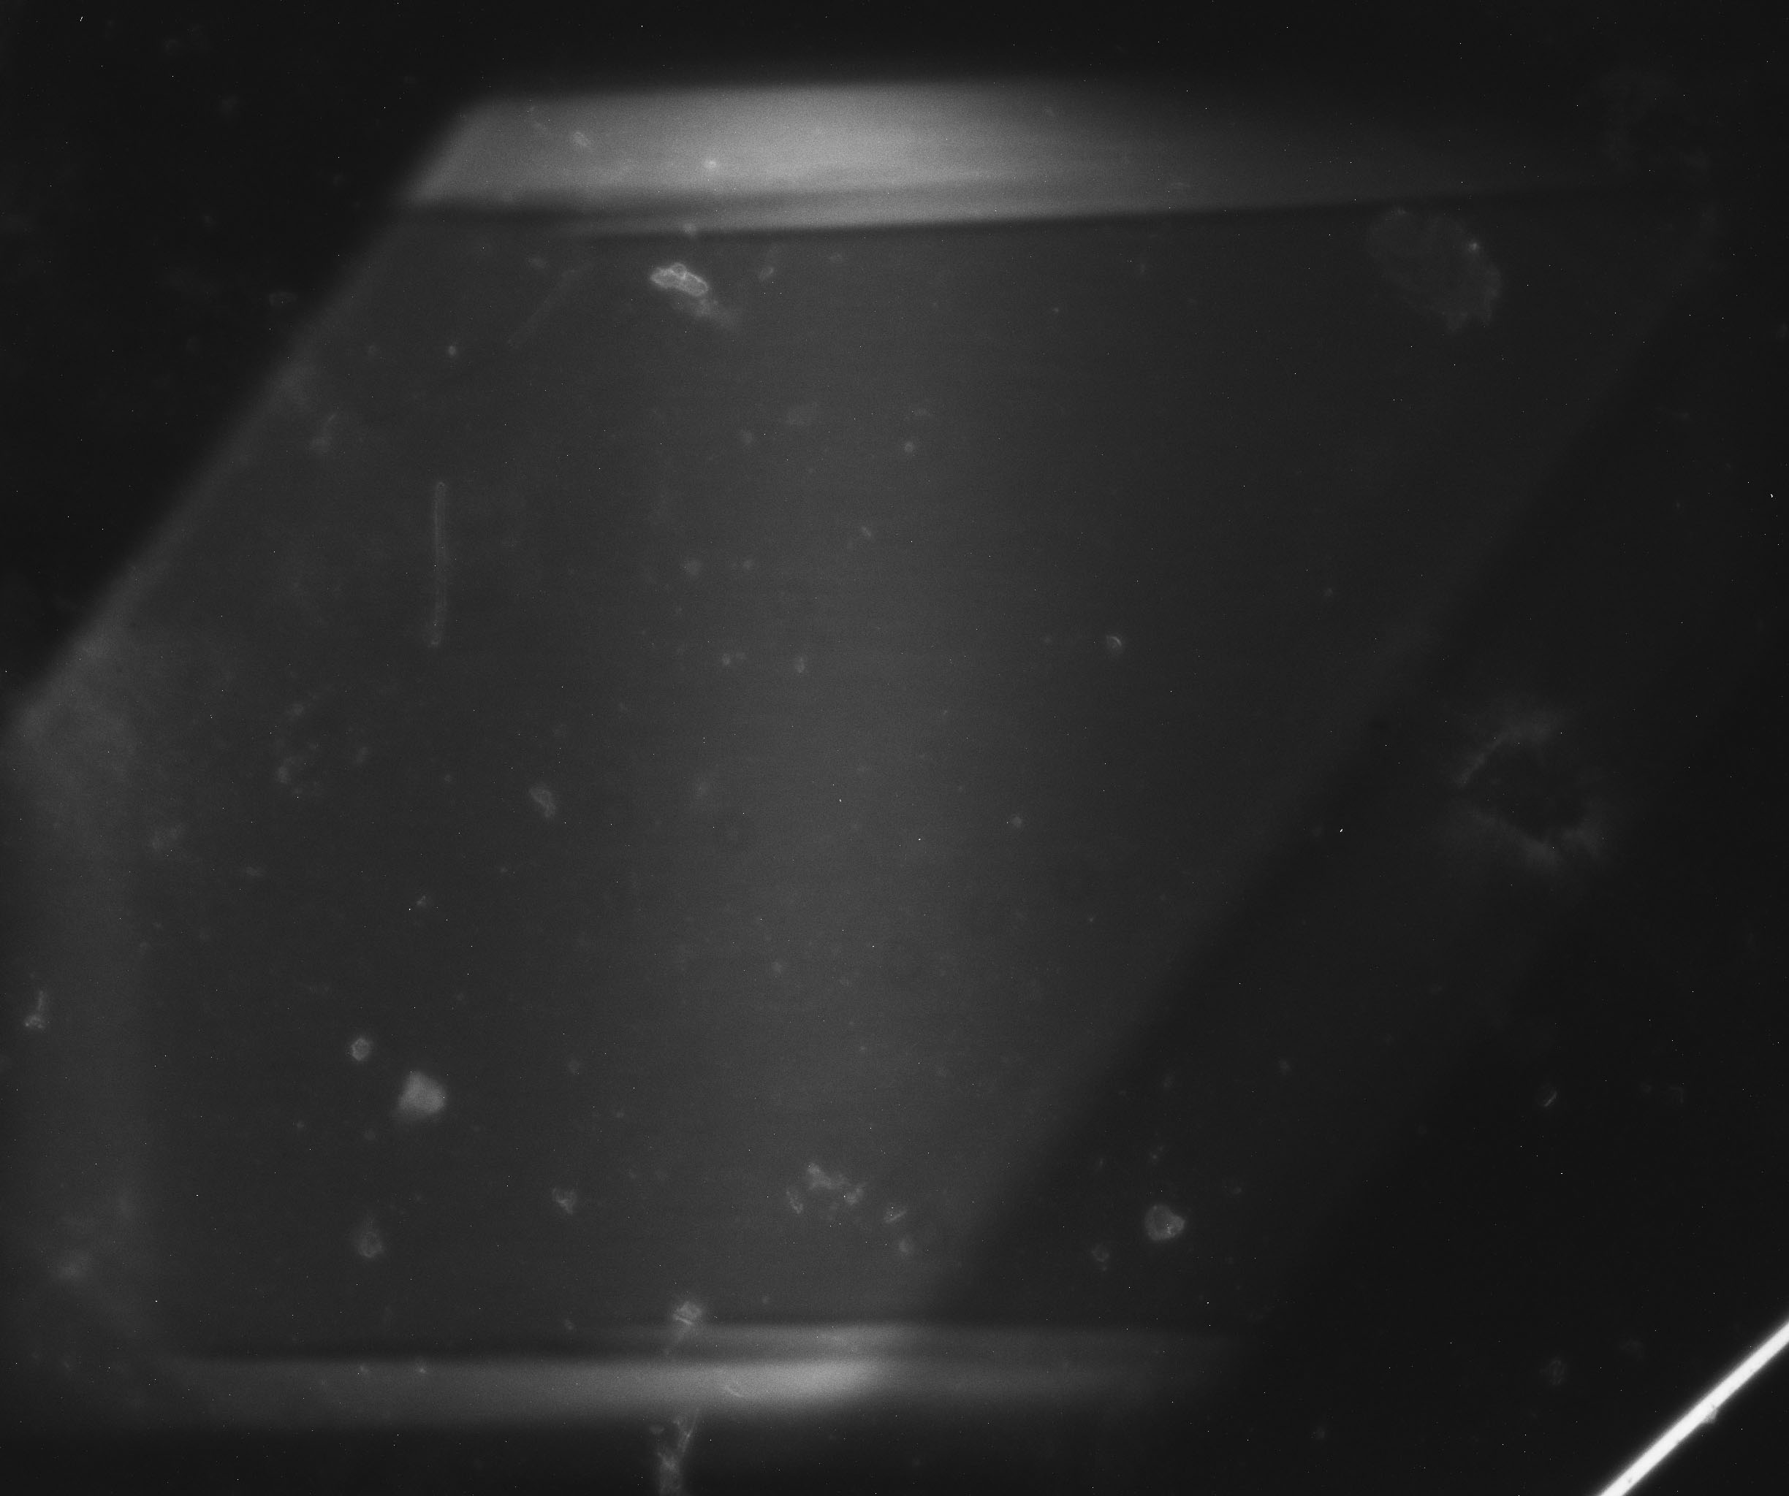
Deformation of CaSiO₃ Perovskite
Fe Sample
10,000 bar
Before Deformation
Fe Sample
10,000 bar
12% Pre-Strain

Slide 29
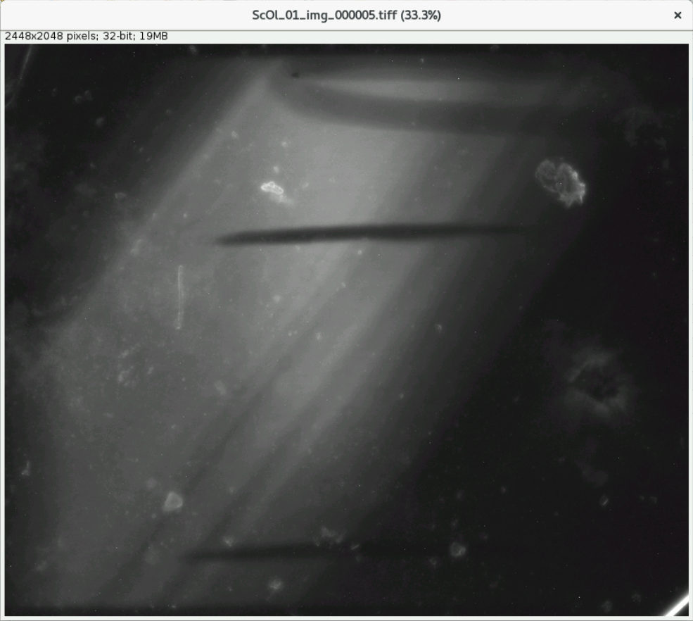
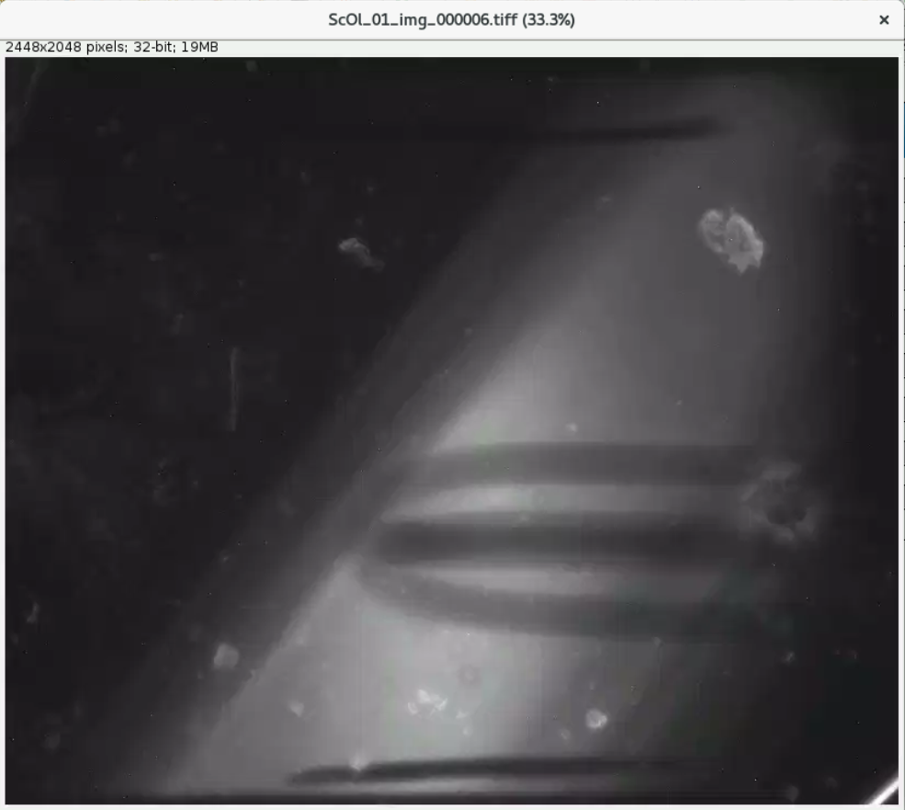
Sample Images Before Deformation
Samples at
7 GPa & 1200°C
Before Deformation
1.776mm
1.197mm

Slide 30
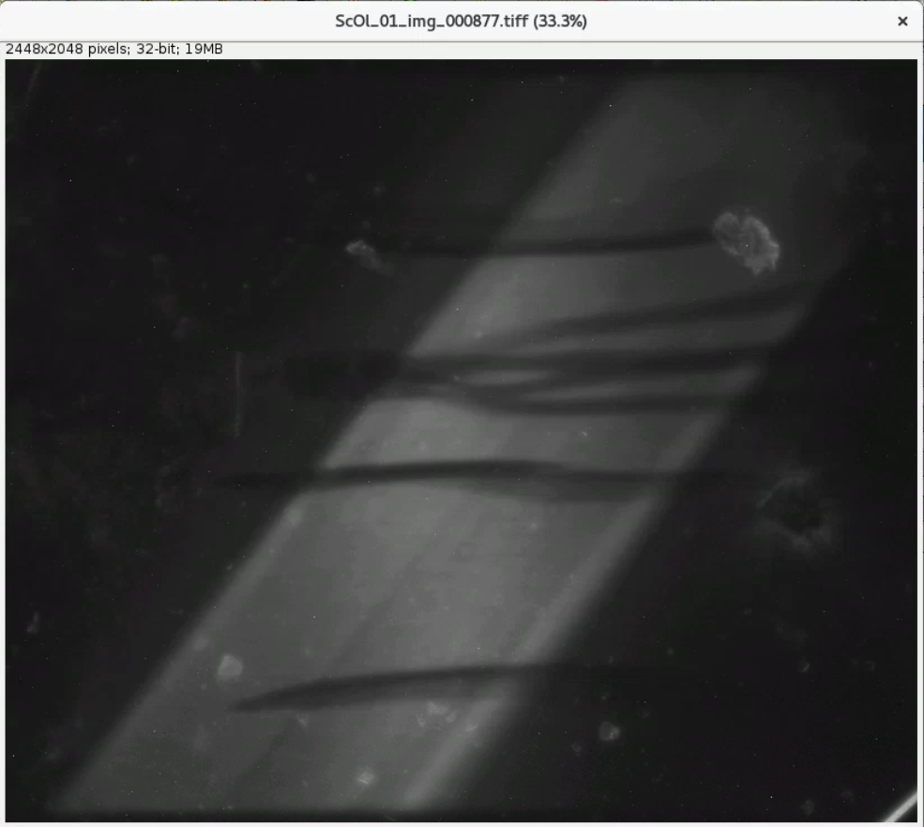
Sample Images After Deformation
Samples at
7 GPa & 1200°C
After Deformation
1.170mm
~60% Total Strain!

Slide 31
HEX: Multi-Purpose High Energy X-rays
Insertion Device Beamline; Sector 27-ID
4.3 Tesla 29 Pole Superconducting Wiggler Source
Double Bent Laue Monochromator with Large Bandwidth
100 mm H x 20 mm V beam size in station 100 m from source
Can operate in either monochromatic or white beam mode
Wiggler magnetic field can be adjusted at any time to allow tuning of the spectrum for best results depending on experiment
Large experimental hutch to allow for moving equipment in and out
Major techniques include Full Field Imaging and Tomography, Phase-Contrast Imaging, and both Energy- and Angle-Dispersive XRD
Now Accepting General User Proposals!!!

Slide 32
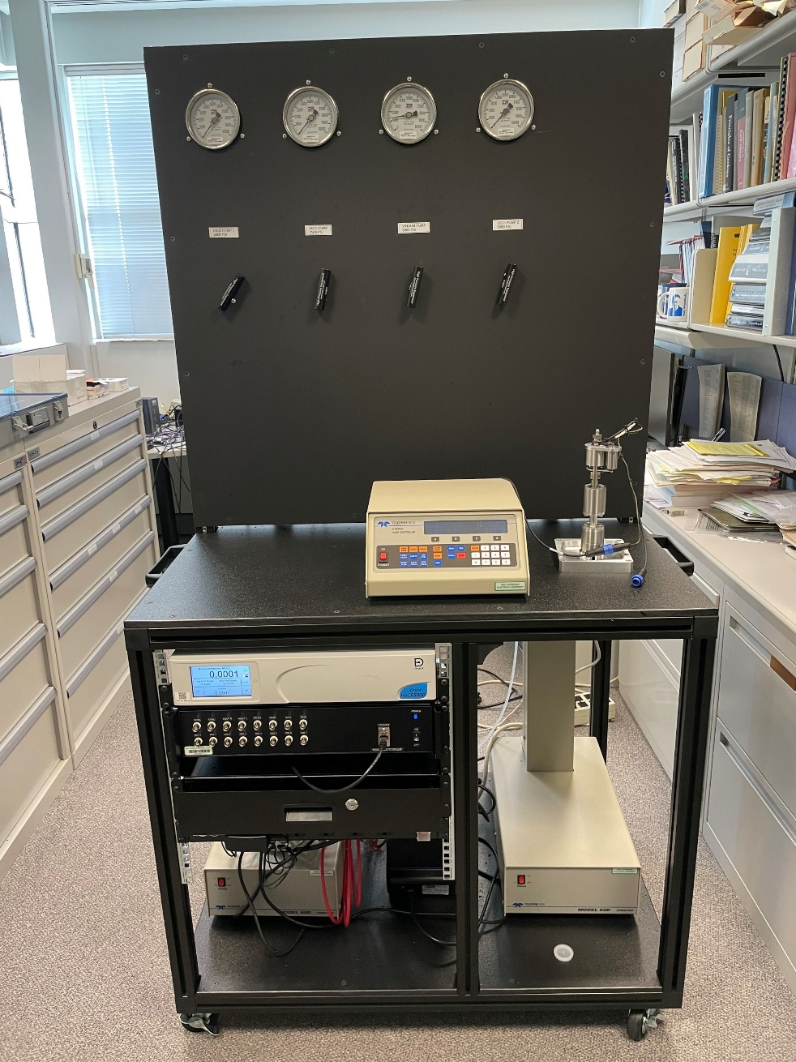
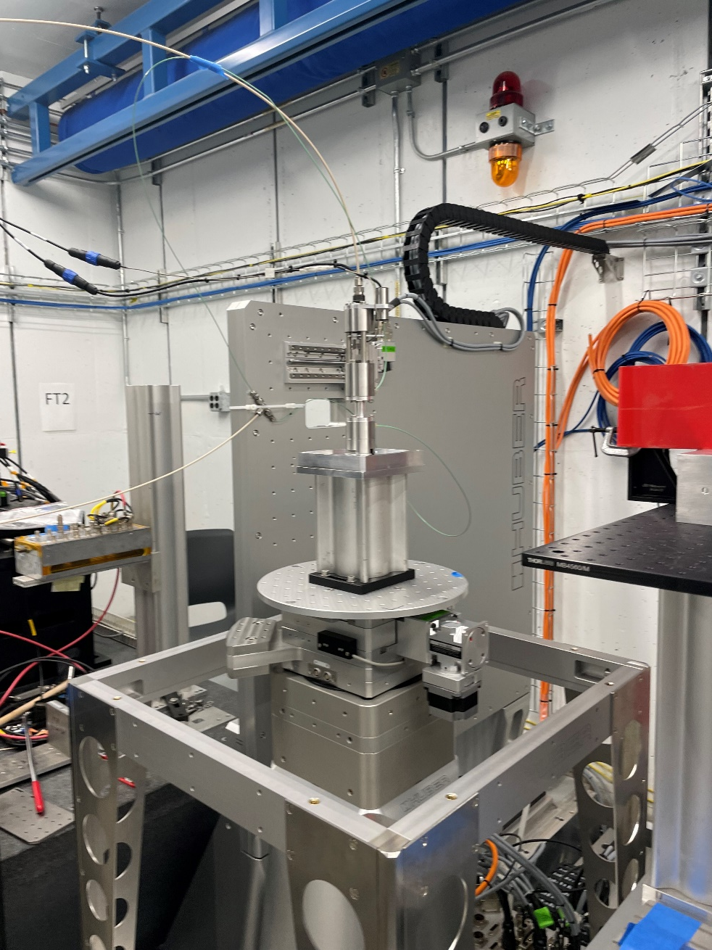
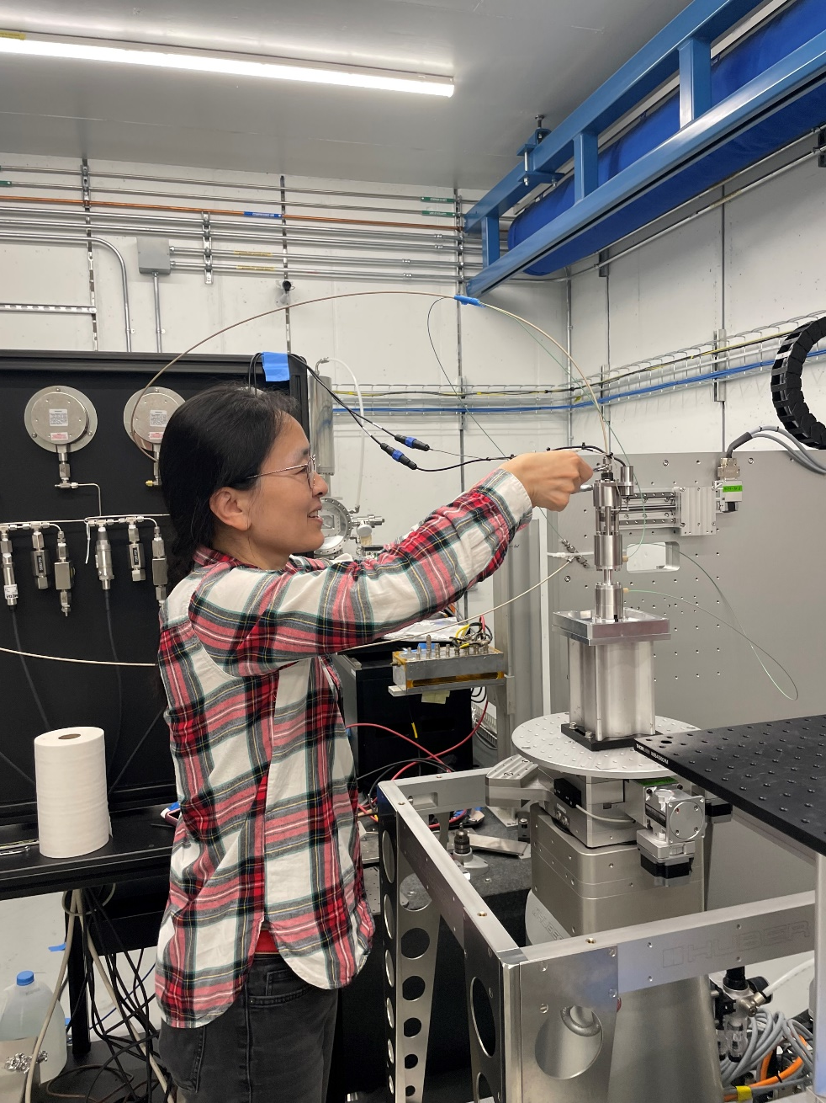
First Rock Deformation Experiments at HEX
Mjolnir pump cart
Sample stage with Mjolnir cell
Wenlu mounting sample

Slide 33
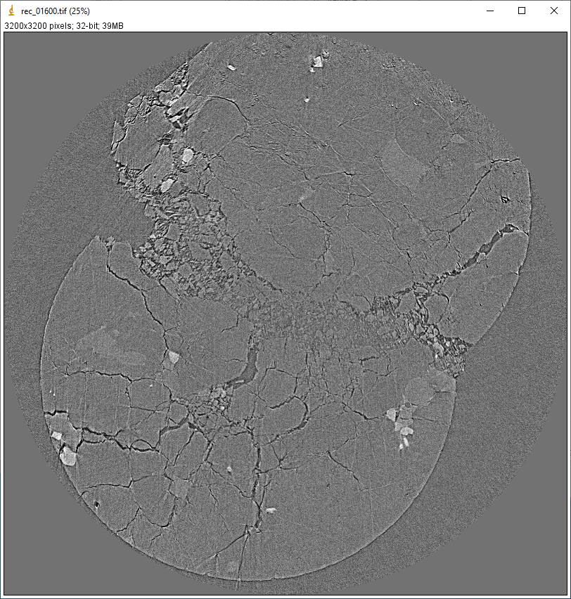
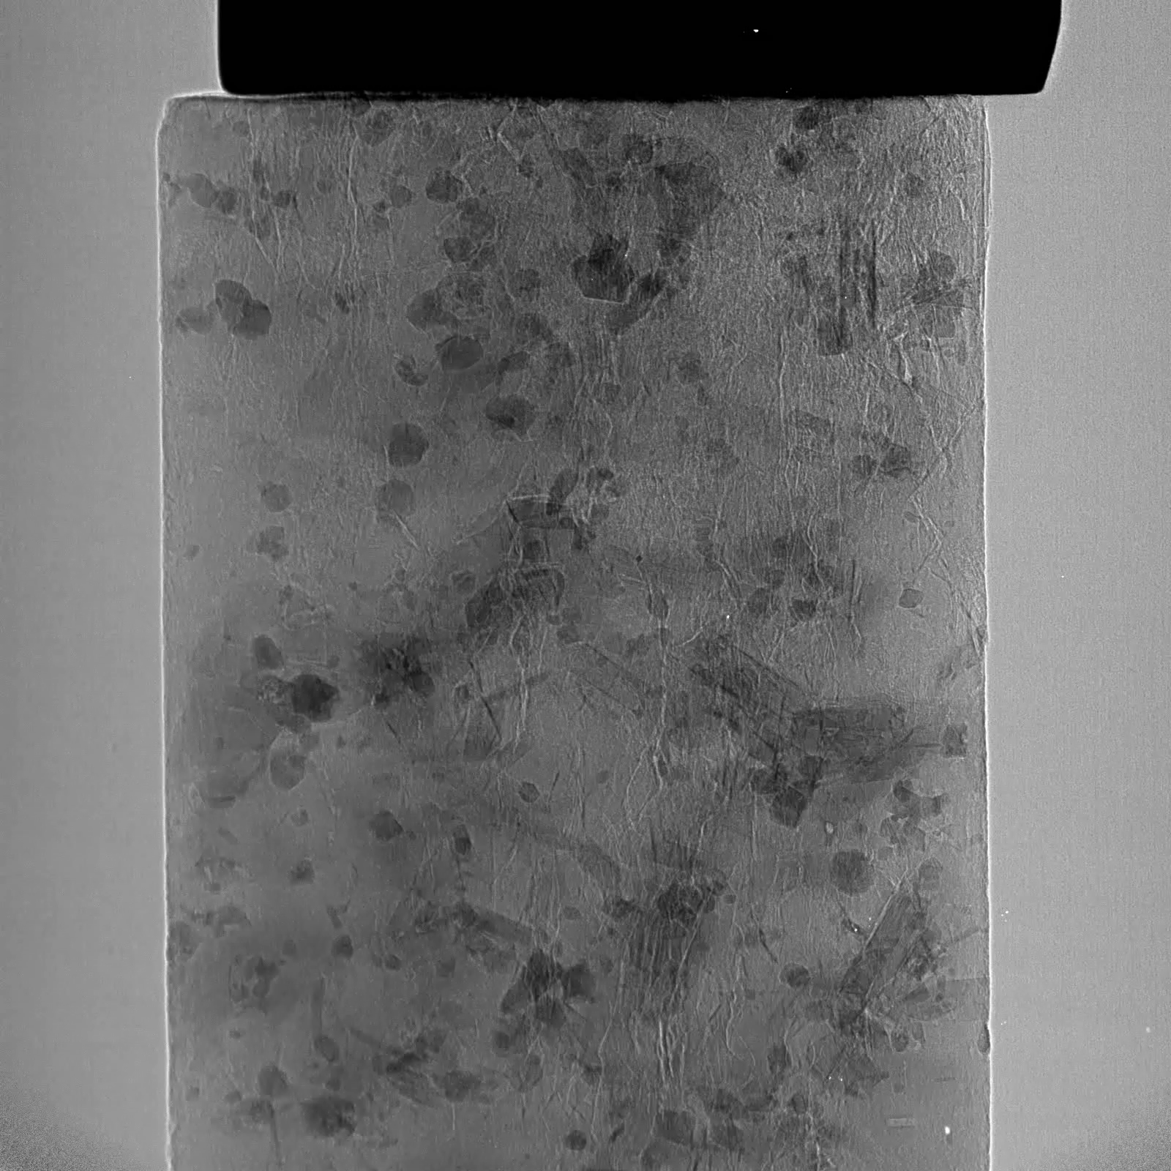
First Rock Deformation Experiments at HEX
Granite after failure in triaxial Mjolnir cell
Video of incipient rock fracture collected at HEX

Slide 34
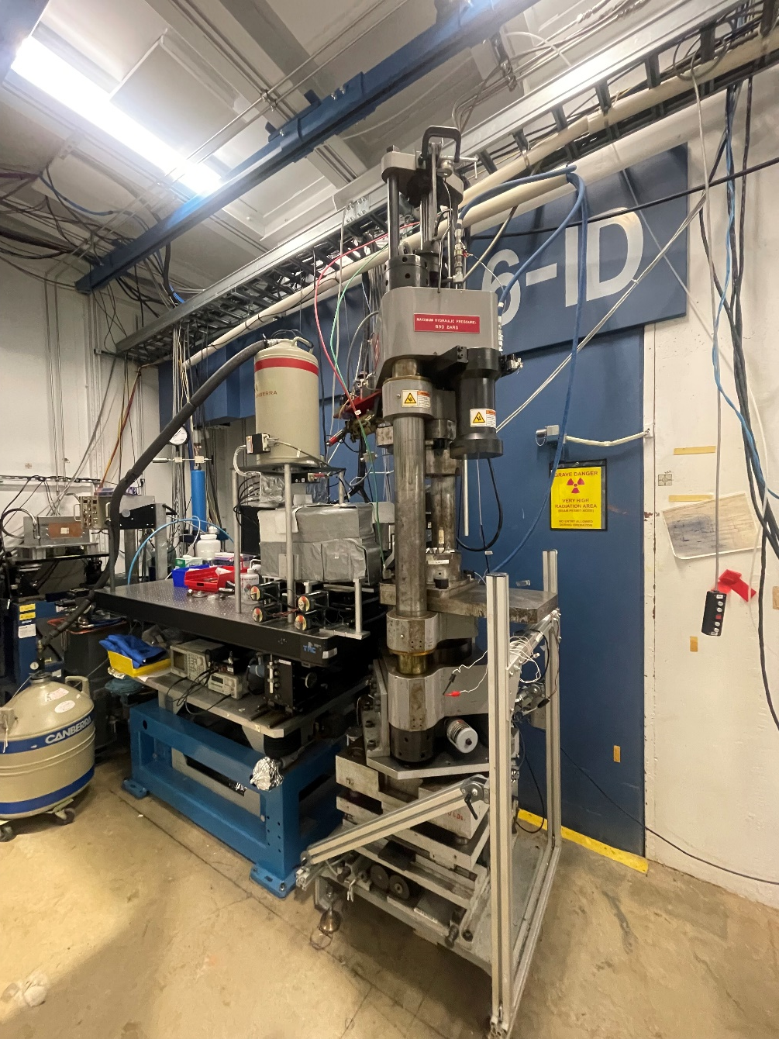
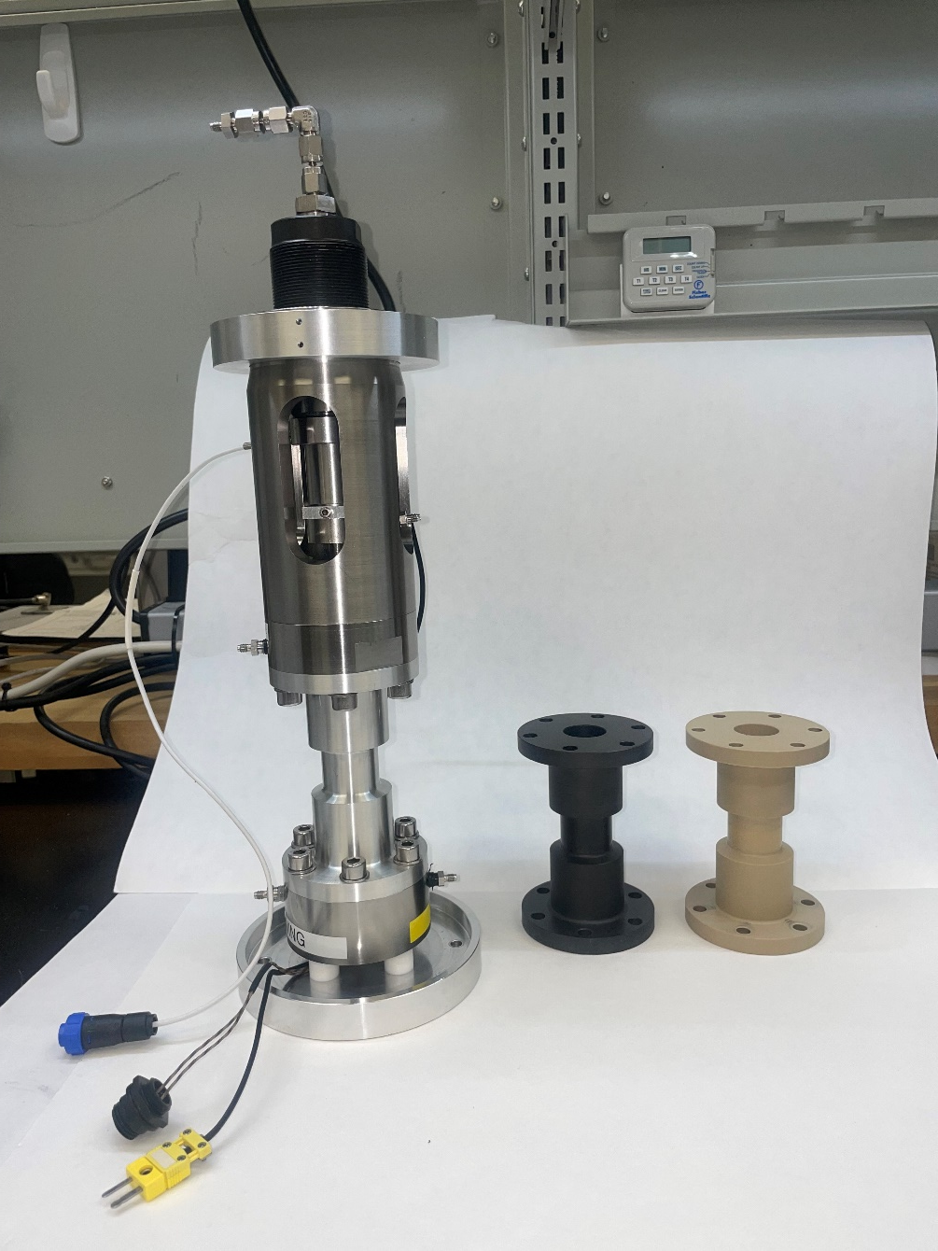
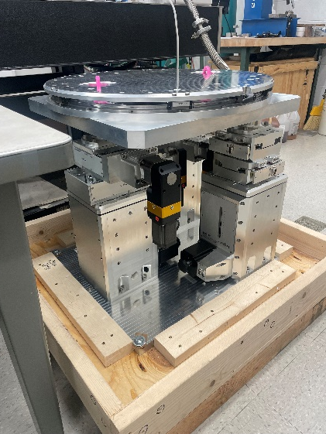
Future Plans in Rock Mechanics @ SBMAX
New 6-BM-B high precision press positioning system – pedestal that can support large volume press and other sample environments
Air bearing rotation stage for tomographic imaging at ambient or moderate pressures in triaxial cells at 6-BM-B
New Heitt Mjolnir more robust triaxial cell and hydraulic pumping system (both 6-BM-B and HEX)
New capabilities and expansion of access to underserved Rock Mechanics, Near Surface, and Geotechnical Engineering communities

