Slide 1
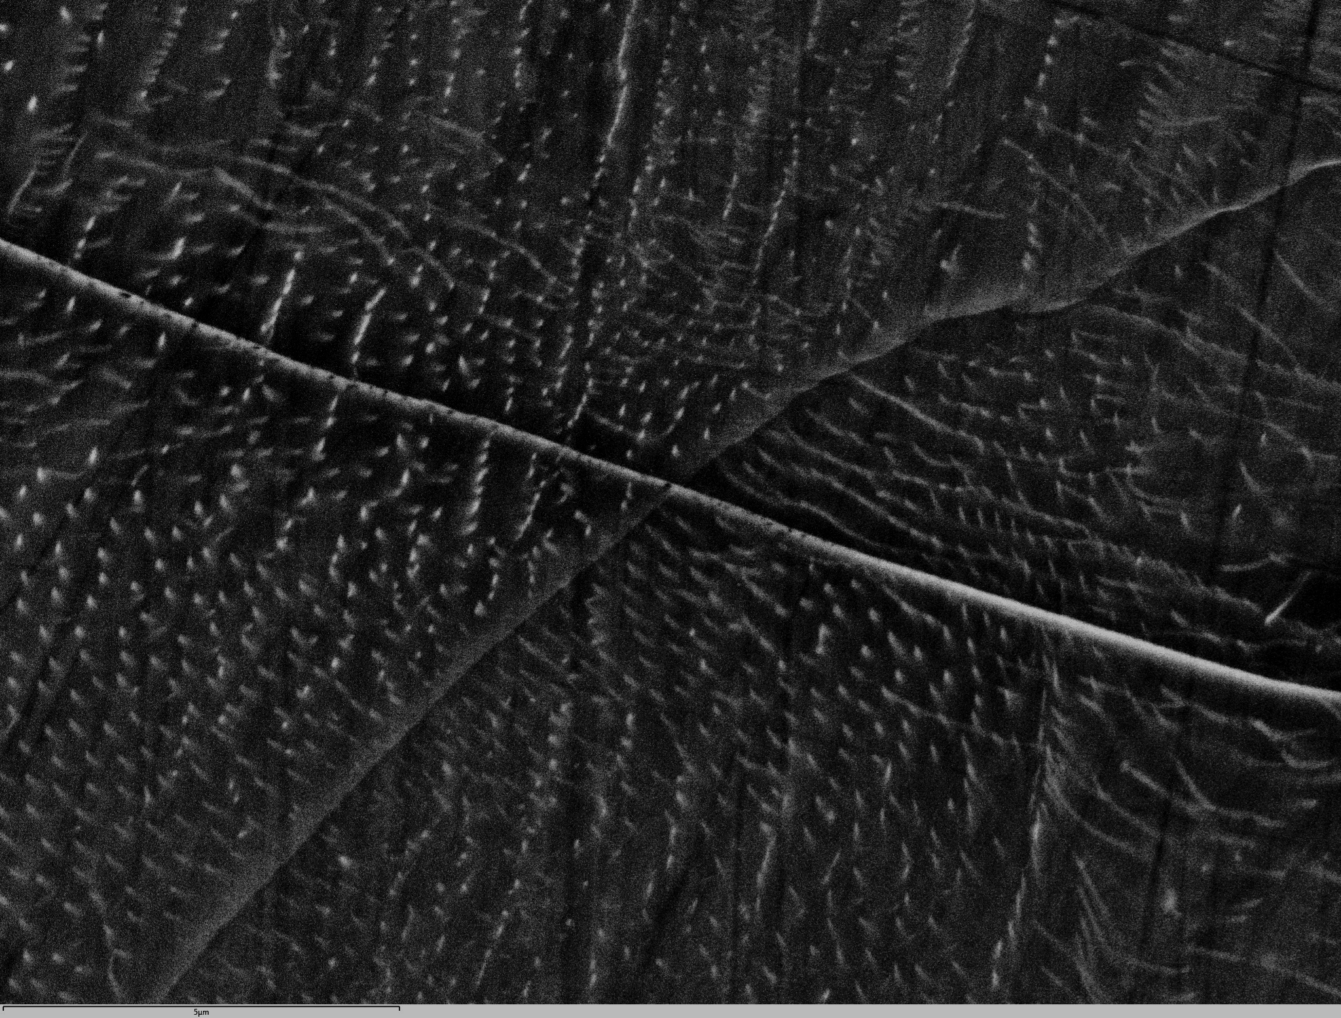

Volumetric strain measurements in the D-DIA for probing transformation plasticity and semi-brittle deformation
Lars Hansen (UMN), Andrew Cross (WHOI), David Goldsby (UPenn), and Adaire Nehring (UMN)
With additional contributions from:
Tom Breithaupt, Haiyan Chen, Amanda Dillman, David Goldsby, Rellie Goddard, Diede Hein, Katie Kumamoto, Veronique Le Roux, Caroline Seyler, Chris Thom, David Wallis

Slide 2
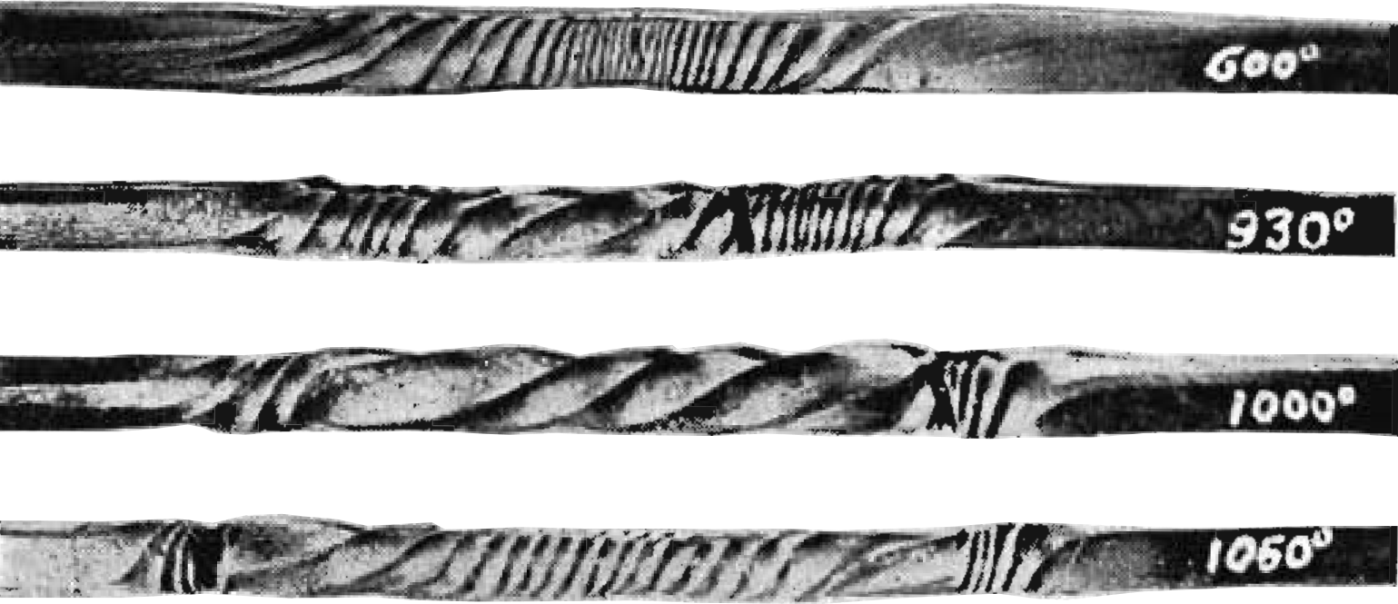
PART 1:
Transformation plasticity as a deformation mechanism
Iron bars in torsion
Constant twist rate
α-Fe
γ-Fe
γ-Fe
α-Fe
Cold
Hot
Cold
Sauveur (1924)
Notes:
Comparatively few experiments on phase transitions – but interest in the topic goes back almost 100 years

Slide 3
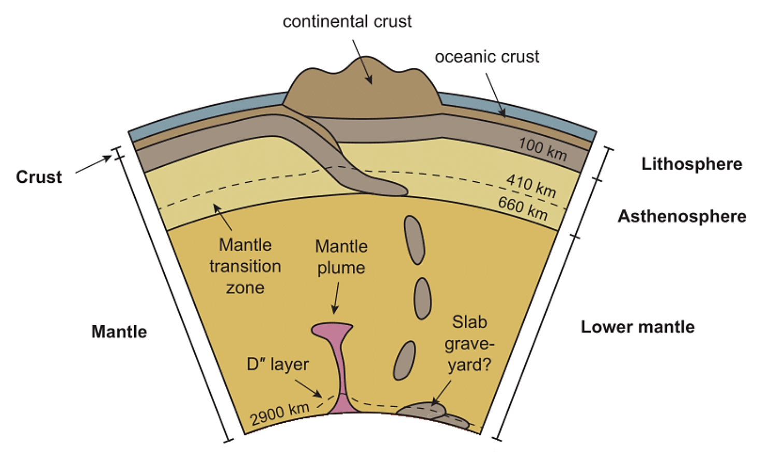
Shear zone nucleation during orogenesis (Schmidt et al., 2003)
Decoupling of mantle convection (Parmentier, 1981; Rubie & Brearley, 1984)
Slab stagnation in mantle transition zone (Sammis & Dein, 1974; Panasyuk & Hager, 1998)
Seismic uncoupling along subduction interfaces (Ruff & Kanamori, 1981)
Deep focus seismicity (Bridgman, 1945; Green & Burnley, 1989)
Mantle plume dynamics (Gordon, 1971)

Slide 4
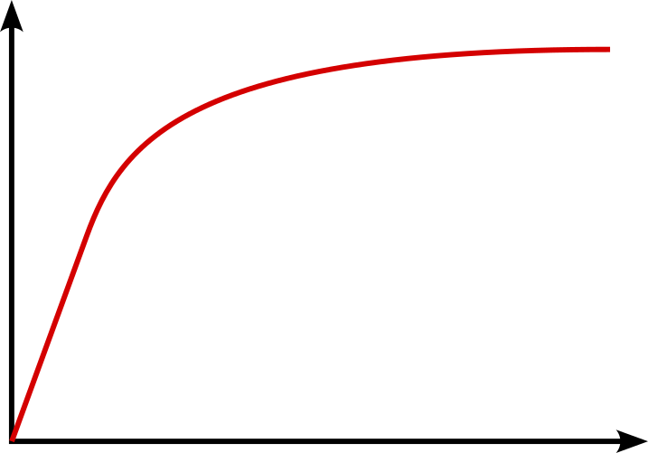


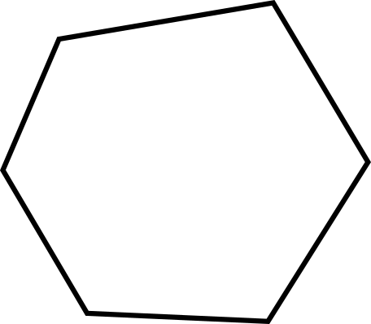

Greenwood & Johnson (1965) model
3) plastic flow produces permanent strain
2) volume change introduces internal stress
1) applied stress < yield stress
Stress
Strain
Notes:
G&J model introduces concept of internal stress – produces anomalous weakening

Slide 5
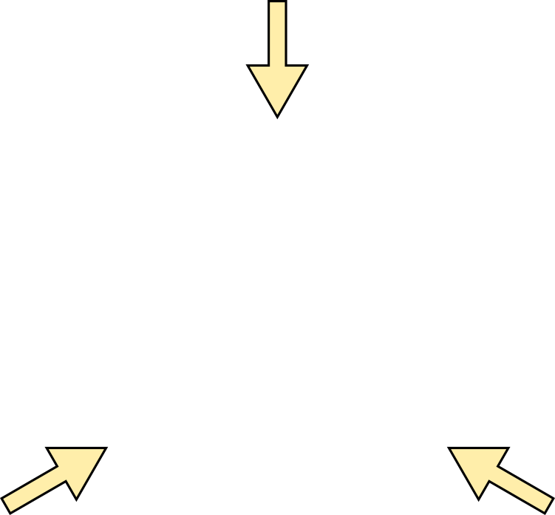
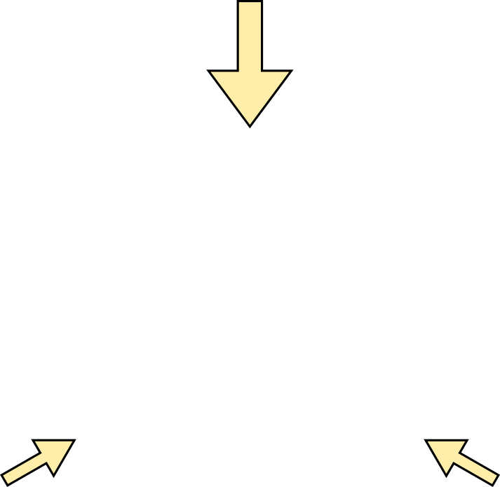
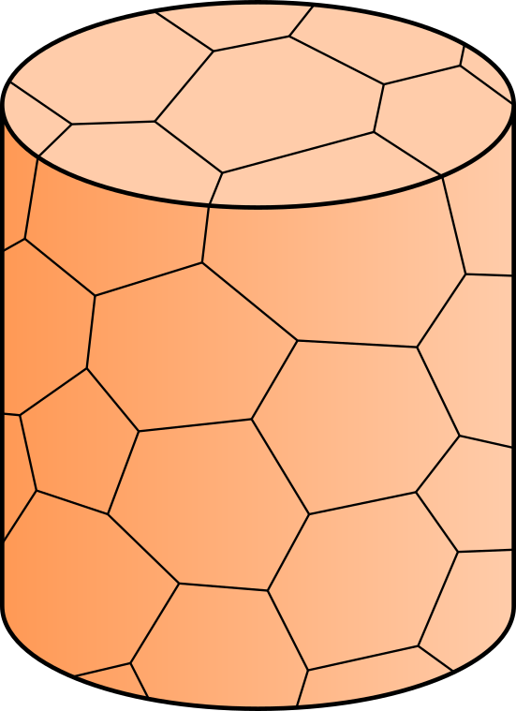
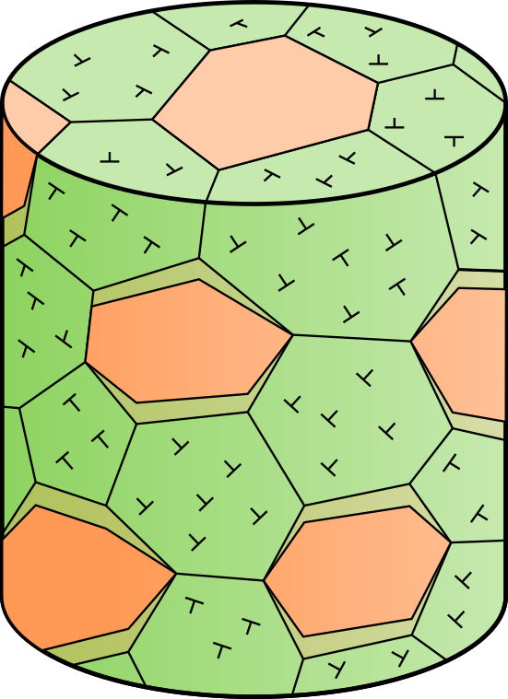

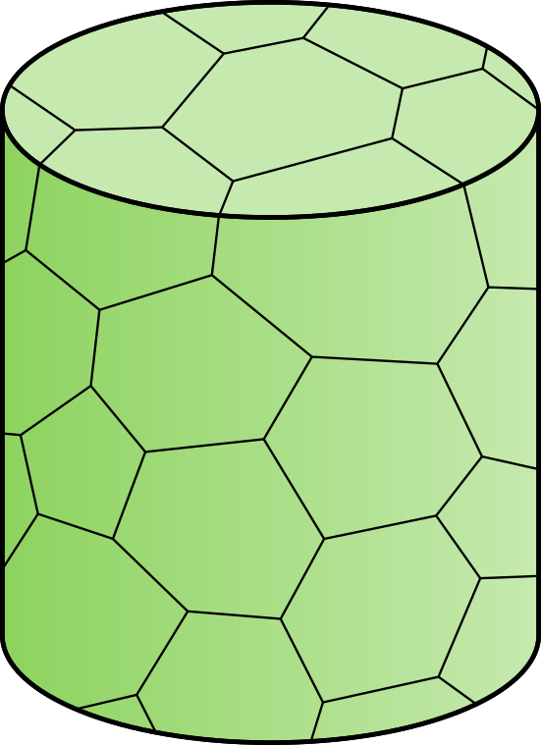
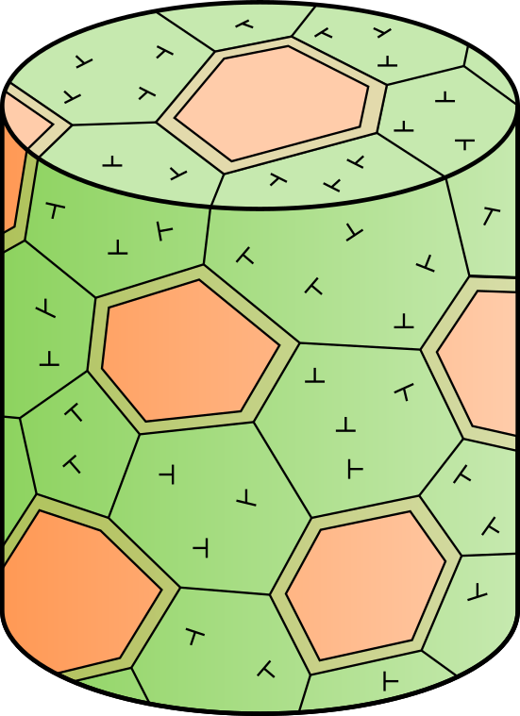
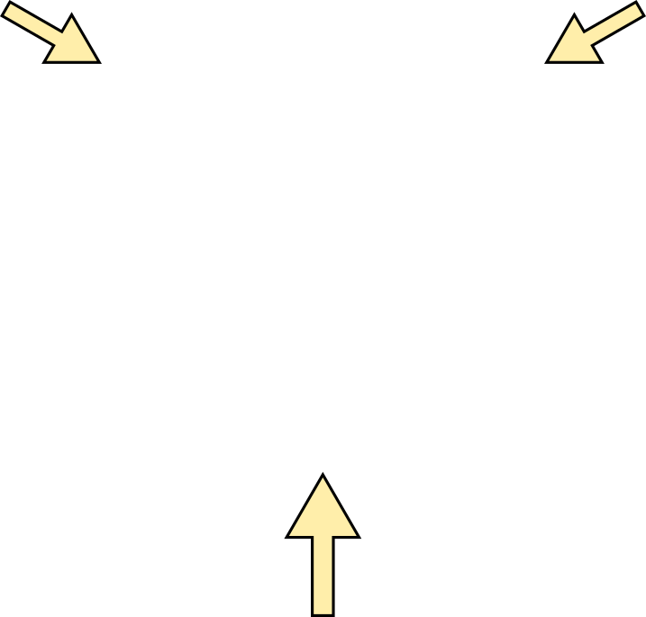
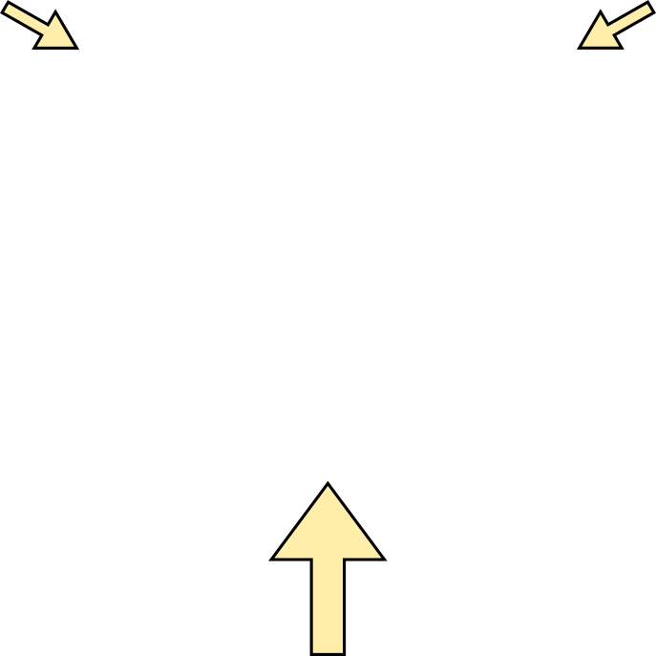
Hydrostatic
(σ₁ = σ₂ = σ₃)
Non-hydrostatic
(σ₁ > σ₂ ≥ σ₃)
σ₁
σ₂
σ₃
Notes:
And also predicts volume change anisotropy

Slide 6
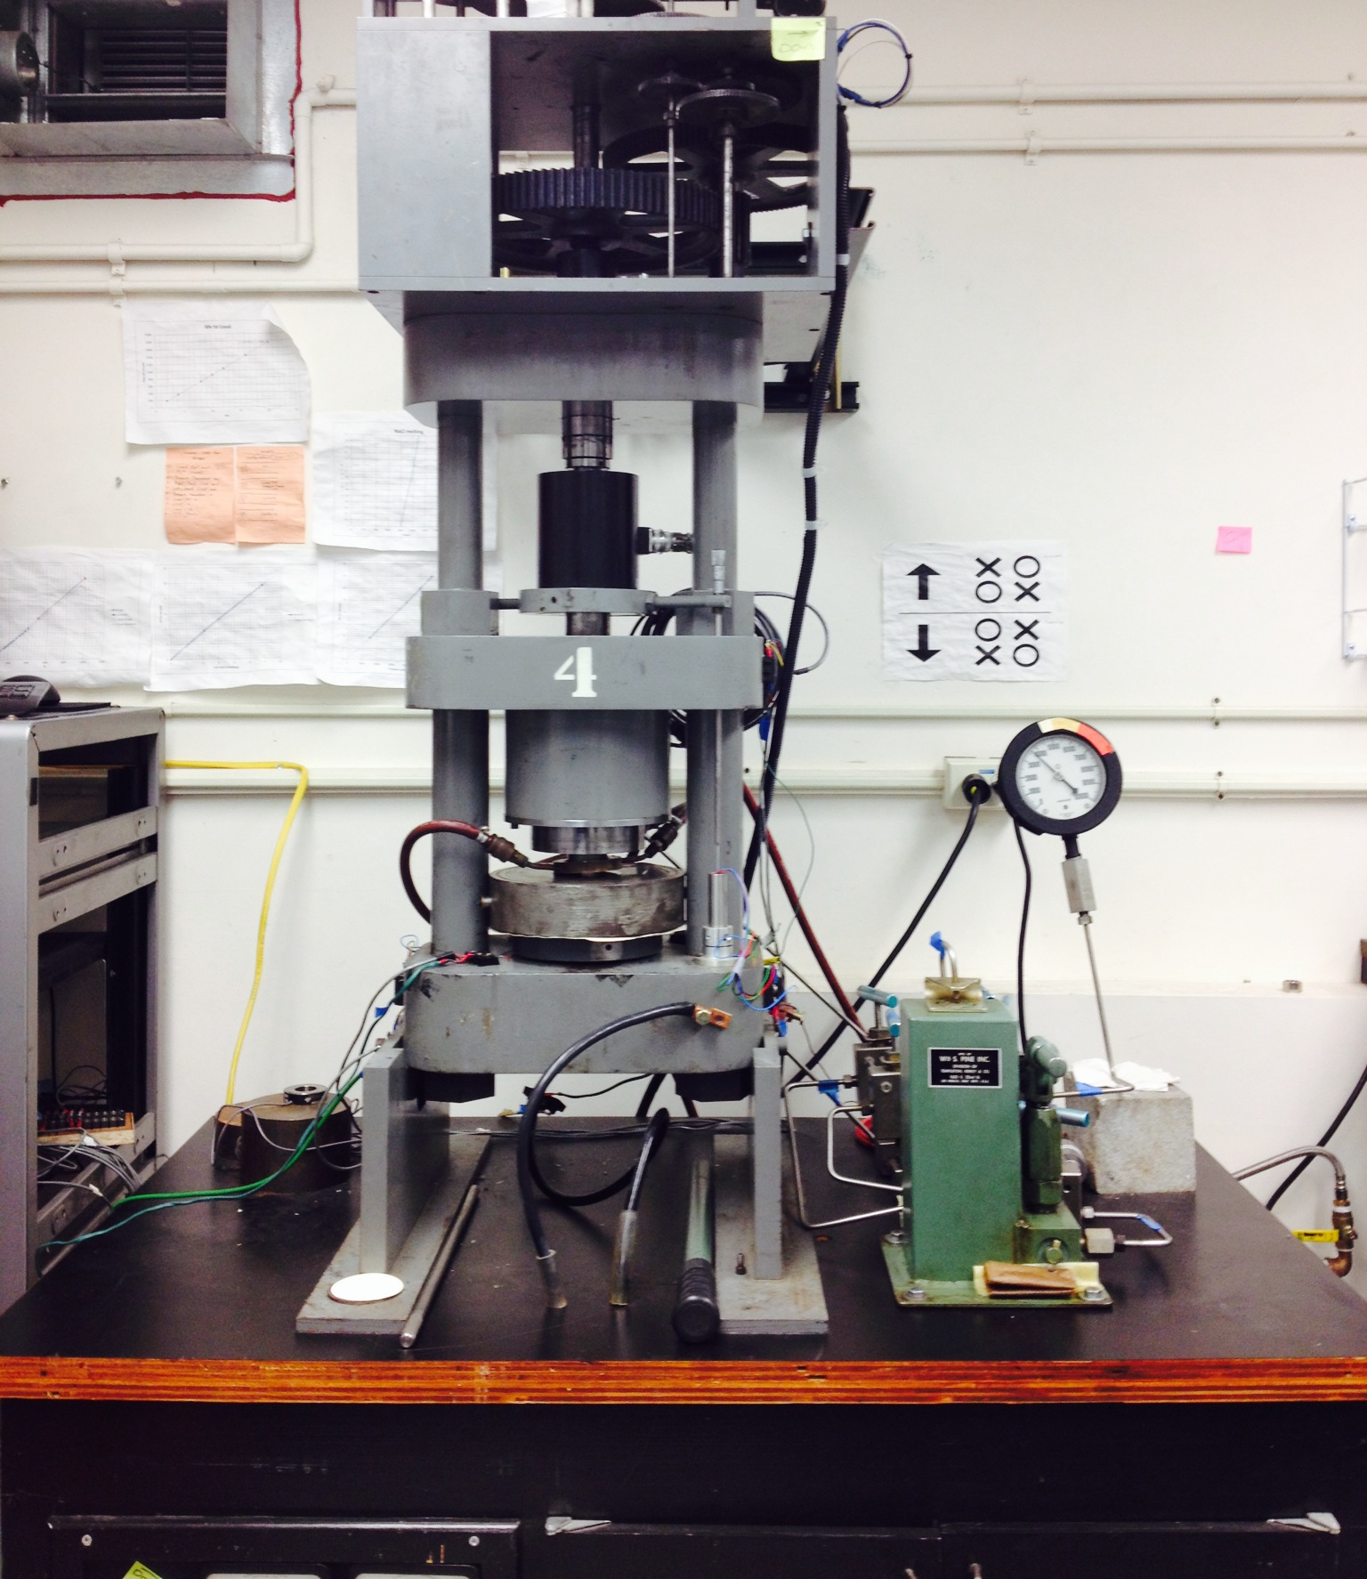
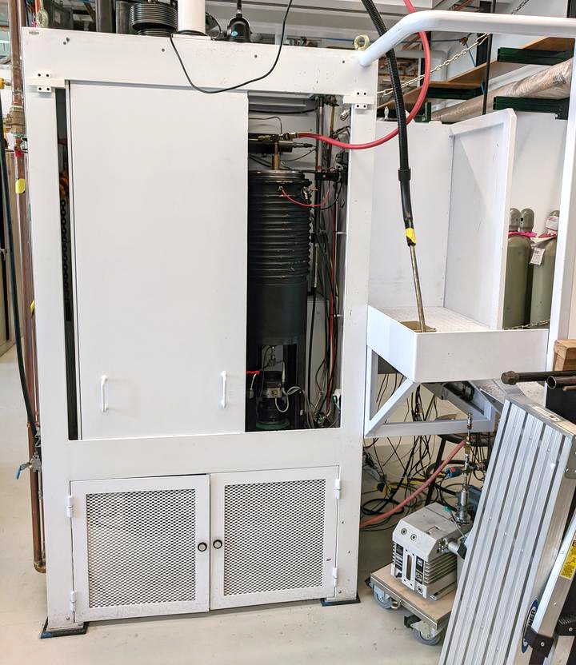
Conventional rigs not well suited to studying transient phenomena
Griggs apparatus
Paterson apparatus
Thick steel pressure vessel
P < 2 GPa
P < 0.3 GPa

Slide 7
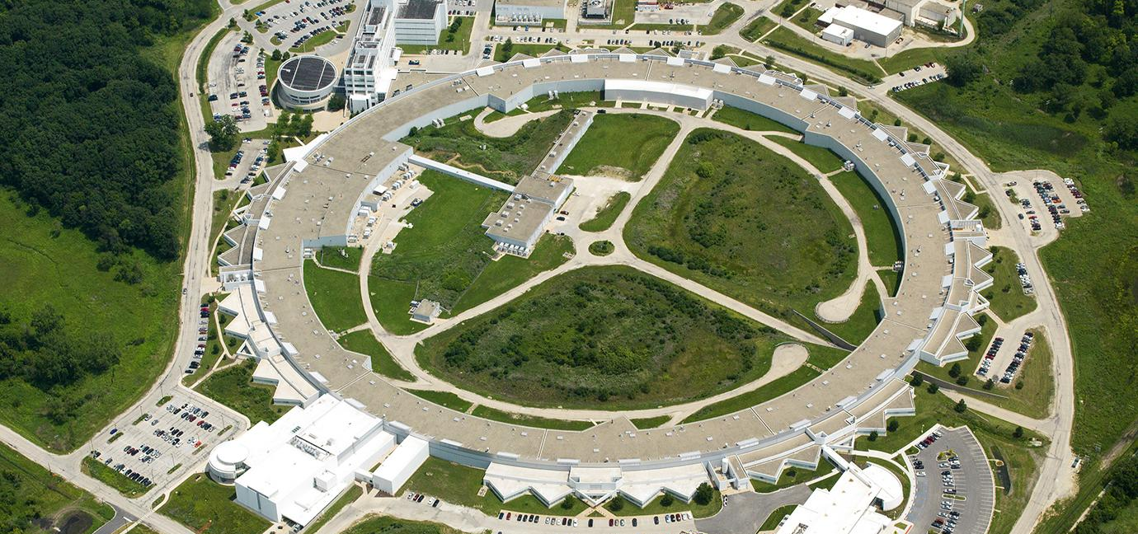
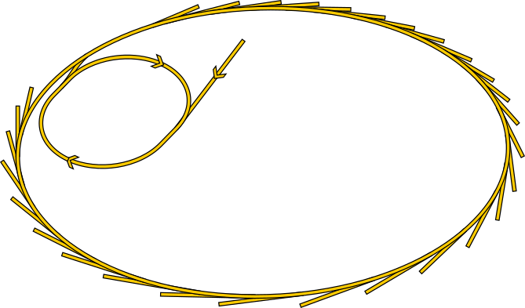

Utilizing the D-DIA at 6-BM-B at the Advanced Photon Source
linear
accelerator
X-rays
booster synchrotron
storage ring

Slide 8
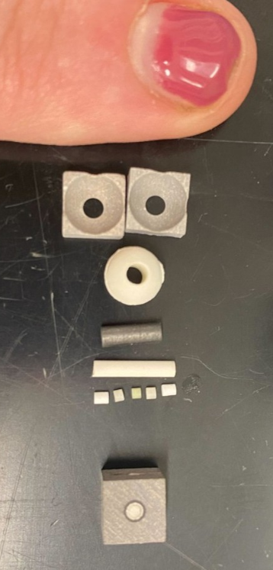
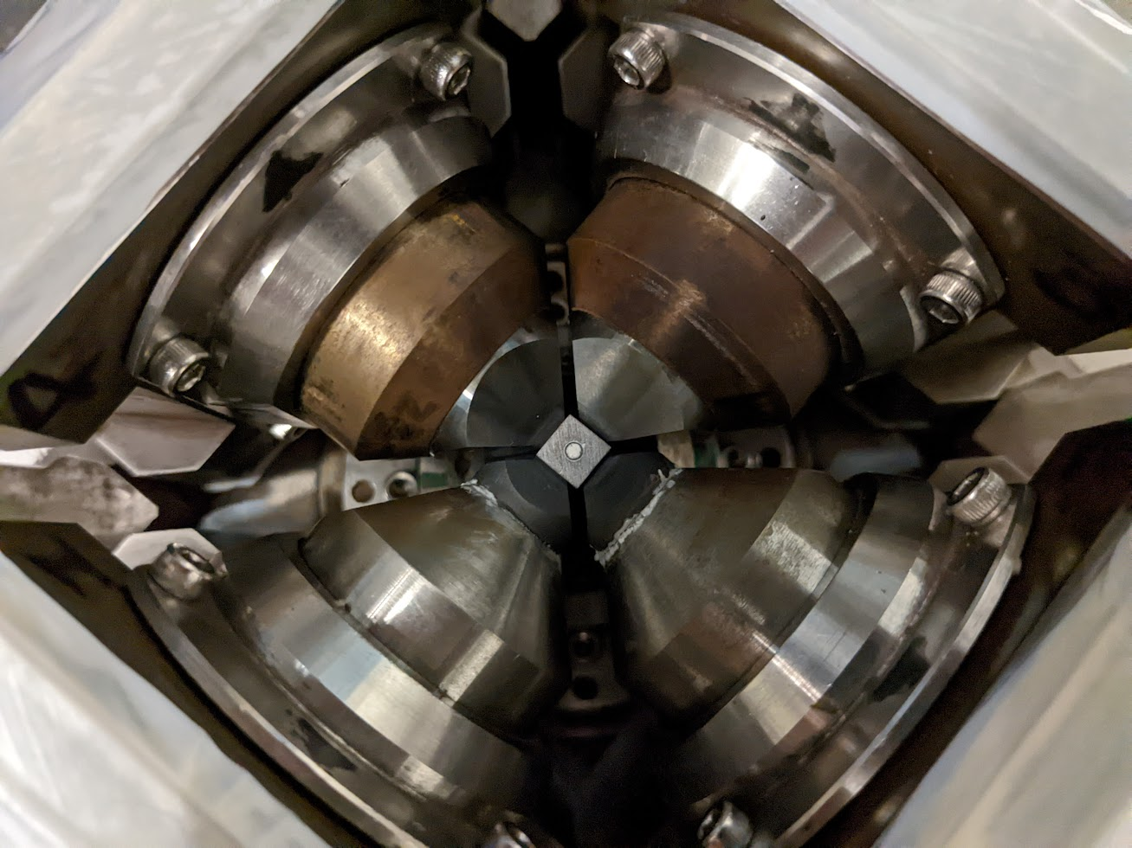
D-DIA assembly and apparatus
sample

Slide 9
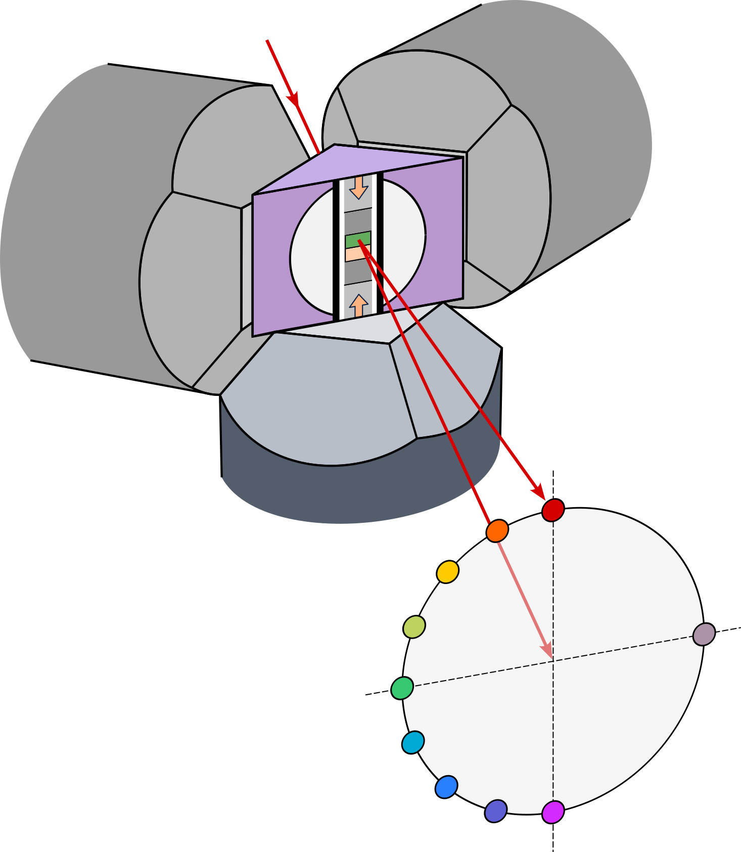
Energy Dispersive X-ray diffraction provides in-situ stress…
X-rays
(122)
(131)
(140)
(210)
(112)
(130)
(211)
(041)
(002)
10
9
Intensity
8
7
6
5
4
2
1
3
2
3
1
4
10
detector
array
2.0
2.2
2.4
2.6
2.8
3.0
5
Lattice spacing, d (Å)
6
7
after Goddard et al. (submitted)
8
9

Slide 10
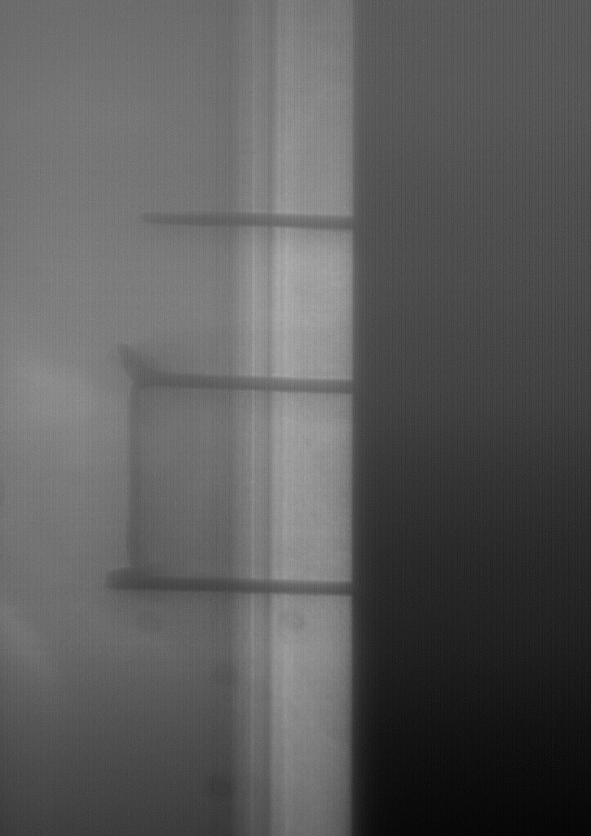
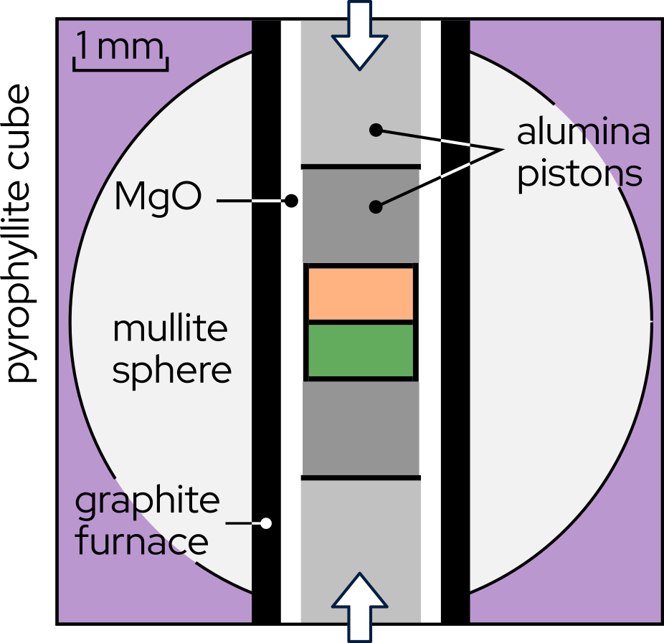
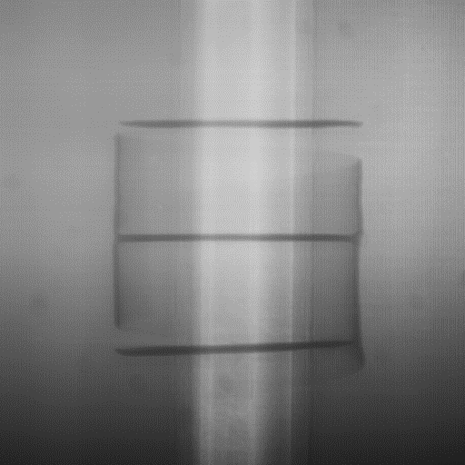
…strain resolution down to 10⁻⁵…
Al₂O₃ piston
Quartz
opaque WC anvil
Olivine
Al₂O₃ piston
0.5 mm
Notes:
Detect changes in length down to one hundredth of a percent

Slide 11
…strain resolution down to 10⁻⁵…
Al₂O₃ piston
Quartz
opaque WC anvil
Olivine
radial displ.
axial displ.
Al₂O₃ piston
0.5 mm
Notes:
Detect changes in length down to one hundredth of a percent

Slide 12
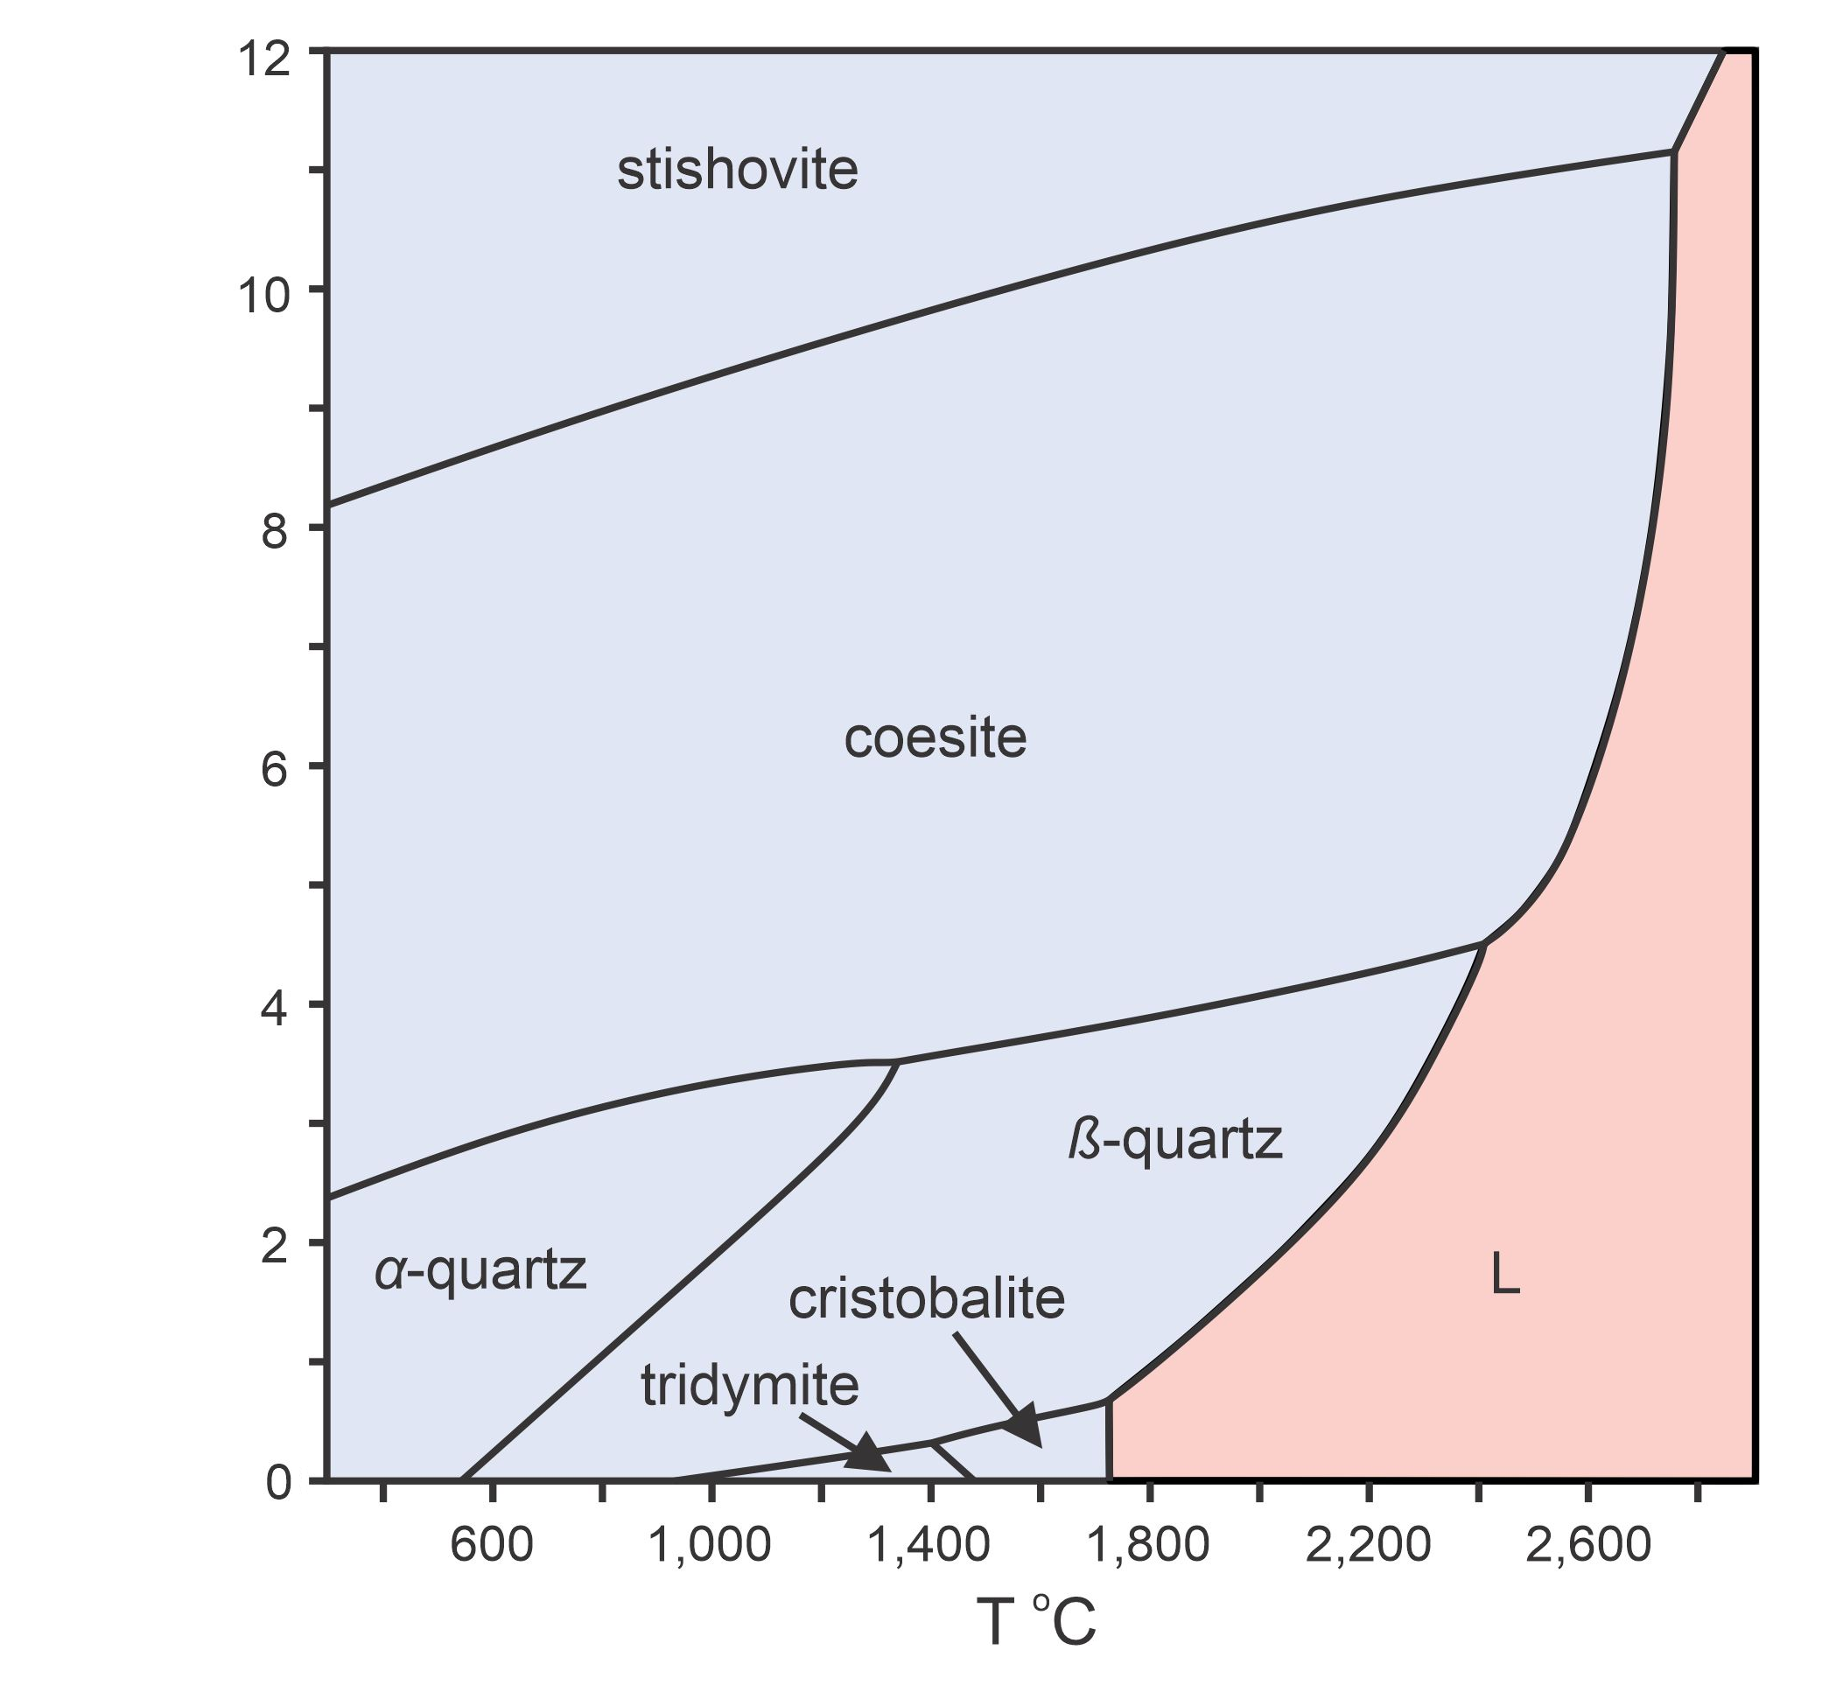
Experiments
Transform quartz into coesite (and back to quartz) under:
Hydrostatic conditions (no deformation)
Non-hydrostatic conditions (during creep deformation)
P
(GPa)
1)
2)

Slide 13
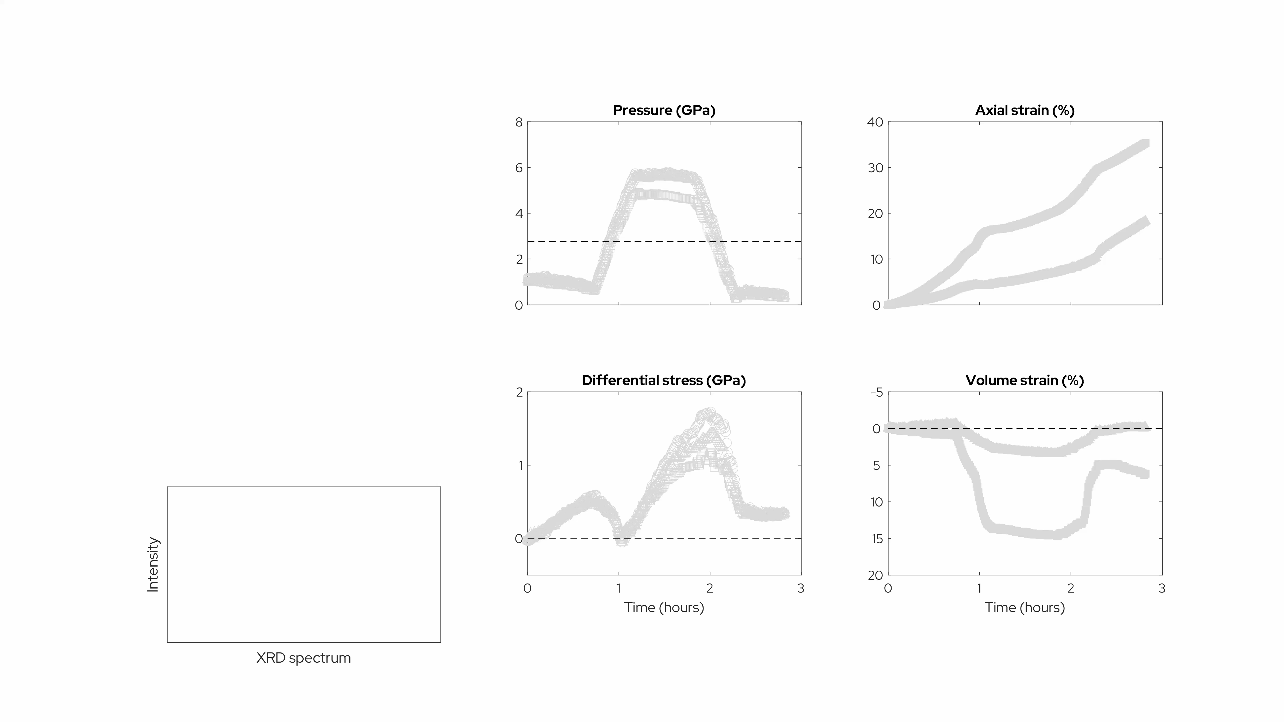
San588: quartz-coesite (SiO₂) @ 900°C
Non-hydrostatic
Cross et al. (2025)

Slide 14
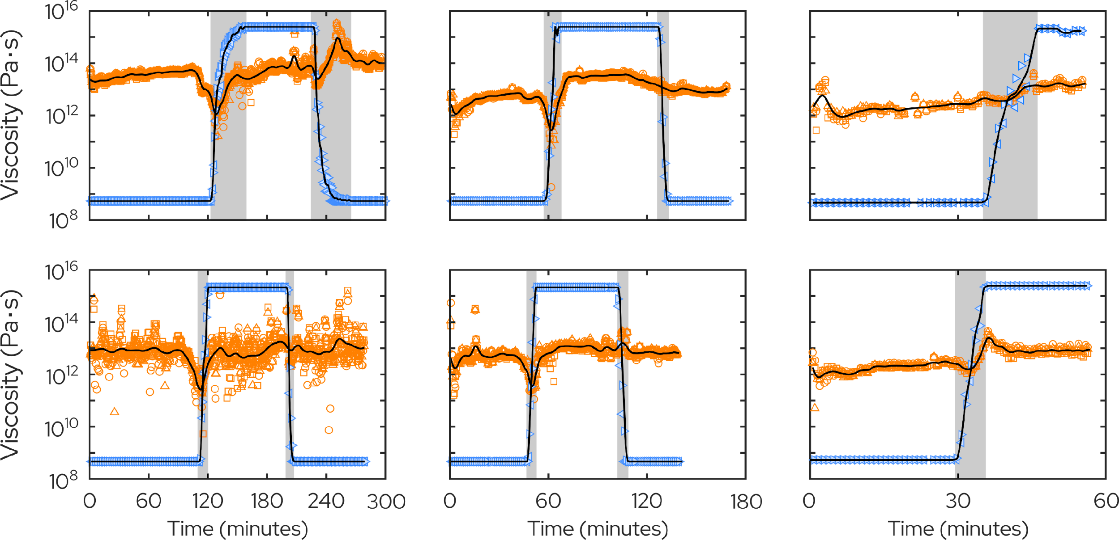
Slow deformation
(0.0003 mm/s)
Fast deformation
(0.01 mm/s)
Viscosity
Viscosity
% coesite
Significant viscosity reduction depending on relative rates of deformation and transformation
Cross et al. (2025)
Notes:
Up to two orders of magnitude weakening during the phase transformation.
Magnitude of transient weakening doesn’t appear to be temperature sensitive. However, it *is* rate sensitive – basically, it’s all controlled by the rate of deformation versus the rate of transformation. When the transformation is fast, relative to deformation (left hand panels), there’s marked weakening. On the other hand, when deformation is fast relative to the transformation, there’s little weakening.
Maybe this is all controlled by the relative proportions of transformation and deformation related dislocations?

Slide 15
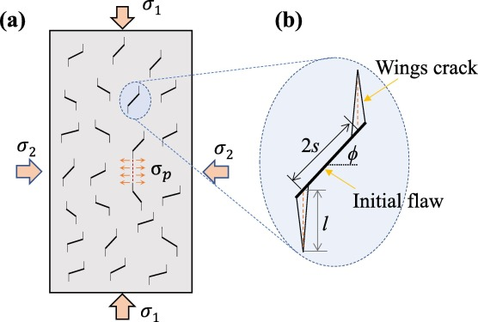
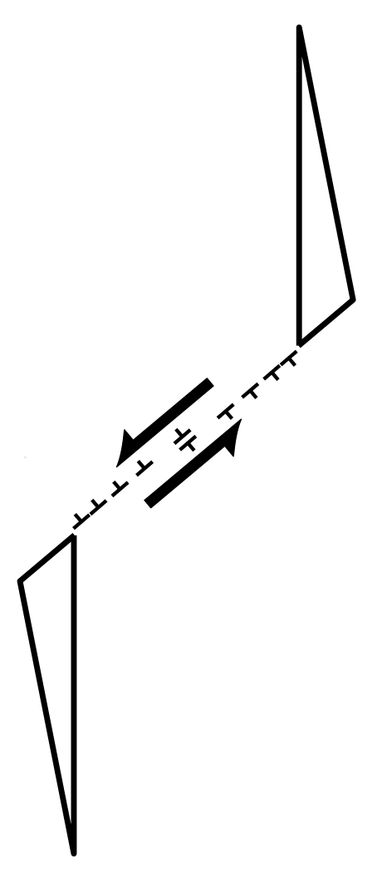
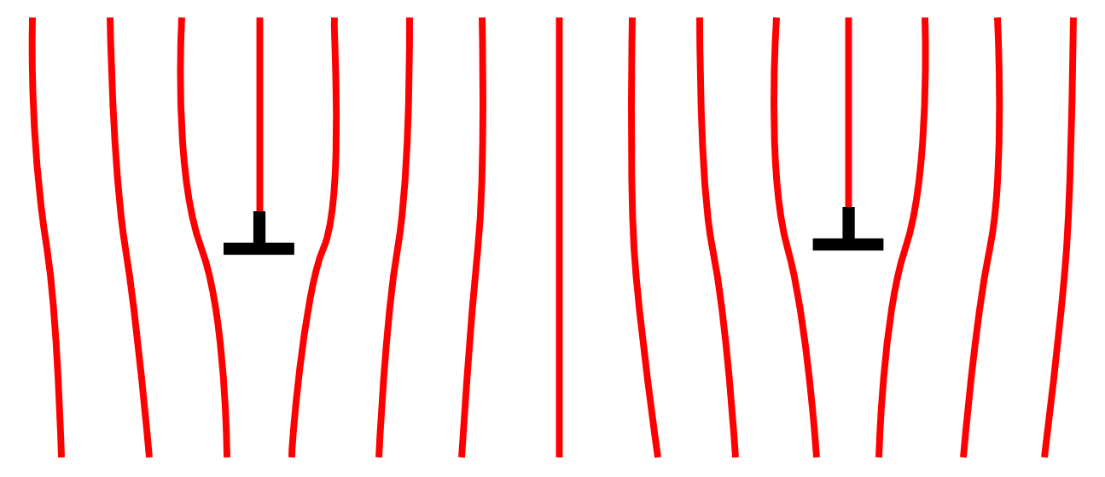
PART 2:
Elucidating the micromechanics of semibrittle flow
dislocation interactions
Wen et al. (Comp. Geo., 2022)
crack nucleation, growth, interaction
dislocation-crack interactions

Slide 16
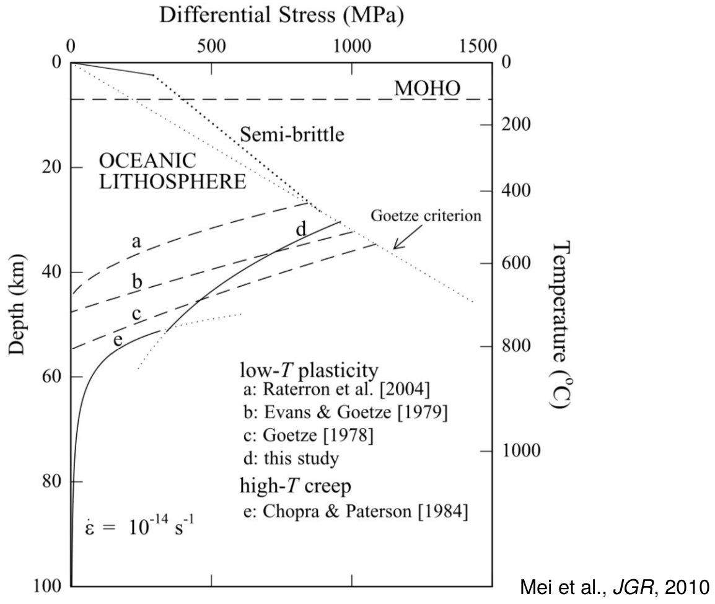
Semibrittle flow is the poorest constrained aspect of lithospheric strength
Built on the work of:
Sibson, 1977
Bird, 1978
Goetze and Evans, 1979
Brace and Kohlstedt, 1980
Kirby, 1980
Kohlstedt, Evans and Mackwell 1995
Mei et al., JGR, 2010

Slide 17
Progressive activation of different mechanisms
Stress
Strain

Slide 18
Progressive activation of different mechanisms
Stress
dislocation nucleation and glide
Strain

Slide 19
Progressive activation of different mechanisms
Stress
dislocation interactions and backstress
Strain

Slide 20
Progressive activation of different mechanisms
Stress
Strain
crack nucleation and growth

Slide 21
Progressive activation of different mechanisms
steady-state semibrittle flow?
Stress
Strain
Brantut (2025)
dislocation-crack interaction

Slide 22
Experiments on semibrittle flow of olivine
Al₂O₃ piston
opaque WC anvil
coarse
fine
Al₂O₃ piston
0.5 mm
Notes:
Detect changes in length down to one hundredth of a percent

Slide 23
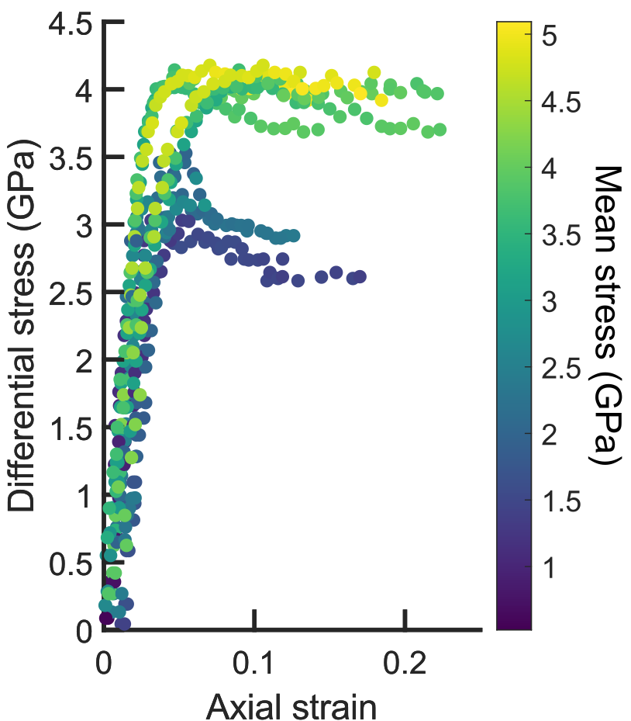
Range of behaviors depending on pressure
Room temperature
Nehring et al. (in prep.)

Slide 24
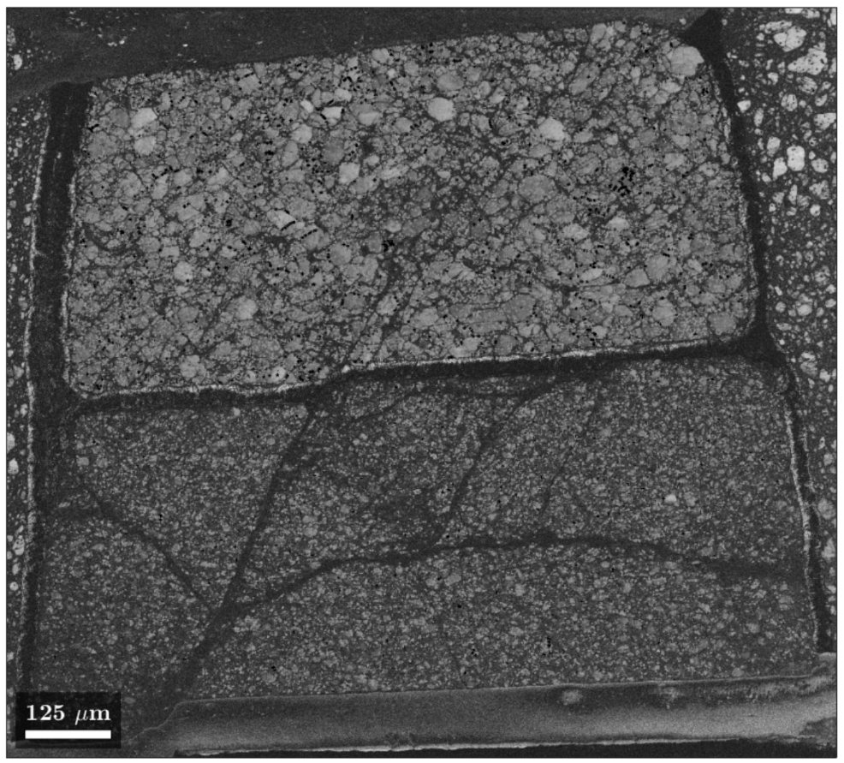
Range of behaviors depending on pressure
brittle failure
Room temperature
Room temperature
Nehring et al. (in prep.)

Slide 25
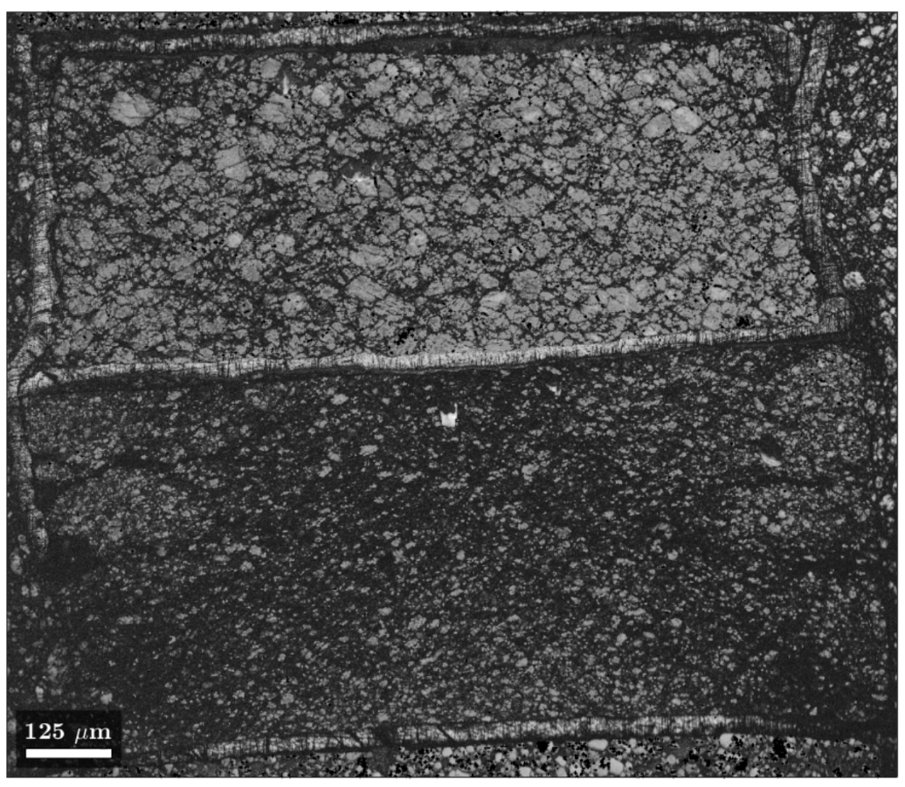
Range of behaviors depending on pressure
semi-brittle flow?
Room temperature
Room temperature
Nehring et al. (in prep.)

Slide 26
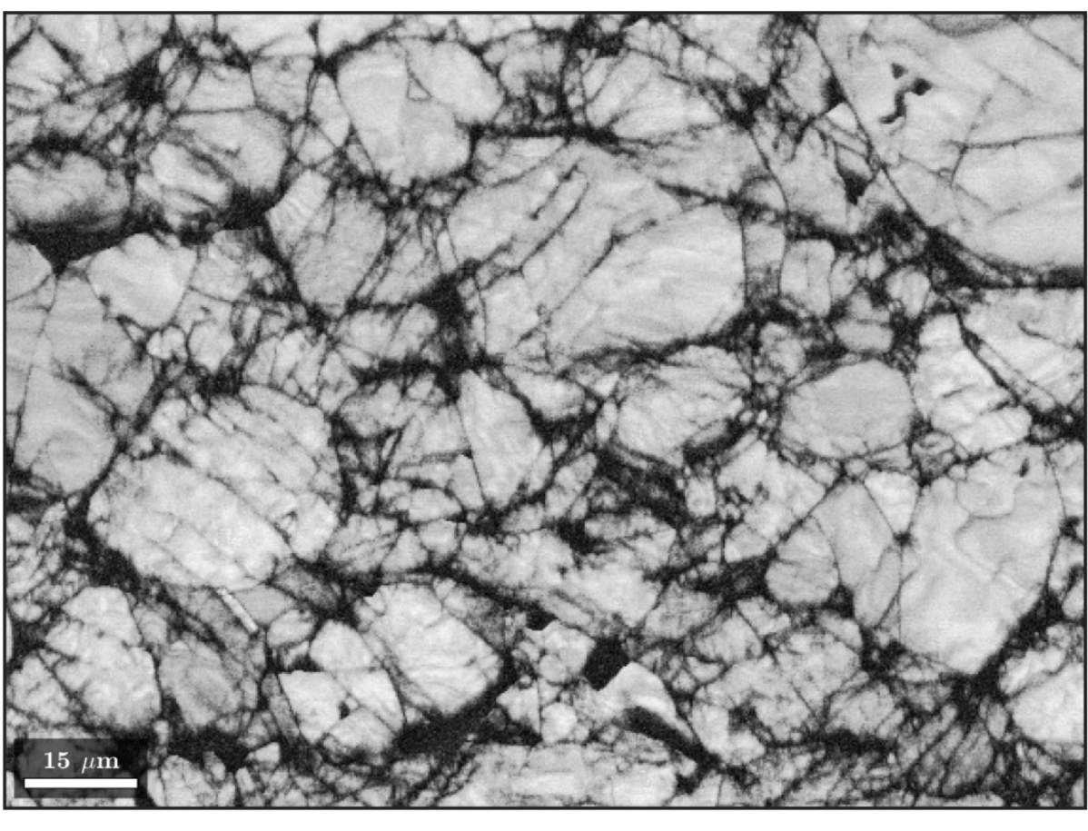
Are cracks produced during deformation or unloading?
Nehring et al. (in prep.)

Slide 27
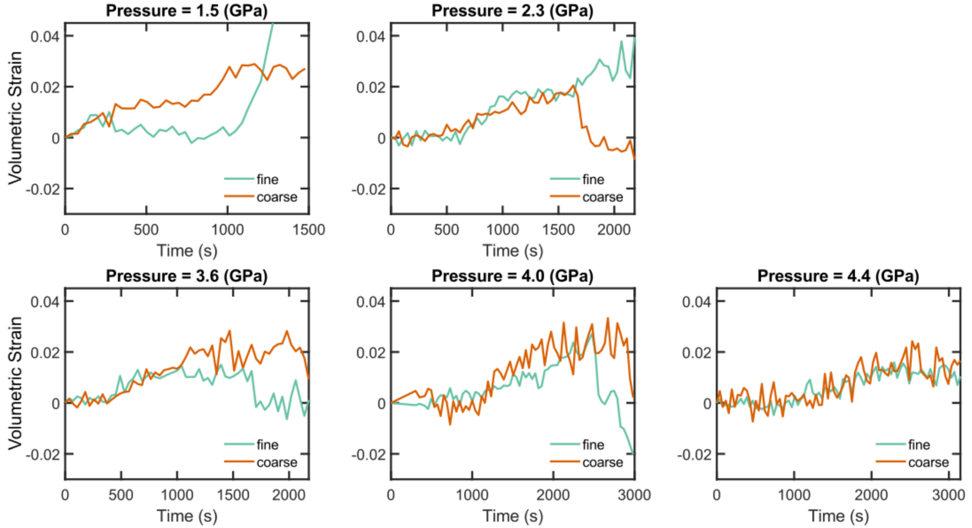
Dilation measured during deformation
↑ compaction
↓ dilation

Slide 28
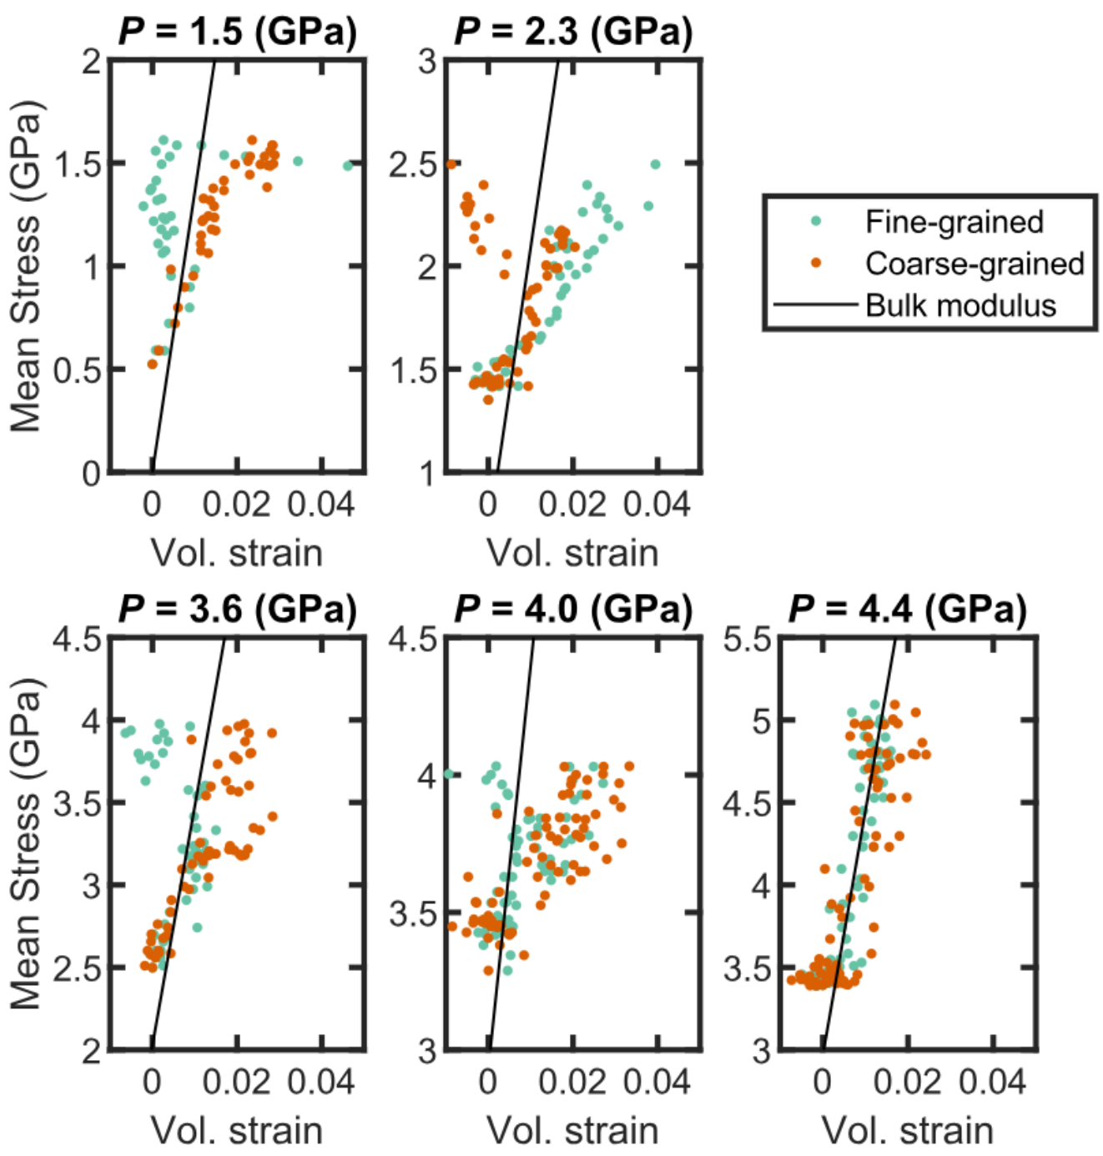
Dilation measured during deformation

Slide 29
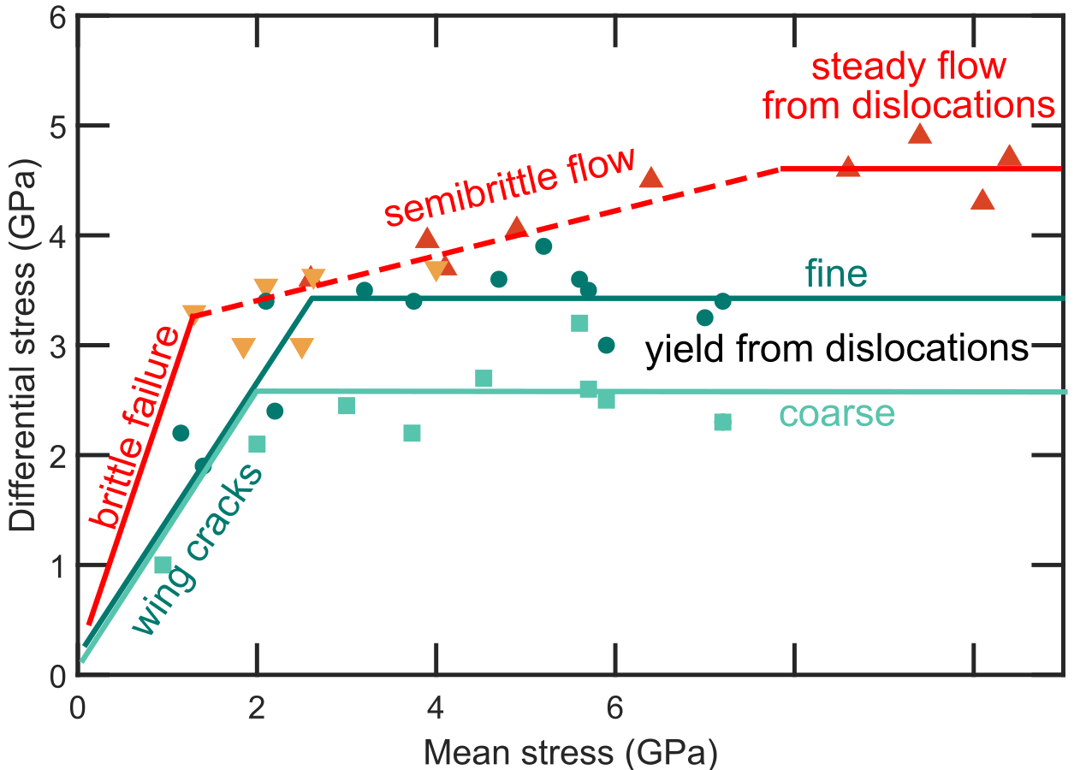
room temperature
8 10

Slide 30
Brantut (2025)
room temperature
8 10

Slide 31
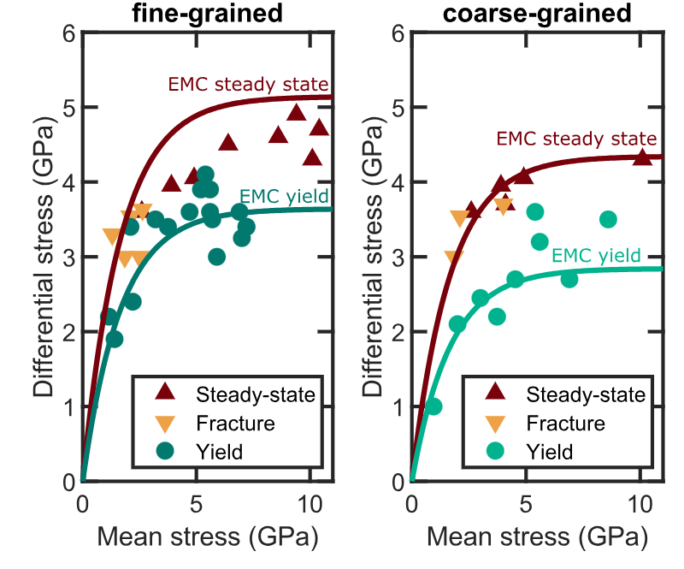
Best-fit of this model to our data
Brantut (2025)
Nehring et al. (in prep.)

Slide 32
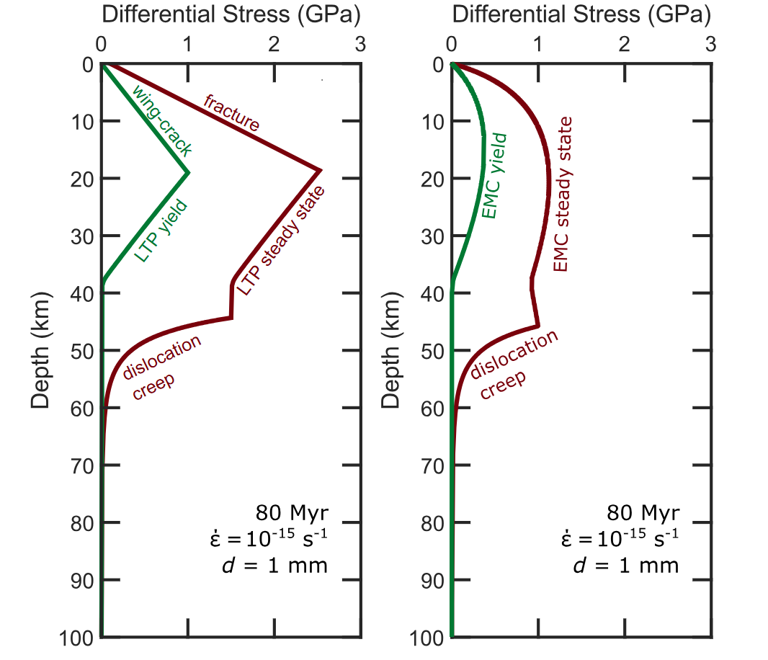
Extrapolation to the lithosphere—major strength reduction
Previous best guess w/out semi-brittle flow
Incorporation of semi-brittle flow
Nehring et al. (in prep.)

