Slide 1
Spatiotemporal development of damage, multiscale failure, and compaction localization in porous limestone
Teng-fong Wong
Department of Geosciences, Stony Brook University
Department of Earth and Environmental Sciences, CUHK
Department of Civil and Environmental Engineering, UCI
Collaborators: Patrick Baud (Strasbourg), Lingcao Huang, Lin Liu (CUHK), Fanbao Meng, Wanying Huang, Jie Liu (SYSU), Benoit Cordonnier, François Renard (Oslo).
SEES-ISRD 2025

Slide 2
Spatiotemporal development of damage, multiscale failure, and compaction localization in porous limestone
Imaging the spatiotemporal development of strain localization: AE vs μCT.
Imaging of confined deformation, multiscale failure, pore collapse and compaction localization of porous limestone in real time.
Spatiotemporal distribution of strain and evolution of compaction localization characterized by digital volume correlation.
Image-based finite element modeling of the control of porosity heterogeneity on failure.
SEES-ISRD 2025

Slide 3
AE and Mechanics of Shear Localization
The fact that the number of AE events had to be multiplied by a factor of 600 to match the crack count data indicates that less than 0.2% of the new microcracks were accompanied by detectable AE. It would appear that most of the large, grain-size microcracks that formed during loading were inefficient at radiating acoustic energy in the detection bandwidth (possibly because they grew too slowly). ... For example, a number of studies have analyzed focal mechanisms of AE events. The question should be asked as to how representative these events are of the total microcrack population. (Lockner, 1993)
Fig. 39. Plot of AE locations for a Westerly granite sample triaxially compressed (with σ1 in the vertical direction) at confining pressure of 50 MPa. Each point represents an AE event. Bottom plot of each set is view looking along-strike of eventual fracture plane. Middle plot is face-on view of fault in which sample has been rotated couterclockwise by 90o. Top plot is view looking down on sample. The data for set (a) were collected in the pre-peak stage when the differential stress increased from about 50 MPa below to the peak. Projections of surface trace of eventual fault plane are shown in (a) for reference. Shear localization initiated in set (b) and developed in the post-peak stage from (b) to (f) (after Lockner et al. 1992)

Slide 4
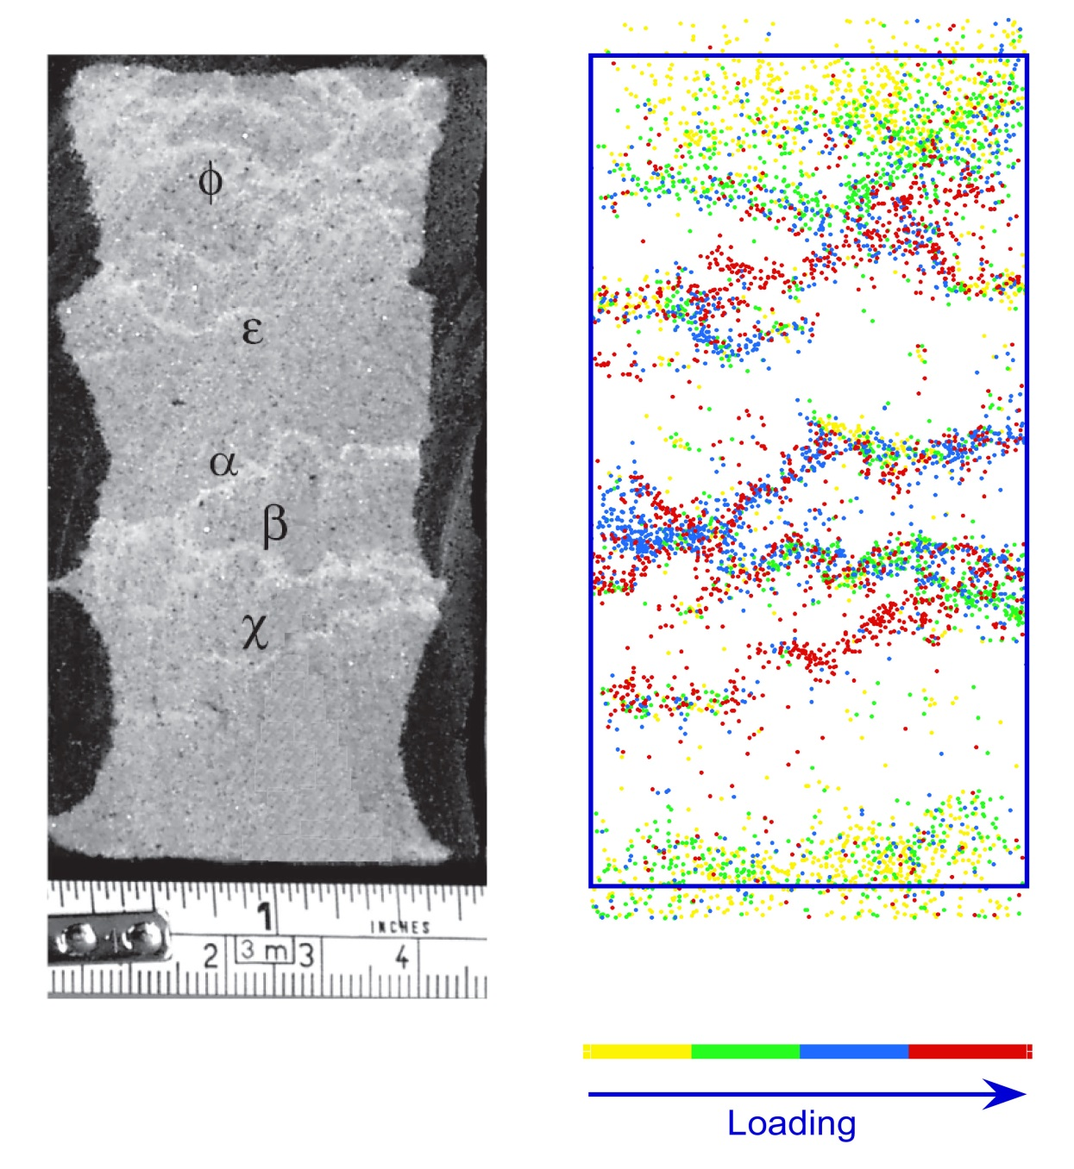
AE locations associated with the development of discrete compaction bands in Bleurswiller sandstone (at confining pressure of 60 MPa)
AE and Mechanics of Compaction Localization
Saint-Maximin limestone with 20% quartz deformed triaxially in wet conditions at an effective pressure of 9 MPa: AE hypocenter distribution for different intervals of volumetric strain
(Baud, Schubnel, Heap & Rolland, JGR 2017)
(Fortin, Stanchits, Dresen & Guéguen, JGR 2006)

Slide 5
Spatiotemporal development of damage, multiscale failure, and compaction localization in porous limestone
Imaging the spatiotemporal development of strain localization: AE vs μCT.
Imaging of confined deformation, multiscale failure, pore collapse and compaction localization of porous limestone in real time.
Spatiotemporal distribution of strain and evolution of compaction localization characterized by digital volume correlation.
Image-based finite element modeling of the control of porosity heterogeneity on failure.
SEES-ISRD 2025

Slide 6
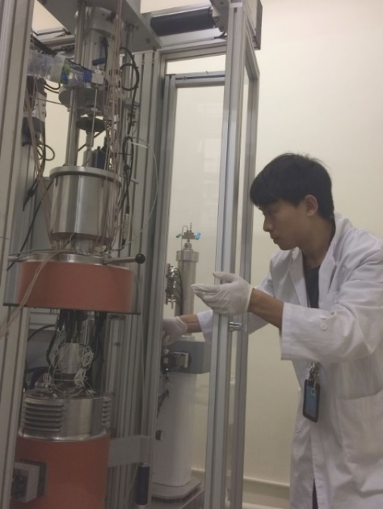
Diameter 5 mm, height 10 mm; voxel size 6.5 μm
ESRF Beamline ID19
Triaxial rig of the same Sanchez design at CUHK

Slide 7
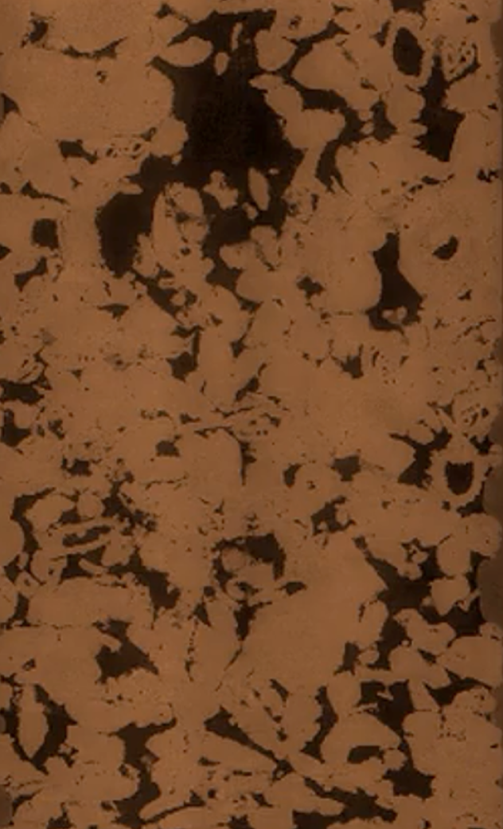
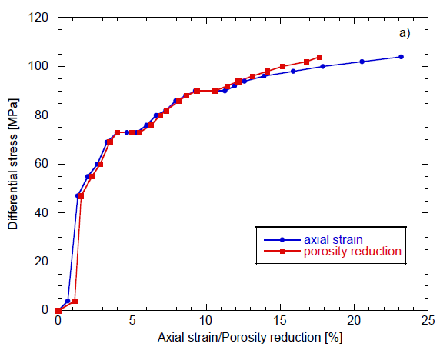
Differential stress as a function of axial strain (blue) and porosity re-duction (red), both calculated from the CT images, for the sample deformed in this study at a confining pressure of 20 MPa.
Leitha limestone is a carbonate grainstone composed of >99% calcite. Porosity of sample deformed at ESRF is 26%.
* Porosity heterogeneity manifested by a cluster of macropores located in the upper part of sample.
* Inelastic yielding developed in two sequential stages.
* Axial strain basically coincides with porosity reduction, which implies that there was negligible lateral deformation, a constitutive behavior that would promote the development of compaction localization.
porosity 31%

Slide 8
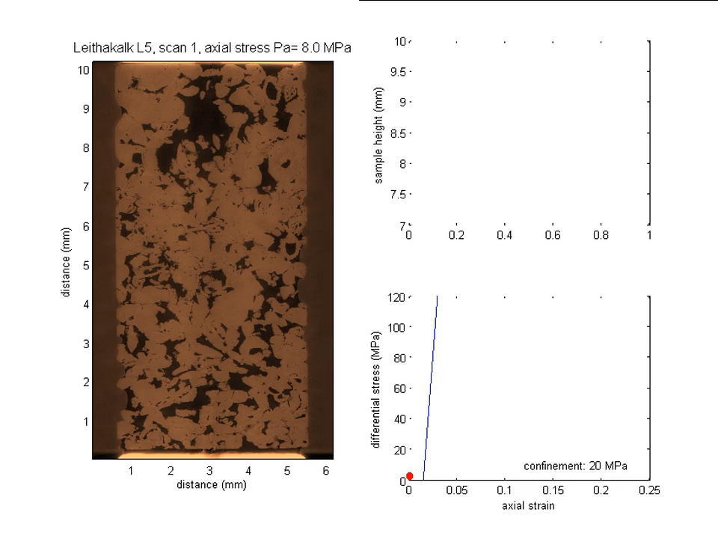
4D Synchrotron X-ray Imaging of Compressive Failure
Leitha limestone
P_{c}=20 MPa

Slide 9
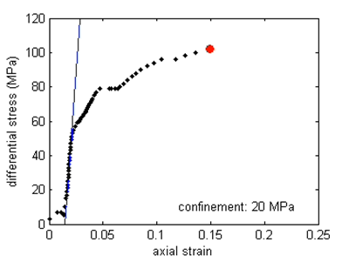
Development of compaction localization at the mesosopic scale
156 layers
Thickness 10x6.5 μm

Slide 10
Development of Pore Collapse Imaged in Real Time
Sequential images of pore collapse and damage in top layer

Slide 11
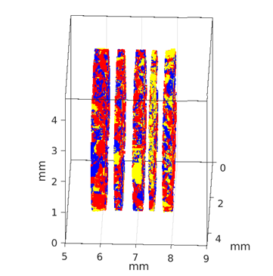
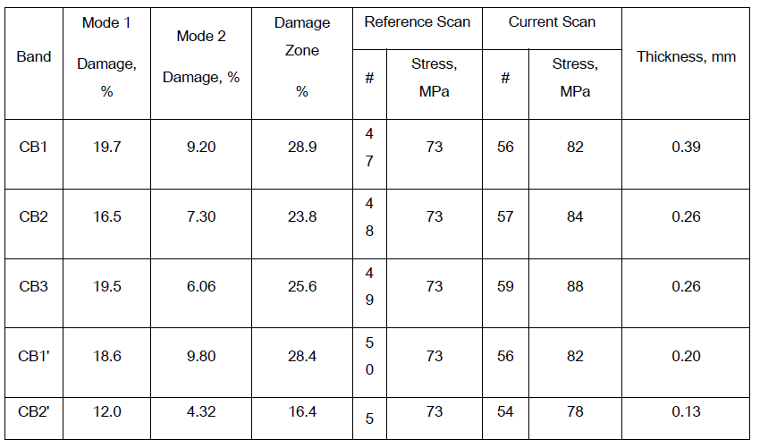
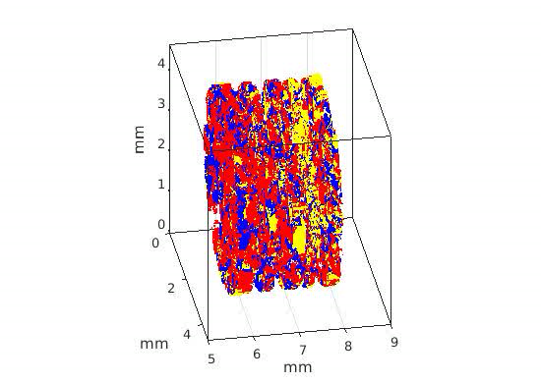
Damage in Five Discrete Compaction Bands
Five CBs with thickness of 0.13-0.29 mm and average spacing of 0.5 mm
3D visualization of damage and porosity reduction in the CBs (porosity: yellow, void→solid (compaction): red, solid→ void (dilation): blue)
Huang et al. (2019)

Slide 12
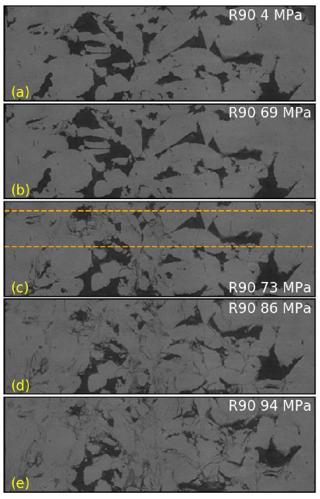
Compaction Localization Imaged in Real Time
Fig.9.(a–e) Five micrographs of CB3 acquired at different levels of stress marked in inset of Fig.1. The width of the micrographs is 4.55 mm

Slide 13
Spatiotemporal development of damage, multiscale failure, and compaction localization in porous limestone
Imaging the spatiotemporal development of strain localization: AE vs μCT.
Imaging of confined deformation, multiscale failure, pore collapse and compaction localization of porous limestone in real time.
Spatiotemporal distribution of strain and evolution of compaction localization characterized by digital volume correlation.
Image-based finite element modeling of the control of porosity heterogeneity on failure.
SEES-ISRD 2025

Slide 14
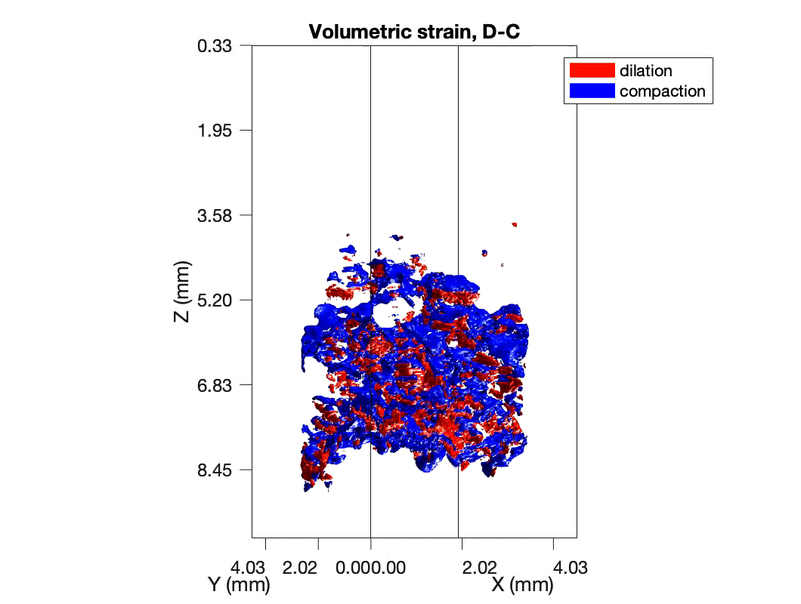
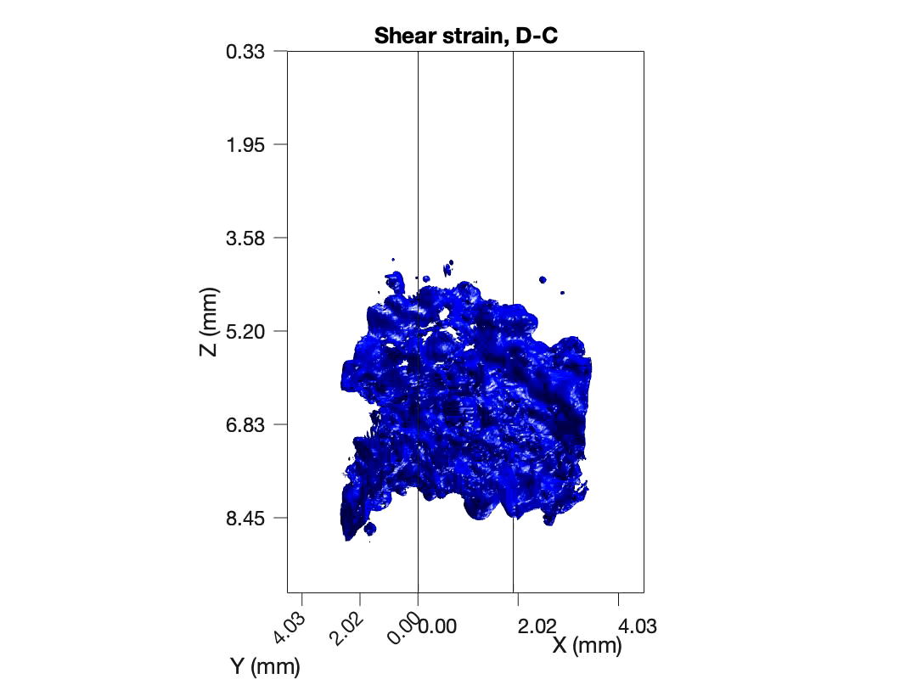

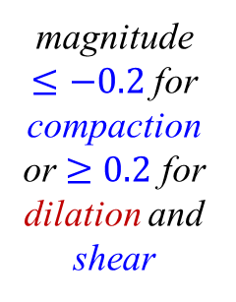
Meng, Huang, Baud & Wong (JMPS, 2023)
Localization of volumetric and deviatoric strains: Phase D-C
The code TomoWarp2 (Tudisco et al., 2017) was adopted for digital volume correlation of the CT images.
The grid spacing of the DVC nodes was 5 voxels in each direction and the correlation window was a cuboid made up of 16 × 16 × 16 voxels centered on the analysis node.
* During the second stage of yielding, the initial development of volumetric strain was spatially concentrated in the lower half of the sample. Clustering of compaction was more pronounced than dilation, with the latter mostly located at the boundary of a compactive cluster.
* Concentration of shear strain had developed in parallel, and it seems to be spatially correlated with clustering of volumetric strain.
magnitude $≤−0.2$ for compaction or $≥0.2$ for dilation and shear
$$ε_{v}=ε_{11}+ε_{22}+ε_{33}$$

Slide 15
Spatial complexity of strain within CB1
Serial sections of CB1 (0.39 mm thick) highlight the 3D geometric complexity and spatial heterogeneity associated with the progressive development of strain concentration and compaction localization.
The displacement and strain fields derived from DVC are denoted by two capital letters, with the first and second letters corresponding to the displaced and reference images, respectively; e.g., displacement E-C denotes the displacement vector derived by maximizing the cross-correlation of the grey-level data of the reference image C and displaced image E.

Slide 16
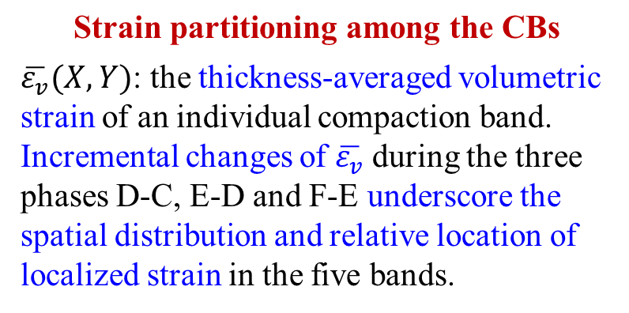
$$\text{Strain} \text{partitioning} \text{among} \text{the} \text{CBs}$$
$\overline{ε_{v}}(X,Y)$: the thickness-averaged volumetric strain of an individual compaction band. Incremental changes of $\overline{ε_{v}}$during the three phases D-C, E-D and F-E underscore the spatial distribution and relative location of localized strain in the five bands.
Accumulation of these strains is shown for phase F-C. By stage F, the five CBs covered distinct domains on the circular cross-section without significant spatial overlap.

Slide 17
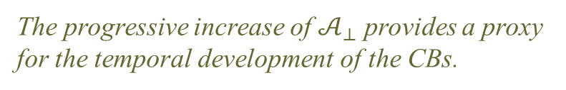
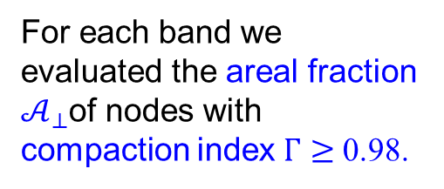
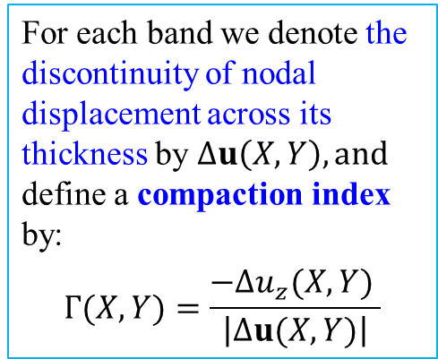
CB as a discontinuity in normal displacement
For each band we denote the discontinuity of nodal displacement across its thickness by $∆u\left(X,Y\right), and$ define a compaction index by:
$$Γ(X,Y)=\frac{−Δu_{z}(X,Y) }{\left|∆u(X,Y)\right|}$$
The displacement discontinuity for a pure compaction band should be such that Γ =1. Significant fractions have relatively high index values with Γ > 0.5.
For each band we evaluated the areal fraction $𝒜_{⊥}$of nodes with compaction index $Γ≥$ 0.98.
The progressive increase of $𝒜_{⊥}$ provides a proxy for the temporal development of the CBs.

Slide 18
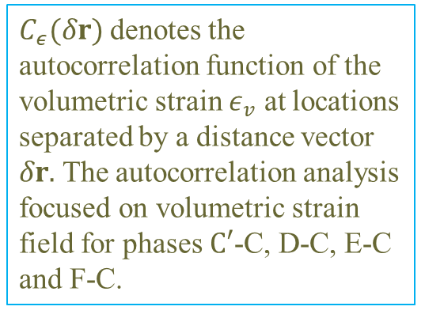
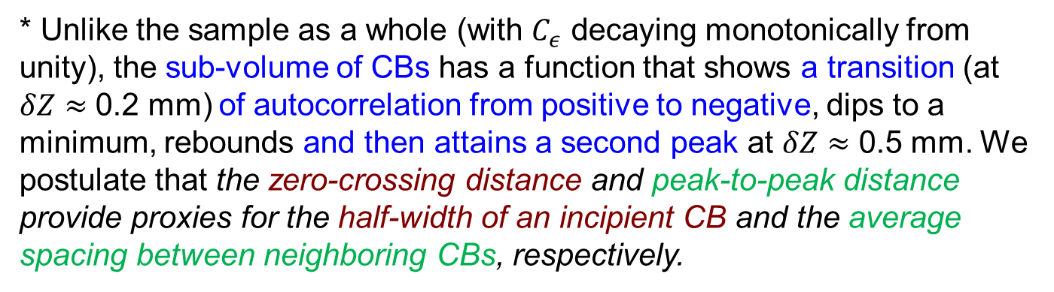
Autocorrelation of volumetric strain
$C_{ε}(δr)$ denotes the autocorrelation function of the volumetric strain $ε_{v}$ at locations separated by a distance vector $δr.$ The autocorrelation analysis focused on volumetric strain field for phases $C′$-C, D-C, E-C and F-C.
* First consider the auto-correlation function in the axial direction, with 𝛿(𝐫)=(0,0,𝛿𝑍)
* Unlike the sample as a whole (with $C_{ε}$ decaying monotonically from unity), the sub-volume of CBs has a function that shows a transition (at $δZ≈$ 0.2 mm) of autocorrelation from positive to negative, dips to a minimum, rebounds and then attains a second peak at $δZ≈$ 0.5 mm. We postulate that the zero-crossing distance and peak-to-peak distance provide proxies for the half-width of an incipient CB and the average spacing between neighboring CBs, respectively.

Slide 19
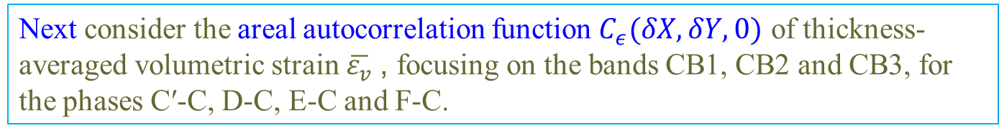
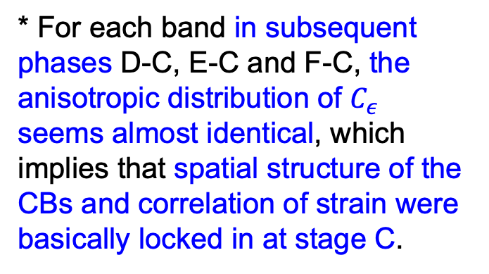
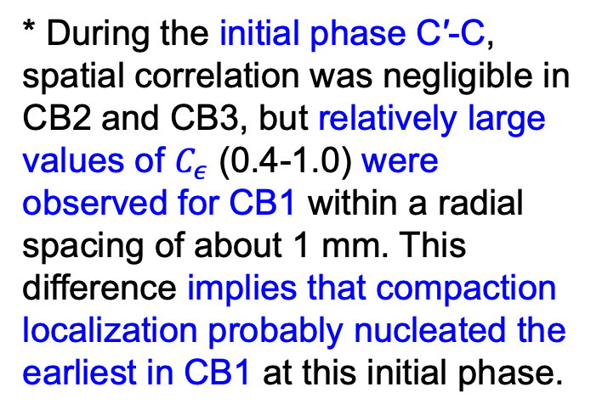
Next consider the areal autocorrelation function $C_{ε}(δX,δY,0)$ of thickness-averaged volumetric strain $\overline{ε_{v}}$, focusing on the bands CB1, CB2 and CB3, for the phases C′-C, D-C, E-C and F-C.
* During the initial phase C′-C, spatial correlation was negligible in CB2 and CB3, but relatively large values of $C_{ε}$ (0.4-1.0) were observed for CB1 within a radial spacing of about 1 mm. This difference implies that compaction localization probably nucleated the earliest in CB1 at this initial phase.
* For each band in subsequent phases D-C, E-C and F-C, the anisotropic distribution of $C_{ε}$ seems almost identical, which implies that spatial structure of the CBs and correlation of strain were basically locked in at stage C.

Slide 20
Spatiotemporal development of damage, multiscale failure, and compaction localization in porous limestone
Imaging the spatiotemporal development of strain localization: AE vs μCT.
Imaging of confined deformation, multiscale failure, pore collapse and compaction localization of porous limestone in real time.
Spatiotemporal distribution of strain and evolution of compaction localization characterized by digital volume correlation.
Image-based finite element modeling of the control of porosity heterogeneity on failure.
SEES-ISRD 2025

Slide 21
(2024)
A finite element mesh of the solid skeleton of the limestone sample was established based on X‐ray μCT data. The tetrahedral mesh has an average edge length of 24 pixels (156 μm). Embedded in it are 639,617 elements and 1,624,345 nodes.
Whereas comprehensive efforts were made to incorporate the geometric complexity of the pore space into the FE model, we deliberately adopted basic laws of mechanics to describe the grain‐scale deformation, yield, and failure, instead of complicated constitutive models or spatially heterogeneous mechanical properties which would mask the primary influence of porosity heterogeneity.
The FE simulations were conducted using the dynamic analysis scheme of Abaqus® Explicit. The constitutive response is elastoplastic, obeying the Drucker-Prager yield criterion together with a non-associated flow rule. Guided by laboratory observations, the angle of internal friction and dilatancy are selected to be 30º and 0º, respectively.

Slide 22
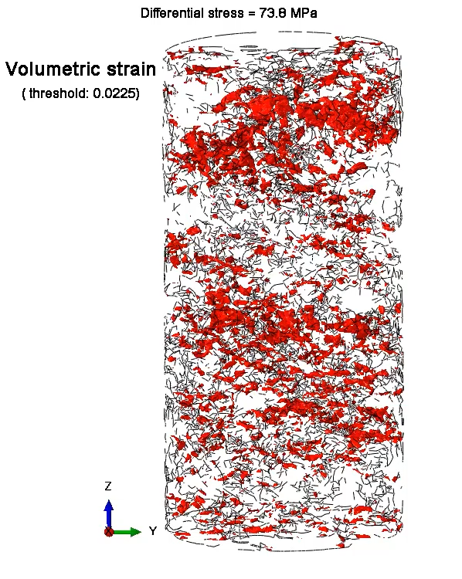
FE Modeling Based on Synchrotron X-ray Imaging
* Loading from A to B brackets the first yield point C*; the yield stress and cohesion are assumed to be constant, which corresponds to a constant UCS of 105 MPa.
* Loading from B to D brackets the second yield point C**, with a hybrid response that involves transient hardening and creep. For the transient phase, we implemented a linear increase of cohesion between FE3 and FE4, which corresponds to an increase of the UCS from 105 to 155 MPa.
* To reproduce the creep phase, we inhibited strain hardening by keeping the UCS constant at 155 MPa between FE4 and FE5.
* Beyond the hybrid yielding episode, strain hardening was simulated with a linear increase of cohesion, corresponding to an increase of UCS from 155 MPa at FE5 to 170 MPa at FE6.
The distribution of volumetric strain computed by the FE model at stage FE5.

Slide 23
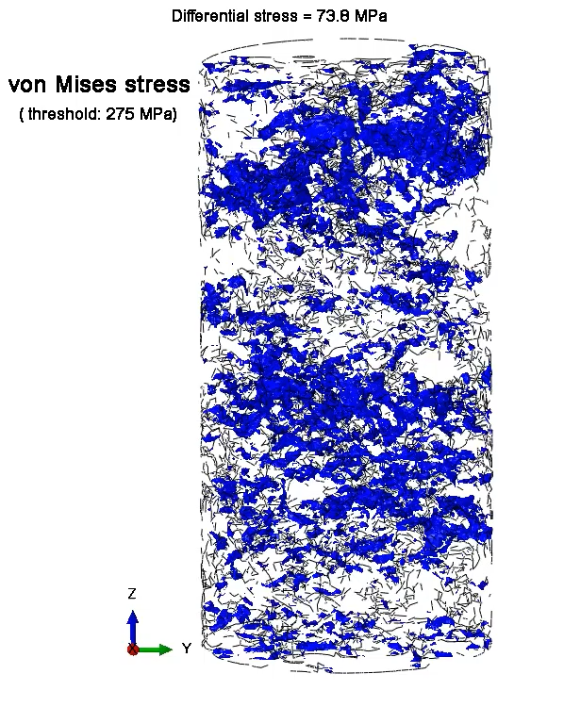
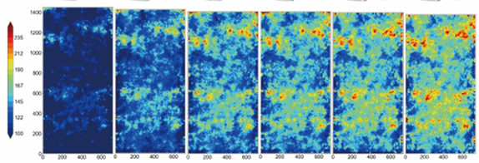
Spatiotemporal Distribution of Local Stress
Evolution of the nodal stress field from simulation stage FE2 to FE7
von Mises stress
FE7
FE3
FE4
FE7
* Our simulations demonstrate that the pore space and its preexisting heterogeneity have fundamental control over the onset and development of compaction localization.
* Simulations of the spatiotemporal distribution of stresses indicate that stress concentrations precursory to compaction banding might have developed at FE3 well before the second yield point C** (beyond FE4) could register in the macroscopic inelastic response and damage.

Slide 24
Evolution of Local Stress Tensor
Figure 12. The nodal value of von Mises stress as a function of nodal axial strain at the six locations in CBs. For comparison with the stress tensors shown, the three stages of loading (FE2, FE4 and FE7) are marked by blue circles, green squares and red triangles, respectively.
* The nodal stress tensor within a CB falls into three different categories. The more common Category 1 is also the most vulnerable to failure. In this quasi‐uniaxial compressive state, σ₁ is aligned in a direction subparallel to the sample axis, with magnitude significantly higher than the other two.
* The mode of failure is likely quasi-uniaxial compressive failure along the σ₁ direction accompanied by intensive grain crushing, which may promote the in-plane propagation of a CB. The nodal stress evolution involves the complex interplay of hardening and apparent softening.

