Slide 1

Experimental investigation on the effects of pore fluid pressure on extension-shear mixed-mode fracture in porous and non-porous rocks
Hiroko Kitajima, Cate Tilley, Casey Ruplinger, Jacob Tristan, and Daniel Worley
Center for Tectonophysics and Department of Geology & Geophysics, Texas A&M University

Slide 2
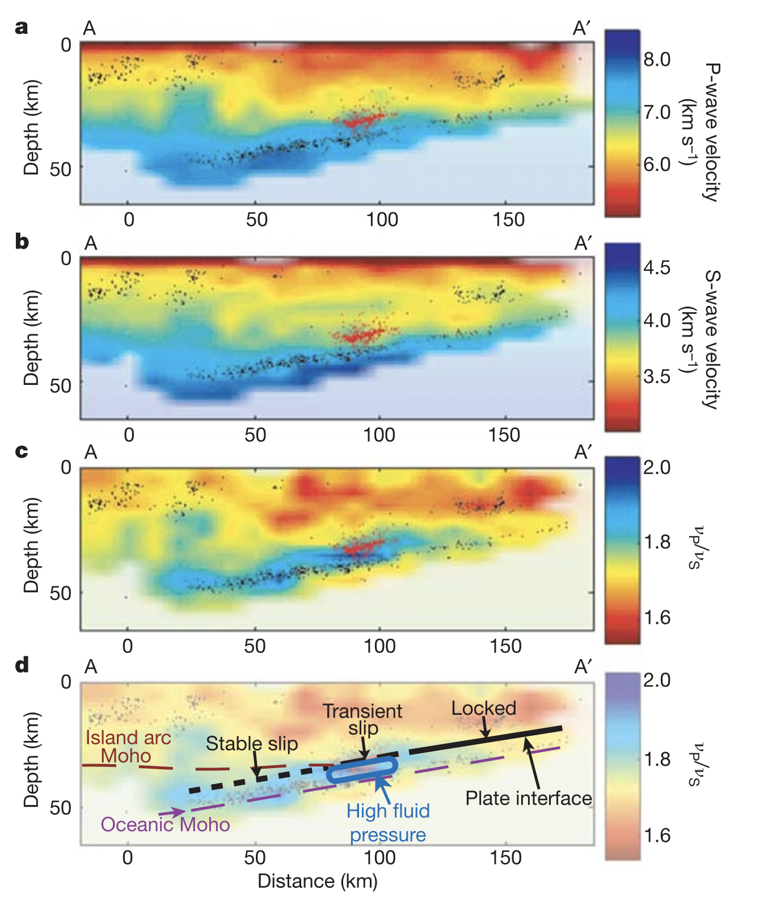
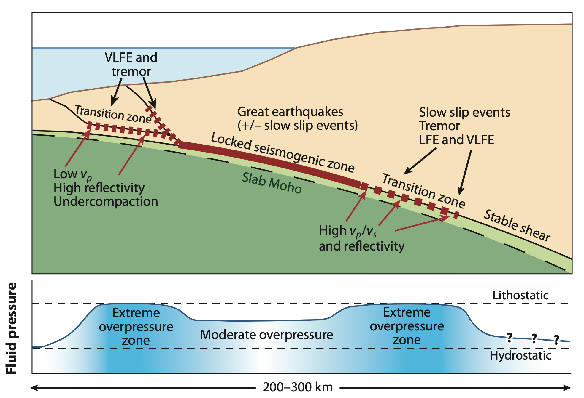
Deformation at low effective stress
Elevated pore fluid pressure and low effective normal (or mean) stress likely exists along plate boundary faults.
Saffer & Tobin (2011)
Shelly et al. (2006)
Notes:
Saffer and tobin figure 9

Slide 3
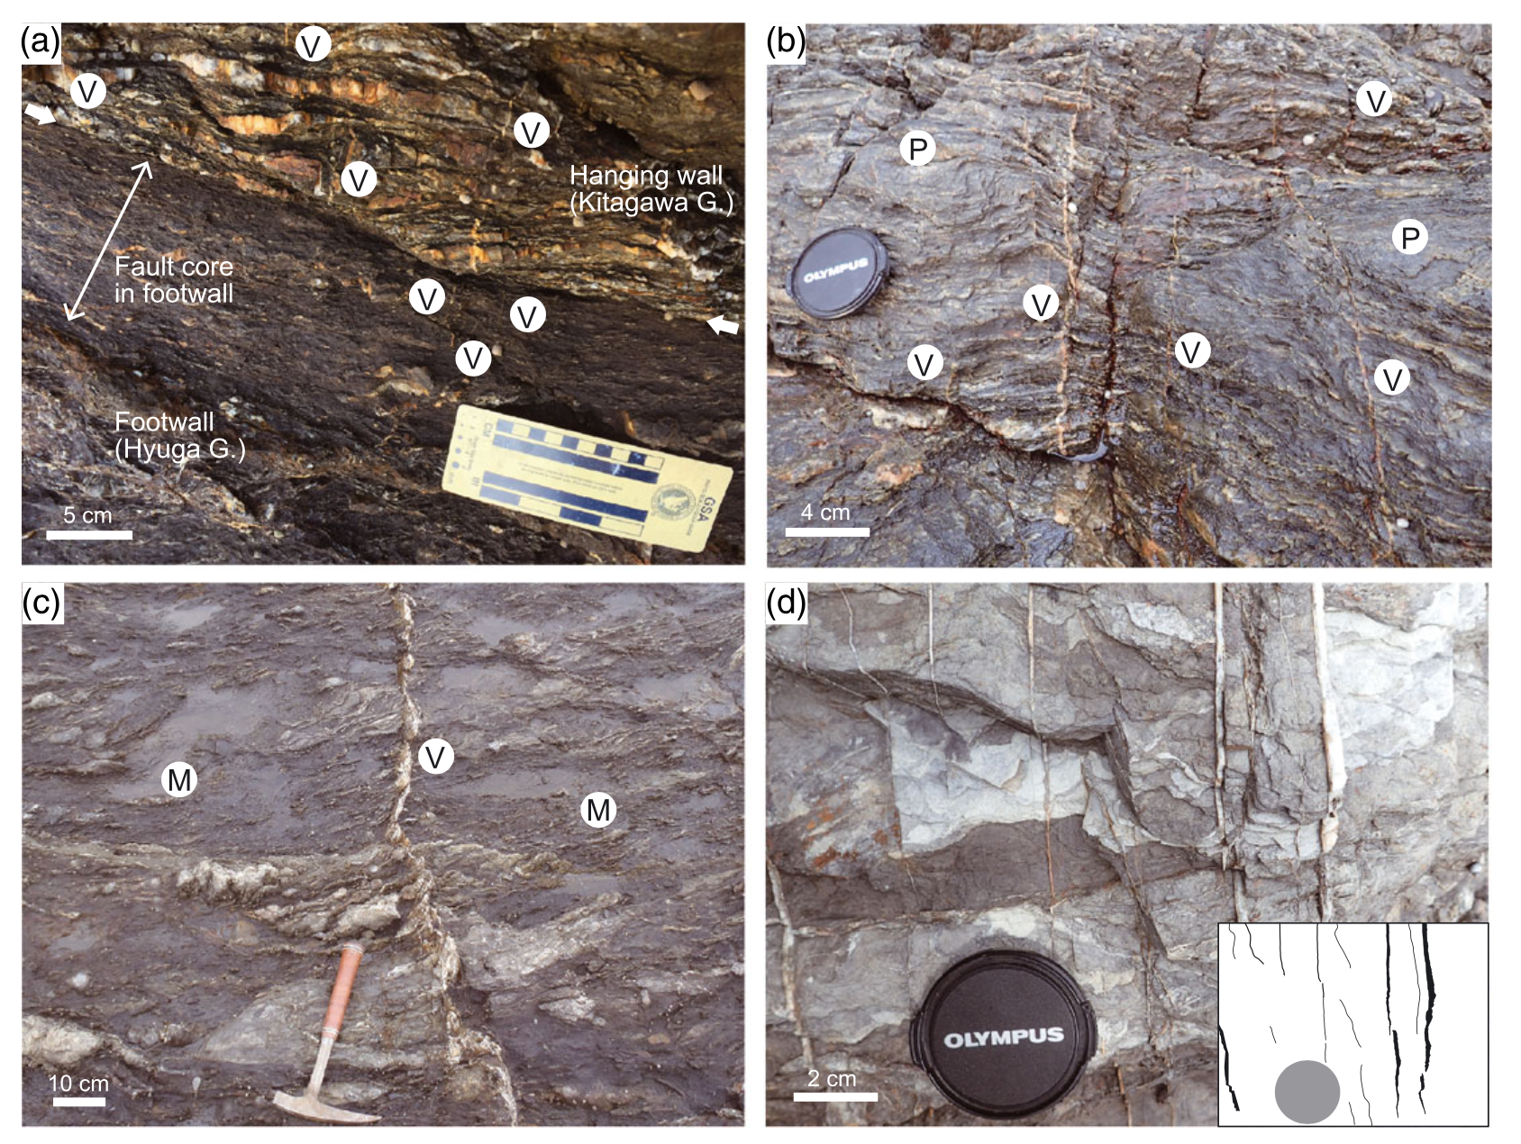
Deformation at low effective stress
Elevated pore fluid pressure and low effective normal (or mean) stress likely exists along plate boundary faults.
Otsubo et al. (2016)
Saffer & Tobin (2011)
Notes:
Saffer and tobin figure 9

Slide 4
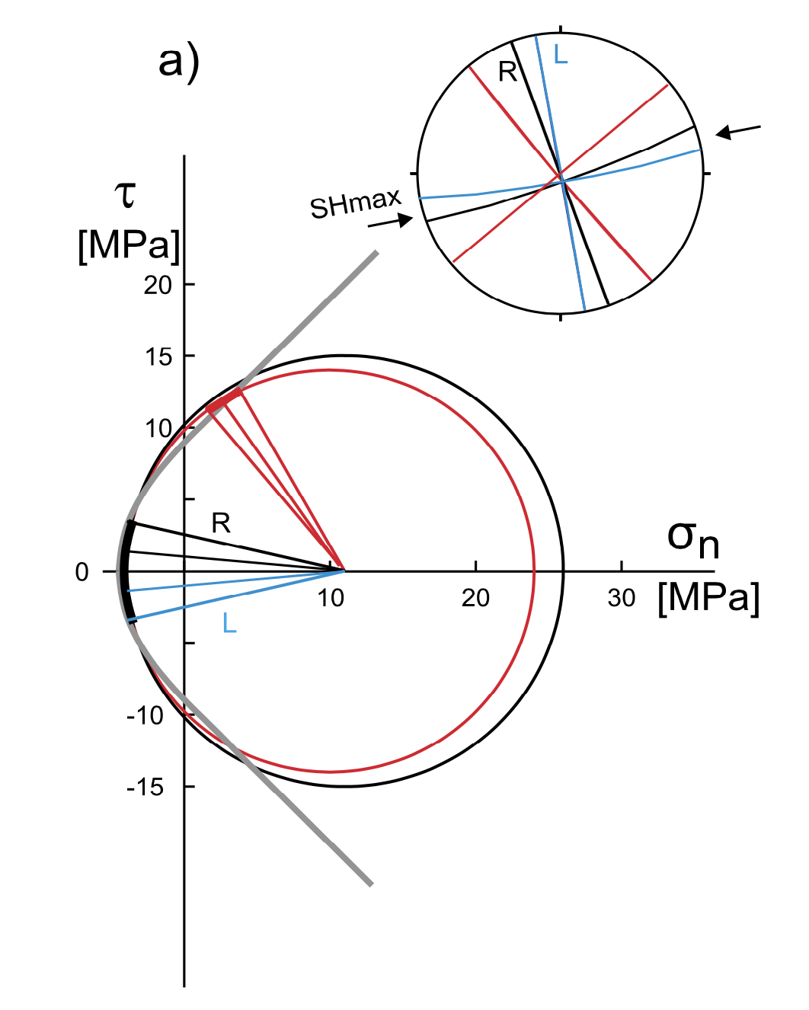
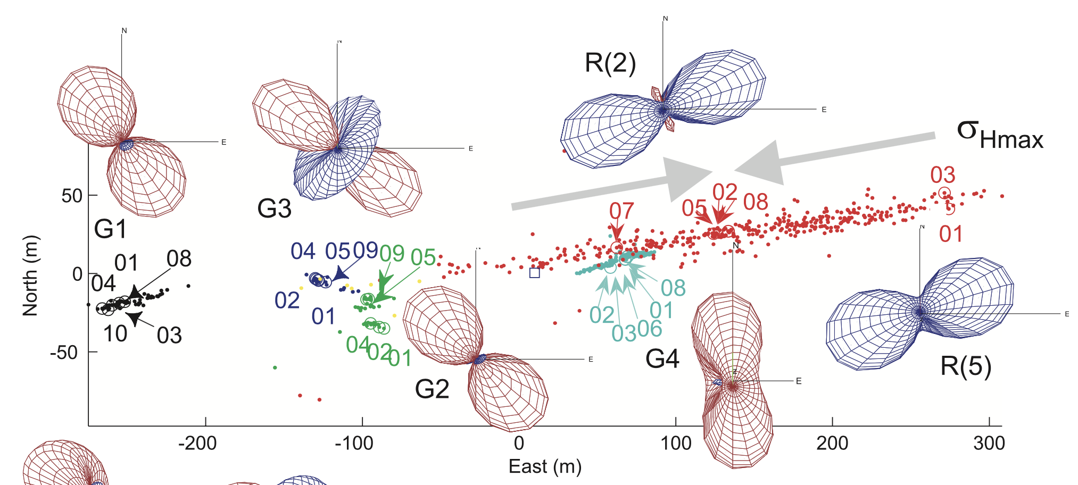
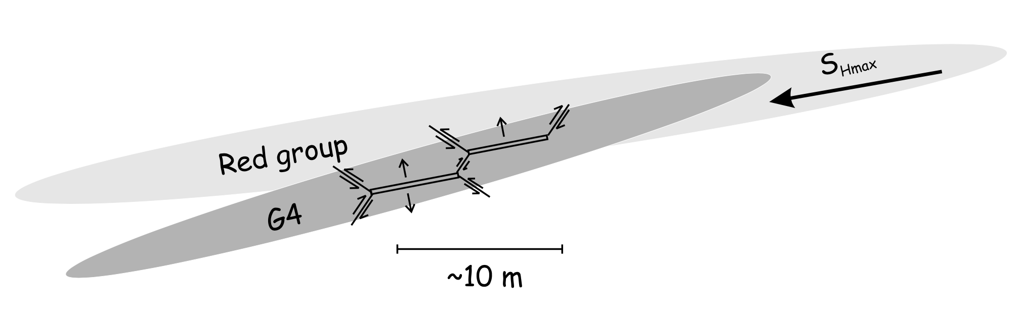
Deformation at low effective stress
Hydraulic stimulation at Cotton Valley gas field in Texas
(Šílený, et al., 2009; Fischer & Guest, 2011 )

Slide 5
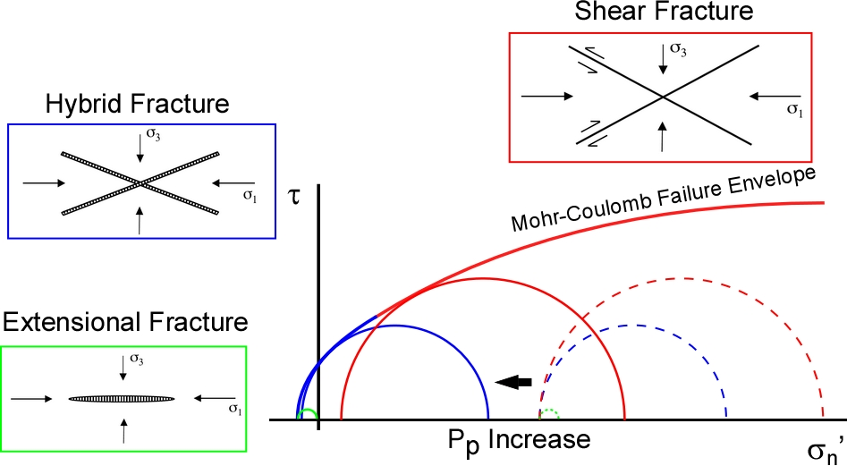
Deformation at low effective stress
Effective stress law (e.g., Terzaghi, 1946; Jaeger et al., 2009)
σ_{n}’ = σ_{n} – αP_{p} (α = 0 - 1)
As pore pressure increases, effective normal stresses decrease.
The mode of a fracture depends on both pore fluid pressure and differential stress.
Extension-shear mixed-mode fracture
Modified from (Sibson, 2017)

Slide 6
Objectives of this study
Document the deformation behaviors at very low effective pressure
Investigate the effects of pore fluid pressure on extension-shear mixed-mode fractures
Is Terzhaghi’s effective stress law valid in a tensile stress field?
Conduct triaxial extension deformation tests
Rock type
Porous and permeable rocks: Berea sandstone; Indiana limestone
Non-porous and impermeable rocks: Carrara marble; Westerly granite
Under pore pressure-controlled conditions
Strain rate: 10⁻⁵ s⁻¹ for Berea sandstone; 10⁻⁶ – 10⁻⁸ s⁻¹ for Carrara marble

Slide 7
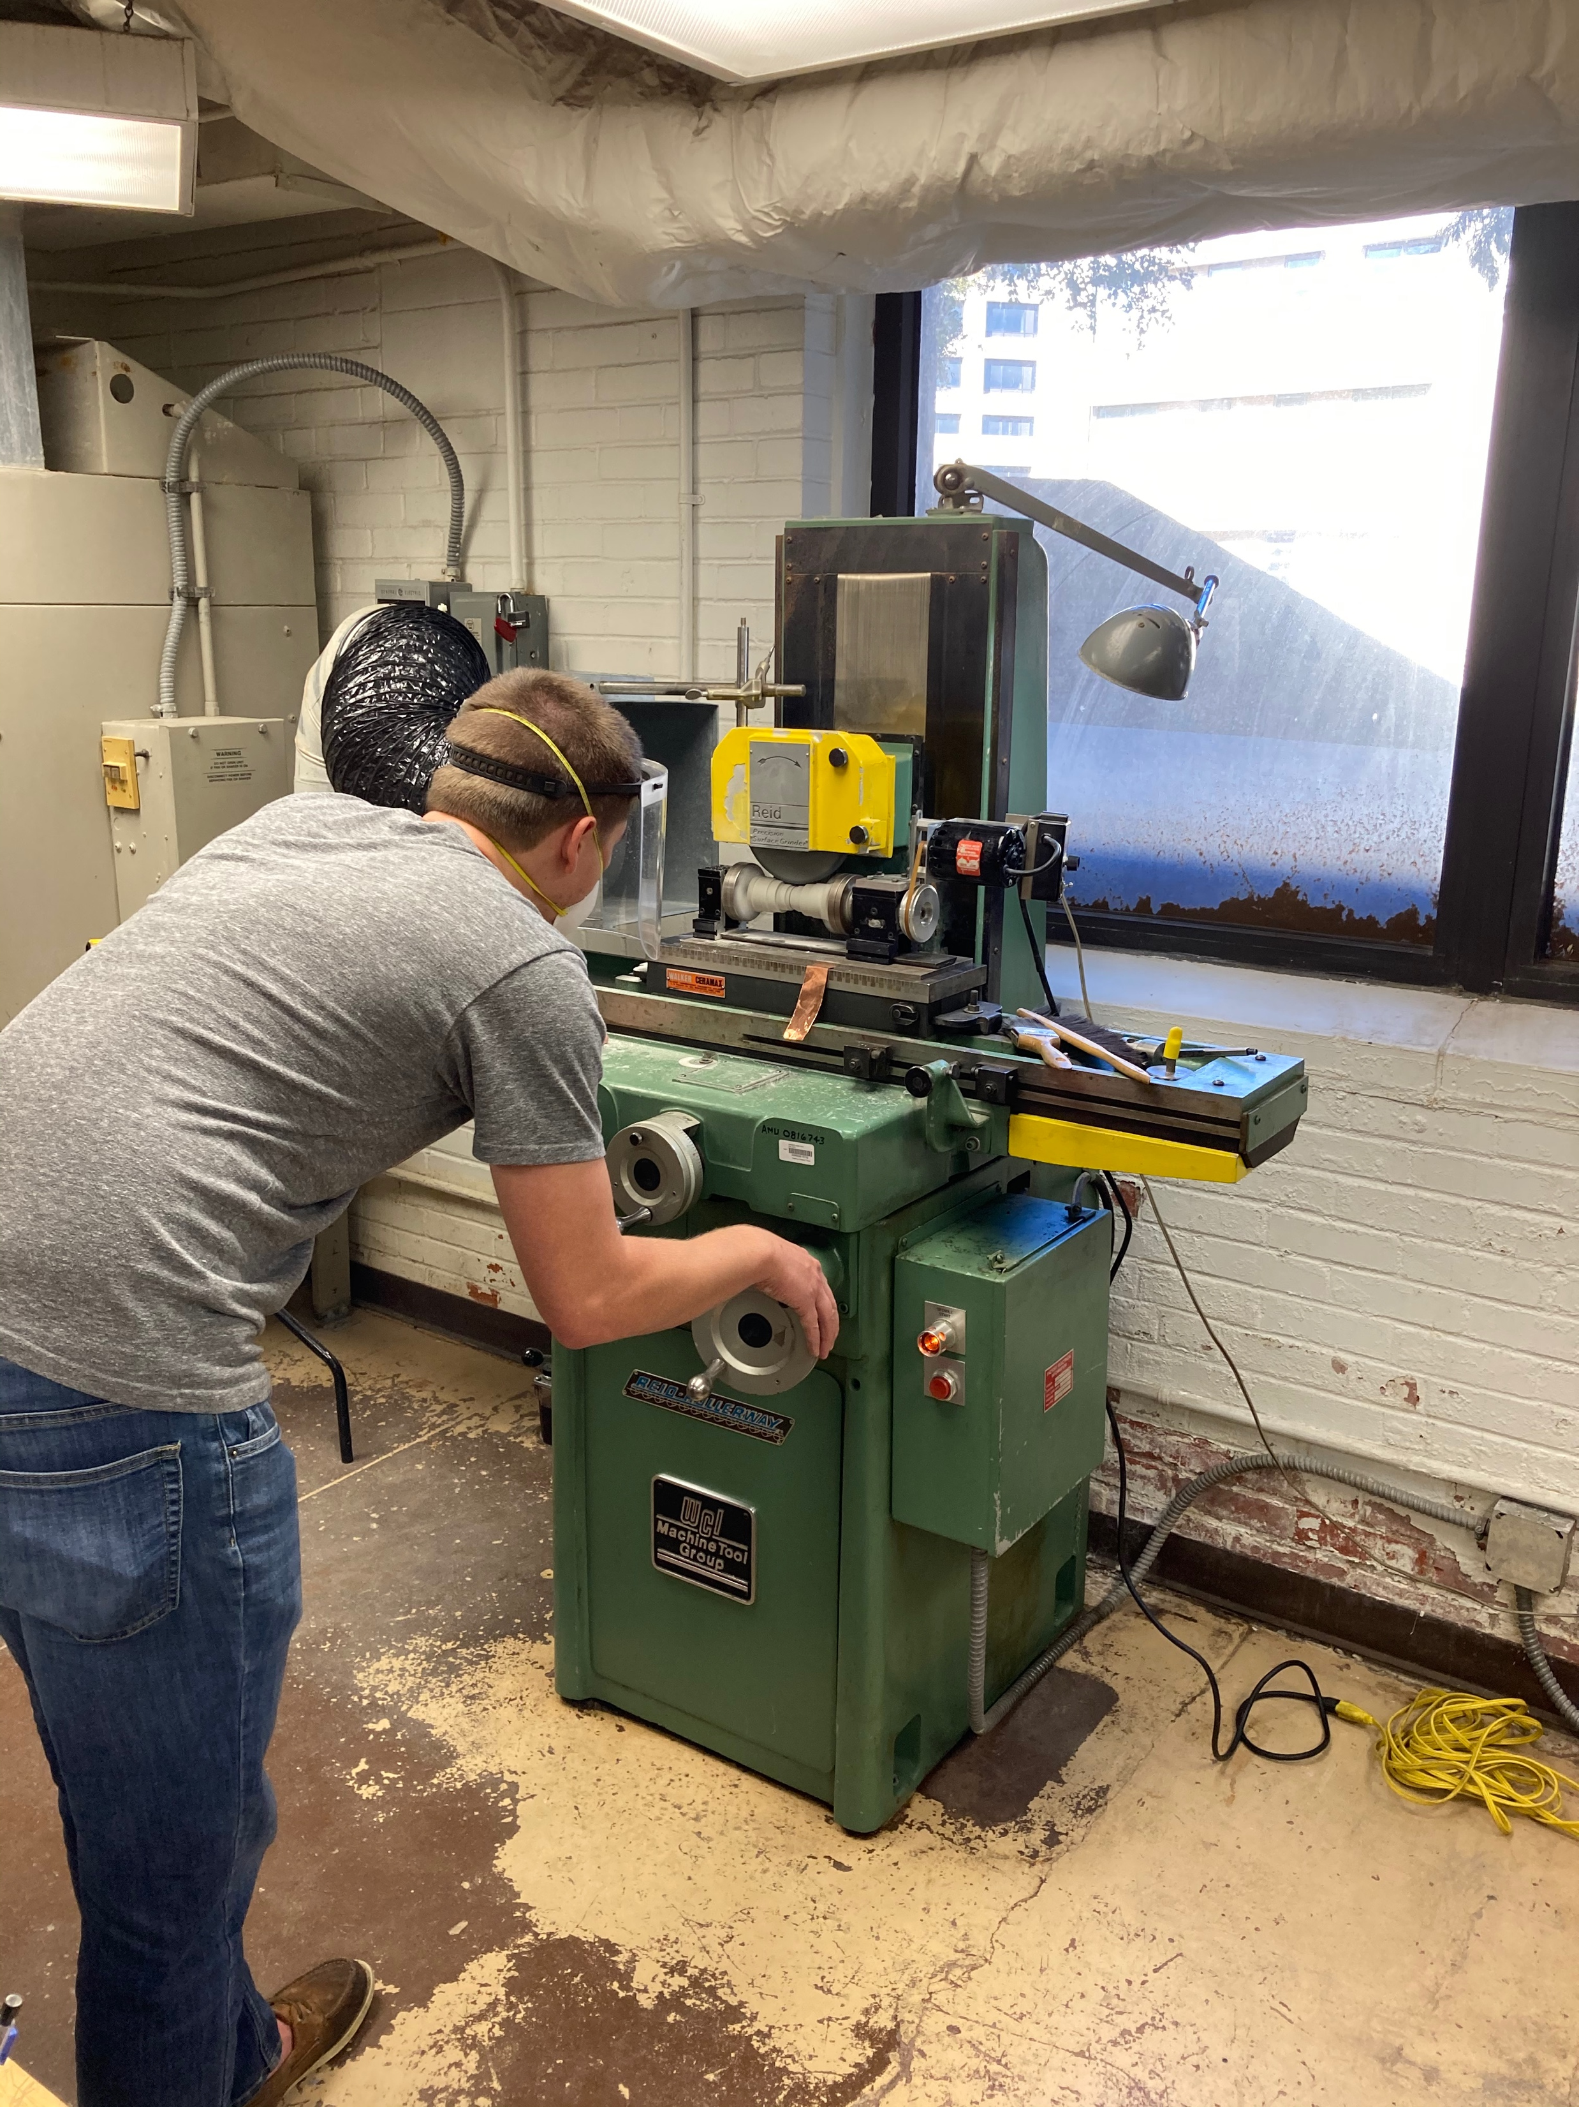
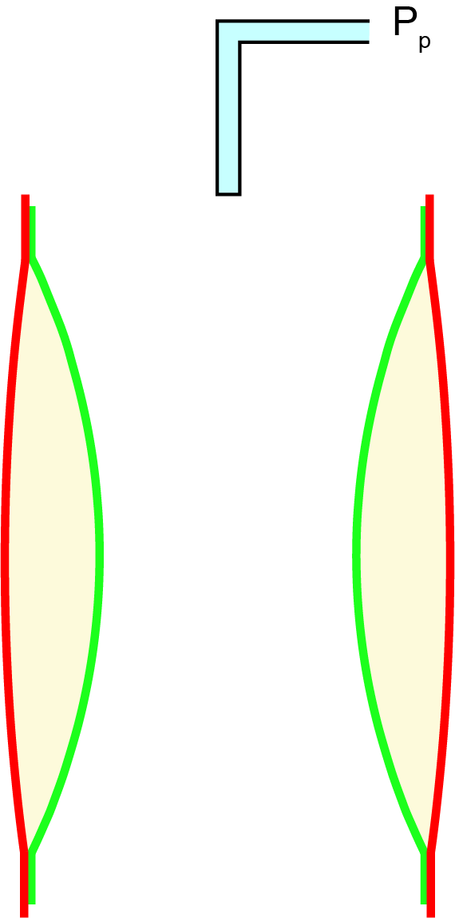
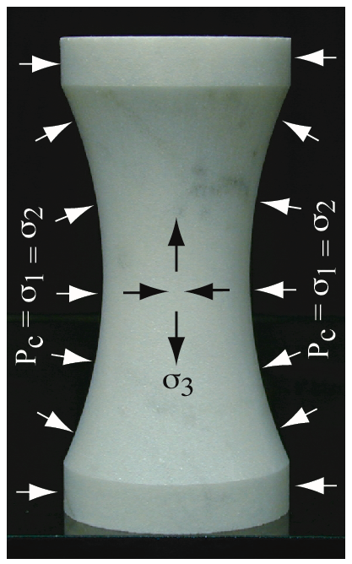
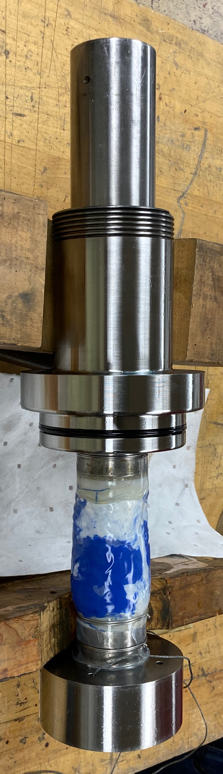
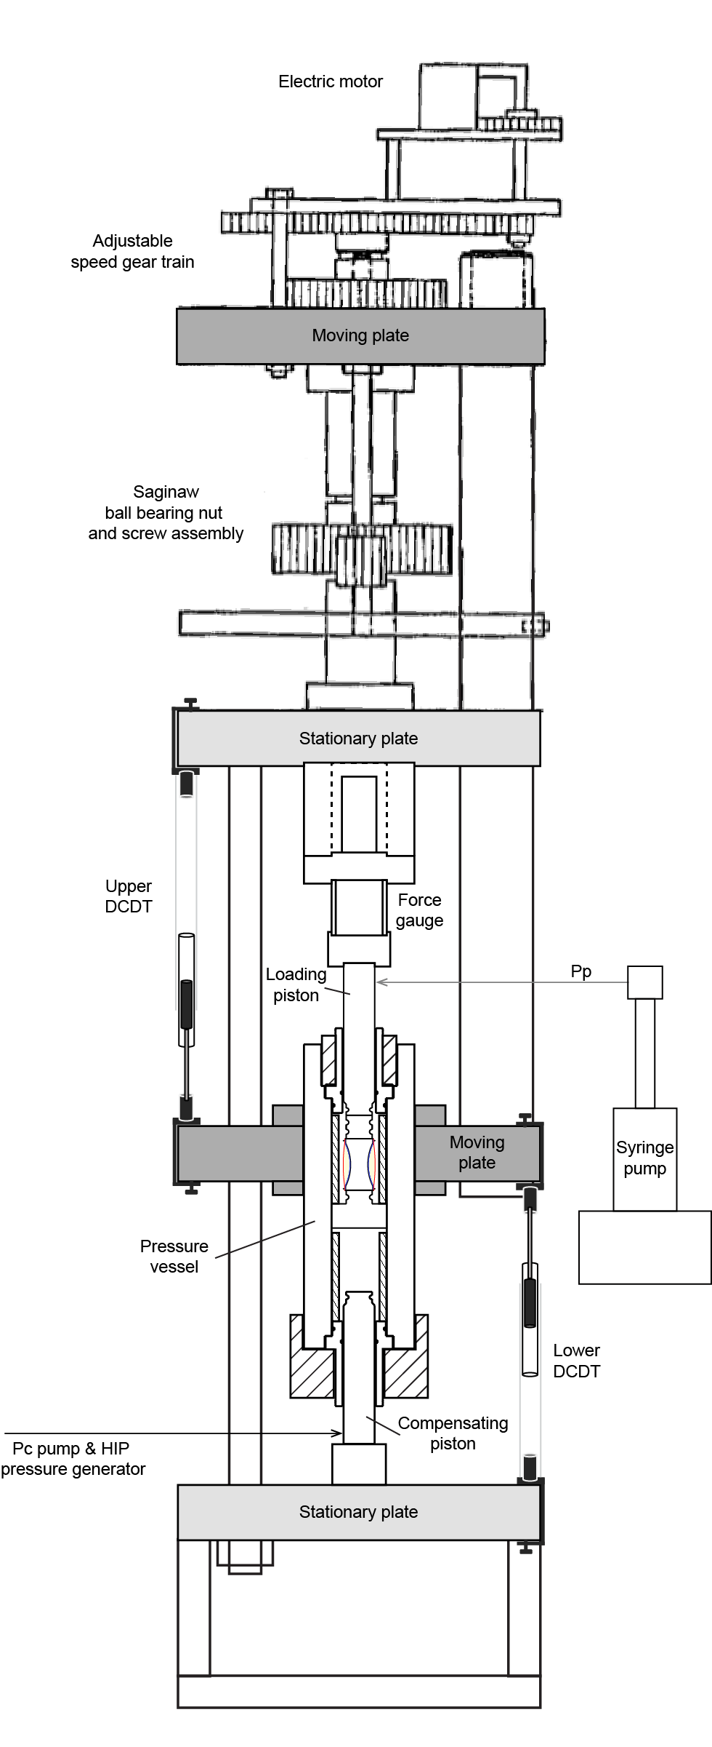
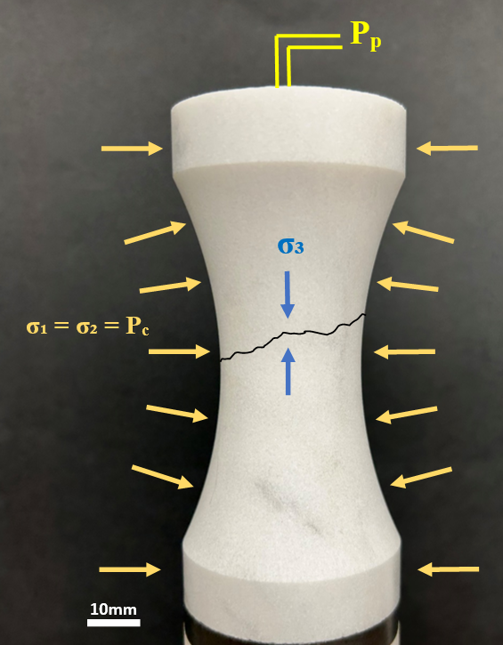
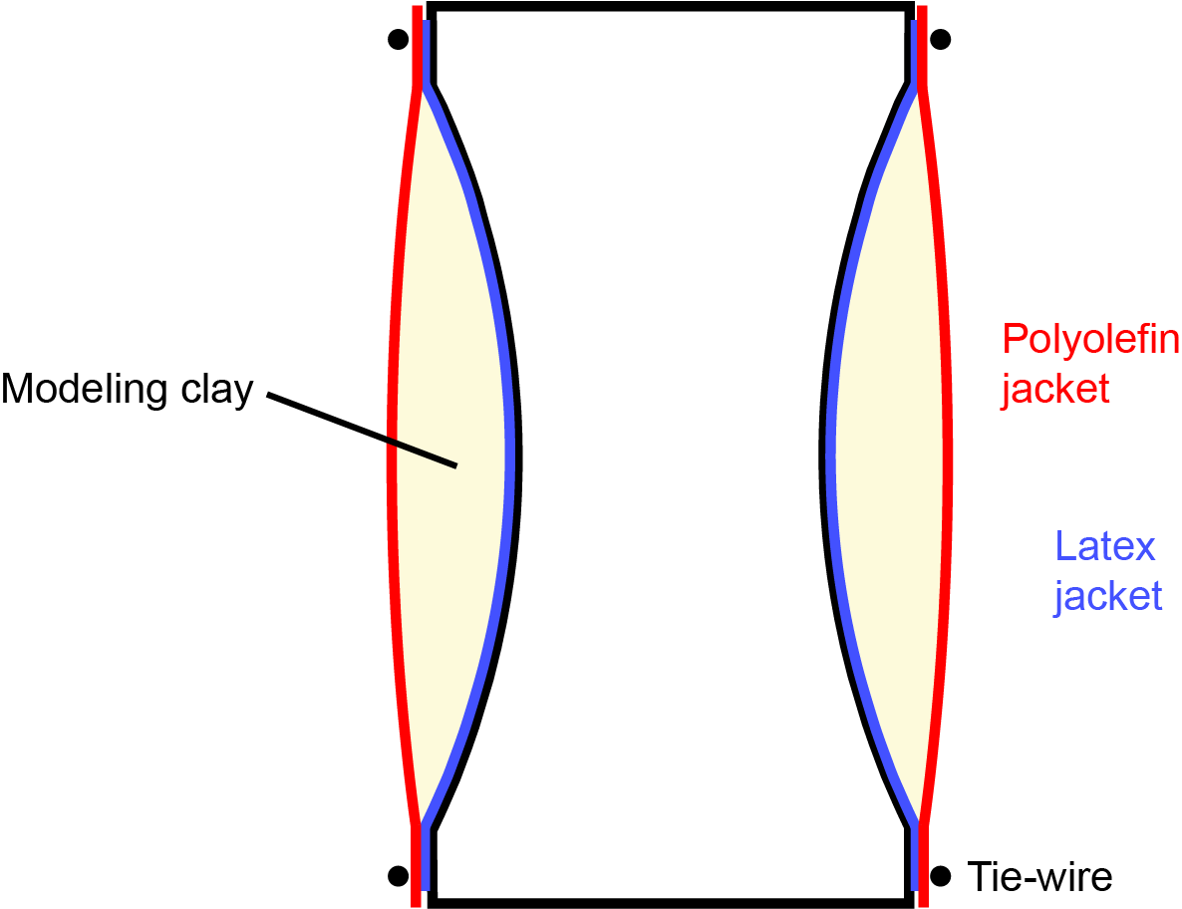
Triaxial extension tests
Dog-bone geometry
Creates a uniform stress concentrated at the center of the neck.
Jacketing
Isolate confining and pore pressure fluid media (silicone oil vs. distilled water)
Do not hold the strength (Jacket strength<< rock strength)
Homogeneously distribute the confining pressure
A combination of latex jacket, modeling clay , and polyolefin jacket is used.
(Brace, 1968; Ramsey and Chester, 2004; Bobich, 2005; Choens, 2015)
modeling clay
a)
c)
b)
Notes:
Using Diagram:
The necked geometry creates a uniform stress in the necked region.

Slide 8
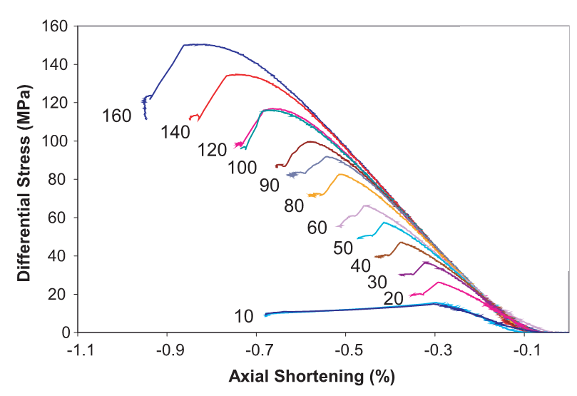
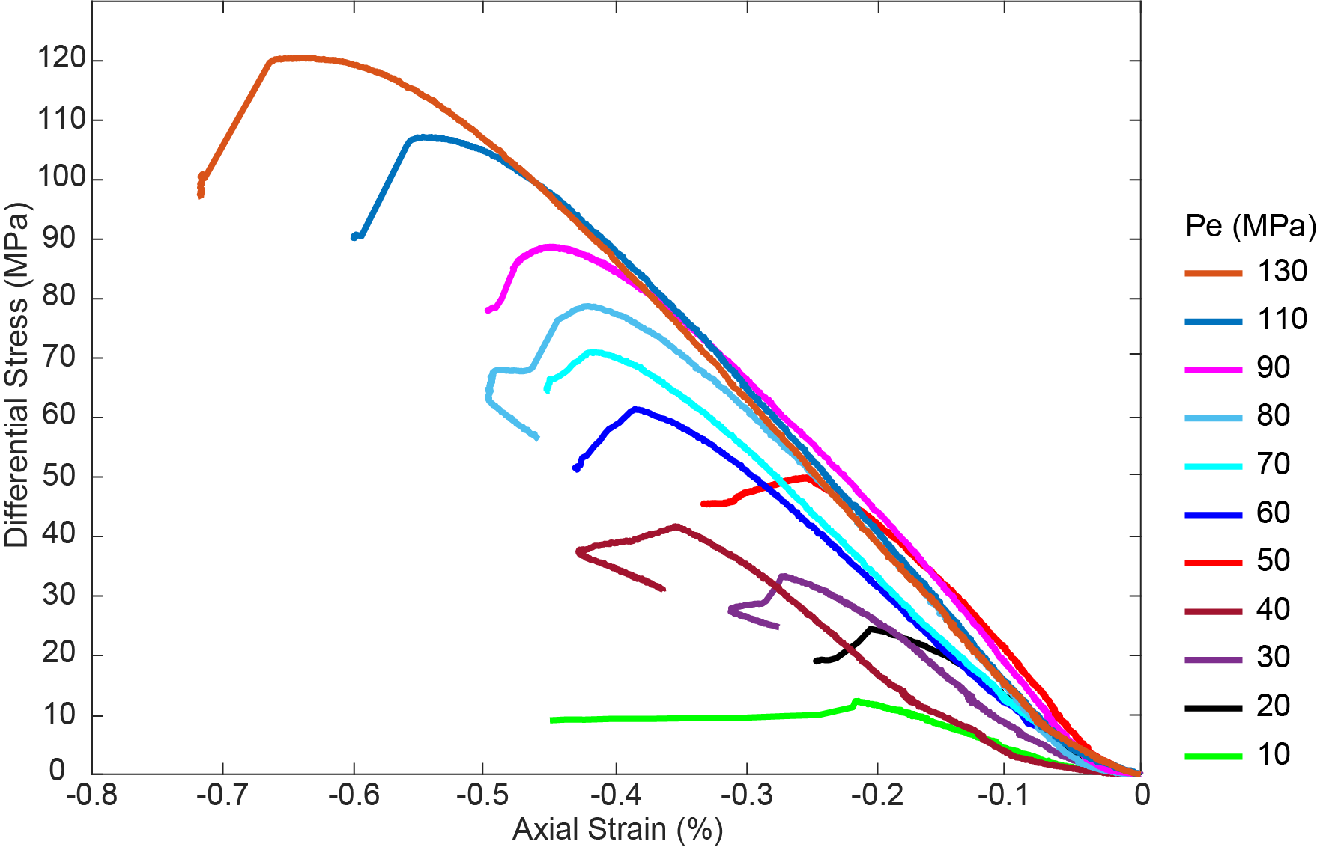
Results : stress-strain curves (Berea sandstone)
Pore pressure controlled (Pp = 10 MPa; distilled water)
Dry (Bobich 2005)
Fracture strength increases with σ₁’ = Pc – Pp = Pe.
Fracture strength of Berea sandstone in pore-pressure controlled conditions is smaller than in dry conditions.

Slide 9

Results : stress-strain curves (Carrara marble)
Pore pressure controlled (Pp = 10 MPa; $\dot{ε}$= 10⁻⁶ s⁻¹)
Dry ($\dot{ε}$= 10⁻⁶ s⁻¹ ; Ramsey, 2003)
Pe = Pc - Pp (MPa)
Fracture strength of Carrara marble in pore-pressure-controlled conditions is greater than in dry conditions.
Notes:
Change the y-axis

Slide 10
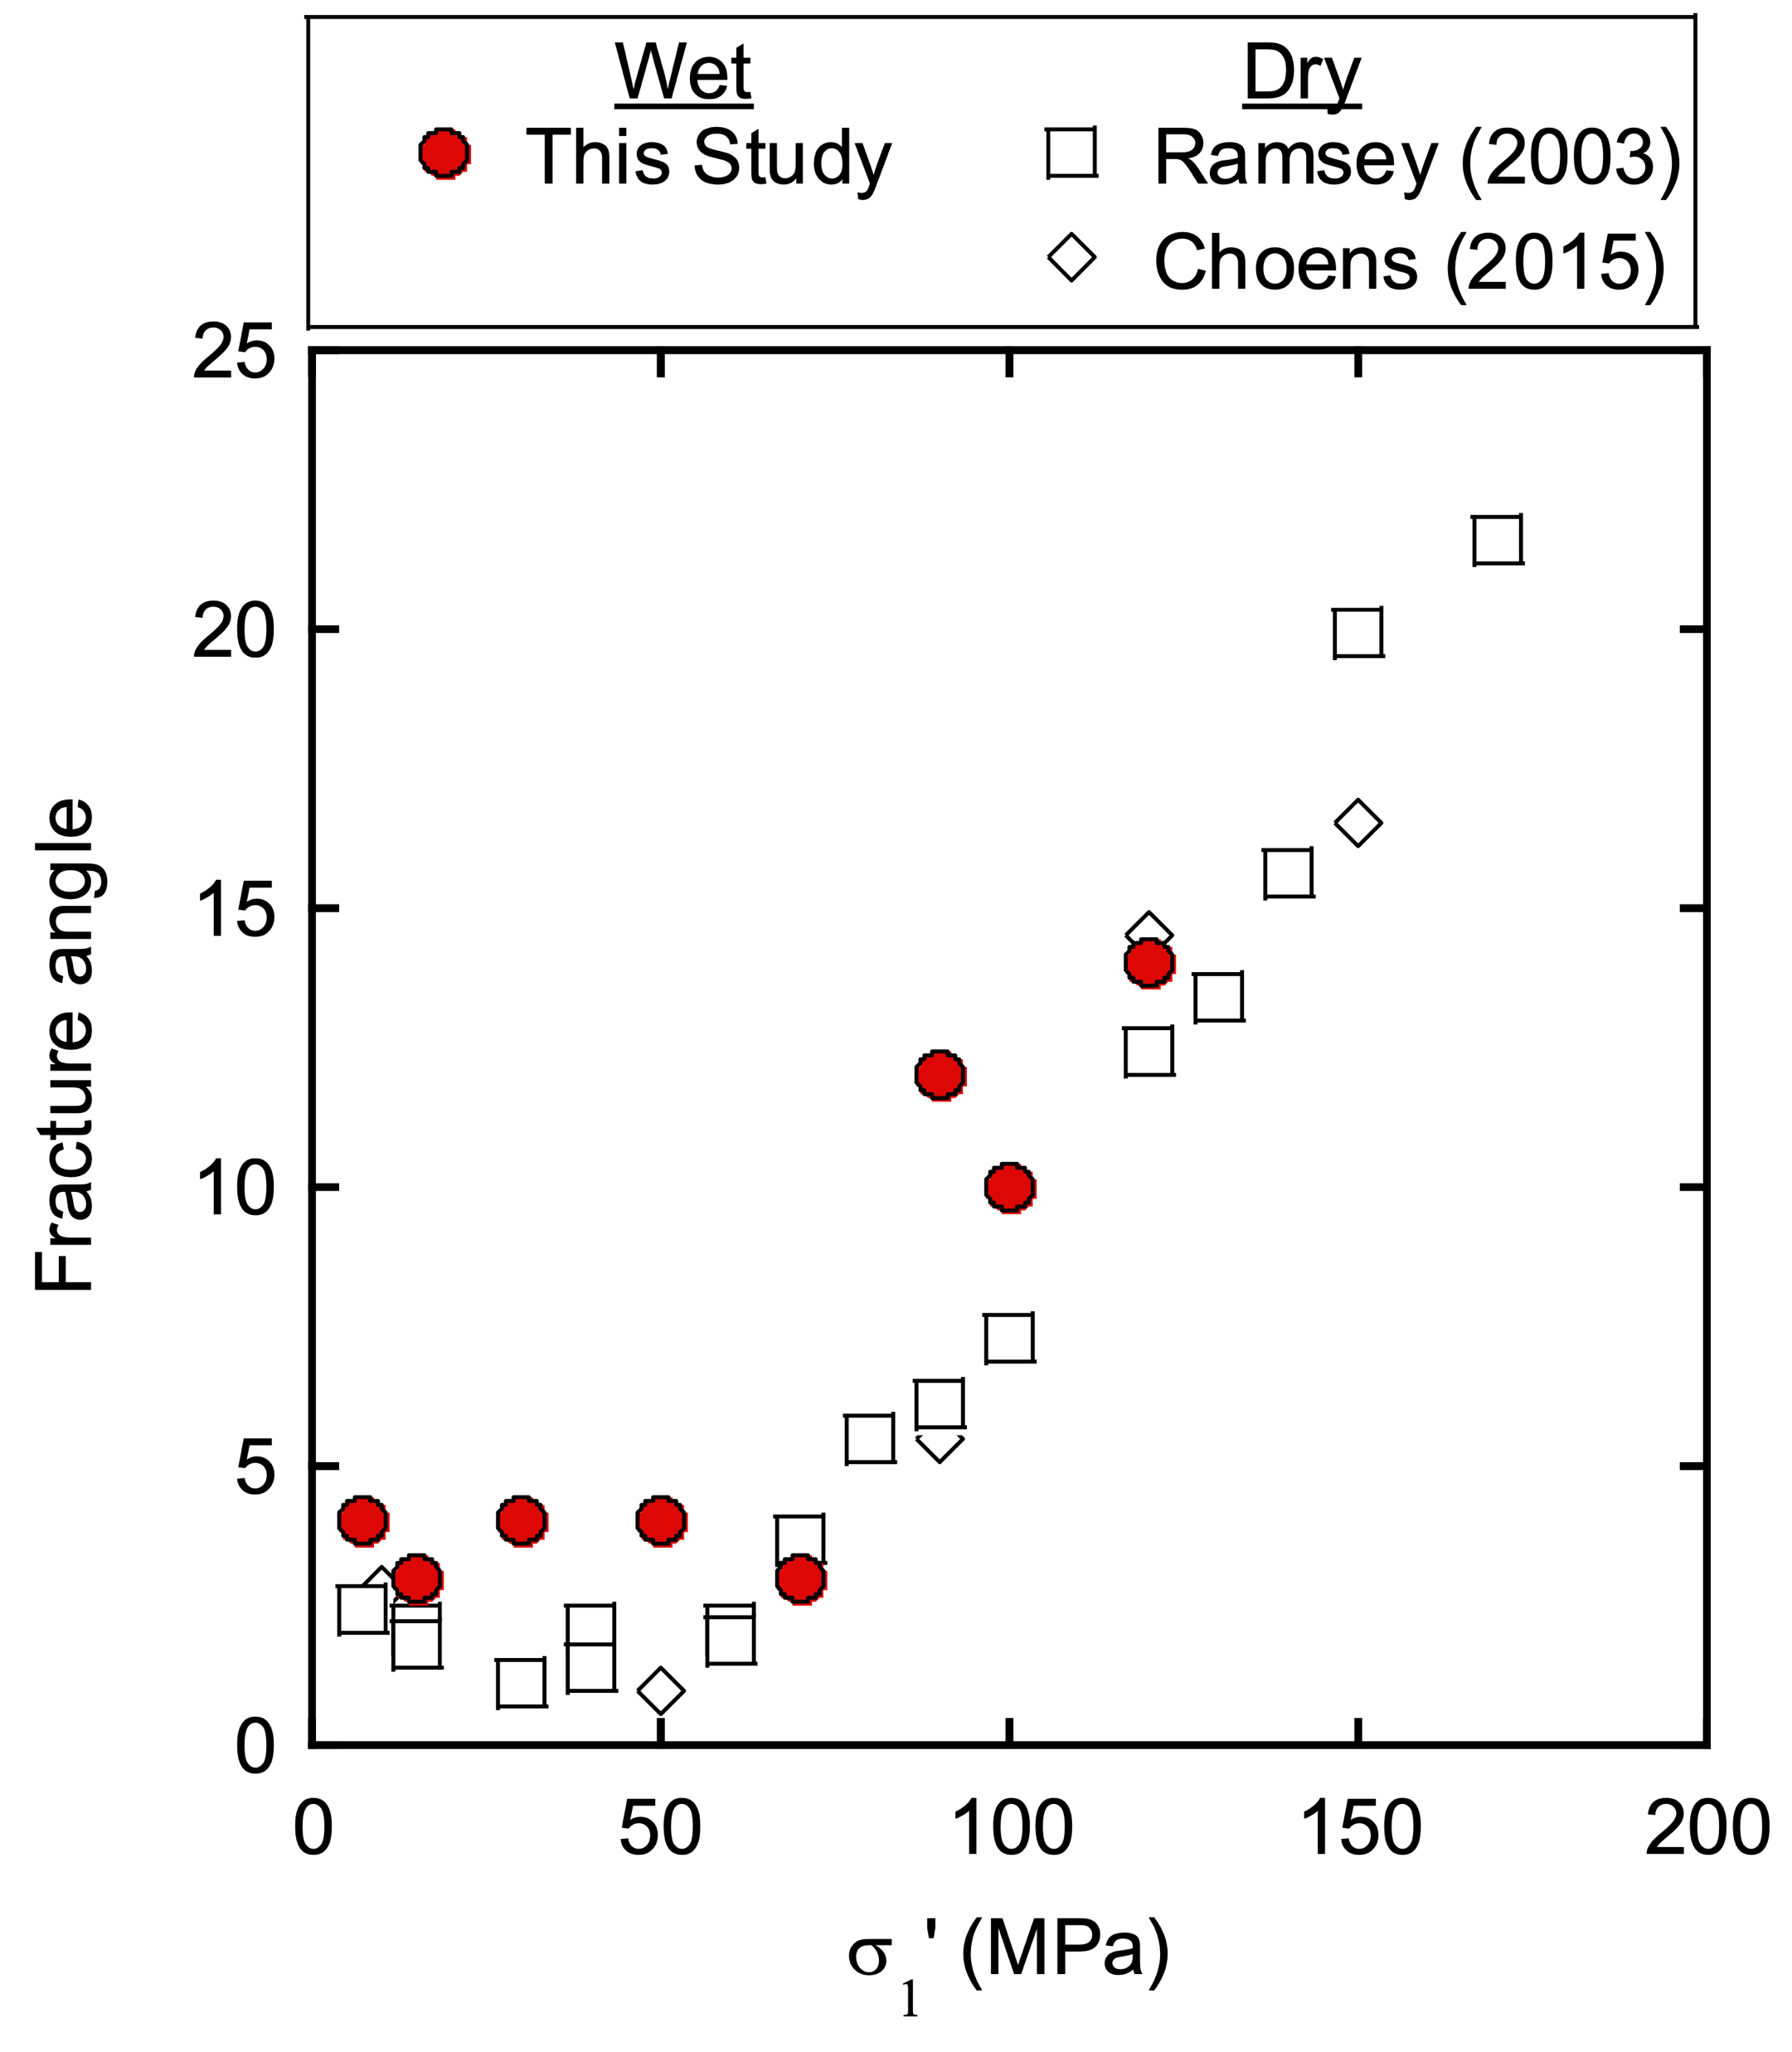
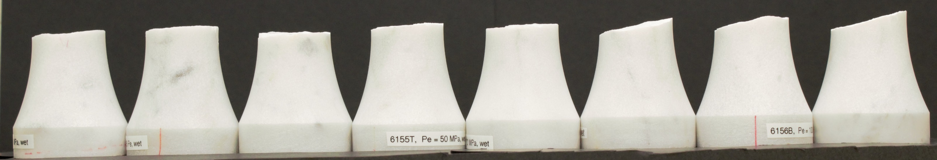

Fracture morphology
Carrara marble
Fracture angle is low at σ₁’< 50 MPa and increases with σ₁’ when σ₁’ >50 MPa.
The comminution increases with σ₁’.
Little difference between pore pressure and dry conditions.
Transition from extension to shear fractures with increasing σ₁’
(°)
$σ_{1}^{′}=σ_{1}−P_{p}$ (MPa)
Pe (MPa)
7.5
15
30
50
70
90
100
120
1 cm

Slide 11
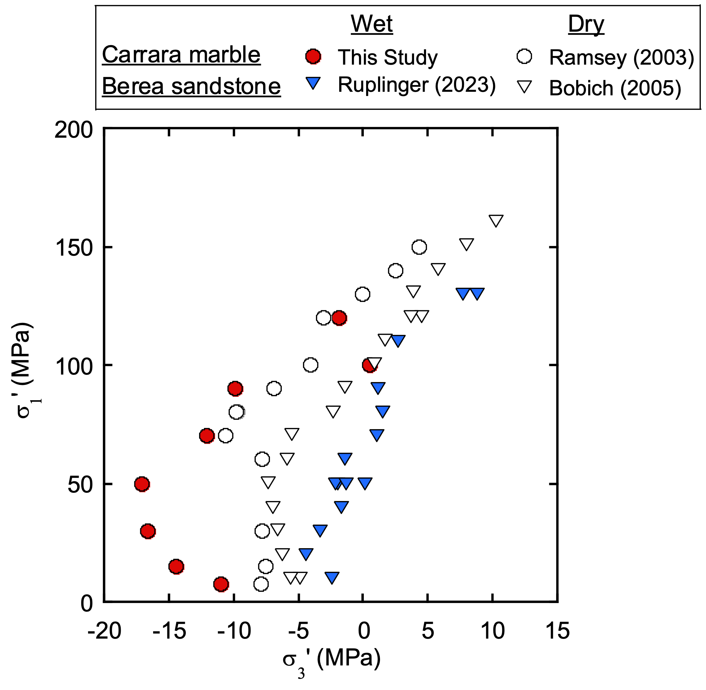
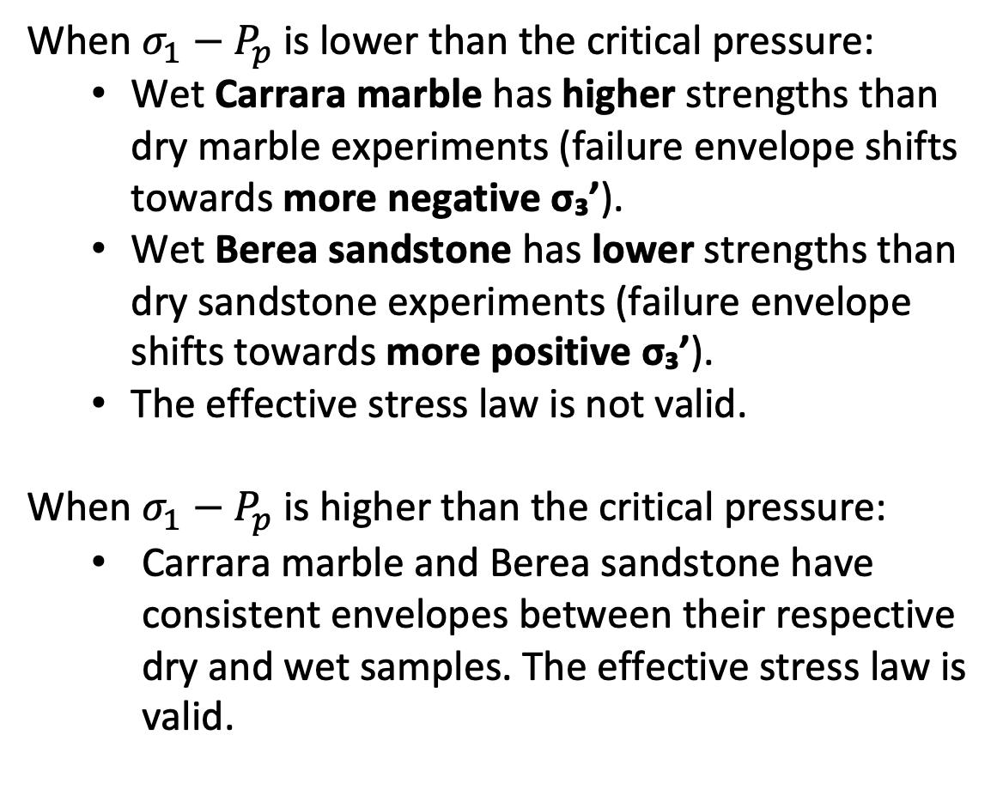


Failure envelopes: Carrara marble vs. Berea sandstone
When $σ_{1}−P_{p}$ is lower than the critical pressure:
Wet Carrara marble has higher strengths than dry marble experiments (failure envelope shifts towards more negative σ₃’).
Wet Berea sandstone has lower strengths than dry sandstone experiments (failure envelope shifts towards more positive σ₃’).
The effective stress law is not valid.
When $σ_{1}−P_{p}$ is higher than the critical pressure:
Carrara marble and Berea sandstone have consistent envelopes between their respective dry and wet samples. The effective stress law is valid.
$σ_{1}−P_{p}$ (MPa)
$σ_{3}−P_{p}$ (MPa)

Slide 12
Effects of Strain Rate on Fracture Strength – Carrara Marble
Pore pressure-controlled conditions: fracture strength increases with strain rate.
Dry conditions: fracture strength is independent of strain rate.

Slide 13
Effects of Strain Rate on Fracture Strength – Carrara Marble
Pore pressure within Carrara marble is lower than the controlled pore pressure (10 MPa) due to its low permeability, resulting in an increase in effective pressure and fracture strength (Dilatancy hardening).
Brace and Martin (1968), Paterson and Wong (2005)

Slide 14
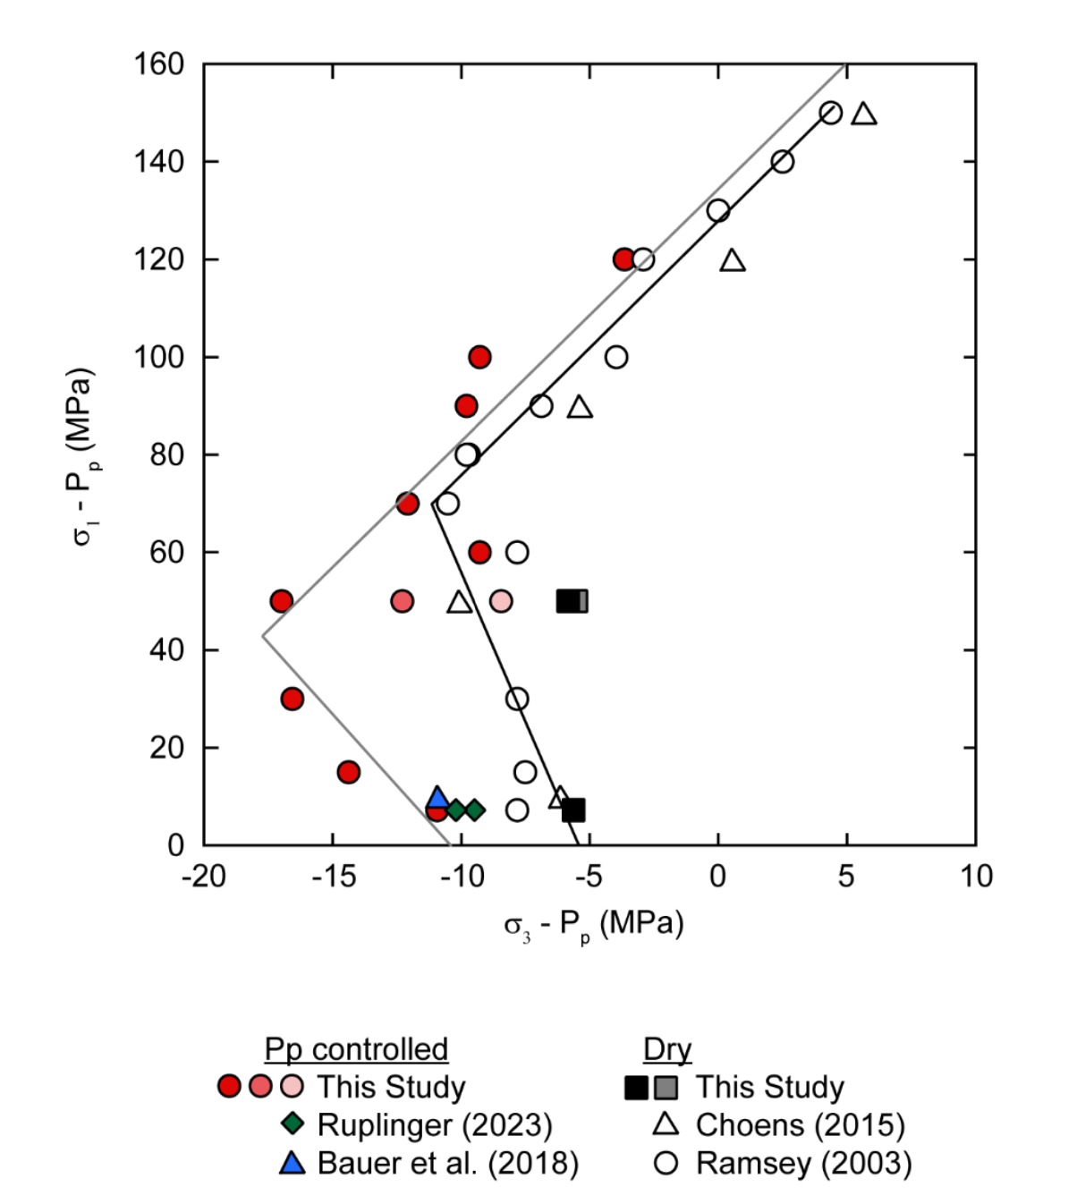
Effects of Strain Rate on Fracture Strength – Carrara Marble
Dilatancy hardening effects are more pronounced at low effective stress.
Pore fluid pressure in pores and cracks within the tight rocks is hard to measure or quantify directly, but crucial for fracture initiation and propagation.
10⁻⁶
10⁻⁷
10⁻⁸

Slide 15
Slow Fracture Propagation at P_{c} – P_{p}= 7.5 MPa
Fracture strength is independent of the combinations of P_{c} and P_{p}, but depends on P_{c} – P_{p}. The effective stress law is valid.
A slight increase in differential stress over axial strain from yield to failure is observed only in P_{p}-controlled conditions.
Ramsey (2003)
Notes:
Point out dilatancy hardening in the red one.

Slide 16
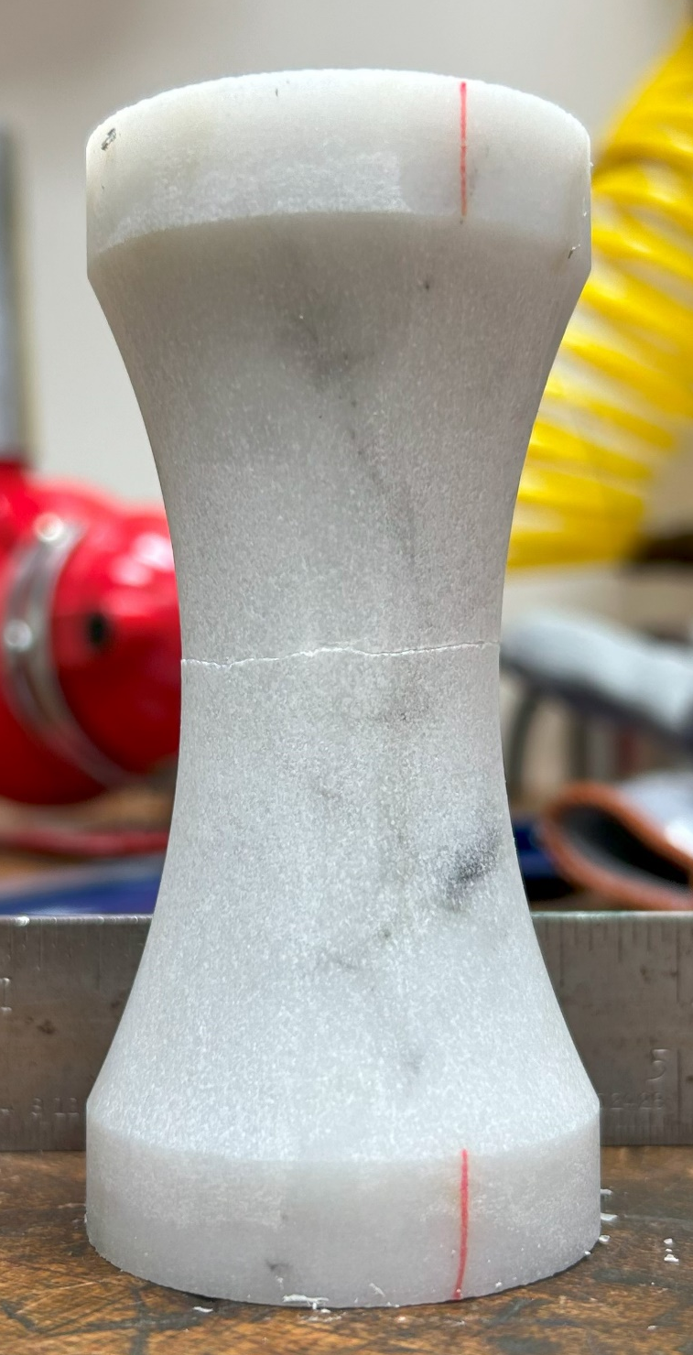
Slow Fracture Propagation at P_{c} – P_{p}= 7.5 MPa
Lower pore fluid diffusion rate due to low permeability leads to slow fracture propagation.
Higher P_{p} assists in opening microcracks to develop macroscopic extension fracture.
Notes:
But still, it takes time to connect all the microcracks to develop large fracture.

Slide 17
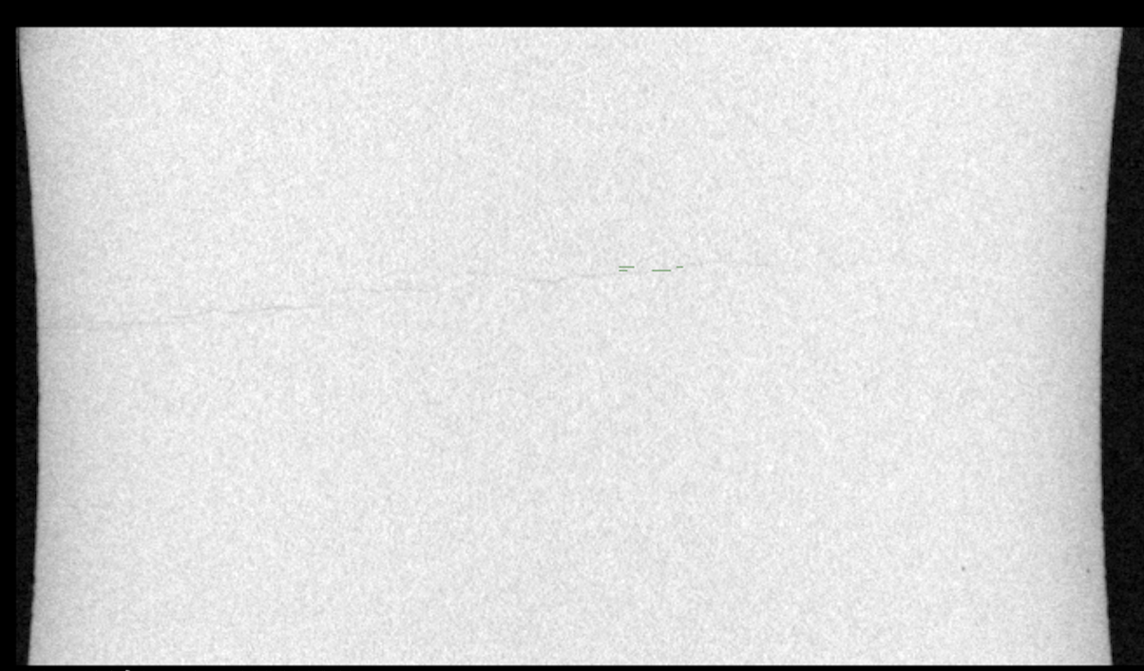
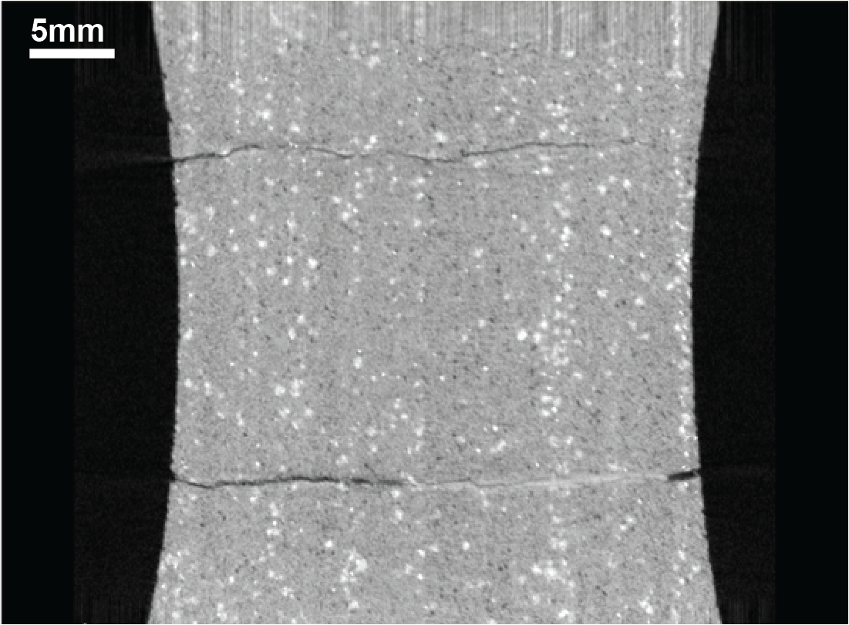
Micro X-ray CT
Carrara marble (Pc = 70 MPa and Pp = 10 MPa)
Berea sandstone (Pc = 60 MPa and Pp = 10 MPa)
5 mm
5 mm
Small opening
Not-fully fractured
Macroscopic fracture seems to be initiated at a side and propagated to the other side.
Opened fractures
Some comminution
Two fractures (likely due to stress concentrations related to bedding planes)

Slide 18
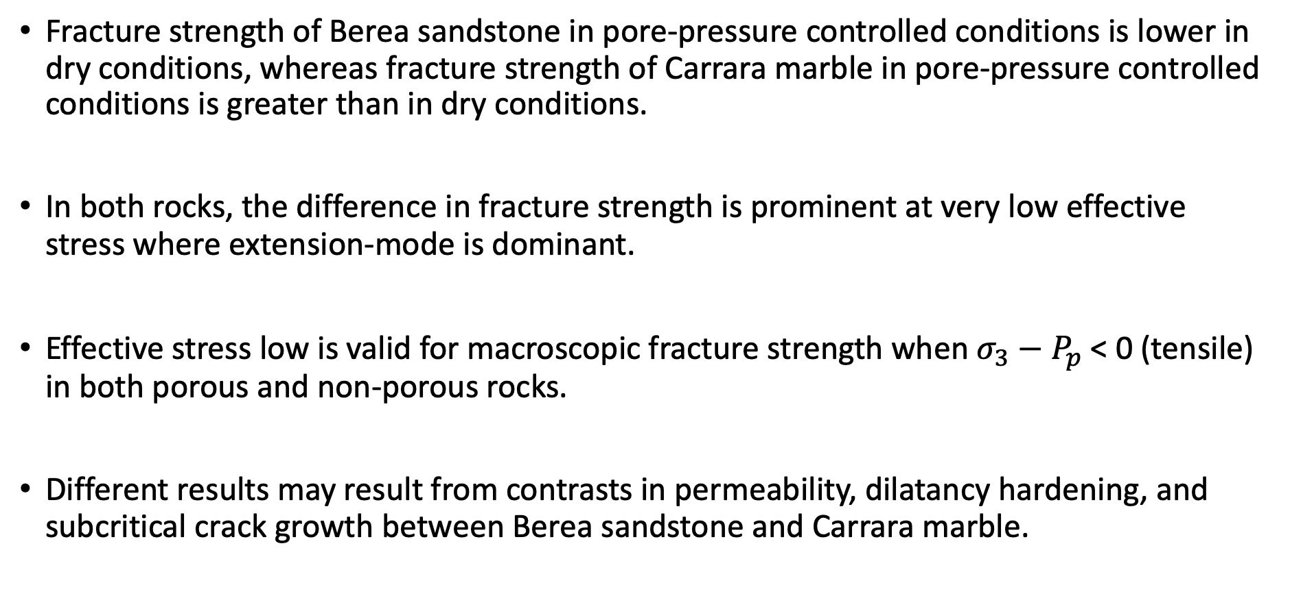
Summary
Fracture strength of Berea sandstone in pore-pressure controlled conditions is lower in dry conditions, whereas fracture strength of Carrara marble in pore-pressure controlled conditions is greater than in dry conditions.
In both rocks, the difference in fracture strength is prominent at very low effective stress where extension-mode is dominant.
Effective stress low is valid for macroscopic fracture strength when $σ_{3}−P_{p}$ < 0 (tensile) in both porous and non-porous rocks.
Different results may result from contrasts in permeability, dilatancy hardening, and subcritical crack growth between Berea sandstone and Carrara marble.

Slide 19
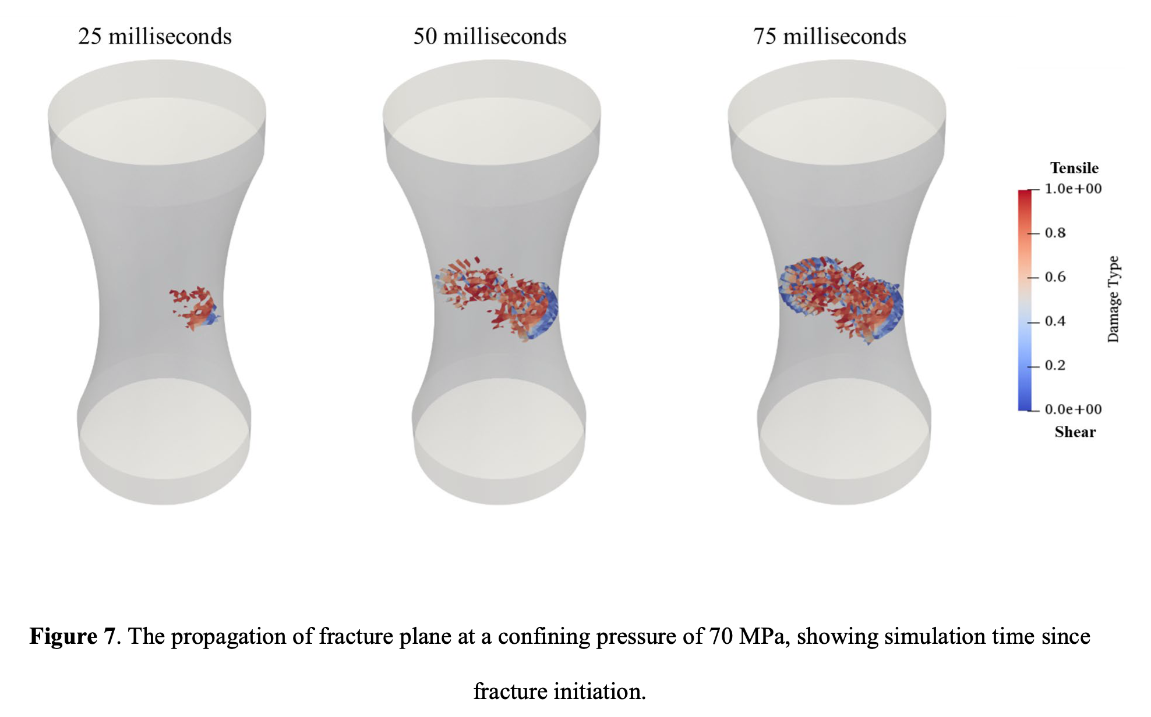
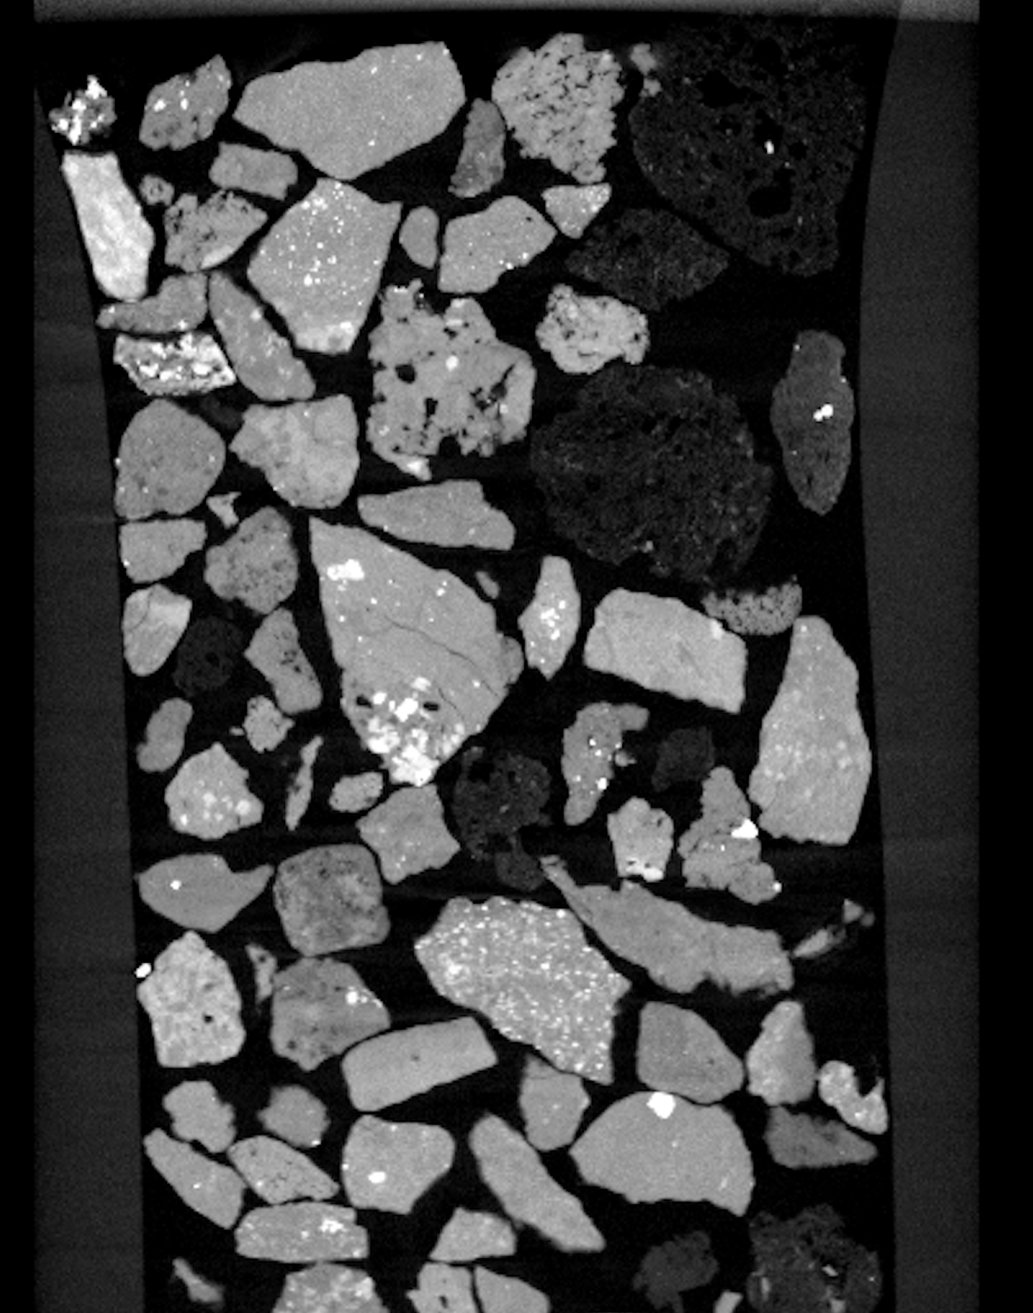
Ongoing and future study
Characterization of fracture deformations (profilometer, CT scan, thin sections)
Cyclic load-unload tests to capture fracture initiation and propagation
FDEM numerical simulation (collaboration with LANL)
Experiments on other permeable and impermeable rocks (Indiana limestone; Westerly granite)
Effects of σ₂ (true-triaxial tests on a hollow cylinder)
Isolated pore
Volcanic lapilli (IODP Exp. 398: Hellenic Arc volcanic field)
(Boyce et al., 2020)

