Slide 1
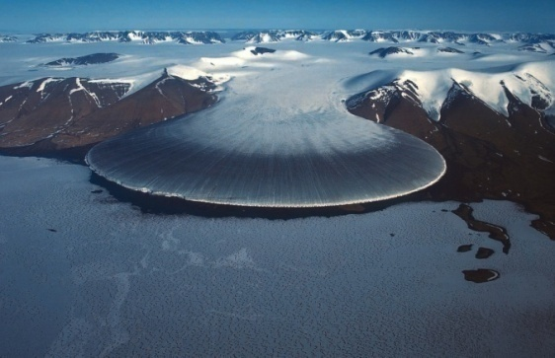
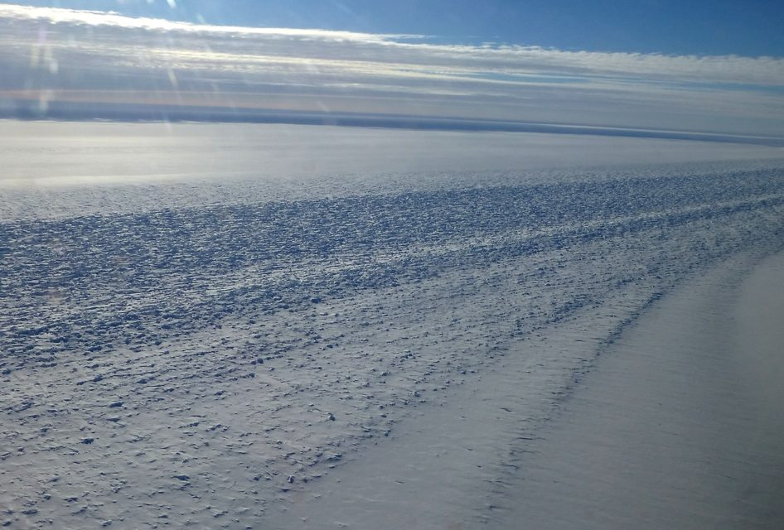
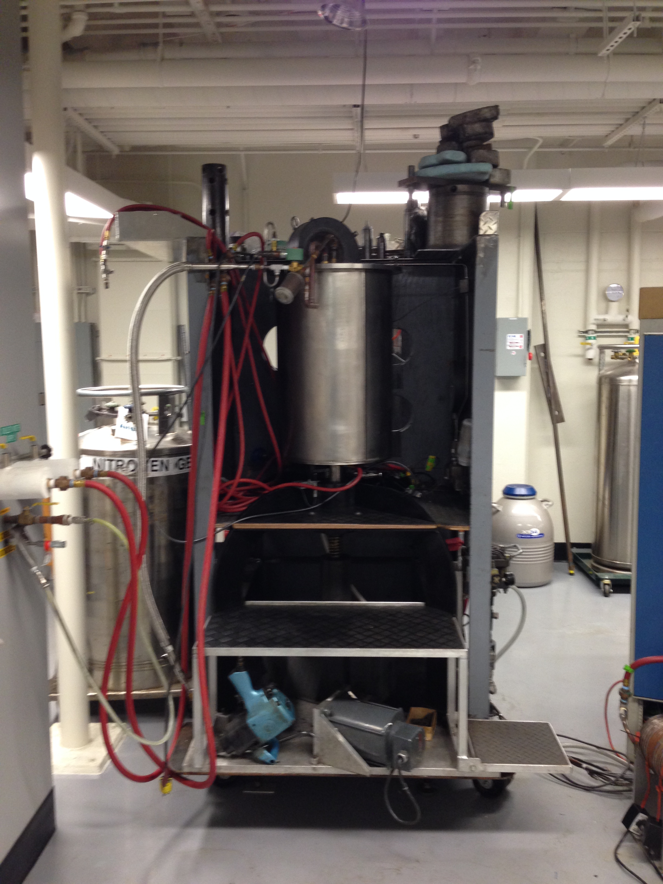
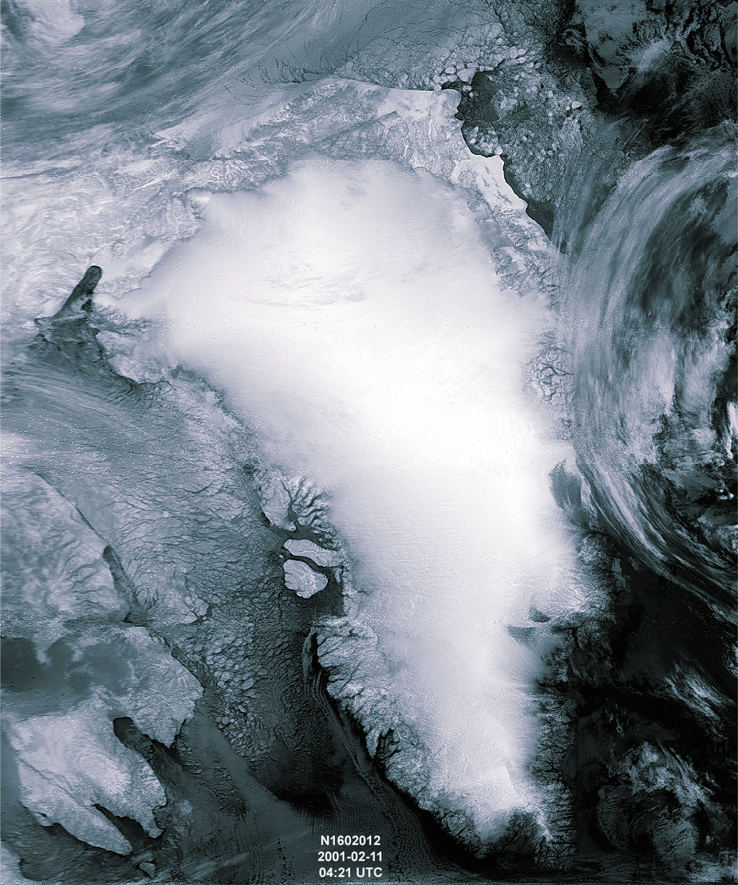
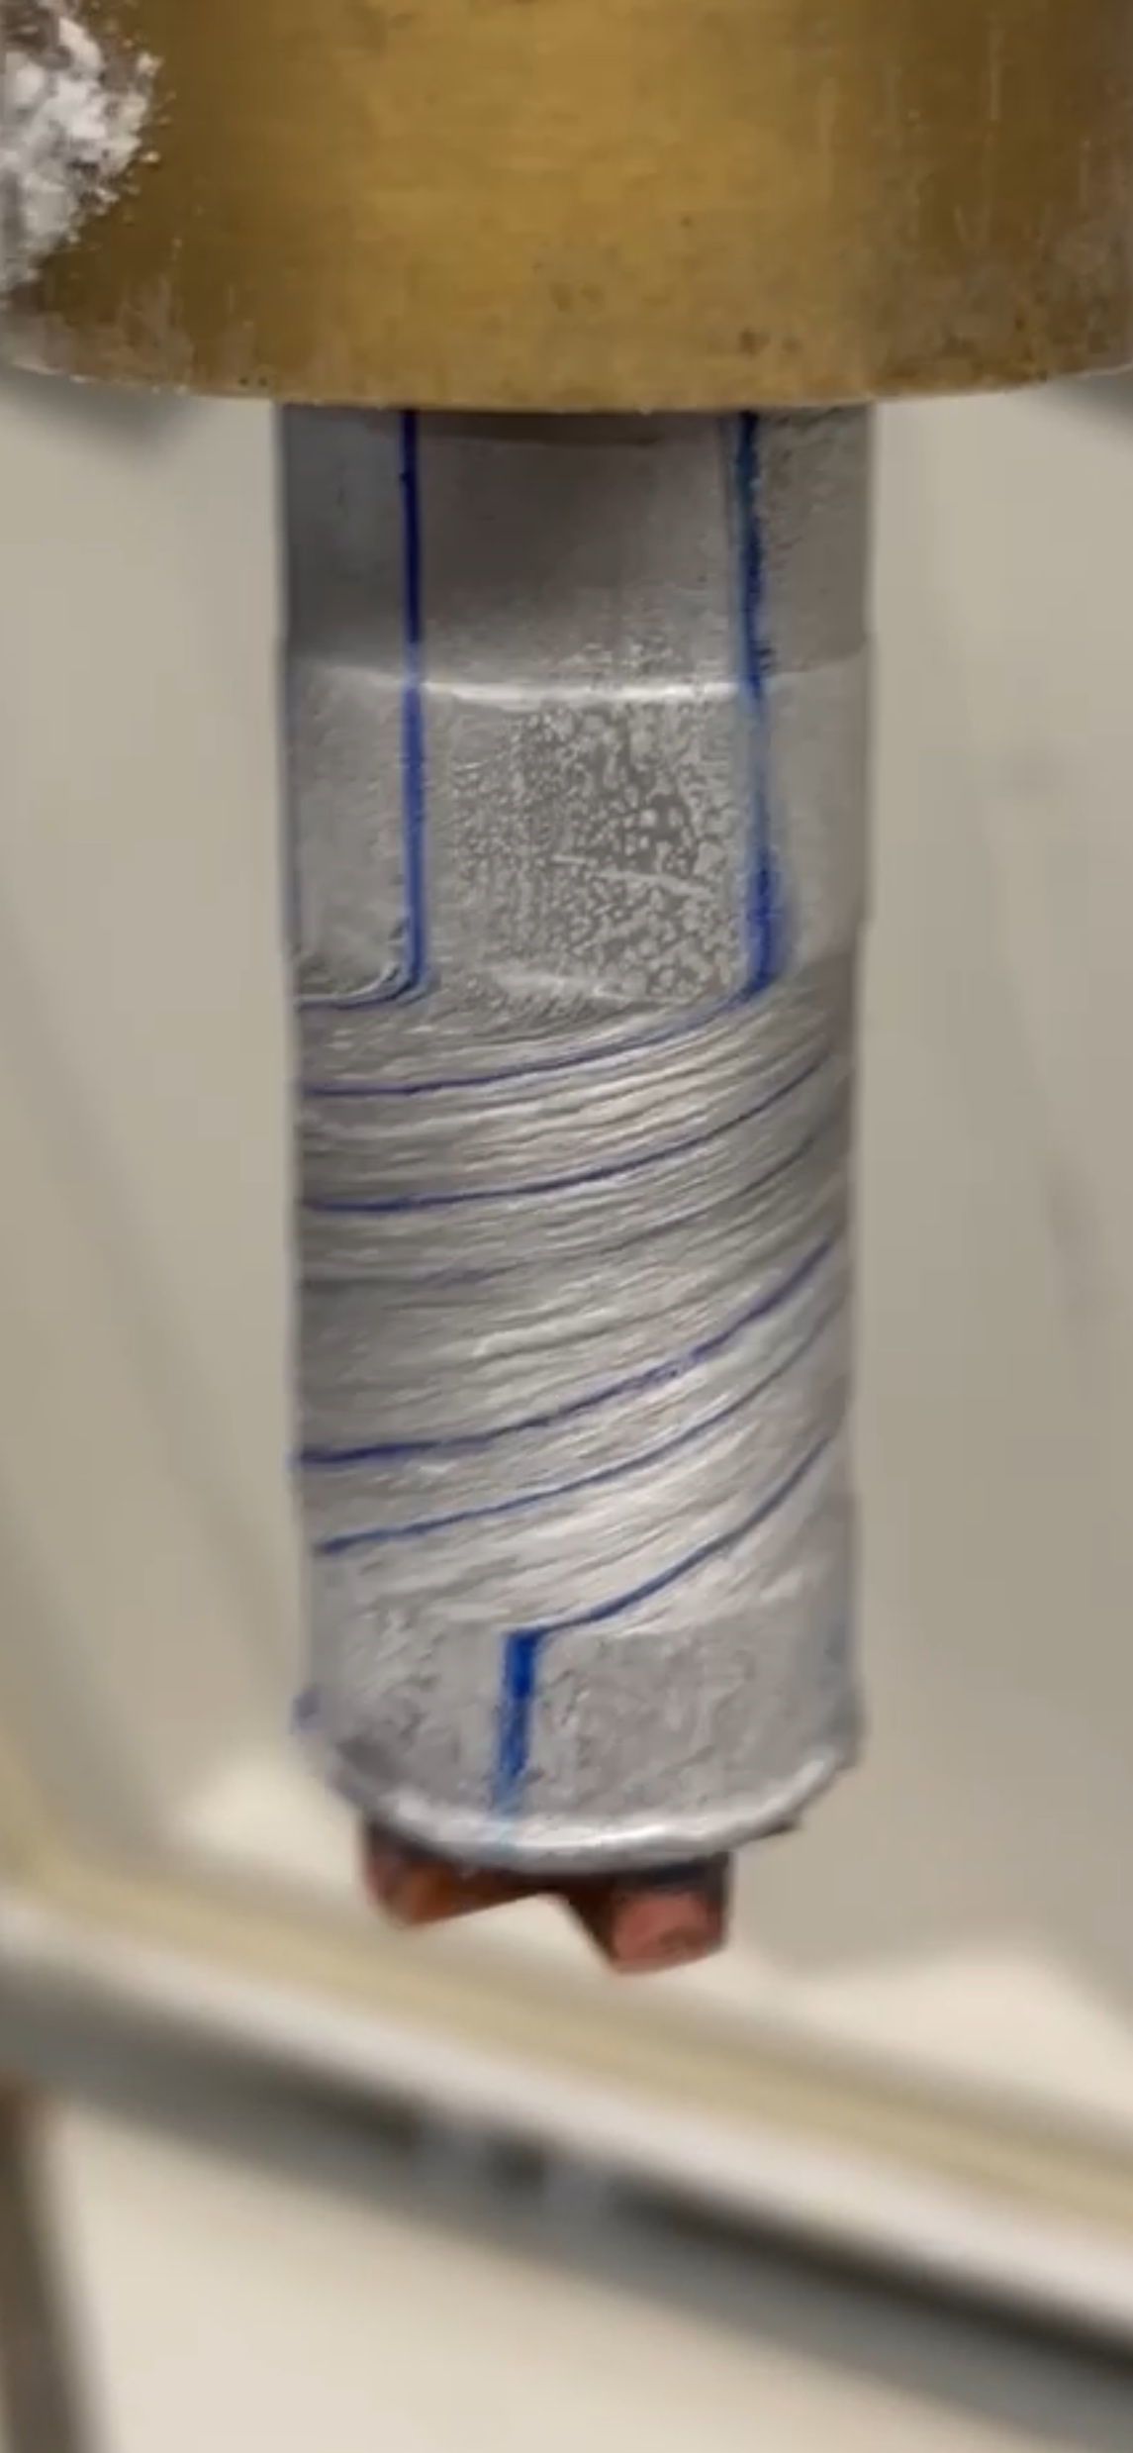
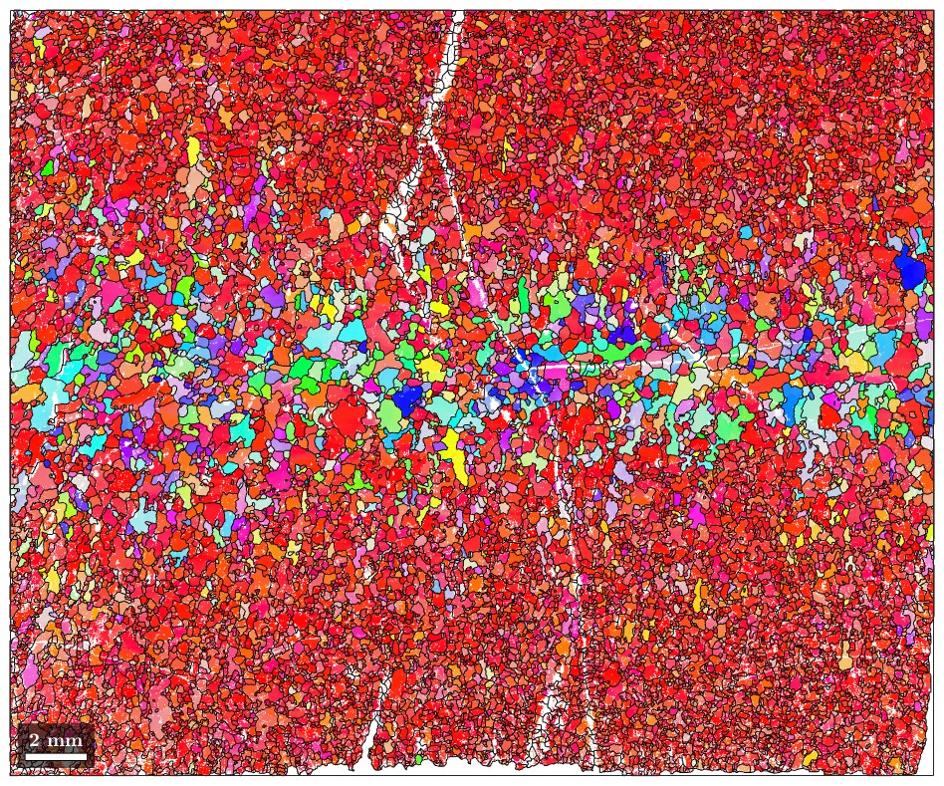
Mechanical Anisotropy of Ice Single Crystals: Implications for Flow of Polycrystalline Ice
David L. Goldsby, Jacob Fowler, Ratul Das
Earth and Environmental Science, University of Pennsylvania
SEES Workshop, UChicago, August 11-13, 2025

Slide 2
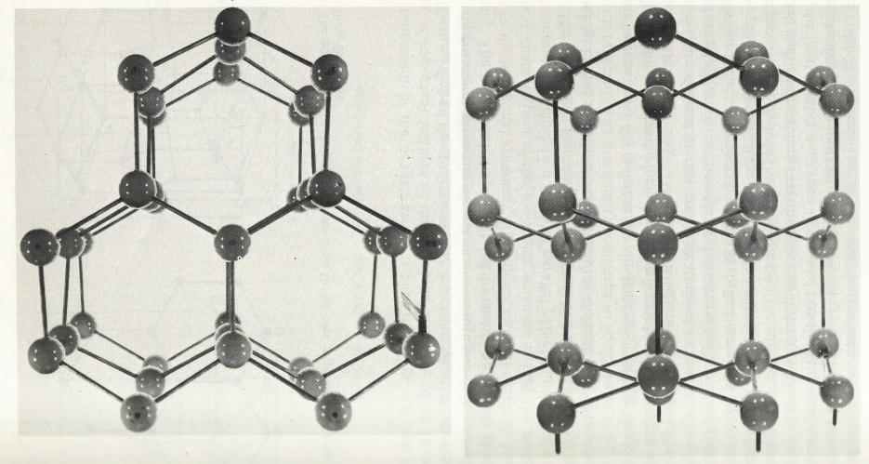
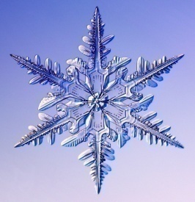
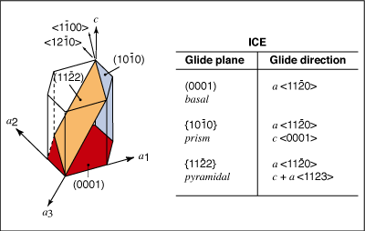
Dislocation slip systems in ice
Down the c-axis
Perp. to c-axis
T
Basal glide
Increasing
difficulty of
slip
basal slip
prismatic slip
pyramidal
Basal glide gives only 2 independent slip systems – insufficient for compatible deformation – need 5
Notes:
Ice belongs to the hexagonal crystal system, as is a matter of common experience.
Dislocation glide can occur on several slip systems.
Easiest slip occurs on the closest packed plane with the widest separation – the basal plane.
Basal dislocations – in the plane of the snowflake
With increasing difficulty of slip
Prismatic slip
Pyramidal slip
As we’ll see in a moment, ice exhibits an enormous plastic anisotropy – the basal slip system is orders of magnitude weaker than other, non-basal slip systems. Anisotropy is so extreme that ice is often referred to as a material with only a single available slip system.
By the end of this talk, we’ll see that this disparity in the strengths of the single crystal slip systems in ice has enormous consequences for the flow of glaciers and ice sheets, and by extension icy moons.

Slide 3
Ice single crystals
Polycrystalline ice
basal slip
basal planes
optimally
oriented
for basal
slip
45º
T
non-basal slip
no resolved
shear stress
on basal
plane
T
T
non-basal
Von Mises criterion – 5 independent slip systems
Basal slip – provides 2 independent slip systems
Notes:
So, if we take a single crystal of ice and orient it in a testing machine so that it has maximum resolved shear stress on the basal slip system, shown by the black line. So, we have a half plane of atoms that terminate on the basal plane, and the ice crystal deforms via glide on the basal plane.
Now, if we orient the basal plane normal to the applied stress, no resolved shear stress on basal dislocations – they feel no applied stress and don’t move. Other non-basal slip systems can be activated. The stress required to activate hard slip is much larger than for basal slip.
POLYCRYSTAL – When polycrystalline ice is deformed (assume it is homogeneous with a uniform grain size and a random initial orientation of grains), will have some grains that are suitablly oriented for basal slip, some not. Can see that some non-basal slip is required to deform the polycrystal.
This concept is more elegantly and precisely stated in the Von Mises criterion, that says that for deformation via dislocation glide, must have five independent slip systems available.
Basal slip only provides two.

Slide 4
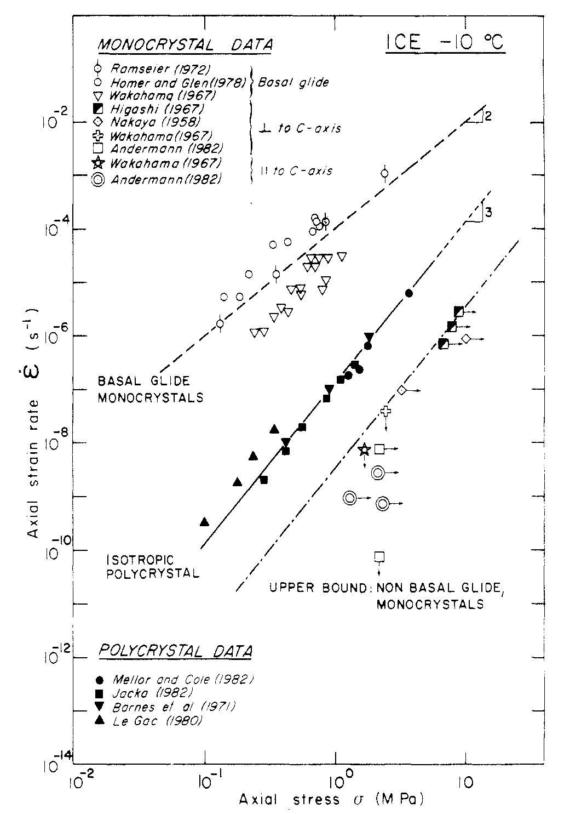
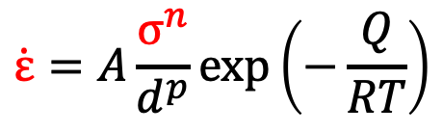
Single crystal
vs. polycrystal
T= 263 K
T
n = 2.4
basal slip
n = 3
$$\dot{ε}=A\frac{σ^{n}}{d^{p}}\exp\left(−\frac{Q}{RT}\right)$$
T
Duval, Ashby and Andermann (1983)
hard slip
Notes:
We expect that the strength of a polycrystalline ice sample of random oriented grains would be some appropriate average of the single crystal creep strengths.
That is what is observed. Plot is one of stress vs. strain rate. Data are plotted for a common temperature of -10 C, for grain sizes of 1 mm or larger. Slopes on the plot are equal to the stress exponent.
Basal slip in black.
Hard slip in green.
Polycrystalline data in blue, intermediate between strengths of the other two.
Glen law in red – n=3
NOTE CURVATURE IN CREEP DATA
n>3 at high stress FRACTURING??
n<=2 at low stress TRANSIENT CREEP??

Slide 5
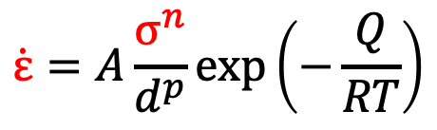
Single crystal
vs.
polycrystal
basal slip
T
n = 2.4
n = 4
Transition
to GSS
flow
hard slip
T
T= 263 K
$$\dot{ε}=A\frac{σ^{n}}{d^{p}}\exp\left(−\frac{Q}{RT}\right)$$
Notes:
We expect that the strength of a polycrystalline ice sample of random oriented grains would be some appropriate average of the single crystal creep strengths.
That is what is observed. Plot is one of stress vs. strain rate. Data are plotted for a common temperature of -10 C, for grain sizes of 1 mm or larger. Slopes on the plot are equal to the stress exponent.
Basal slip in black.
Hard slip in green.
Polycrystalline data in blue, intermediate between strengths of the other two.
Glen law in red – n=3
NOTE CURVATURE IN CREEP DATA
n>3 at high stress FRACTURING??
n<=2 at low stress TRANSIENT CREEP??

Slide 6
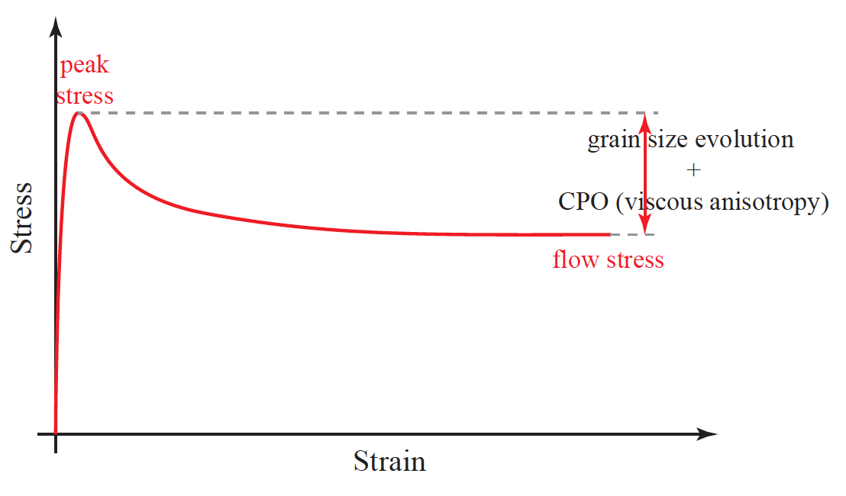
Stress-strain curve for polycrystalline ice
Peak stress
Stress
Homogeneous Uniform grain size,
random CPO
Flow stress
Heterogeneous Non-uniform recrystallized grain size,
strong CPO
Strain

Slide 7
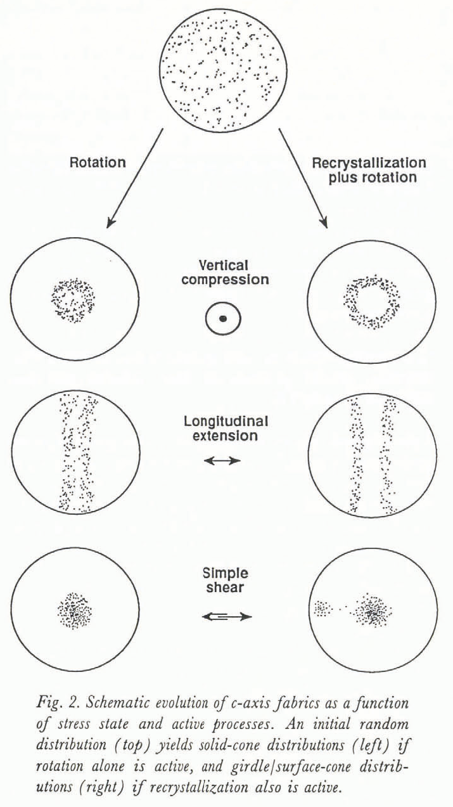
Crystallographic preferred orientation (CPO) “Fabric”
Rotation
Recrystallization
Stress state
Vertical compression
Longitudinal extension
Rotation &
Dynamic
Recrystallization
Simple shear
Alley (J. Glac.,1992)
Notes:
This is a plot of strain vs. stress from uniaxial creep tests on ice. Slope is the stress exponent.
Expect a transition to diffusion creep at low stresses, but where is it?

Slide 8
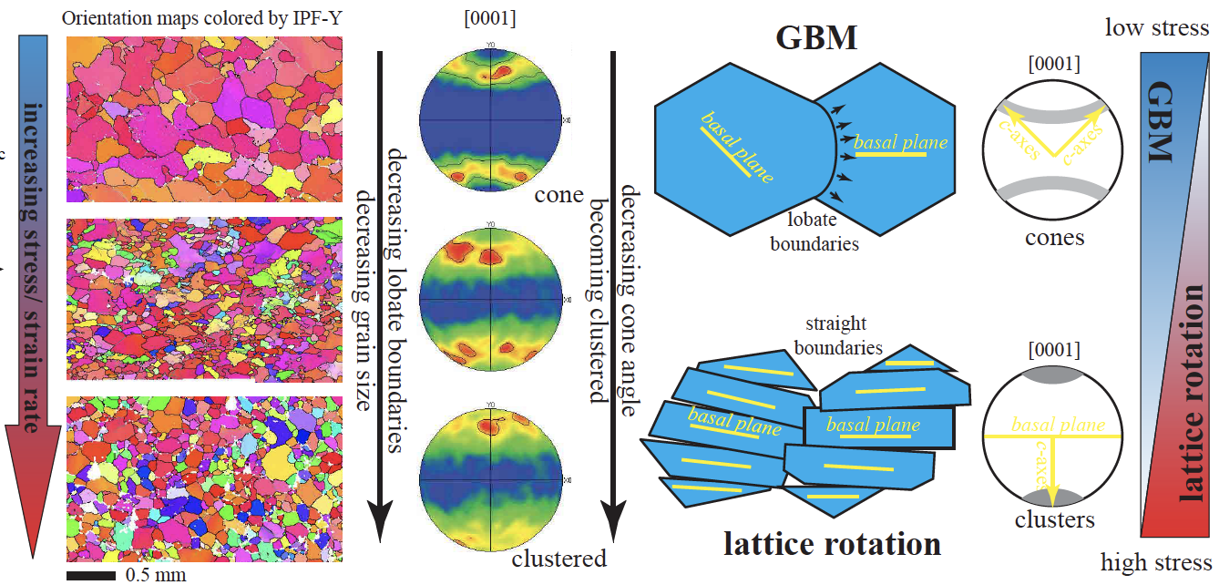
CPO from recrystallization/grain rotation
Qi et al. (2017)

Slide 9
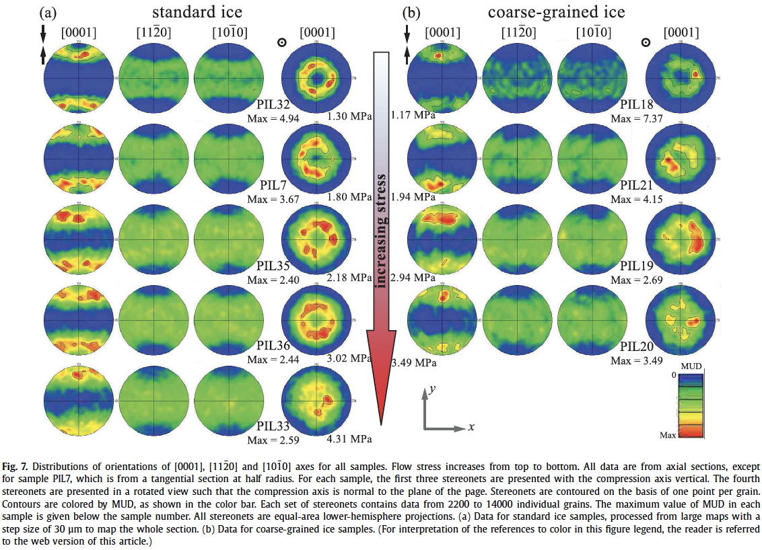
Down-stress transition from rotation to GBM fabrics
Qi et al. (2017)
Compression experiments, strains only up to ~30%

Slide 10
Key questions
Does CPO continue to evolve at larger strains?
If so, is this associated with progressive weakening?
How much strain is required for the microstructure
to reach a steady state?
Can we place an experimentally determined bound
on viscous anisotropy?
Notes:
This is a plot of strain vs. stress from uniaxial creep tests on ice. Slope is the stress exponent.
Expect a transition to diffusion creep at low stresses, but where is it?

Slide 11
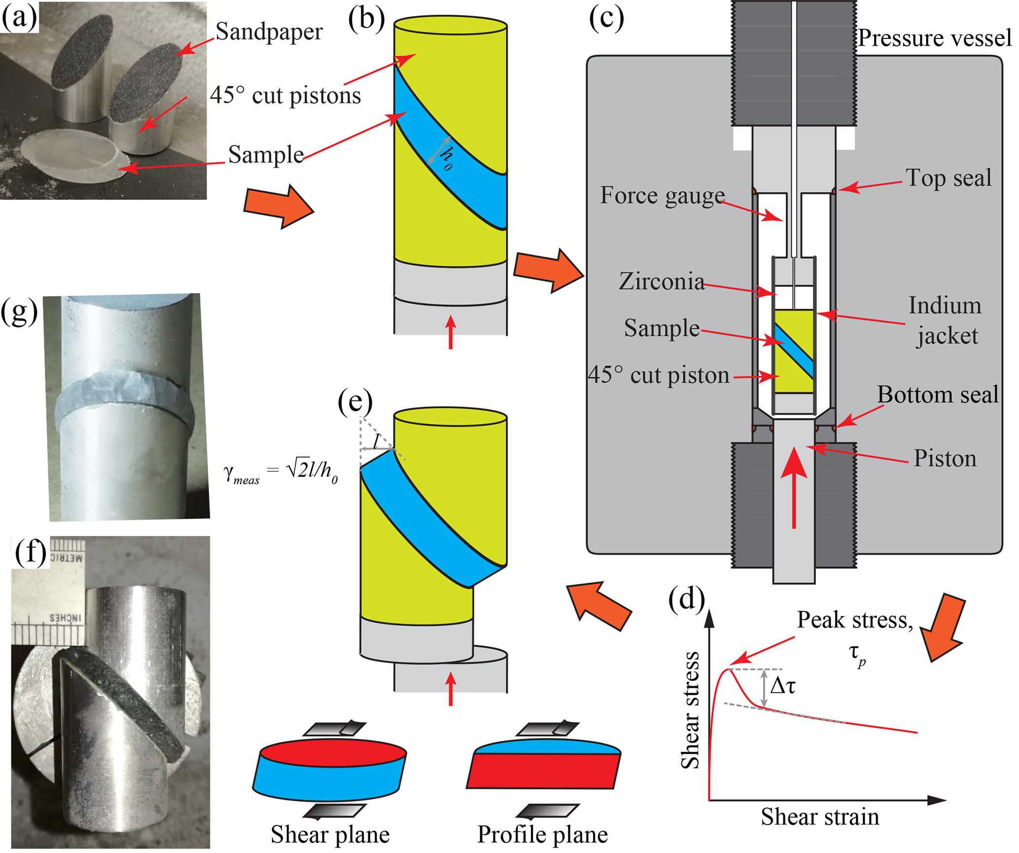
Direct-shear experiments
Strains up to ~2
Notes:
This is a plot of strain vs. stress from uniaxial creep tests on ice. Slope is the stress exponent.
Expect a transition to diffusion creep at low stresses, but where is it?

Slide 12
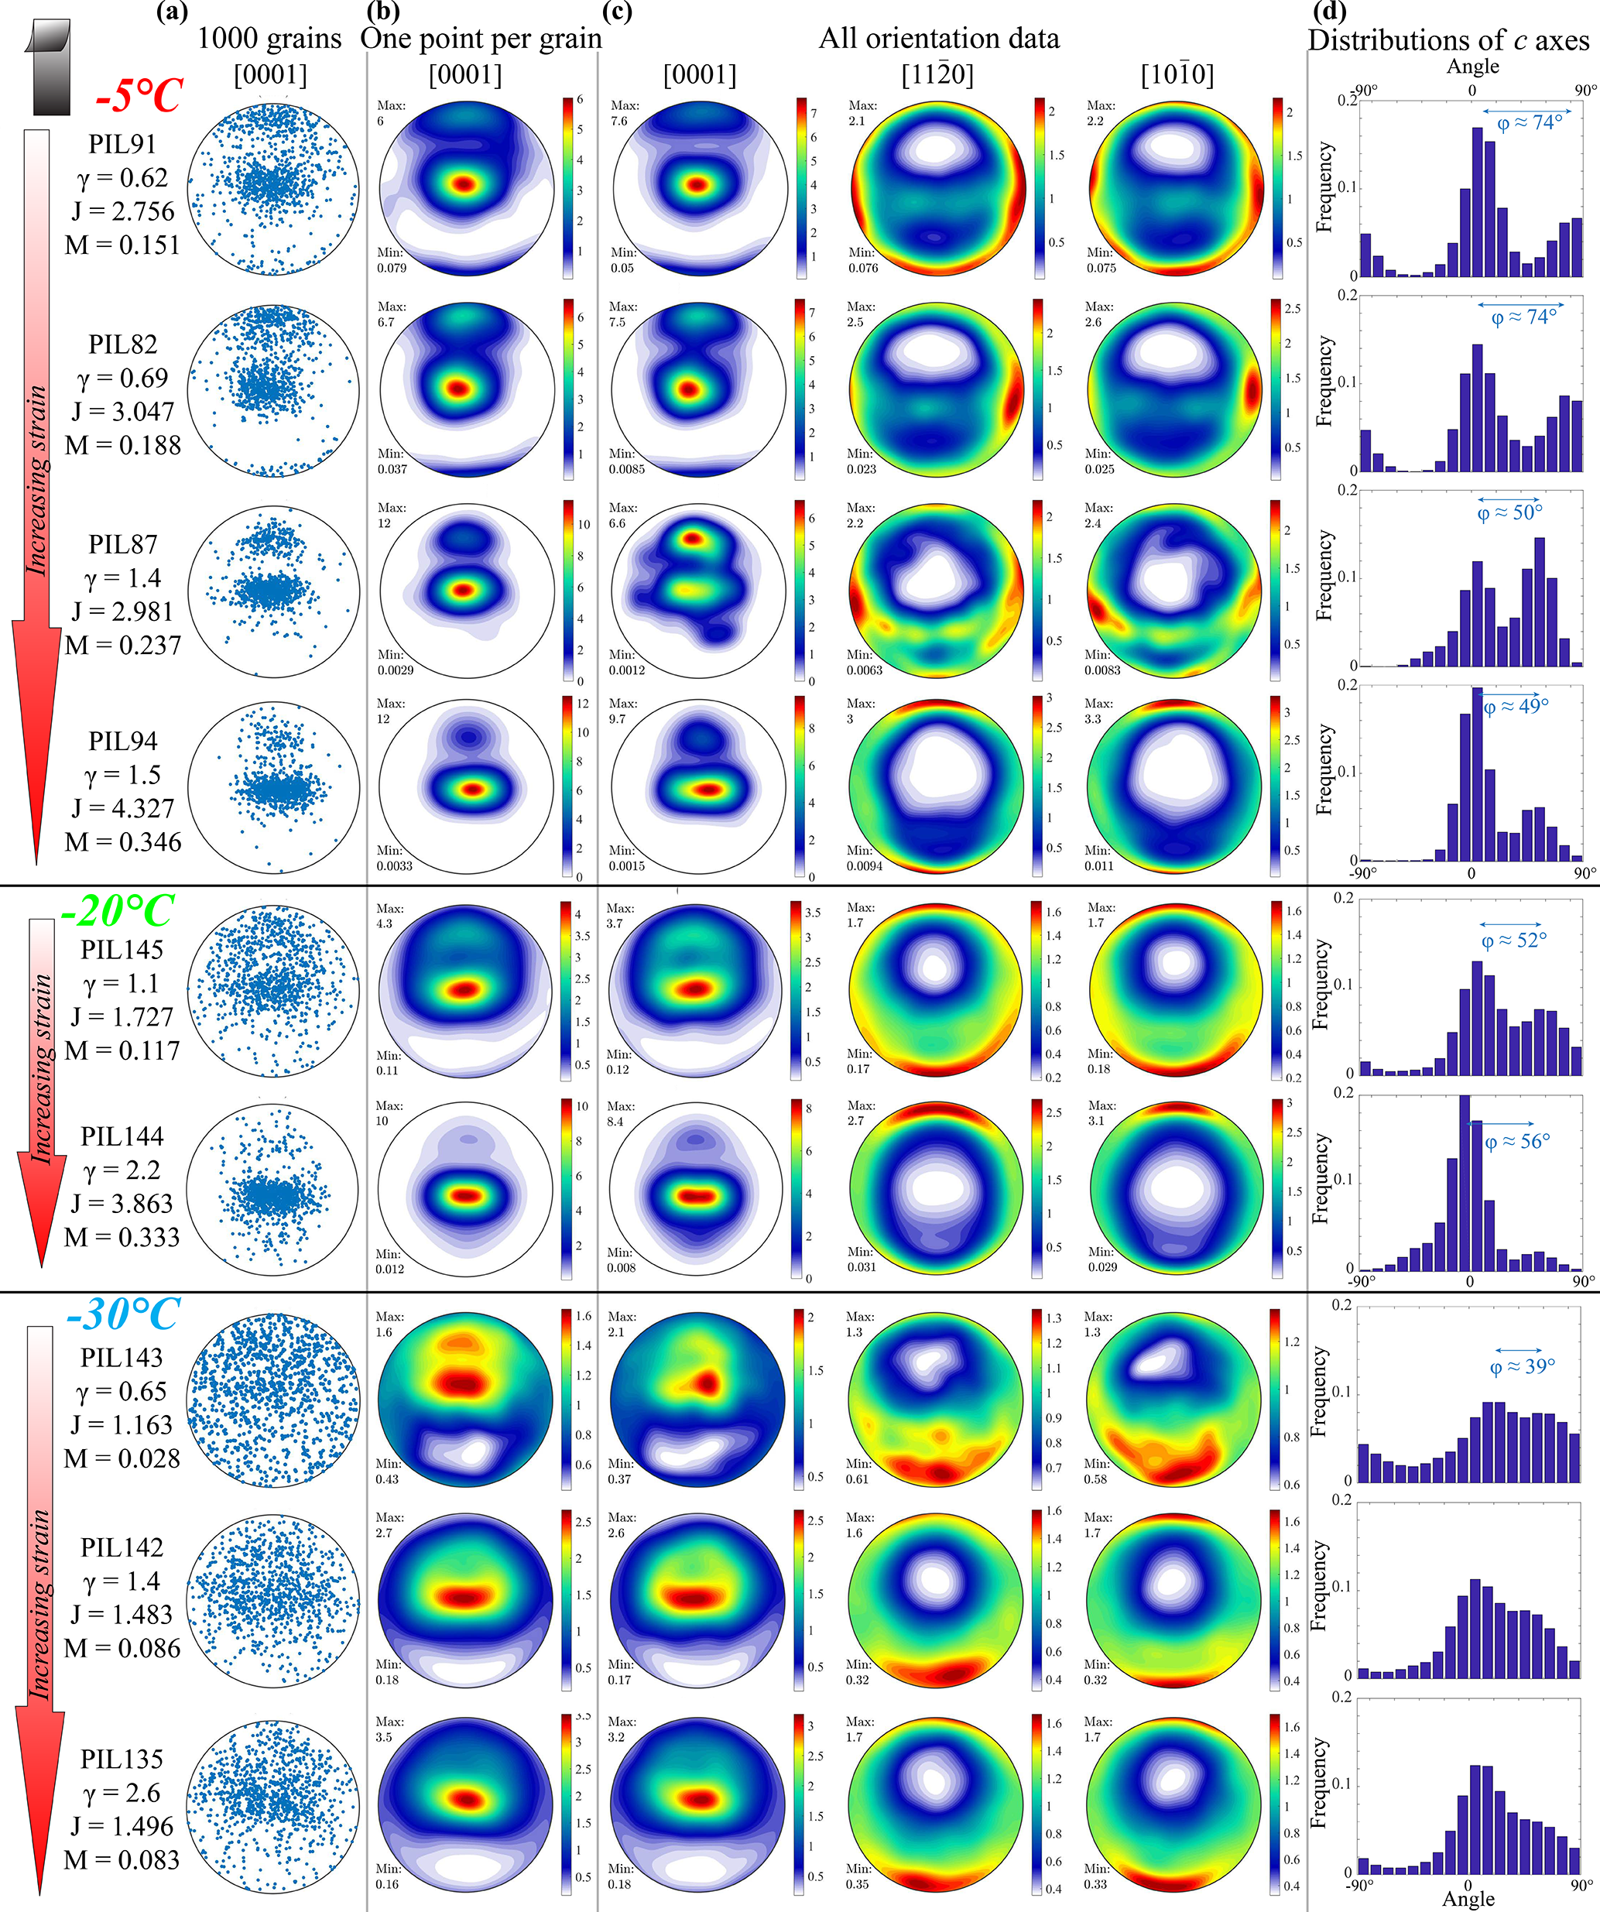
CPO development with larger strain in direct shear
Two-max patterns
persist to larger
strains
decreasing T,
increasing stress
Two-max patterns
merge to single
max with strain
Qi, Goldsby, Prior
(2019)

Slide 13
Direct-shear experiments
Experiments show strain weakening, but…
Notes:
This is a plot of strain vs. stress from uniaxial creep tests on ice. Slope is the stress exponent.
Expect a transition to diffusion creep at low stresses, but where is it?

Slide 14
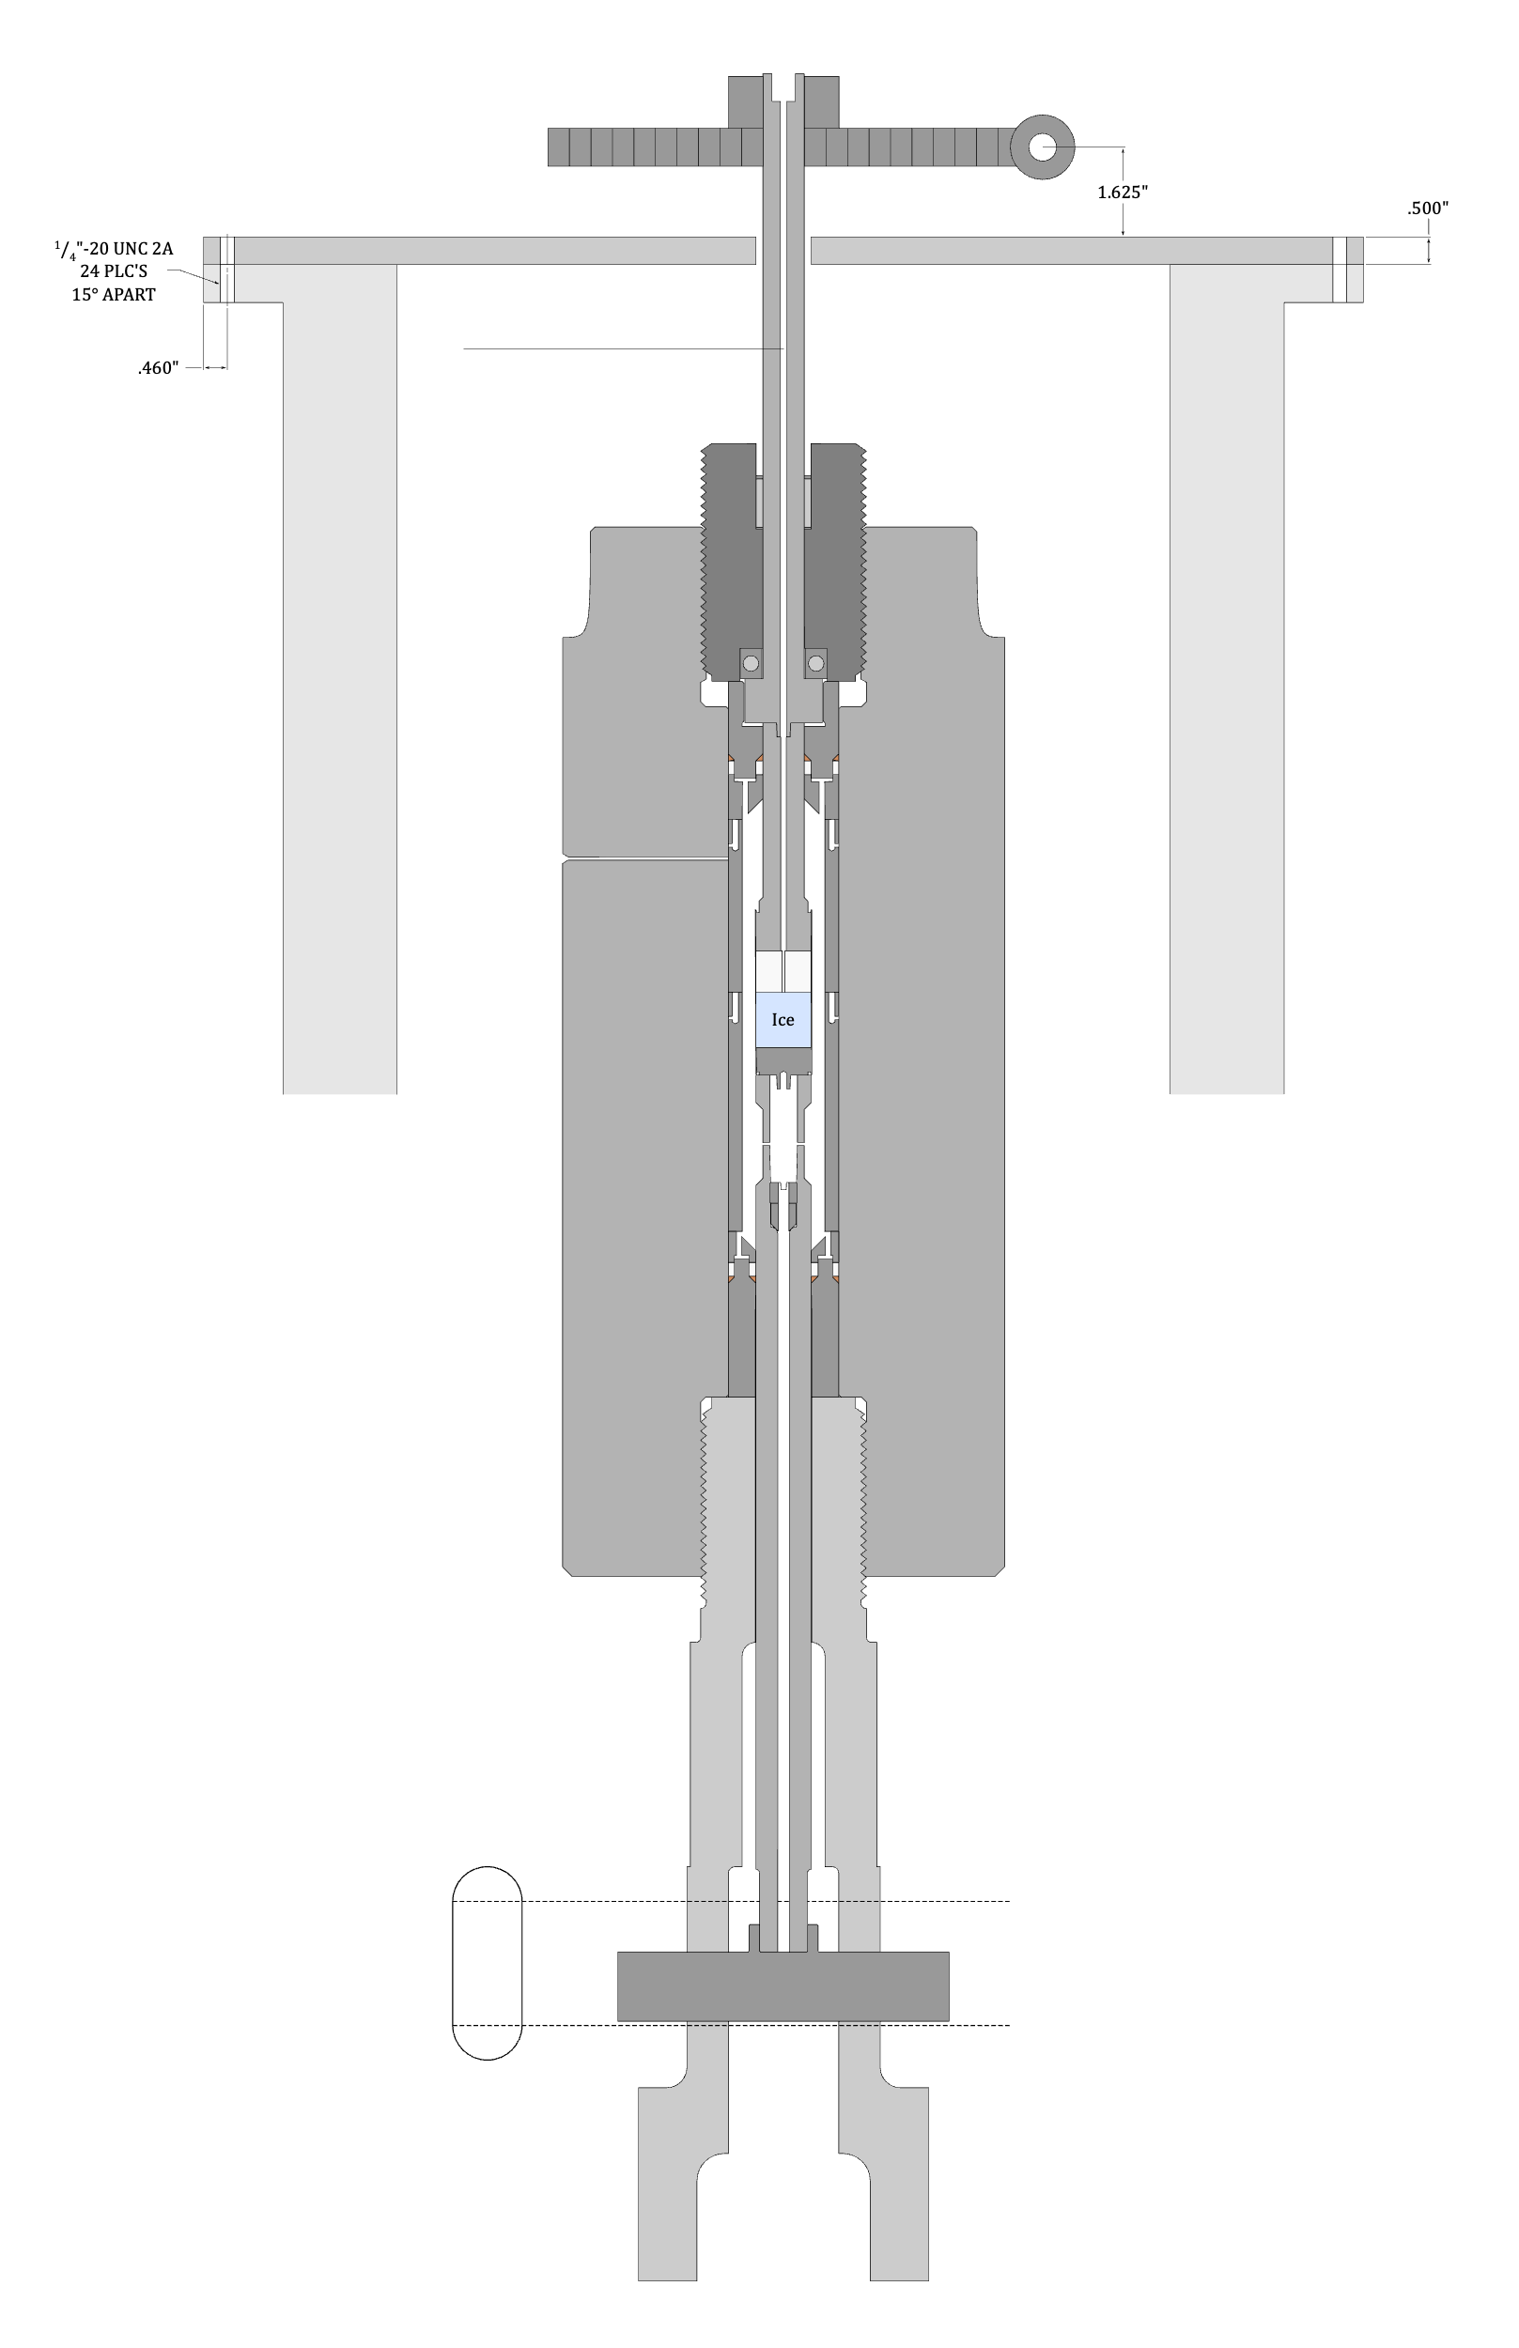
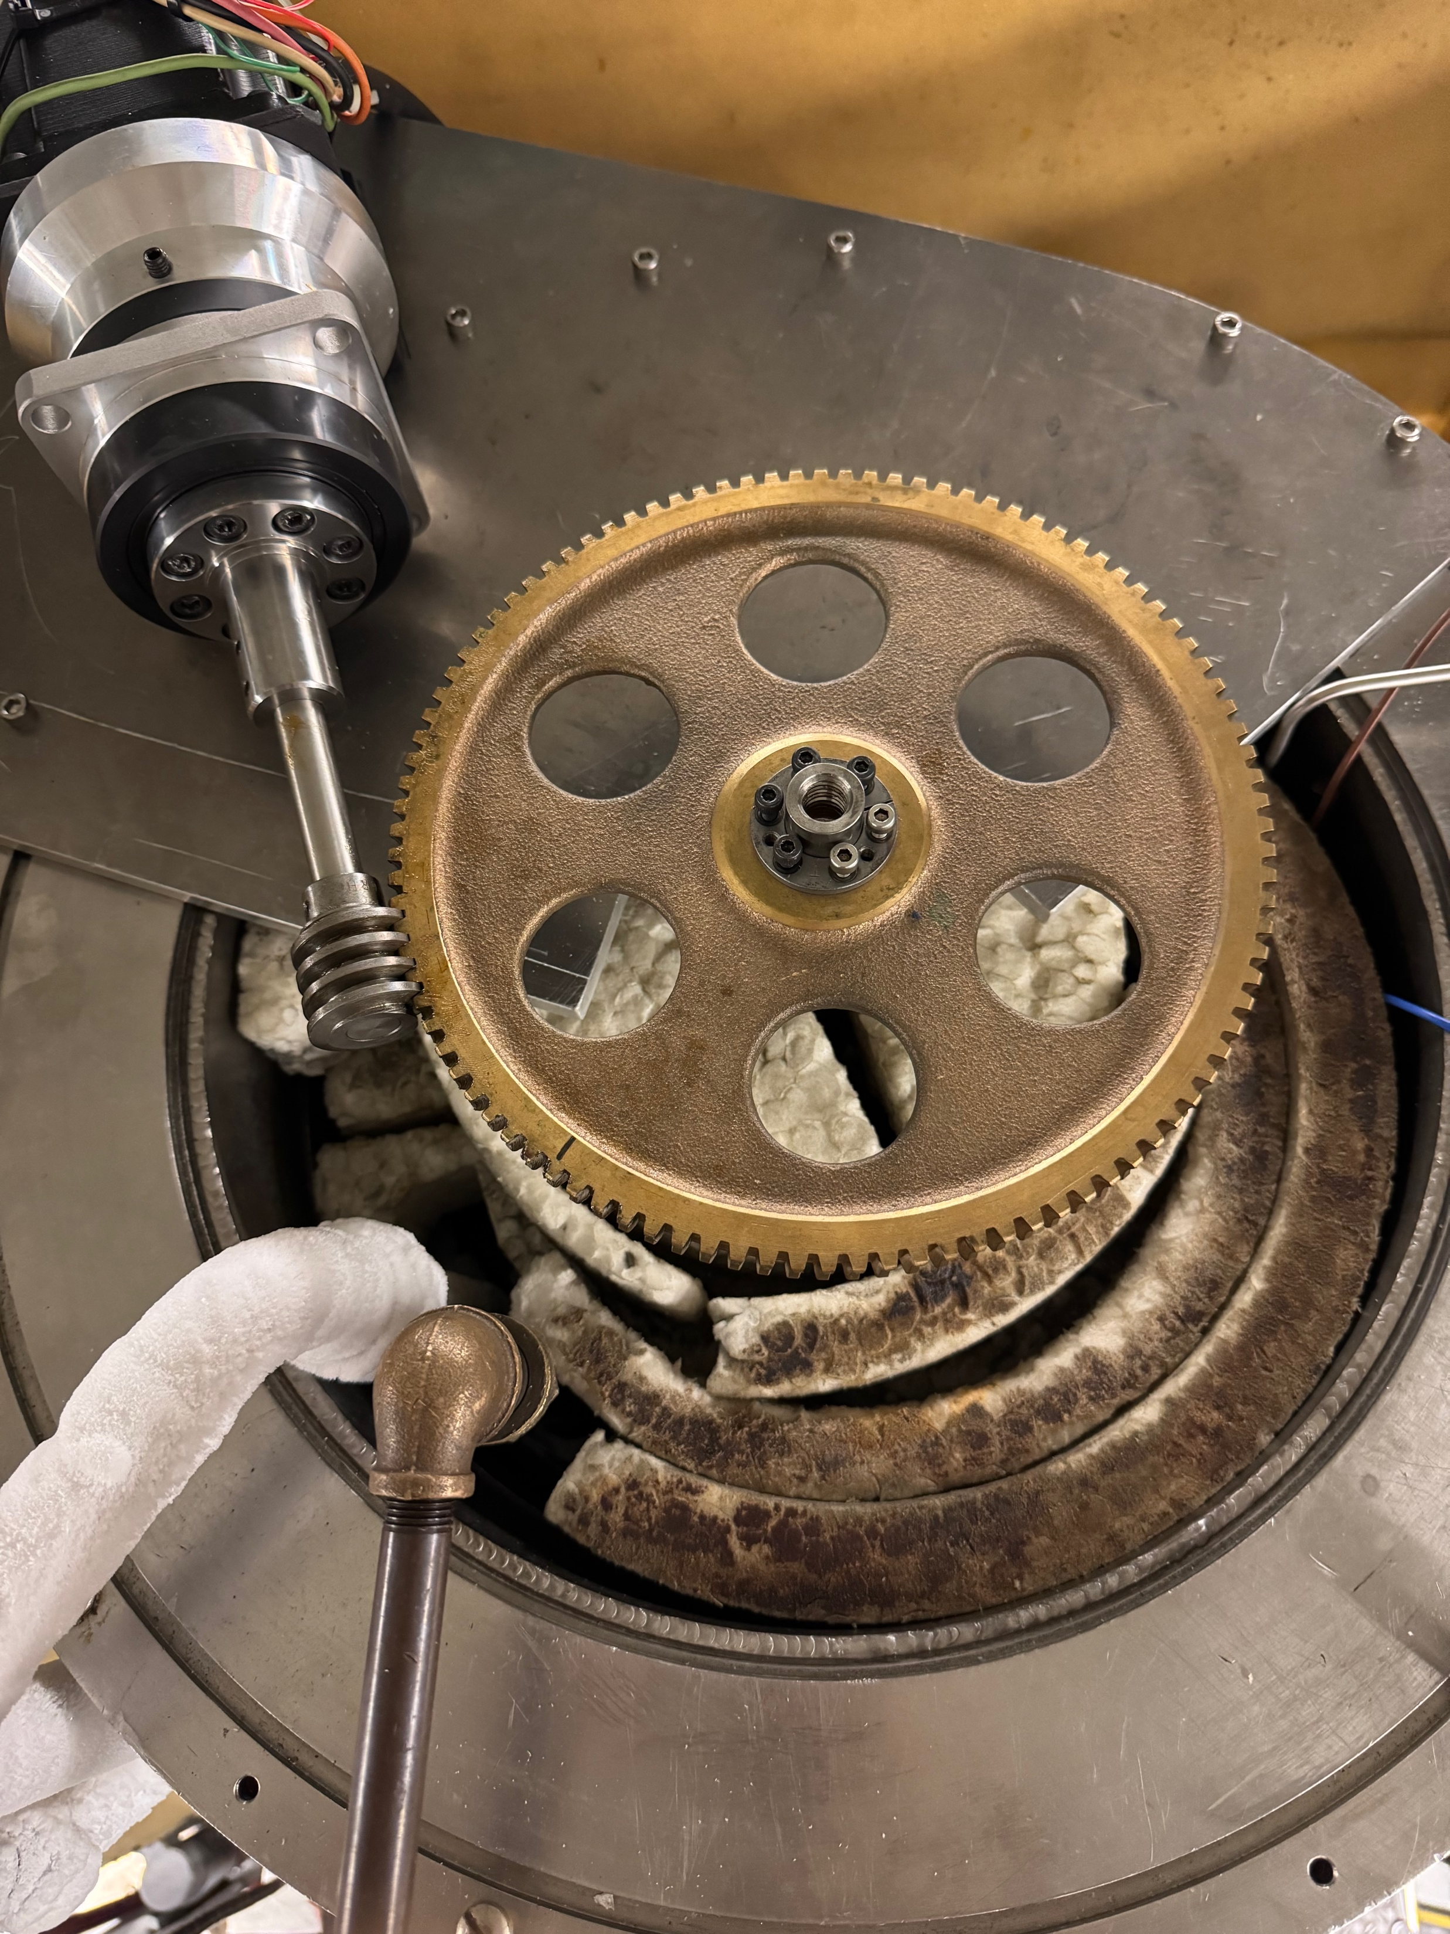
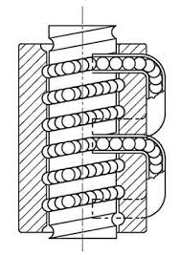
High-pressure torsion/
compression apparatus
Gear
Worm
Ball
bearing
Top nut
34-frame stepper motor with 100:1
harmonic drive
Cryostat
Load/torque
cell – strain
gaged
Pressure
vessel
anti-rotation
slot
Thrust
bearing/
anti-rotation

Slide 15
Torsion sample
assembly
Cu-plated steel
piston
”welds”
Indium
jacket
Zirconia spacer
(thermal break
for welding)
SOLID CYLINDER
OF ICE
Cu-plated steel
spacer

Slide 16
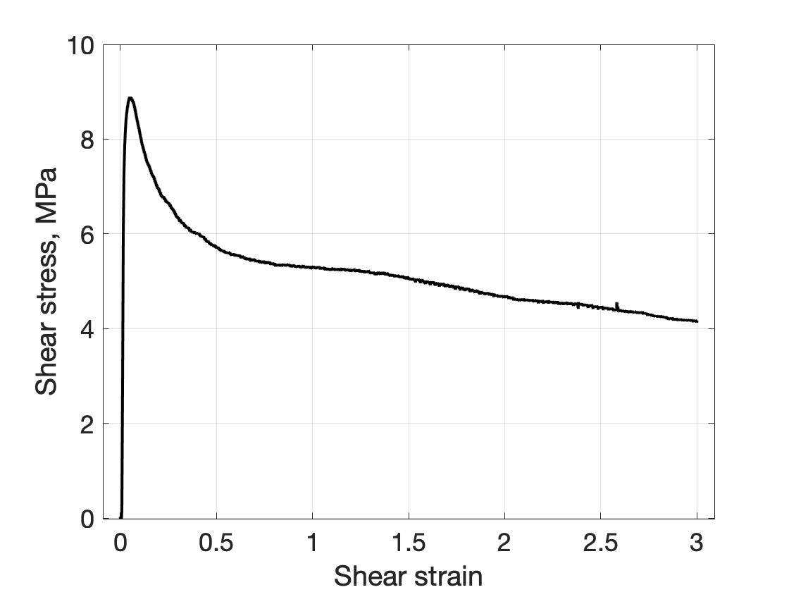
Continuous weakening to a shear strain of 300%
Strengthening of CPO?
Reduction of grain size?
TOR19

Slide 17
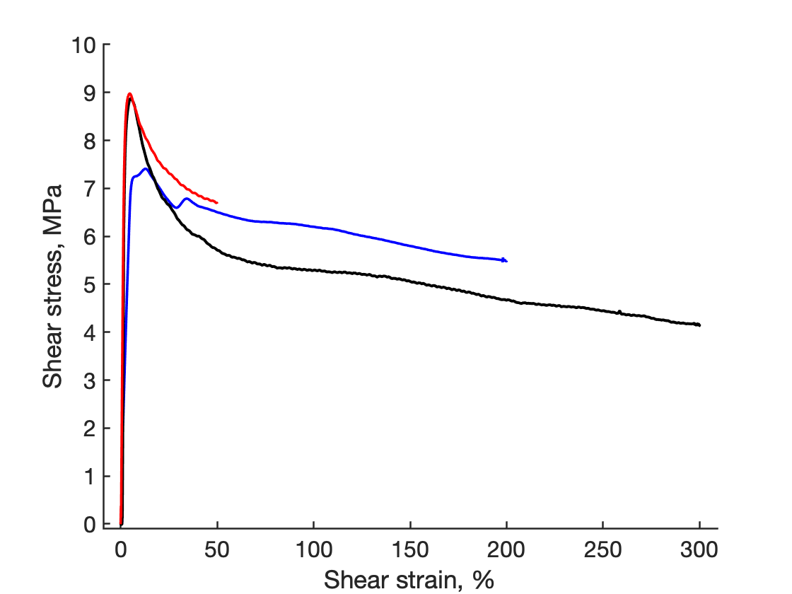
Samples weaken continuously in shear
Weakening due to:
Strengthening of CPO?
Reduction of grain size?
Other?
TOR23,
3.9e-5 s-1
TOR14,
1.7e-5 s-1
Constant strain rate
experiments
TOR19
strain rate=2.7e-5 s-1

Slide 18
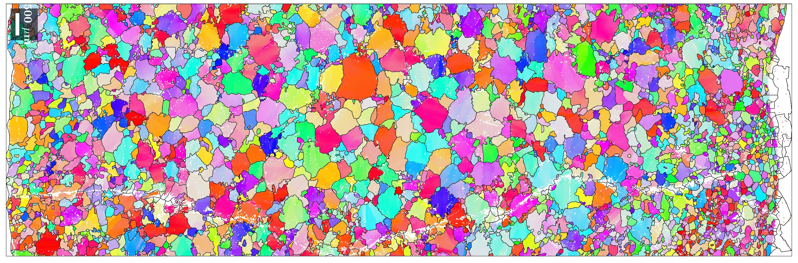
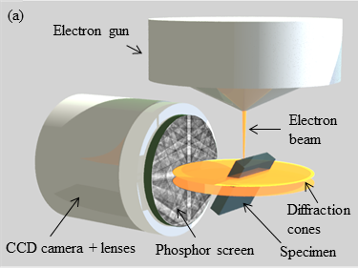
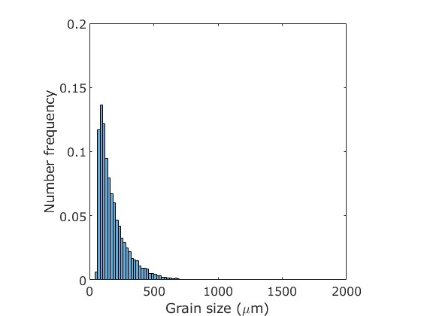
Electron Backscatter Diffraction
Grain orientation
(crystallographic
preferred orientation, CPO), texture
Grain size distribution
Madi Fleming and Dave Prior
University of Otago

Slide 19
Reference frames for EBSD sections
3D sample cuts
B = Cross section
C = Surface
A
C
B
X
EBSD viewing plane
Z
X
X
Y
.
.
A = storage
B = cross section
Side view of sample on ingot
C = surface

Slide 20
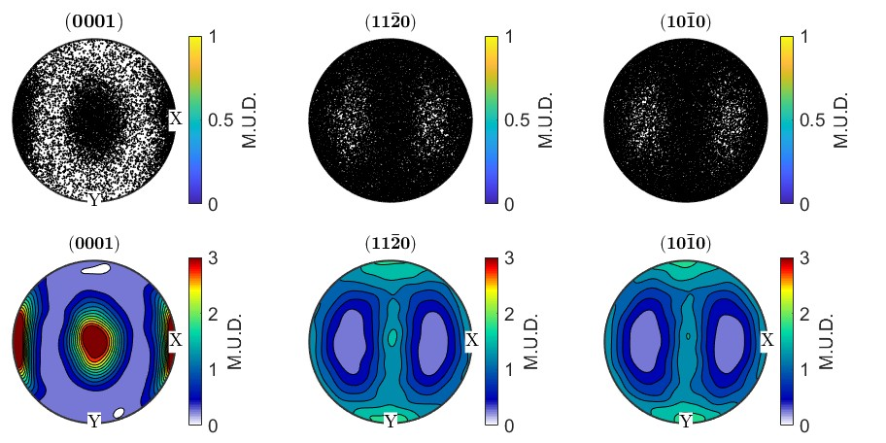
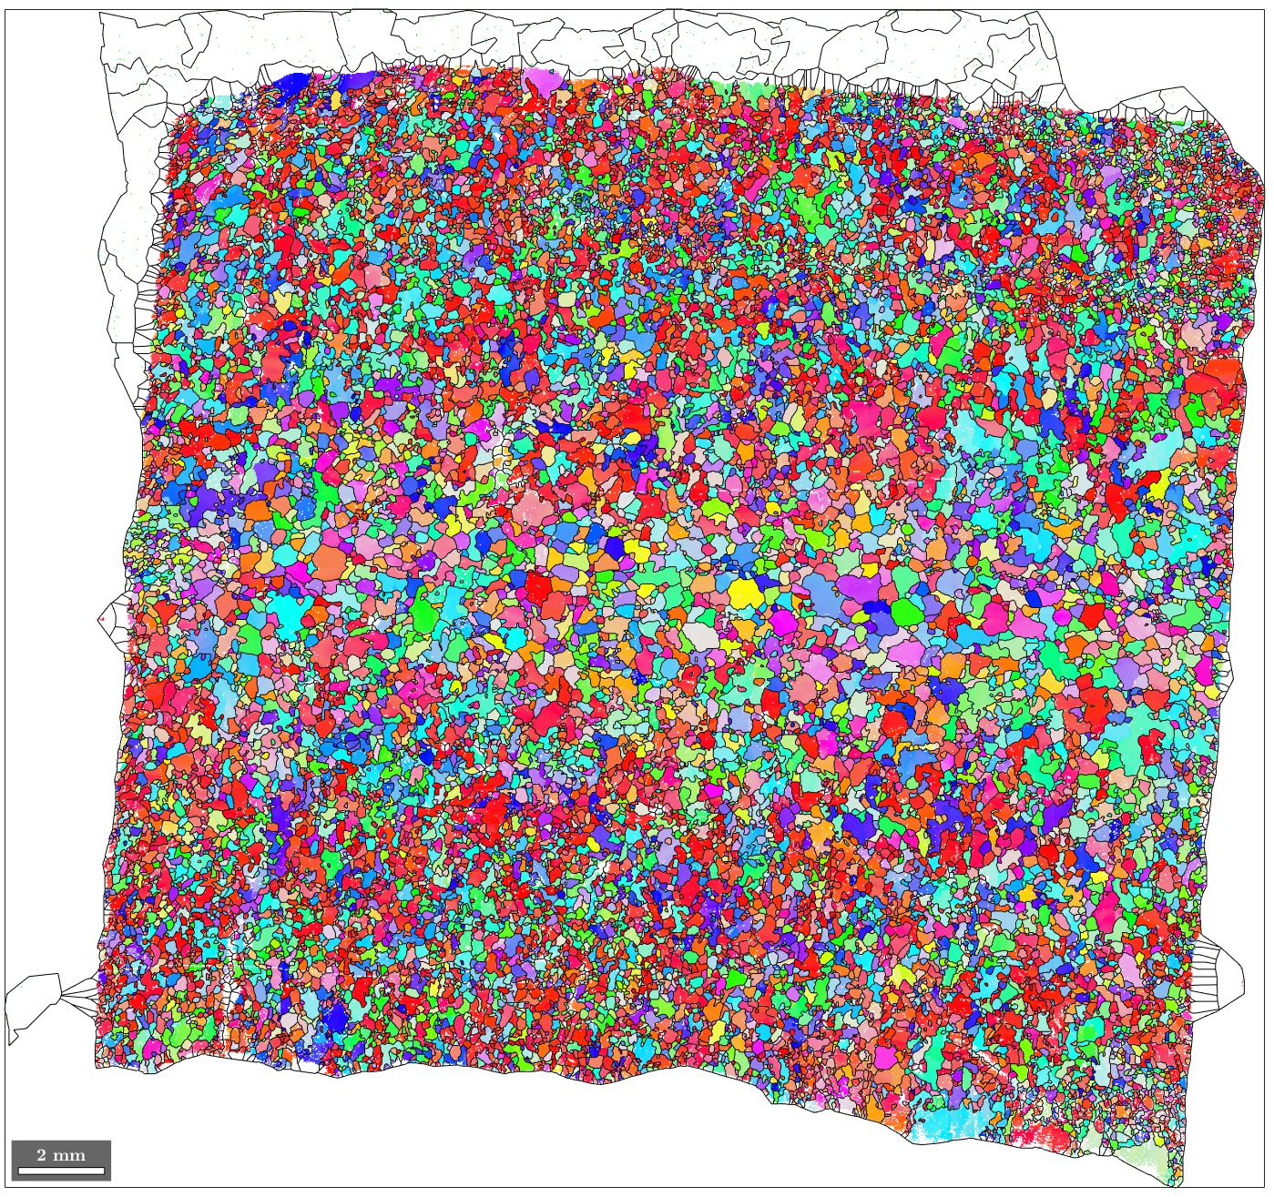
TOR23-B
Shear strain ~50 %
M index 0.079
c-axes
TOP
BOTTOM

Slide 21
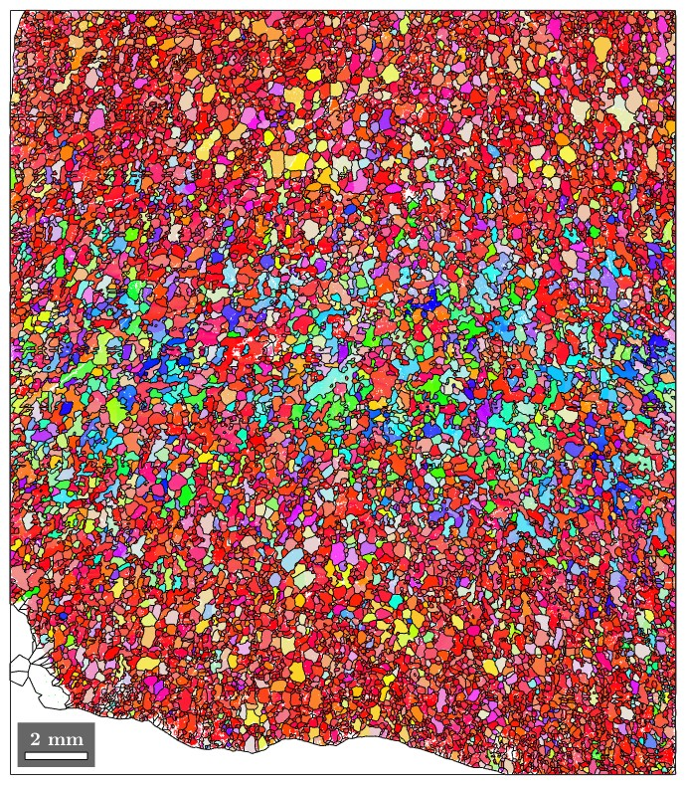
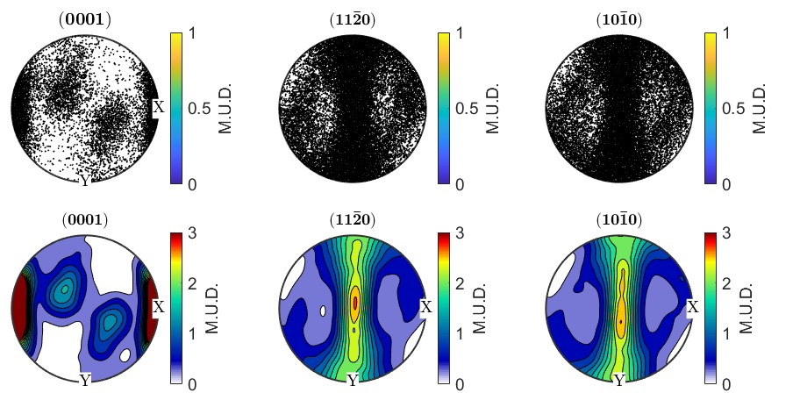
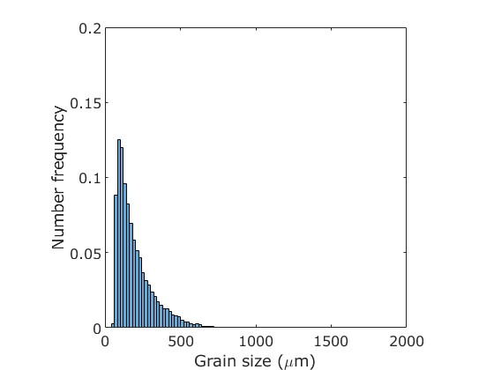
TOR14-B
Shear strain ~200 % M index 0.209
c-axes
TOP
BOTTOM

Slide 22
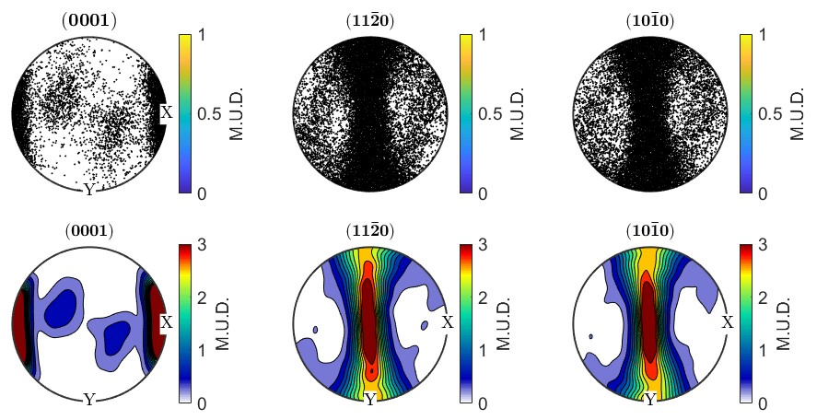
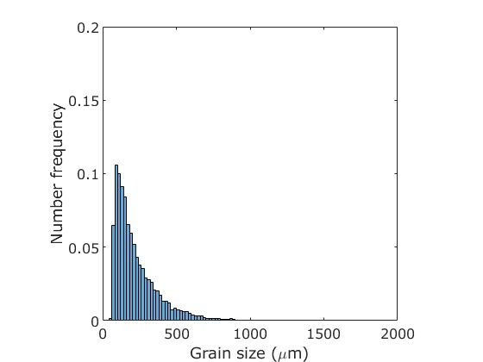
TOR19-B
Shear strain ~300 %
M index 0.429
c-axes
TOP
BOTTOM

Slide 23
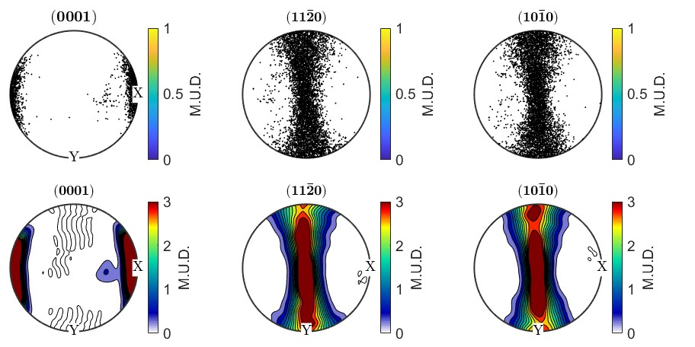
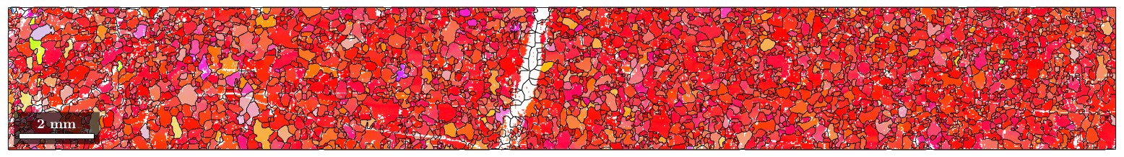
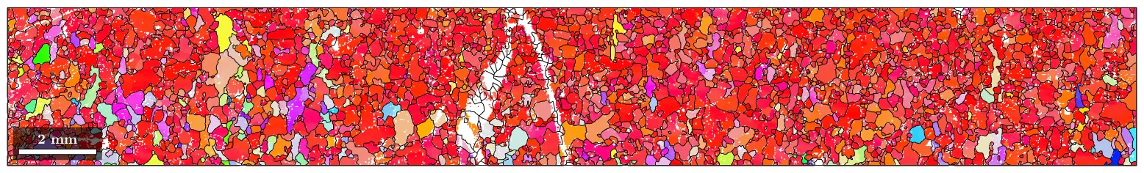
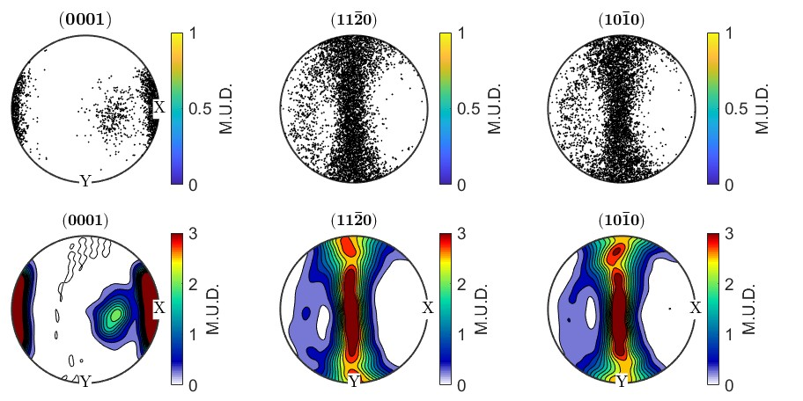
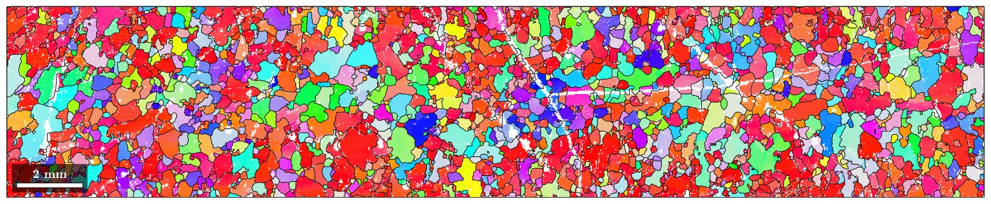
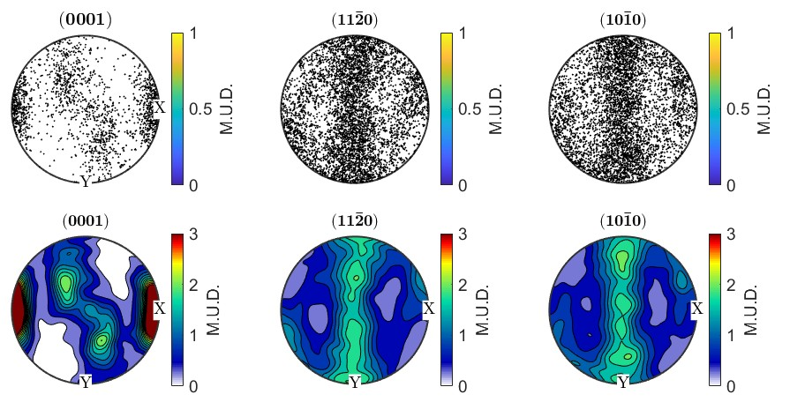
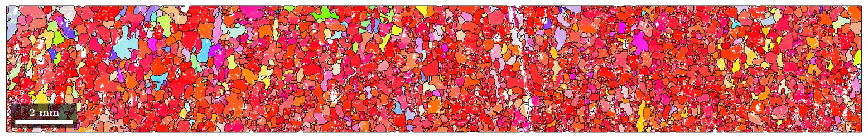
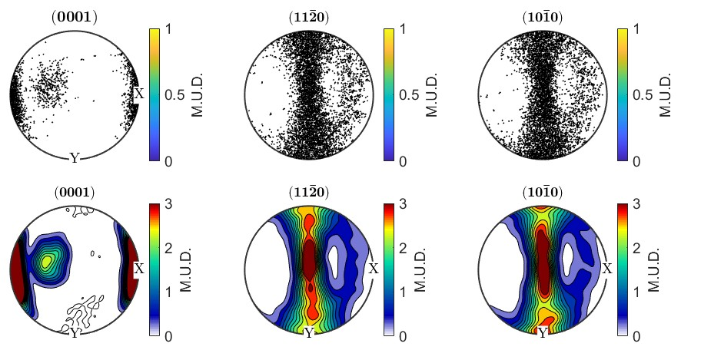
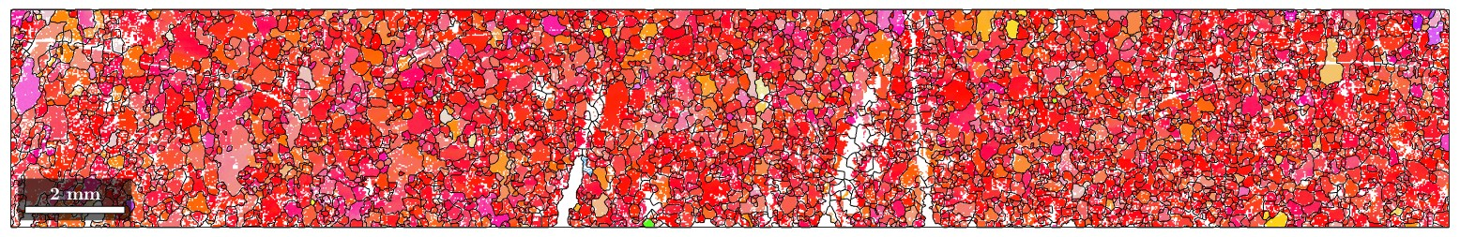
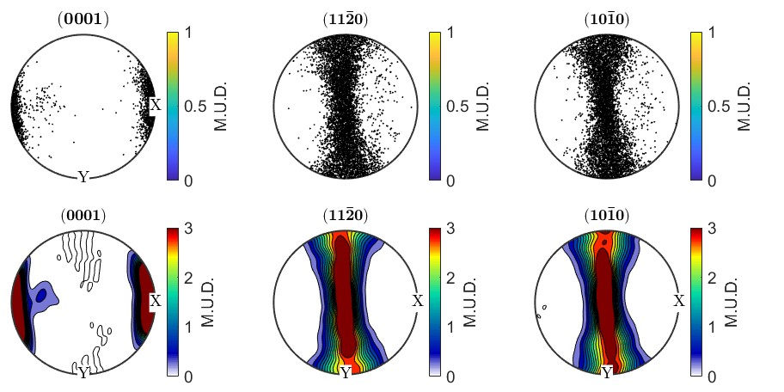
A closer look at the CPOs from 300%-strain sample

Slide 24
Closer look at CPOs from 300%-strain sample
Outside rim
Second max persists
to large strain
Middle
Outside rim
c-axes CPOs

Slide 25
Samples weaken continuously in shear
TOR23,
3.9e-5 s-1
TOR14,
1.7e-5 s-1
Weakening due to:
Strengthening of CPO?
Not much variation in
GS distributions
TOR19
2.7e-5 s-1

Slide 26
Hollow sample
torsion assembly
Cu-plated steel
piston
”welds”
Indium
jacket
Zirconia spacer
(thermal break)
HOLLOW CYLINDER
OF ICE
Solid cylinder of
indium
Cu-plated steel
spacer

Slide 27
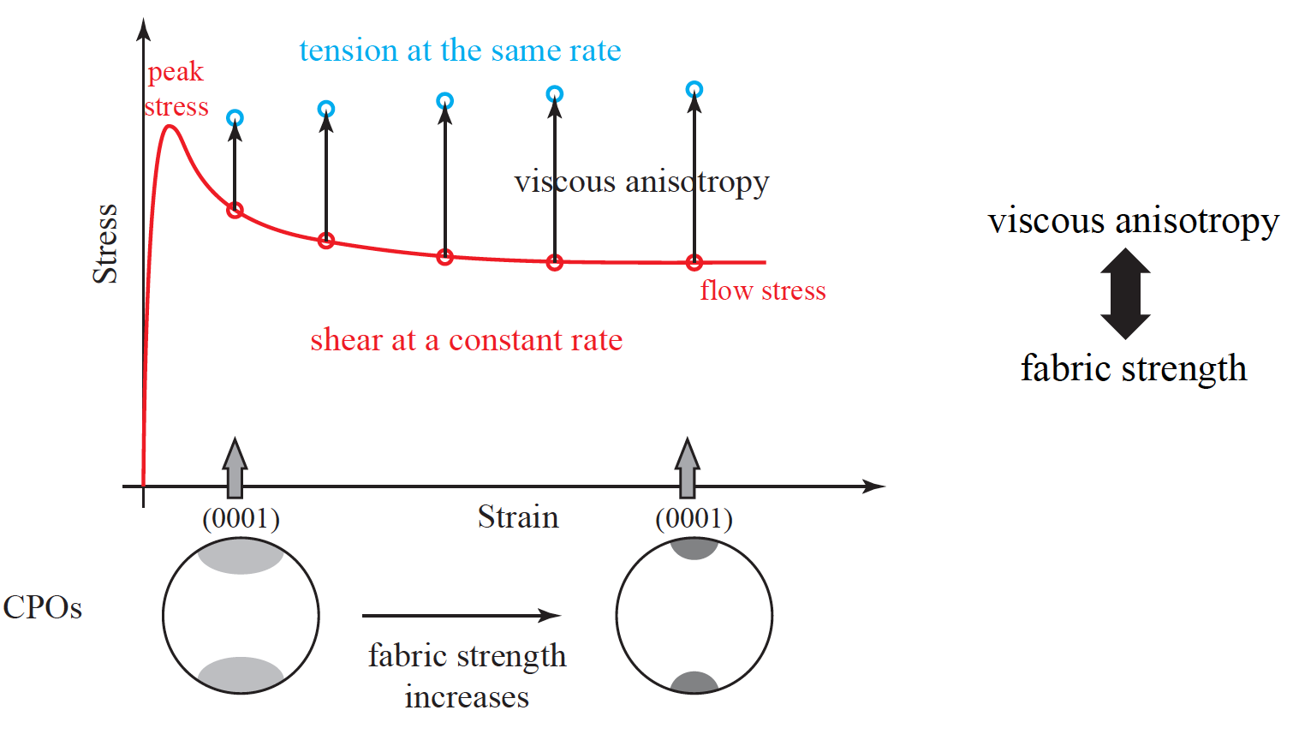

Torsion-compression experiments
Determination of viscous anisotropy
compression
compression
torsion
CPO strength increases
Hansen et al. (2012)
c-axis fabric
stronger c-axis fabric

Slide 28
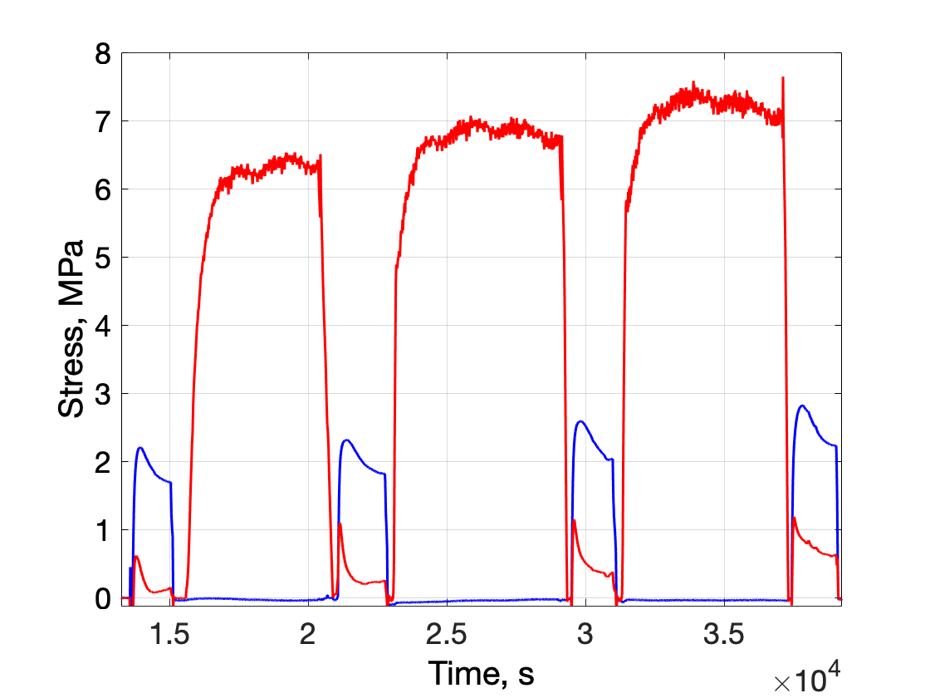
Compression-torsion experiments
Shear
Compression
TOR13

Slide 29
Conclusions
The CPO of ice deformed in simple shear strengthens progressively to highest shear strains obtained, ~300%.
This increase in CPO strength appears to cause a steady decrease in flow strength.
Thus far, the influence of a strong shear-induced CPO on the flow strength of ice compressed perpendicular to the shear plane (and basal planes) appears to be small.
Notes:
This is a plot of strain vs. stress from uniaxial creep tests on ice. Slope is the stress exponent.
Expect a transition to diffusion creep at low stresses, but where is it?

